Slide 1


Corporate Financial Accounting
Fifteenth Edition
Chapter 10
Liabilities: Current, Installment Notes, and Contingencies
Copyright © 2019 Cengage. All Rights Reserved.

Slide 2
Current Liabilities
When a company or a bank advances credit, it is making a loan.
The company or bank is called a creditor (or lender).
The individuals or companies receiving the loans are called debtors (or borrowers).
Debt is recorded as a liability by the debtor.
  Long-term liabilities are debts due beyond one year.
  Current liabilities are debts that will be paid out of current assets and are due within one year.

Slide 3
Accounts Payable and Accruals
Accounts payable transactions involve a variety of purchases on account, including the purchase of merchandise and supplies.
Accrued liabilities reflect an obligation to pay current assets in the future.
Accrued liabilities are normally recorded at the end of an accounting period as part of the adjustment process.
For most companies, accounts payable and accrued liabilities are the largest portion of current liabilities.

Slide 4
Short-Term Notes Payable (1 of 2)
Notes may be issued to purchase merchandise or other assets. Notes may also be issued to creditors to satisfy an account payable created earlier.
Each note transaction affects a debtor (borrower) and a creditor (lender).
A company may also borrow from a bank by issuing a note.

Slide 5
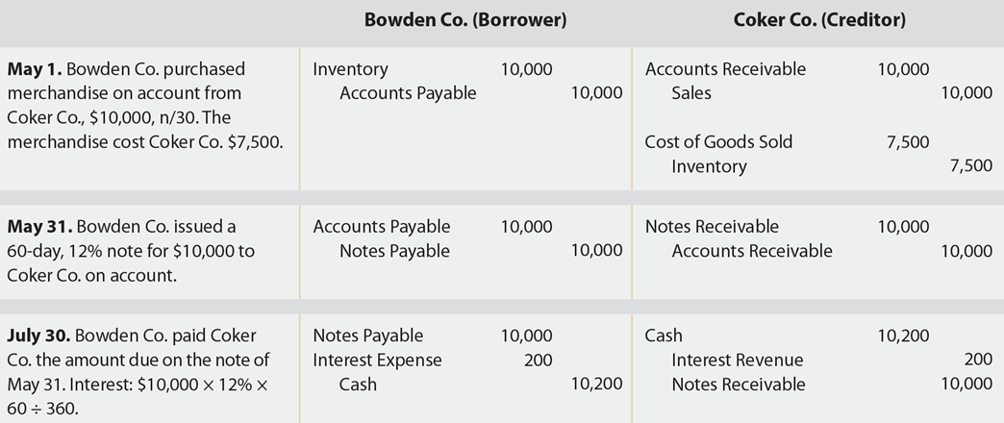
Note Transactions: Borrower and Creditor

Slide 6
Short-Term Notes Payable (2 of 2)
In some cases, a discounted note may be issued rather than an interest-bearing note.
A discounted note has the following characteristics:
  The interest rate on the note is called the discount rate.
  The amount of interest on the note, called the discount, is computed by multiplying the discount rate times the face amount of the note.
  The debtor (borrower) receives the face amount of the note less the discount, called the proceeds.
  The debtor must repay the face amount of the note on the due date.

Slide 7
Current Portion of Long-Term Debt
The current portions of long-term debt, such as the current portion of installment notes, are reported on the balance sheet as a current liability.
  An installment note is a debt that requires the borrower to make equal periodic payments to the lender for the term of the note.
  Installment notes are often used to purchase property, plant, and equipment.

Slide 8
Payroll Liabilities
In accounting, payroll refers to the amount paid to employees for services they provided during the period.
A company’s payroll is important for the following reasons:
  Payroll and related payroll taxes significantly affect the net income of most companies.
  Payroll is subject to federal and state regulations.
  Good employee morale requires payroll to be paid timely and accurately.

Slide 9
Liability for Employee Earnings (1 of 2)
Salary usually refers to payment for managerial and administrative services.
  Salary is normally expressed in terms of a month or a year.
Wages usually refers to payment for employee manual labor.
  The rate of wages is normally stated on an hourly or weekly basis.
The salary or wage of an employee may be increased by bonuses, commissions, profit sharing, or cost-of-living adjustments.

Slide 10
Liability for Employee Earnings (2 of 2)
Companies engaged in interstate commerce must follow the Fair Labor Standards Act. This act, sometimes called the Federal Wage and Hour Law, requires employers to pay a minimum rate of 1½ times the regular rate for all hours worked in excess of 40 hours per week.
Exemptions are provided for executive, administrative, and some supervisory positions.

Slide 11
Deductions from Employee Earnings
The total earnings of an employee for a payroll period, including any overtime pay, are called gross pay.
From this amount is subtracted one or more deductions to arrive at the net pay.
  Net pay is the amount paid to the employee.
  The deductions normally include the following:
    Federal income taxes
    State income taxes
    Local income taxes
    Medical insurance
    Pension contributions

Slide 12
Income Taxes (1 of 3)
Employers normally withhold a portion of employee earnings for payment of the employees’ federal income tax.
Each employee authorizes the amount to be withheld by completing an “Employee’s Withholding Allowance Certificate,” called a W-4.

Slide 13
Income Taxes (2 of 3)
On the W-4, an employee indicates marital status and the number of withholding allowances.
  A single employee may claim one withholding allowance.
  A married employee may claim an additional allowance for a spouse.
  An employee may also claim an allowance for each dependent other than a spouse.
Each allowance reduces the federal income tax withheld from the employee’s pay.

Slide 14
Income Taxes (3 of 3)
  The federal income tax withheld depends on each employee’s gross pay and W-4 allowance.
  Withholding tables issued by the Internal Revenue Service (IRS) are used to determine amounts to withhold.

Slide 15
FICA Tax (1 of 2)
Employers are required by the Federal Insurance Contributions Act (FICA) to withhold a portion of the earnings of each employee.
The FICA tax withheld contributes to the following two federal programs:
  Social security, which provides payments for retirees, survivors, and disability insurance.
  Medicare, which provides health insurance for senior citizens.

Slide 16
FICA Tax (2 of 2)
The amount withheld from each employee is based on the employee’s earnings paid in the calendar year.
The withholding tax rates and maximum earnings subject to tax are often revised by Congress.
  To simplify, this chapter assumes the following rates and earnings subject to tax:
    Social security: 6% on all earnings
    Medicare: 1.5% on all earnings

Slide 17
Other Deductions
Employees may choose to have additional amounts deducted from their gross pay, such as deductions for
  retirement savings,
  charitable contributions, and
  life insurance.

Slide 18
Computing Employee Net Pay
Gross earnings less payroll deductions equals net pay, sometimes called take-home pay.

Slide 19
Employer’s Payroll Taxes
Employers are subject to the following payroll taxes for amounts paid to their employees:
  FICA Tax
    Employers must match the employees’ FICA tax contribution.
  Federal Unemployment Compensation Tax (FUTA)
    This employer tax provides for temporary payments to those who become unemployed.
  State Unemployment Compensation Tax (SUTA)
    This employer tax provides temporary payments to those who become unemployed.

Slide 20
Recording Payroll
The payroll liabilities are normally recorded at the end of each payroll period.
Employers must match the employees’ social security and Medicare taxes.
In addition, an employer must pay state and federal unemployment compensation taxes.

Slide 21
Paying Payroll
Companies pay employees either by electronic funds transfer or by issuing payroll checks.
  With electronic funds transfers, the employees’ net pay is electronically deposited into their bank account each period. The employees receive a payroll statement summarizing how the net pay was computed.
Most companies use a special payroll bank account for payroll.
  An advantage of using a separate payroll bank account is that reconciling the bank statements is simplified.

Slide 22
Internal Controls for Payroll
Some examples of payroll controls include the following:
  The hiring and firing of employees should be properly authorized and approved in writing.
  All changes in pay rates should be properly authorized and approved in writing.
  Employees should be observed when arriving for work to verify that employees are “checking in” for work only once and only for themselves. Employees may “check in” for work by using a time card or by swiping their employee ID card.
  A special payroll bank account should be used.

Slide 23
Employees’ Fringe Benefits
Many companies provide their employees benefits in addition to salary and wages earned. Such fringe benefits may include vacation, medical, and retirement benefits.
The cost of employee fringe benefits is recorded as an expense by the employer.

Slide 24
Vacation Pay (1 of 2)
Most employers provide employees vacations, sometimes called compensated absences.
The liability to pay for employee vacations could be accrued as a liability at the end of each pay period. However, many companies wait and record an adjusting entry for accrued vacation at the end of the year.

Slide 25
Vacation Pay (2 of 2)
If employees are required to take all their vacation time within one year, the vacation pay payable is reported as a current liability on the balance sheet.
If employees are allowed to accumulate their vacation pay, the estimated vacation pay payable that will not be taken within a year is reported as a long-term liability.
When employees take vacation, the liability for vacation pay is decreased by debiting Vacation Pay Payable. Salaries or Wages Payable and the other related payroll accounts for taxes and withholdings are credited.

Slide 26
Pensions
A pension is a cash payment to retired employees.
Pension rights are accrued by employees as they work, based on the employer’s pension plan.
Two basic types of pension plans are defined contribution and defined benefit plans.

Slide 27
Defined Contribution Plans (1 of 2)
In a defined contribution plan, the company invests contributions on behalf of the employee during the employee’s working years.
  Normally, the employee and the employer contribute to the plan.
  The employee’s pension depends on the total contributions and the investment returns earned on those contributions.

Slide 28
Defined Contribution Plans (2 of 2)
One of the more popular defined contribution plans is the 401k plan.
  Under this plan, employees contribute a portion of their gross pay to investments, such as mutual funds.
  A 401k plan offers employees two advantages:
    The employee contribution is deducted before taxes.
    The contributions and related earnings are not taxed until withdrawn at retirement.
In most cases, the employer matches some portion of the employee’s contribution.
The employer’s cost is debited to Pension Expense.

Slide 29
Defined Benefit Plans (1 of 2)
In a defined benefit plan, the company pays the employee a fixed annual pension based on a formula. The formula is normally based on such factors as the employee’s years of service, age, and past salary.
In a defined benefit plan, the employer is obligated to pay for (fund) the employee’s future pension benefits.
The pension cost of a defined benefit plan is debited to Pension Expense. Cash is credited for the amount contributed (funded) by the employer, and any unfunded amount is credited to Unfunded Pension Liability.

Slide 30
Defined Benefit Plans (2 of 2)
If the unfunded pension liability is to be paid within one year, it is reported as a current liability on the balance sheet.
Any portion of the unfunded pension liability that will be paid beyond one year is a long-term liability.

Slide 31
Postretirement Benefits Other Than Pensions (1 of 2)
Employees may earn rights to other postretirement benefits from their employers. Such benefits may include
  dental care
  eye care
  medical care
  life insurance
  tuition assistance
  tax services
  legal services

Slide 32
Postretirement Benefits Other Than Pensions (2 of 2)
The estimate of the annual benefits expense is recorded by debiting Postretirement Benefits Expense. If the benefits are fully funded, Cash is credited for the same amount. If the benefits are not fully funded, a postretirement benefits plan liability account is also credited.
The financial statements should disclose the nature of the postretirement benefit liabilities. These disclosures are usually included as notes to the financial statements.

Slide 33
Installment Notes (1 of 2)
An installment note is a debt that requires the borrower to make equal periodic payments to the lender for the term of the note.
Each note payment includes the following:
  Payment of a portion of the amount initially borrowed, called the principal
  Payment of interest on the outstanding balance
  At the end of the note’s term, the principal will have been repaid in full.

Slide 34
Installment Notes (2 of 2)
Installment notes are often used to purchase specific assets such as equipment and are often secured by the purchased asset.
  If the borrower fails to pay the note, the lender has the right to take possession of the pledged asset and sell it to pay off the debt.
  Installment notes that are secured by purchased assets are sometimes called mortgage notes.

Slide 35
Issuance
When an installment note is issued, an entry is recorded debiting Cash and crediting Notes Payable.

Slide 36
Periodic Payments
Each installment note payment includes an interest and principal component.
  The interest portion of an installment note payment is computed by multiplying the interest rate by the carrying amount (book value) of the note at the beginning of the period.
  The principal portion of the payment is then computed as the difference between the total installment note payment (cash paid) and the interest component.
  After the final payment, the carrying amount on the note is zero, indicating that the note has been paid in full.

Slide 37
Contingent Liabilities
Some liabilities may arise from past transactions only if certain events occur in the future. These potential obligations are called contingent liabilities.
The accounting for contingent liabilities depends on the following two factors:
  Likelihood of occurring
    The likelihood of occurring is classified as probable, reasonably possible, or remote.
  Measurement
    The ability to measure the potential liability is classified as estimable or not estimable.

Slide 38
Probable and Estimable
If a contingent liability is probable and the amount of the liability can be reasonably estimated, it is recorded and disclosed.
The liability is recorded by debiting an expense and crediting a liability.
If the product is repaired under warranty, the repair costs are recorded by debiting Product Warranty Payable and crediting Cash, Supplies, Wages Payable, or other appropriate accounts.

Slide 39
Probable and Not Estimable
A contingent liability whose occurrence is probable but not estimable is disclosed in the notes to the financial statements.

Slide 40
Reasonably Possible
A contingent liability whose occurrence is reasonably possible is disclosed in the notes to the financial statements.

Slide 41
Remote
No disclosure needs to be made in the notes to the financial statements for a contingent liability whose occurrence is remote.

Slide 42
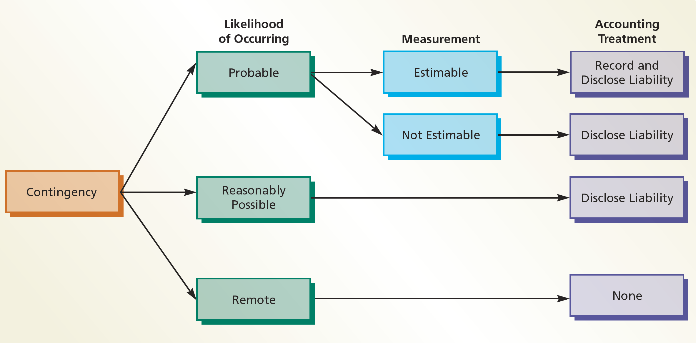
Accounting Treatment of Contingent Liabilities

Slide 43
Reporting Liabilities
Accounts included as current liabilities on the balance sheet include
  accounts payable
  accruals
  notes payable
  the current portion of installment notes payable
  any other debts that are due within one year

Slide 44
Analysis for Decision Making: Quick Ratio (1 of 3)
Current position analysis helps creditors evaluate a company’s ability to pay its current liabilities. This analysis is based on the following three measures:
  Working capital
  Current ratio
  Quick ratio
Working capital is computed as follows:
Working Capital = Current Assets – Current Liabilities
The current ratio is computed as follows:

Slide 45
Analysis for Decision Making: Quick Ratio (2 of 3)
While these two measures can be used to weigh a company’s ability to pay its current liabilities, they do not show the company’s ability to pay these liabilities within a short period of time.
  This is because some current assets, such as inventory, cannot be converted into cash as quickly as other current assets, such as cash and accounts receivable.

Slide 46
Analysis for Decision Making: Quick Ratio (3 of 3)
The quick ratio overcomes this limitation by measuring the “instant” debt-paying ability of a company.
It is computed as follows:
  Quick assets are cash and other current assets that can easily be converted to cash, such as temporary investments and accounts receivable.
  The current and quick ratios are particularly useful in making comparisons across companies.

