Slide 1
Shelly Cashman: Microsoft Excel 2019
Module 1: Creating a Worksheet and a Chart
© 2020 Cengage Learning. All Rights Reserved. May not be copied, scanned, or duplicated, in whole or in part, except for use as permitted in a license distributed with a certain product or service or otherwise on a password-protected website for classroom use.

Slide 2
Objectives (1 of 2)
Start an app
Identify the components of the Microsoft Office ribbon
Describe the Excel worksheet
Enter text and numbers
Use the Sum button to sum a range of cells
Enter a simple function
Copy the contents of a cell to a range of cells using the fill handle
Apply cell styles

Slide 3
Objectives (2 of 2)
Format cells in a worksheet
Create a pie chart
Change a worksheet name and sheet tab color
Change document properties
Preview and print a worksheet
Use the AutoCalculate area to display statistics
Correct errors on a worksheet
Use Microsoft Office Help

Slide 4
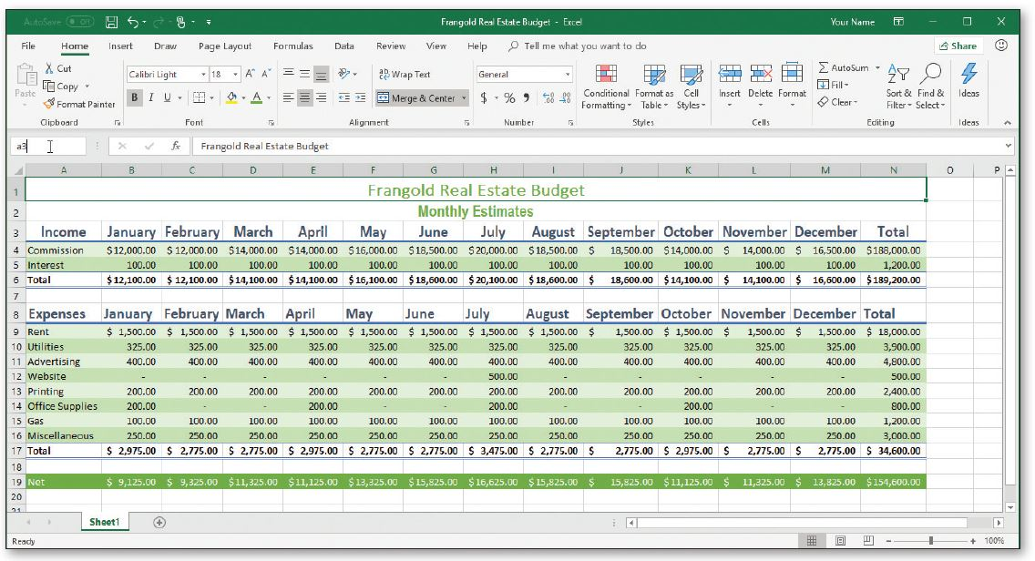
Project: Real Estate Budget Worksheet and Chart (1 of 2)
Notes:
Figure 1-1a: depiction of a real estate budget worksheet

Slide 5
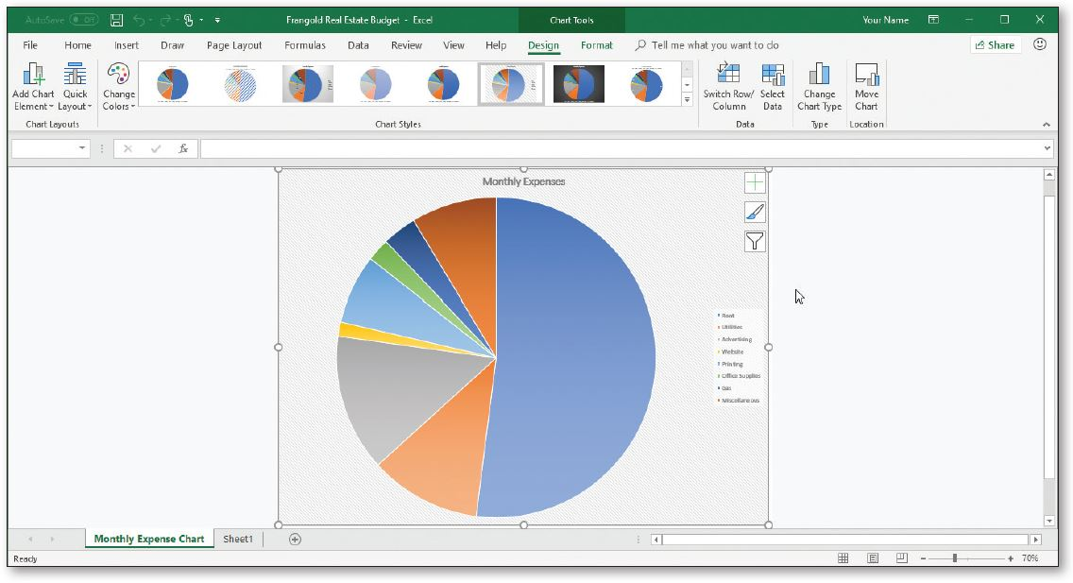
Project: Real Estate Budget Worksheet and Chart (2 of 2)
Notes:
Figure 1-1b: depiction of a pie chart of monthly expenses by category

Slide 6
Starting and Using Excel (1 of 3)
What is Excel?
  A powerful spreadsheet app that allows users to organize data, complete calculations, make decisions, graph data, develop professional-looking reports, publish organized data to the web, and access real-time data from websites
  Four major parts:
    Workbooks and worksheets
    Charts
    Tables
    Web support

Slide 7
Starting and Using Excel (2 of 3)
To Start Excel and Create a Blank Workbook
  If necessary, scroll to display the Excel 2019 app on the Start menu
  Click the Excel 2019 app to run the Excel app and display the Excel start screen
  Click the Blank workbook thumbnail on the Excel start screen to create a blank Excel workbook in the Excel window

Slide 8
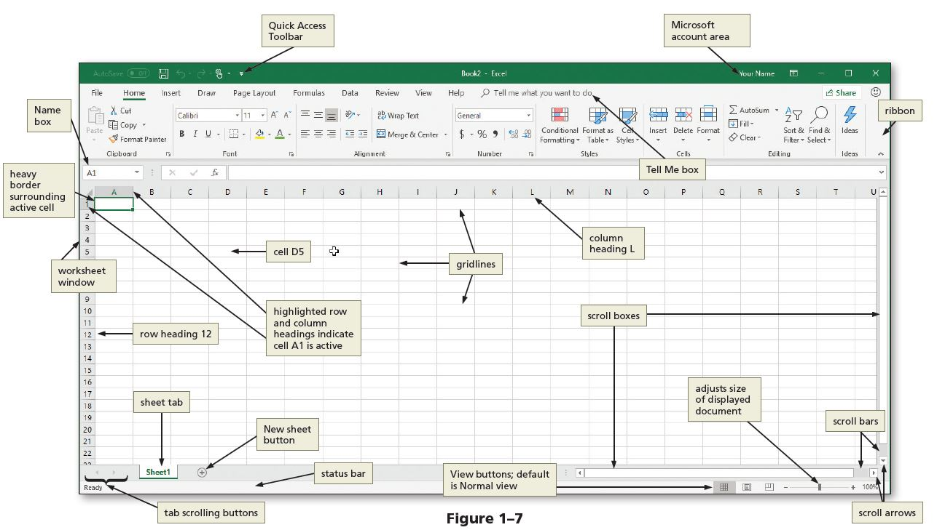
Starting and Using Excel (3 of 3)
Notes:
Figure 1-7: display of an active worksheet

Slide 9
Running and Using an App (1 of 2)
Excel Window
  Worksheet
  Scroll Bars
  Status Bars
  Ribbon
  Mini Toolbar
  Quick Access Toolbar
  KeyTips
  Formula Bar
  Tell Me Box
  Microsoft Account Area

Slide 10
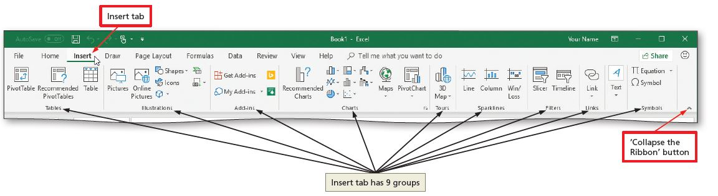
Running and Using an App (2 of 2)
To Display a Different Tab on the Ribbon
  Click Insert on the ribbon to display the Insert tab
  Click the View tab, click Page Layout tab, then click Insert tab
Notes:
Figure 1-15: display of insert tab and collapse the ribbon button

Slide 11
Selecting a Cell
Make the cell active
  Use the mouse
  Use the arrow keys
Cell is active when a heavy border surrounds the cell

Slide 12
Entering Text (1 of 4)
To Enter the Worksheet Titles
  Run Excel and create a blank workbook in the Excel window
  Click the A1 to make the cell A1 the active cell
  Type desired text
  Click the ENTER button to complete the entry and enter the worksheet title
  Click cell A2 to select it
  Click the ENTER button to complete the entry and enter the worksheet subtitle

Slide 13
Entering Text (2 of 4)
To Enter Column Titles
  Click cell A3 and enter a column title
  Press the RIGHT ARROW key to enter a column title and make the cell to the right the active cell
  Repeat the previous steps until all column titles are entered. Click the Enter box after entering the last column title

Slide 14
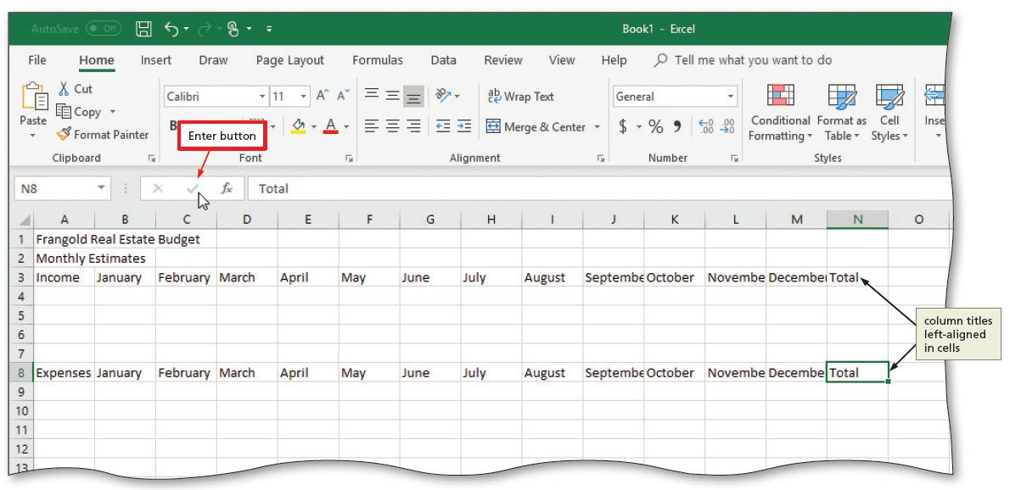
Entering Text (3 of 4)
Notes:
Figure 1-23; display of the enter button

Slide 15
Entering Text (4 of 4)
To Enter Row Titles
  Click cell A4 and enter a row title
  Press the DOWN ARROW key to enter a row title and make the cell below the current cell the active cell
  Repeat the previous steps until all row titles are entered

Slide 16
Entering Numbers
In Excel, you can enter numbers in Excel to represent amounts
If a cell entry contains any other keyboard character, Excel interprets it as text and treats it accordingly
To Enter Numbers
  Click cell B4 to select it
  Type desired number and then press the RIGHT ARROW key to enter the data in the selected cell and make the cell to the right the active cell
  Continue until all numbers are entered

Slide 17
Calculating Sums and Using Formulas (1 of 2)
To Sum a Column of Numbers
  Click the first empty cell below the column of numbers to sum
  Click the AutoSum button on the HOME tab to display a formula in the formula bar and in the active cell
  Click the Enter box in the formula bar to enter a sum in the active cell
  Repeat above steps to enter the SUM function in other locations

Slide 18
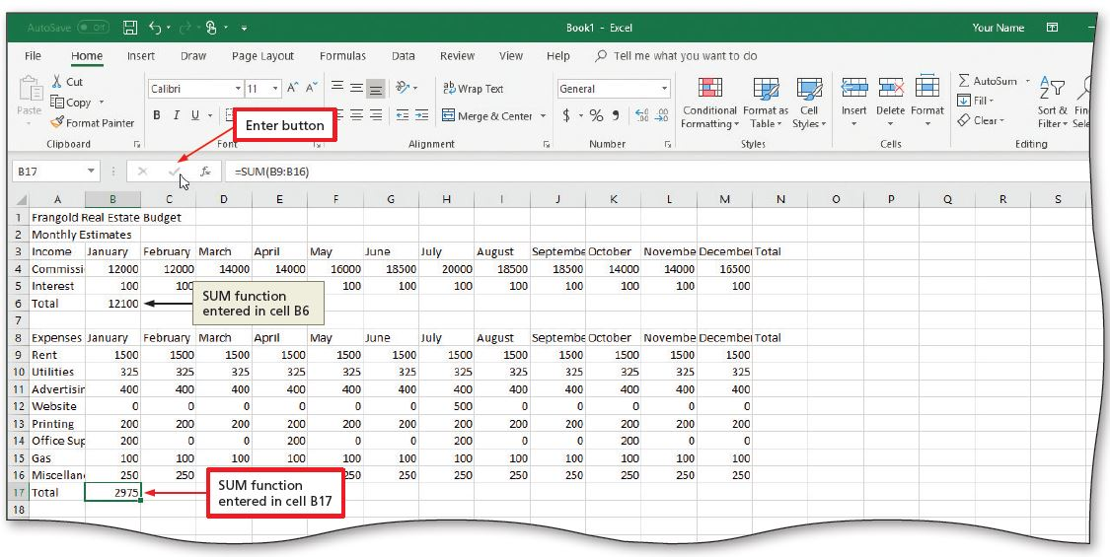
Calculating Sums and Using Formulas (2 of 2)
Notes:
Figure 1-30: display of a sum function

Slide 19
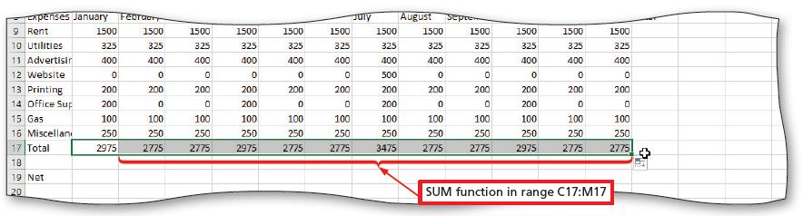
Using the Fill Handle to Copy a Cell to Adjacent Cells (1 of 3)
To Copy a Cell to Adjacent Cells in a Row
  With the cell containing the contents to fill across the row active, point to the fill handle to activate it
  Drag the fill handle to select the destination area to display a shaded border around the source area and the destination area
  Release the mouse button to copy the SUM function from the active cell to the destination area and calculate the sums
  Repeat the above steps to copy the SUM function to other ranges
Notes:
Figure 1-34: SUM function range displayed

Slide 20
Using the Fill Handle to Copy a Cell to Adjacent Cells (2 of 3)
To Calculate Multiple Totals at the Same Time
  Highlight a range at the end of rows or columns of numbers to total
  Click the AutoSum button on the HOME tab to calculate and display the sums of the corresponding rows
  Repeat the above steps to calculate and display the sums of the corresponding rows

Slide 21
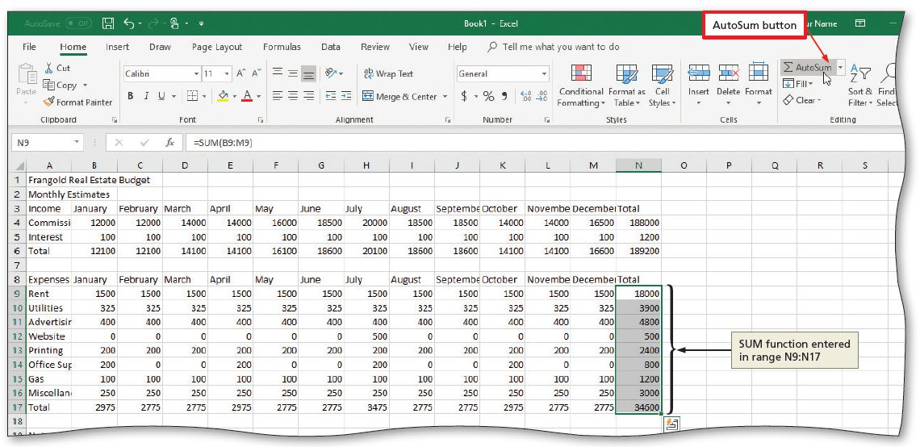
Using the Fill Handle to Copy a Cell to Adjacent Cells (3 of 3)
Notes:
Figure 1-38: multiple sums calculated displayed

Slide 22
Calculating Average, Maximum, and Minimum Values (1 of 2)
To Enter a Formula Using the Keyboard
  Select the cell that will contain the formula
  Type the formula in the cell to display it in the formula bar and in the current cell and to display colored borders around the cells referenced in the formula
  Click the cell to the right to complete the formula and to display the result in the worksheet.

Slide 23
Calculating Average, Maximum, and Minimum Values (2 of 2)
To Copy a Cell to Adjacent Cells in a Row Using the Fill Handle
  Select the cell
  Drag the fill handle to select the destination area to display a shaded border around the source area and the destination area
  Release the mouse button to copy the function from the active cell to the destination area and calculate the results

Slide 24
Saving the Project
To Save a Workbook
  Click File on the ribbon to open Backstage view
  Click Save As, then Click This PC to display the default save location
  Click the More options link to display the Save As dialog box
  Type desired file name in the File name text box
  Click Save button

Slide 25
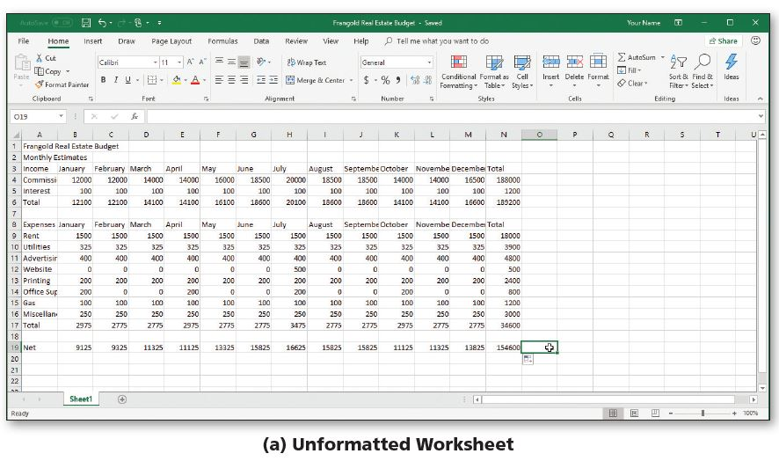
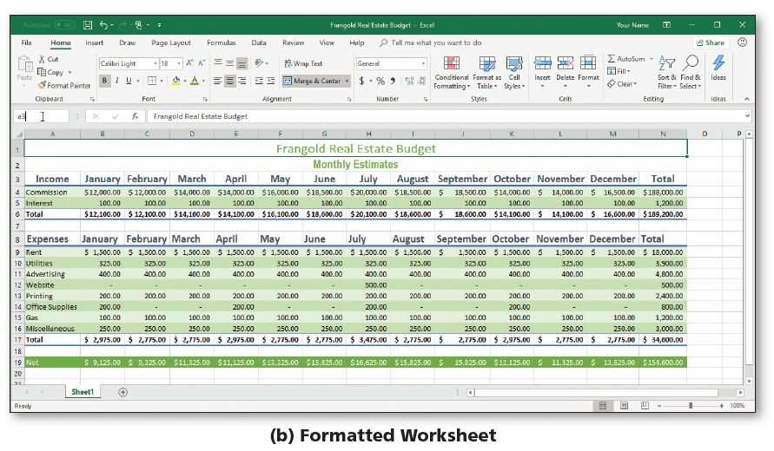
Formatting the Worksheet (1 of 10)
Notes:
Figure 1-46: unformatted worksheet and formatted worksheet

Slide 26
Formatting the Worksheet (2 of 10)
To Change a Cell Style
  Click the desired cell and then click the Cell Styles button on the HOME tab to display the Cell Styles gallery
  Point to the Title cell style in the Titles and Headings area of the Cell Styles gallery to see a live preview of the cell style in the active cell
  Click the Title cell style to apply the cell style to the active cell

Slide 27
Formatting the Worksheet (3 of 10)
To Change the Font
  Click the desired cell for which you want to change the font
  Click the Font arrow on the HOME tab to display the font gallery
  Point to desired font in the Font gallery to see a live preview of the selected font in the active cell
  Click the desired font to change the font of the selected cell

Slide 28
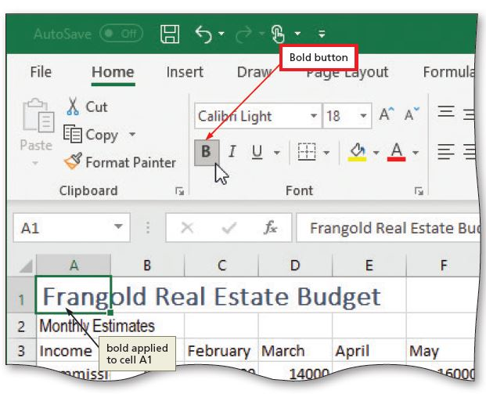
Formatting the Worksheet (4 of 10)
To Apply Bold Style to a Cell
  Click a cell to bold and then click the Bold button on the HOME tab to change the font style of the active cell to bold
Notes:
Figure 1-52: display of bold button

Slide 29
Formatting the Worksheet (5 of 10)
To Increase the Font Size of a Cell Entry
  With the desired cell selected, click the Font Size arrow on the HOME tab to display the Font Size gallery
  Point to the desired font size in the Font Size gallery to see a live preview of the active cell with the selected font size
  Click the desired font size in the Font Size gallery to change the font size in the active cell

Slide 30
Formatting the Worksheet (6 of 10)
To Change the Font Color of a Cell Entry
  Select the cell for which you want to change the font color and then click the Font Color arrow on the HOME tab
  Point to the desired color in the Theme Colors area of the Font Color gallery to see a live preview of the font color
  Click the desired theme to change the font color of the in the active cell

Slide 31
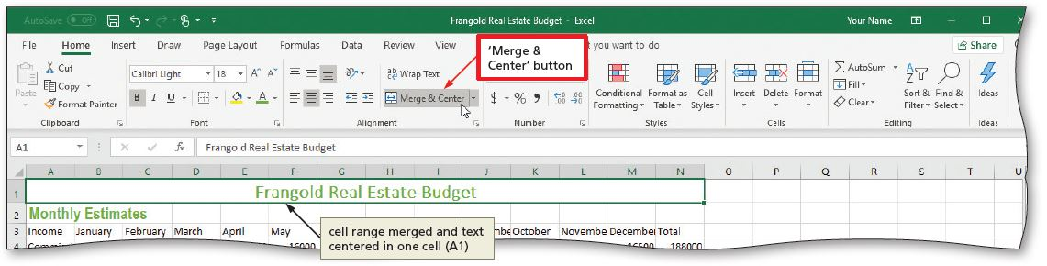
Formatting the Worksheet (7 of 10)
To Center Cell Entries across Columns by Merging Cells
  Drag to select the range of cells you want to merge and center
  Click the “Merge & Center” button on the HOME tab to merge the selected range and center the contents of the leftmost cell across the selected columns
  Repeat the above steps to merge and center other titles
Notes:
Figure 1-58: display of Merge and Center button

Slide 32
Formatting the Worksheet (8 of 10)
To Format Rows Using Cell Styles
  Click a cell and drag to select the desired range
  Click the Cell Styles button on the HOME tab to display the Cell Styles gallery
  Click a Heading cell style to apply the cell style to the selected range and then click the Center button on the HOME tab to center the column headings in the selected range
  Repeat the above steps to format other ranges

Slide 33
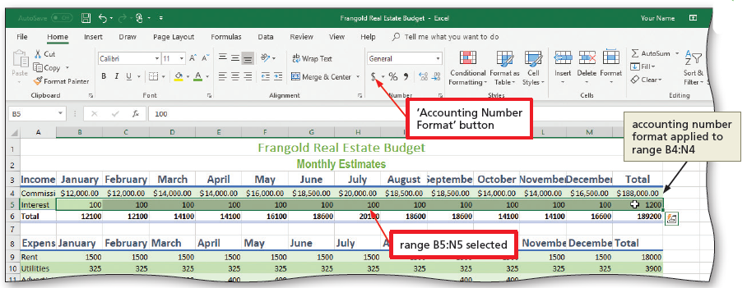
Formatting the Worksheet (9 of 10)
To Format Numbers in the Worksheet
  Select the range of cells containing numbers to format
  Click the desired format on the HOME tab to apply the format to the cells in the selected range
Notes:
Figure 1-64: how to format numbers displayed

Slide 34
Formatting the Worksheet (10 of 10)
To Adjust the Column Width
  Point to the boundary on the right side of the column of which you want to change the size to change the mouse pointer to a split double arrow
  Double-click on the boundary to adjust the width of the column to the width of the largest item in the column
To Use the Name box to Select a Cell
  Click the Name box in the formula bar and then type the cell reference of the cell you wish to select
  Press the ENTER key to change the active cell in the Name box

Slide 35
Adding a Pie Chart to the Worksheet (1 of 2)
To Add a Pie Chart
  Select the range for the pie chart
  Click the “Insert Pie or Doughnut Chart” button on the INSERT tab to display the Insert Pie or Doughnut Chart gallery
  Click the Insert Pie or Doughnut Chart gallery to insert the chart
  Click the chart title to select it
  Type a chart title and then press the ENTER key to change the title
  Deselect the chart title

Slide 36
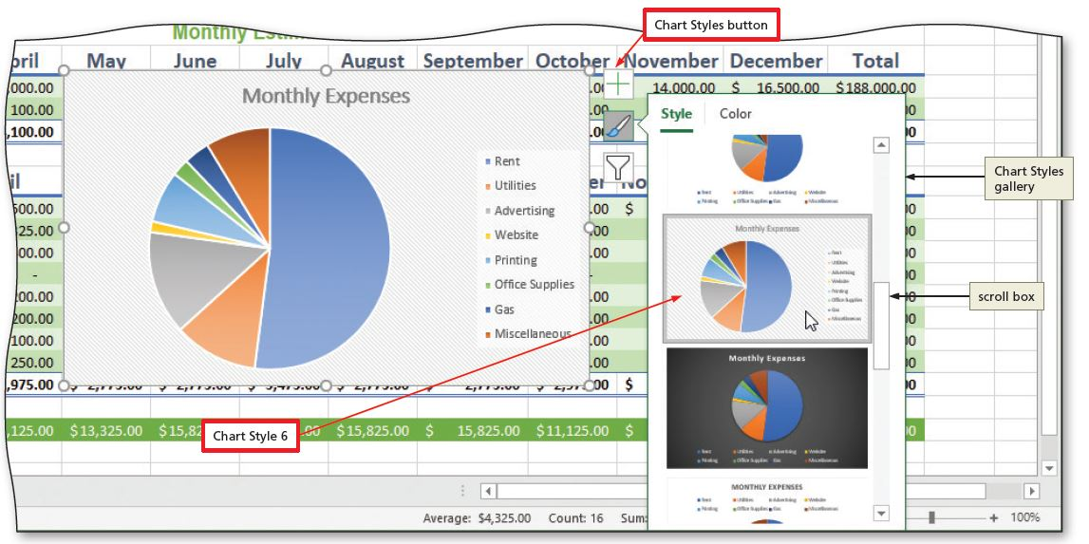
Adding a Pie Chart to the Worksheet (2 of 2)
To Apply a Style to a Chart
  Click the Chart Styles button to display the Chart Styles gallery
  Click a style in the Chart Styles gallery to change the chart style to the desired style
Notes:
Figure 1-76: a display of changing the styles

Slide 37
Changing the Sheet Tab Names and Colors (1 of 2)
To Move a Chart to a New Sheet
  Click the Move Chart button on the CHART TOOLS DESIGN tab
  Click New sheet to select it and then type a title for the worksheet that will contain the chart
  Click the OK button to move the chart to a new chart sheet with a new sheet tab name

Slide 38
Changing the Sheet Tab Names and Colors (2 of 2)
To Change the Sheet Tab Name and Color
  Double-click the sheet tab you wish to change in the lower-left corner of the window
  Type a new name as the worksheet tab name
  Right-click the sheet tab in the lower-left corner of the window to display a shortcut menu
  Point to Tab Color in the Tab Color gallery
  Click the desired color in the Theme Colors area to change the color of the tab

Slide 39
Document Properties
To Change Document Properties
  Click File on the ribbon to open the Backstage view and then click the Info tab in the Backstage view to display the Info gallery
  Click to the right of the property category to display a text box
  If necessary, click the Properties button to display the Properties menu

Slide 40
Printing a Worksheet
To Preview and Print a Worksheet in Landscape Orientation
  In Backstage view, click the Print tab to display the Print screen
  Verify that the printer listed on the Printer Status button will print a hard copy of the workbook. If necessary, click the Printer Status button to display a list of available printer options and then click the desired printer to change the currently selected printer
  Click the Portrait Orientation button in the Settings area and then select Landscape Orientation to change the orientation of the page to landscape.
  Click the No Scaling button and then select “Fit Sheet on One Page” to print the entire worksheet on one page
  Click the Print button in the Print gallery to print the worksheet in landscape orientation on the currently selected printer
  When the printer stops, retrieve the hard copy

Slide 41
Viewing Automatic Calculations
To Use the AutoCalculate Area to Determine a Maximum
  Select the range of which you wish to determine a maximum, and then right-click the status bar to display the Customize Status Bar shortcut menu
  Click Maximum on the shortcut menu to display the Maximum value in the range in the AutoCalculate area of the status bar

Slide 42
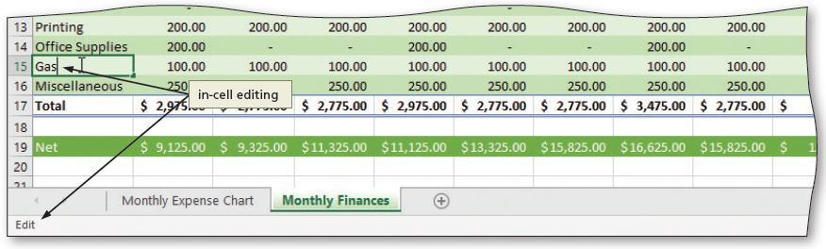
Correcting Errors (1 of 8)
Correcting Errors after Entering Data into a Cell
  If the entry is short, select the cell, retype the entry correctly
  If the entry is long, use the EDIT mode using in-cell editing
Notes:
Figure 1-88: display of in-cell editing

Slide 43
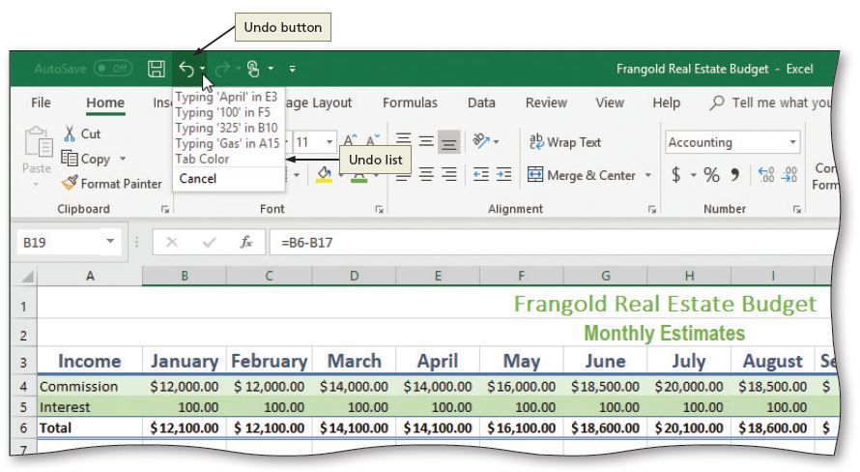
Correcting Errors (2 of 8)
Undoing the Last Cell Entry
Notes:
Figure 1-89: display of undo button

Slide 44
Correcting Errors (3 of 8)
Clearing a Cell or Range of Cells
  To Clear Cell Entries Using the Fill Handle
  To Clear Cell Entries Using the Shortcut Menu
  To Clear Cell Entries Using the Delete Key
  To Clear Cell Entries and Formatting Using the Clear Button
  To Clear Formatting Using the Cell Styles Button

Slide 45
Correcting Errors (4 of 8)
Clearing the Entire Worksheet
  To Clear the Entire Worksheet
    Click the Select All button on the worksheet
    Click the Clear button and then click Clear All

Slide 46
Correcting Errors (5 of 8)
To Obtain Help Using the Search Text Box
  Click Help on the ribbon to display the Help tab
  Click the Help button to display the Help pane
  Type a word in the Search help box
  Press Enter to display the search results
  Click the Close button
  Click Home on the ribbon to display the Home tab

Slide 47
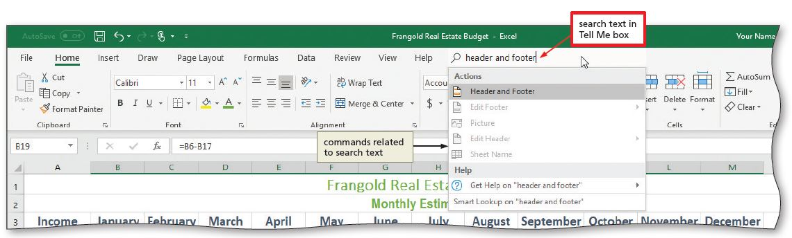
Correcting Errors (6 of 8)
To Obtain Help Using the Tell Me Box
  Type desired text in the Tell Me box and watch the search results appear
Notes:
Figure 1-97: display of search text in Tell Me box

Slide 48
Correcting Errors (7 of 8)
To Save a Workbook with a Different File Name
  Click File on the ribbon to open Backstage view
  Click Save As in Backstage view to display the Save As screen
  Type the desired file name in the File name text box to replace the existing file name
  Click the Save button

Slide 49
Correcting Errors (8 of 8)
To Sign Out of a Microsoft Account
  Click File on the ribbon to open Backstage view
  Click Account to display the Account screen
  Click the Sign out link
  Click Yes
  Click the Back button in the upper-left corner of Backstage view to return to the document
  Click Close to close the workbook and exit Microsoft Excel. If prompted, click Yes

