Slide 1
Shelly Cashman: Microsoft Excel 2019
Module 2: Formulas, Functions, and Formatting
© 2020 Cengage Learning. All Rights Reserved. May not be copied, scanned, or duplicated, in whole or in part, except for use as permitted in a license distributed with a certain product or service or otherwise on a password-protected website for classroom use.

Slide 2
Objectives (1 of 2)
Use Flash Fill
Enter formulas using the keyboard
Enter formulas using Point mode
Apply the MAX, MIN, and AVERAGE functions
Verify a formula using Range Finder
Apply a theme to a workbook
Apply a date format to a cell or range

Slide 3
Objectives (2 of 2)
Add conditional formatting to cells
Change column width and row height
Check the spelling on a worksheet
Change margins and headers in Page Layout view
Preview and print versions and sections of a worksheet

Slide 4
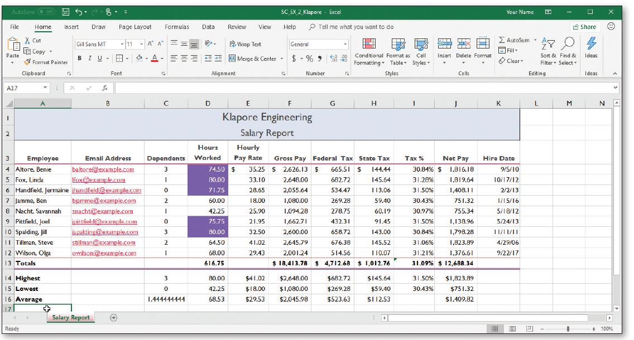
Project: Worksheet with Formulas and Functions
Notes:
Figure 2-1: display of an Excel worksheet

Slide 5
Entering the Titles and Numbers into the Worksheet (1 of 2)
To Enter the Worksheet Title and Subtitle
  Run Excel and create a blank workbook
  Select cell A1 and type the desired text, then press the DOWN ARROW key to enter the worksheet title
  Select cell A2 and type the desired then press the DOWN ARROW key to enter the worksheet subtitle
To Enter the Column Titles
  Select cell A3 and type the desired text, then press the RIGHT ARROW key to enter the column heading
  Continue until all the columns you desire have headings

Slide 6
Entering the Titles and Numbers into the Worksheet (2 of 2)
To Enter the Salary Data
  Use the data in Table 2-1 to enter salary data in a worksheet
  Select cell A4, type desired name, and then press the RIGHT ARROW key two times to enter the employee name and make cell C4 the active cell
  Type a number in cell C4 and then press the RIGHT ARROW key
  Type a number of hours worked in cell D4 and then press the RIGHT ARROW key
  Type an hourly rate in cell E4
  Click cell K4 and type a date

Slide 7
Flash Fill (1 of 2)
To Use Flash Fill
  Click a cell
  Type desired text and then press the DOWN ARROW to select the next cell
  Type desired text again following the same pattern (for example an email address)
  Click Data on the ribbon to select the Data tab
  Click Flash Fill to enter similarly formatted text

Slide 8
Flash Fill (2 of 2)
To Enter the Row Titles
  Select a cell in the A column
  Type desired text and then press the DOWN ARROW key to enter a row header.
  Continue until all Rows have a header
To Change the Sheet Tab Name and Color
  Double-click the Sheet1 tab and enter the desired text as the sheet tab name and then press the ENTER key
  Right-click the sheet tab to display the shortcut menu
  Point to Tab Color on the shortcut menu to display the Tab Color gallery. Click desired color
  Save the workbook

Slide 9
Entering Formulas (1 of 5)
To Enter a Formula Using the Keyboard
  With the cell to contain the formula selected, type the formula in the cell to display the formula in the formula bar and in the current cell and to display colored borders around the cells referenced in the formula
  Press TAB to complete the arithmetic operation indicated by the formula, to display the result in the worksheet, and to select the cell to the right

Slide 10
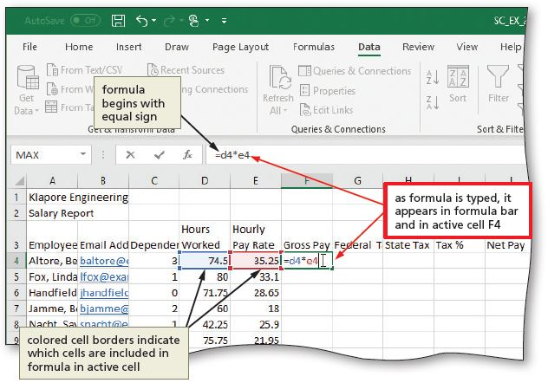
Entering Formulas (2 of 5)
Notes:
Figure 2-7: display of formula as it is typed and appears in formula bar and in active cell

Slide 11
Entering Formulas (3 of 5)
Order of Operations
  From left to right
    First negation (−)
    Then percentages (%)
    Then all exponentiations (^)
    Then all multiplications (*) and divisions (/)
    Finally all additions (+) and subtractions (−)

Slide 12
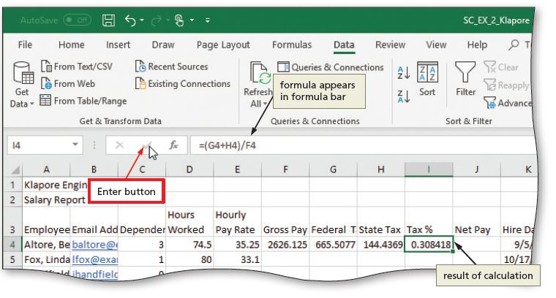
Entering Formulas (4 of 5)
To Enter Formulas Using Point Mode
  With the cell that is to contain the formula selected, begin typing the formula and then click another cell to add a cell reference in the formula
  Finish typing the rest of the formula
  Click the Enter box in the formula bar when you have finished entering the formula
Notes:
Figure 2-12: display of the formula bar

Slide 13
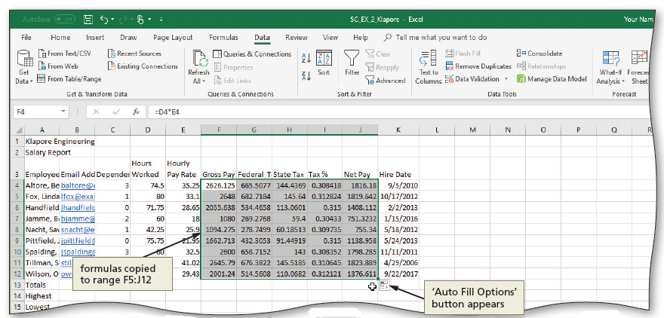
Entering Formulas (5 of 5)
To Copy Formulas Using the Fill Handle
  Select the source range, point to the fill handle, drag the fill handle down to desired location, and continue to hold the mouse button to select the destination range
  Release the mouse to copy the formulas to the destination range
Notes:
Figure 2-14: display of the Auto Fill Options button

Slide 14
Option Buttons (1 of 3)
Table 2-4 Option Buttons in Excel
Name | Menu Function
Auto Fill Options | Provides options for how to fill cells following a fill operation, such as dragging the fill handle
AutoCorrect Options | Undoes an automatic correction, stops future automatic corrections of this type, or causes Excel to display the AutoCorrect Options dialog box
Insert Options | Lists formatting options following an insertion of cells, rows, or columns
Paste Options | Specifies how moved or pasted items should appear (for example, with original formatting, without formatting, or with different formatting)
Trace Error | Lists error-checking options following the assignment of an invalid formula to a cell
Notes:
Table 2-4: Option Buttons in Excel

Slide 15
Option Buttons (2 of 3)
To Determine Totals Using the AutoSum Button
  Display the Home tab
  Select the desired cell to contain the sum, click the AutoSum button to sum the contents of the range and click ENTER to display the total in the selected cell
  Select the range to contain the sums. Click the AutoSum button to display totals in the selected range
  Select the cell to contain the sum, click the AutoSum button to sum the contents of the range and click ENTER

Slide 16
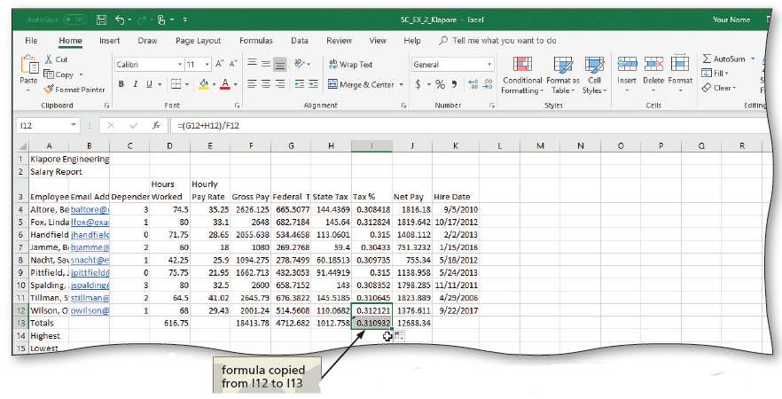
Option Buttons (3 of 3)
To Determine the Total Tax Percentage
  Select the cell to be copied and then drag the fill handle down through the desired cell to be copy the formula
Notes:
Figure 2-16: display of formula to be copied

Slide 17
Using the AVERAGE, MAX, MIN, and other Statistical Functions (1 of 6)
To Determine the Highest Number in a Range of Numbers Using the Insert Function Dialog box
  Select the cell to contain the maximum number
  Click the Insert Function box in the formula bar to display the Insert Function dialog box
  If necessary, scroll to and then click MAX in the Select a function list
  Click the OK button to display the Function Arguments dialog box and type the cell range in the Number1 box to enter the first argument of the function
  Click the OK button to display the highest value in the chosen range in the selected cell

Slide 18
Using the AVERAGE, MAX, and MIN Functions (2 of 6)
To Determine the Lowest Number in a Range of Numbers Using the Sum Menu
  Select cell that is to contain the minimum value and then click the AutoSum arrow in the HOME tab
  Click Min to display the MIN function in the formula bar and in the active cell
  Drag through the range of values of which you want to determine the lowest number
  Click the Enter box to determine the lowest value in the range and display the result in the formula bar and in the selected cell

Slide 19
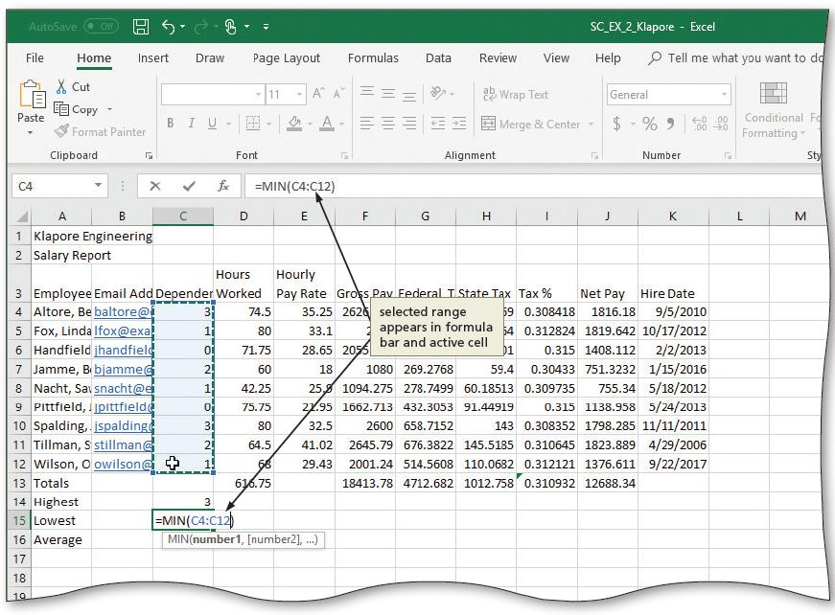
Using the AVERAGE, MAX, and MIN Functions (3 of 6)
Notes:
Figure 2-22: display of selected range appearing in the formula bar and active cell

Slide 20
Using the AVERAGE, MAX, and MIN Functions (4 of 6)
To Determine the Average of a Range of Numbers Using the Keyboard
  Select the cell that will contain the average
  Type =av in the cell to display the Formula AutoComplete list Press the DOWN ARROW key to highlight the required formula
  Double-click AVERAGE in the Formula AutoComplete list to select the function
  Select the range to be averaged to insert the range as the argument to the function
  Click the Enter box to compute the average of the numbers in the selected range and display the result in the selected cell

Slide 21
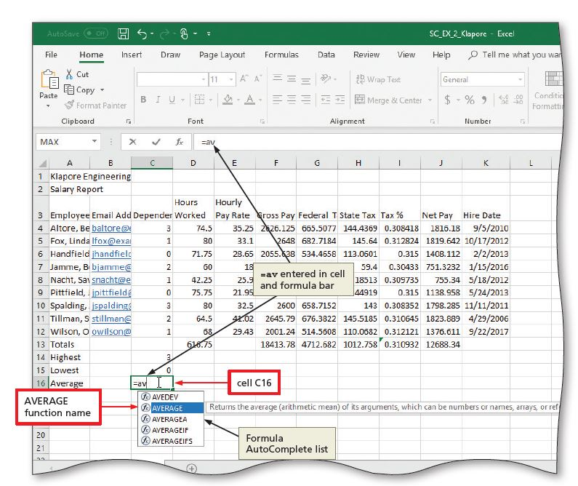
Using the AVERAGE, MAX, and MIN Functions (5 of 6)
Notes:
Figure 2-24: display of Formula AutoComplete list and AVERAGE function name

Slide 22
Using the AVERAGE, MAX, and MIN Functions (6 of 6)
To Copy a Range of Cells across Columns to an Adjacent Range Using the Fill Handle
  Select the source range from which to copy the functions
  Drag the fill handle in the lower-right corner of the selected range through the desired selection cell to copy the functions to the selected range

Slide 23
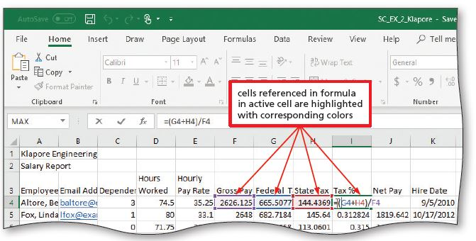
Verifying Formulas using Range Finder
To Verify a Formula Using Range Finder
  Double-click a cell to activate Range Finder
  Press the ESC key to quit Range Finder and then click anywhere in the worksheet to deselect the current cell
Notes:
Figure 2-28: display of using the Range Finder

Slide 24
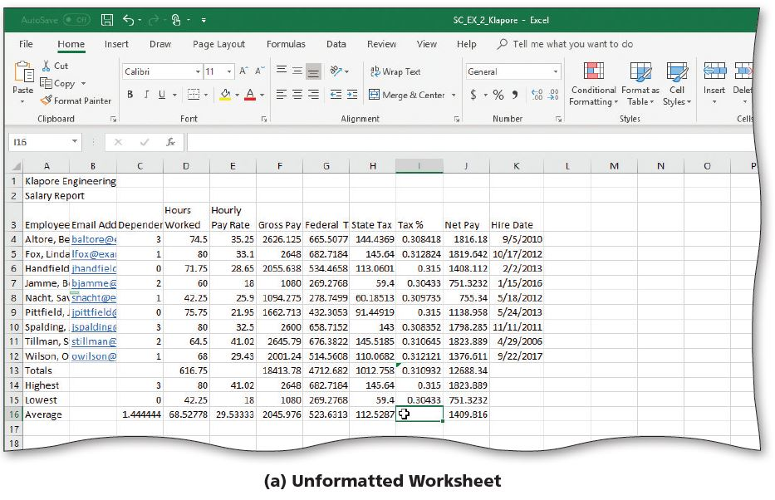
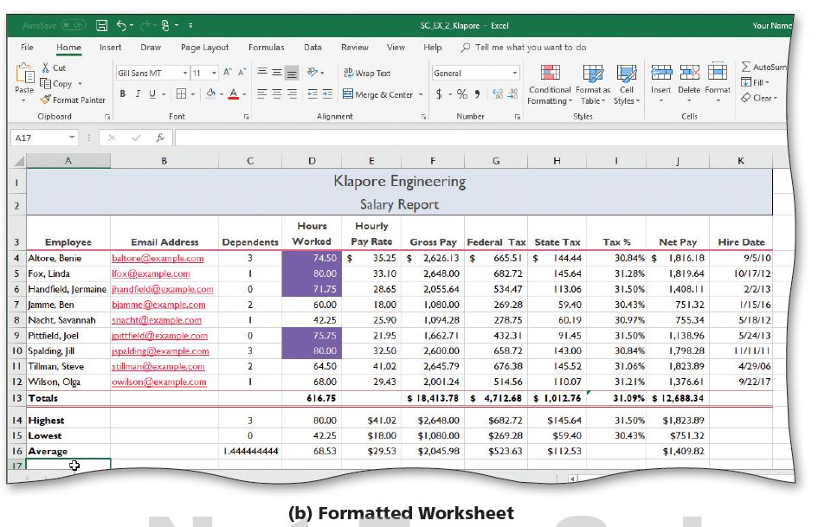
Formatting the Worksheet (1 of 13)
Notes:
Figure 2-29: formatted worksheet
Unformatted worksheet
Formatted worksheet

Slide 25
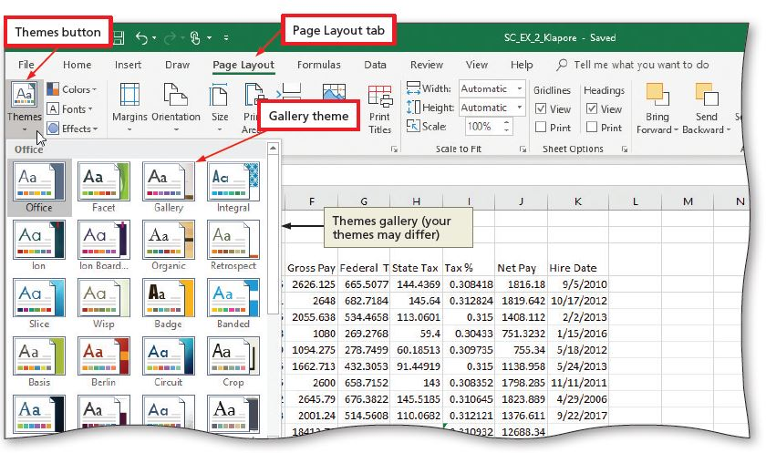
Formatting the Worksheet (2 of 13)
To Change the Workbook Theme
  Click the Themes button on the PAGE LAYOUT tab to display the Themes gallery
  Click the desired theme in the Themes gallery to change the workbook theme
Notes:
Figure 2-30: display of the Themes button

Slide 26
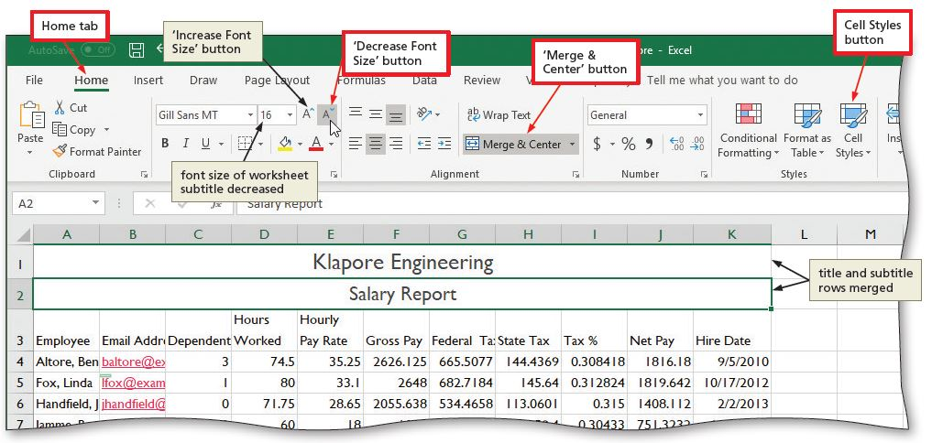
Formatting the Worksheet (3 of 13)
To Format the Worksheet Titles
  Display the Home tab
  Select the range to be merged, click MERGE & CENTER
  Select the range to contain the Title cell style, click Cell Styles button to display the Cell Styles gallery and choose a style
Notes:
Figure 2-32: display of the Cell Styles button, Merge & Center button, and Decrease Font Size button

Slide 27
Formatting the Worksheet (4 of 13)
To Change the Background Color and Apply a Box Border to the Worksheet Title and Subtitle
  Select the range to color and then click the Fill Color arrow on the HOME tab to display the Fill Color gallery
  Click a color to select it and change the background color of the range of cells
  Click the Borders arrow on the HOME tab to display the Borders gallery
  Click a border in the Borders gallery to select it and display a border around the selected range

Slide 28
Formatting the Worksheet (5 of 13)
To Apply a Cell Style to the Column Headings and Format the Total Rows
  Select the range to be formatted
  Use the Cell Styles gallery to apply the cell style
  Click the Center button to center the column headings
  Apply the Total cell style to the range
  Bold the range

Slide 29
Formatting the Worksheet (6 of 13)
To Format Dates and Center Data in Cells
  Select the range to contain the new date format
  On the HOME tab in the Number group, click the Dialog Box Launcher to display the Format Cells dialog box
  If necessary, click the NUMBER tab and click Date in the Category list, and then click a date type to choose the format for the selected range
  Click the OK button to format the dates in the current column using the selected date format style
  Select the range to be centered and then click the Center button on the HOME tab to center the data in the selected range

Slide 30
Formatting the Worksheet (7 of 13)
To Apply an Accounting Number Format and Comma Style Format Using the Ribbon
  Select the range to contain the accounting number format
  While holding down the CTRL key, select the nonadjacent ranges and cells
  Click the “Accounting Number Format” button on the HOME tab to apply the accounting number format to the selected nonadjacent ranges
  Click the Comma Style button on the HOME tab to assign the Comma style format to the selected range

Slide 31
Formatting the Worksheet (8 of 13)
To Apply a Currency Style Format with a Floating Dollar Sign Using the Format Cells Dialog Box
  Select the range to format and then on the HOME tab in the Number group, click the Dialog Box Launcher to display the Format Cells dialog box
  If necessary, click the NUMBER tab to display the Number sheet
  Click Currency in the Category list to select the necessary number format category and then tap or click a style in the Negative numbers list to select the desired currency format
  Click the OK button to assign the currency style format to the selected ranges

Slide 32
Formatting the Worksheet (9 of 13)
To Apply Percent Style Format and Using the Increase Decimal Button
  Select the range to format
  Click the Percent Style button in the HOME tab to display the numbers in the selected range as a rounded whole percent
  Click the Increase Decimal button in the HOME tab two times to display the numbers in the selected range with two decimal places

Slide 33
Formatting the Worksheet (10 of 13)
To Apply Conditional Formatting
  Select the range to which you wish to apply conditional formatting
  Click the Conditional Formatting button on the HOME tab to display the Conditional Formatting menu
  Click New Rule in the Conditional Formatting menu to display the New Formatting Rule dialog box
  Click the desired rule type in the Select a Rule Type area
  Select and type the desired values in the Edit the Rule Description area

Slide 34
Formatting the Worksheet(11 of 13)
Table 2-5 Summary of Conditional Formatting Relational Operators
Relational Operator | Formatting will be applied if…
between | cell value is between two numbers
not between | cell value is not between two numbers
equal to | cell value is equal to a number
not equal to | cell value is not equal to a number
greater than | cell value is greater than a number
less than | cell value is less than a number
greater than or equal to | cell value is greater than or equal to a number
less than or equal to | cell value is less than or equal to a number
Notes:
Table 2-5: Summary of Conditional Formatting Relational Operators

Slide 35
Formatting the Worksheet (12 of 13)
To Change Column Width
  Drag through column headings to select the columns
  Point to the boundary on the right side of column heading to cause the pointer to become a split double arrow
  Double-click the right boundary of the column to change the width of the selected columns to best fit
  To resize a column by dragging, point to the boundary of the right side of the column heading. When the mouse pointer changes to a split double arrow, drag to the desired width, and then lift your finger or release the mouse button to change the column widths

Slide 36
Formatting the Worksheet (13 of 13)
To Change the Row Height
  Point to the boundary below the row heading to resize
  Drag the boundary to the desired row height and then release the mouse button
  Lift your finger or release the mouse button to change the row height

Slide 37
Checking Spelling
To Check Spelling on the Worksheet
  Click cell A1 so that the spell checker begins at the beginning of the worksheet
  Click the Spelling button on the REVIEW tab to run the spell checker and display the misspelled words in the Spelling dialog box
  Apply the desired action to each misspelled word
  When the spell checker is finished, click the Close button

Slide 38
Printing the Worksheet (1 of 3)
To Change the Worksheet’s Margins, Header, and Orientation in Page Layout View
  Click the Page Layout button on the status bar to view the worksheet in Page Layout view
  Click the Adjust Margins button on the PAGE LAYOUT tab to display the Margins gallery
  Click the desired margin style to change the worksheet margins to the selected style
  Click above cell A1 in the center area of the Header area
  Type the desired worksheet header, and then press the ENTER key
  Click the “Change Page Orientation” button on the PAGE LAYOUT tab to display the Change Page Orientation gallery
  Click the desired orientation in the Orientation gallery to change the worksheet’s orientation

Slide 39
Printing the Worksheet (2 of 3)
To Print a Worksheet
  Click FILE on the ribbon to open Backstage view
  Click the Print to display the Print screen
  If necessary, click Printer Status button to display a list of available printer and click the desired printer
  Click the No Scaling button and then select “Fit Sheet on One Page”
  Click Print

Slide 40
Printing the Worksheet (3 of 3)
To Print a Section of the Worksheet
  Select the range to print
  Click FILE on the ribbon to open Backstage view
  Click the Print to display the Print screen
  Click “Print Active Sheets” in the Settings area on the PRINT screen to display a list of printing options
  Click Print Selection to print the selected range
  Click the Print button in the Print screen to print the selected range of the worksheet
  Click the Normal button on the status bar to return to Normal view

Slide 41
Displaying and Printing the Formulas Version of the Worksheet (1 of 2)
To Display the Formulas in the Worksheet and Fit the Printout on One Page
  Press CTRL+ACCENT MARK (`) to display the worksheet with formulas
  Click the Page Setup Dialog Box Launcher on the PAGE LAYOUT tab to display the Page Setup dialog box
  If necessary, click the desired Orientation in the Page sheet to select it
  If necessary, click Fit to in the Scaling area to select it
  Click the Print button to open the Print screen in Backstage view. Select the Print Selection button in the Settings area of the Print gallery and then click Print Active Sheets
  Click the Print button to print the worksheet
  After viewing and printing the formulas version, press CTRL+ACCENT MARK (`) to display the values version

Slide 42
Displaying and Printing the Formulas Version of the Worksheet (2 of 2)
To Change the Print Scaling Option Back to 100%
  Click the Page Setup Dialog Box Launcher on the PAGE LAYOUT tab to display the Page Setup dialog box
  Click the Adjust to option button in the Scaling area to select the Adjust to setting
  If necessary, type 100 in the Adjust to box to adjust the print scaling to 100%
  Click OK
  Display the Home tab
  Save the workbook, sign out and exit Excel

