Slide 1
Shelly Cashman: Microsoft Excel 2019
Module 4: Financial Functions, Data Tables, and Amortization Schedules
© 2020 Cengage Learning. All Rights Reserved. May not be copied, scanned, or duplicated, in whole or in part, except for use as permitted in a license distributed with a certain product or service or otherwise on a password-protected website for classroom use.

Slide 2
Objectives (1 of 2)
Assign a name to a cell and refer to the cell in a formula using the assigned name
Determine the monthly payment of a loan using the financial function PMT
Use the financial functions PV (present value) and FV (future value)
Create a data table to analyze data in a worksheet
Create an amortization schedule
Control the color and thickness of outlines and borders

Slide 3
Objectives (2 of 2)
Add a pointer to a data table
Analyze worksheet data by changing values
Use names and print sections of a worksheet
Set print options
Protect and unprotect cells in a worksheet
Hide and unhide worksheets and workbooks
Use the formula checking features of Excel

Slide 4
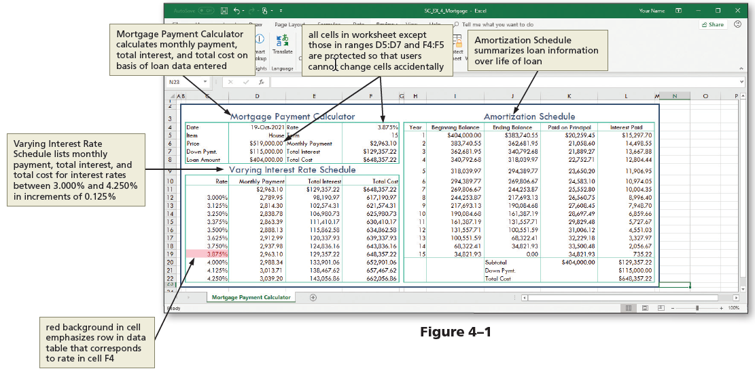
Project: Mortgage Payment Calculator with Data Table and Amortization Schedule (1 of 3)
Notes:
Figure 4-1: Excel worksheet using proper design guidelines

Slide 5
Project—Mortgage Payment Calculator with Data Table and Amortization Schedule (2 of 3)
To Apply a Theme to the Worksheet
  Start Excel and create a blank worksheet in the Excel workbook
  Apply a theme to the workbook
To Enter the Section and Row Title and System Date
  Select a cell and type a section title
  Select a range and then click “Merge & Center.” Click the Cell Styles button and select a style
  Click Middle Align button to vertically align the text
  Right-click a cell to open the shortcut menu and then click Format Cells. Click Number tab, click Date in the Category, scroll down and select a date format, click OK

Slide 6
Project—Mortgage Payment Calculator with Data Table and Amortization Schedule (3 of 3)
To Adjust the Column Widths and Row Height
  Click column heading A and then drag through column B to select both columns. Position the pointer on the right boundary of column B and then drag to the left until ScreenTip indicates desired width
  Click row heading 1 to select it and then drag through row heading 2 to select both. Position the pointer on the bottom of row heading 2 and then drag until the ScreenTip indicates the desired height
To Change the Sheet Tab Name
  Double-click the Sheet tab and enter a new name

Slide 7
Creating Cell Names (1 of 8)
To Format Cells before Entering Values
  Select the desired range and while holding down CTRL, select the nonadjacent range
  Right-click one of the ranges to display the shortcut menu and then click Format Cells to display the Format Cells dialog box
  Click the NUMBER tab, select the desired category from the list
  Click OK

Slide 8
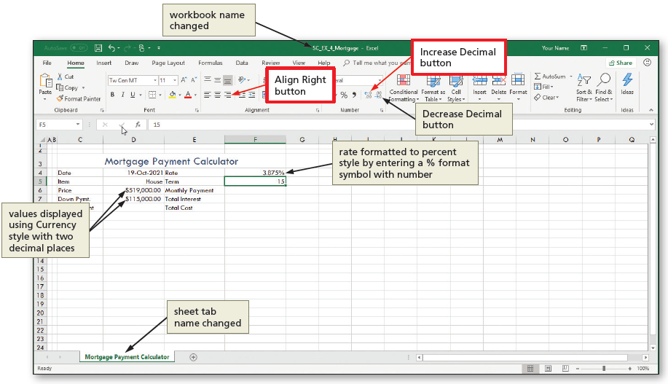
Creating Cell Names (2 of 8)
To Enter the Loan Data
Notes:
Figure 4-5: display of Increase Decimal button and Align Right button

Slide 9
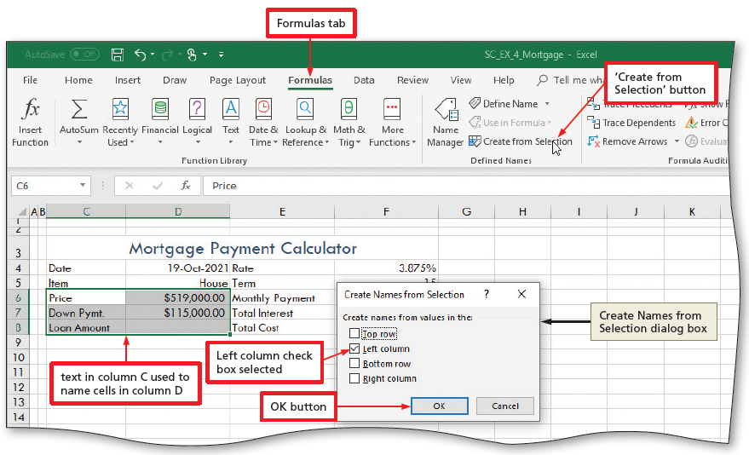
Creating Cell Names (3 of 8)
To Create Names Based on Row Titles
  Select the desired range
  Click the “Create from Selection” button on the FORMULAS tab to display the Create Names from Selection dialog box
  Click the OK button to name the cells selected in the right column of the selection
Notes:
Figure 4-6: display of Formulas tab with “Create from Selection” button

Slide 10
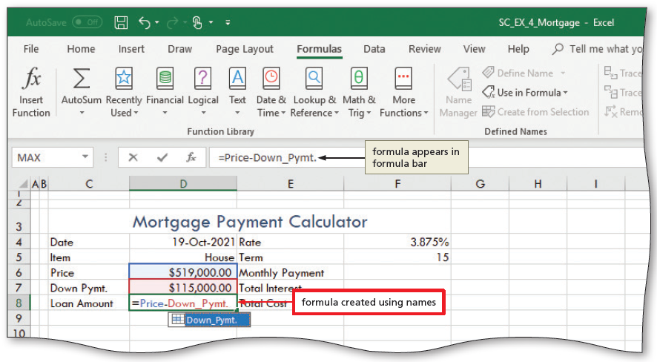
Creating Cell Names (4 of 8)
To Enter the Loan Amount Formula Using Names
  Select the cell to contain the formula
  While entering the formula, double-click the cells to include in the formula to use the names of the cells rather than the cell references
  Click the Enter box to assign the formula to the selected cell
Notes:
Figure 4-9: display of formula created using names

Slide 11
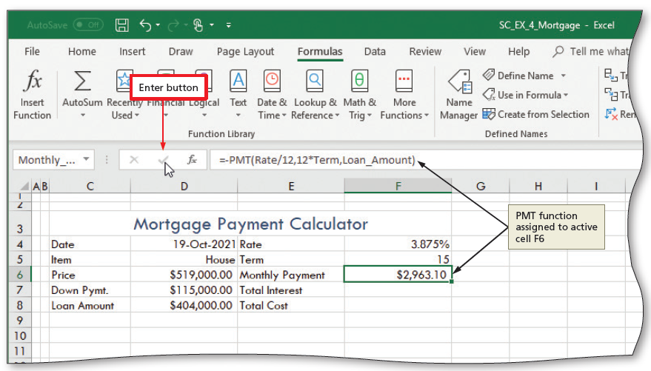
Creating Cell Names (5 of 8)
To Enter the PMT Function
  Select the cell to contain the formula
  Enter the PMT function
  ex: –pmt (Rate/12, 12*Term, Loan_Amount)
Notes:
Figure 4-12: display of Enter button with PMT function assigned to active cell F6

Slide 12
Creating Cell Names (6 of 8)
Table 4-1 Frequently Used financial Functions
Function | Description
FV (rate, periods, payment) | Returns the future value of an investment based on periodic, constant payments and a constant interest rate.
PMT (rate, periods, loan amount) | Calculates the payment for a loan based on the loan amount, constant payments, and a constant interest rate.
PV (rate, periods, payment) | Returns the present value of an investment. The present value is the total amount that a series of future payments now is worth.
Notes:
Table 4-1: Frequently Used Financial Functions

Slide 13
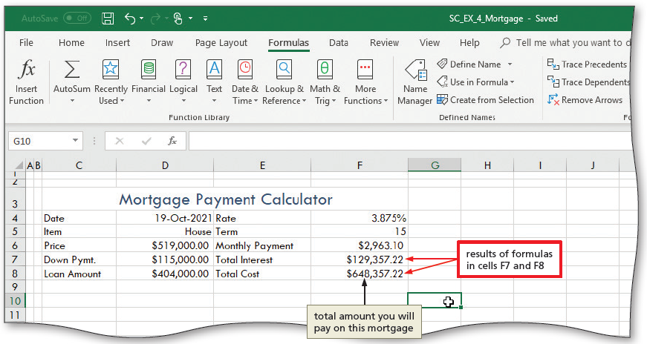
Creating Cell Names (7 of 8)
To Determine the Total Interest and Total Cost
  Select a cell and enter a formula
Notes:
Figure 4-13: display of results of formulas in cells F7 and F8

Slide 14
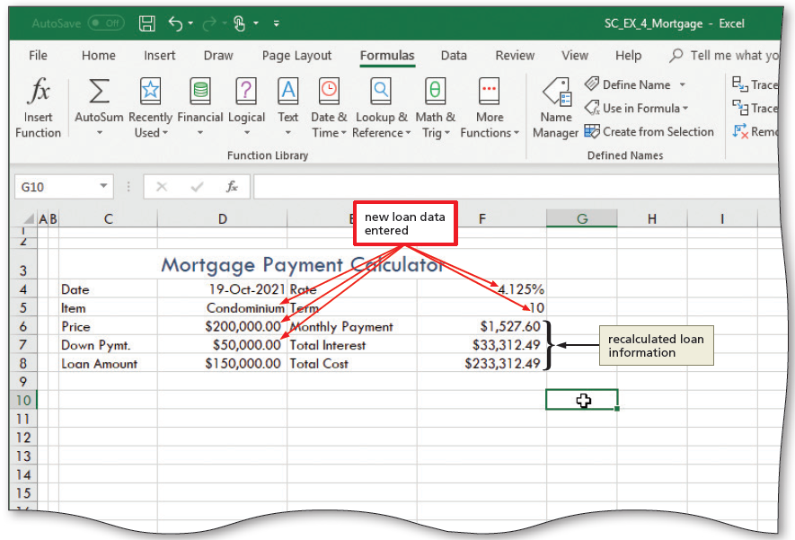
Creating Cell Names (8 of 8)
To Enter New Loan Data
Notes:
Figure 4-14: display of new loan data entered

Slide 15
Using a Data Table to Analyze Worksheet Data (1 of 4)
To Enter the Data Table Title and Column Titles
  Select a cell and type the desired data table section title
  Elect a cell and then click the Format Painter button on the HOME tab to copy the format of the cell and then click another cell and apply the copied format
  Position the pointer on the bottom boundary of a row heading and drag up or down until the ScreenTip indicates the desired height

Slide 16
Using a Data Table to Analyze Worksheet Data (2 of 4)
To Create a Percentage Series Using the Fill Handle
  Type the first two percentages in the series, each in an individual cell
  Select the two cells containing the percentages
  Drag the fill handle through the last cell in the desired series—do not lift your finger or release the mouse button
  Lift your finger or release the mouse button to generate the percent series
  Click the Increase decimal button on the HOME tab to increase the number of decimal places

Slide 17
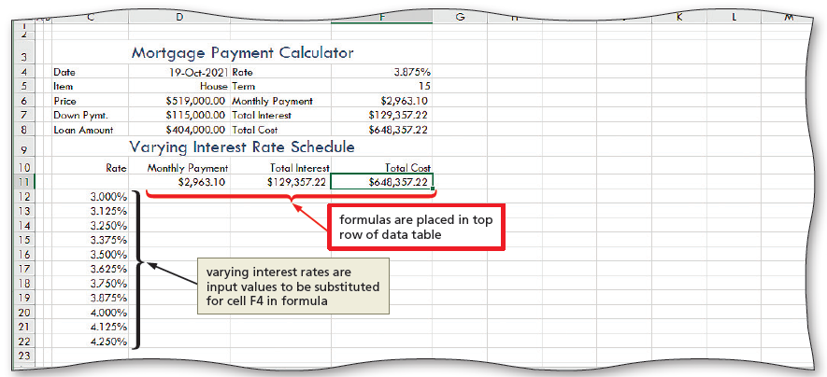
Using a Data Table to Analyze Worksheet Data (3 of 4)
To Enter the Formulas in the Data Table
  Choose a cell and make it active, then press the RIGHT ARROW key to enter the first parameter of the function to be used in the data table
  Type the function and then press the RIGHT ARROW key
Notes:
Figure 4-19: display of formulas as they are placed in rows of data table

Slide 18
Using a Data Table to Analyze Worksheet Data (4 of 4)
To Define a Range as a Data Table
  Select the range in which to create the data table
  Click Data Table on the What-If Analysis menu to display the Data Table dialog box
  Click the “Column input cell” box and then click the cell to select as the desired input cell for the data table
  Click the OK button to create the data table

Slide 19
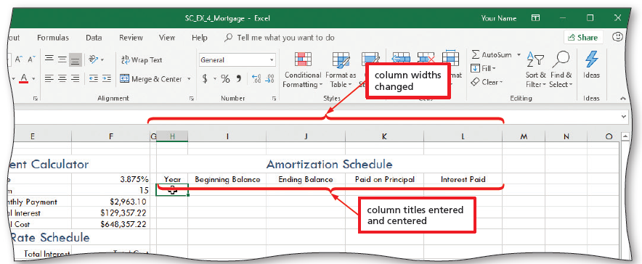
Creating an Amortization Schedule (1 of 12)
To Change the Column Widths and Enter Titles
Notes:
Figure 4-24: display of column widths changed and column titles entered and centered

Slide 20
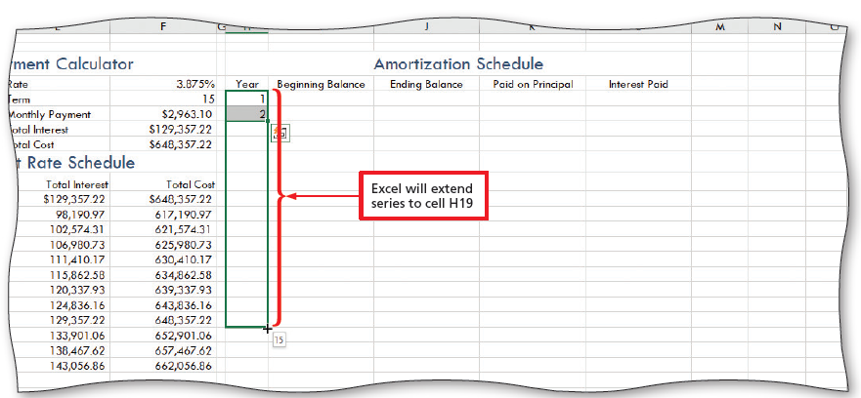
Creating an Amortization Schedule (2 of 12)
To Create a Series of Integers Using the Fill Handle
Notes:
Figure 4-25: display of range selected for fill series to complete

Slide 21
Creating an Amortization Schedule (3 of 12)
Table 4-2 Formulas for the Amortization Schedule
Cell | Column Heading | Formula | Example
I5 | Beginning Balance | =D8 | The beginning balance (the balance at the end of a year) is the initial loan amount in cell D8.
J5 | Ending Balance | =IF(H5<=$F$5, PV($F$4/12, 12*($F$5–H5), –$F$6), 0) | The ending balance (the balance at the end of a year) is equal to the present value of the payments paid over the remaining life of the loan. (This formula is fully explained in the following text.)
K5 | Paid on Principal | =I5–J5 | The amount paid on the principal at the end of the year is equal to the beginning balance (cell I5) minus the ending balance (cell J5).
L5 | Interest Paid | =IF(I5>0, 12*$F$6–K5, 0) | The interest paid during the year is equal to 12 times the monthly payment (cell F6) minus the amount paid on the principal (cell K5).
Notes:
Table 4-2: Formulas for the Amortization Schedule

Slide 22
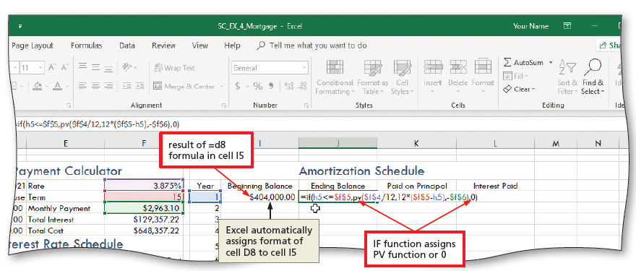
Creating an Amortization Schedule (4 of 12)
To Enter the Formulas in the Amortization Schedule
Notes:
Figure 4-26: display of =IF(H5<=$F$5, PV($F$4/12, 12*($F$5-H5), -$F$6), 0)

Slide 23
Creating an Amortization Schedule (5 of 12)
To Copy the Formulas to Fill the Amortization Schedule
  Select the range of cells to copy and then drag the fill handle down through the last row to copy the formulas through the amortization schedule
  Create a reference so that the beginning balance of one year is equal to the cell that contains the ending balance of the previous year
  Select the beginning balance and drag the fill handle through the end of the range

Slide 24
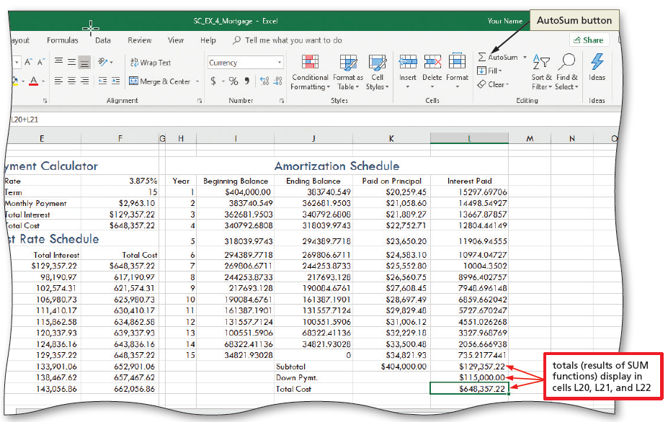
Creating an Amortization Schedule (6 of 12)
To Enter the Total Formulas in the Amortization Schedule
Notes:
Figure 4-33: display total formulas and AutoSum button

Slide 25
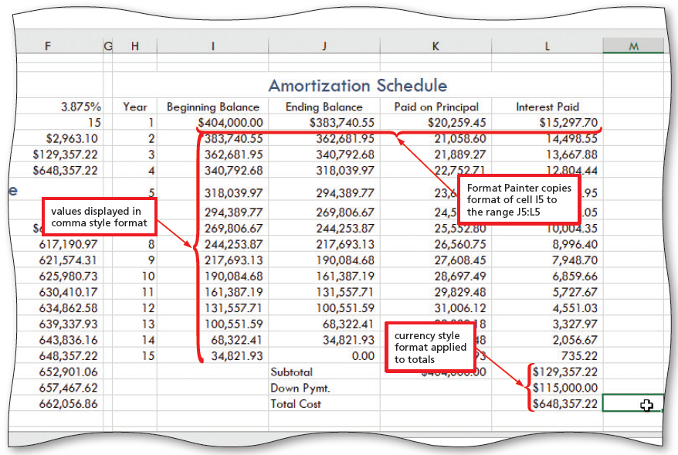
Creating an Amortization Schedule (7 of 12)
To Format the Numbers in the Amortization Schedule
Notes:
Figure 4-34: display total Format Painter copied into format of cells and values displayed in style format

Slide 26
Creating an Amortization Schedule (8 of 12)
To Add Custom Borders to a Range
  Select the desired range and then press and hold or right-click to display a shortcut menu and mini toolbar
  Click Format Cells on the shortcut menu
  Display the BORDER tab and click the Color arrow to display the Colors palette and select a desired color
  Click a desired border in the Style area
  Click the OK button to add the border

Slide 27
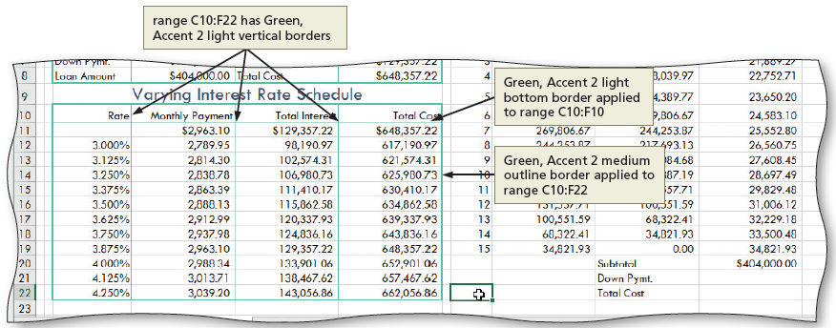
Creating an Amortization Schedule (9 of 12)
To Add Borders to the Varying Interest Rate Schedule
Notes:
Figure 4-39: display of borders added to a varying interest rate schedule

Slide 28
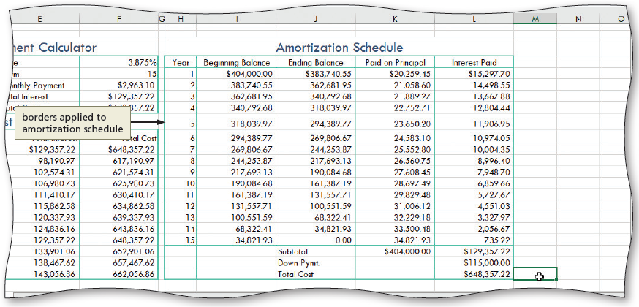
Creating an Amortization Schedule (10 of 12)
To Add Borders to the Amortization Schedule
Notes:
Figure 4-40: display of borders added to an amortization schedule

Slide 29
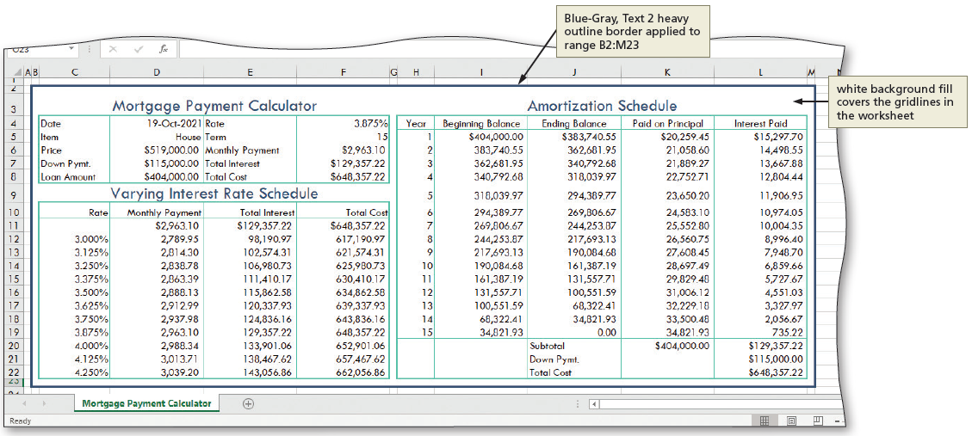
Creating an Amortization Schedule (11 of 12)
To Use Borders and Fill Color to Visually Define and Group the Financial Tools
Notes:
Figure 4-41: display of borders and fill color to define and group financial tools

Slide 30
Creating an Amortization Schedule (12 of 12)
To Add a Pointer to the Data Table Using Conditional Formatting
  Select the desired range and then click the conditional formatting button on the HOME tab
  Point to “Highlight Cells Rules” to display the submenu
  Click the desired rule
  Click the OK button to apply the conditional formatting rule

Slide 31
Printing Sections of the Worksheet (1 of 4)
To Set Up a Worksheet to Print
  Click the Page Setup Dialog Box Launcher on the PAGE LAYOUT tab to display the Page Setup dialog box
  If necessary, click the PAGE tab to display the Page sheet and then click Fit to in the Scaling area to set the worksheet to print on one page
  Click the SHEET tab to display the tab and then click “Black and white” in the Print area to select the check box
  Click the OK button to close the Page Setup dialog box

Slide 32
Printing Sections of the Worksheet (2 of 4)
To Set the Print Area
  Select the range to set as the print area, and then click the Print Area button on the PAGE LAYOUT tab to display the Print Area menu
  Click “Set Print Area” on the Print Area menu to set the range of the worksheet which Excel should print
  To clear the print area, click the Print Area button on the PAGE LAYOUT tab to display the Print Area menu and then click the “Clear Print Area” command on the Print Area menu to reset the print area to the entire worksheet

Slide 33
Printing Sections of the Worksheet (3 of 4)
To Name and Print Sections of a Worksheet
  If necessary, select the range to name, and then type the desired range name as the name of the range to create a range name
  Press the ENTER key to create a range name
  Select the desired range to print
  Click File on the Ribbon to open the Backstage view and then click the PRINT tab in the Backstage view to display the Print gallery
  If necessary, click the “Print Active Sheets” button in the Settings area and select Print Selection to select the desired item to print

Slide 34
Printing Sections of the Worksheet (4 of 4)
Creating Formulas with Defined Names
  To Define a Name for a Range of Cells
  To Use a Defined Name in a Formula

Slide 35
Protecting and Hiding Worksheets and Workbooks (1 of 4)
To Protect a Worksheet
  Select the range(s) to unprotect
  Right-click one of the selected ranges to display a shortcut menu and mini toolbar
  Click Format Cells on the shortcut menu to display the Format Cells dialog box
  Click the PROTECTION tab and then click Locked to remove the check mark
  Click the OK button to close the Format Cells dialog box
  Deselect the ranges

Slide 36
Protecting and Hiding Worksheets and Workbooks (2 of 4)
To Protect a Worksheet (cont.)
  Click the Protect Sheet button on the REVIEW tab to display the Protect Sheet dialog box
  When Excel displays the Protect Sheet dialog box, ensure that the “Protect worksheet and contents of locked cells” check box at the top of the dialog box and the first two check boxes in the list contain check marks so that the user of the worksheet can select both locked and unlocked cells
  Click the OK button to close the Protect Sheet dialog box

Slide 37
Protecting and Hiding Worksheets and Workbooks (3 of 4)
To Hide and Unhide a Worksheet
  Right-click the sheet tab to hide to display a shortcut menu
  Click Hide on the shortcut menu to hide the sheet
  Right-click any sheet tab to display a shortcut menu
  Click Unhide on the shortcut menu to open the Unhide dialog box
  When Excel displays the Unhide dialog box, click the sheet to unhide
  Click the OK button to unhide the hidden sheet

Slide 38
Protecting and Hiding Worksheets and Workbooks (4 of 4)
To Hide and Unhide a Workbook
  Click the Hide Window button on the VIEW tab to hide the workbook
  Click the Unhide Window button on the VIEW tab to display the Unhide dialog box
  If necessary, click to select the workbook to unhide
  Click the OK button to unhide the selected hidden workbook and display the workbook in the same state as it was in when it was hidden

Slide 39
Formula Checking (1 of 2)
Table 4-3 Error Checking Rules
Rule | Description
Cells containing formulas that result in an error | The cell contains a formula that does not use the expected syntax, arguments, or data types.
Inconsistent calculated column formula in tables | The cell contains formulas or values that are inconsistent with the column formula or tables.
Cells containing years represented as 2 digits | The cell contains a text date with a two-digit year that can be misinterpreted as the wrong century.
Numbers formatted as text or preceded by an apostrophe | The cell contains numbers stored as text.
Formulas inconsistent with other formulas in the region | The cell contains a formula that does not match the pattern of the formulas around it.
Formulas which omit cells in a region | The cell contains a formula that does not include a correct cell or range reference.
Unlocked cells containing formulas | The cell with a formula is unlocked in a protected worksheet.
Formulas referring to empty cells | The cells referenced in a formula are empty.
Data entered in a table is invalid | The cell has a data validation error.
Notes:
Table 4-3: Error Checking Rules

Slide 40
Formula Checking (2 of 2)
To Enable Background Formula Checking
  Click Options in Backstage view to open the Excel Options dialog box
  Click Formulas in the left pane to display the Excel options related to formula calculation, performance, and error handling in the right pane
  If necessary, click “Enable background error checking” in the Error Checking to select it
  Click any check box to enable desired rules

