Slide 1
Shelly Cashman: Microsoft Excel 2019
Module 5: Working with Multiple Worksheets and Workbooks
© 2020 Cengage Learning. All Rights Reserved. May not be copied, scanned, or duplicated, in whole or in part, except for use as permitted in a license distributed with a certain product or service or otherwise on a password-protected website for classroom use.

Slide 2
Objectives (1 of 2)
Format a consolidated worksheet
Fill using a linear series
Use date, time, and rounding functions
Apply a custom format code
Create a new cell style
Copy a worksheet
Drill to add data to multiple worksheets at the same time
Select and deselect sheet combinations

Slide 3
Objectives (2 of 2)
Enter formulas that use 3-D cell references
Use the Paste gallery
Format a 3-D pie chart with an exploded slice and lead lines
Save individual worksheets as separate workbook files
View and hide multiple workbooks
Consolidate data by linking separate workbooks

Slide 4
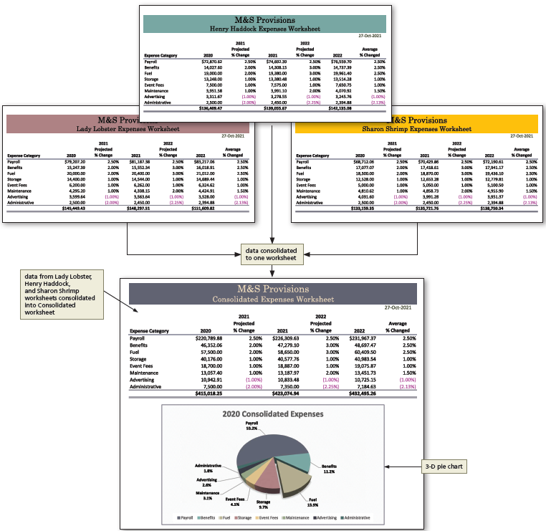
Project—Consolidated Expenses Worksheet
Notes:
Figure 5-1: Display of consolidated worksheet.

Slide 5
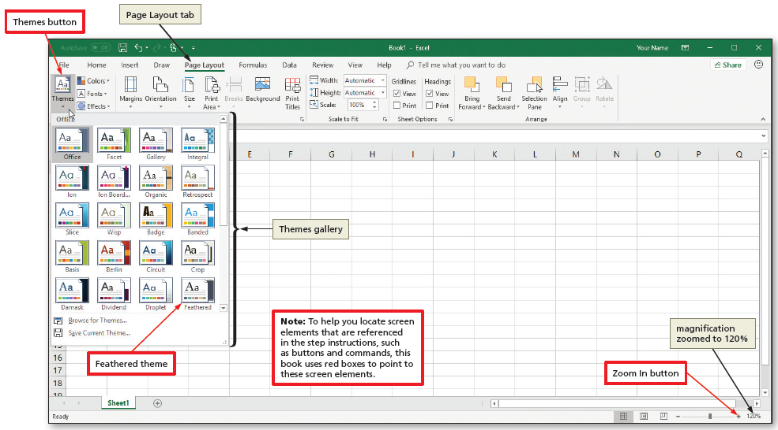
Creating the Consolidated Worksheet
To Apply a Theme
  Display the Page Layout tab, click the Themes button and scroll to the desired theme
Notes:
Figure 5-3: Display of Page Layout tab with Themes button.

Slide 6
Fill Series
To Create Linear Series
  Enter a value in the desired cell
  Select the desired range, including the desired cell
  Drag the AutoFill handle on the lower right of the cell to the desired location

Slide 7
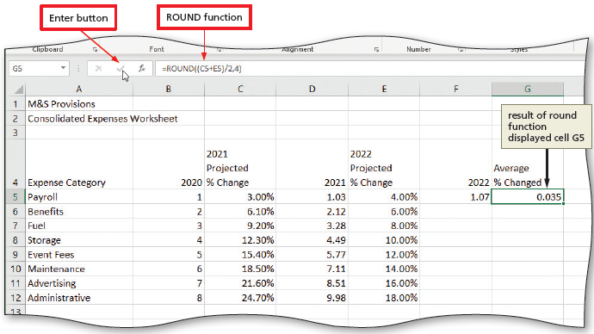
Date, Time, and Round Functions
To Enter Formulas Using the ROUND Function
  Select the desired cell. Type the =round formula and then click the Enter box in the formula bar to display the formula and the resulting value in the select cell
  Drag the fill handle on the lower right of the cell to the desired location
  Click the AutoSum button on the Home tab, select the desired cell range, and then press the Enter button to sum the column
Notes:
Figure 5-15: Display of ROUND function with Enter button and result of round function displayed in cell G5.

Slide 8
Format Codes (1 of 2)
Table 5-5 Format Symbols in Format Codes
Format Symbol | Example of Symbol in Code | Description
# (number sign) | ###.## | Serves as a digit placeholder. If the value in a cell has more digits to the right of the decimal point than number signs in the format, Excel rounds the number. All digits to the left of the decimal point are displayed.
0 (zero) | 0.00 | Works like a number sign (#), except that if the number is less than 1, Excel displays a 0 in the ones place.
. (period) | #0.00 | Ensures Excel will display a decimal point in the number. The placement of zeros determines how many digits appear to the left and right of the decimal point.
% (percent) | 0.00% | Displays numbers as percentages of 100. Excel multiplies the value of the cell by 100 and displays a percent sign after the number.
, (comma) | #,##0.00 | Displays a comma as a thousands separator.
( ) | #0.00;(#0.00) | Displays parentheses around negative numbers.
$, +, or – | $#,##0.00; ($#,##0.00) | Displays a floating sign ($, +, or –).
* (asterisk) | $*##0.00 | Displays a fixed sign ($, +, or –) to the left, followed by spaces until the first significant digit.
[color] | #.##;[Red]#.## | Displays the characters in the cell in the designated color. In the example, positive numbers appear in the default color, and negative numbers appear in red.
” ” (quotation marks) | $0.00 “Surplus”; $-0.00 “Shortage” | Displays text along with numbers entered in a cell.
_ (underscore) | #,##0.00_) | Adds a space. When followed by a parentheses, positive numbers will align correctly with parenthetical negative numbers.
Notes:
Table 5-5: Format Symbols in Format Codes.

Slide 9
Format Codes (2 of 2)
To Create a Custom Format Code
  Select the range of cells and right-click any of the selected ranges to display a shortcut menu, and then click Format Cells to display the Format Cells dialog box
  If necessary, click the Number tab and then click Custom in the Category list
  Delete the word General in the Type box, and then enter the desired format code
  Click OK to display the numbers using the custom format code

Slide 10
Creating a Cell Style (1 of 2)
To Create a New Cell Style
  Click the Cell Styles button to display the Cell Styles gallery
  Click “New Cell Style” in the Cell Styles gallery to display the Style dialog box
  Type the desired name for the new style
  Click the Format button to display the Format Cells dialog box and select desired formats
  Click OK to close the Format Cells dialog box
  Click OK to add create the new style

Slide 11
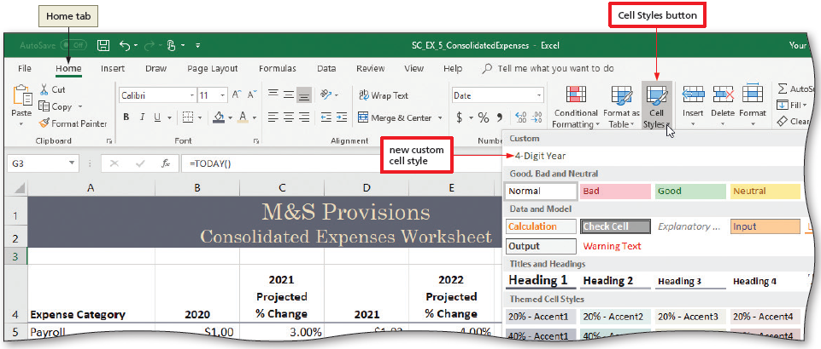
Creating a Cell Style (2 of 2)
To Apply a New Style
  Select the desired cell(s) and then click the Cell Styles button to display the Cell Styles gallery
  Click the name of the new style to assign the style to the selected cell(s)
Notes:
Figure 5-29: Display of Home tab, Cell Styles button, and new custom cell style.

Slide 12
Working with Multiple Worksheets (1 of 3)
To Add a Worksheet to a Workbook
  Click the New sheet button at the bottom of the window to add a new worksheet to a workbook
To Copy and Paste from One Worksheet to Another
  Click the sheet tab for the sheet containing the data to copy
  Click the Select All button to select the entire worksheet and then click the Copy button to copy the contents of the worksheet
  Press ENTER to copy the data from the Office Clipboard to the selected sheet

Slide 13
Working with Multiple Worksheets (2 of 3)
To Copy a Worksheet Using a Shortcut Menu
  Right-click the desired sheet tab to display the shortcut menu
  Click “Move or Copy” to display the Move or Copy dialog box
  Click the desired location and then click to place a check mark in the “Create a copy” check box
  Click OK to add a copy of the worksheet to the workbook
To Copy a Worksheet Using CTRL
  Select a sheet
  CTRL+drag the selected sheet tab to a location to the right of the other sheet tabs. Do not release the drag
  Release the drag to create the worksheet copy

Slide 14
Working with Multiple Worksheets (3 of 3)
To Drill an Entry through Worksheets
  Right-click Sheet1 and then click “Select All Sheets”
  Type the entry in the desired cell and then press the DOWN ARROW key to change sample data to the actual value
  Enter the remaining entry changes in the other cells and then select a blank cell to select the same cell in all of the selected workbooks
  Right-click the Sheet1 tab and then click Ungroup Sheets
  Click through the sheet tabs in use to verify that all are identical

Slide 15
Referencing Cells Across Worksheets (1 of 2)
To Enter a 3-D Reference
  Select the desired cell and then click the AutoSum button to display the SUM function
  Click the desired sheet tab to display the worksheet, and then click the same cell to select the first portion of the argument for the SUM function
  SHIFT+click a new desired sheet tab to select the ending range of the argument for the SUM function
  Click the Enter box in the formula bar to enter the SUM function with the 3-D references in the selected cell

Slide 16
Referencing Cells Across Worksheets (2 of 2)
To Use the Paste Gallery
  With the desired cell active, click the Copy button to copy the selected cell to the Office Clipboard
  Select the desired range and then click the Paste arrow to display the Paste gallery
  Click the Formulas button in the Paste gallery to copy the SUM function to the desired range replicating the 3-D references
  Press ESC to clear the marquee

Slide 17
Formatting Pie Charts (1 of 9)
To Insert a 3-D Pie Chart on a Worksheet
  Select the range to identify the category names and data for the pie chart
  Display the Insert tab, click the “Insert Pie or Doughnut Chart” button and then click 3-D in the Insert Pie or Doughnut Chart gallery to create the desired chart type
  Click the chart title, select the text, and then type the desired text to change the chart title
  Click the Cart Styles button to display the Chart styles gallery, and select a style

Slide 18
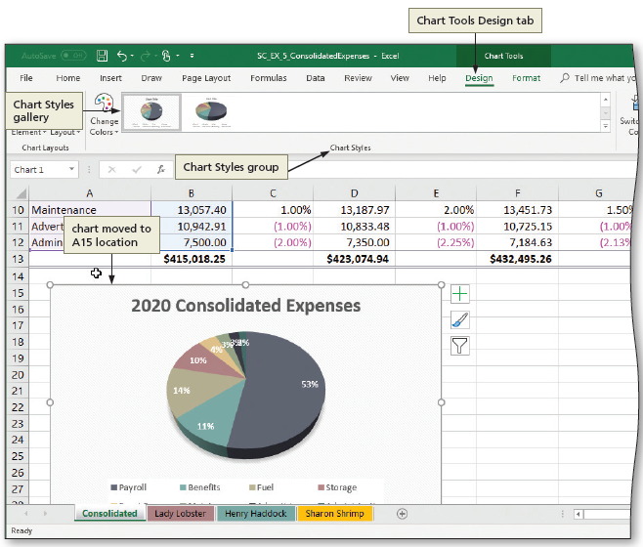
Formatting Pie Charts (2 of 9)
To Move a Chart on the Same Worksheet
  Point to the border of the chart. The pointer will change to a four-headed arrow. Drag the chart below the worksheet numbers to the desired location
Notes:
Figure 5-47: Display of Design tab, Chart Styles gallery, Chart Styles group, and chart moved to new location.

Slide 19
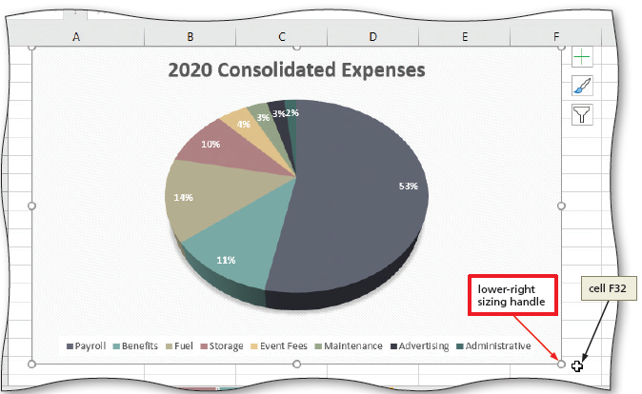
Formatting Pie Charts (3 of 9)
To Resize a Chart
  SHIFT+drag the lower-right resizing handle of the chart until the chart is the desired size
  If necessary, click the zoom out until you can see the entire chart
Notes:
Figure 5-48: Display of pie chart resized.

Slide 20
Formatting Pie Charts (4 of 9)
To Explode a Slice
  Click a pie slice twice (do not double-click)
  Right-click the desired slice to display a shortcut menu
  Click “Format Data Point” on the shortcut menu to open the Format Data Point pane
  Drag the Point Explosion slider to the desired size to set how far the slice in the 3-D pie chart should be offset from the rest of the chart

Slide 21
Formatting Pie Charts (5 of 9)
To Rotate the 3-D Pie Chart
  Right-click the chart to display a shortcut menu, and then click “3-D Rotation” on the shortcut menu to open the Format Chart Area pane
  Click the X Rotation up arrow (Format Chart Area dialog box) to the desired X rotation to rotate the chart

Slide 22
Formatting Pie Charts (6 of 9)
To Format Data Labels
  Click the Chart Elements button to display the Chart Elements gallery. Point to Data Labels and then click the Data Labels arrow to display the Data Labels submenu
  Click More Options to display the Format Data Labels pane
  In the Labels Options area, click to display check marks in the desired areas
  Scroll down in the pane and click the Number arrow to display the Number settings, and then click the Category button and then click Percentages to choose the number style
  Click Text Options in the Format Data Labels pane to display text options
  Click the Text Fill arrow to display the text fill options, and then select the desired fill
  Click the Color button arrow to display the text color options, and then select a color

Slide 23
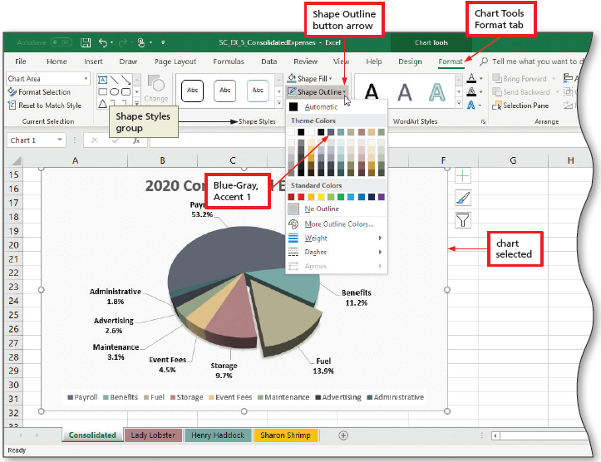
Formatting Pie Charts (7 of 9)
To Add a Chart Border
  Click Format on the ribbon to display the Chart Tools Format tab
  Click the Shape Outline button arrow to display the Shape Outline gallery
  Click on the desired theme on the Theme Color area to apply a chart border.
Notes:
Figure 5-57: Display of Chart Tools Format tab with Shape Outline button arrow, color selected, and chart selected.

Slide 24
Formatting Pie Charts (8 of 9)
To Change Margins and Center the Printout Horizontally
  Right-click desired sheet tab and click “Select All Sheets” on the shortcut menu
  Display the PAGE LAYOUT tab and click the Page Setup Dialog Box Launcher to display the Page Setup dialog box
  When Excel displays the Page Setup dialog box, if necessary, click the Page tab to select desired orientation and scaling
  Make the Margins tab the active tab to set the top, bottom, left, and right margins as desired
  Click the Horizontally check box in the “Center on page” area to center the worksheet on the printed page horizontally

Slide 25
Formatting Pie Charts (9 of 9)
To Add a Header
  Click the Page Layout button on the status bar to display the worksheet in Page Layout view
  Display the Header area. Click a header box to select it as the area for a header, and then type the desired name
  Enter desired text into the other header areas
To Add a Footer
  Scroll down to the footer area
  Click the middle footer box to select it and then click the Sheet Name button
  Enter the desired text into that footer and repeat with the other footer areas

Slide 26
Creating Separate Files from Worksheets
To Create a Separate File from a Worksheet
  Right-click on the desired sheet and then click “Move or Copy” on the shortcut menu to display the Move or Copy dialog box
  Click the To book button to display the choices
  Click (new book) in the list to create a new workbook
  Click the “Create a copy” check box to ensure it displays a check mark
  Click OK to create the new workbook

Slide 27
Consolidating Data by Linking Separate Workbooks (1 of 4)
To Search For and Open Workbooks
  Go to Backstage view and then click Open to display the Open screen
  Click Browse in the left pane and then navigate to the location of your previously saved solution files
  Type the desired text in the Search box as the search text to display the files associated with the desired text
  CTRL+click each of the location workbook names one at a time to select the workbooks to open
  Click the Open button to open the selected workbooks

Slide 28
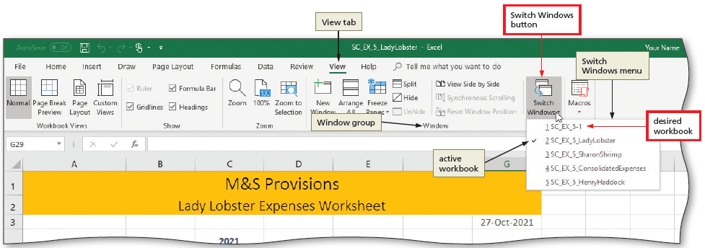
Consolidating Data by Linking Separate Workbooks (2 of 4)
To Switch to a Different Open Workbook
  Display the View tab and then click the Switch Windows button to display the names of open workbooks
  Click the name of the desired workbook
Notes:
Figure 5-66: Display of View tab with Switch Windows button and desired workbook.

Slide 29
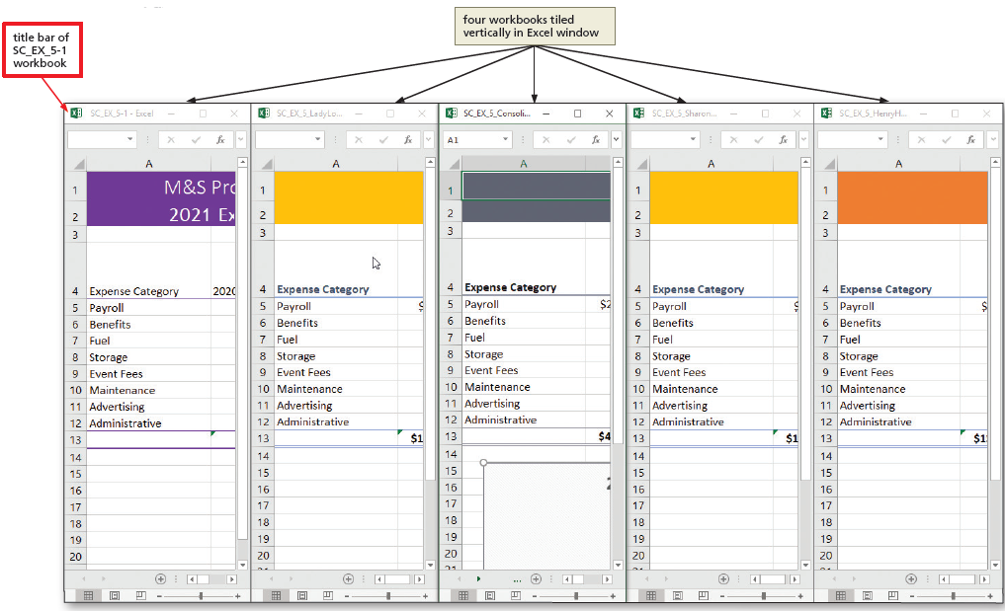
Consolidating Data by Linking Separate Workbooks (3 of 4)
To Arrange Multiple Workbooks
  Click the Arrange All button to display the Arrange Windows dialog box
  Click Vertical to arrange the windows vertically, and then, if necessary, click the “Windows of active workbook” check box to clear it
  Click OK to display the opened workbooks arranged vertically
Notes:
Figure 5-69: Display of four workbooks tiled vertically in Excel window.

Slide 30
Consolidating Data by Linking Separate Workbooks (4 of 4)
To Consolidate Data by Linking Workbooks
  Select the desired worksheet and begin a formula in the desired cell
  Display the View tab and then click the Switch Windows button to display the Switch Windows menu
  Select the next desired worksheet and select the desired cell to use the formula from the first worksheet
  Continue selecting cells to reference from other workbooks by using the Switch Windows button until the formula is complete

