Slide 1
Shelly Cashman: Microsoft Excel 2019
Module 7: Creating Templates, Importing Data, and Working with SmartArt, Images, and Screenshots
© 2020 Cengage Learning. All Rights Reserved. May not be copied, scanned, or duplicated, in whole or in part, except for use as permitted in a license distributed with a certain product or service or otherwise on a password-protected website for classroom use.

Slide 2
Objectives (1 of 2)
Create and use a template
Import data from a text file, an Access database, a webpage, and a Word document
Use text functions
Paste values and paste text
Transpose data while pasting it
Convert text to columns
Replicate formulas
Use the Quick Analysis gallery

Slide 3
Objectives (2 of 2)
Find and replace data
Insert and format a bar chart
Insert and modify a SmartArt graphic
Add pictures to a SmartArt graphic
Apply text effects
Include a hyperlinked screenshot
Use ALT text
Differentiate ways to link and embed

Slide 4
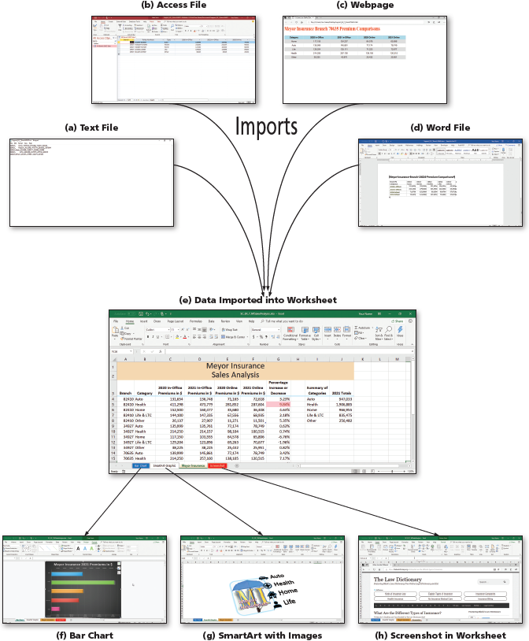
Project—Meyor Insurance
Notes:
Figure 7-1: Display of completed sales analysis workbook. (a) Provides the requested data in a plain text format. (b) Provides the requested data in a Microsoft Access table. (c) Provides the requested data in a webpage. (d) Provides the requested data in a Microsoft Word document. (e) Excel provides the tools necessary to import and manipulate the data from these sources into a single worksheet. (f) Using the data from the worksheet, create a bar chart to summarize total sales by category. (g) SmartArt graphics that include images. (h) A hyperlinked screenshot to support your work.

Slide 5
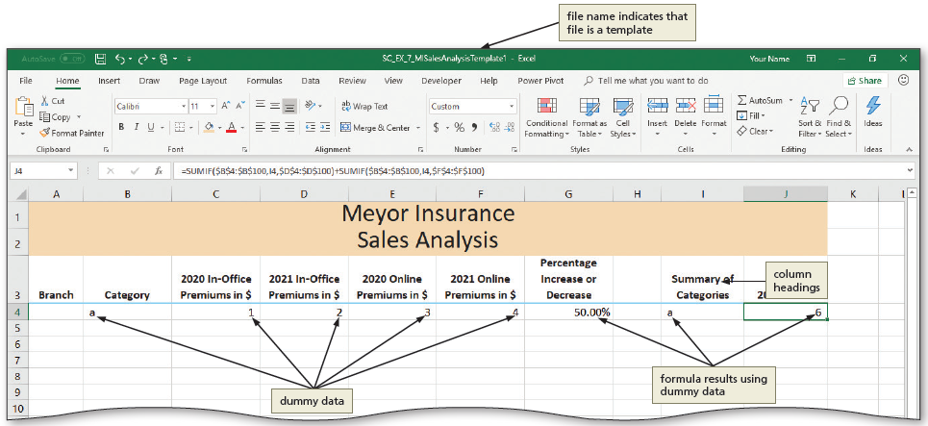
Creating Templates (1 of 3)
Notes:
Figure 7-4: Display of a template.

Slide 6
Creating Templates (2 of 3)
To Save the Template
  Click the Save button to display the Save As screen
  Type the desired file name in the File name box
  Click the “Save as type” arrow and then click Excel Template in the list to specify that this workbook should be saved as a template
  Navigate to the desired save location
  Click Save to save the template

Slide 7
Creating Templates (3 of 3)
To Open a Template-Based File and Save It as a Workbook
  With Excel active, click File Explorer button on the taskbar to start the File Explorer app
  Navigate to the location of the file to be opened
  Double-click the template file to open a new file based on the template
  Click the Save button to display the Save As screen
  Type the file name in the File name box and then navigate to your storage location
  Click Save to save the file

Slide 8
Importing Data (1 of 13)
To Import Data from a Text File
  Click the first cell on the worksheet to contain the imported data
  Click Data on the ribbon to display the Data tab
  Click the “From Text/CSV” button to display the Import Data dialog box
  If necessary, navigate to the location of the Data files to display the files
  Double-click the name of the file to display the preview window
  Click the Load arrow, then click Load To to display the Import Data dialog box
  Click the Exiting worksheet option button to place the data in the current worksheet rather than on a new sheet
  Click OK to import the data

Slide 9
Importing Data (2 of 13)
To Format the CSV Data
  Display the Table Tools Design tab
  Click to remove the check mark in the Banded Rows check box
  Click to remove the check mark in the Header Row check box to display a Microsoft Excel dialog box
  Click the Yes button to remove the header row
  Delete the desired row
  If needed, adjust the column widths

Slide 10
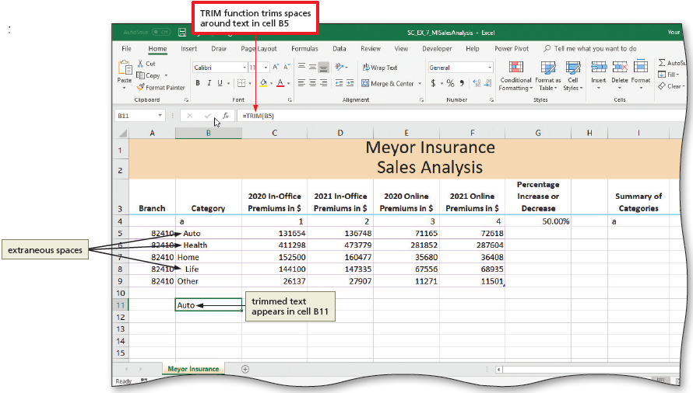
Importing Data (3 of 13)
To Use the Trim Function
  Select the desired cell, type =trim(cell#) and then click Enter button to trim the spaces from the data in the (cell) and display it in the desired cell
Notes:
Figure 7-19: Display of TRIM function trims spaces around text selected in cell B5 and placing in cell B11.

Slide 11
Importing Data (4 of 13)
To Paste Values Only
  With the desired range selected press CTRL+C to copy the data
  Right-click one of the cells to display the shortcut menu
  In the Paste Options area, click the Values icon to paste only the values
  Click the save button on the Quick Access toolbar to save the file with the new data

Slide 12
Importing Data (5 of 13)
To Import Data from an Access Table
  Click the first cell on the worksheet to contain the imported data
  Click the Get Data button to display the Get Data menu
  Point to the From Database command to display the submenu
  Click “From Microsoft Access Database” to display the Import Data dialog box
  Navigate to the location of Data Files
  Double-click the desired file to display the Navigator dialog box
  Click the name of the desired table to display the preview

Slide 13
Importing Data (6 of 13)
To Delete a Column Using Power Query
  In the Navigator dialog box, click the Edit button to display the Power Query Editor window
  Click the desired column heading to delete
  Click the Remove Columns button to remove the column from the import
  Click the “Close & Load” arrow to display the “Close & Load” menu
  Click the “Close & Load To” command to close the Power Query Editor Window and to display the Import Data dialog box
  Click OK to import the data

Slide 14
Importing Data (7 of 13)
To Format the Access Data
  Select a cell, click the Banded Rows check box to remove its check mark
  Click the Header Row check box to remove its check mark. When Excel displays a dialog box, click the Yes button.
  Delete the desired row
  Click the Save button on the Quick Access toolbar to save the file
  Close the Queries & Connections pane

Slide 15
Importing Data (8 of 13)
To Import Data from a Webpage
  Click the first cell on the worksheet to contain the imported data
  Click the From Web button to display the From Web dialog box
  Type the Web page address in the URL box
  Click OK to display the Navigator dialog box
  Click the table name, then click the Web View tab to look at the data
  Click the Edit button to display the Power Query Editor window
  Make desired selections
  Click the “Close & Load” arrow and then click the “Close & Load To” command to close the Power Query Editor Window
  When Excel displays the Import Data dialog box, click the Existing worksheet option button.
  Click OK to import the data

Slide 16
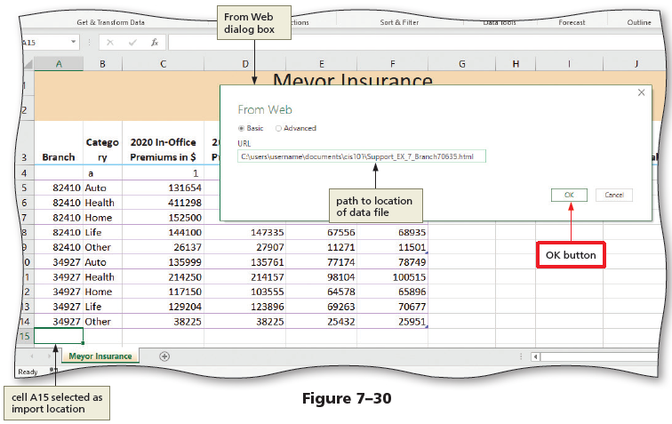
Importing Data (9 of 13)
Notes:
Figure 7-30: Display of From Web dialog box.

Slide 17
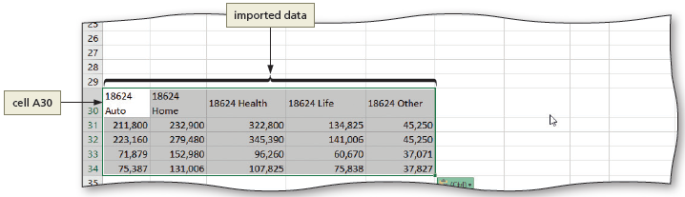
Importing Data (10 of 13)
To Copy from Word and Paste to Excel
  Open the file from which the data should be copied.
  Select the data and press CTRL+C to copy the contents to the Office clipboard
  Close Word and make Excel the active window
  Click the desired cell to paste into
  Press CTRL+V to paste the data
Notes:
Figure 7-37: Display of imported data.

Slide 18
Importing Data (11 of 13)
To Transpose Columns and Rows
  With the range to be copied selected, press CTRL+C to copy the selection to the Office Clipboard
  Click a cell to prepare for pasting data into that location
  Click the Paste arrow to display the Paste gallery
  Click the Transpose button in the Paste gallery to transpose and paste the copied cells

Slide 19
Importing Data (12 of 13)
To Convert Text to Columns
  Select the cells to prepare for converting the text to columns
  Display the Data tab
  Click the “Text to Columns” button to display the Convert Text to Columns Wizard—Step 1 of 3 dialog box
  Click the Fixed width option button
  Click the Next button to accept a fixed width column and to display the Convert Text to Columns Wizard—Step 2 of 3 dialog box
  Click the Finish button to close the dialog box and separate the data

Slide 20
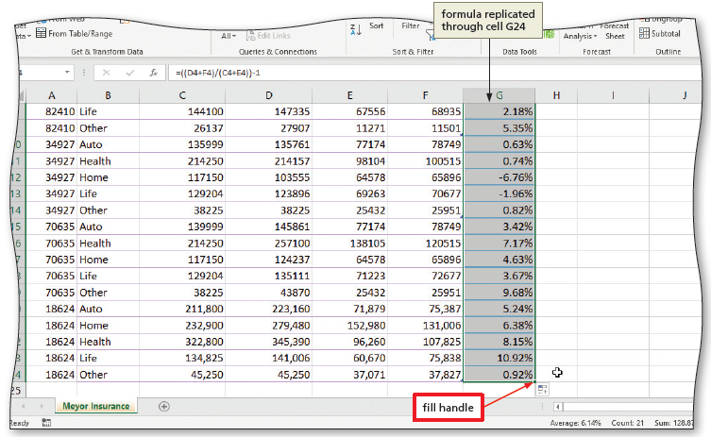
Importing Data (13 of 13)
To Replicate Formulas
  Click the formula(s) to replicate
  Drag the fill handle down through the end of the data to replicate the formula
Notes:
Figure 7-44: Display of fill handle and formula replicated through cell G24.

Slide 21
Using the Quick Analysis Gallery (1 of 2)
To Format Using the Quick Analysis Gallery
  With the range you want formatted selected, click the Quick Analysis button to display the Quick Analysis gallery
  If necessary, click the Formatting tab to display the Quick Analysis gallery formatting options
  Click the desired settings
  Click a desired cell and type a legend for the formatting

Slide 22
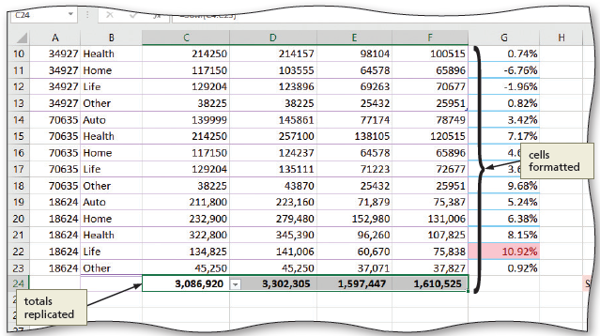
Using the Quick Analysis Gallery (2 of 2)
To Total Data
  Click a cell. Type =sum(cell#:cell#) and then click the ENTER button
  Drag the fill handle to the right to replicate the totals for remaining columns
Notes:
Figure 7-50: Display of cells formatted and totals replicated.

Slide 23
Using the Find and Replace Commands (1 of 2)
To Find Data
  Click the “Find & Select” button to display the Find & Select menu
  Click Find to display the Find and Replace dialog box
  Click the Options button to expand the dialog box
  Type desired text in the Find what box to enter the search string
  Click Match case and then click “Match entire cell contents” to place check marks in those check boxes
  Click the Find Next button
  Continue clicking the Find Next button to find additional occurrences of the string

Slide 24
Using the Find and Replace Commands (2 of 2)
To Find and Replace
  Click the Find & Select button to display the Find & Select menu
  Click Replace on the Find & Select menu to display the Find and Replace dialog box
  Type desired text in the Find what box, and the desired text in the Replace with box to specify the text to find and to replace
  If desired, click Match case and then “Match entire cell contents” to place check marks in those check boxes
  Click the Replace All button to replace the string
  Click OK, click Close, and click Save

Slide 25
Inserting a Bar Chart (1 of 4)
To Insert a Chart Using the Quick Analysis Gallery
  Select the data to include in the chart
  Click the Quick Analysis button to display the Quick Analysis gallery
  Click the Charts tab to display the buttons related to working with charts in the gallery
  Select a chart
  Click the Move Chart button to display the Move Chart dialog box
  Click the New sheet option button, and then type the desired sheet name in the New sheet box
  Click OK to move the chart to the new sheet

Slide 26
Inserting a Bar Chart (2 of 4)
To Format the Chart
  Click the desired style button to change the style of the chart
  Right-click any of the data bars on the chart to display the shortcut menu
  Click “Format Data Series” on the shortcut menu to display the Format Data Series pane
  Select the different options to make changes to the chart

Slide 27
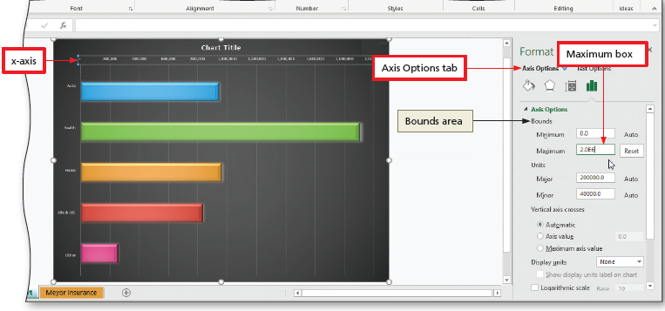
Inserting a Bar Chart (3 of 4)
To Format Axis Options
  Right-click the y-axis and then click Format Axis on the shortcut menu to display the Format Axis pane
  Repeat for the x-axis
  Click the Axis Options tab to display the sheet and make the desired selection
Notes:
Figure 7-68: Display of x-axis, Axis Options tab, and Maximum box.

Slide 28
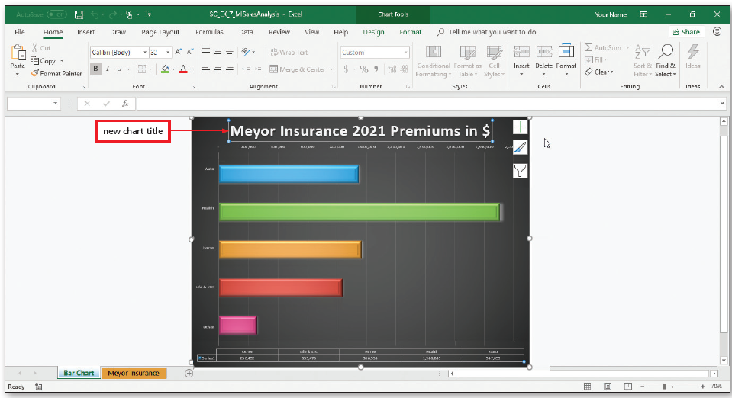
Inserting a Bar Chart (4 of 4)
To Format the Chart Title
  Click the chart title and select all of the text
  Display the Home tab and change the font size
  Type the desired text and click the Save button
Notes:
Figure 7-72: Display of new chart title.

Slide 29
Working with SmartArt Graphics (1 of 4)
To Insert a SmartArt Graphic
  Click the “Insert SmartArt Graphic” button to display the Choose a SmartArt Graphic dialog box
  Click the desired type of SmartArt in the left pane
  Click the desired layout to see a preview of the chart in the preview area
  Click OK to insert the desired type of SmartArt graphic in the worksheet

Slide 30
Working with SmartArt Graphics (2 of 4)
To Color and Resize the SmartArt Graphic
  Click the Change Colors button to display the Change Colors gallery
  Click the desired color
  Drag the sizing handles to resize the SmartArt graphic to the desired size
To Add Shapes to a SmartArt Graphic
  Click the Add Shape button to add shapes to the SmartArt graphic

Slide 31
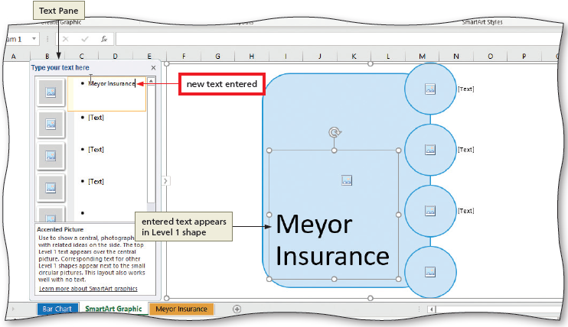
Working with SmartArt Graphics (3 of 4)
To Add Text to a SmartArt Graphic
  Click the Text Pane button to display the Text Pane
  Click the first bulleted item in the Text Pane and then type the desired text
  If desired, enter text in the other boxes
Notes:
Figure 7-79: Display of Text pane with new text entered.

Slide 32
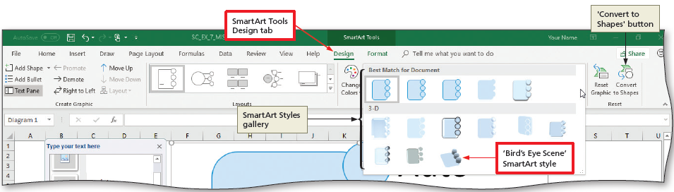
Working with SmartArt Graphics (4 of 4)
To Add a Style to a SmartArt Graphic
  Click More button to display the SmartArt Style gallery
  Click the desired style to apply the style to the SmartArt graphic
Notes:
Figure 7-81: Display of SmartArt Tools Design tab and “Bird’s Eye Scene” SmartArt style.

Slide 33
Pictures and Icons (1 of 3)
To Add a Picture to a SmartArt Graphic
  In the Text Pane, click the first Insert Picture icon to display the Insert Pictures dialog box
  Click the From a File button to display the Insert Picture dialog box and then browse to the desired file
  Double-click the desired file to place it in the SmartArt graphic
To Apply Picture Effects
  Click the Picture Effect button and then point to the desired effect
  Experiment with Sharpen/Soften, Corrections, Brightness/Contrast, and Artistic Effects

Slide 34
Pictures and Icons (2 of 3)
To Insert Icons
  In the Text Pane, click on an Insert Picture icon to display the Insert Pictures dialog box
  Click From Icons to display the Insert Icons dialog box
  Select the desired icon
  Click Insert to insert the icon
  Click the Graphics Tools Format tab on the ribbon to display the tab
  Click on a style and a color
  Close the Text Pane
  Click the Save button to save the file

Slide 35
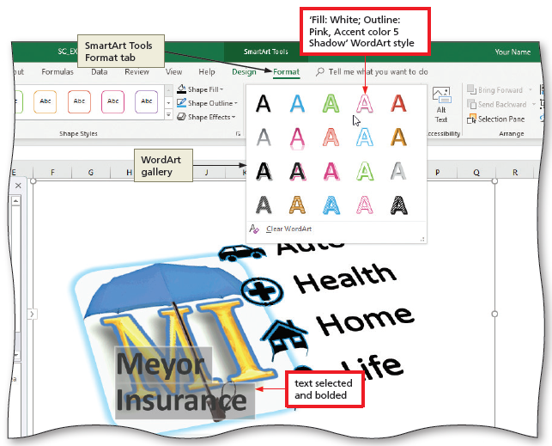
Pictures and Icons (3 of 3)
To Format Text Using WordArt Styles
  Display the SmartArt Tools Format tab
  Click the More button to display the WordArt gallery
  Click on a style, close the Text Pane, and save the workbook
Notes:
Figure 7-95: Display of SmartArt Tools Format tab with WordArt gallery.

Slide 36
Text Boxes
To Draw a Text Box
  Click the Text button to display a gallery with additional buttons related to inserting text objects
  Click the Text Box button and then move the pointer into the worksheet
  Drag to crate a text box of desired size
  Type desired text
  Click the Shape Outline arrow and then click desired effect

Slide 37
Alternative Text
To Add ALT text
  Right-click the border of the SmartArt graphic to display the shortcut menu
  Click “Edit Alt Text” to display the Alt Text pane and click in its text box
  In the text box, type the desired text
  Close the Alt Text pane
  Save the workbook

Slide 38
Object Linking and Embedding
Copy and Paste
Embedded Objects
  To Embed an Object from Another App
Linked Objects
  To Link an Object from Another App
  To Edit the Link to a File
  To Create a New Object
  To Break an External Link
  To Update a Linked Object from Another App

Slide 39
Using Screenshots on a Worksheet
To Insert a Screenshot on a Worksheet
  Display the webpage you wish to insert
  Click the Excel app button on the taskbar to return to Excel
  Display the Insert tab
  Click the “Take a Screenshot” button to display Screenshot gallery
  Click the live preview corresponding to the webpage you wish to insert in the worksheet to start the process of inserting a screenshot
  Click Yes to insert the screen shot with a hyperlink

Slide 40
Shapes (1 of 2)
To Create a Shape and Copy It
  Click the Shapes button to display the Shapes gallery
  Select the desired shape
  Move the pointer into the worksheet to the desired location
  Drag the shape to the desired size
  With the shape still selected, press CTRL+C to copy the shape
  Press CTRL+V to paste the copy of the shape into the spreadsheet
  Move the shape to the desired location

Slide 41
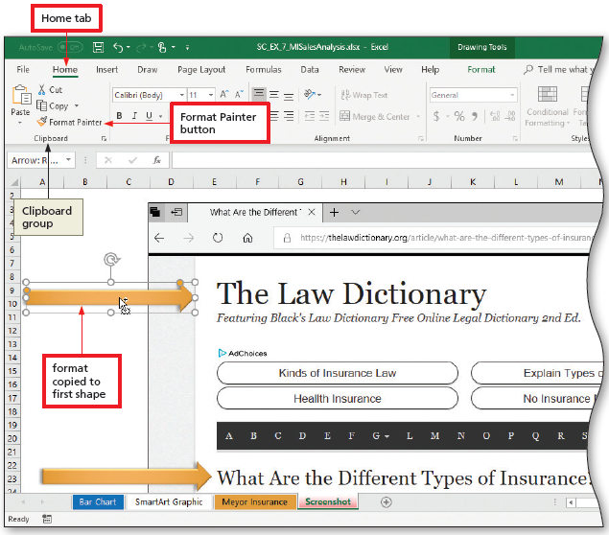
Shapes (2 of 2)
Using the Format Painter with Objects
  Click the Format Painter button
  Click the desired shape to apply the formatting. Do not deselect
Notes:
Figure 7-118: Display of Home tab with Format Painter button.

