Slide 1
Shelly Cashman: Microsoft Excel 2019
Module 8: Working with Trendlines, PivotTables, PivotCharts, and Slicers
© 2020 Cengage Learning. All Rights Reserved. May not be copied, scanned, or duplicated, in whole or in part, except for use as permitted in a license distributed with a certain product or service or otherwise on a password-protected website for classroom use.

Slide 2
Objectives (1 of 2)
Analyze worksheet data using a trendline
Create a PivotTable report
Format a PivotTable report
Apply filters to a PivotTable report
Create a PivotChart report
Format a PivotChart report
Apply filters to a PivotChart report

Slide 3
Objectives (2 of 2)
Analyze worksheet data using PivotTable and PivotChart reports
Create calculated fields
Create slicers to filter PivotTable and PivotChart reports
Format slicers
Examine other statistical and process charts
Create a Box and Whisker Chart

Slide 4
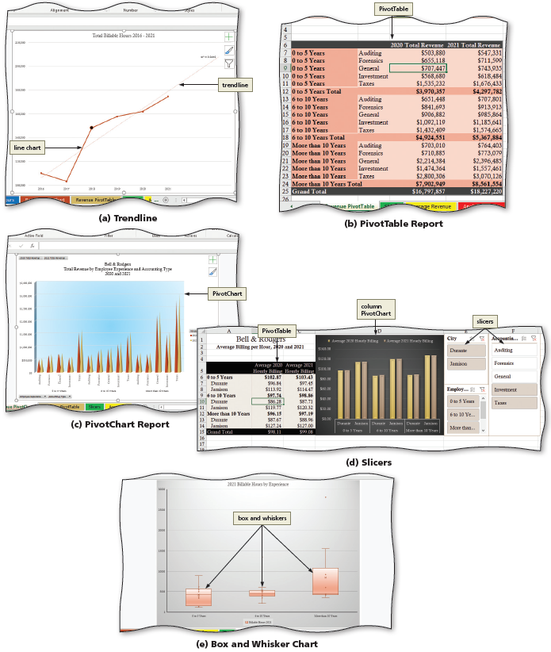
Project: Bell & Rodgers Accounting
Notes:
Figure 8-1: Display of PivotTables and PivotCharts. (a) Trendline. (b) PivotTable Report. (c) PivotChart Report. (d) Slicers. (e) Box and Whisker Chart

Slide 5
Line Charts and Trendlines (1 of 3)
To Create a 2-D Line Chart
  Select the range of cells to be charted
  Click the Insert on the ribbon to display the Insert tab
  Click the “Insert Line or Area Chart” to display the Insert Line and Area Chart gallery
  Click “Line with Markers” in the 2-D Line area to insert a 2-D line chart with data markers
  Click the Move Chart button to display the Move Chart dialog box
  Click New sheet to select the option button
  If necessary, double-click the default text in the New sheet text box to select the text, and then type the desired text
  Click OK to move the chart to a new sheet

Slide 6
Adding a Trendline to a Chart (2 of 3)
To Add a Trendline to a Chart
  Click the “Add Chart Element” button to display the Add Chart Element menu
  Point to the Trendline to display the Trendline gallery
  Click “More Trendline Options” to display the Format Trendline pane
  If necessary, click the Trendline Options button
  Click the desired trendline type
  Click the desired options in the Format Trendline dialog box
  Click the Close button to close the pane

Slide 7
Adding a Trendline to a Chart (3 of 3)
To Change the Format of a Data Point
  Click the desired data point twice to select the single point. Do not double-click.
  Right-click the selected data point do display the shortcut menu
  Click “Format Data Point” on the shortcut menu to display the Format Data Point pane
  Click the “Fill & Line” button, then click desired option
  Click the Format Data Point pane and click the Save button to save the workbook

Slide 8
Creating and Formatting PivotTable Reports (1 of 10)
To Create a Blank PivotTable
  Click the desired cell containing the data for the PivotTable
  Click the PivotTable button to display the Create PivotTable dialog box
  Click OK to create a blank PivotTable report on a new worksheet and display the Field List
To Add Data to the PivotTable
  Drag the desired field from the “Choose fields to add to report” area to the desired locations (rows or columns)
  Drag the desired fields to the Values area

Slide 9
Creating and Formatting PivotTable Reports (2 of 10)
To Change the Layout of a PivotTable
  Click the Report Layout button to display the Report Layout menu
  Click the desired layout
To Change the View of a PivotTable Report
  Change the order of the fields in the ROWS or COLUMNS area to change the view

Slide 10
Creating and Formatting PivotTable Reports (3 of 10)
To Filter a PivotTable Report Using a Report Filter
  Drag the desired field from the “Choose fields to add to report” area to the Filters area in the PivotTable
  Click the filter button to display the filter menu
  Click to select the desired criterion
  Click OK to update the display

Slide 11
Creating and Formatting PivotTable Reports (4 of 10)
To Filter a PivotTable Report Using Multiple Selection Criteria
  Drag the desired button from the ROWS or COLUMNS area to the Filters area
  Drag the desired button from the Filters area to the ROWS or COLUMNS area
  Click the filter button to display the filter menu
  Click the “Select Multiple Items” check box to prepare to select multiple criteria
  Click OK

Slide 12
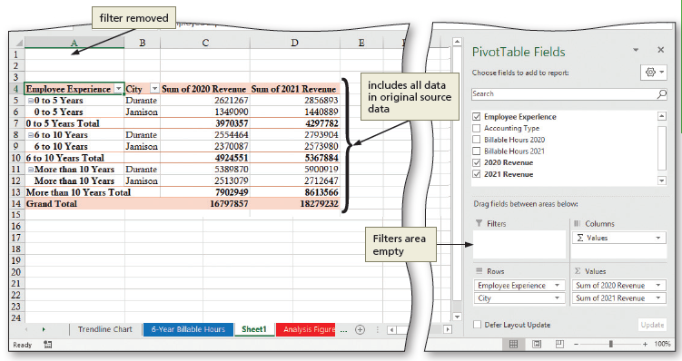
Creating and Formatting PivotTable Reports (5 of 10)
To Remove a Report Filter from a PivotTable Report
  Click the filter button and then click the (All) check box to include all criteria in the PivotTable report
  Click OK
  Drag the desired button out Filters area to remove the field from the report
Notes:
Figure 8-33: Display of filter removed and filters area empty

Slide 13
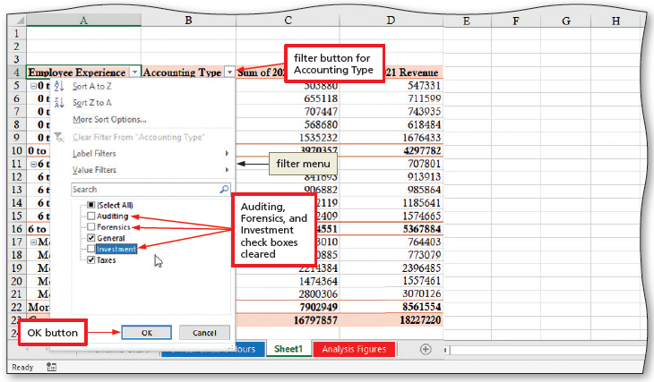
Creating and Formatting PivotTable Reports (6 of 10)
To Filter a PivotTable Report Using the Row Label Filter
  Click the filter button to display the filter menu for the desired field
  Click the desired check boxes on the filter menu
  Click OK to update the display
Notes:
Figure 8-34: Display of filter button, check boxes checked and OK button

Slide 14
Creating and Formatting PivotTable Reports (7 of 10)
To Format a PivotTable Report
  Select a cell in the PivotTable
  Click the More button in the PivotTable Styles group to expand the gallery
  Click the desired style
  Format the cells as desired using the Format Cells dialog box
To Switch Summary Functions
  Right-click the desired cell to display the shortcut menu, and then point to “Summarize Values By” to display the Summarize Values By submenu
  Click the desired command

Slide 15
Creating and Formatting PivotTable Reports (8 of 10)
To Customize the Field Headers and Field List
  Click the Field List button and the Field Headers button to show or hide the fields
  Click the Options button to display the PivotTable Options dialog box
  Click the desired settings, and then click OK
To Insert a New Summary Function
  Click “Value Field Settings” to display the Value Field Settings dialog box
  In the Custom Name text box, type desired text.
  Click OK

Slide 16
Creating and Formatting PivotTable Reports (9 of 10)
To Expand and Collapse Categories
  Click the Collapse button to collapse the desired selection
  Right-click the desired cell to display the shortcut menu and then point to Expand/Collapse to display the Expand/Collapse submenu
  Click the desired settings
To Update a PivotTable
  Modify the contents of the desired cell on the desired sheet tab
  Click the desired PivotTable sheet tab to make it active
  Click any cell in the PivotTable report to make it active
  Click the Refresh button to update the PivotTable report

Slide 17
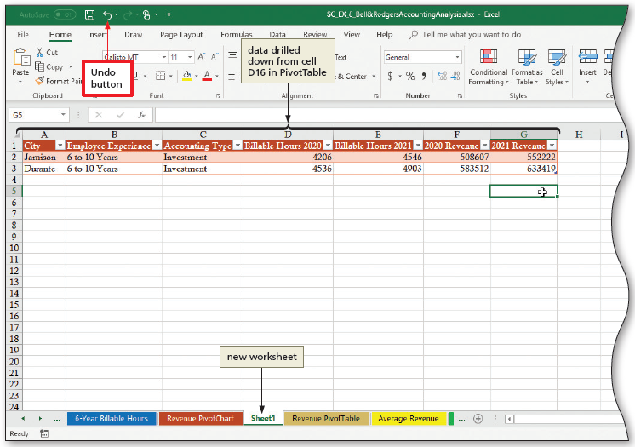
Creating and Formatting PivotTable Reports (10 of 10)
To Drill Down into PivotTable
  Double-click in a cell to drill down in the data. Click away from the data to remove the selection.
  Click the Undo button on the Quick Access Toolbar to remove the drilled data worksheet and return to the PivotTable report
Notes:
Figure 8-55: Display of Undo button and data drilled down from cell

Slide 18
Creating and Formatting PivotChart Reports (1 of 7)
To Create a PivotChart Report from an Existing PivotTable Report
  Select a cell in the PivotTable report
  Click the Field List button to display the Field List
  Click the PivotChart button to display the Insert Chart dialog box
  Click the desired chart type
  Click OK to add the chart to the worksheet

Slide 19
Creating and Formatting PivotChart Reports (2 of 7)
To Change the PivotChart Type and Reset Chart Elements
  Click the chart to select the data series
  Right-click to display the shortcut menu
  Click “Format Data Series” on the shortcut menu to open the Format Data Series pane
  Click the desired chart type
  Click the Chart Elements arrow to display the Chart Elements menu
  Click the desired formatting changes
  Close the Format Wall pane

Slide 20
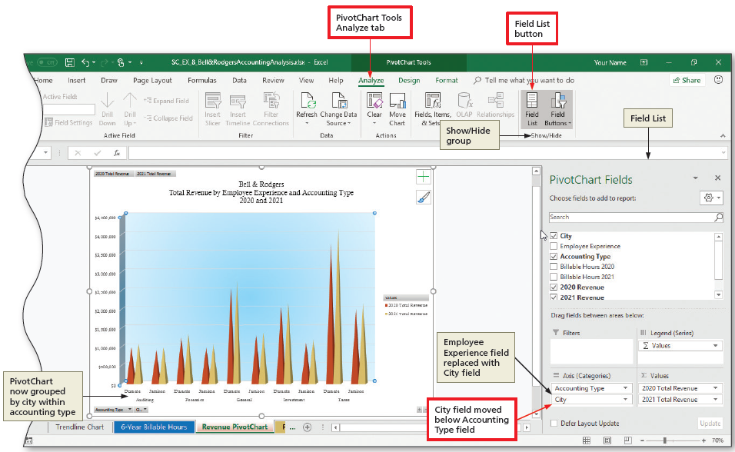
Creating and Formatting PivotChart Reports (3 of 7)
To Change the View of a PivotChart Report
  If necessary, click the Field List button to display the Field List
  In the “Choose fields to add to report area”, select and deselect the fields as desired
  Click the PivotChart Report sheet tab to make it the active tab
Notes:
Figure 8-66: Display of PivotChart Tools Analyze tab and Field List button

Slide 21
Creating and Formatting PivotChart Reports (4 of 7)
To Create a PivotChart and PivotTable Directly from Data
  Select a cell containing the data
  Click the PivotChart arrow to display the PivotChart menu
  Click the “PivotChart & PivotTable” on the PivotChart menu to display the Create PivotTable dialog box
  If necessary, click New Worksheet
  Click OK to add a new worksheet containing a blank PivotTable and blank PivotChart
  Add the desired fields to the Axis Fields and Values areas

Slide 22
Creating and Formatting PivotChart Reports (5 of 7)
To Create a Calculated Filed to a PivotTable Report
  If necessary, click the PivotTable to make it active
  Click the “Fields, Items, & Sets” button to display the Fields, Items, & Sets menu
  Click the Calculated Field to display the Insert Calculated Field dialog box
  Enter the name, and formula, and then click the Add button to add the calculated field to the Fields list
  Click OK to close the dialog box

Slide 23
Creating and Formatting PivotChart Reports (6 of 7)
To Format the PivotTable
  Click the Field List button to display the Field List
  Click DESIGN on the ribbon and make the desired formatting changes
  Use the Field List button, the “+/− Buttons” button, and the Field Headers button to hide the field list, the Expand/Collapse buttons, and the field headers

Slide 24
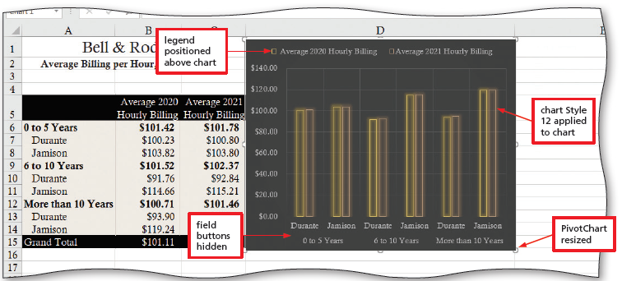
Creating and Formatting PivotChart Reports (7 of 7)
To Format the PivotChart
  Click in the PivotChart report to select it
  Apply the desired styles from the Chart Styles gallery
  Use the “Change Colors” button to change the colors
  Click the Field Buttons button to show or hide the field button
Notes:
Figure 8-77: Display of field buttons hidden, legend positioned above chart, chart style applied, and PivotChart resized

Slide 25
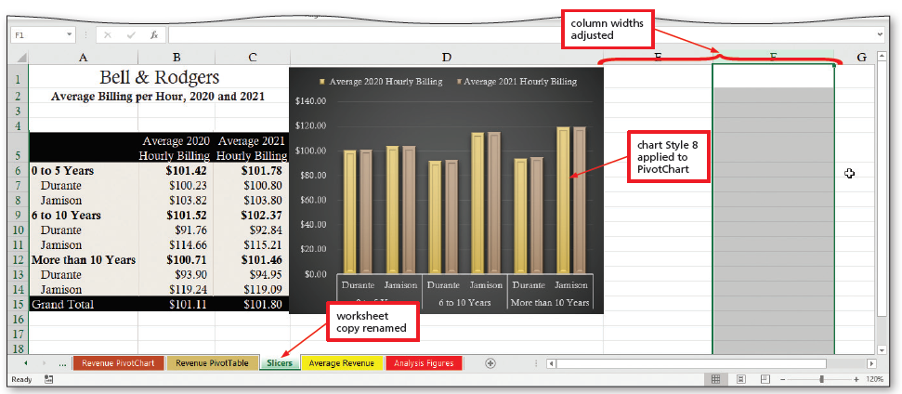
Working with Slicers (1 of 4)
To Copy a PivotTable and PivotChart
  Create a copy of the worksheet
Notes:
Figure 8-78: Display of column width adjusted, worksheet copy renamed

Slide 26
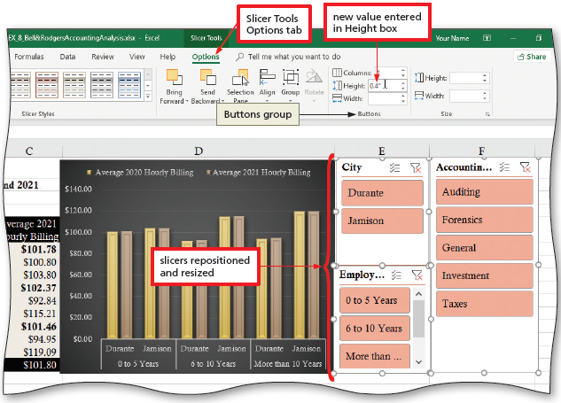
Working with Slicers (2 of 4)
To Format Slicers
  Click and then drag the desired slicer to the desired location
  Hold down the CTRL and then click to select multiple slicers
  Click the desired Slicer style to apply it to the slicers
  Click any cell to deselect the slicer
Notes:
Figure 8-81: Display of Slicer Tools Options tab and slicers repositioned and resized

Slide 27
Working with Slicers (3 of 4)
To Use the Slicers
  Hold down CTRL and then click the desired slicer to remove the data from the PivotTable and PivotChart calculations.
  Release CTRL and then click the desired slicer to display that slicer’s data only
  Click different slicers slicer to see the data for those slicers only

Slide 28
Working with Slicers (4 of 4)
To Use the Slicers to Review Data Not in the PivotTable
  Click the Clear Filter button on the desired slicers to remove the filters and return the PivotTable and PivotCharts to their unfiltered states
  Click a button in the desired slicer to see the aggregate data options
  Click different styles and combinations of styles to see how the aggregate data changes

Slide 29
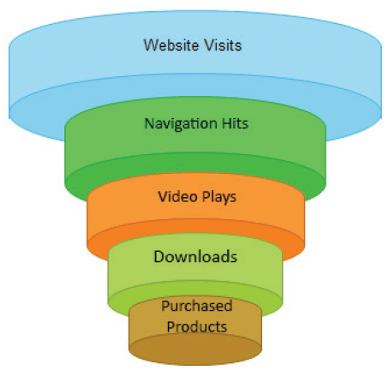
Other Excel Charts (1 of 9)
Funnel Charts
Notes:
Figure 8-87: Display of a funnel chart

Slide 30
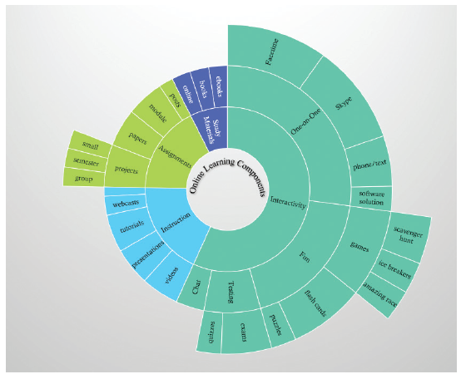
Other Excel Charts (2 of 9)
Sunburst Charts
Notes:
Figure 8-88: Display of a sunburst chart

Slide 31
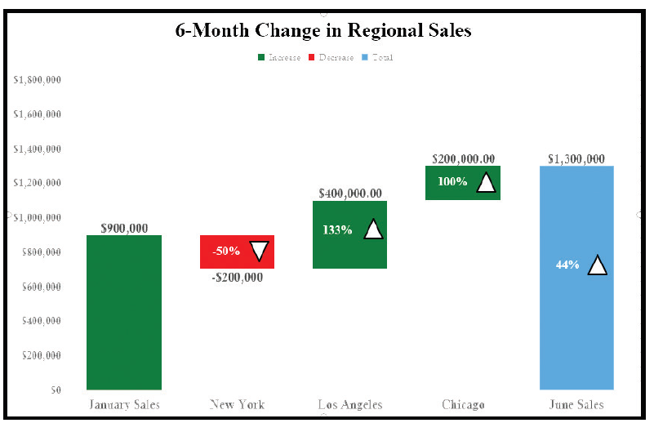
Other Excel Charts (3 of 9)
Waterfall Charts
Notes:
Figure 8-89: Display of a waterfall chart

Slide 32
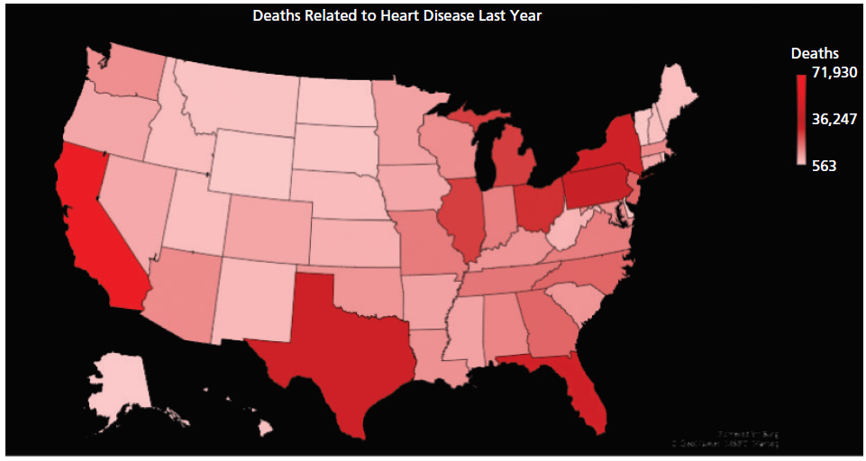
Other Excel Charts (4 of 9)
Map Charts
Notes:
Figure 8-90: Display of a map chart

Slide 33
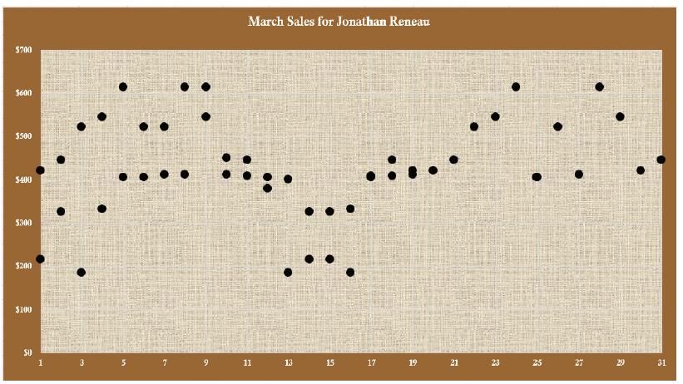
Other Excel Charts (5 of 9)
Scatter Charts
Notes:
Figure 8-91: Display of a scatter chart

Slide 34
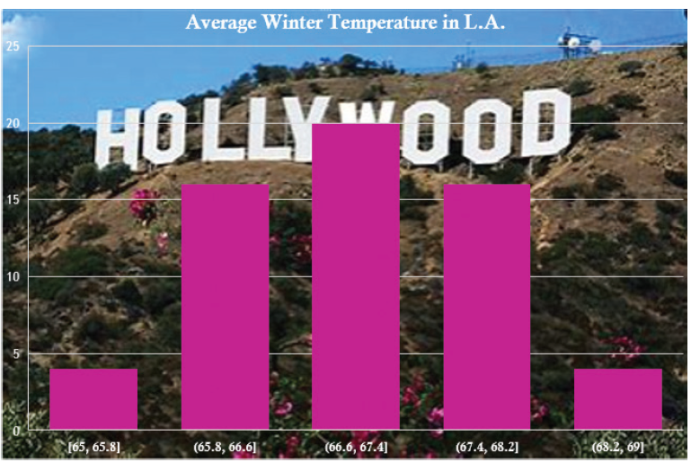
Other Excel Charts (6 of 9)
Histogram Chart
Notes:
Figure 8-92: Display of a histogram chart

Slide 35
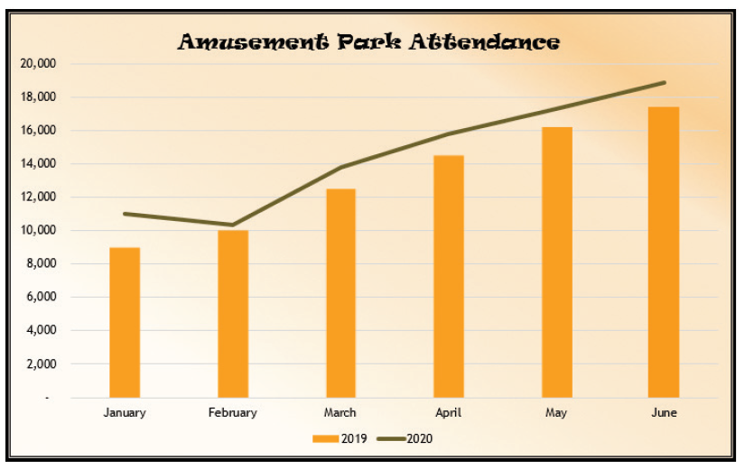
Other Excel Charts (7 of 9)
Combo Charts
Notes:
Figure 8-93: Display of a combo chart

Slide 36
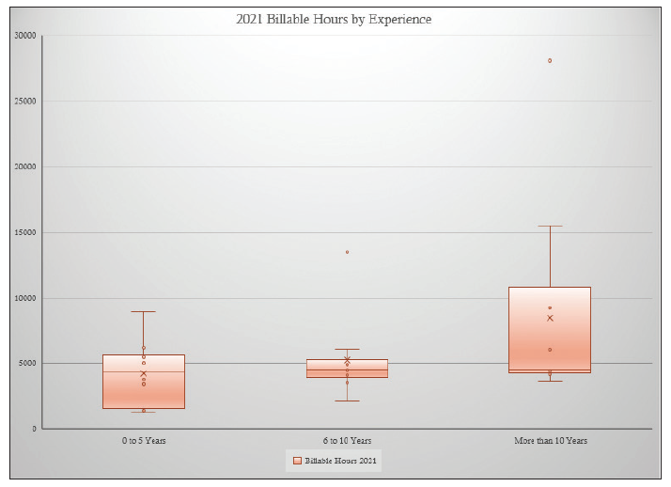
Other Excel Charts (8 of 9)
Box and Whisker Charts
Notes:
Figure 8-94: Display of a box and whisker chart

Slide 37
Other Excel Charts (9 of 9)
To Create a Box and Whisker Chart
  Click the Analysis Figures tab to display the Analysis Figures sheet
  Select the desired cells
  Click the “Insert Statistic Chart” button to display its gallery
  Click Box and Whisker to create the chart
  Click the Move Chart button to display the Move Chart dialog box
  Click New sheet to select the option button
  Double-click the default text in the New sheet box to select the text, and then type Box and Whisker Chart to enter a name for the new worksheet
  Click OK

