Slide 1
Shelly Cashman: Microsoft Excel 2019
Module 9: Formula Auditing, Data Validation, and Complex Problem Solving
© 2020 Cengage Learning. All Rights Reserved. May not be copied, scanned, or duplicated, in whole or in part, except for use as permitted in a license distributed with a certain product or service or otherwise on a password-protected website for classroom use.

Slide 2
Objectives (1 of 2)
Use formula auditing techniques to analyze a worksheet
Trace precedents and dependents
Use error checking to identify and correct errors
Add data validation rules to cells
Use trial and error to solve a problem on a worksheet
Use goal seeking to solve a problem

Slide 3
Objectives (2 of 2)
Circle invalid data on a worksheet
Enable the Solver add-in
Use Solver to solve a complex problem
Use the Scenario Manager to record and save sets of what-if assumptions
Create a Scenario Summary report
Create a Scenario PivotTable
Draw with inking techniques

Slide 4
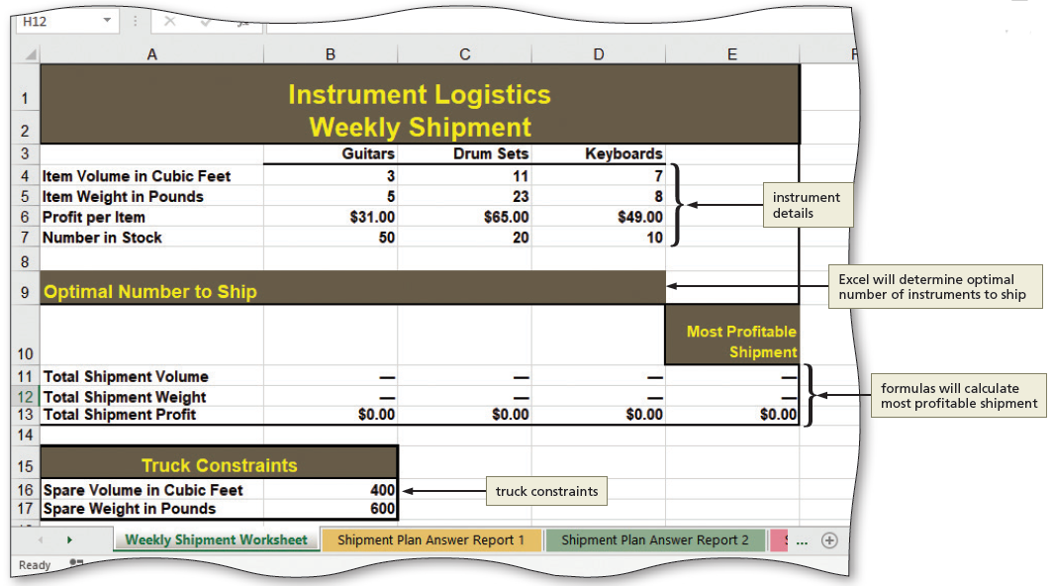
Project: Instrument Logistics Analysis (1 of 3)
Notes:
Figure 9-1a: display of scheduling plan worksheet

Slide 5
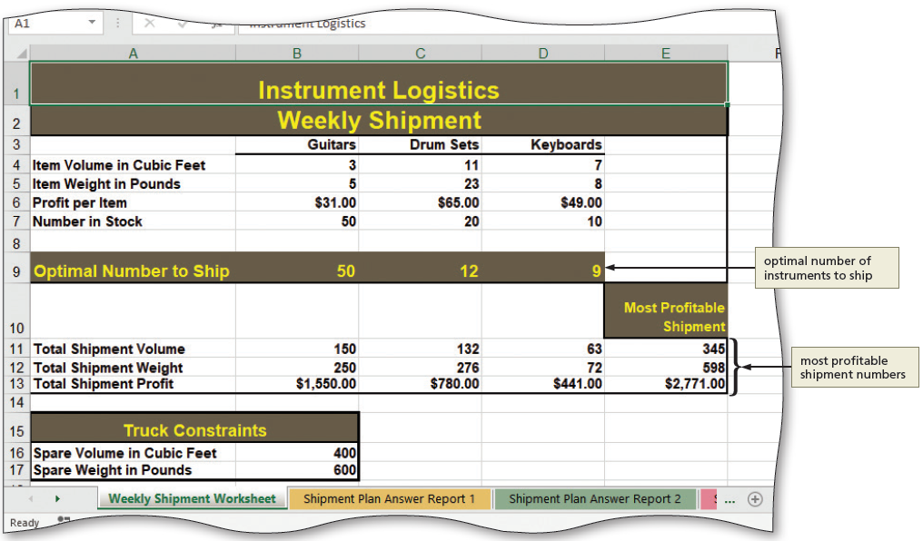
Project: Instrument Logistics Analysis (2 of 3)
Notes:
Figure 9-1b: Display of Solver solution

Slide 6
Project: Instrument Logistics Analysis (3 of 3)
To View Named Cells
  Click the Name Manager button to display the Name Manager dialog box
  To see the full name of each named cell, widen the column by pointing to the border between the column headings until the pointer changes to a double-headed arrow, then double-click
  Review the named cells and their location
  Close the Name Manager dialog box

Slide 7
Formula Auditing (1 of 6)
To Trace Precedents
  Select the cell for which you wish to trace the precedents
  Click the Trace Precedents button to draw a tracer arrow across precedents of the selected cell
  Click the Trace Precedents button again to draw arrows indicating the next level of precedents
To Remove the Precedent Arrows
  Click the “Remove Arrows” arrow to display the “Remove Arrows” menu
  Click “Remove Precedent Arrows” on the Remove Arrows menu to remove precedent arrows
  Repeat to remove any remaining precedent arrows

Slide 8
Formula Auditing (2 of 6)
To Trace Dependents
  Click the cell for which you want to trace dependents
  Click the Trace Dependents button to draw arrows to dependent cells
  Click the Trace Dependents button again to draw arrows indicating the indirectly dependent cells—cells that depend directly or indirectly on the selected cell
To Remove the Dependent Arrows
  Click the “Remove Arrows” as necessary to remove all of the dependent arrows

Slide 9
Formula Auditing (3 of 6)
To Use the Trace Error Button
  Select a cell to display the Trace Error button
  Click the Trace Error button to display its menu
  Click Trace Error on the menu to display precedent arrows directly involved in the error
  Click the Remove Arrows button to remove all of the arrows

Slide 10
Formula Auditing (4 of 6)
To Use Error Checking to Correct Errors
  Click the desired cell to select it
  Click the Error Checking button to display the Error Checking dialog box. If necessary, drag the dialog box away from the figures on the worksheet so the figures are visible
  Read the message in the Error Checking dialog box
  Look at the formula
  Click the “Edit in Formula Bar” button and edit the cell
  Click the Enter button in the formula bar to complete the edit of the cell and to correct the error in the cell and any dependent errors
  Click the Resume button to continue checking errors
  Click OK as the error correction is complete

Slide 11
Formula Auditing (5 of 6)
Table 9-1 Common Excel Error Codes
Error Code | Description
#DIV/0! | Indicates that a formula divides a number by zero
#N/A! | Indicates that a formula cannot locate a referenced value
#NAME? | Indicates use of an invalid function name
#NULL! | Indicates that a formula incorrectly contains a space between two or more cell references
#NUM! | Indicates that a formula contains invalid numeric values
#REF! | Indicates that a cell reference in a formula is not valid; it may be pointing to an empty cell, for instance
#VALUE! | Indicates that a calculation includes nonnumeric data
Notes:
Table 9-1: Common Excel Error Codes

Slide 12
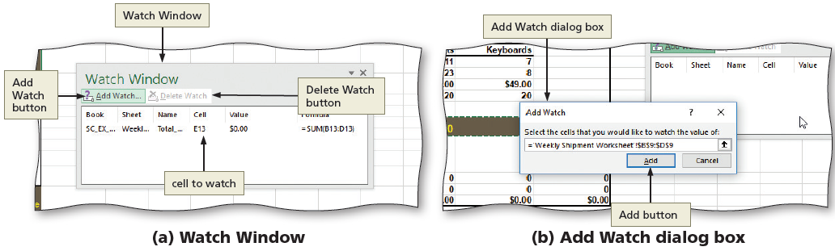
Formula Auditing (6 of 6)
Watch Window
Notes:
Figure 9-21: display of a) Watch window and b) Add Watch dialog box

Slide 13
Data Validation
To Add Data Validation to Cells
  Select the cells to which you wish to add the data validation
  Click the Data Validation button to display the Data Validation dialog box
  Set the desired values on the Settings, Input Message, and Error Alert tabs
  Click OK to accept the data validation settings for the selected cells

Slide 14
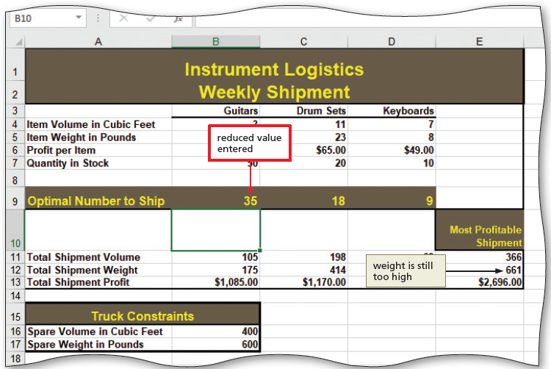
Solving Complex Problems (1 of 3)
To Use Trial and Error to Attempt to Solve a Complex Problem
  Trial and error is not making blind guesses
  If you understand how the spreadsheet is set up and how the various variables interact, you can use this knowledge and logic to inform each subsequent trial following the first trial
Notes:
Figure 9-32: display of reduced value entered

Slide 15
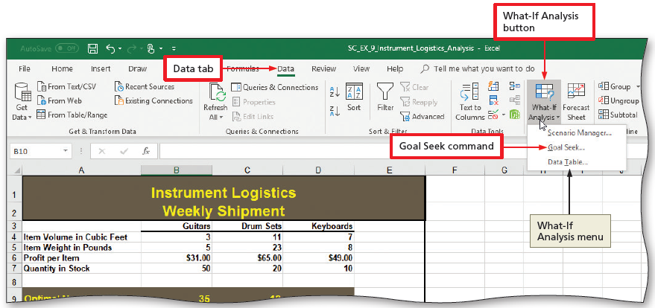
Solving Complex Problems (2 of 3)
To Use Goal Seek to Attempt to Solve a Complex Problem
  Click the “What-If Analysis” button to display the What-If Analysis menu
  Click Goal Seek to display the Goal Seek dialog box
  Enter the desired values in the Set cell, To value, and “By changing cell” text boxes
  Click OK to seek the goal
Notes:
Figure 9-33: display of Data tab, “What-If Analysis” button and Goal Seek Command on the What IF Analysis menu

Slide 16
Solving Complex Problems (3 of 3)
To Circle Invalid Data
  Click the Data Validation arrow to display the Data Validation menu
  Click “Circle Invalid Data” on the Data Validation menu to place a red validation circle around invalid data
To Clear Validation Circles
  Click the Data Validation arrow to display the Data Validation menu
  Click “Clear Validation Circles” on the Data Validation menu to remove the red validation circle(s)

Slide 17
Customizing Excel Add-Ins
To Enable the Solver Add-In
  Click the File tab to display Backstage view
  Click the Options tab to display the Excel Options dialog box
  Click the Add-Ins tab to display the “View and manage Microsoft Add-Ins” screen
  Click the Manage button to display the list
  Click Excel Add-Ins in the Manage list to select it as the add-in type
  Click Go to display the Add-Ins dialog box
  Click to select the Solver Add-In check box in the Add-ins available list
  Click OK to apply the setting and to close the Add-Ins dialog box
  Display the Data tab to verify the addition of the Analyze group and Solver button

Slide 18
Solver Requirements (1 of 6)
To Enter Constraints with Solver
  Click the Solver button to display the Solver Parameters dialog box
  Click the Set Objective box and then, in the worksheet, click a cell to set the objective cell
  Click the Max option button in the To area if necessary to specify that the value of the target cell should be as large as possible
  Click the “By Changing Variable Cells” box and then, in the worksheet, select the range of cells to set the cells that you want Solver to manipulate
  Click the Add button to display the Add Constraint dialog box
  Select a constraint and then select a range of cells to apply the constraint
  Do not close the Add Constraint dialog box

Slide 19
Solver Requirements (2 of 6)
To Enter Constraints with Named Cells
  Click the Add button to add another constraint
  Type the name in the Cell Reference box
  Click the desired value for the constraint
  Click the Constraint box, and then type the name to specify that constraint
  Repeat as necessary
  Do not close the Solver Parameters dialog box

Slide 20
Solver Requirements (3 of 6)
To Set Solver Options
  With the Solver Parameters dialog box still open, click the “Select a Solving Method” arrow to display the choices
  Click on one of the selections to select it
  Click the Options button to display the Options dialog box
  Select the desired options
  Click OK to return to the Solver Parameters dialog box

Slide 21
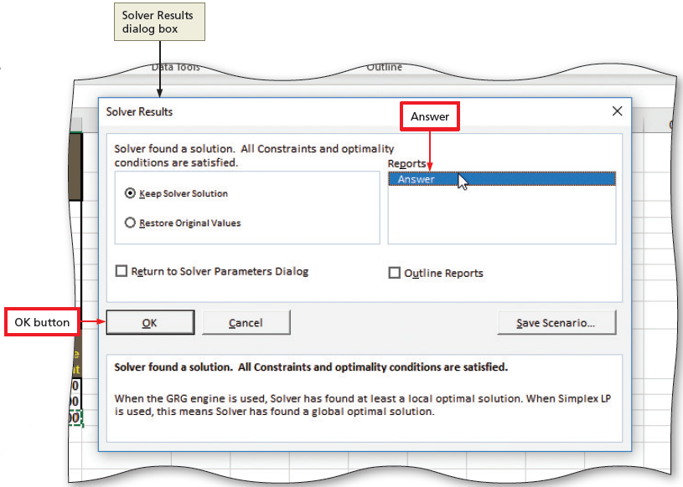
Solver Requirements (4 of 6)
To Find the Optimal Solution
  Click the Solve button to display the Solver Results dialog box indicating that Solver found a solution to the problem
  Click Answer in the Reports list to select the report to generate
  Click OK to display the values found by Solver and the newly recalculated totals
Notes:
Figure 9-55: display of Solver Results dialog box with Answer and OK button

Slide 22
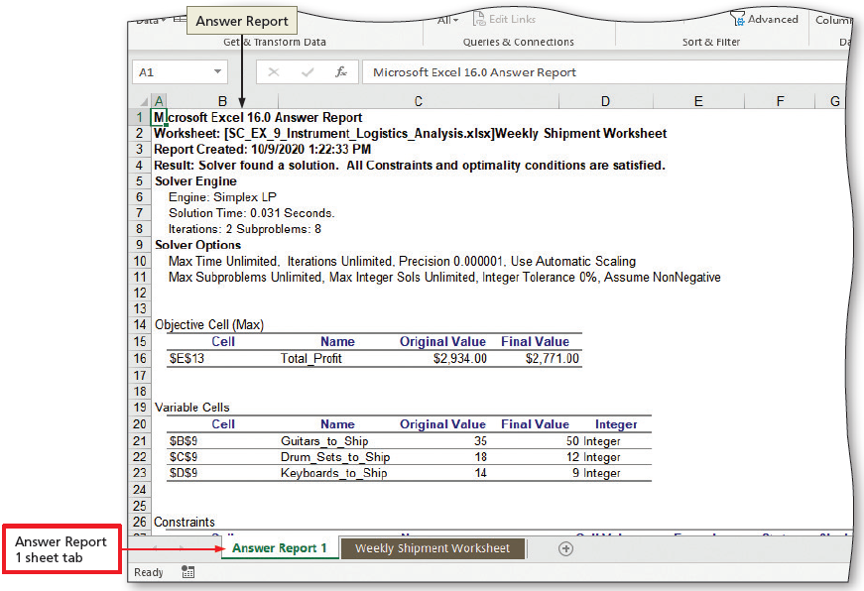
Solver Requirements (5 of 6)
To View the Solver Answer Report
  Click the Answer Report 1 sheet tab to display the Solver Answer Report
Notes:
Figure 9-57: display of Answer Report 1 sheet tab

Slide 23
Solver Requirements (6 of 6)
Table 9-3 Commonly Used Solver Parameters
Parameter | Meaning
Max Time | The total time that Solver should spend trying different solutions, expressed in seconds
Iterations | The number of possible answer combinations that Solver should try
Constraint Precision | Instructs Solver in how close it must come to the target value in order to consider the problem to be solved. For example, if the target value is 100 and you set tolerance to 5%, then generating a solution with a target value of 95 is acceptable.
Use Automatic Scaling | Selected by default, specifies that Solver should internally rescale values of variables, con restraints, and the objective to reduce the effect of outlying values
Notes:
Table 9-3: Commonly Used Solver Parameters

Slide 24
Using Scenarios and Scenario Manager to Analyze Data (1 of 7)
To Save the Current Data as a Scenario
  Click the “What-If Analysis” button to display the What-If Analysis menu
  Click Scenario Manager on the What-If Analysis menu to display the Scenario Manager dialog box, which indicates that no scenarios are defined
  Click the Add button to open the Add Scenario dialog box
  When Excel displays the Add Scenario dialog box, type the desired name in the Scenario name text box
  Click the “Changing Cells: Collapse Dialog” button to collapse the dialog box
  Select the range(s) to select the cells for the scenario

Slide 25
Using Scenarios and Scenario Manager to Analyze Data (2 of 7)
To Save the Current Data as a Scenario (cont.)
  Click the Expand Dialog button to display the expanded Edit Scenario dialog box
  Click OK to accept the settings and display the Scenario Values dialog box
  Click OK to display the Scenario Manager dialog box with the new scenario selected in the Scenarios list
  Click Close to save the new scenario in the workbook

Slide 26
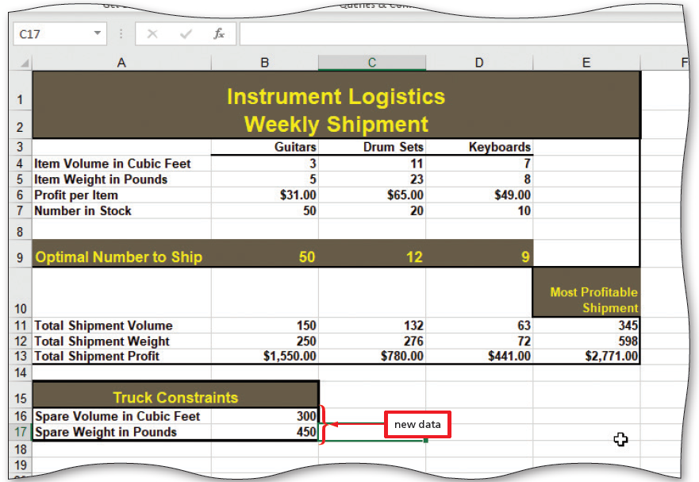
Using Scenarios and Scenario Manager to Analyze Data (3 of 7)
To Add the Data for a New Scenario
  Modify cells to include new data
Notes:
Figure 9-64: display of new data entered for new scenario

Slide 27
Using Scenarios and Scenario Manager to Analyze Data (4 of 7)
To Use Solver to Find a New Solution
  Click the Solver button to display the Solver Parameters dialog box with the objective cell, changing cells, and constraints used with the previous scenario
  Click the Solve button to solve the problem and display the Solver Results dialog box
  Click the desired item in the Reports list to select a report type
  Click OK to display the solution found by Solver

Slide 28
Using Scenarios and Scenario Manager to Analyze Data (5 of 7)
To View the Solver Answer Report for the Shipment 2 Solution
  Drag the Answer Report 1 sheet tab to the right of the Shipment Answer Report 1 sheet tab to move the worksheet in the workbook
  Rename the Answer Report 1 worksheet
  If desired, change the sheet tab color

Slide 29
Using Scenarios and Scenario Manager to Analyze Data (6 of 7)
To Save the Second Solver Solution as a Scenario
  Click the desired sheet tab to make it the active worksheet
  Click the “What-If Analysis” button and then click Scenario Manager on the What-If Analysis menu to display the Scenario Manager dialog box
  Click the Add button to display the Add Scenario dialog box.
  Type the desired text in the Scenario name text box to name the new scenario
  Click OK to display the Scenario Values dialog box with the current values from the worksheet
  Click OK to display the updated Scenarios list in the Scenario Manager dialog box
  Click the Close button to save the scenario and close the dialog box

Slide 30
Using Scenarios and Scenario Manager to Analyze Data (7 of 7)
To Show a Saved Scenario
  Click the “What-If Analysis” button to display the What-If Analysis menu
  Click Scenario Manager on the What-If Analysis menu to display the Scenario Manager dialog box
  Select the desired scenario in the Scenarios list
  Click the Show button to display the data for the selected scenario in the worksheet
  Click the Close button to close the dialog box

Slide 31
Summarizing Scenarios (1 of 2)
To Create a Scenario Summary Worksheet
  Click the “What-If Analysis” button to display the What-If Analysis menu
  Click Scenario Manager on the What-If Analysis menu to display the Scenario Manager dialog box
  Click the Summary button to display the Scenario Summary dialog box
  Click OK to generate a Scenario Summary report

Slide 32
Summarizing Scenarios (2 of 2)
To Create a Scenario PivotTable Worksheet
  Click the “What-If Analysis” button to display the What-If Analysis menu
  Click Scenario Manager to display the Scenario Manager dialog box
  Click the Summary button to display the Scenario Summary dialog box
  Click the “Scenario PivotTable report” option button in the Report type area
  Click OK to create the Scenario PivotTable

Slide 33
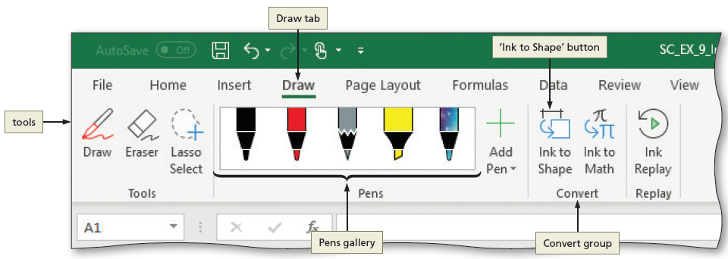
Ink Annotations (1 of 4)
Notes:
Figure 9-80: display of Draw tab, Pens gallery, and “Ink to Shape” button

Slide 34
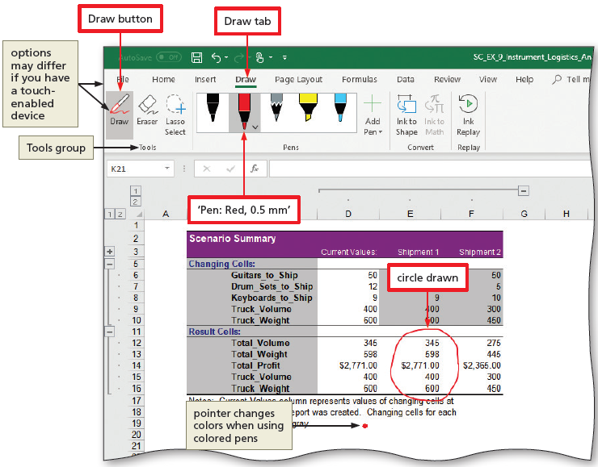
Ink Annotations (2 of 4)
To Draw with a Pen
  Make a worksheet active
  Click Draw on the ribbon to display the Draw tab
  Click the Draw button to turn on the ability to draw
  Select a pen and draw
Notes:
Figure 9-81: display of Draw tab, Draw button, and circle drawn

Slide 35
Ink Annotations (3 of 4)
To Use the “Ink to Shape” Tool
  Click a pen to display an arrow
  Click the pen arrow to display the pen gallery
  Select a thickness
  Click the “Ink to Shape” button to select it
  Draw. Do not lift your finger or the mouse button
  Lift your finger or release the mouse button
  When Excel converts your drawing into a shape, click the Draw button to turn it off
  Use the sizing handles to resize the arrow as necessary

Slide 36
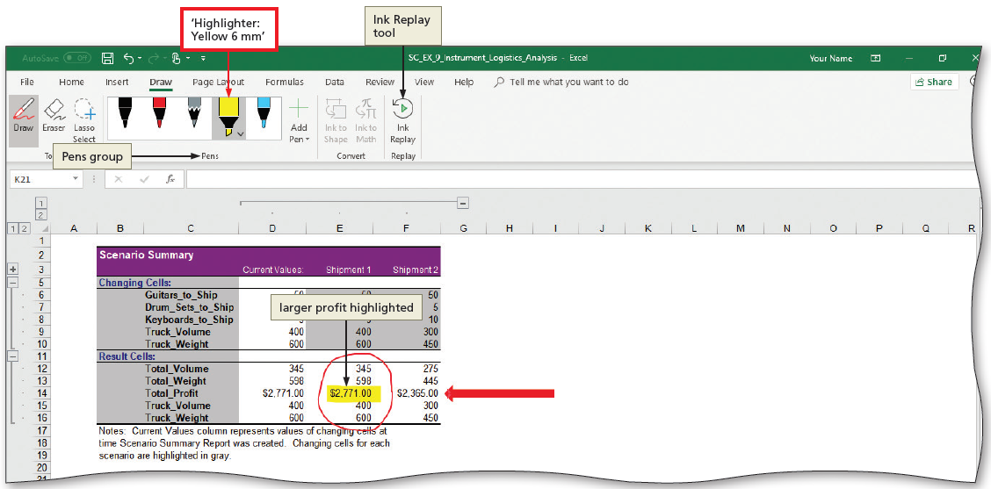
Ink Annotations (4 of 4)
To Highlight with Ink
  In the Pens group, click Highlighter
  Drag through the selected area
Notes:
Figure 9-85: display of “Highlighter: Yellow 6 mm” and Ink Replay tool

