Slide 1
Shelly Cashman: Microsoft Excel 2019
Module 10: Data Analysis with Power Tools and Creating Macros
© 2020 Cengage Learning. All Rights Reserved. May not be copied, scanned, or duplicated, in whole or in part, except for use as permitted in a license distributed with a certain product or service or otherwise on a password-protected website for classroom use.

Slide 2
Objectives (1 of 2)
Explain the Excel power tools
Customize the ribbon and enable data analysis
Use the Get & Transform data commands
Create a query using Power Query Editor
Build a PivotTable using Power Pivot
Explain data modeling
Create a measure
View cube functions

Slide 3
Objectives (2 of 2)
Use Power View
Create tiles in a Power View report
Use 3D Maps
Save a tour as an animation
Explain Power BI
Create hyperlinks
Use the macro recorder to create a macro
Execute a macro

Slide 4
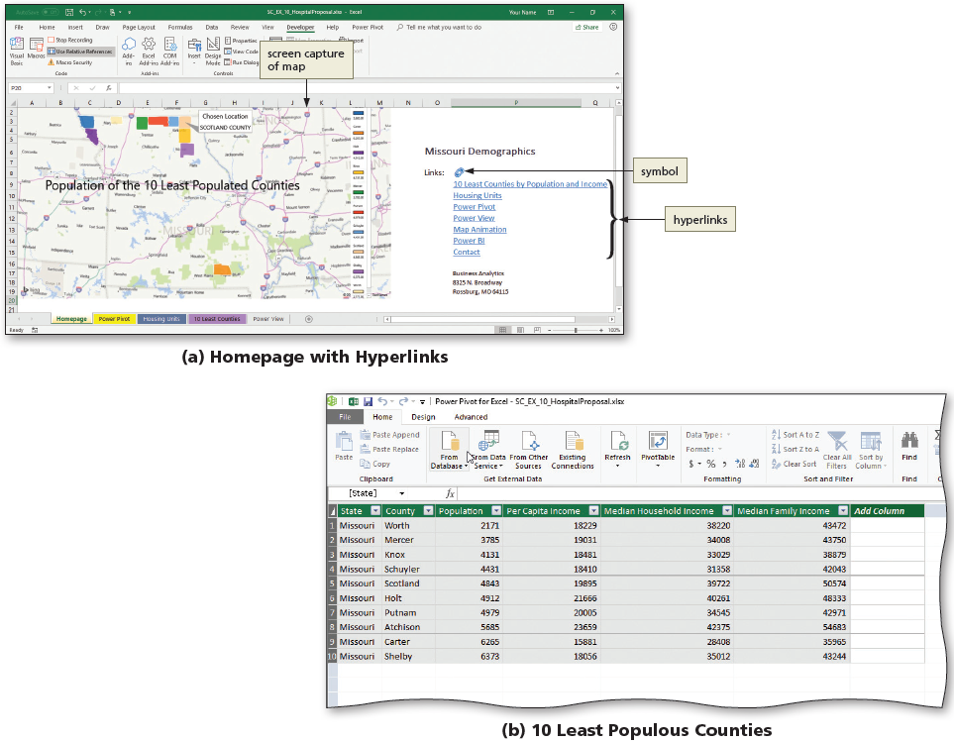
Project: Business Decisions Demographics (1 of 5)
Notes:
Figure 10-1: display of project
Homepage with hyperlinks
10 least populous counties

Slide 5
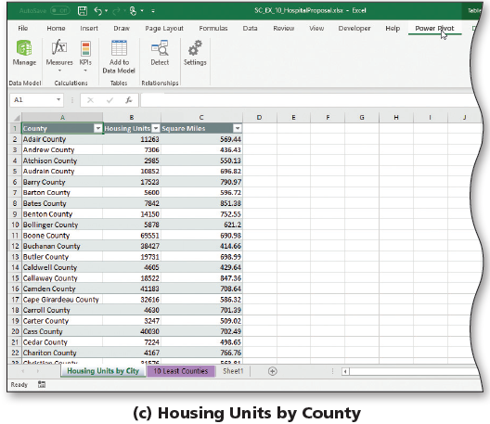
Project: Business Decisions Demographics (2 of 5)
Notes:
Figure 10-1: display of project
c) Housing units by county

Slide 6
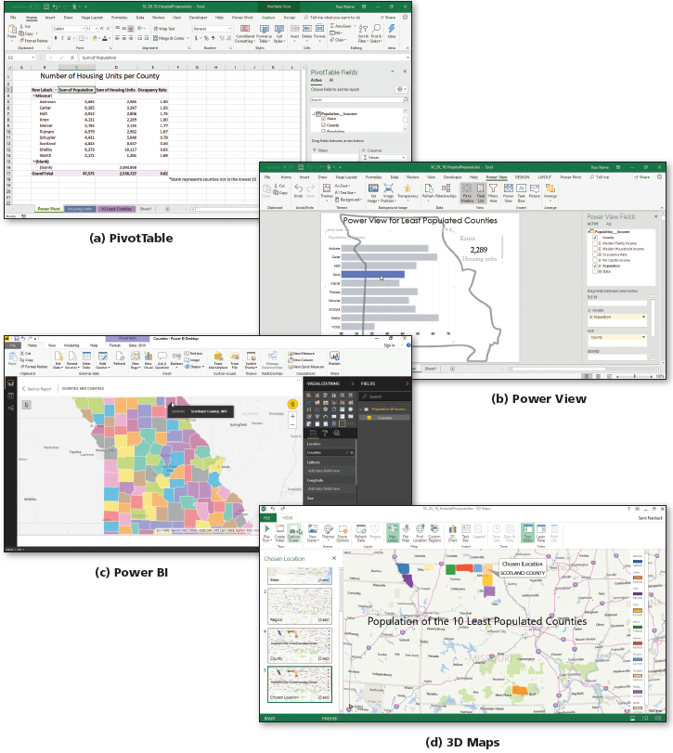
Project: Business Decisions Demographics (3 of 5)
Notes:
Figure 10-2: display of project
PivotTable
Power View
Power BI
3D Maps

Slide 7
Project: Business Decisions Demographics (4 of 5)
To Enable Data Analysis
  Display Backstage view and then click the Options tab to open the Excel Options dialog box
  In the left pane of the dialog box, click Data to display the Data options area
  Click to display a check mark in the “Enable Data Analysis add-ins: Power Pivot, Power View, and 3D Maps” check box
  Click OK to close the dialog box and enable the data analysis tools

Slide 8
Project: Business Decisions Demographics (5 of 5)
To Customize the Ribbon
  Right-click a blank area of the ribbon to display the shortcut menu
  Click the “Customize the Ribbon” command on the shortcut menu to display the Customize Ribbon area of the Excel Options dialog box
  In the Main Tabs area, scroll as necessary, and then click to display a check mark in both the Developer and the Power Pivot check boxes
  In the Main Tabs area, click Insert to select Insert tab
  Click the New Group button to insert a new group on the selected tab
  Click the “Choose commands from” button to display the menu
  Click “Commands Not in the Ribbon” to display only those commands
  Scroll down and click “Insert a Power View Report” to select it
  Click the Add button to add the command to the new group
  Click OK to display the customization on the ribbon

Slide 9
Get & Transform (1 of 3)
To Get Data
  Display the Data tab
  Click the Get Data button to display the Get Data menu
  Point to the From File command to display the From File submenu
  Click From Workbook on the From File submenu to display the Import Data dialog box
  Navigate to the desired folder
  Double-click the desired file
  Click the desired table to review the data
  Click the Load button to import the data

Slide 10
Get & Transform (2 of 3)
To Edit Data Using the Power Query Editor
  On the right side of the screen, double-click on a query in the Queries and Connections pane to display the Power Query Editor window
  Click the desired column then click the column filter to display the filter menu
  On the filter menu, click the desired option
  Click the Keep Rows button to display the menu
  Click OK to return to the Power Query Editor window
  Click the “Close & Load” button to load the transformed data into the worksheet in the Excel window

Slide 11
Get & Transform (3 of 3)
To Edit Using the Query Tools Query Tab
  Display the Query Tools Query tab
  Click the Edit button to display the Power Query Editor window
  Click the Remove Rows button to display the Remove Rows menu
  Click the “Remove Top Rows” to display the Remove Top Rows dialog box
  Click OK to remove the first row
  Click the “Use First Row As Headers” button to use the imported table’s column headings
  Click the “Close & Load” button

Slide 12
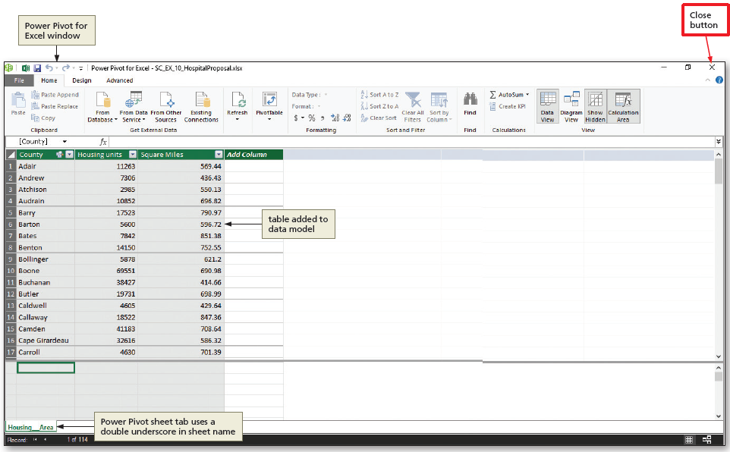
Power Pivot (1 of 6)
To Add a Query to a Data Model
  Click Power Pivot on the ribbon to display the Power Pivot tab
  Click the “Add to Data Model” button to add the data on the current worksheet to the data model
  Close the Power Pivot for Excel window to return to the regular Excel window
Notes:
Figure 10-27: display of Power Pivot for Excel window, table added to data model, and Close button

Slide 13
Power Pivot (2 of 6)
To Build a PivotTable Using Power Pivot
  Click the PivotTable button to display the Create PivotTable dialog box
  Click the New Worksheet option button to select it
  Click OK to create a PivotTable on a new sheet and to display the PivotTable Fields task pane
  In the PivotTable Fields pane, click the desired field to display the fields from the query table
  Click the appropriate check box
  Scroll up in the “Choose fields to add to the report” area and then click the desired field
  Click the appropriate check box

Slide 14
Power Pivot (3 of 6)
To Create a Relationship
  Click the CREATE button in the yellow relationships message to display the Create Relationship dialog box
  Click the Table button and then click the desired table
  Click the Related Table button and then click the desired table
  Click the Column button and then click the desired button
  Click OK to create the relationship between the tables and adjust the numbers in the PivotTable

Slide 15
Power Pivot (4 of 6)
To Create a Measure
  Click any cell in the PivotTable and then click the Measures button to display the menu
  Click New Measure in the Measures menu to display the Measure dialog box
  In the Measure name text box, select any default text and type desired text
  In the Description text box, select any default text and type desired text
  In the Formula box following the equal sign, type [ (left bracket) to prompt Excel to display the available fields that exist in the PivotTable

Slide 16
Power Pivot (5 of 6)
To Create a Measure (cont.)
  Double-click the [desired field] to insert it into the formula
  Type /[ to enter the division symbol and to display again available fields
  Double-click the [desired field] to insert it into the formula
  In the Category box, click Number
  Click OK to create the measure and display the new column

Slide 17
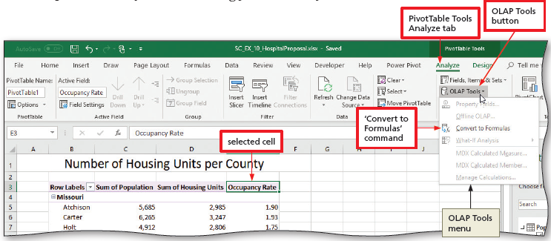
Power Pivot (6 of 6)
To View Cube Functions
  Click desired cell
  Display the PivotTable Tools Analyze tab
  Click the OLAP Tools button to display the menu
  Click “Convert to Formulas” on the OLAP Tools menu to view the cube function in the formula bar
Notes:
Figure 10-43: display of PivotTable Tools Analyze tab and OLAP Tools button with selected cell and “Convert to Formulas” command

Slide 18
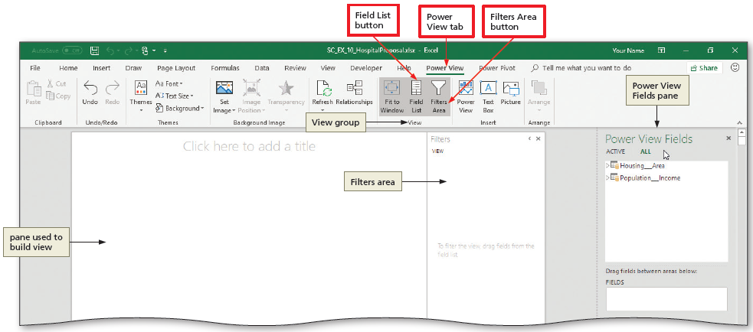
Power View (1 of 4)
To Start Power View
  Click the “Power View” button to open Power View and display the Power View sheet tab
Notes:
Figure 10-45: display of the Power View tab

Slide 19
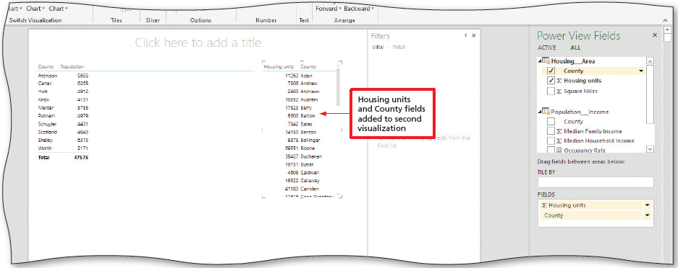
Power View (2 of 4)
To Create a Power View Report
  Click the expand triangle beside the desired table to display the fields
  Click the desired check boxes to move them to the Fields area in the Power View Fields pane and to display them in the report
  In the report, drag the lower-right corner of the table to the desired size
Notes:
Figure 10-49: display of Housing and County fields added to second visualizations

Slide 20
Power View (3 of 4)
To Format the Power View Report
  Display the Power View tab
  Click the Themes button to display the Power View themes
  Click the desired theme to change to change the colors in the Power Pivot report
  Enter the title text
  Click the Set Image button to display its menu
  Click the Set Image command to display the Open dialog box. Navigate to the data
  Double-click on the desired file to create the background image

Slide 21
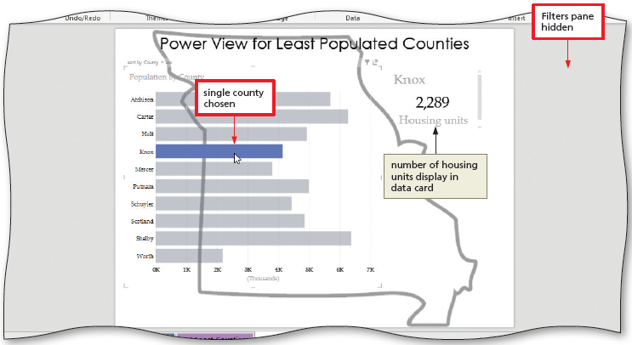
Power View (4 of 4)
To Use the Bar Chart
  Above the bar chart, click the desired bar
Notes:
Figure 10-62: Display of bar chosen and filters pane hidden

Slide 22
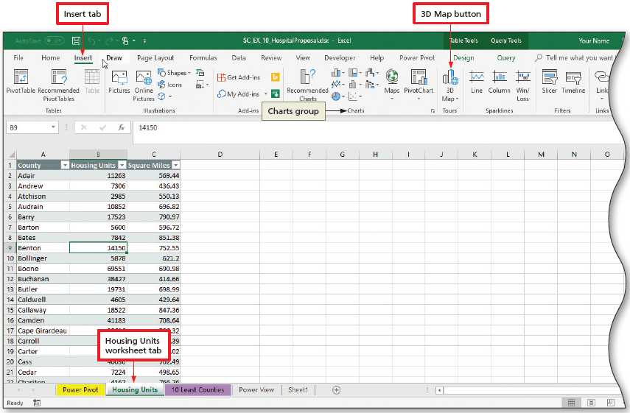
3D Maps (1 of 3)
To Open the 3D Maps Window
  Click a sheet and click anywhere within the data
  Display the Insert tab
  Click the 3D Map button to open the 3D Maps window
Notes:
Figure 10-63: Display of Insert tab and 3D Map button

Slide 23
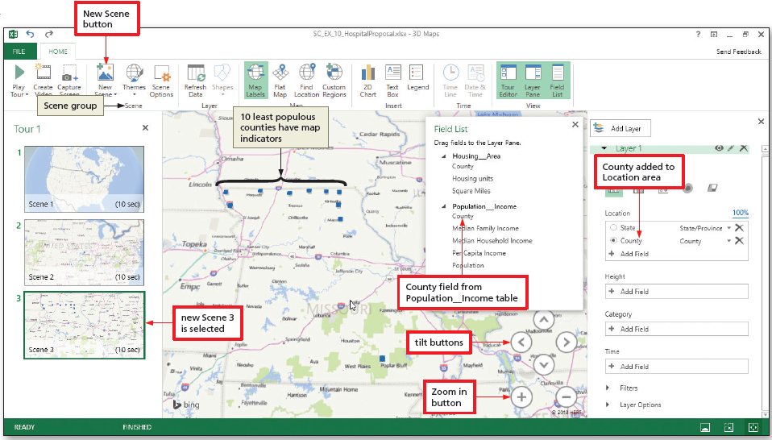
3D Maps (2 of 3)
To Create Scenes
  In the 3D Maps window, click the New Scene button to add a new scene
Notes:
Figure 10-66: Display of New Scene button

Slide 24
3D Maps (3 of 3)
To Finish the Animation Steps
  Click the Play Tour button to play the animation
  Click the Create Video button to display the Create Video dialog box
  Click the desired option button
  Click the Create button
  Click the Save button to save the video
To Capture a Screen
  Select a scene and click the Capture Screen button to place a copy on the clipboard
  Click the Paste button to paste the sheet

Slide 25
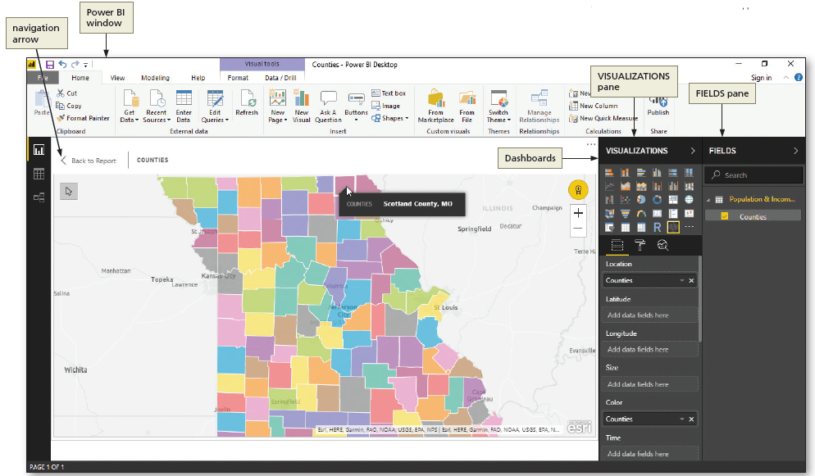
Power BI
Notes:
Figure 10-81: Display of a Power BI window

Slide 26
Formatting a Home Page with Hyperlinks and Symbols (1 of 3)
Table 10-4 Homepage Text and Hyperlinks
Cell | Text | Hyperlink location | Hyperlink
O6 | Missouri Demographics | <none> | <none>
O8 | Links: | <none> | <none>
P9 | 10 Least Counties by Population and Income | Place in This Document | 10 Least Counties
P10 | Housing Units | Place in This Document | Housing Units
P11 | Power Pivot | Place in This Document | Power Pivot
P12 | Power View | Place in This Document | Power View
P13 | Map Animation | Existing File or Web Page | SC_EX_10_ChosenHospitalLocation.mp4
P14 | Power BI | Existing File or Web Page | http://powerbi.microsoft.com
P15 | Contact | E-mail Address | businessanalytics@missouri.biz
Notes:
Table 10-4: Homepage Text and Hyperlinks

Slide 27
Formatting a Home Page with Hyperlinks and Symbols (2 of 3)
To Insert a Hyperlink
  Display the Insert tab
  Select the cell you wish to make a hyperlink and then click the Link button to display the Insert Hyperlink dialog box
  Click the “Place In This Document” button to identify the type of hyperlink
  Click OK to assign the hyperlink

Slide 28
Formatting a Home Page with Hyperlinks and Symbols (3 of 3)
To Insert a Symbol
  Select a cell, click the Symbols button to display the gallery
  Click the Symbol button in the gallery to display the Symbol dialog box
  Click the Font arrow to display the list
  Scroll to the desired Font
  Scroll to the desired symbols
  Click the Insert button to insert the symbol

Slide 29
Macros (1 of 2)
To Enable Macros
  Click the Developer tab to make it the active tab
  Click the Macro Security button
  Click “Enable all macros” to select the option button
  Click OK
To Record Macros
  Click the “Use Relative References” button to indicate relative references
  Click the Record Macro button
  Type the desired text in the Macro name text box
  Type a description
  Click OK to begin recording the macro and to change the Record Macro button to the Stop Recording button

Slide 30
Macros (2 of 2)
To Run a Macro
  Click the Power Pivot sheet tab
  Press CTRL +M to execute the macro with the shortcut key
  Click the desired cell
  Click Run to execute the macro
To Reset the Ribbon
  Right-click a blank area of the ribbon and then click “Customize the Ribbon”
  Click the Reset button
  Click “Reset all customizations”
  When Excel asks if you want to delete all customizations, click the Yes button
  Click OK

