Slide 1
Shelly Cashman: Microsoft Excel 2019
Module 11: User Interfaces, Visual Basic for Applications (V B A), and Collaboration Features
© 2020 Cengage Learning. All Rights Reserved. May not be copied, scanned, or duplicated, in whole or in part, except for use as permitted in a license distributed with a certain product or service or otherwise on a password-protected website for classroom use.

Slide 2
Objectives (1 of 2)
Create custom color and font schemes and save them as an Excel theme
Add and configure worksheet form controls
Record user input to another location on the worksheet
Understand Visual Basic Applications (VBA) code and explain event-driven programs
Explain sharing and collaboration techniques

Slide 3
Objectives (2 of 2)
Use passwords to assign protected and unprotected status a to a worksheet
Compare workbooks
Review a digital signature on a workbook
Insert and edit comments in a workbook
Format a worksheet background
Enhance charts and sparklines
Save a custom view of a worksheet

Slide 4
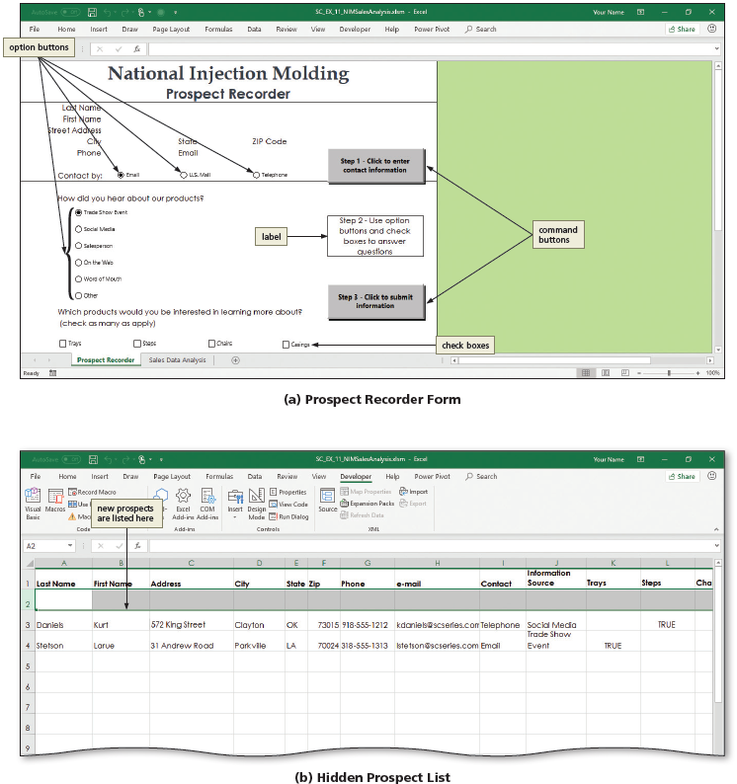
Project: National Injection Molding Sales Analysis (1 of 3)
Notes:
Figure 11-1: Display of project. (a) Prospect Recorder Form. (b) Hidden Prospect List

Slide 5
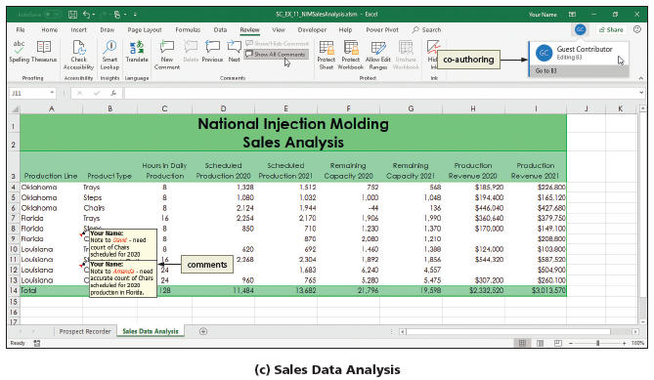
Project: National Injection Molding Sales Analysis (2 of 3)
Notes:
Figure 11-1: Display of project. (c) Sales Data Analysis

Slide 6
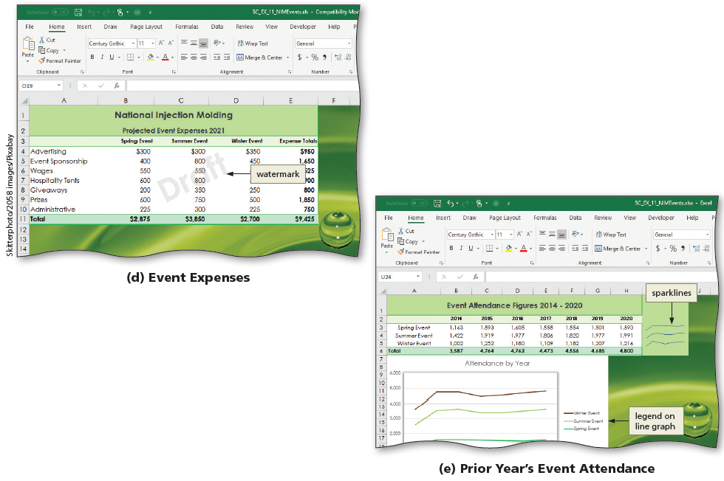
Project: National Injection Molding Sales Analysis (3 of 3)
Notes:
Figure 11-1: Display of final project. (d) Event Expenses. (e) Prior Year’s Event Attendance

Slide 7
Creating a Custom Theme
To Create a New Color Scheme
  Click the Colors button to display the Color Scheme gallery
  Click Customize Colors to display the Create New Theme Colors dialog box
  Type the desired name in the Name box to name the color scheme
  In the Theme colors area, click the desired accent button to display a gallery of color choices
  Select the desired colors
  Click Save to save the color scheme

Slide 8
Designing the User Interface (1 of 5)
To Display the Developer Tab
  Display the Backstage view
  Click Options in the left pane to display the Customize the Ribbons tools
  Click Customize Ribbon in the left pane to display the Customize the Ribbons tools
  Click the Developer check box in the Main Tabs list to select the Developer tab for display on the ribbon
  Click OK to close the dialog box

Slide 9
Designing the User Interface (2 of 5)
To Add Option Buttons to a Worksheet
  Display the Developer ab and then click the Insert button to display the Controls gallery
  Click the Option Button button in the Form Controls area in the Controls gallery
  Drag the worksheet to create an option button control in the desired cell
To Add Check Boxes to a Worksheet
  Click the Insert Controls button on the DEVELOPER tab to display the Controls gallery
  Click the desired control in the Form Controls area in the Controls gallery
  Drag the mouse pointer to the desired location

Slide 10
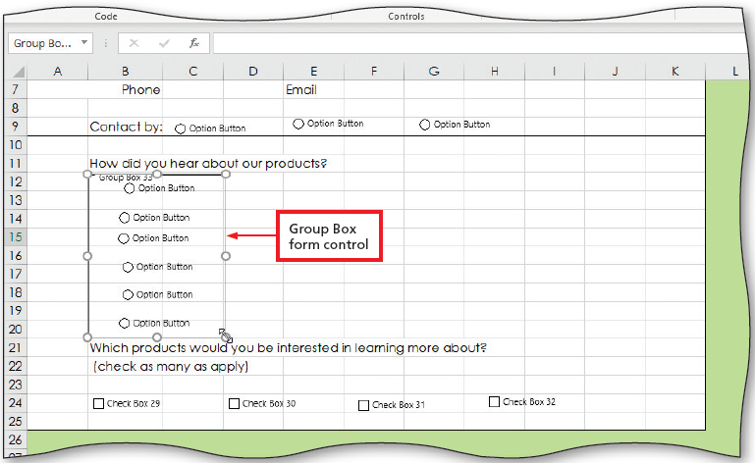
Designing the User Interface (3 of 5)
To Group Option Buttons Using a Group Box
  Click the Insert button to display the Controls gallery
  Click the Group Box button in the Form Controls area in the Controls gallery
  Drag the pointer so the Group Box control is in the desired location
Notes:
Figure 11-16: Display of Group Box form control

Slide 11
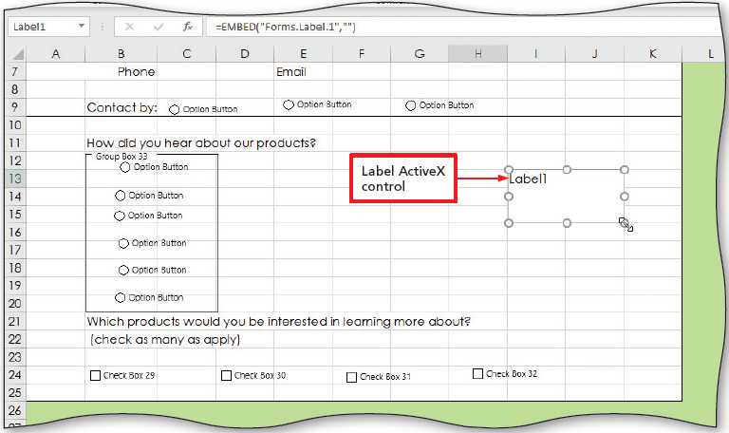
Designing the User Interface (4 of 5)
To Add a Label Control to the Worksheet
  Click the Insert button to display the Controls gallery
  Click the Label button in the ActiveX Controls area of the Controls gallery
  Drag in the worksheet from the desired cell through the desired area to create a Label form control
Notes:
Figure 11-17: Display of Label ActiveX control

Slide 12
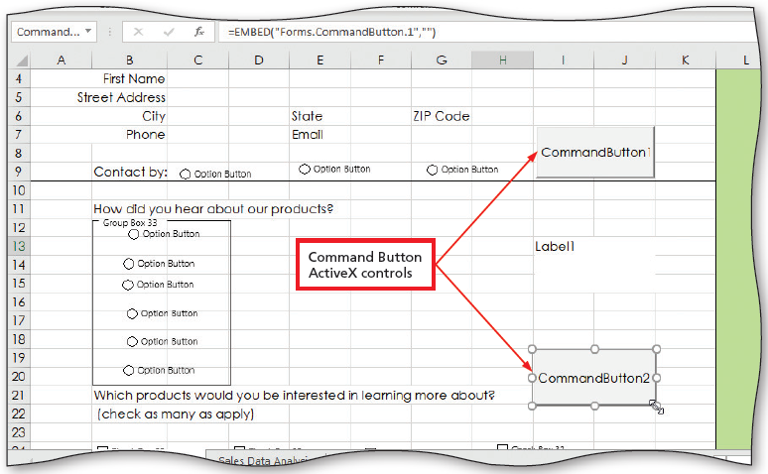
Designing the User Interface (5 of 5)
To Add Command Buttons to the Worksheet
  Click the Insert button to display the Controls gallery
  Click the Command Button button in the ActiveX Controls area of the Controls gallery
  Drag in the worksheet from the desired cell through the desired are to create a Command button
Notes:
Figure 11-18: Display of Command Button ActiveX controls

Slide 13
Setting Form Control Properties (1 of 2)
To Format the Option Buttons
  Right-click the first option button control in the Contact by area to display the shortcut menu
  Click Edit Text on the shortcut menu to edit the control text
  Type desired text
  Resize the control so that it just encloses the new text
  Repeat as needed
  ALT+drag the control until the right edge is aligned with the right edge of desired column
  CTRL+click the other two controls to select all three option button controls
  Display the Drawing Tools Format tab and then click the Shape Height box arrow

Slide 14
Setting Form Control Properties (2 of 2)
To Align and Distribute
  Click the Align Objects button to display the Align menu
  Click the desired alignment on the Arrange menu to align the three controls as desired
  Click the Align Objects button again to display the alignment options
  Click the desired distribution on the Arrange menu to distribute the controls as desired

Slide 15
Setting ActiveX Control Properties (1 of 2)
To Set Command Button Properties
  Select the two command button controls
  Display the Developer tab and then click the Control Properties button to open the Properties window
  Click the desired property
  Click on the desired changes
  Click on another property and make the desired changes
  Click OK to apply the change
  Select the first command button only
  In the Properties pane, click Name, and then type the desired name
  Repeat for the Caption and remaining Command buttons

Slide 16
Setting ActiveX Control Properties (2 of 2)
To Set Label Properties
  Select the label control
  In the Properties pane, click Name and then type the desired text
  In the Properties pane, click on other properties and make desired changes
  Click Caption and then type the desired text
  Close the Properties window
To Align and Distribute Controls
  Select the command buttons and the label and use the Align button to apply the desired options

Slide 17
Storing User Input (1 of 2)
To Create from Selection
  Select the range
  Click the “Create from Selection” button to display the Create from Selection dialog box
  Because the headings are at the top, click the Top row check box
  Click OK to name the cells

Slide 18
Storing User Input (2 of 2)
To Evaluate Option Button Selection
  Right-click the control to link to display the shortcut menu
  Click Format Control to display the Format Control dialog box
  If necessary, click the Control tab to display the Control sheet
  Type the desired text in the Cell link box to link the control to the desired cell
  Click OK to close the dialog box
  Type the formula (i.e. =INDEX(contact,$I$41) to record text rather than numbers
  Click the Enter button

Slide 19
Writing Code for a Command Button (1 of 2)
To Enter the Command Button Procedures
  Display the Developer tab and then click the Design Mode button to make Design Mode active
  Right-click the Step 1 button on the worksheet to display the shortcut menu
  Click View Code to display the Microsoft Visual Basic for Applications editor and then, maximize the window
  Click in the blank line between the beginning and end lines of code
  Press TAB before you enter each line of VBA code
  Click the Object arrow and then click cmdStep3 on the list to display the beginning and ending code for the submit button
  Enter the desired VBA code
  Verify your code

Slide 20
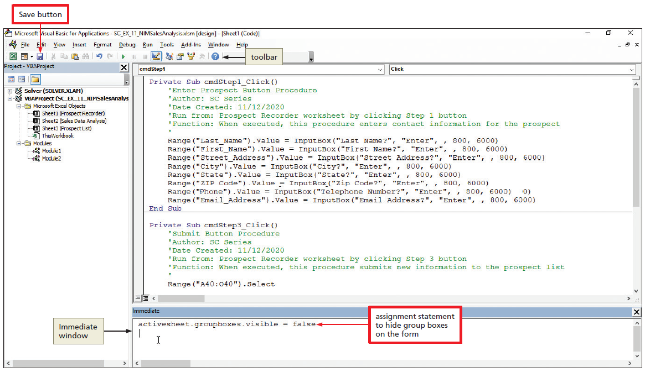
Writing Code for a Command Button (2 of 2)
To Remove the Outline from the Group Box Control
  Press CTRL+G to open the Immediate window
  Type activesheet.groupboxes.visible = false
  Press ENTER execute the code, which hides the box around the group control
Notes:
Figure 11-41: Display of assignment statement to hide group boxes on the form and Save button

Slide 21
Preparing, Protecting, and Testing Worksheets (1 of 3)
To Prepare Worksheet for Distribution
  Click the Design Mode button to exit Design Mode
  Display Backstage view
  Click Options to display the Excel Options dialog box
  Click the Advanced tab to display the advanced options
  Scroll to the “Display options for this worksheet” area in the right pane
  Click to clear the “Show row and column headers” check box, the “Show page breaks” and “Show a zero in cells that have zero value” check box
  Click OK to close the Excel Options dialog box
  Display the View tab
  Click to clear the Gridlines, Formula Bar, and Headings check boxes to remove those features from the worksheet
  Click the “Collapse the Ribbon” button on the ribbon to hide it

Slide 22
Preparing, Protecting, and Testing Worksheets (2 of 3)
To Password Protect the Workbook
  Display the Review tab and then click the Protect Sheet button to display the Protect Sheet dialog box
  Type the desired text in the “Password to unprotect sheet” box
  Click OK to display the Confirm Password dialog box
  Type the same password in the “Reenter password to proceed” box
  Click OK to close the dialog boxes

Slide 23
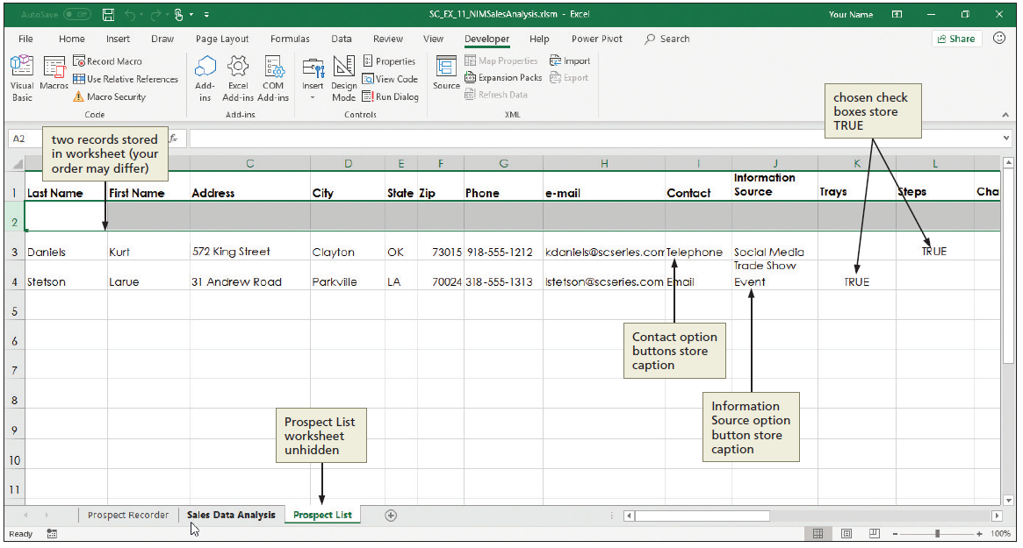
Preparing, Protecting, and Testing Worksheets (3 of 3)
To Test the Controls in the Worksheet
Notes:
Figure 11-47: Display of two records stored in worksheet, chosen check boxes store TRUE, Contact option buttons store caption, Information Source option button store caption, and Prospect List worksheet unhidden

Slide 24
Sharing and Collaboration (1 of 3)
To Distribute via OneDrive
  Click Share Workbook to open the Share dialog box
  Click the OneDrive button and sign in if necessary
  When Excel displays the Send Link dialog box, enter a recipient’s email address above the blue line
  Click the Send button
  Close the Link Sent dialog box

Slide 25
Sharing and Collaboration (2 of 3)
To Co-Author a Workbook
  Make sure that AutoSave is on in the upper-left corner of the title bar
  Ask the second workbook user to click the link you sent
  When the second user comes online, click the picture or initials in the upper-right corner of the ribbon
  Ask the user to click on a cell, type new text, and then save the workbook
  In your copy of the workbook, click the Save button on the Quick Access Toolbar to display the Microsoft Excel dialog box indicating the workbook has been updated with changes saved by another user
  Close the workbook and ask the other user to do the same

Slide 26
Sharing and Collaboration (3 of 3)
To Unprotect a Password-Protected Worksheet
  If necessary, click the desired sheet tab to make it the active sheet
  Display the REVIEW tab, and then click the Unprotect Sheet button to display the Unprotect Sheet dialog box
  When the Unprotect Sheet dialog box appears, type the password in the Password box
  Click OK to unprotect the worksheet
  Save and close the workbook

Slide 27
Using Comments to Annotate a Worksheet (1 of 3)
To Add Comments to a Worksheet
  Display the Review tab and click the “Show All Comments” button to toggle the option off and hide all comments in the workbook
  Right click the cell to contain the comment
  Click Insert Comment on the shortcut menu to open a comment box next to the selected cell and display a comment indicator in the cell
  Enter the comment text in the comment box
  Click outside the comment box to close the comment box and display only the red comment indicator in the cell

Slide 28
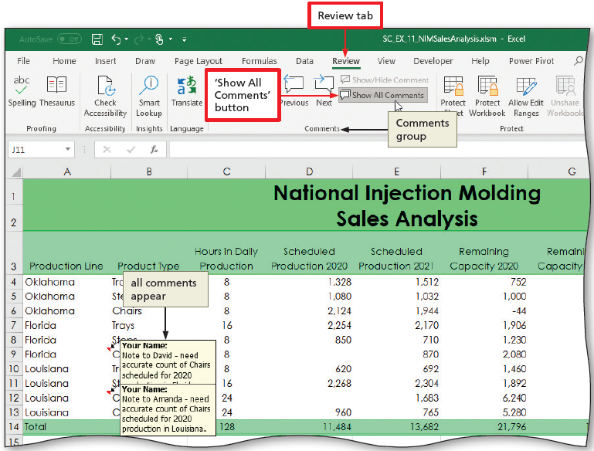
Using Comments to Annotate a Worksheet (2 of 3)
To Display and Move among Comments
  Point to the comment indicator in the cell to display the related comment
  Click the Next button to display the next comment
  Click the “Show All Comments” button to show all comments in the workbook
Notes:
Figure 11-57: Display of Review tab and “Show All Comments” button

Slide 29
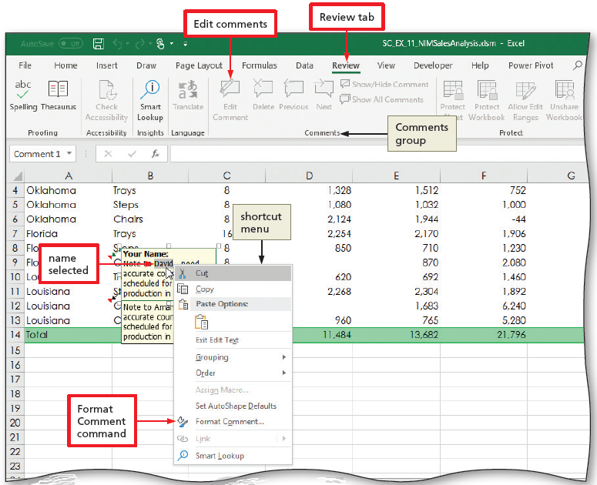
Using Comments to Annotate a Worksheet (3 of 3)
To Edit Comments on a Worksheet
  Click the cell containing the comment to edit
  Click the Edit Comment button to open the comment for editing
  Change the comment text as desired
  Click OK
Notes:
Figure 11-58: Display of Review tab, Edit comments, and Format Comment command

Slide 30
Comparing Workbooks (1 of 2)
To Compare Workbooks Side by Side
  Open the two workbooks to compare
  Display the View tab and then click the “View Side by Side” button to display the workbooks side by side
  Use one scroll bar to scroll one of the worksheets and use synchronous scrolling
To Turn Off Workbook Sharing
  Display the Review tab and then click the Unshare Workbook button
  Save the workbook with the desired file name

Slide 31
Comparing Workbooks (2 of 2)
To Add a Signature Box and Digital Signature to a Workbook
  Click the Insert tab and then click the Signature Line arrow in the Text group to display the list
  Click the “Microsoft Office Signature Line” command
  Enter your name in the Suggested signer box and then click OK to add the signature box to the workbook
  Right-click the signature box and then click Sign on the shortcut menu to display the Sign dialog box
  In the Sign dialog box, enter your name in the signature box or click the Select Image link to select a file that contains an image of your signature
  Click the Sign button to digitally sign the document

Slide 32
Finalizing a Workbook (1 of 6)
To Add a Watermark to a Worksheet
  Display the INSERT tab and then click the WordArt button to display the Insert WordArt gallery
  Click the desired fill to insert a new WordArt object
  Select the text in the WordArt object and then type the desired text as the watermark text
  Point to the border of the WordArt object, and when the pointer changes to a four-headed arrow, drag the WordArt object to the desired location
  With the WordArt text selected, right-click the WordArt object to display a shortcut menu
  Click “Format Text Effects” on the shortcut menu to open the Format Shape task pane

Slide 33
Finalizing a Workbook (2 of 6)
To Add a Watermark to a Worksheet (cont.)
  If necessary, click the Text Options tab to display the txt options
  Click the “Text Fill & Outline” button and then expand the Text Fill section
  Set the Transparency slider to the desired percentage
  Click the Close button in the Format Shape task pane
  With the WordArt object still selected, drag the rotation handle to the desired orientation of the WordArt object

Slide 34
Finalizing a Workbook (3 of 6)
To Add a Legend to a Chart
  Click anywhere in the chart to select it
  Click the Chart Elements button to display the CHART ELEMENTS gallery
  Point to Legend to display an arrow and then click the arrow to display the Legend submenu
  Click Right to add a legend to the right side of the chart
  Click the Chart Elements button to close the gallery

Slide 35
Finalizing a Workbook (4 of 6)
To Add a Shadow to a Chart Element
  Click anywhere in the plot area to select it
  Right-click the plot area to display a shortcut menu
  Click “Format Plot Area” on the shortcut menu to open the Format Plot Area task pane
  Click the Effects button and then expand the Shadow settings
  Click the Presets button to display the Shadow gallery
  Click the desired shadow effect to apply it to the plot area of the chart
  Close the Format Plot Area pane and then deselect the plot area

Slide 36
Finalizing a Workbook (5 of 6)
To Add Sparklines Using the Quick Access Gallery
  With the desired range selected, click the Quick Analysis button to display the Quick Analysis gallery
  Click the SPARKLINES tab to display the Quick Analysis gallery related to sparklines
  Click the desired sparkline type to insert a sparklines in the desired cells
  Click another cell to deselect the range
  Save the file

Slide 37
Finalizing a Workbook (6 of 6)
To Save a Custom View of a Workbook
  Click View on the ribbon to display the View tab
  Resize the workbook window as desired
  Click the Custom Views button to display the Custom Views dialog box
  Click the Add button to display the Add View dialog box
  Type the desired view name in the Name box to provide a name for the custom view
  Click OK to close the dialog box

Slide 38
Setting Internationalization Features (1 of 3)
To Save a Workbook in an Earlier Version of Excel
  Display Backstage view, click Save As, and then navigate to the location where you store your filed
  Click the “Save as type” arrow to display the list of file types
  Click the desired format to select the file format
  Click the Save button to display the Microsoft Excel-Compatibility Checker dialog box
  Resize the dialog box so that it displays all the issues
  Click the Continue button to save the workbook in the new file format

Slide 39
Setting Internationalization Features (2 of 3)
To Mark a Workbook as Final
  Display Backstage view
  Click the Protect Workbook button in the Info Gallery to display the Protect Workbook menu
  Click “Mark as Final” on the Protect Workbook menu to display the Microsoft Excel dialog box
  Click the Continue button on the Microsoft Excel-Compatibility Checker dialog box
  Click OK to indicate you want to mark the workbook as final
  Click OK to close the Microsoft Excel dialog box and mark the workbook as final

Slide 40
Setting Internationalization Features (3 of 3)
To Inspect a Document for Hidden and Personal Information
  Display Backstage view
  Click the “Check for Issues” button to display the Check for Issues menu
  Click Inspect Document to display the Document Inspector dialog box
  Click the Inspect button to run the Document Inspector and display its results
  Click the Close button to close the dialog box

