Slide 1
3
Applications of Differentiation
P
Copyright © Cengage Learning. All rights reserved.

Slide 2
3.1
Extrema on an Interval
Copyright © Cengage Learning. All rights reserved.

Slide 3
Objectives
Understand the definition of extrema of a function on an interval.
Understand the definition of relative extrema of a function on an open interval.
Find extrema on a closed interval.

Slide 4
Extrema of a Function

Slide 5
Extrema of a Function
In calculus, much effort is devoted to determining the behavior of a function f on an interval I.
Does f have a maximum value on I? Does it have a minimum value? Where is the function increasing? Where is it decreasing?
In this chapter, you will learn how derivatives can be used to answer these questions. You will also see why these questions are important in real-life applications.

Slide 6
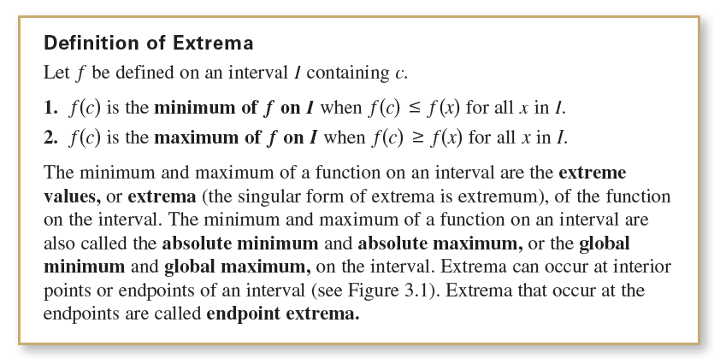
Extrema of a Function

Slide 7
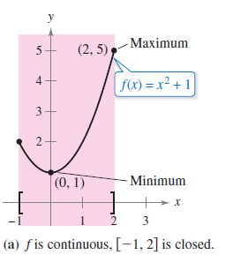
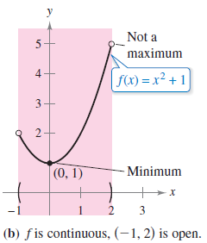
Extrema of a Function
A function need not have a minimum or a maximum on an interval. For instance, in Figures 3.1(a) and (b), you can see that the function f(x) = x² + 1 has both a minimum and a maximum on the closed interval [–1, 2] but does not have a maximum on the open interval (–1, 2).
Figure 3.1(a)
Figure 3.1(b)

Slide 8
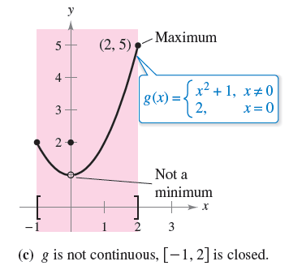
Extrema of a Function
Moreover, in Figure 3.1(c),
you can see that continuity
(or the lack of it) can affect the
existence of an extremum on
the interval.
This suggests the theorem below.
Figure 3.1(c)

Slide 9
Relative Extrema and Critical Numbers

Slide 10
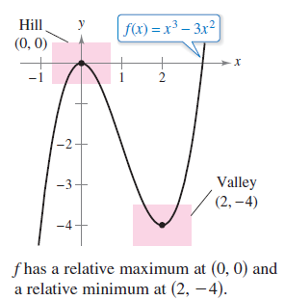
Relative Extrema and Critical Numbers
In Figure 3.2, the graph of f(x) = x³ – 3x² has a relative maximum at the point (0, 0) and a relative minimum at the point (2, – 4).
Informally, for a continuous function,
you can think of a relative maximum
as occurring on a “hill” on the graph,
and a relative minimum as occurring
in a “valley” on the graph.
Figure 3.2

Slide 11
Relative Extrema and Critical Numbers
Such a hill and valley can occur in two ways.
When the hill (or valley) is smooth and rounded, the graph has a horizontal tangent line at the high point (or low point).
When the hill (or valley) is sharp and peaked, the graph represents a function that is not differentiable at the high point (or low point).

Slide 12
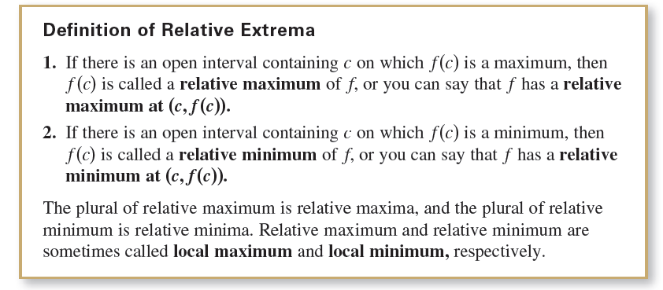
Relative Extrema and Critical Numbers

Slide 13
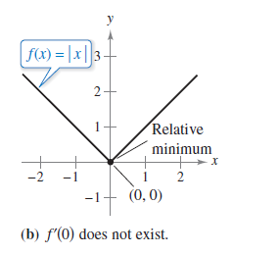
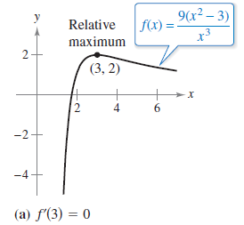
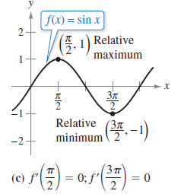
Example 1 – The Value of the Derivative at Relative Extrema
Find the value of the derivative at each relative extremum
shown in Figure 3.3.
Figure 3.3

Slide 14
Example 1(a) – Solution
The derivative of is
At the point (3, 2), the value of the derivative is f'(3) = 0
[See Figure 3.3(a)].
Figure 3.3(a)

Slide 15
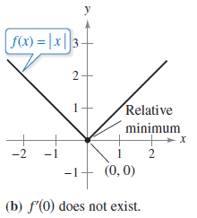
Example 1(b) – Solution
cont’d
At x = 0, the derivative of f(x) = |x| does not exist because the following one-sided limits differ [See Figure 3.3(b)].
Figure 3.3(b)

Slide 16
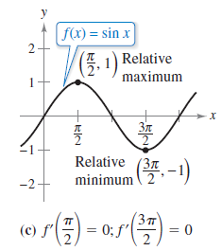
Example 1(c) – Solution
cont’d
The derivative of f(x) = sin x is f'(x) = cos x.
At the point (π/2, 1), the value of the
derivative is f'(π/2) = cos(π/2) = 0.
At the point (3π/2, –1), the value of the
derivative is f'(3π/2) = cos(3π/2) = 0
[See Figure 3.3(c)].
Figure 3.3(c)

Slide 17
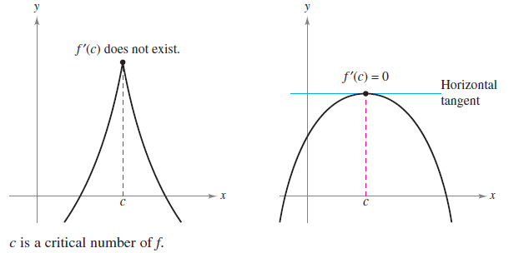
Relative Extrema and Critical Numbers
Note in Example 1 that at each relative extremum, the derivative either is zero or does not exist. The x-values at these special points are called critical numbers.
Figure 3.4 illustrates the two types of critical numbers.
Figure 3.4

Slide 18
Relative Extrema and Critical Numbers
Notice in the definition above that the critical number c has to be in the domain of f, but c does not have to be in the domain of f'.

Slide 19
Finding Extrema on a Closed Interval

Slide 20
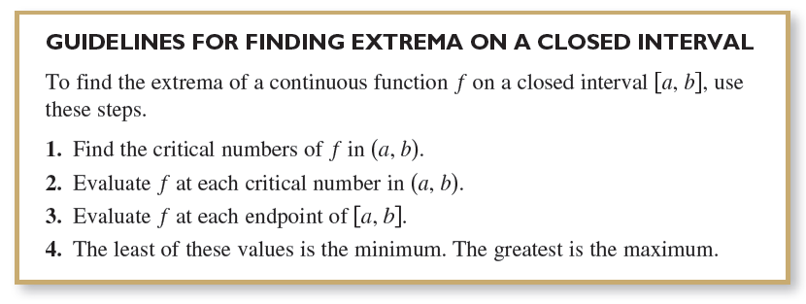
Finding Extrema on a Closed Interval
Theorem 3.2 states that the relative extrema of a function
can occur only at the critical numbers of the function.
Knowing this, you can use the following guidelines to find
extrema on a closed interval.

Slide 21
Example 2 – Finding Extrema on a Closed Interval
Find the extrema of f(x) = 3x⁴ – 4x³ on the interval [–1, 2].
Solution:
Begin by differentiating the function.
f(x) = 3x⁴ – 4x³ Write original function.
f'(x) = 12x³ – 12x² Differentiate.

Slide 22
Example 2 – Solution
cont’d
To find the critical numbers of f in the interval (– 1,2), you must find all x-values for which f'(x) = 0 and all x-values for which f'(x) does not exist.
12x³ – 12x² = 0 Set f'(x) equal to 0.
12x²(x – 1) = 0 Factor.
x = 0, 1 Critical numbers
Because f' is defined for all x, you can conclude that these are the only critical numbers of f.

Slide 23
Example 2 – Solution
cont’d
By evaluating f at these two critical numbers and at the endpoints of [–1, 2], you can determine that the maximum is f(2) = 16 and the minimum is f(1) = –1, as shown in the table.

Slide 24
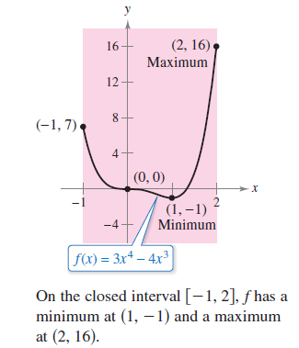
Example 2 – Solution
cont’d
The graph of f is shown in Figure 3.5.
Figure 3.5

Slide 25
Example 2 – Solution
cont’d
In Figure 3.5, note that the critical number x = 0 does not yield a relative minimum or a relative maximum.
This tells you that the converse of Theorem 3.2 is not true.
In other words, the critical numbers of a function need not produce relative extrema.

