Slide 1

5
Logarithmic, Exponential, and Other Transcendental Functions
P
Copyright © Cengage Learning. All rights reserved.

Slide 2

5.3
Inverse Functions
Copyright © Cengage Learning. All rights reserved.

Slide 3
Objectives
Verify that one function is the inverse function of another function.
Determine whether a function has an inverse function.
Find the derivative of an inverse function.

Slide 4
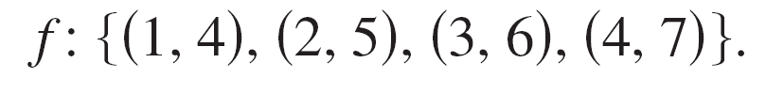
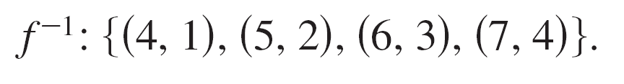
Inverse Functions
The function f (x) = x + 3 from A = {1, 2, 3, 4} to B = {4, 5, 6, 7} can be written as
By interchanging the first and second coordinates of each ordered pair, you can form the inverse function of f. This function is denoted by f ^{–1}. It is a function from B to A and
can be written as

Slide 5
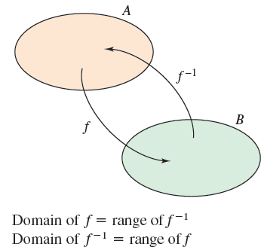
Inverse Functions
Note that the domain of f is equal to the range of f ^{–1}, and vice versa, as shown in Figure 5.9. The functions f and f ^{–1} have the effect of “undoing” each other. That is, when you form the composition of f with f ^{–1} or the composition of f ^{–1} with f, you obtain the identity function.
f (f ^{–1}(x)) = x and f ^{–1}(f (x)) = x
Figure 5.9

Slide 6
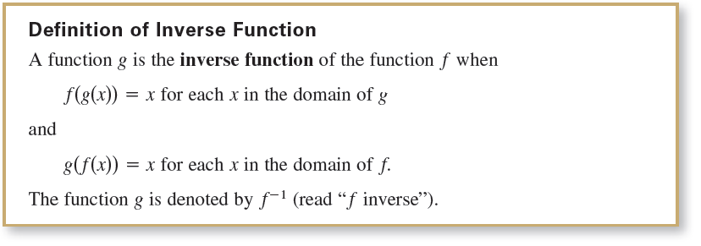
Inverse Functions

Slide 7
Inverse Functions
Here are some important observations about inverse functions.
If g is the inverse function of f, then f is the inverse
function of g.
2. The domain of f ^{–1} is equal to the range of f, and the
range of f ^{–1} is equal to the domain of f.
3. A function need not have an inverse function, but when it
does, the inverse function is unique.

Slide 8
Inverse Functions
You can think of f ^{–1} as undoing what has been done by f.
For example, subtraction can be used to undo addition, and division can be used to undo multiplication. So,
are inverse functions of each other and
are inverse functions of each other.

Slide 9
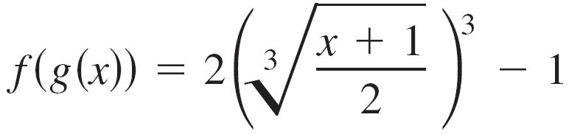
Example 1 – Verifying Inverse Functions
Show that the functions are inverse functions of each other.
and
Solution:
Because the domains and ranges of both f and g consist of all real numbers, you can conclude that both composite functions exist for all x.
The composition of f with g is

Slide 10

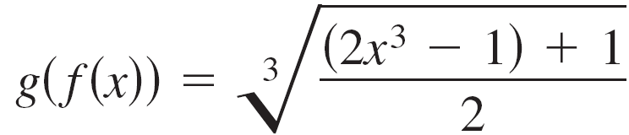


Example 1 – Solution
cont'd
The composition of g with f is

Slide 11
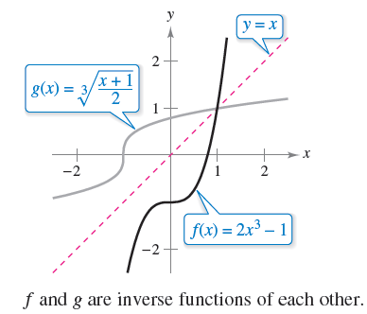
Example 1 – Solution
cont'd
Because f (g(x)) = x and g(f (x)) = x, you can conclude f and g are inverse functions of each other (see Figure 5.10).
Figure 5.10

Slide 12
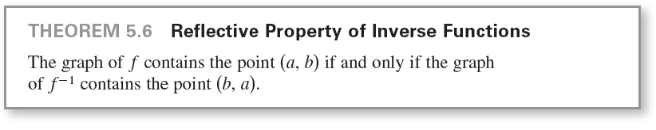
Inverse Functions
In Figure 5.10, the graphs of f and g = f ^{–1} appear to be mirror images of each other with respect to the line y = x. The graph of f ^{–1} is a reflection of the graph of f in the line y = x.
This idea is generalized in the next theorem.

Slide 13
Existence of an Inverse Function

Slide 14
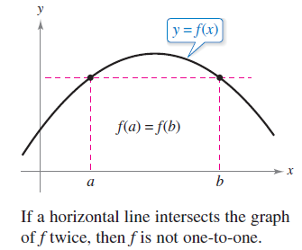
Existence of an Inverse Function
Not every function has an inverse function, and Theorem 5.6 suggests a graphical test for those that do—the Horizontal Line Test for an inverse function.
This test states that a function f has an inverse function if and only if every horizontal line intersects the graph of f at most once (see Figure 5.12).
Figure 5.12

Slide 15
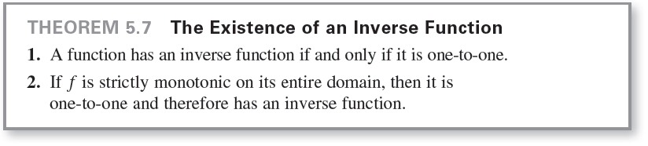
Existence of an Inverse Function
The next theorem formally states why the Horizontal Line
Test is valid.

Slide 16
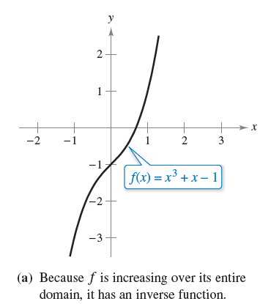
Example 2(a) – The Existence of an Inverse Function
From the graph of f (x) = x³ + x – 1
shown in Figure 5.13(a), it appears
that f is increasing over its entire
domain.
To verify this, note that the
derivative, f'(x) = 3x² + 1, is
positive for all real values of x.
So, f is strictly monotonic, and it
must have an inverse function.
Figure 5.13

Slide 17
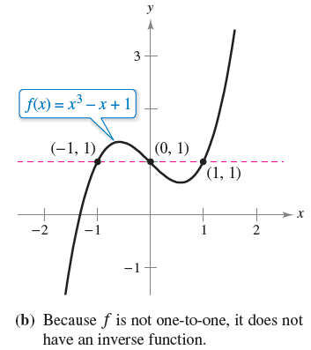
Example 2(b) – The Existence of an Inverse Function
cont'd
From the graph of f (x) = x³ – x + 1
shown in Figure 5.13(b), you can
see that the function does not pass
the Horizontal Line Test.
In other words, it is not one-to-one.
For instance, f has the same value
when x = –1, 0, and 1.
So, by Theorem 5.7, f does not have an inverse function.
Figure 5.13

Slide 18
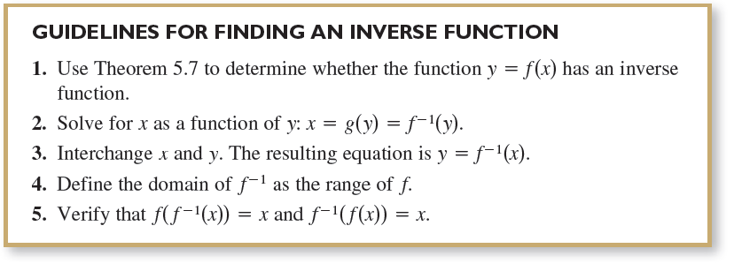
Existence of an Inverse Function
The following guidelines suggest a procedure for finding an inverse function.

Slide 19
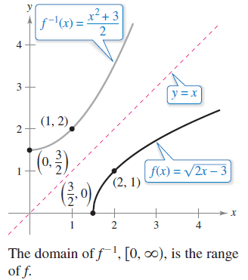
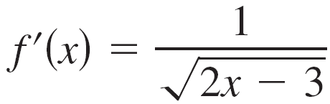
Example 3 – Finding an Inverse Function
Find the inverse function of
Solution:
From the graph of f in Figure 5.14,
it appears that f is increasing over
its entire domain, .
To verify this, note that
is positive on the domain of f.
So, f is strictly monotonic and
it must have an inverse function.
Figure 5.14

Slide 20
Example 3 – Solution
cont'd
To find an equation for the inverse function, let y = f (x), and solve for x in terms of y.

Slide 21
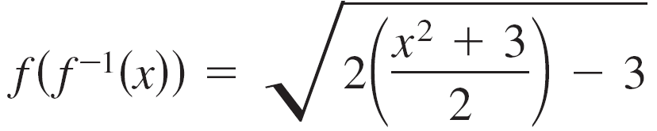

Example 3 – Solution
cont'd
The domain of f ^{–1} is the range of f, which is .
You can verify this result as shown.

Slide 22
Existence of an Inverse Function
You are given a function that is not one-to-one on its domain.
By restricting the domain to an interval on which the function is strictly monotonic, you can conclude that the new function is one-to-one on the restricted domain.

Slide 23
Example 4 – Testing Whether a Function Is One-to-One
Show that the sine function
f(x) = sin x
is not one-to-one on the entire real number line. Then show that [–π/2, π/2] is the largest interval, centered at the origin, on which f is strictly monotonic.

Slide 24
Example 4 – Solution
It is clear that f is not one-to-one, because many different x-values yield the same y-value.
For instance,
sin(0) = 0 = sin(π)
Moreover, f is increasing on the open interval (–π/2, π/2), because its derivative
f'(x) = cos x
is positive there.

Slide 25
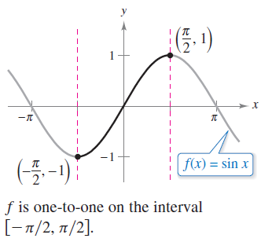
Example 4 – Solution
cont'd
Finally, because the left and right endpoints correspond to relative extrema of the sine function, you can conclude that f is increasing on the closed interval [–π/2, π/2] and that on any larger interval the function is not strictly monotonic
(see Figure 5.15).
Figure 5.15

Slide 26
Derivative of an Inverse Function

Slide 27
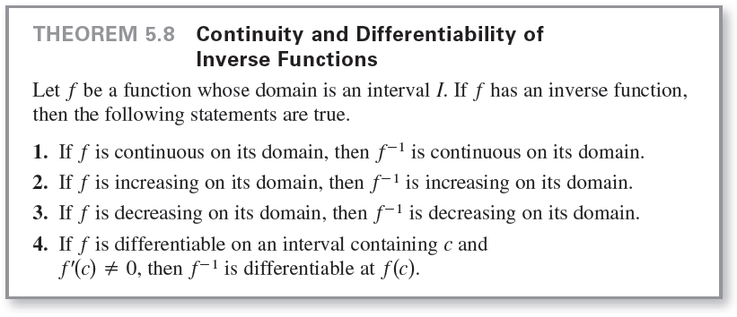
Derivative of an Inverse Function
The next two theorems discuss the derivative of an inverse function.

Slide 28
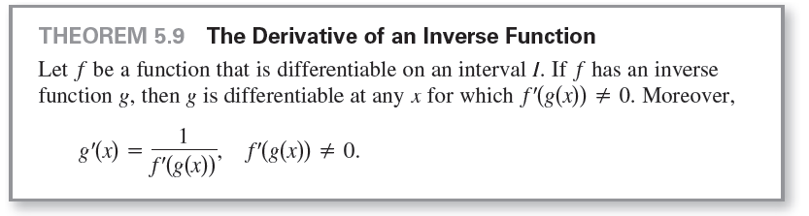
Derivative of an Inverse Function

Slide 29
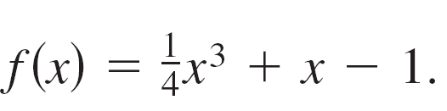
Example 5 – Evaluating the Derivative of an Inverse Function
Let
a. What is the value of f ^{–1}(x) when x = 3?
b. What is the value of (f ^{–1})'(x) when x = 3?
Solution:
Notice that f is one-to-one and therefore has an inverse function.
a. Because f (x) = 3 when x = 2, you know that f ^{–1}(3) = 2.

Slide 30
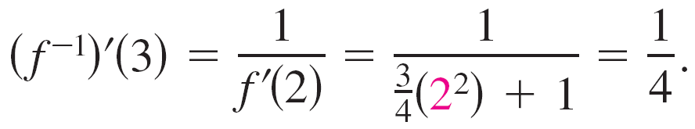
Example 5 – Solution
cont'd
b. Because the function f is differentiable and has an
inverse function, you can apply Theorem 5.9
(with g = f ^{–1}) to write
Moreover, using you can conclude that

Slide 31
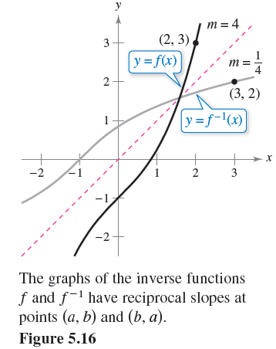
Derivative of an Inverse Function
In Example 5, note that at the point (2, 3), the slope of the graph of f is m = 4, and at the point (3, 2), the slope of the graph of f ^{–1} is m = as shown in Figure 5.16.
Figure 5.16

Slide 32

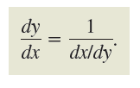
Derivative of an Inverse Function
In general, if y = g(x) = f ^{–1}(x), then f (y) = x and f'(y) = . It follows from Theorem 5.9 that
This reciprocal relationship is sometimes written as

Slide 33

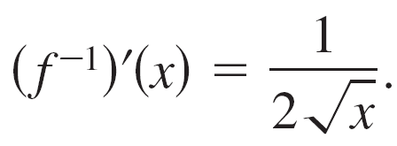
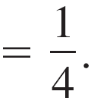
Example 6 – Graphs of Inverse Functions Have Reciprocal Slopes
Let f(x) = x² (for x ≥ 0), and let . Show that the slopes of the graphs of f and f ^{–1} are reciprocals at each of the following points.
a. (2, 4) and (4, 2) b. (3, 9) and (9, 3)
Solution:
The derivative of f and f ^{–1} are
f'(x) = 2x and
a. At (2, 4), the slope of the graph of f is .
At (4, 2), the slope of the graph of f ^{–1} is

Slide 34
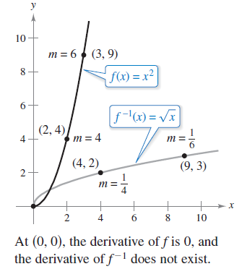
Example 6 – Solution
cont'd
b. At (3, 9), the slope of the graph of f is f'(3) = 2(3) = 6.
At (9, 3), the slope of the graph of f ^{–1} is
So, in both cases, the slopes are
reciprocals, as shown in Figure 5.17.
Figure 5.17

