Slide 1
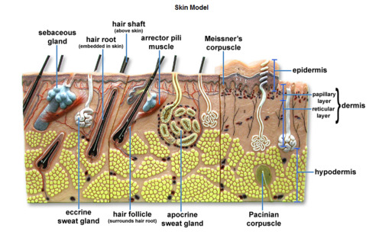

Slide 2
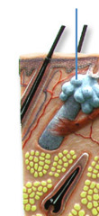
Hair Shaft (above skin)
Hair Root (embedded in skin)
Sebaceous Gland
Arrector Pili Muscle

Slide 3
Meissner's Corpuscle- mechanoreceptor for touch
Apocrine Sweat Gland- is a type of merocrine sweat gland composed of a coiled secretory portion located at the junction of the dermis and subcutaneous fat
Apocrine Sweat Gland- apocrine sweat glands are found only in certain locations of the body: the axillae (armpits), areola and nipples of the breast, ear canal, eyelids, wings of the nostril, perianal region, and some parts of the external genitalia
Merocrine(or eccrine) is a term used to classify exocrine glands and their secretions in the study of histology. A cell is classified as merocrine if the secretions of that cell are excreted via exocytosis from secretory cells into an epithelial-walled duct or ducts and thence onto a bodily surface or into the lumen.
Eccrine Sweat Gland-major sweat glands of the human body, found in virtually all skin, with the highest density in palms and soles, then on the head, but much less on the trunk and the extremities
Hair Follicle
Apocrine Sweat Gland
Pacinian Corpuscle- mechanoreceptor for vibration and pressure.

Slide 4
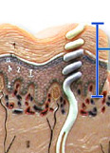
Epidermis
Dermis (papillary layer, reticular layer)
Hypodermis

Slide 5
Sebaceous Gland
Eccrine Sweat Gland
Apocrine Sweat Gland
?

Slide 6
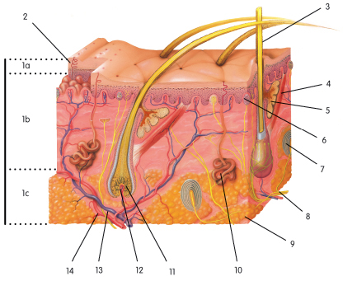
In the figure below, which layer (1a, 1b, or 1c) is the EPIDERMIS?

Slide 7
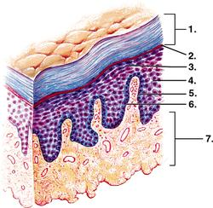
Stratum corneum
Stratum lucidum
Stratum granulosum
Stratum spinosum
Stratum basale
Basement membrane
Dermis

Slide 8
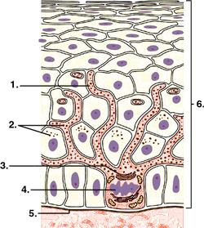
Cellular extension of melanocyte
Pigment granules
Golgi apparatus
Melanocyte nucleus
Basement membrane
Epidermis

Slide 9
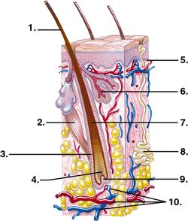
Hair shaft
Arrector pili muscle
Hair follicle
Region of cell division
Basement membrane
Sebaceous gland
Keratinized cells
Eccrine sweat gland
Hair papilla
Dermal blood vessels

Slide 10
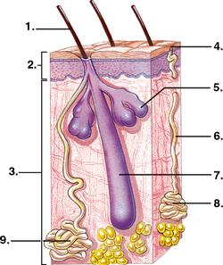
Hairshaft
Epidermis
Dermis
Pore
Sebaceous gland
Duct
Hair follicle
Eccrine sweat gland
Apocrine sweat gland

Slide 11
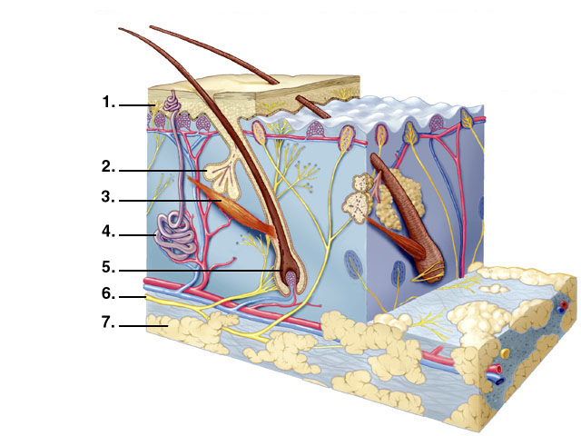
Free nerve endings
Oil gland
Arrector pili muscle
Sweat gland
Hair root
Nerve
Fat

Slide 12
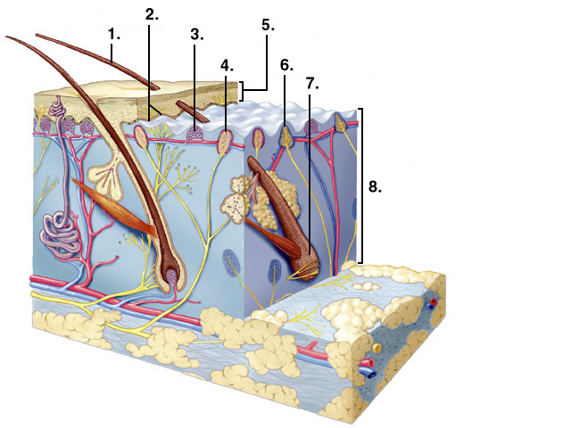
Hair shaft
Melanocytes
Capillaries
Sensory Receptor
Epidermis
Sensory receptor
Hair follicle
Dermis

Slide 13
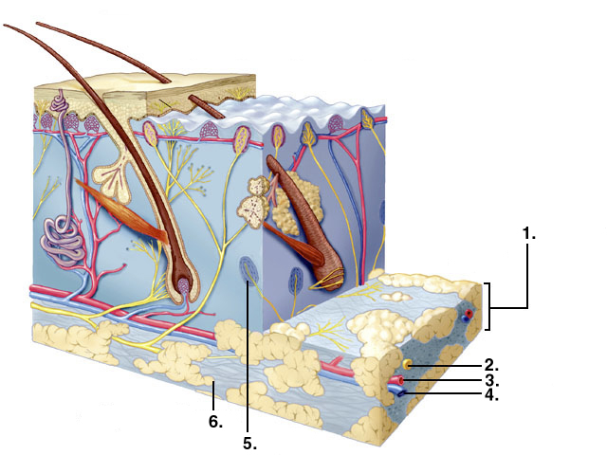
Subcutaneous layer
Nerve
Artery
Vein
Sensory receptor
Adipose tissue

Slide 14
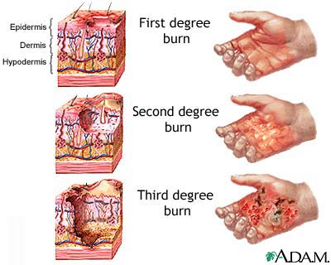
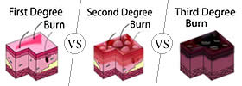
A burn which destroys the entire thickness of skin, appears blanched (gray-white) or blackened, and is not painful due to destroyed nerves is considered a: 1. Partial-thickness burn 2. 1st degree burn 3. 2nd degree burn 4. 3rd degree burn

Slide 15
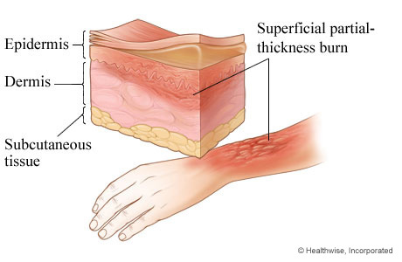
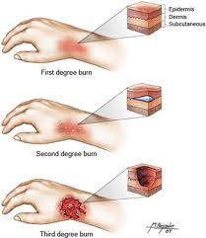
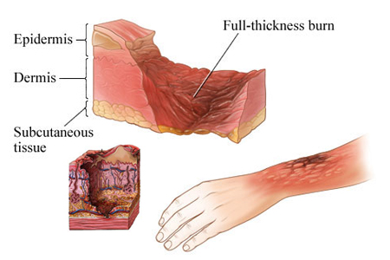

Slide 16
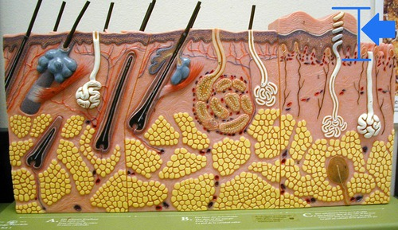
Epidermis

Slide 17
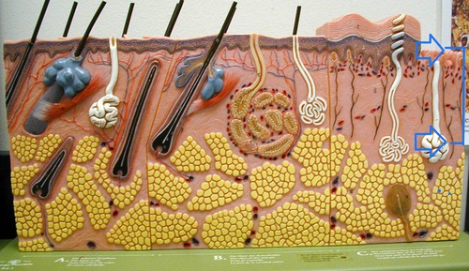
Dermis

Slide 18
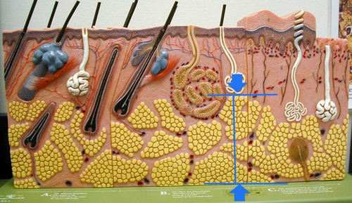
Hypodermis

Slide 19
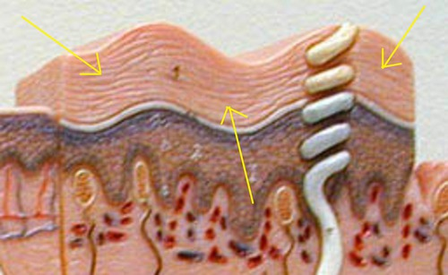
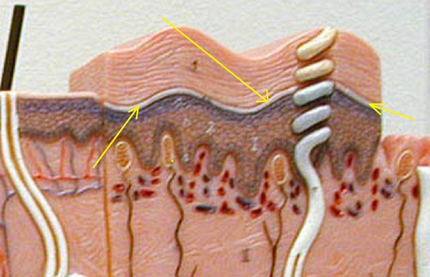
Stratum corneum
Stratum lucidum

Slide 20
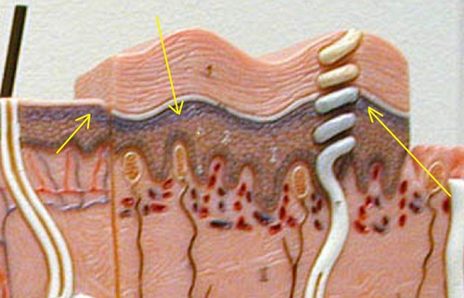
Stratum granulosum

Slide 21
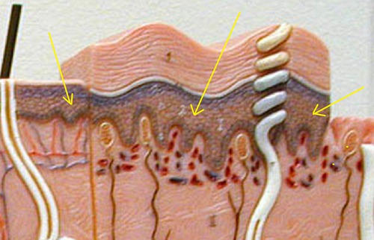
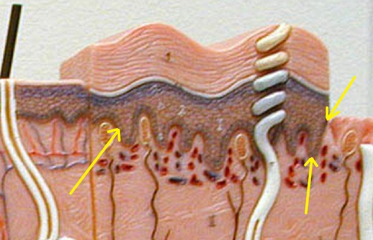
Stratum spinosum
Stratum basale

Slide 22
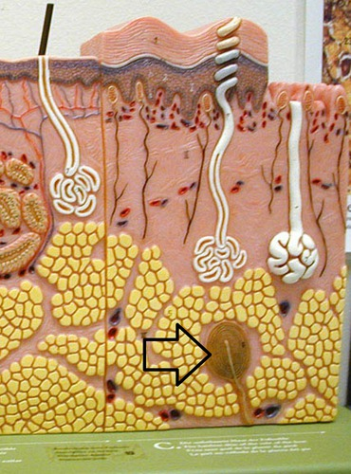
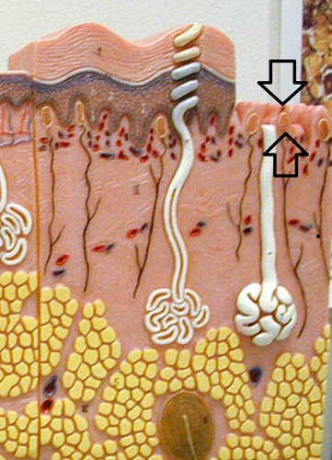
Meisnner’s corpuscle
Pacinian Corpuscle

Slide 23
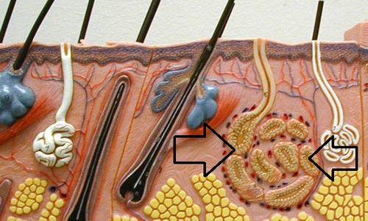
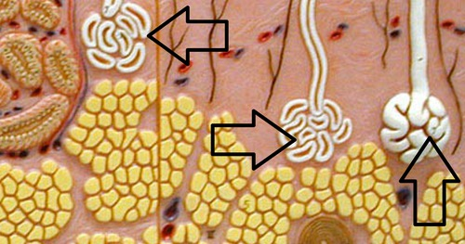
Apocrine sweat gland
Eccrine sweat gland

Slide 24
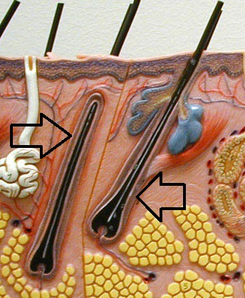
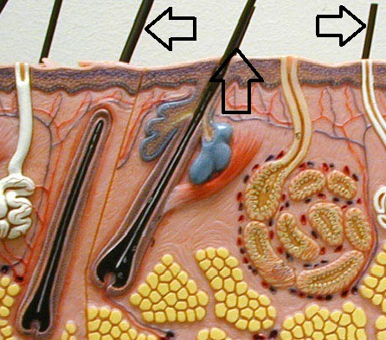
- actual exposed piece of hair above the skin
Hair shaft
Hair follicle

Slide 25
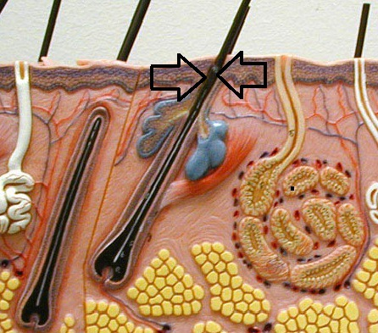
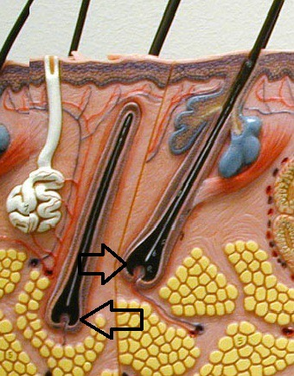
Hair root - (inside/under the skin)
Hair bulb

Slide 26
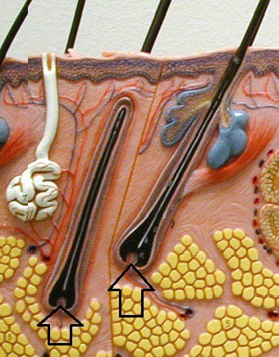
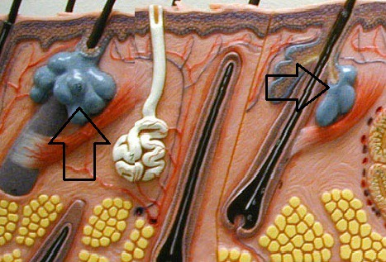
Sebaceous gland
Hair papilla

Slide 27
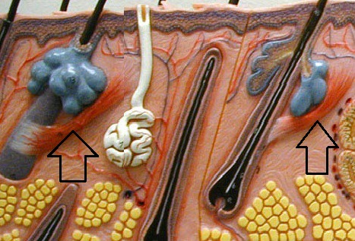
Arrector pili muscle

Slide 28
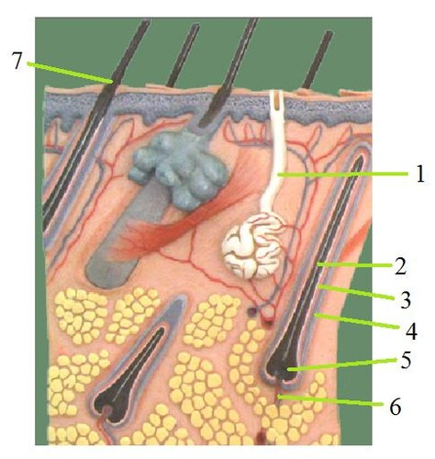
Skin from scalp
Eccrine suderiferous gland
Hair root
Inner epithelial layer
External epithelial layer
Hair bulb
Papillae of hair
Shaft of hair

Slide 29
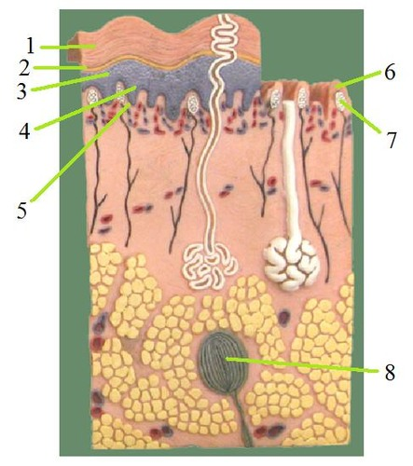
Skin from sole of the foot:
Stratum corneum
Stratum lucidum
Stratum granulosum
Stratum spinosum
Stratum basale
Dermal papillae
Meissner’s corpuscles
Pacinian corpuscle

Slide 30
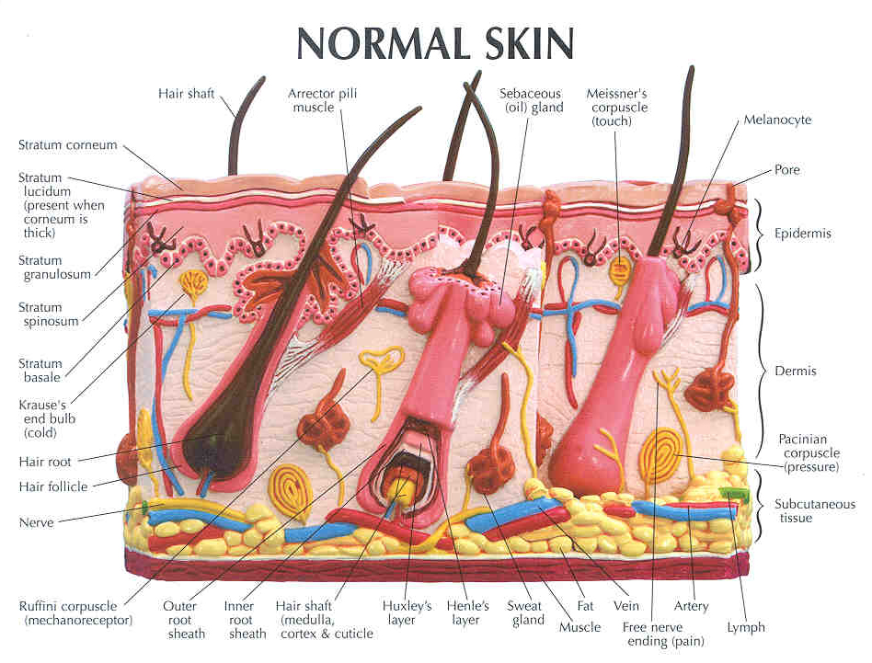

Slide 31
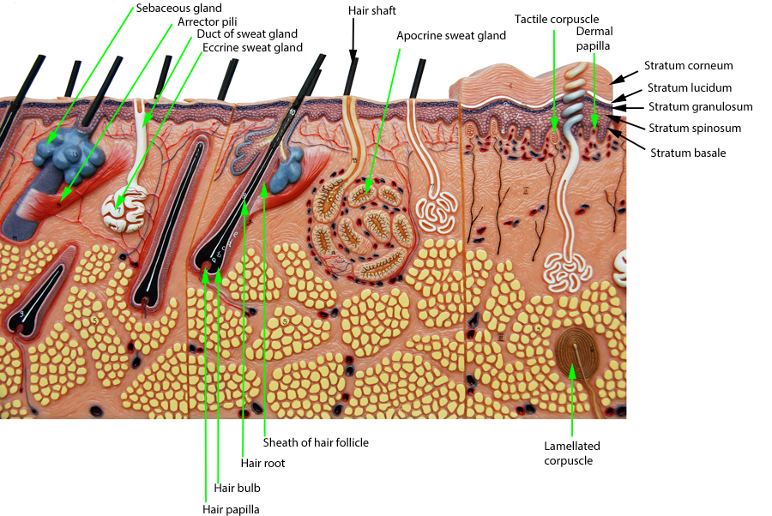

Slide 33
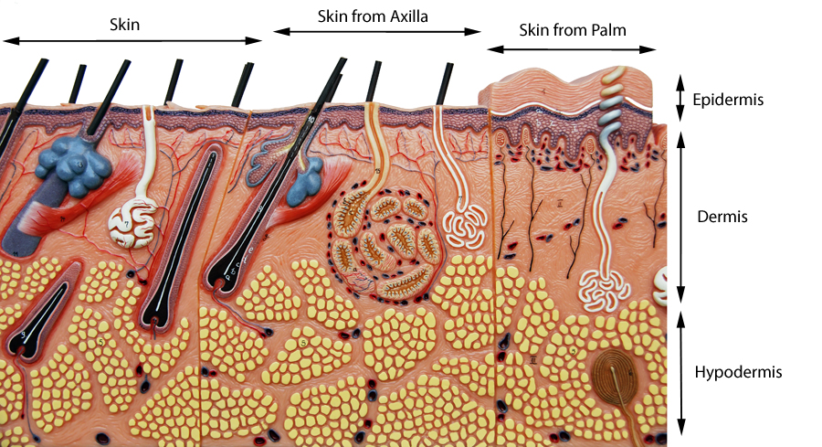

Slide 35
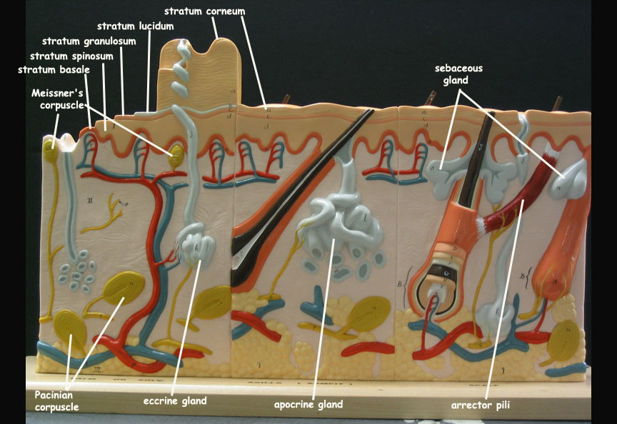

Slide 36
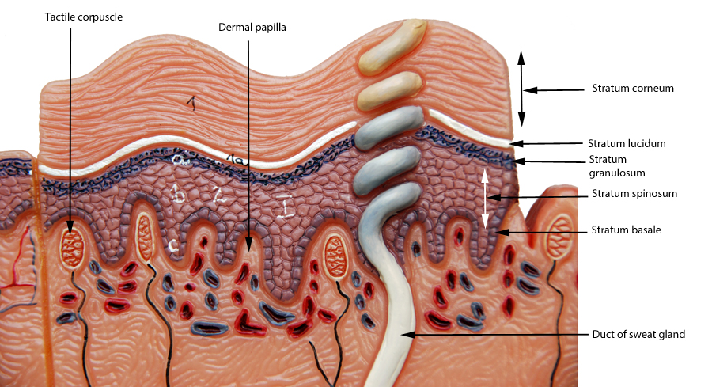

Slide 37
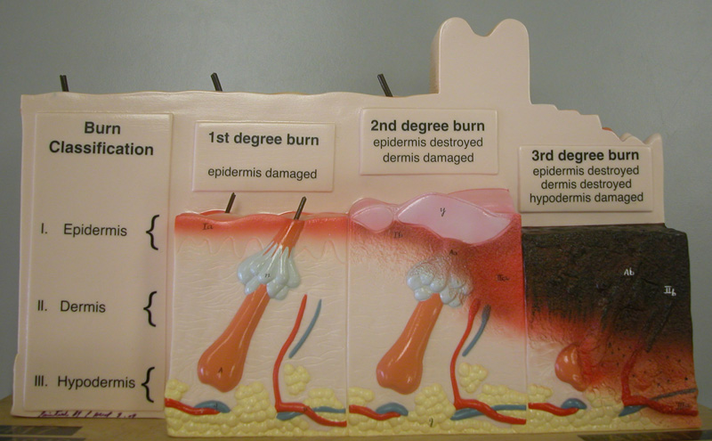

Slide 38
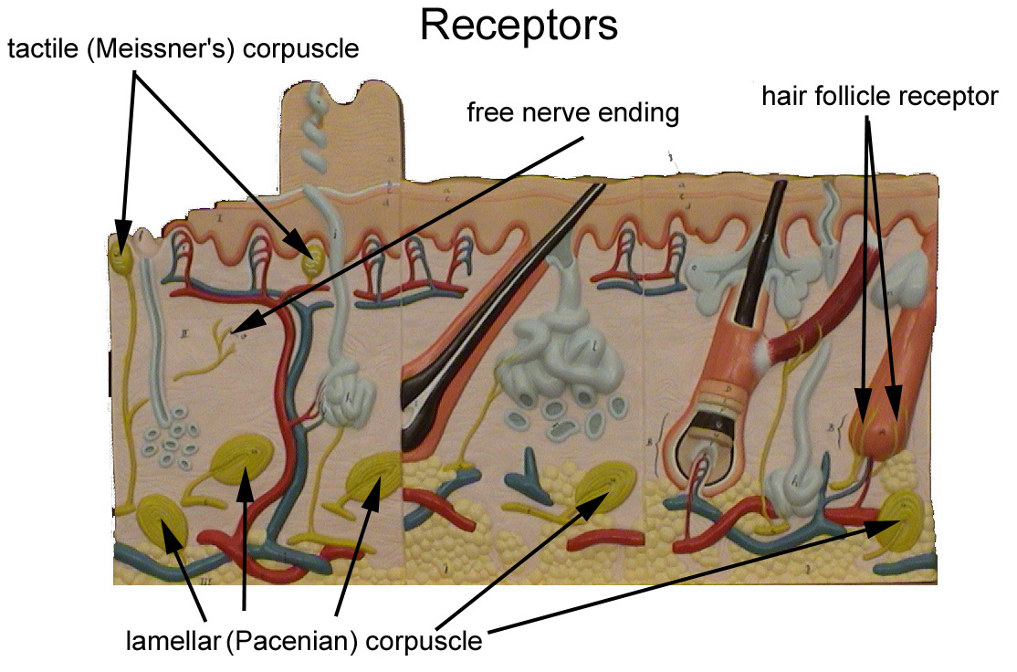

Slide 39
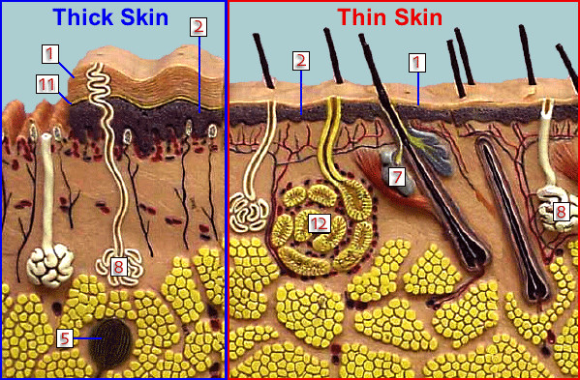

Slide 40
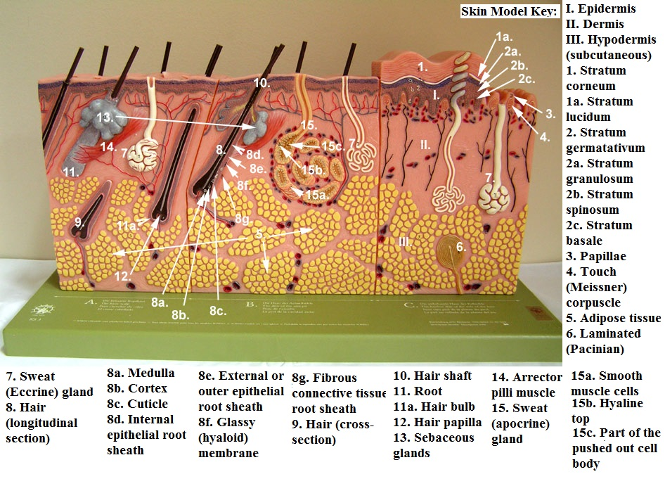

Slide 41
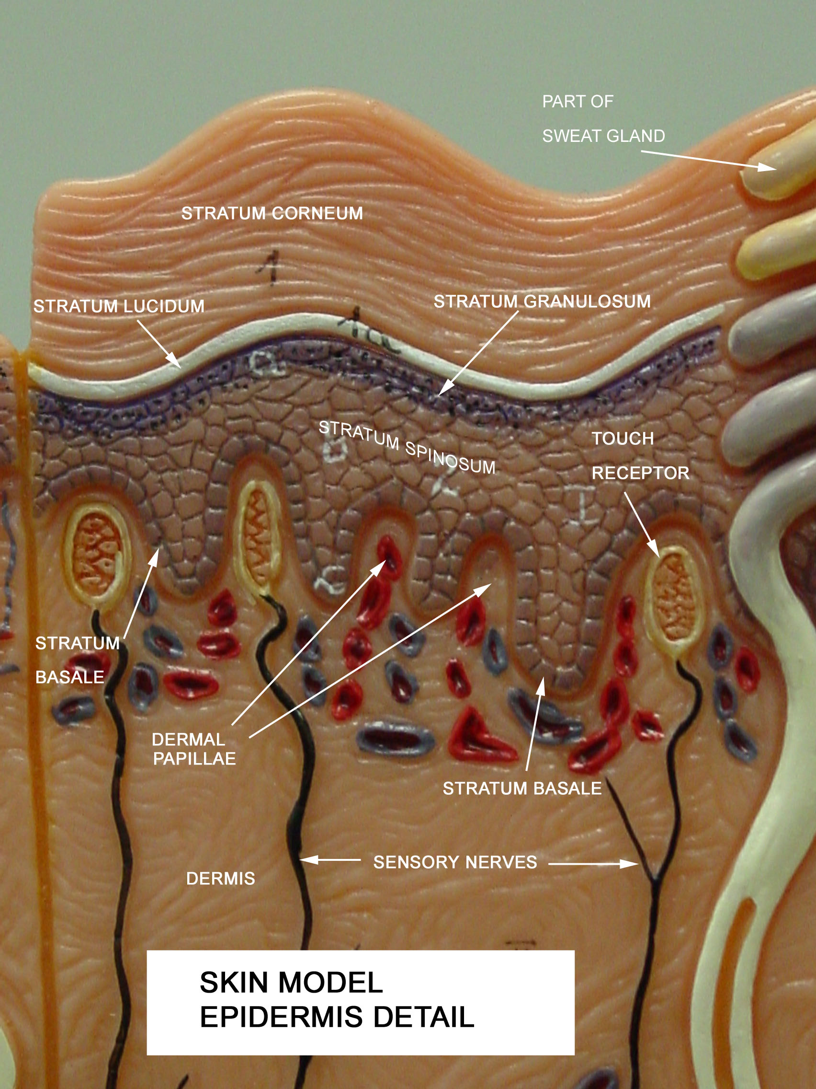

Slide 43
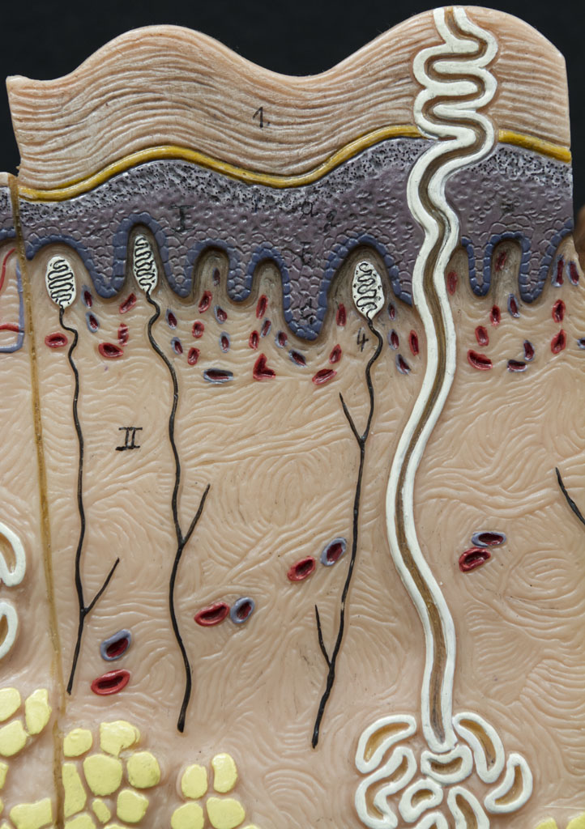
The Epidermis of theSkin (21A)
Study
Test
Central
canal
Stratum
corneum
Stratum
lucidum
Stratum
granulosum
Stratum
spinosum
Stratum
germinativum
Found only in the “thick” skin of the palms and soles.

Slide 44
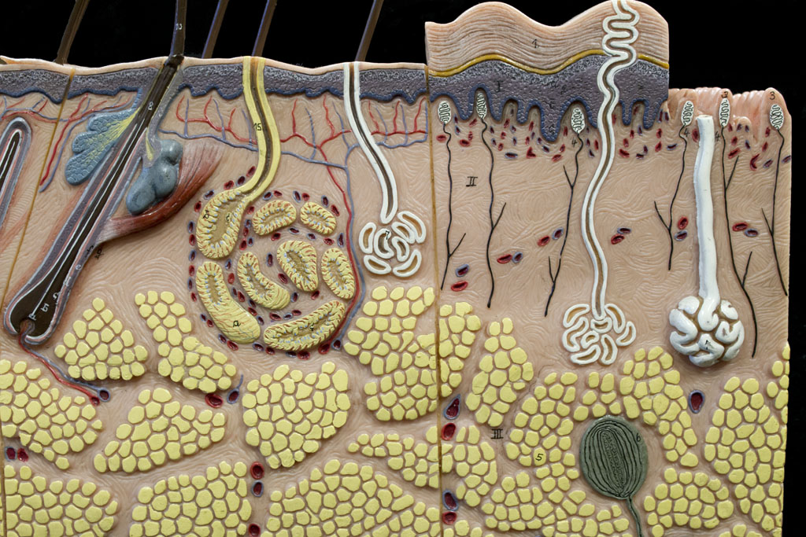
The Dermis of the Skin (21A)
Study
Test
Arrector
pili muscle
Tactile
corpuscles
Papillary
layer
Sebaceous
gland
Reticular
layer
Hair
follicle
Eccrine
sweat gland
Apocrine
sweat
gland
Lamellated
corpuscle
Hypodermis

Slide 45
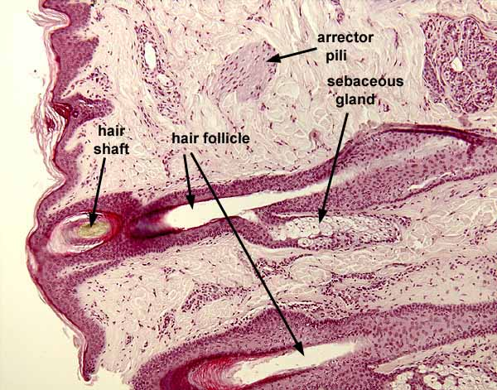

Slide 56
EPIDERMAL BASEMENT MEMBRANE

