Slide 1
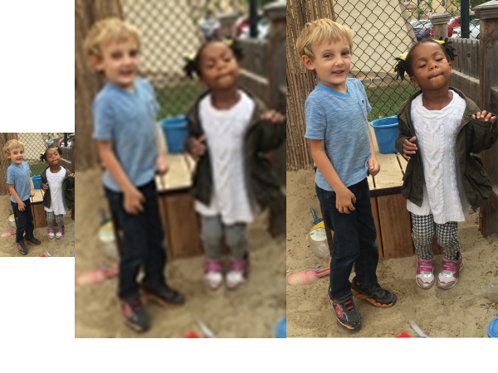
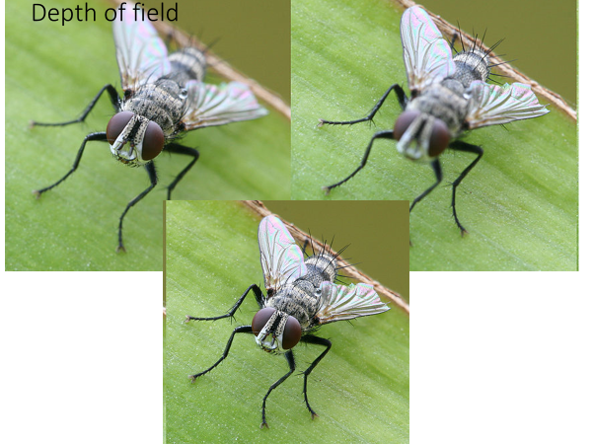
Exercise : MICROSCOPE
Microscopes are expensive and delicate experiments, so proper care and handling procedures must be followed when working with them.
The microscope purpose is:
a) Magnification – making it bigger
b) Resolving power – making it clearer
c) Contrast – light and dark (shadow)

Slide 2
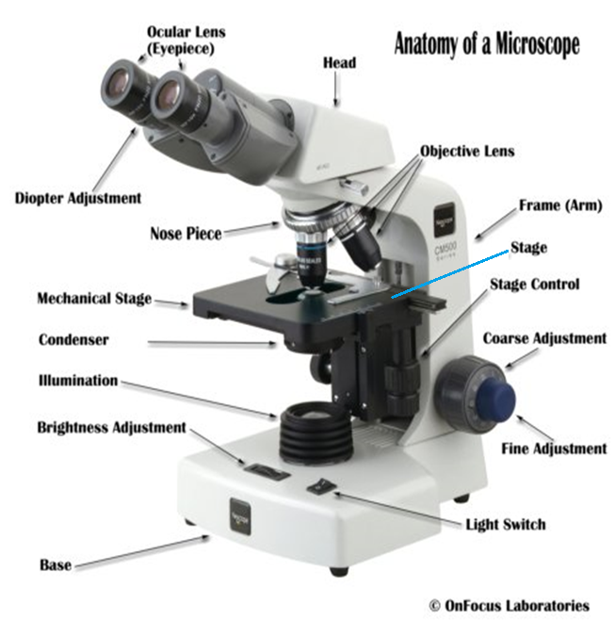
Parts of the Microscope
Ocular lens - The lens the viewer looks through to see the specimen. The eyepiece usually contains a 10X or 15X power lens.

Slide 3
Parts of the Microscope
Arm – Serves as a handle

Slide 4
Parts of the Microscope
Nose Piece – Revolves and holds the objectives. When changing objectives a;ways turn the nosepiece instead of using the objectives themselves. The objectives will click into place when properly aligned.

Slide 5
Parts of the Microscope
Objective Lens – Lower lenses attached to the nosepiece. The magnification of each objective is stamped on the housing of the objective. The magnification may vary with different brands. Never touch the objective lenses.

Slide 6
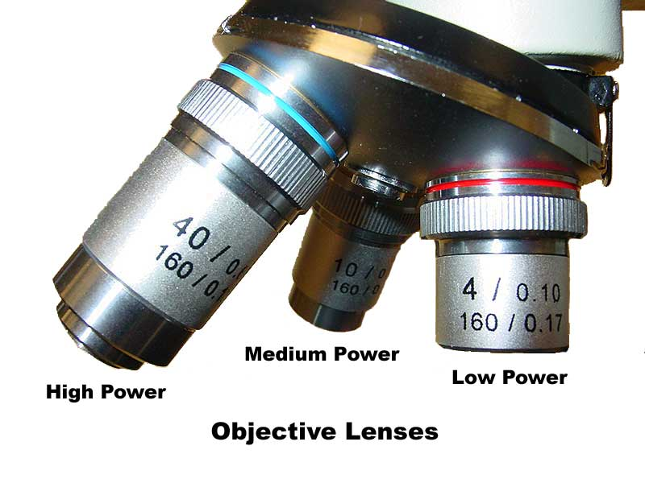
Parts of the Microscope
Scanning (low power) Objective – Used for viewing larger specimens or searching for a specimen, the shortest objective usually magnifies an object 4x or 5x.

Slide 7
Parts of the Microscope
Median-power Objective – Used for coarse and prelimanry focusing, magnifies an objective 10x

Slide 8
Parts of the Microscope
High-power Objective – Used for final and fine focusing, magnifies an objective approximately 40x or 45x.

Slide 9
Parts of the Microscope
Stage – Platform on which slides are placed. Some microscopes have a mechanical stage to accurately control the movement of the slides. Stage slips secure the slide.

Slide 10
Parts of the Microscope
Illumination (Light source) - Serves as a form of illumination for the microscope

Slide 11
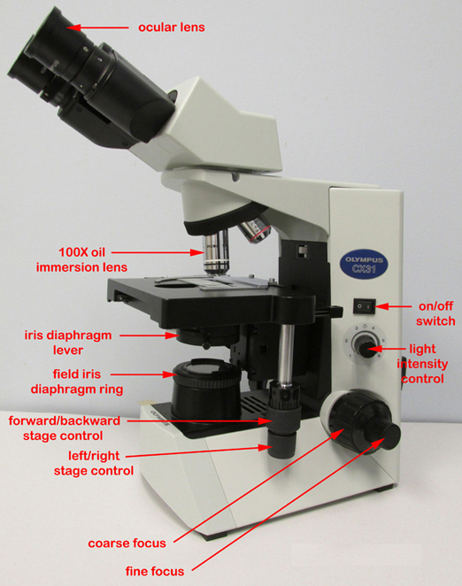
Parts of the Microscope
Iris diaphragm – Regulates light entering the microscope, usually is controlled by a mechanical lever on a rotating disk.

Slide 12
Parts of the Microscope
Condenser – A lens system found beneath the stage, used to focus the light on the specimen.

Slide 13
Parts of the Microscope
Coarse Adjustment – Used to adjust the nicroscope on scanning and low power only.

Slide 14
Parts of the Microscope
Fine Adjustment – Used to adjust the specimen into final focus.

Slide 15
Parts of the Microscope
Base – the supportive portion of the microscope which rests on the laboratory table.

Slide 16
Exercise: MICROSCOPE
Procedures:
Part A: Getting familiar with the microscope
Notice the eyepiece, what is the magnifying power of the eye piece? ____________
Notice the low-power objective lens: It reads “4X lens.” It is used to view the whole slide. If total magnifying power of this lens is determined by multiplying the magnifying power of the eyepiece by the magnifying power of the objective, what is the total magnifying power of this objective? ______________
Notice the high-power objective lens: It reads “Holds 40X lens.” Used to view object in even greater detail. What is the total magnifying power of this lens? _________________

Slide 17
Exercise: MICROSCOPE
Procedures:
Part A: Getting familiar with the microscope
Notice the eyepiece, what is the magnifying power of the eye piece? ___10x______
Notice the low-power objective lens: It reads “4X lens.” It is used to view the whole slide. If total magnifying power of this lens is determined by multiplying the magnifying power of the eyepiece by the magnifying power of the objective, what is the total magnifying power of this objective? __40x_________
Notice the high-power objective lens: It reads “Holds 40X lens.” Used to view object in even greater detail. What is the total magnifying power of this lens? _____400x________

Slide 18
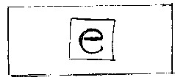
Exercise: MICROSCOPE
Procedures:
Part B: Focusing the letter “e”
Lower the stage using the coarse adjustment knob.
Place the slide of the letter “e” on the stage and stabilize it with the stage clips. Center the “e” the best you can on the stage.
Place the lowest (ie. 4X Objective Lens) into position.
Looking into the eyepiece. SLOWLY use the coarse adjustment to raise the stage closer to the objective lens until the object (ie. “e”) comes into focus.
Once the object is seen, it may be necessary to adjust the amount of light. To increase or decrease contrast, rotate the iris diaphragm slightly.
Use the fine adjustment knob to sharpen focus if necessary.

Slide 19
Exercise: MICROSCOPE
Procedures:
In the space provided, draw an outline of the letter “e” as it appears through the eyepiece.
Magnification: ______40X_______
Specimen: _________________

Slide 20
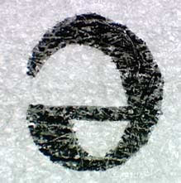
Exercise: MICROSCOPE
Procedures:
In the space provided, draw an outline of the letter “e” as it appears through the eyepiece.
Magnification: ______40X_______
Specimen: _________________

Slide 21
Exercise: MICROSCOPE
Procedures:
Change Magnification. Place the 10X (medium power) objective lens into position. Follow procedures 6 – 8. Draw the outline of the letter “e” as it appears through the eyepiece.
Magnification: ______100X______
Specimen: _________________

Slide 22
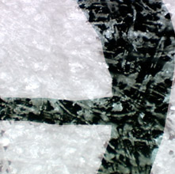
Exercise: MICROSCOPE
Procedures:
Change Magnification. Place the 10X (medium power) objective lens into position. Follow procedures 6 – 8. Draw the outline of the letter “e” as it appears through the eyepiece.
Magnification: ______100X______
Specimen: _________________

Slide 23
Exercise: MICROSCOPE
Procedures:
Change Magnification. Place the 40X (medium power) objective lens into position. Follow procedures 6 – 8. Draw the outline of the letter “e” as it appears through the eyepiece.
Magnification: ______400X______
Specimen: _________________

Slide 24
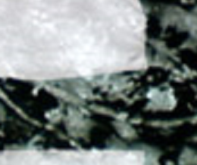
Exercise: MICROSCOPE
Procedures:
Change Magnification. Place the 40X (medium power) objective lens into position. Follow procedures 6 – 8. Draw the outline of the letter “e” as it appears through the eyepiece.
Magnification: ______400X______
Specimen: _________________

Slide 25
Exercise: MICROSCOPE
Analysis Question:
1. What happens to the microscope image when you move the microscope slide towards you?
2. What happens to the image when you move the microscope slide away from you?
3. How do you move your eyepiece image to the right?

Slide 26
Exercise: MICROSCOPE
Analysis Question:
1. What happens to the microscope image when you move the microscope slide towards you?
Microscope image moves away from me.
2. What happens to the image when you move the microscope slide away from you?
Microscope image moves towards me.
3. How do you move your eyepiece image to the right?
Move the stage to the left.

Slide 27
Exercise: MICROSCOPE
Procedures: Distance and Diameter
Working distance is the distance between the objective lens and the specimen. As the working distance decreases, magnification increases. More light is needed when the working distance decreases. Thus, more light must be made available when using the high power and oil immersion objectives.
The circular field you see when you look through the ocular is known as the field of view. The field of view changes at different magnifications. The size of a specimen can be estimated if one knows the diameter of the field of view at each magnification. To do this, one must first determine the diameter of the field of view for both low and high power.

Slide 28
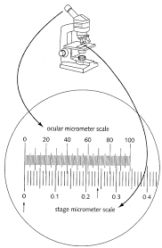
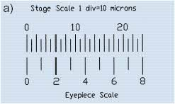
Exercise: MICROSCOPE
Procedures: Distance and Diameter
To determine the field of view:
1) Place a translucent plastic millimeter ruler on the microscope stage as if it were a slide. If no plastic ruler is available, mount a paper millimeter ruler. If your microscope has an ocular or stage micrometer, use it instead of the ruler.

Slide 29
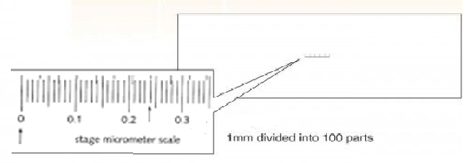
Exercise: MICROSCOPE
Procedures: Distance and Diameter
To determine the field of view:
1) Place a translucent plastic millimeter ruler on the microscope stage as if it were a slide. If no plastic ruler is available, mount a paper millimeter ruler. If your microscope has an ocular or stage micrometer, use it instead of the ruler.

Slide 30
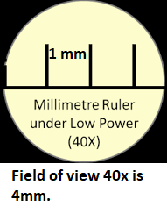
Exercise: MICROSCOPE
Procedures: Distance and Diameter
To determine the field of view:
Using the low-power objective, record the number of millimeters (to tenths) you see along the field with a transparent ruler in the slide
Your value____________________

Slide 31
Exercise: MICROSCOPE
Procedures: Distance and Diameter
To determine the field of view:
Convert the figure you attained to micrometers (1 millimeter = 1,000 micrometers). This is the diameter of the field of view for the low power objective (LPD).
Your value (LPD)__________________

Slide 32
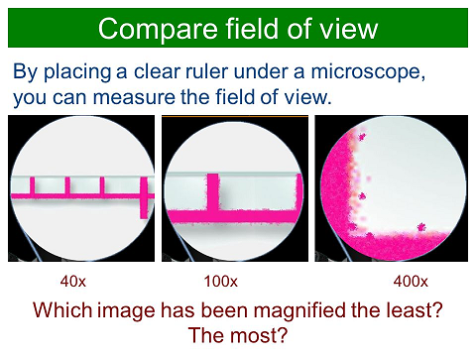
Exercise: MICROSCOPE
Procedures: Distance and Diameter

Slide 33
Exercise: MICROSCOPE
Procedures: Distance and Diameter
To determine the field of view:
A more precise method for measuring the size of the microscope object is to use a standardized ocular micrometer or stage micrometer. These devices are found on more advanced microscopes.

Slide 34
Exercise: MICROSCOPE
Procedures: Focus and Depth

Slide 35
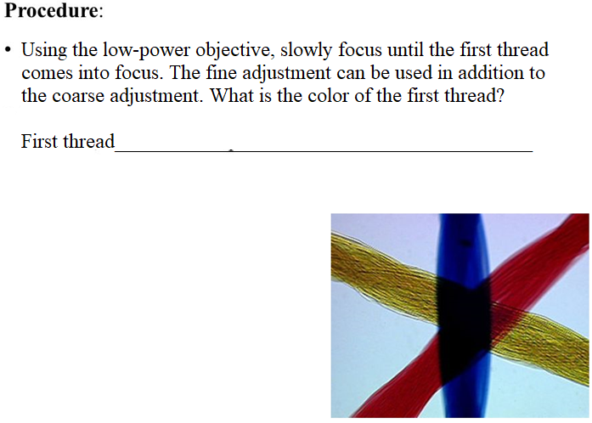
Exercise: MICROSCOPE
Procedures: Focus and Depth
Blue

Slide 36

Exercise: MICROSCOPE
Procedures: Focus and Depth
Yellow

Slide 37
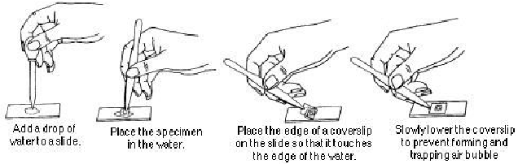
Exercise: MICROSCOPE
Procedures: Preparing Slides (Wet mounts)
To prepare a wet mount:
Clean and dry a slide and coverslip thoroughly.
Holding the coverslip at a 45-degree angle, place its edge in the margin of the drop of liquid on the slide, and release the coverslip slowly.

Slide 38
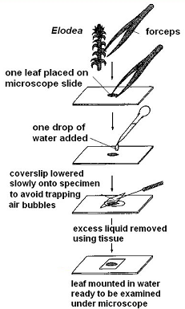
Exercise: MICROSCOPE
Procedures: Preparing Slides (Wet mounts)
To prepare a wet mount:
Clean and dry a slide and coverslip thoroughly.
Holding the coverslip at a 45-degree angle, place its edge in the margin of the drop of liquid on the slide, and release the coverslip slowly.
Place the specimen (Elodea leaf) to be studied in the center of the slide. Lower a coverslip. Always place a coverslip over the wet mounts.

Slide 39
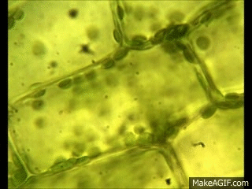
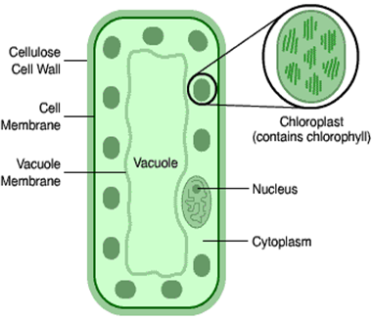
Exercise: MICROSCOPE
Procedures: Preparing Slides (Wet mounts)

Slide 40
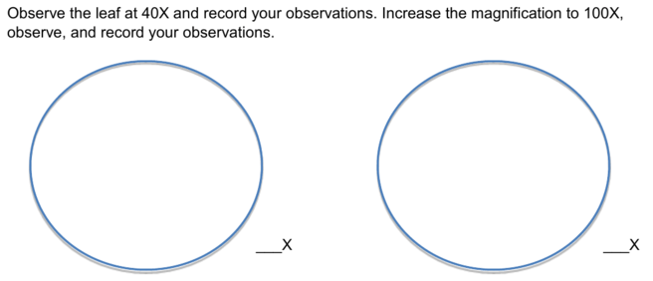
Exercise: MICROSCOPE
Procedures: Preparing Slides (Wet mounts)
To prepare a wet mount:
4) Sketch your observation in the spaces provided below.

Slide 41
Exercise: MICROSCOPE
Procedures: Preparing Slides (Wet mounts)
To prepare a wet mount:
4) Sketch your observation in the spaces provided below.

Slide 42

Microscope Concepts

Slide 43
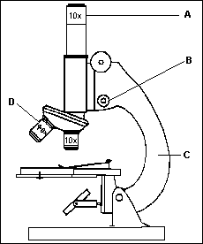
What was the highest possible magnification that can be obtained when using this microscope?
Objective x Ocular
40 x 10 =
400x
E
F

Slide 44
What happens to the amount of light in the field of view when switching from low to high power?
The amount of light decreases (so the field of view gets darker)
E
F

Slide 45
What happens to the field of view when switching from low to high power?
The field of view decreases ( so you see less of the slide).
E
F

Slide 46
Which structure can only be used to focus the specimen under high power? Support your answer.
The fine adjustment
because using the coarse adjustment under high power can break the objective lens or the slide.
E
F

Slide 47
What are two possible adjustments that need to be made when switching to high power?
Adjust the diaphragm to make the field of view brighter.
Focus with the fine adjustment.

Slide 48
What happens to the number of cells that are visible in the field of view when switching to high power?
The number of cells that are visible in the field of view decreases.

Slide 49
What must be done to the microscope before switching from low power to high power?
Center the specimen
Focus with the coarse adjustment

Slide 50
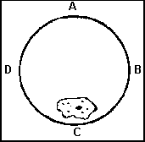
The diagram represents a cell in the field of view of a compound light microscope. In which direction should the slide be moved on the microscope stage to center the cell in the field of view?
Towards C

Slide 51


The image to the left is placed on the slide. A student then views the letter “f” under low power. Which diagram below most closely resembles the image under low power?

Slide 52
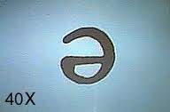

What Happens to Image?
Compound Microscopes:
  Image becomes inverted and upside down

Slide 53
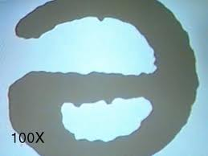
What Happens to Image?
When you increase magnification
  Object appears larger
  Field of view gets smaller

Slide 54
A student sees the image to the left when observing the letter "f" with the low-power objective lens of a microscope. Which diagram below most closely resembles the image the student will see after switching to high power?

Slide 55
The total magnification of an image is the result of the combined magnifications of the
eyepiece and diaphragm
objective and eyepiece
objective and mirror
low-power and high-power objectives

Slide 56
A student views some cheek cells under low power. Before switching to high power, the student should
(1) adjust the eyepiece
(2) center the image being viewed
(3) remove the slide from the stage
(4) remove the coverslip

Slide 57
A student changes the objective of a microscope from 10x to 50x. If this is the only change made, what will happen to the field of view?
(1) Its diameter will decrease.
(2) Its diameter will increase.
(3) Its brightness will increase.
(4) Its brightness will remain the
same.

Slide 58
To locate a specimen on a prepared slide with a compound microscope, a student should begin with the low-power objective rather than the high-power objective because the
(1) field of vision is smaller under low power than under high power
(2) field of vision is larger under low power than under high power
(3) specimen does not need to be stained for observation under low power but must be stained for observation under high power
(4) amount of the specimen that can be observed under low power is less than the amount that can be observed under high power

Slide 59
After switching from the high-power to the low-power objective lens of a compound light microscope, the area of the low-power field will appear
(1) larger and brighter
(2) smaller and brighter
(3) larger and darker
(4) smaller and darker

Slide 60
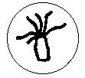

The diagram represents a hydra as viewed with a compound light microscope. If the hydra moves to the right of the slide preparation, which diagram below best represents what will be viewed through the microscope?

Slide 61
Which part of a microscope should be used with the low power objective, but not with the high-power objective?
a. fine adjustment
b. diaphragm
c. coarse adjustment
d. eyepiece

Slide 62
A prepared slide was placed on the stage of a microscope so that the slide faced the student, as shown in the diagram below.
pr
Which image will the student most likely see?
pr

Slide 63
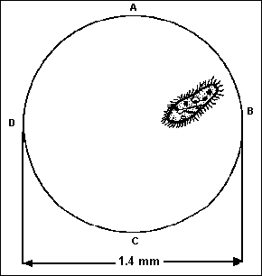
This organism could be centered in the field of view by moving the microscope slide towards
(1) A (2) B (3) C (4) D

Slide 64
250um
500um
125um
Cell is approximately 375um
1mm
1000um
The diameter is 1mm. What is the length of the cell in um?

Slide 65
1750um
3.5mm
3500um
The length of the cell is approximately 1750um.

Slide 66
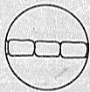
There are 3 cells across the field of view.
1500/3
= 500um
Field of view = 1.5mm
= 1500um

Slide 67
Determining the Size of an Object Under a Microscope

Slide 68
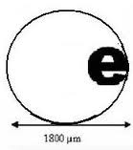
View and draw object on low power
Estimate how many objects would fit across diameter of field of view
Divide the diameter of FOV by the number of objects that can fit across it.
Ex:
  Three letter “e”s fit across FOV of 1800 micrometers
  Each letter is about 600 micrometers
1800 micrometers = 600 µm
3 letter “e”

Slide 69
Magnification
How much can you enlarge the image?
Ex: 100x = 100 times as big

Slide 70
Finding Total Magnification
Multiply strengths of two lenses you are using.
  Ocular lens x Objective lens
  Ex:
  Ocular = 10x
  High Power Objective= 45x
  Total Magnification = (10 x 45) = 450x

Slide 71
Practice
Find Total Magnification:
  Ocular 2x, Objective 30x =
  Ocular 10x, Objective 60x =
  If Ocular is 10x and Total mag. = 350x
  What is the strength of the objective lens?
60x
600x
35x

Slide 72
Note:
As you increase magnification you need to let in more light to see your specimen (adjust diaphragm)

Slide 73
Resolution
How sharp can you get the image?
Ability of microscope to distinguish two objects as being separate (ex: one cell from another)

Slide 74
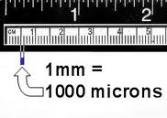
Important Unit for Microscopes
Micrometers (microns) = µm
1/1000th of a millimeter
1000 micrometers = 1 mm

Slide 75
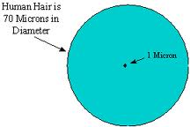
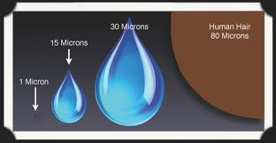
How Big is a Micron?

Slide 76
End

