Slide 1
Bones and Skeletal Tissues
PART 1

Slide 2
Structure of a Typical Long Bone
Diaphysis – “shaft” of a bone
Epiphysis – ends of a bone
Blood vessels – well vascularized
Medullary cavity – hollow cavity filled with yellow marrow
Membranes
Periosteum, perforating fibers (Sharpey’s fibers), and endosteum
Compact bone – dense outer layer of bone
Spongy (cancellous) bone – internal network of bone

Slide 3
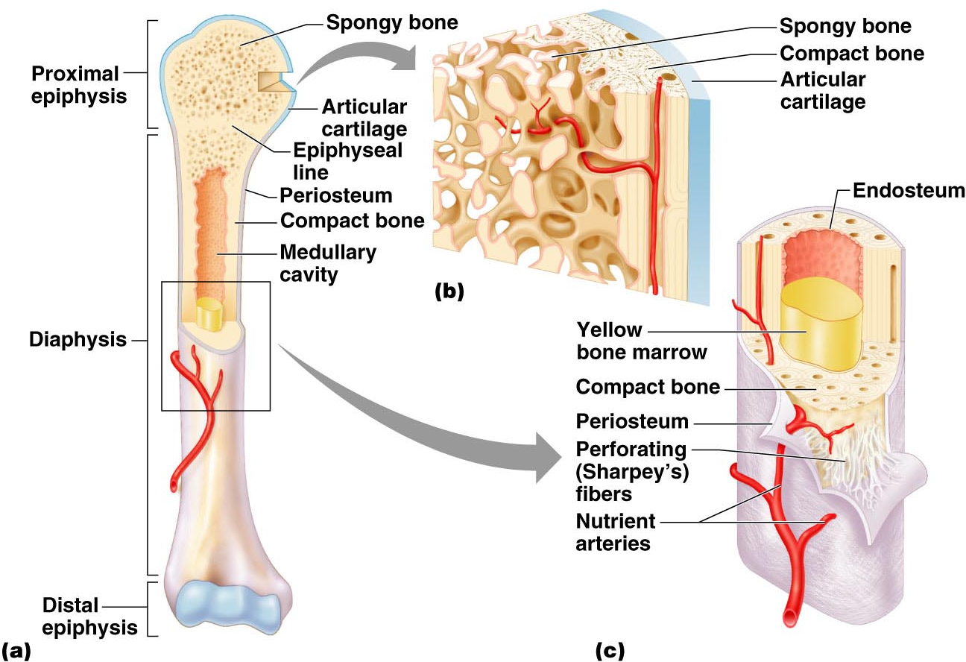
Structure of a Long Bone
Figure 6.3a–c

Slide 4
Bone Markings
Table 6.1

Slide 5
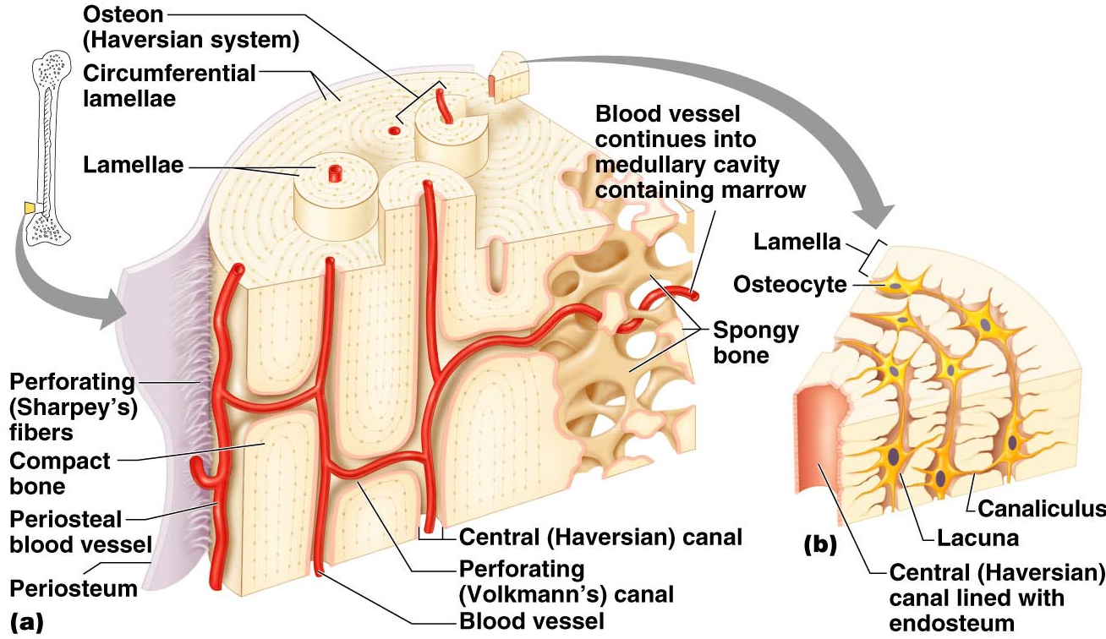
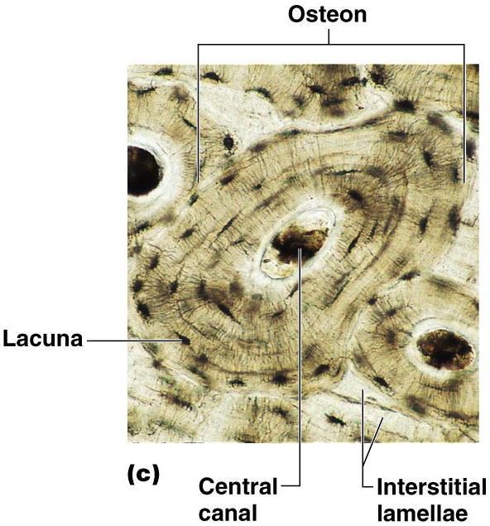
Microscopic Structure of Compact Bones
Figure 6.6

Slide 6
The Axial Skeleton (Skull)

Slide 7
The Skeleton
Consists of
Bones, cartilage, joints, and ligaments
Composed of 206 named bones grouped into two divisions
Axial skeleton (80 bones)
Appendicular skeleton (126 bones)

Slide 8
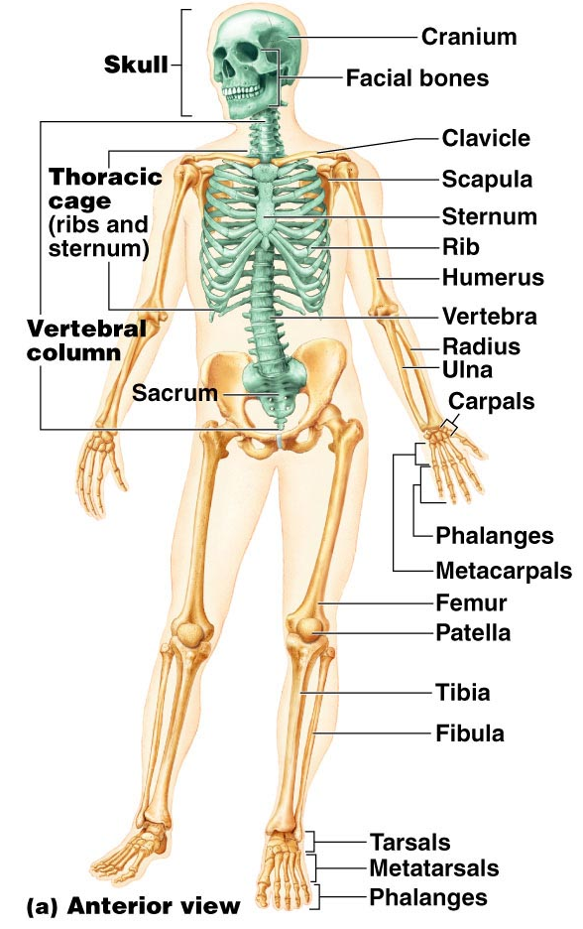
The Axial Skeleton
Formed from 80 named bones
Consists of skull, vertebral column, and bony thorax
Figure 7.1a

Slide 9
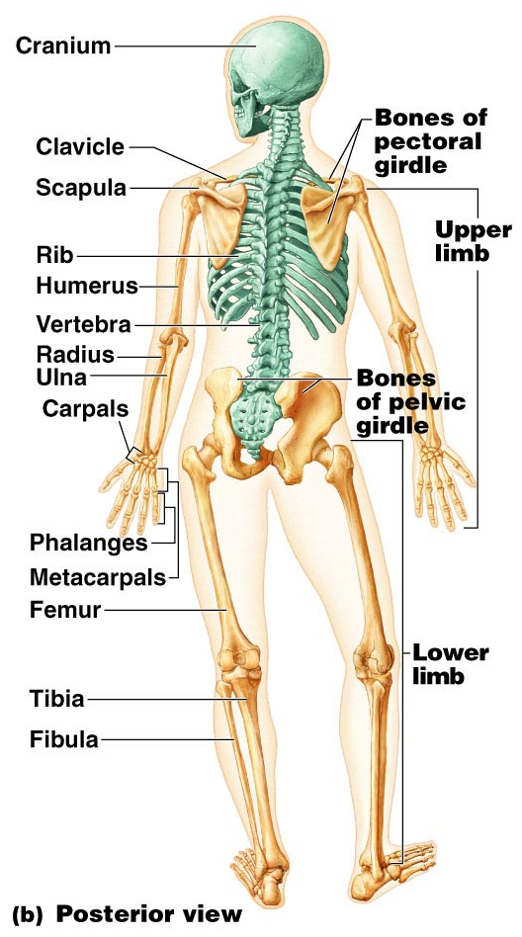
The Axial Skeleton
Figure 7.1b

Slide 10
Bone Markings
Projections that provide attachment for muscles and ligaments
Projections that help form joints
Depressions and openings for passage of nerves and blood vessels

Slide 11
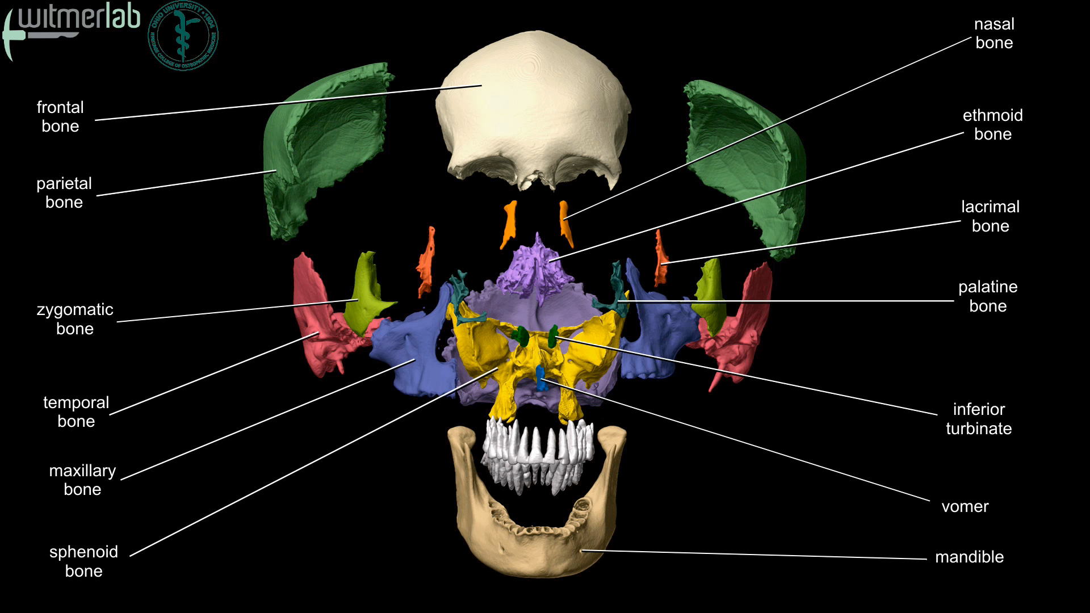

Slide 12
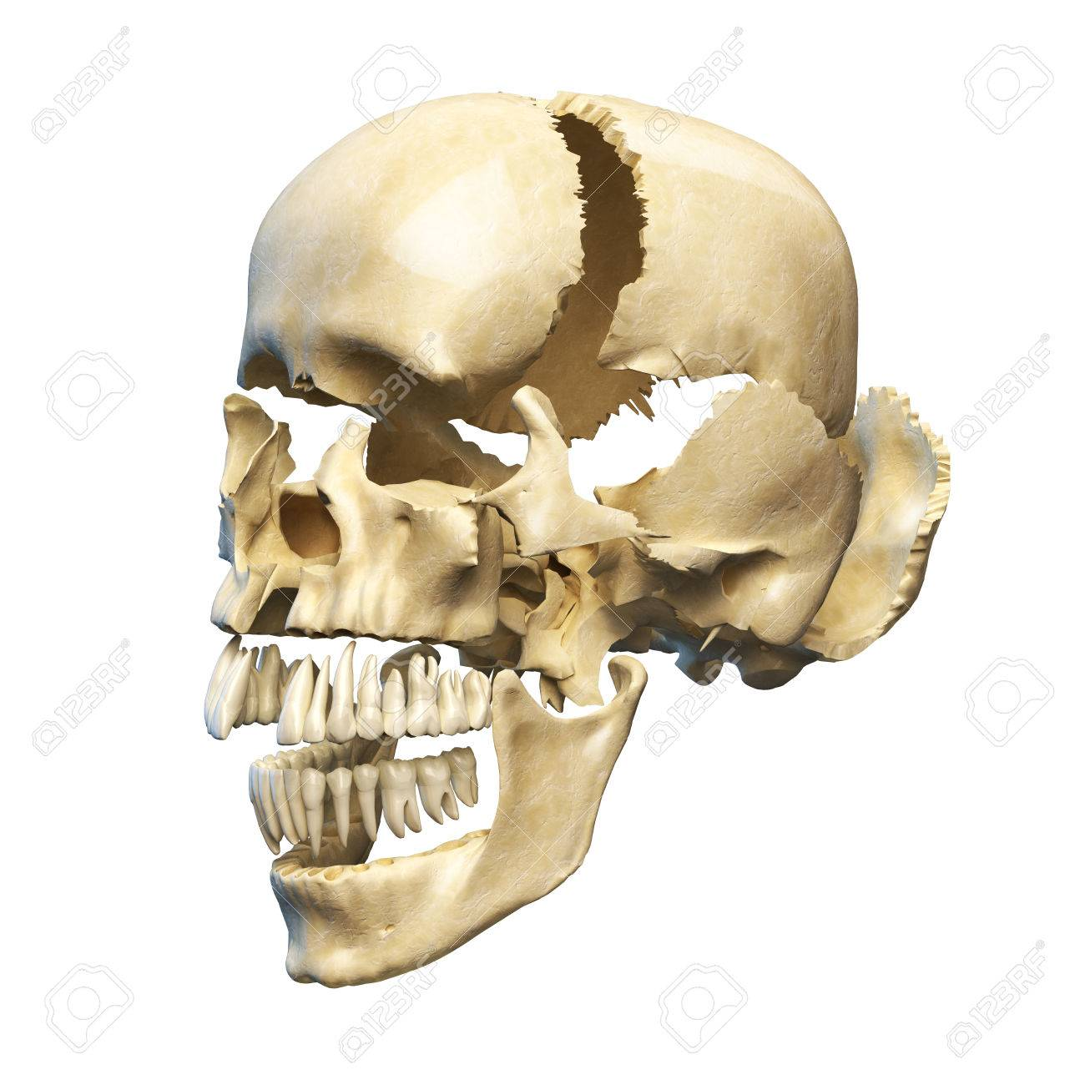

Slide 13
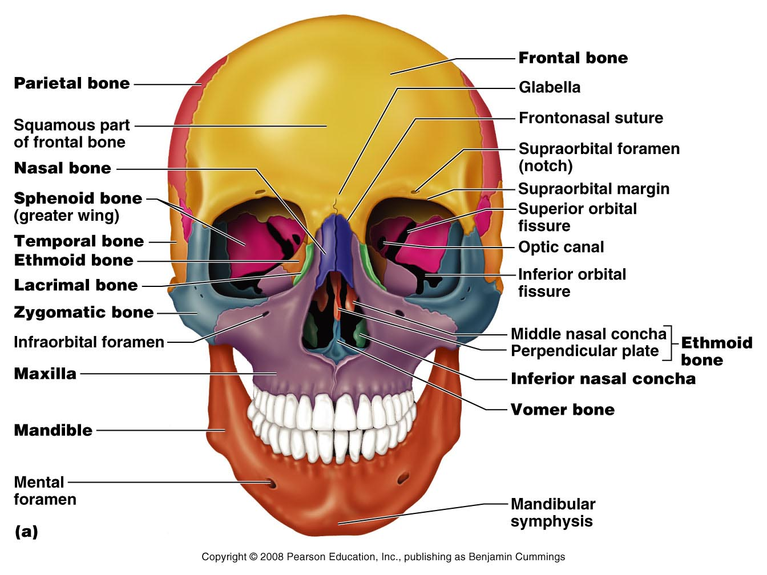
The Skull
Formed by cranial and facial bones
Figure 7.2a

Slide 14
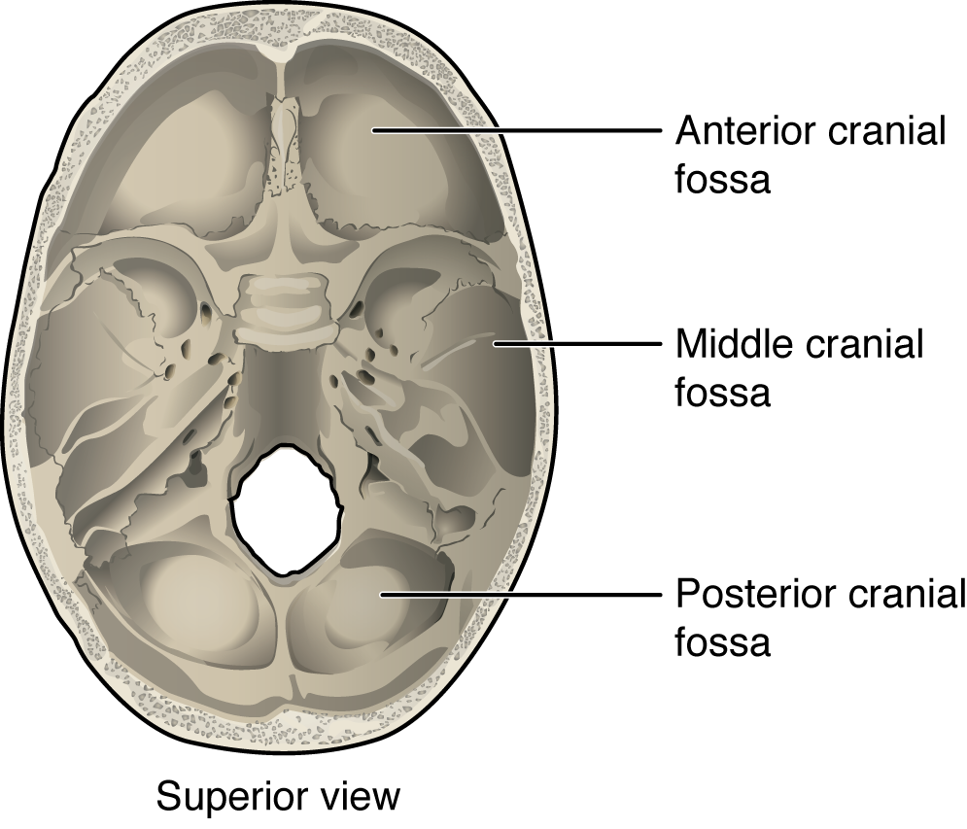

Slide 15
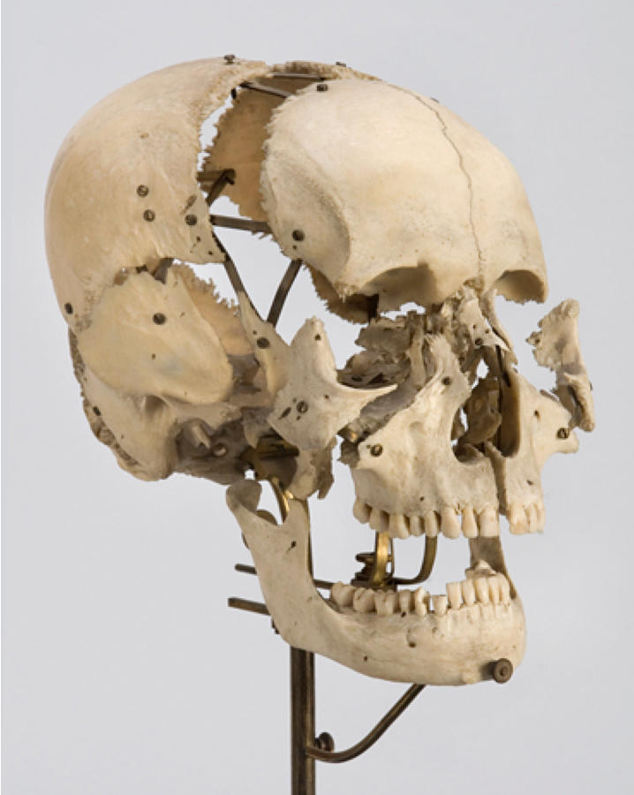

Slide 16
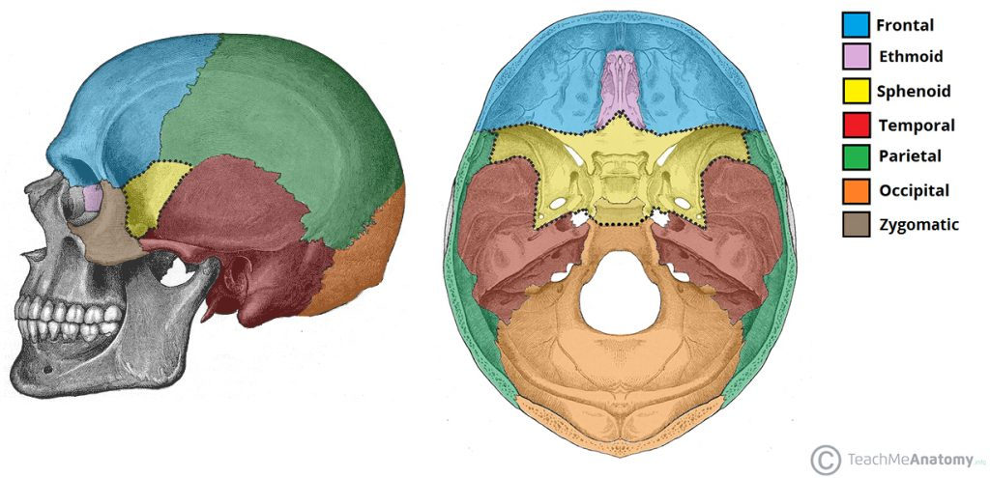
Cranium

Slide 17
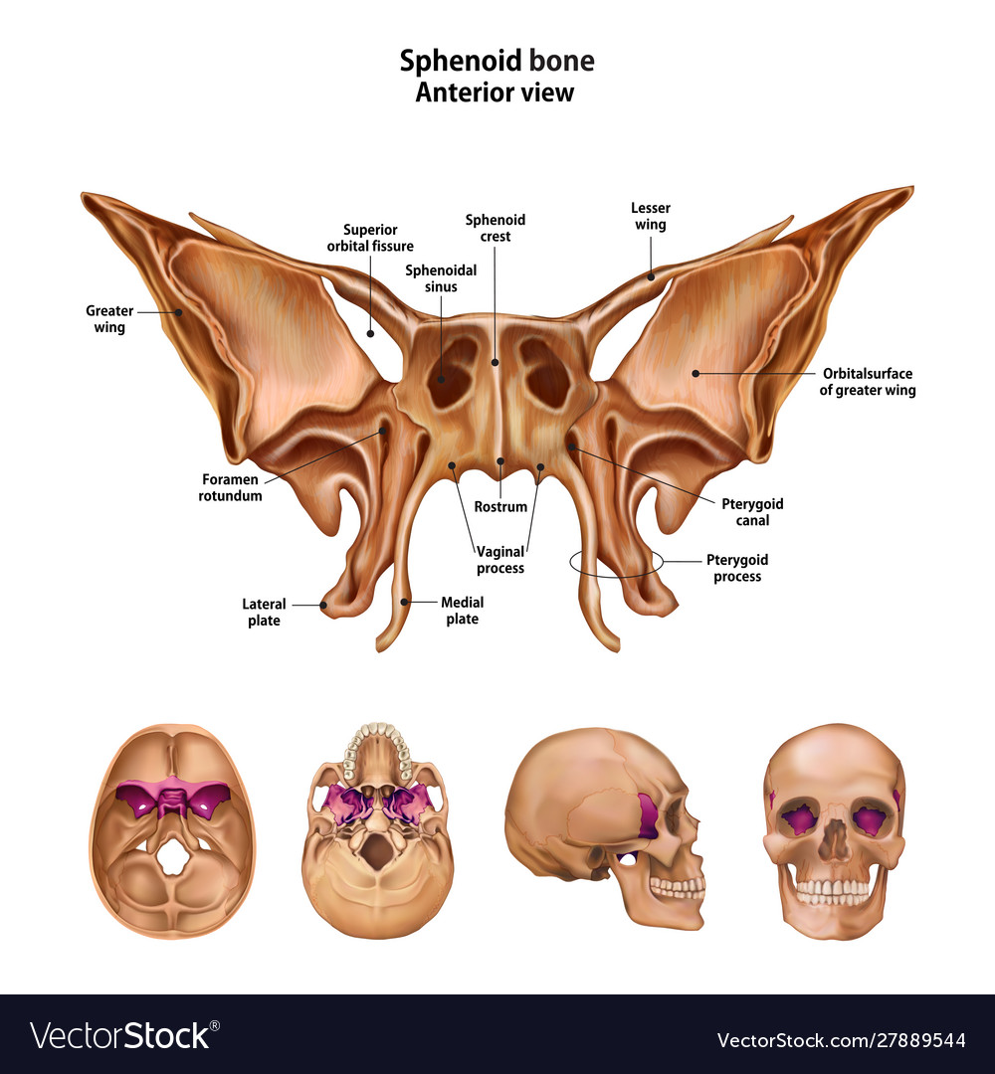
Sphenoid

Slide 18
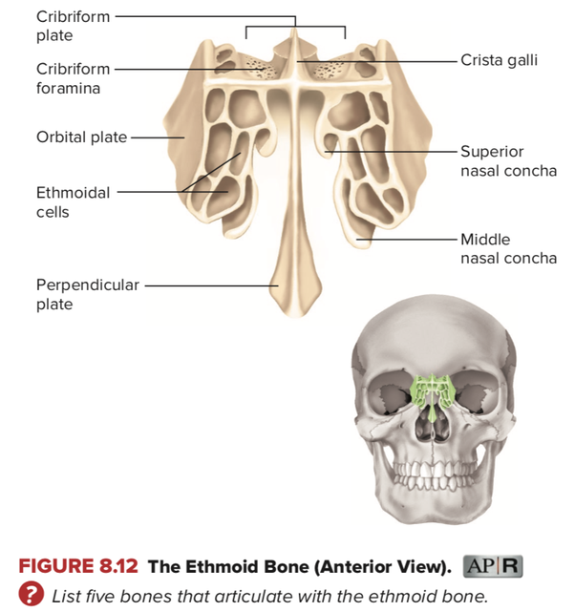

Slide 19
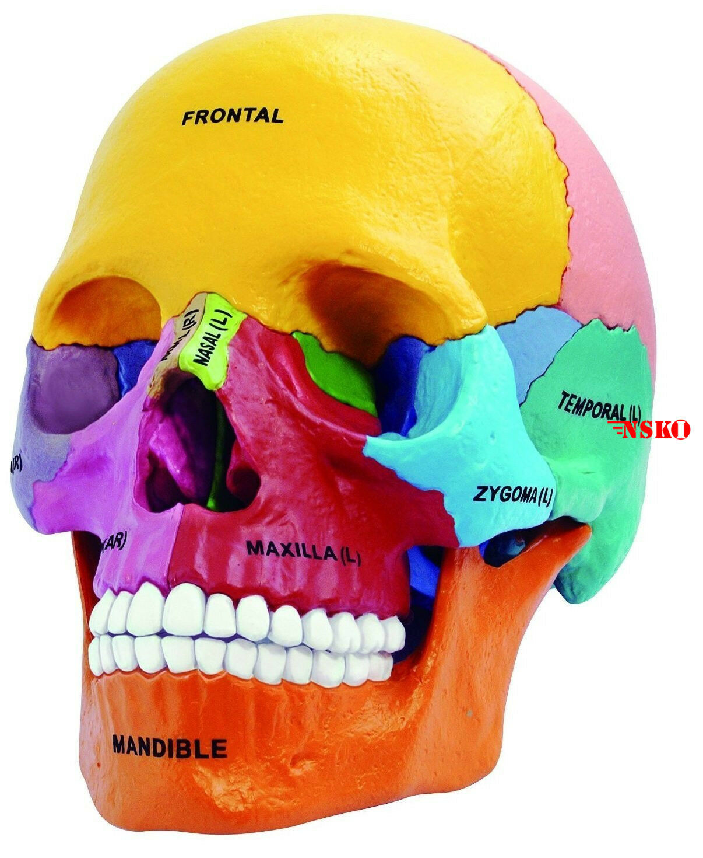

Slide 20
The Cranium
The cranium serves to
Enclose brain
Provide attachment sites for some head and neck muscles

Slide 21
The Face
Facial bones serve to
Form framework of the face
Form cavities for the sense organs of sight, taste, and smell
Provide openings for the passage of air and food
Hold the teeth in place
Anchor muscles of the face

Slide 22
Overview of Skull Geography
Facial bones form anterior aspect
Cranium is divided into cranial vault and the base
Internally, prominent bony ridges divide skull into distinct fossae

Slide 23
Overview of Skull Geography
The skull contains smaller cavities
Middle and inner ear cavities – in lateral aspect of cranial base
Nasal cavity – lies in and posterior to the nose
Orbits – house the eyeballs
Air-filled sinuses – occur in several bones around the nasal cavity

Slide 24
Overview of Skull Geography
The skull contains approximately 85 named openings
Foramina, canals, and fissures
Provide openings for important structures
Spinal cord
Blood vessels serving the brain
12 pairs of cranial nerves

Slide 25
Cranial Bones
Formed from eight large bones
Paired bones include
Temporal bones
Parietal bones
Unpaired bones include
Frontal bone
Occipital bone
Sphenoid bone
Ethmoid bone

Slide 26
Frontal Bones
Forms the forehead and roofs of the orbits
Forms superciliary arches
Internally, it contributes to the anterior cranial fossa
Contains frontal sinuses

Slide 27
Parietal Bones and Sutures
Parietal bones form superior and lateral parts of skull
Four sutures of the cranium
Coronal suture – runs in the coronal plane
Located where parietal bones meet the frontal bone
Squamous suture – occurs where each parietal bone meets a temporal bone inferiorly

Slide 28
Parietal Bones and Sutures
Sutures of the cranium (continued)
Sagittal suture – occurs where right and left parietal bones meet superiorly
Lambdoid suture – occurs where the parietal bones meet the occipital bone posteriorly

Slide 29
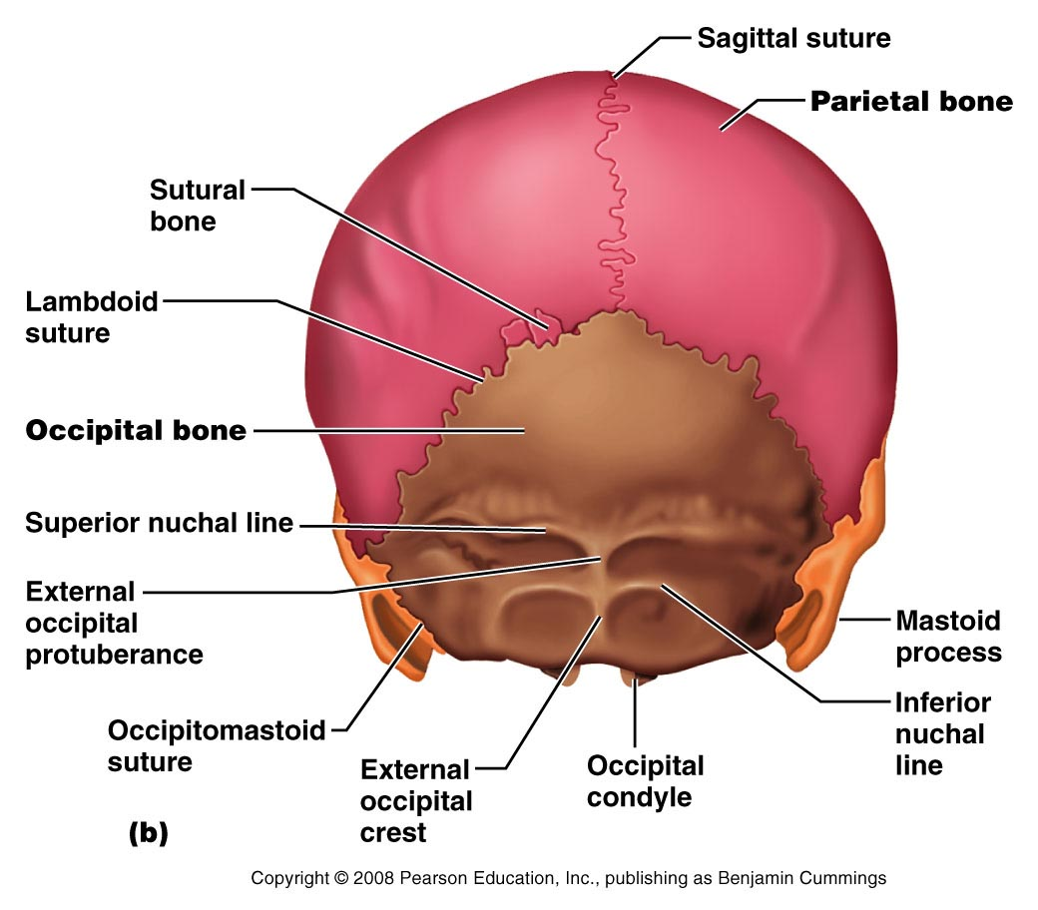
The Skull – Posterior View
Figure 7.2b

Slide 30
Occipital Bone
Forms the posterior portion of the cranium and cranial base
Articulates with the temporal bones and parietal bones
Forms the posterior cranial fossa
Foramen magnum located at its base

Slide 31
Occipital Bone
Features and structures
Occipital condyles
Hypoglossal foramen
External occipital protuberance
Superior nuchal lines
Inferior nuchal lines

Slide 32
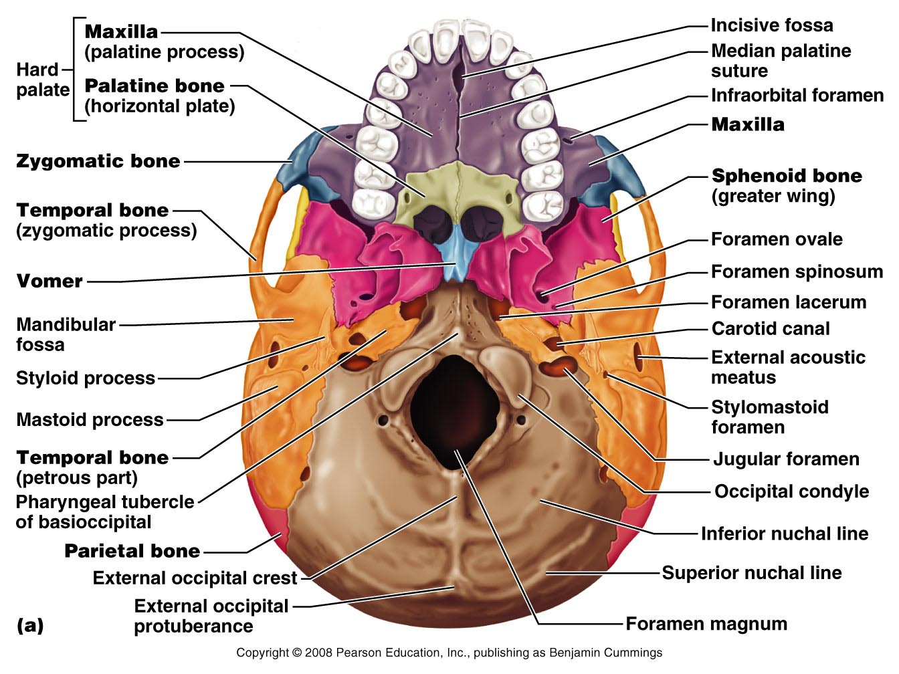
Inferior Aspect of the Skull
Figure 7.4a

Slide 33
Temporal Bones
Lie inferior to parietal bones
Form the inferolateral portion of the skull
Term “temporal”
Comes from Latin word for time
Specific regions of temporal bone
Squamous, temporal, petrous, and mastoid regions

Slide 34
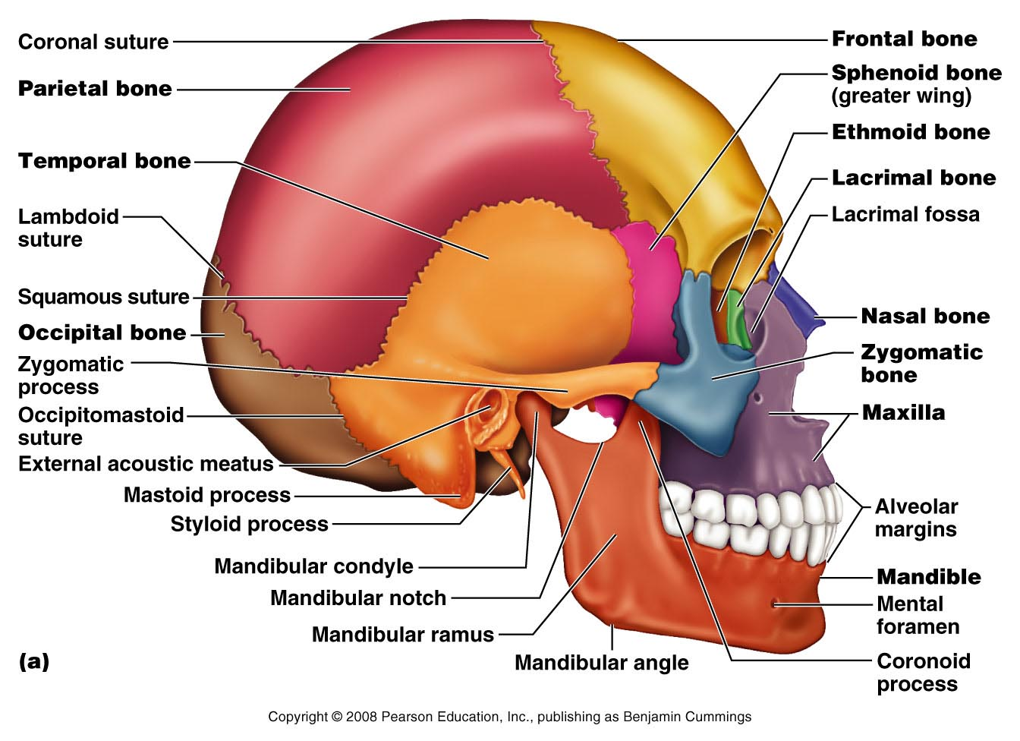
Lateral Aspect of the Skull
Figure 7.3a

Slide 35
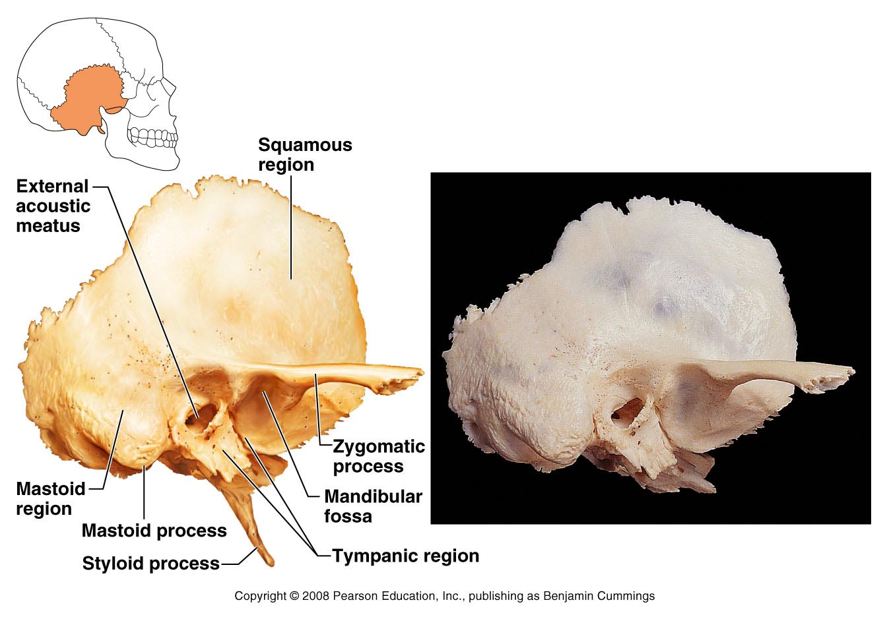
The Temporal Bone
Figure 7.5

Slide 36
The Sphenoid Bone
Spans the width of the cranial floor
Resembles a butterfly or bat
Consists of a body and three pairs of processes
Contains five important openings

Slide 37
The Sphenoid Bone
Figure 7.6a

Slide 38
The Sphenoid Bone
Figure 7.6b

Slide 39
The Ethmoid Bone
Lies between nasal and sphenoid bones
Forms most of the medial bony region between the nasal cavity and orbits

Slide 40
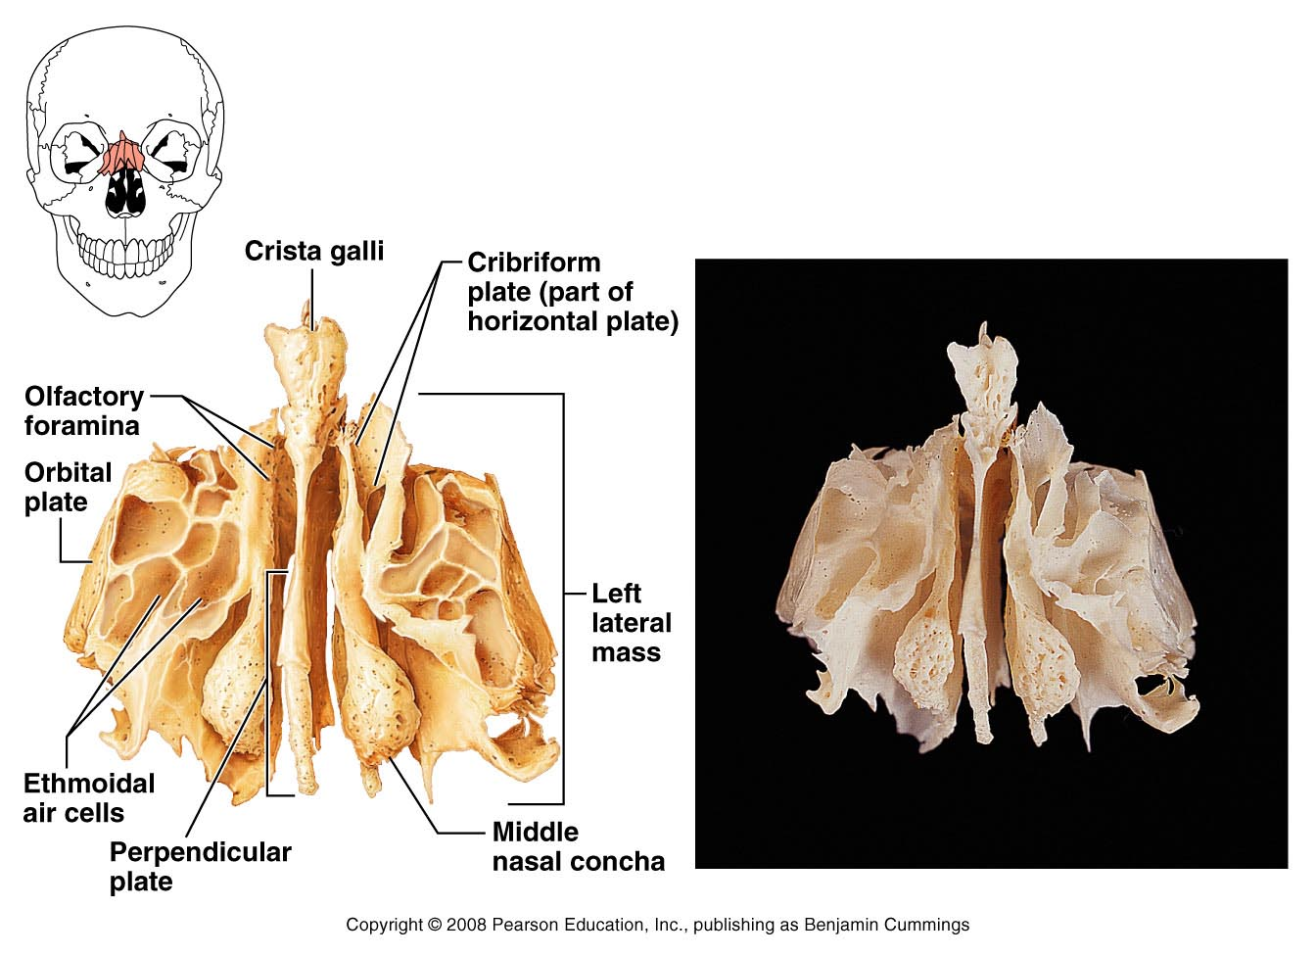
The Ethmoid Bone
Figure 7.7

Slide 41
Bones of the Skull
Table 7.1 (1 of 2)

Slide 42
Facial Bones
Unpaired bones
Mandible and vomer
Paired bones
Maxillae
Zygomatic bones
Nasal bones
Lacrimal bones
Palatine bones
Inferior nasal conchae

Slide 43
Mandible
The lower jawbone is the largest and strongest facial bone
Composed of two main parts
Horizontal body
Two upright rami

Slide 44
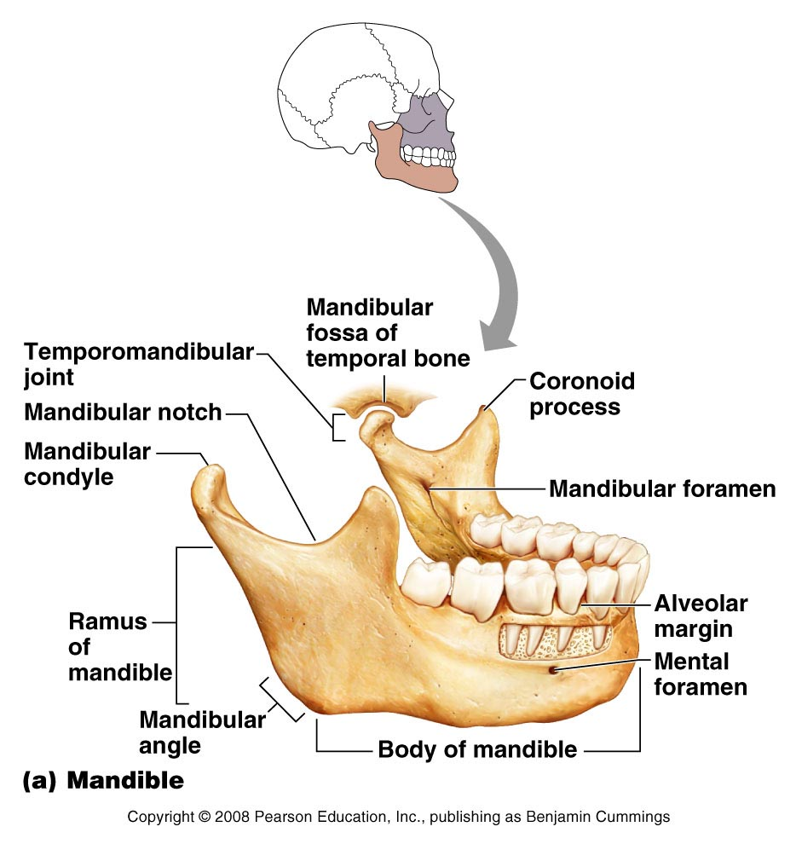
Mandible
Figure 7.8a

Slide 45
Maxillary Bones
Articulate with all other facial bones except the mandible
Contain maxillary sinuses – largest paranasal sinuses
Forms part of the inferior orbital fissure

Slide 46
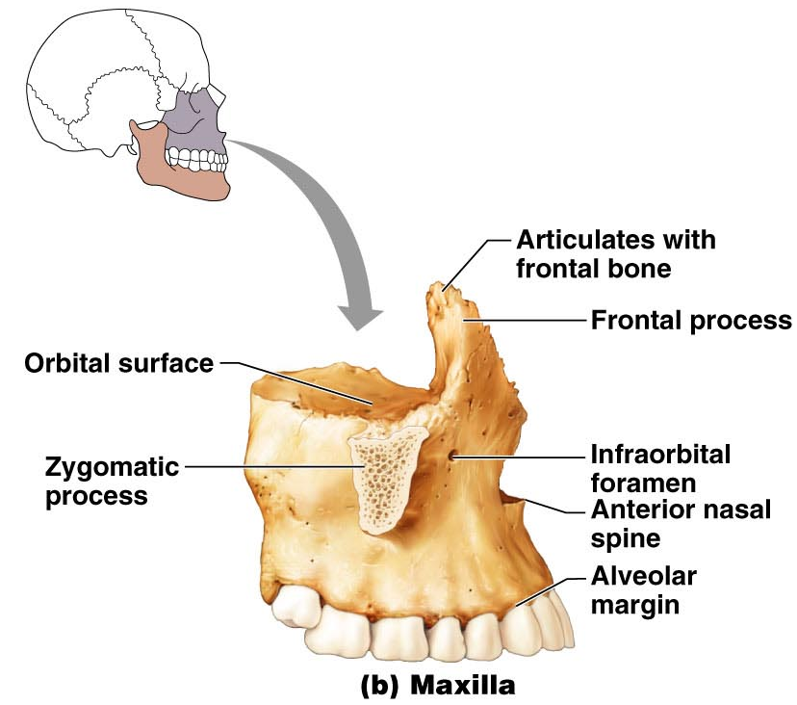
Maxillary Bones
Figure 7.8b

Slide 47
Maxillary Bones
Figure 7.4a

Slide 48
Other Bones of the Face
Zygomatic bones
Form lateral wall of orbits
Nasal bones
Form bridge of nose
Lacrimal bones
Located in the medial orbital walls
Palatine bones
Complete the posterior part of the hard palate

Slide 49
Other Bones of the Face
Vomer
Forms the inferior part of the nasal septum
Inferior nasal conchae
Thin, curved bones that project medially form the lateral walls of the nasal cavity

Slide 50
Facial Bones
Table 7.1 (2 of 2)

Slide 51
Bones of the Face
Figure 7.2a

Slide 52
Special Parts of the Skull
Orbits
Nasal cavity
Paranasal sinuses
Hyoid bone

Slide 53
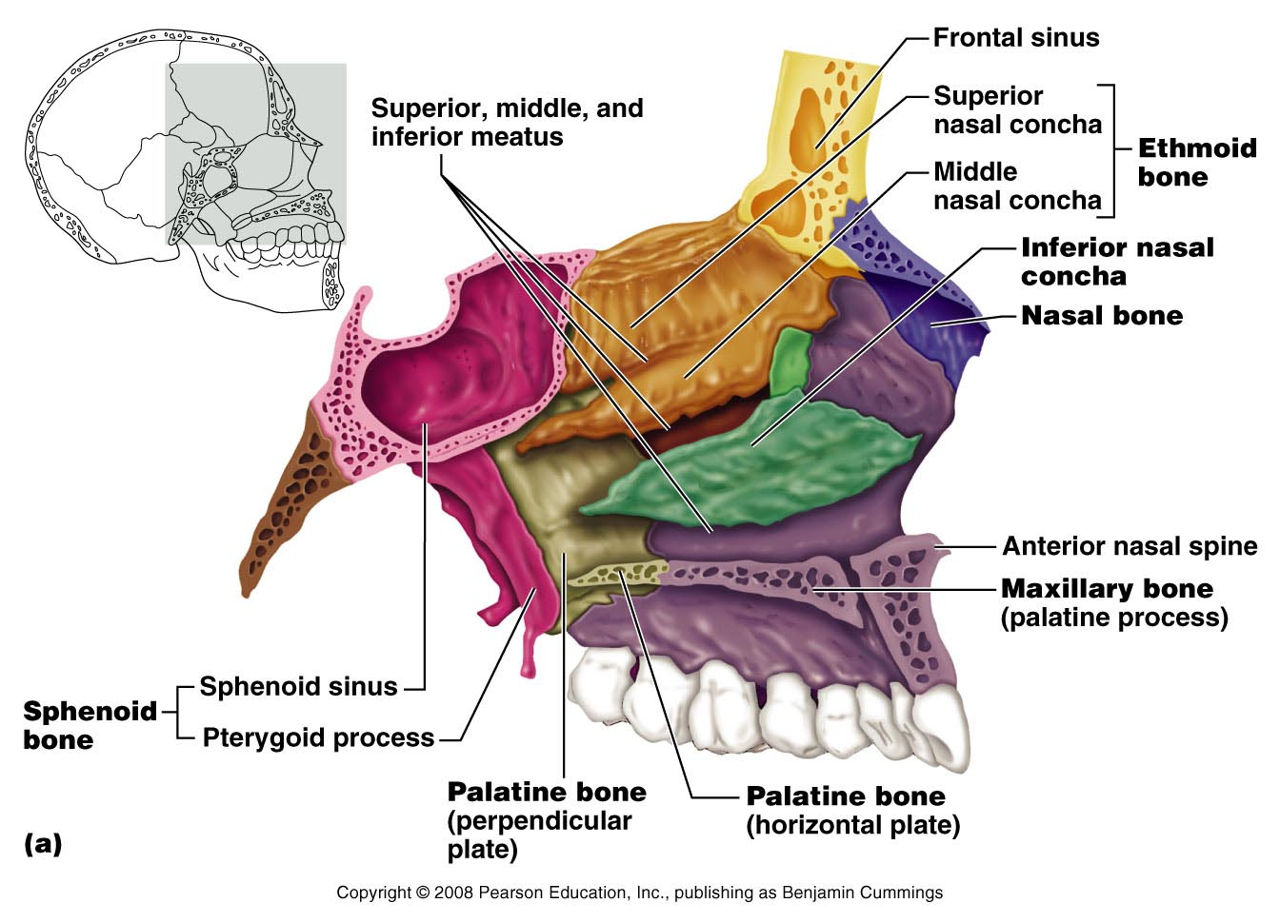
Nasal Cavity
Figure 7.9a

Slide 54
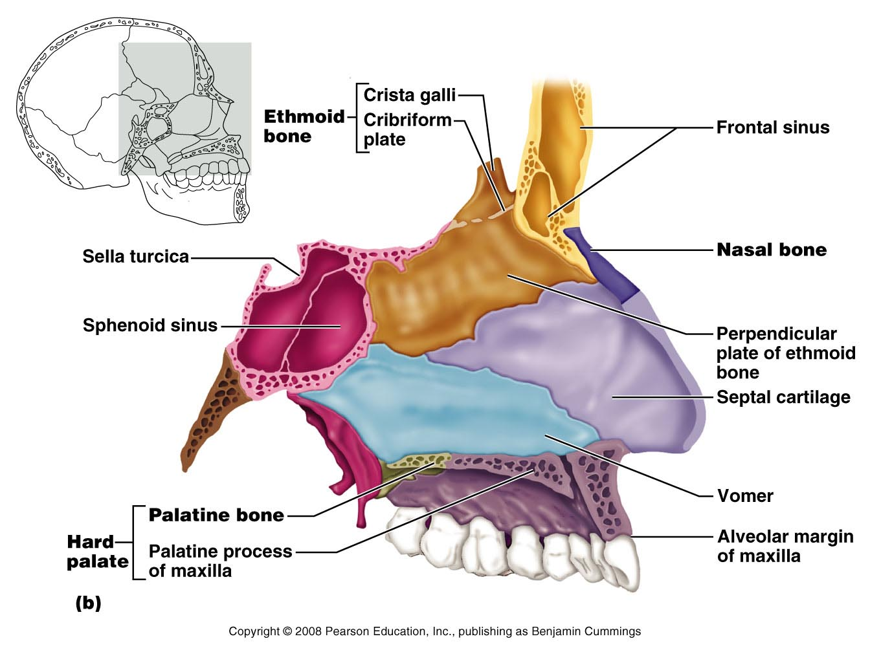
Nasal Septum
Figure 7.9b

Slide 55
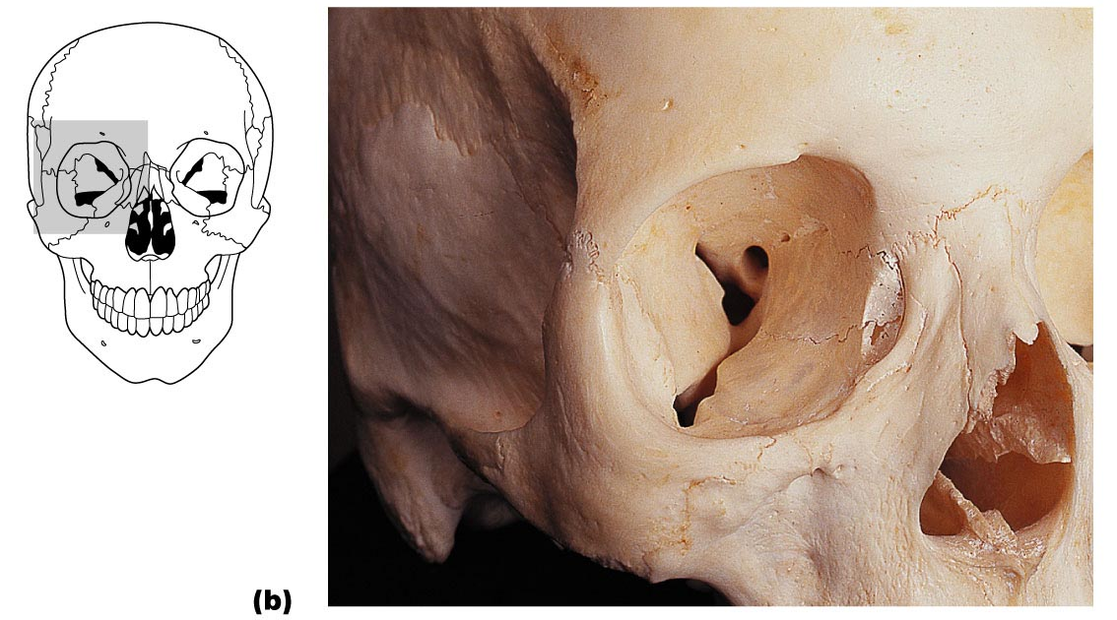
Orbits
Figure 7.10b

Slide 56
Paranasal Sinuses
Air-filled sinuses are located within
Frontal bone
Ethmoid bone
Sphenoid bone
Maxillary bones
Lined with mucous membrane
Serve to lighten the skull

Slide 57
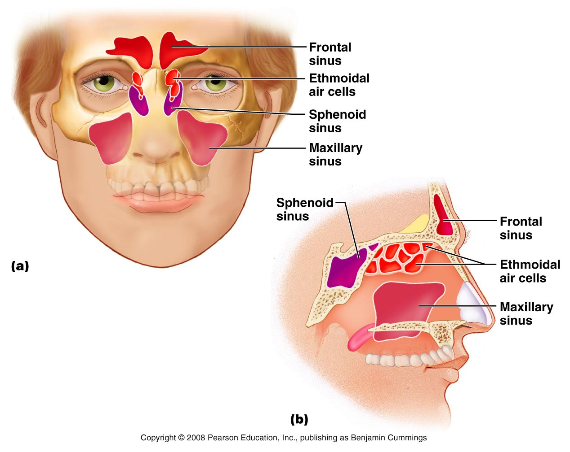
Paranasal Sinuses
Figure 7.11a, b

Slide 58
Skeletal Tissue and Axial Skeleton (Skull)
END

