Slide 1
Blood Histology
WLAC

Slide 2
Blood Smear
Wright's stain for blood.
Erythrocytes (red blood cells) → pink-red
Leukocytes (white blood cells):
Nuclei → blue-purple
Cytoplasm → pale blue
Neutrophil granules → pale purple-pink
Eosinophil granules → bright orange-red
Basophil granules → deep blue-purple
Azurophil granules→ blue-purple
Thrombocytes (platelets) → lavender

Slide 3
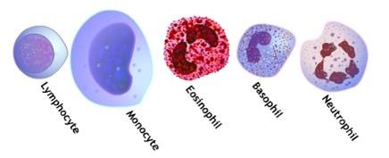
Differential Count

Slide 4
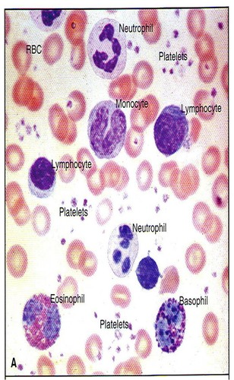

Slide 5
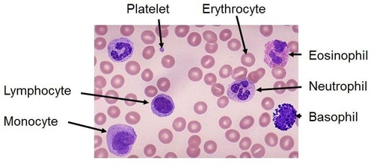

Slide 6
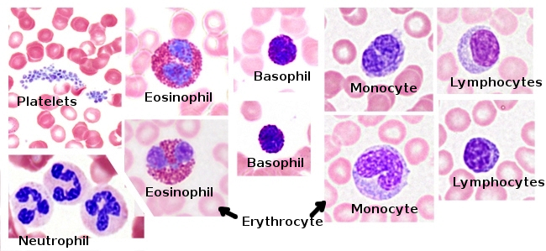

Slide 7
Eosinophils

Slide 8
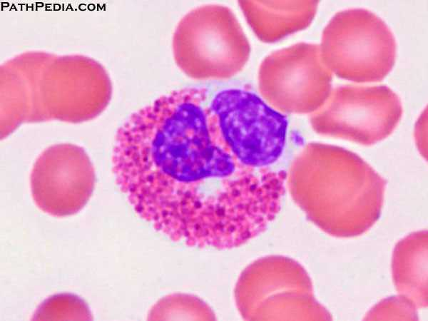
Eosinophils

Slide 9
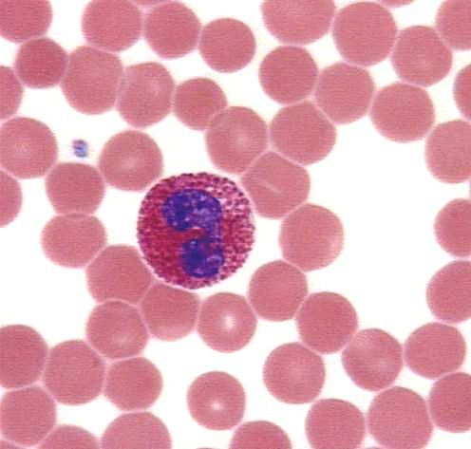
Eosinophils

Slide 10
Eosinophils

Slide 11
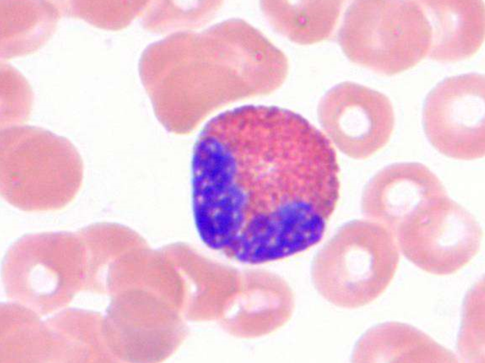
Eosinophils

Slide 12
Basophils

Slide 13
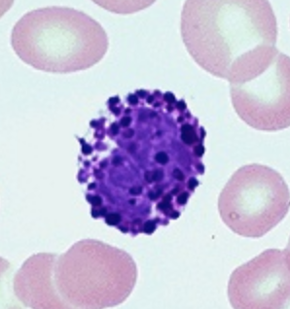
Basophil

Slide 14
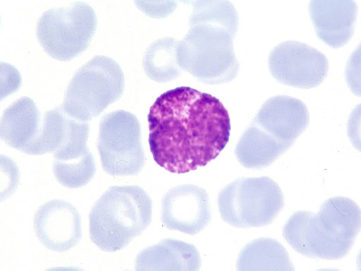
Basophil

Slide 15
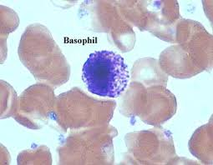
Basophil

Slide 16
Neutrophil

Slide 17
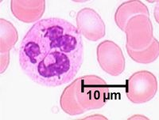
Neutrophil

Slide 18
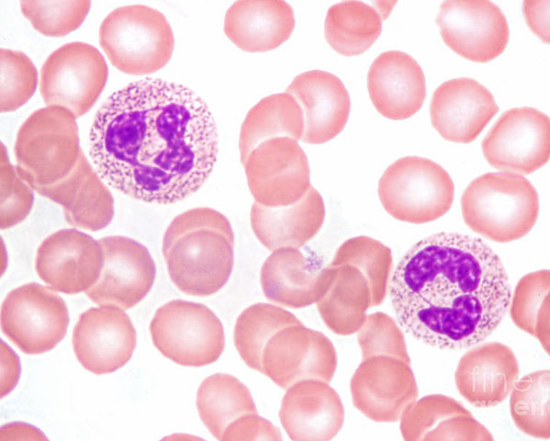
Neutrophil

Slide 19
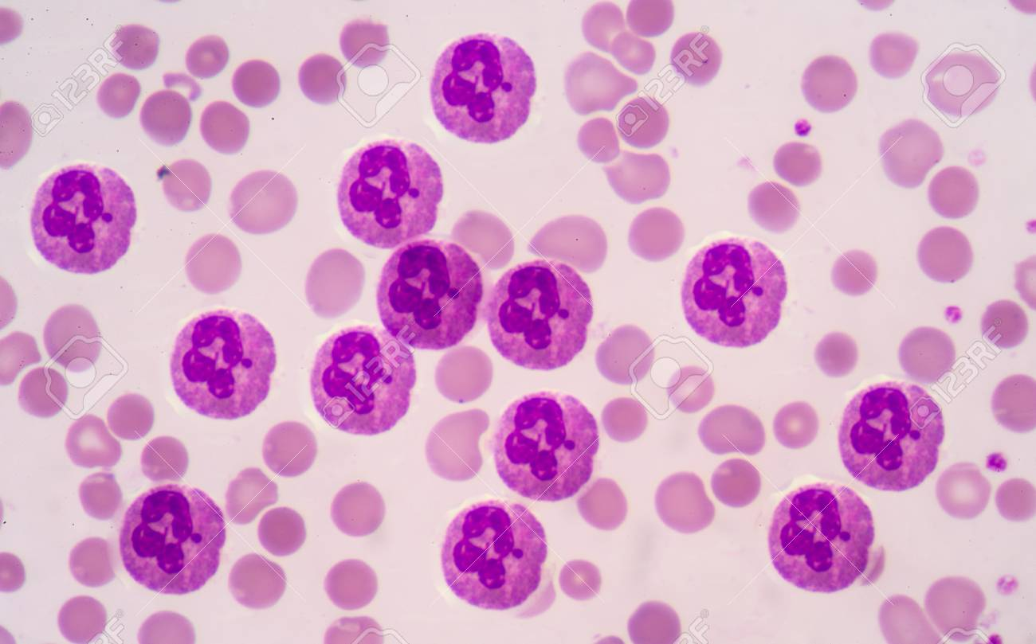
Neutrophil

Slide 20
Lymphocyte

Slide 21
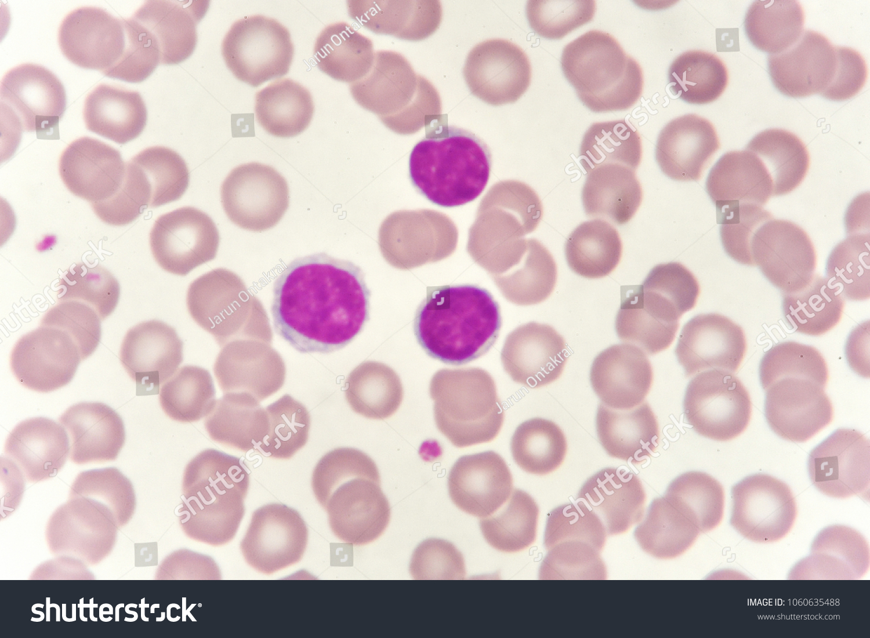
Lymphocyte

Slide 22
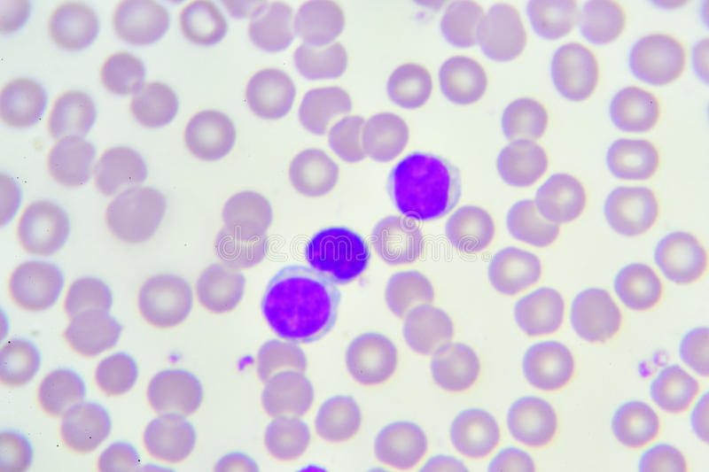
Lymphocyte

Slide 23
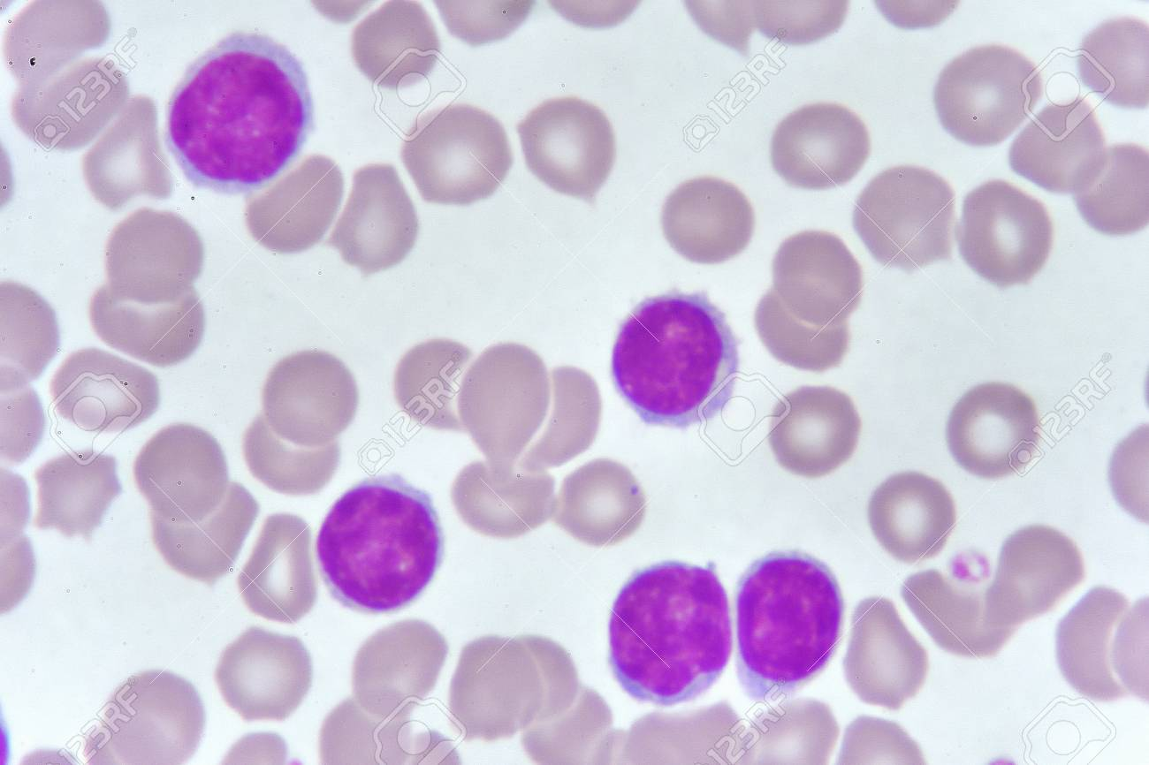
Lymphocyte

Slide 24
Monocyte

Slide 25
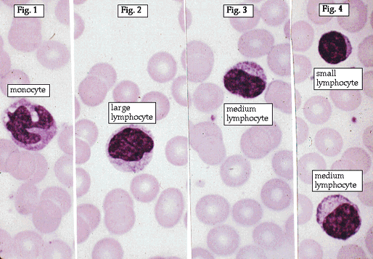
Monocyte

Slide 26
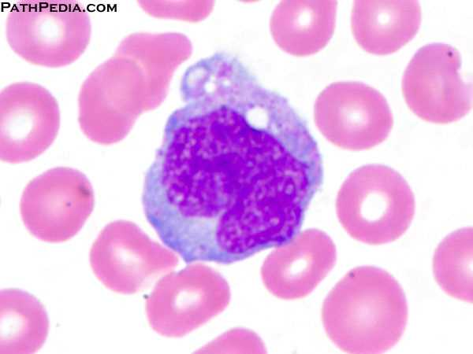
Monocyte

Slide 27
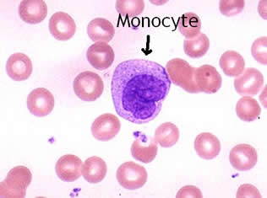
Monocyte

Slide 28
Erythrocyte

Slide 29
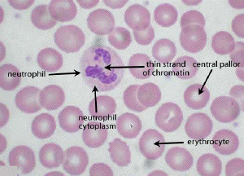
Red Blood Cell

Slide 30
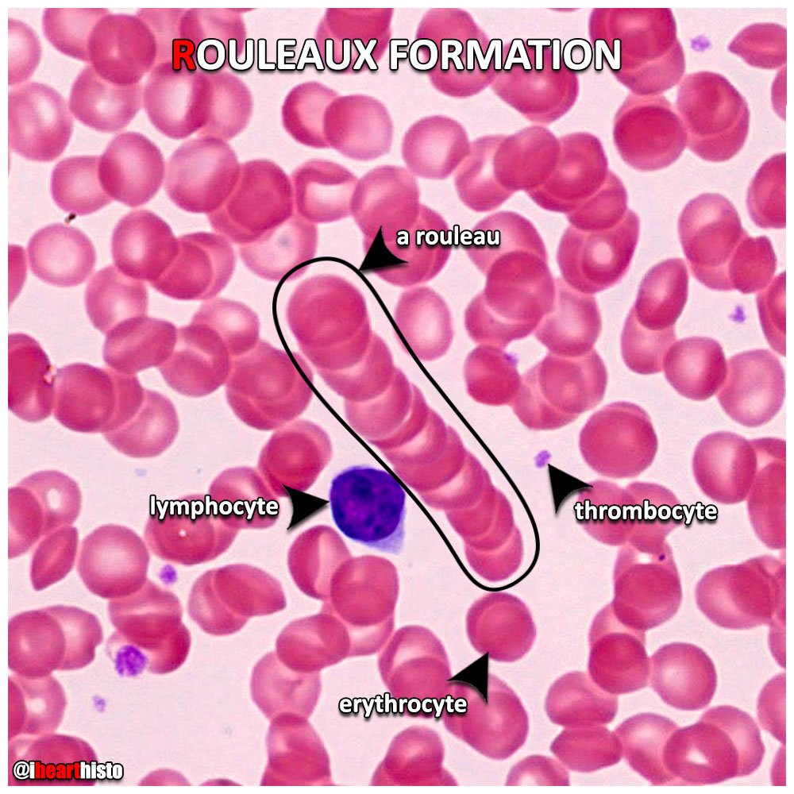
Red Blood Cell

Slide 31
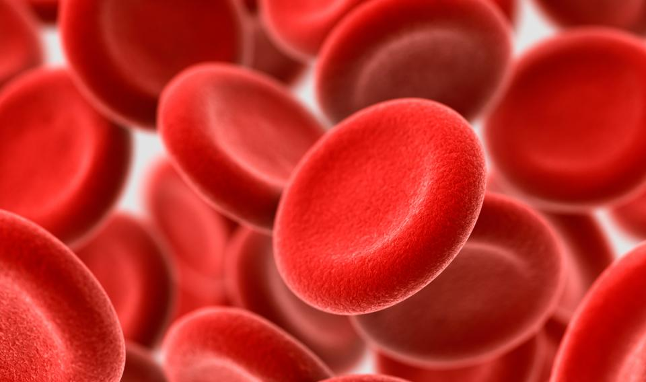
Eosinophils

Slide 32
Platelet

Slide 33
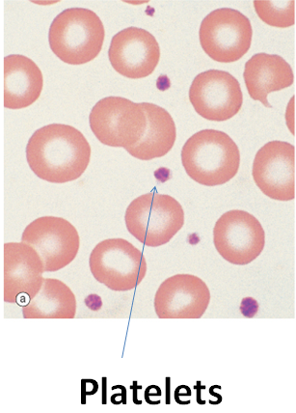
Platelet

Slide 34
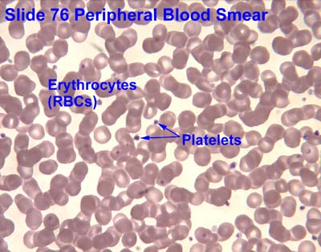
Platelet

Slide 35
Abnormal Blood Pathology

Slide 36
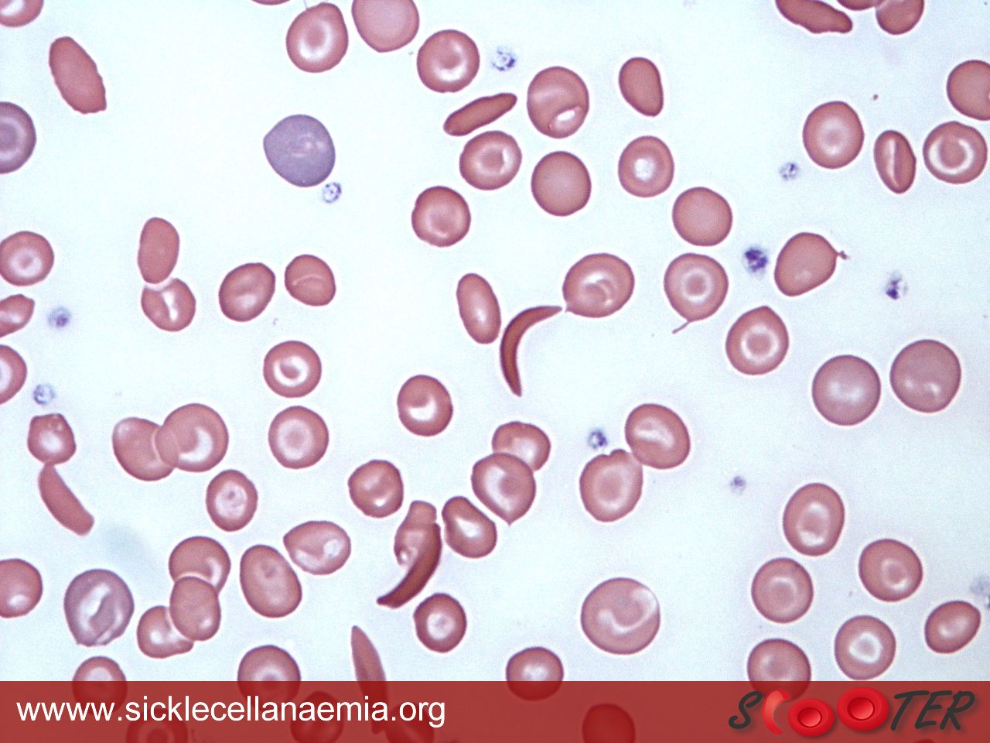
Sickle Cell Anemia

Slide 37
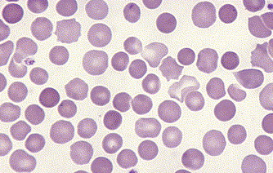
Erythrocyte, spherocytosis

Slide 38
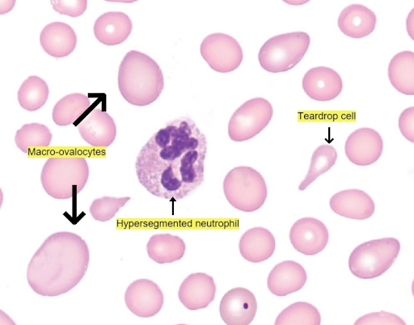
Erythrocyte, megaloblastic anemia

Slide 39
Platelet

