Slide 1
Cells: The Living Units

Slide 2
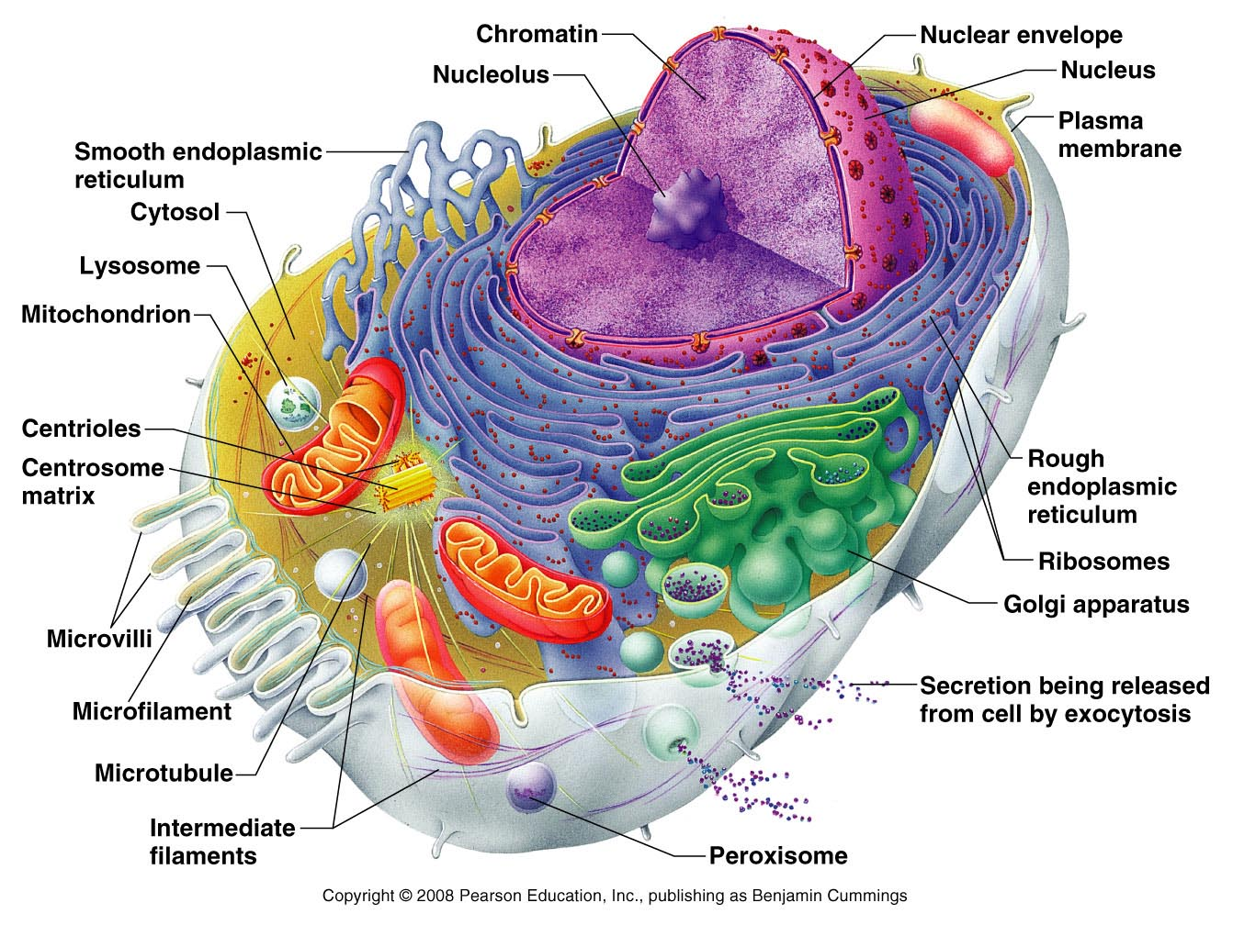
Introduction to Cells
Cells – the smallest living units in our bodies
Cells have three main components
Plasma membrane
Cytoplasm
Nucleus

Slide 3
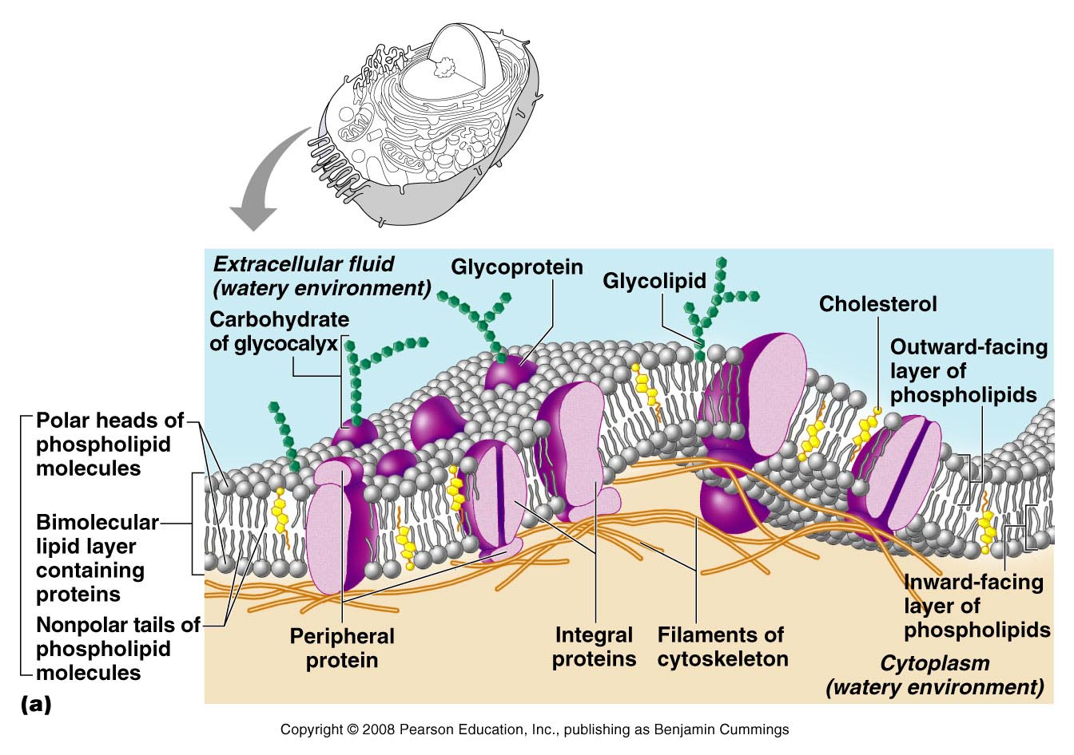
The Plasma Membrane
Plasma membrane defines the extent of the cell
Structure of membrane
Fluid mosaic model (lipid bilayer)
membrane proteins
Functions – relate to location at the interface of cell’s exterior and interior
Provides barrier against substances outside cell
Some plasma membranes act as receptors

Slide 4
The Plasma Membrane
Determines which substances enter or leave the cell
Membrane is selectively permeable
Diffusion – molecules move from a region where they are more concentrated to an area where they are less concentrated
Osmosis – the diffusion of water across a membrane

Slide 5
The Cytoplasm
Cytoplasm – lies internal to plasma membrane
Consists of cytosol, organelles, and inclusions
Cytosol (cytoplasmic matrix)
Jelly-like fluid in which other cellular elements are suspended
Consists of water, ions, and enzymes

Slide 6
Cytoplasmic Organelles
1) Ribosomes – constructed of proteins and ribosomal RNA
Site of protein synthesis
NOTE: Most antibiotics work by blocking bacterial protein synthesis.
The antibiotic works on one of the subunits to prevent bacteria from multiplying!

Slide 7
Structure of a Generalized Cell
Figure 2.1

Slide 8
Cytoplasmic Organelles
2) Endoplasmic reticulum – “network within the cytoplasm”
Rough ER – ribosomes stud the external surfaces
Smooth ER – consists of tubules in a branching network
No ribosomes are attached; therefore no protein synthesis

Slide 9
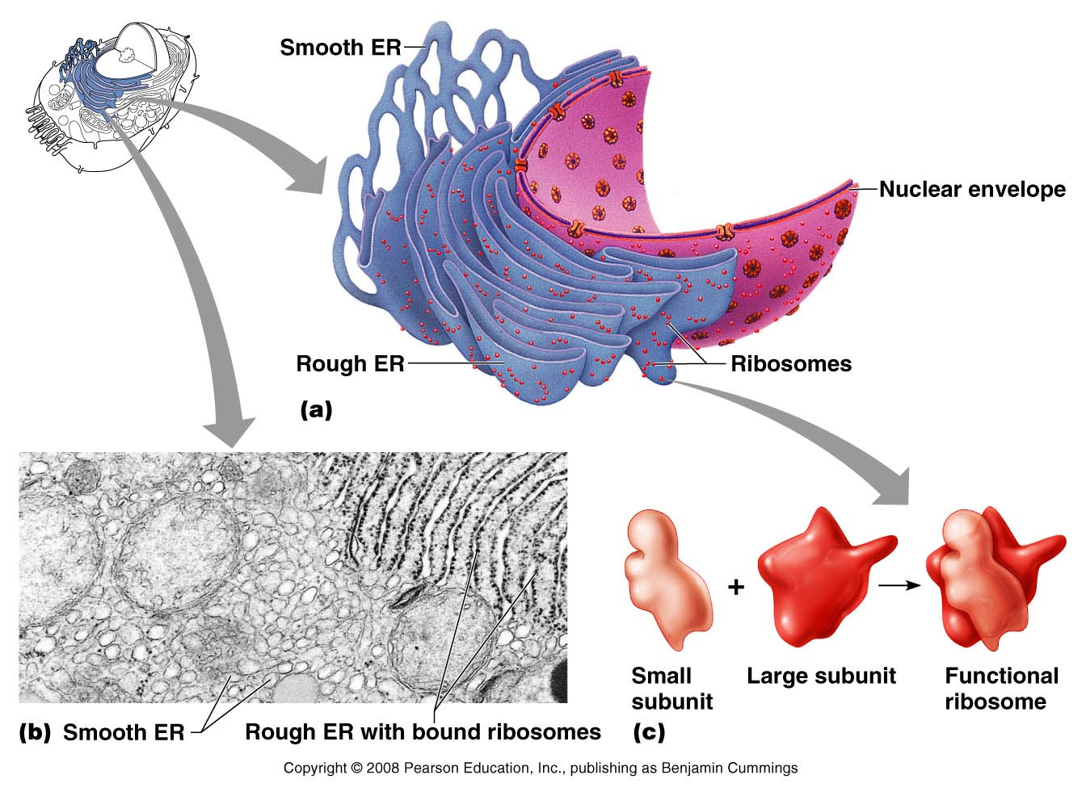
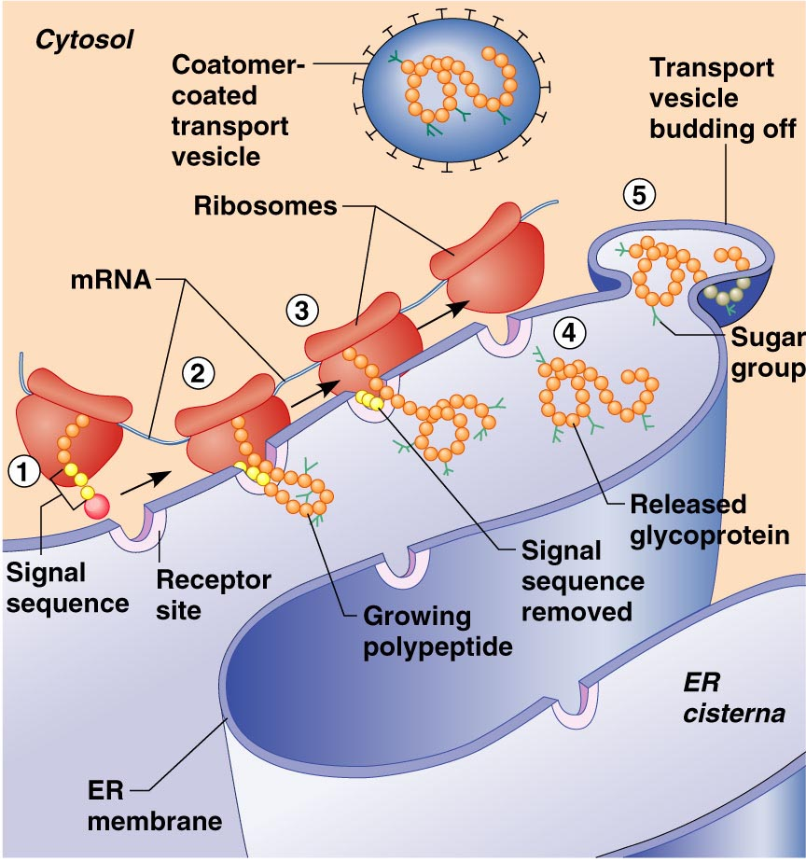
The Endoplasmic Reticulum and Ribosomes

Slide 10
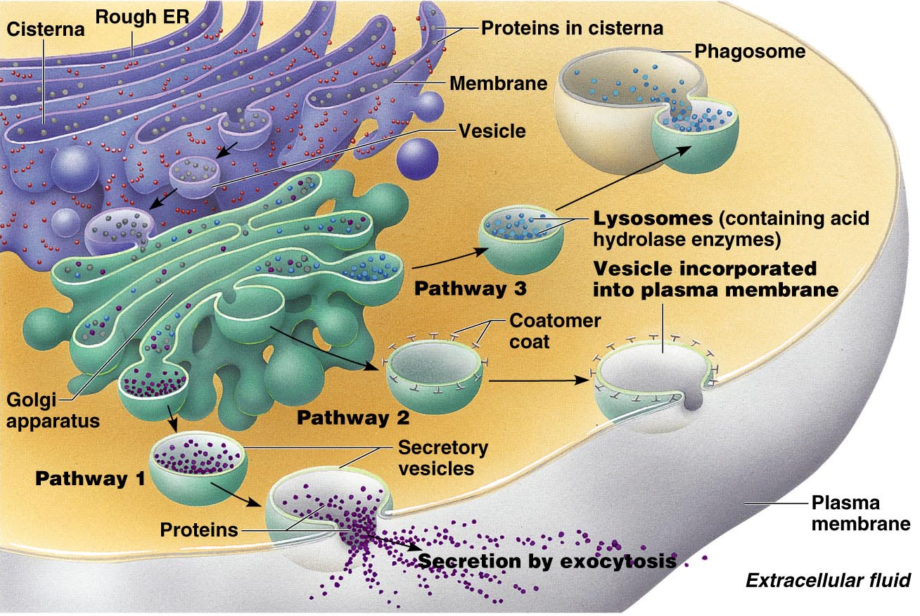
Cytoplasmic Organelles
3) Golgi apparatus – a stack of three to 10 disk-shaped envelopes
Sorts products of rough ER and sends them to proper destination
Products of rough ER move through the Golgi

Slide 11
Cytoplasmic Organelles
4) Lysosomes – membrane-walled sacs containing digestive enzymes
Digest unwanted substances
5) Peroxisomes – membrane-walled sacs of oxidase enzymes
Enzymes neutralize free radicals and break down poisons
Break down long chains of fatty acids
Are numerous in the liver and kidneys

Slide 12
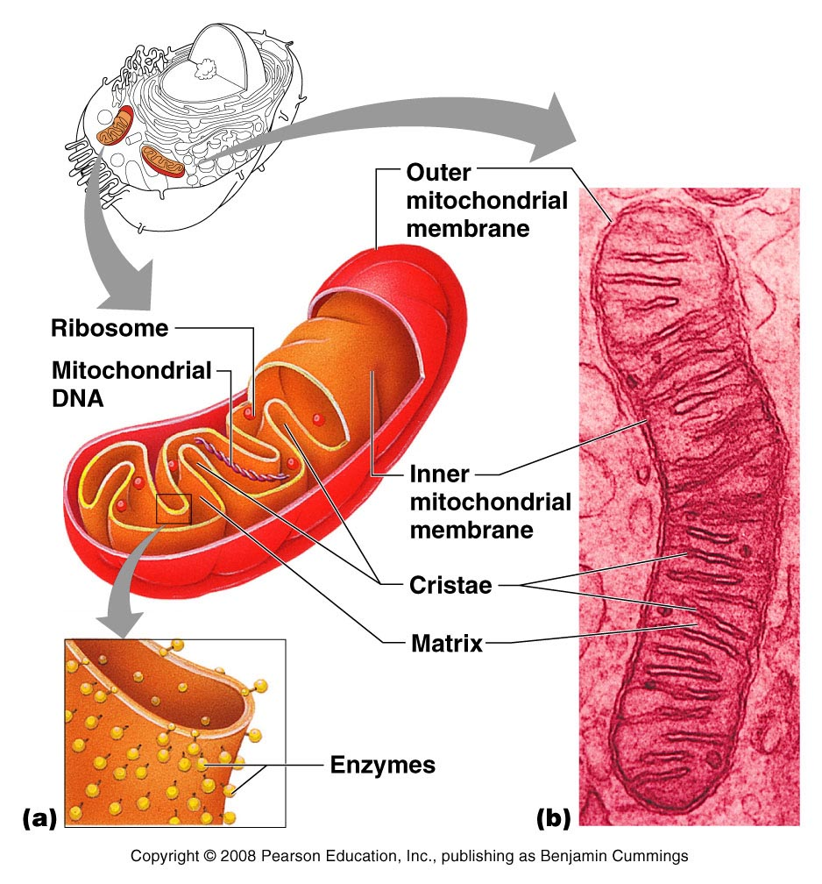
Mitochondria
6) Mitochondria – generate most of the cell’s energy; most complex organelle
More abundant in energy-requiring cells, like muscle cells and sperm
Figure 2.10

Slide 13
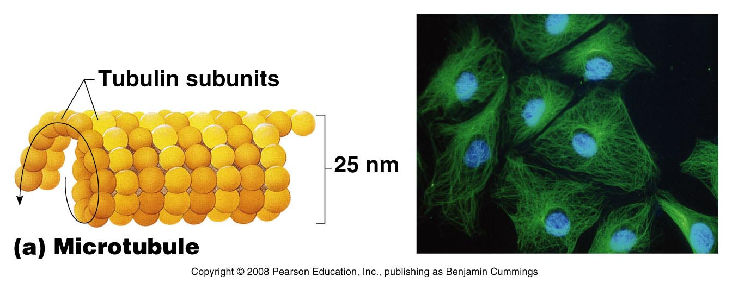
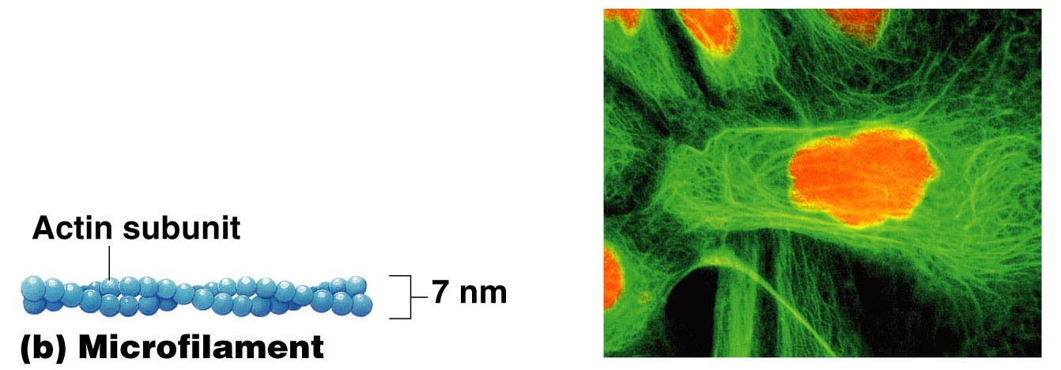
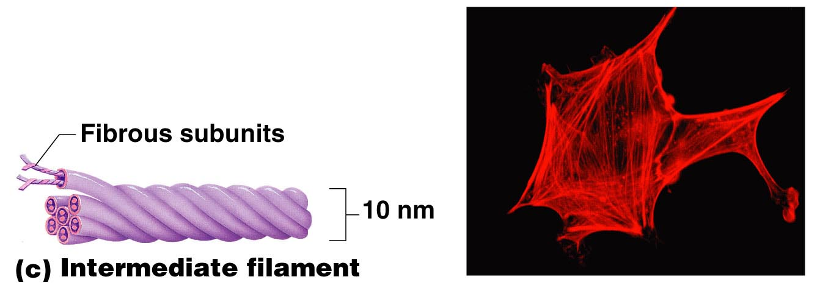
Cytoplasmic Organelles
7) Cytoskeleton – “cell skeleton” – an elaborate network of rods (3 types):
Microtubules – cylindrical structures made of proteins
Microfilaments – filaments of contractile protein actin
Intermediate filaments – protein fibers

Slide 14
Cytoplasmic Organelles
8) Centrosomes and centrioles
Centrosome – a spherical structure in the cytoplasm
Composed of centrosome matrix and centrioles
Centrioles – paired cylindrical bodies
Consists of 27 short microtubules
Act in forming cilia
Necessary for karyokinesis (nuclear division)

Slide 15
Cytoplasmic Inclusions
9) Temporary structures
Not present in all cell types
May consist of pigments, crystals of protein, and food stores
Lipid droplets – found in liver cell and fat cells
Glycosomes – store sugar in the form of glycogen

Slide 16
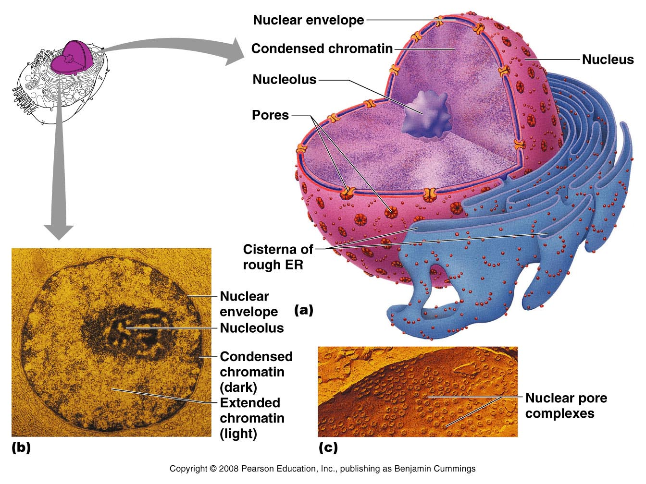
The Nucleus
The nucleus – “central core” or “kernel” – control center of cell
DNA directs the cell’s activities
Nucleus is approximate 5µm in diameter
Nuclear envelope – two parallel membranes separated by fluid-filled space
Chromatin – composed of DNA and histone proteins
Nucleolus (“little nucleus”) – in the center of the nucleus
Contains parts of several chromosomes
Site of ribosome subunit manufacture

Slide 17
Cellular Diversity
Specialized functions of cells relates to
Shape of cell
Arrangement of organelles

Slide 18
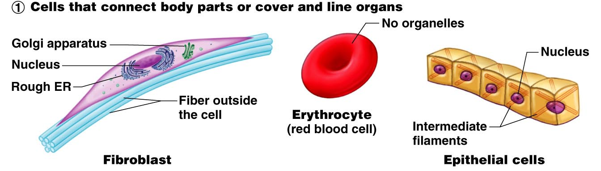
Cellular Diversity
Cells that connect body parts or cover organs
Fibroblast – makes and secretes protein component of fibers
Erythrocyte – concave shape provides surface area for uptake of the respiratory gases
Epithelial cell – hexagonal shape allows maximum number of epithelial cells to pack together

Slide 19
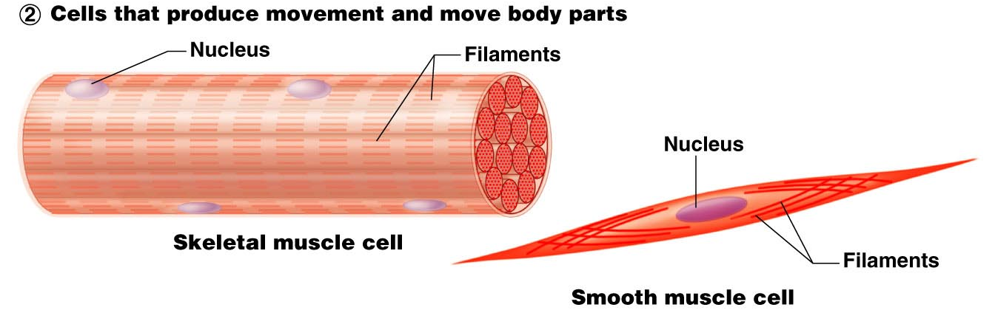
Cellular Diversity
Cells that move organs and body parts
Skeletal and smooth muscle cells
Elongated and filled with actin and myosin
Contract forcefully

Slide 20
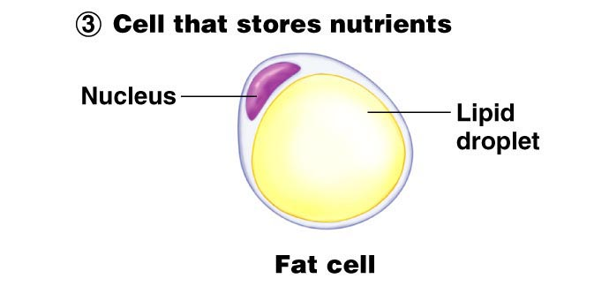
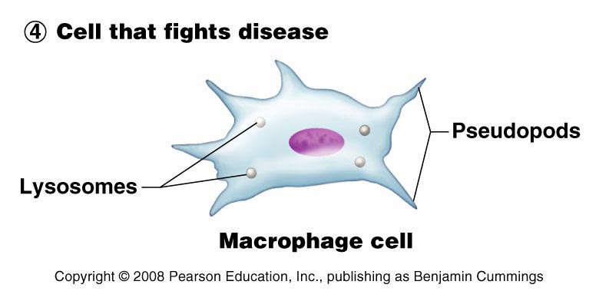
Cellular Diversity
Cells that store nutrients
Fat cell – shape is produced by large fat droplet in its cytoplasm
Cells that fight disease
Macrophage – moves through tissue to reach infection sites

Slide 21
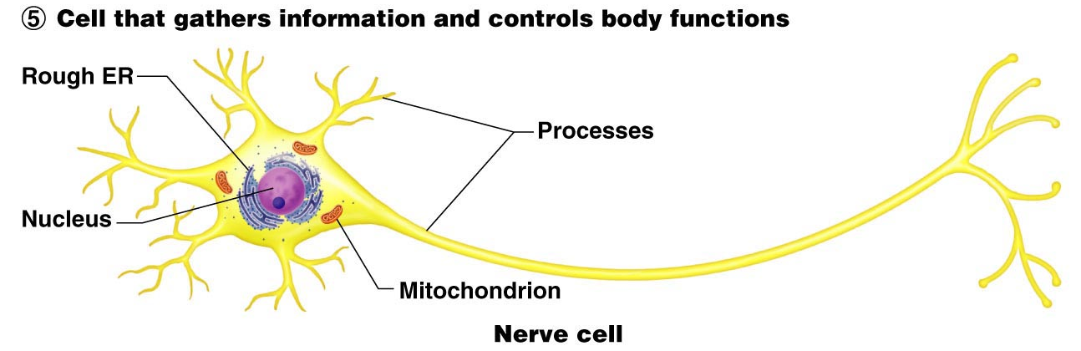
Cellular Diversity
Cells that gather information
Neuron – has long processes for receiving and transmitting messages
Figure 2.16, step 5

Slide 22
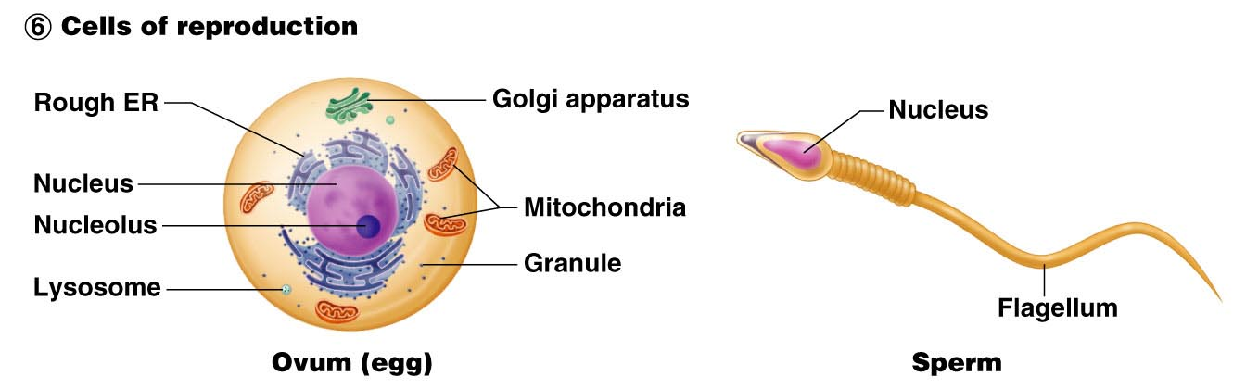
Cellular Diversity
Cells of reproduction
Oocyte (female) – largest cell in the body
Contains many copies of organelles for distribution to daughter cells
Sperm (male) – possesses long tail for swimming to the egg for fertilization
Figure 2.16, step 6

Slide 23
Cells: The Living Units
END

