Slide 1
Muscles of the Body
AXIAL MUSCLES

Slide 2
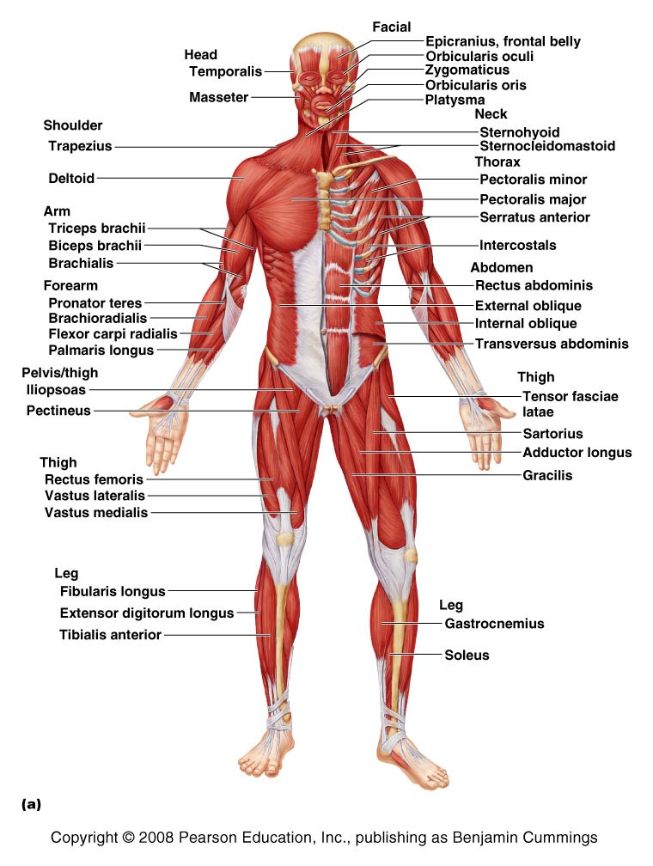
Superficial Muscles of the Body – Anterior View
Figure 11.7a

Slide 3
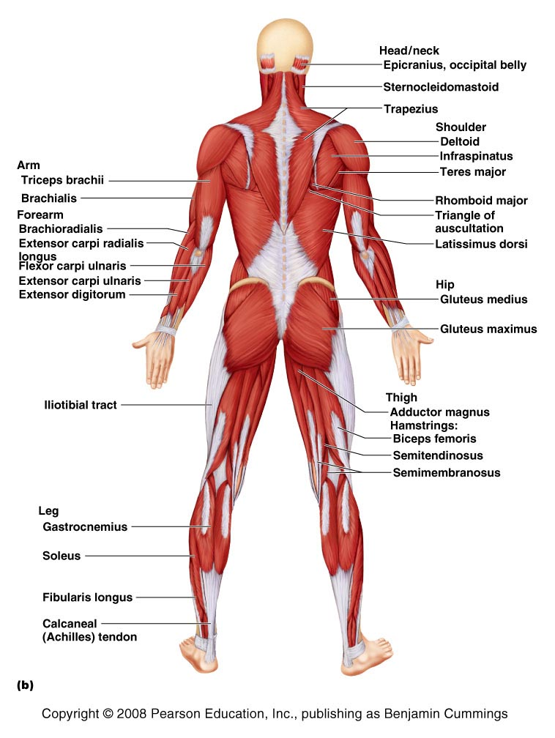
Superficial Muscles of the Body – Posterior View
Figure 11.7b

Slide 4
Muscles of the Head – Facial Expression
Muscles of facial expression
Lie in the face and scalp
Thin and variable in shape
Often insert in the skin – not on bones
Innervated by cranial nerve VII – the facial nerve

Slide 5
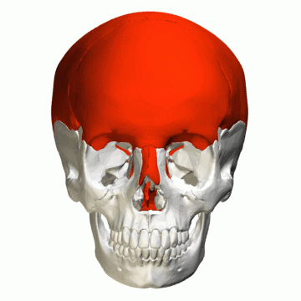
Epicranius

Slide 6
Muscles of the Scalp
Muscles | ATTACHMENT | MUSCLE ACTION
Muscle | Origin | Insertion | Action | Nerve Supply
EPICRANIUS
A) Frontal belly | Galea aponeurotica | Eyebrow skin & root of nose | Forehead wrinkling | Facial n. (CN VII)
B) Occipital belly | Occipital and temporal bones | Galea aponeurotica | Pulls scalp posteriorly | Facial n.
SUPRAHYOID MUSCLES –pulls throat together with esophagus up (e.g. during swallowing)
This muscle is loose, can easily be pulled off. It’s continuous, raise your eyebrow, you can feel the pull of the muscle until the back of the head.

Slide 7
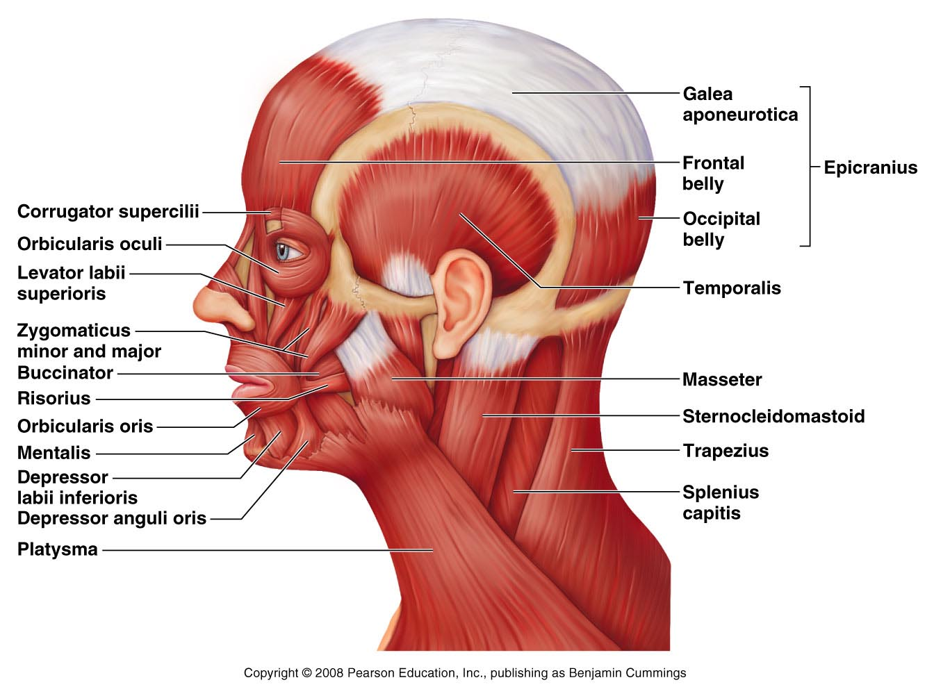
Muscles of the Head – Facial Expression
Figure 11.8

Slide 8
Muscles of the Head – Facial Expression
Orbicularis – round
Oculi – eye
Oris - mouth
Figure 11.8

Slide 9
Muscles of the Head – Facial Expression
Muscles insert at lips
12
Use a clock as a Guide
6
Figure 11.8

Slide 10
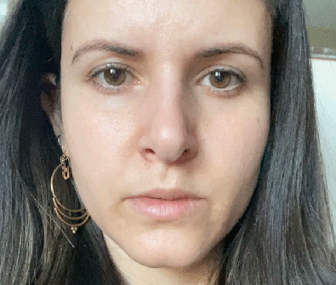
Muscles of the Head – Facial Expression
12
1
Muscle just below (origin) the orbicularis oculi; Opens lip
Use a clock as a Guide
Elevates lip, above
6
Figure 11.8

Slide 11
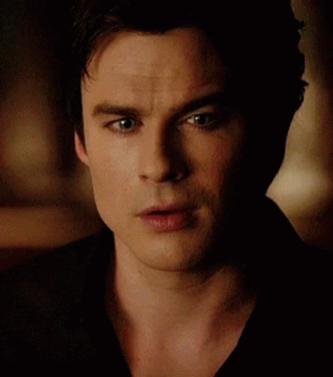
Muscles of the Head – Facial Expression
12
1
Use a clock as a Guide
Muscle originate at Zygomatic bone
2
Smile emoji
6
Figure 11.8

Slide 12
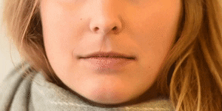
Muscles of the Head – Facial Expression
12
1
Use a clock as a Guide
2
Latin: Risor means laugh
3
Straight lip Emoji
6
Figure 11.8

Slide 13
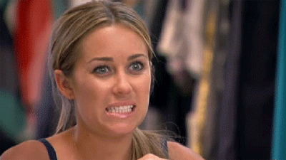
Muscles of the Head – Facial Expression
12
1
Use a clock as a Guide
2
3
4
Grimace
6
Depress angle of the lips

Slide 14
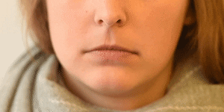
Muscles of the Head – Facial Expression
12
1
Use a clock as a Guide
2
3
4
Pout
5
6
Figure 11.8

Slide 15
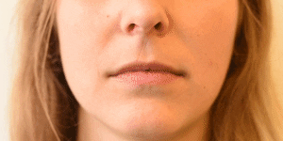
Muscles of the Head – Facial Expression
12
1
Use a clock as a Guide
2
3
5
6
Protrudes lower lip
Figure 11.8

Slide 16
Muscles of the Face
Muscles | ATTACHMENT | MUSCLE ACTION
Muscle | Origin | Insertion | Action | Nerve Supply
Corrugator supercilli | Arch of frontal bone | Eyebrow skin | Draws eyebrow together | Facial n.
Orbicularis oculi | Frontal and maxillary bone | Eyelid tissue | Closes eye | Facial n.
Zygomaticus | Zygomatic bone | Skin & muscle of mouth corner | Smiling muscle (raises corners of mouth) | Facial n.
Risorius | Lateral fascia assoc. w/ masseter | Skin at angle of mouth | Draws corner of lip laterally | Facial n.
Levator labii superioris | Zygomatic bone | Skin of upper lip | Opens lips | Facial n.
Depressor labii inferioris | Body of mandible (lateral to midline) | Skin & muscle of lower lip | Draws lip inferiorly (pouting) | Facial n.
Depressor anguli oris | Body of mandible (below incisors) | Skin & muscle at angle of mouth | Draws corner of mouth down & lateral (grimace) | Facial n.
Orbicularis oris | Maxilla and mandible | Muscle and skin around mouth | Closes lip (purses and protrudes lip) | Facial n.
Mentalis | Mandible below incisors | Skin of chin | Protrudes lower lip (wrinkles chin) | Facial n.
Buccinator | Molar region of maxilla and mandible | Orbicularis oris | Compresses cheek (whistling, sucking) | Facial n.
Platysma | Chest fascia | Below margin of mandible | Tenses skin of neck | Facial n.

Slide 17
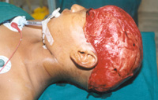
Person riding the ferris wheel (South Amercia), hair caught in a stationary object.

Slide 18
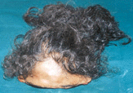
The whole scalp was pulled off (with hair and skin)

Slide 19
Muscles Mastication and Tongue Movement
Four main pairs of muscles involved in mastication
Innervated by mandibular division of the trigeminal nerve (cranial nerve V)
Prime movers of jaw closure
Masseter and temporalis
Side-to-side movement
Pterygoid muscles
Compression of cheeks
Buccinator muscles

Slide 20
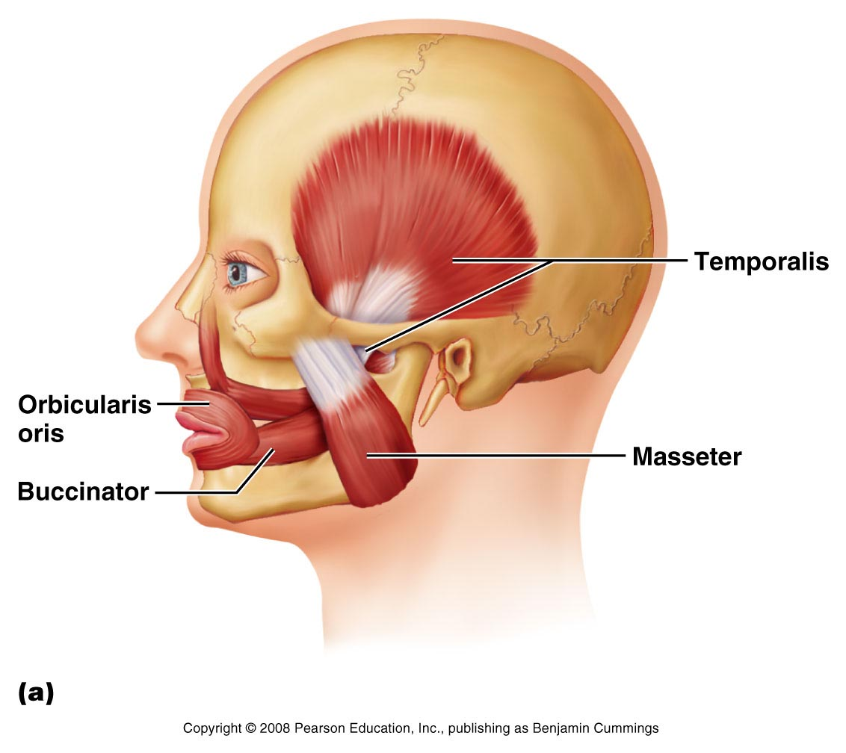
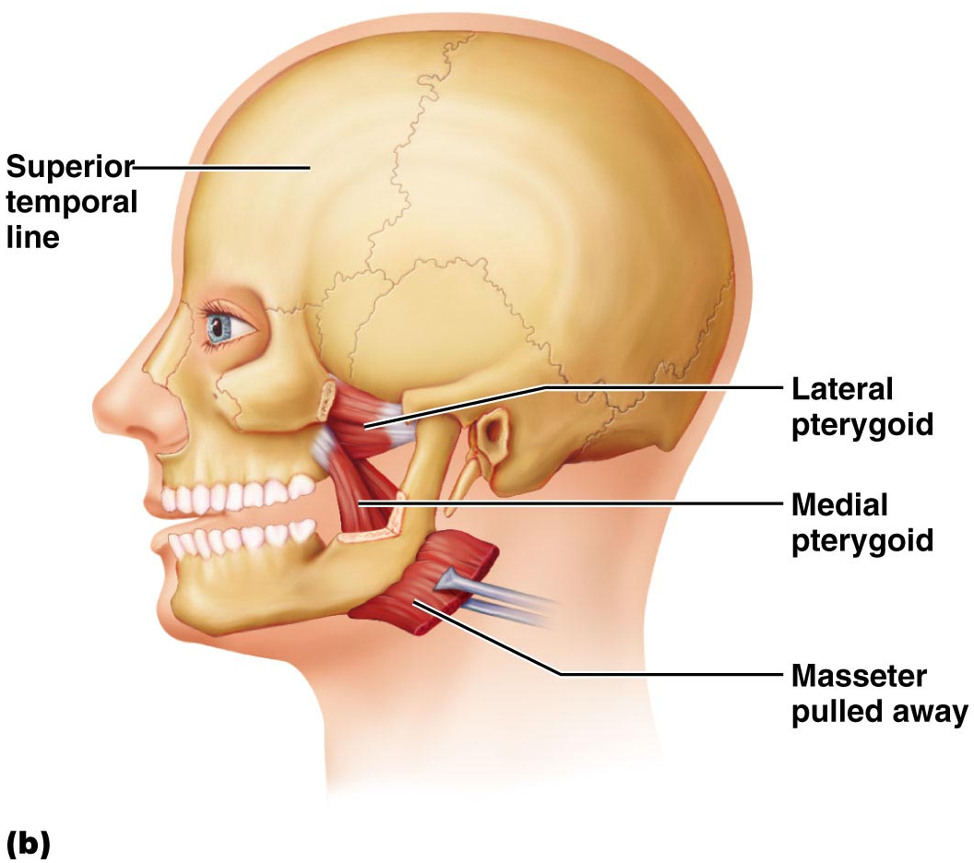
Muscles of Mastication and Tongue Movement
Cranial Nerve 5 (Trigeminal nerve) – Muscles of Mastication
Jaw closure
Prime mover of Jaw closure
Part oF mastication (underneath RISORIUS) – sucking on the straw
But innervated by Cranial Nerve 7 (Facial nerve)
Side to side movement
Paralysis of Cranial Nerve 5, inability of Chewing, but Cranial 7 is still intact so liquid diet possible with a straw.
Figure 11.9a, b

Slide 21
Muscles of Mastication
Muscle | ATTACHMENT | MUSCLE ACTION
Muscle | Origin | Insertion | Action | Nerve Supply
Masseter | Zygomatic arch & bone | Angle and ramus of mandible | Prime mover of jaw closure | Trigeminal n. (CN-V) mandibular br.
Temporalis | Temporal fossa | Coronoid process of mandible | Closes jaw | Trigeminal n. (CN-V) mandibular br.
Medial Pterygoid | Medial surface of lateral pterygoid plate | Medial surface of mandible (near angle) | Side-side movement (grinding) | Trigeminal n. (CN-V) mandibular br.
Lateral Pterygoid | Greater wing & lateral pterygoid plate of sphenoid bone | Mandibular condyle | Side-side movement (grinding) | Trigeminal n. (CN-V) mandibular br.
Buccinator | Molar region of maxilla and mandible | Orbicularis oris | Compresses cheek (whistling, sucking) | Facial n.

Slide 22
Temporalis

Slide 23
Masseter

Slide 24
Muscles Mastication and Tongue Movement
Extrinsic muscles of the tongue
Move tongue
Laterally
Anteriorly
Posteriorly
All innervated by cranial nerve XII – the hypoglossal nerve
OLFACTORYOPTICOCCULOMOTORTROCHLEARTRIGEMINAL ABDUCENSFACIAL AUDITORYGLOSSOPHAYNGEALVAGUSSPINAL ACC HYPOGLOSSAL

Slide 25
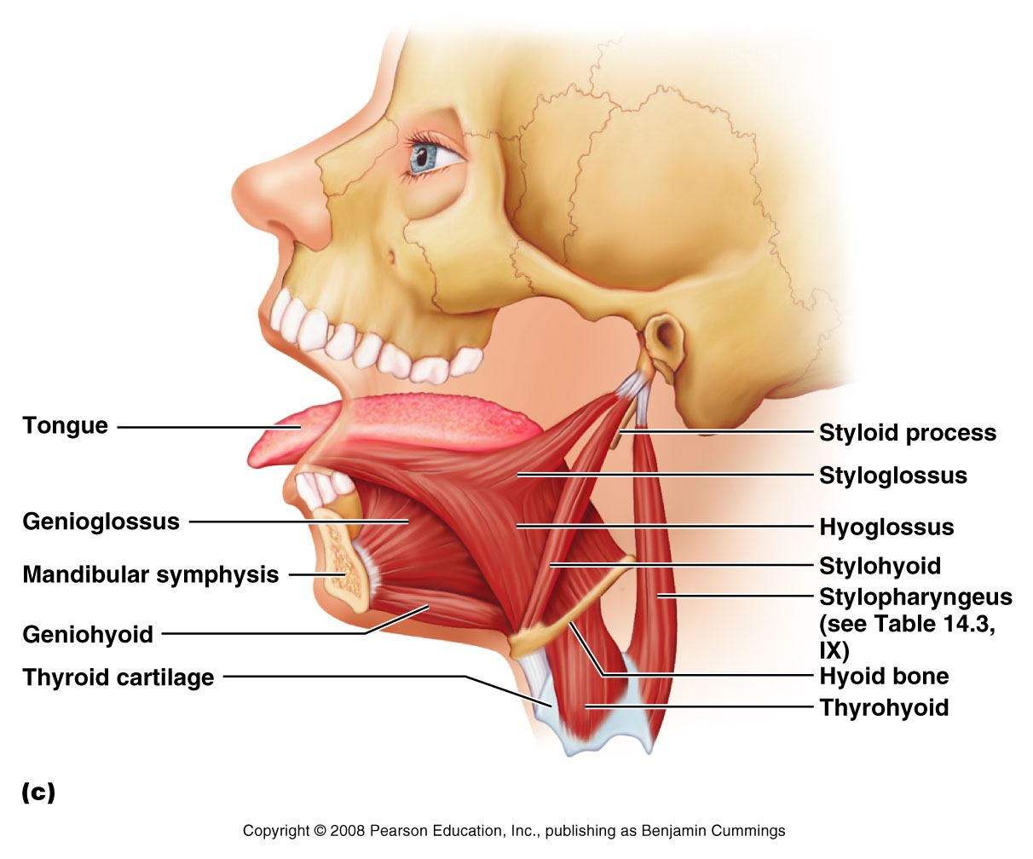
Muscles never push since muscle contracts (which is PULL)
Note: Muscles end in the name GLOSSUS
Why can I stick out my tongue?
Contract Genioglossus and retract your lips. It looks like you are protruding (pushing) the tongue.
Inner mandible (geni/o) to tongue tip
Styloid process of temporal bone to tongue tip
Hyoid bone to tongue tip
Figure 11.9c

Slide 26
Muscles promoting Tongue movement (extrinsic muscles)
Muscle | ATTACHMENT | MUSCLE ACTION
Muscle | Origin | Insertion | F | Nerve Supply
Genioglossus | Internal surface mandible | Inferior tongue & hyoid bone body | Protract tongue | Hypoglossal n. (CN XII)
Hyoglossus | Body & greater horn of hyoid | Inferolateral tongue | Depress tongue and draws its sides downward | Hypoglossal n. (CN XII)
Styloglossus | Styloid process temporal bone | Lateroinferior tongue | Retracts (& elevates) tongue | Hypoglossal n. (CN XII)
X- arm (humerus) movement Y- shoulder movement

Slide 27
Muscles of the Anterior Neck and Throat – Swallowing
The neck is divided into anterior and posterior triangles
Anterior triangle
Divided into suprahyoid and infrahyoid muscles
Participate in swallowing
Pharyngeal constrictors
Squeeze food into the esophagus

Slide 28
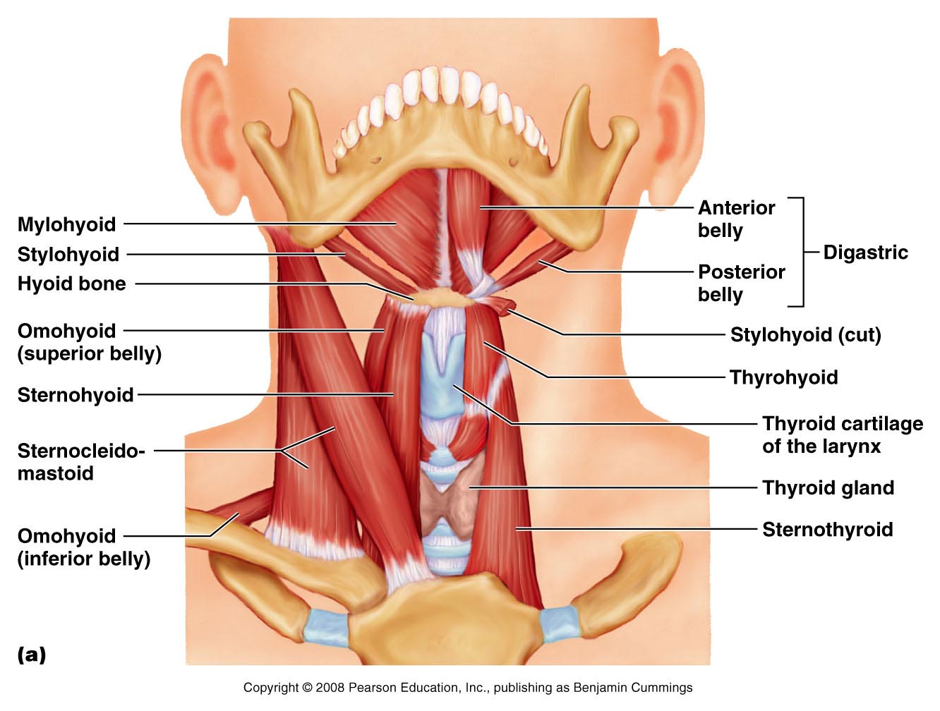
Muscles of the Anterior Neck and Throat – Swallowing
SUPRAHYOID MUSCLES –pulls throat together with esophagus up (e.g. during swallowing)
SUPRAHYOID MUSCLES
Anterior Triangle
INFRAHYOID MUSCLES
INFRAHYOID MUSCLES –depress throat together with esophagus down (e.g. after swallowing)
Figure 11.10a

Slide 29
Muscles of the Anterior Neck and Throat – Swallowing
DIGASTRIC, STYLOHYOID AND MYLOHYOID
SUPRAHYOID MUSCLES
Anterior Triangle
Mylohyoid to hyoid
Mandible to hyoid
Styloid process temporal bone to hyoid
Hyoid to mandible
Figure 11.10a

Slide 30
Muscles of the Anterior Neck and Throat – Swallowing
Anterior Triangle
Scapula to hyoid
Thyroid cartilage to hyoid
Sternum to hyoid
INFRAHYOID MUSCLES
Scapula to hyoid
Sternum to thyroid cartilage
STERNOHYOID, STERNOTHYROID, THYROHYOID. OMOHYOID
Figure 11.10a

Slide 31
Muscles of the Anterior Neck and Throat (Swallowing)
Muscle | ATTACHMENT | MUSCLE ACTION
Muscle | Origin | Insertion | F | Nerve Supply
Digastric | Ant. Belly –lower margin mandible Post. Belly- Mastoid process temporal bone | Connective tissue loop hyoid bone | Form floor of oral cavity; anchor tongue, elevate hyoid,move larynx superiorly during swallowing | Trigeminal n. (CN V) Mandibular br. for ant. belly- Facial n.; post. Belly- Facial n.
Stylohyoid | Styloid process temporal bone | Hyoid bone | Refer above | Facial n.
Mylohyoid | Medial surface mandible | Hyoid bone (& median raphe) | Refer above | Trigeminal n. (CN V) mandibular branch
Geniohyoid | Inner surface mandibular symphysis | Hyoid bone | Refer above | 1st vervical spinal n. via hypoglassal n. (CN XII)
Sternohyoid | Manubrium & medial end of clavicle | Lower margin of hyoid bone | Depress hyoid bone and larynx during swallowing and speaking | C1-C3 through ansa cervicalis
Sternothyroid | Posterior surface of manubrium | Thyroid cartilage | Refer above | C1-C3 through ansa cervicalis
Omohyoid | Superior surface scapula | Hyoid bone (lower border) | Refer above | C1-C3 through ansa cervicalis
Thyrohyoid | Thyroid cartilage | Hyoid bone | Refer above | C1 via Hypoglossal n.
Superior, middle, inferior pharyngeal constrictors | Ant. Mandible and medial pterygoid (sup.); hyoid bone (middle); Laryngeal cartilage (inf.) | Posterior median raphe of pharynx | Constrict sequentially during swallowing (propel food to esophagus) | Phayngeal plexus (branch of Vagus n. (CN X))
Suprahyoid muscles
Infrahyoid muscles
Pharyngeal constrictor muscles

Slide 32
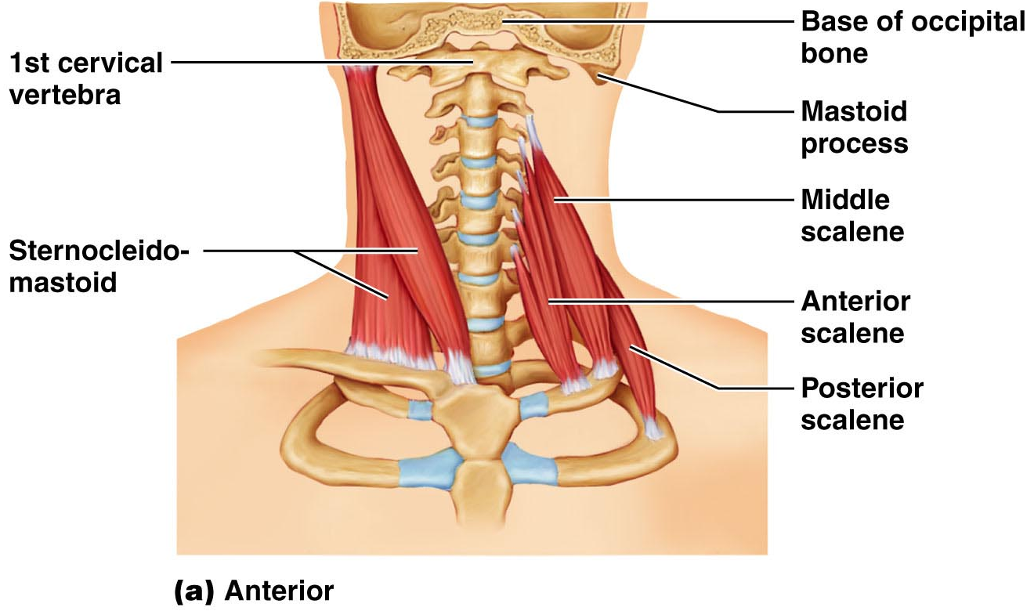
Muscles of the Neck and Vertebral Column
Head movement
Sternocleidomastoid
Splenius capitis and splenius cervicis
Sternum and clavicle (cleid/o) to Mastoid process of temporal bone
Turns head side to side.
Figure 11.11a

Slide 33
Muscles of the Neck and Vertebral Column (Head movements and Trunk Extension)
Anterolateral Neck Muscles | ATTACHMENT | MUSCLE ACTION
Muscle | Origin | Insertion | F | Nerve Supply
Sternocleidomastoid | Manubrium & median portion of clavicle | Mastoid process of Temporal bone and superior nuchal line | Prime mover head flexion | Accessory n. (CN XI); C@ & C3 ventral rami
Scalenes | Transverse process cervical vertebrae | Anterolateral 1st 2 ribs | Elevate 1st 2 ribs; flex and rotate neck | Cervical spinal nerves

Slide 34
Muscles of the Neck and Vertebral Column
Trunk extension
Deep muscles of the back
Maintain normal curvatures of the spine
Form a column from sacrum to the skull
Erector spinae group (Concentrate into this muscles) – maintain posture
Largest of the deep back muscles (ILS)
Iliocostalis [Iliac (Ili/o) crest to ribs (cost/o)]
Longissimus
Semispinalis

Slide 35
Muscles of the Neck and Vertebral Column (Head movements and Trunk Extension)
Intrinsic Muscles of the Back | ATTACHMENT | MUSCLE ACTION
Muscle | Origin | Insertion | F | Nerve Supply
Capitis | Ligamentum nuchae; spinous process of C7-T6 | Mastoid process of Temporal and Occipital bone | Extend or hyperextend the head | Cervical spinal nerves (dorsal rami)
Cervicis | Refer above | Transverse process C2-C4 vertebrae | Extend or hyperextend the head | Cervical spinal nerves (dorsal rami)
Iliocostalis (lumborum, thoracis cervicis) | Iliac crest Inferior 6 ribs Ribs 3 – 6 | Angle of ribs Angle of ribs Transverse process of Cervical vertebrae C6-C4 | Extend and laterally flex the vertebral column | Spinal nerves (dorsal rami)
Longissimus (thoracis cervicis, capitis) | Transverse process of lumbar to cervical vertebrae | Transverse processes superior to origin; (capitis) mastoid process | Extend and laterally flex the vertebral column Extends head and turns face toward the same side (capitis) | Spinal nerves (dorsal rami)
Spinalis ( thoracis, cervicis, capitis) | Spines of upper lumbar, lower thoracic vertebrae | Spines of upper thoracic and cervical vertebrae | Extends vertebral column | Spinal nerves (dorsal rami)
Semispinalis (thoracis, cervicis, capitis) | Transverse process C7-T12 | Occipital bone (capitis) Cervical spinous process (cervicis) Thoracic vertebrae T1-T4 (Thoracis) | Extends vertebral column & head and rotates them to opposite side | Spinal nerves (dorsal rami)
Quadratus lumborum | Iliac crest and lumbar fascia | Transverse process of upper vert. And lower margin rib 12 | Flexes vertebral column laterally | T12 and upper lumbar spinal nerves (ventral rami)
Splenius
Erector Spinae

Slide 36
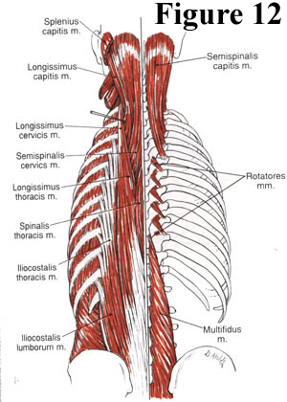
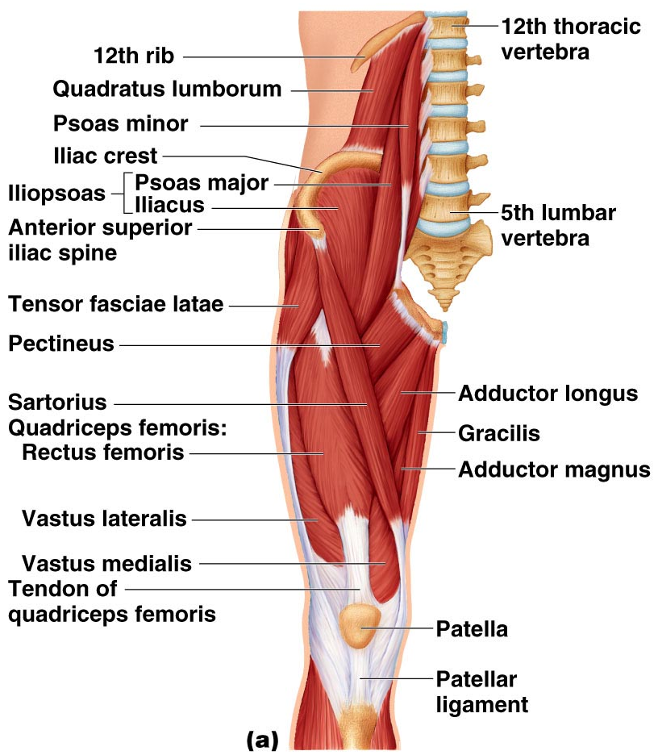
Muscles of the Neck and Vertebral Column

Slide 37
Muscles of the Neck and Vertebral Column
I
L
S
Inside pelvic cavity
Psoas major
Iliacus
Inguinal Ligament
At thigh
Iliopsoas

Slide 38
Iliocostalis

Slide 39
Longissimus

Slide 40
Muscles of the Neck and Vertebral Column
I
L
S
Inside pelvic cavity
Psoas major
Iliacus
Inguinal Ligament
At thigh
Iliopsoas

Slide 41
Iliopsoas

Slide 42
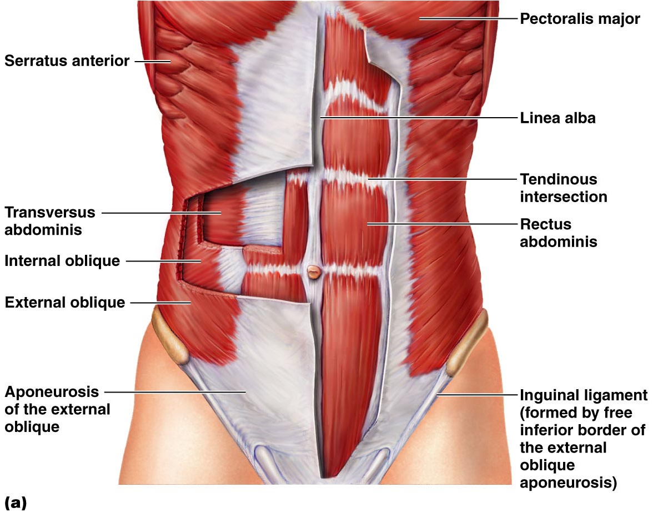
Muscles of the Abdominal Wall
Figure 11.13a

Slide 43
Muscles of the Abdominal Wall
8 Packs (Referred before as 6 pack since it looks like 6 pack of beer in your abdomen)
Figure 11.13a

Slide 44
Muscles of the Abdominal Wall
OBLIQUES
Figure 11.13a

Slide 45
Muscles of the Abdominal Wall
OBLIQUES
Fibers transverse
Fibers lateral to medial upward
Fibers lateral to medial downward. Like, hands in the pocket
Figure 11.13a

Slide 46
Muscles of the Abdominal Wall
Figure 11.13b

Slide 48
Muscles of the Abdominal Wall: Trunk Movements and Compression of Abdominal Viscera
Anterolateral Abdominal Wall | ATTACHMENT | MUSCLE ACTION
Muscle | Origin | Insertion | F | Nerve Supply
External Oblique | Fleshy strips from outer surface of lower 8 ribs | Linea alba (via broad aponeurosis) | Flex vertebral column and compress abdominal contents; Trunk rotation & lateral flexion | Intercostal nerves (T7-T12)
Internal Oblique | Lumbar fascia; iliac crest; inguinal ligament | Linea alba; pubic crest; last 3 –4 ribs and costal margin | Flex vertebral column and compress abdominal contents; Trunk rotation & lateral flexion | Intercostal nerves (T7-T12, L1)
Transversus abdominis | Inguinal ligament, lumbar fascia; cartilage of last 6 ribs | Linea alba; pubic crest | Compresses abdominal contents | Intercostal nerves (T7-T12, L1)
Rectus Abdominis | Pubic crest and symphysis | Xiphoid process and costal cartilage 5 - 7 | Flex and rotate lumbar region of vertebral column | Intercostal nerves T6, or T7 – T12)

Slide 49
Superficial Muscles of the Anterior Thorax
Movements of the scapula
Pectoralis major
Pectoralis minor

Slide 50
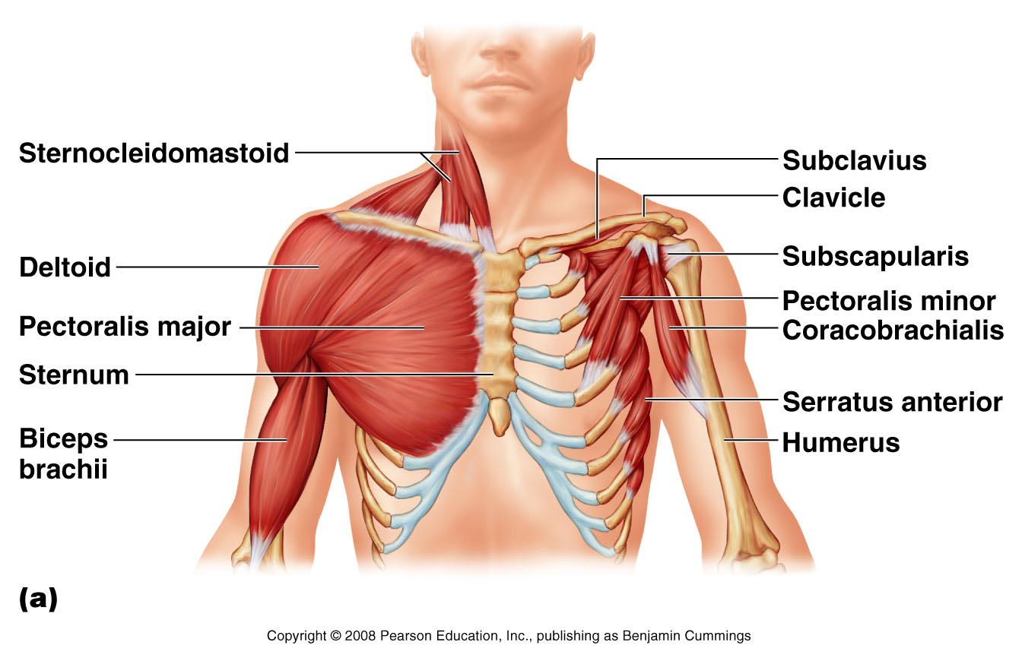
Superficial Muscles of the Anterior Thorax
Coracoid process to ribs 3, 4, 5
Ribs, sternum, and clavicle to humerus
Figure 11.15a

Slide 51
Superficial muscles of the Anterior and Posterior Thorax: Movements of the Scapula
Anterior Thorax muscles | ATTACHMENT | MUSCLE ACTION
Muscle | Origin | Insertion | Muscle Action | Nerve Supply
Pectoralis minor | Anterior surface of rib 3 - 5 | Coracoid process of scapula | Draws scapula forward and downward | Medial and lateral pectoral nerves C6 – C8)
Serratus anterior | Muscle slips from ribs 1 - 8 | Anterior surface of vertebral border of scapula | Rotates scapula so that its inferior angle moves laterally and upward | Long thoracic nerve (C5 – C7)
Subclavius | Costal cartilage rib 1 | Groove on inferior surface of clavicle | Help stabilize and depress pectoral girdle | Nerve to subclavius (C5 and C6)

Slide 52
Superficial Muscles of the Posterior Upper Thorax
Movements of the scapula
Trapezius
Levator scapulae
Rhomboid major
Rhomboid minor

Slide 53
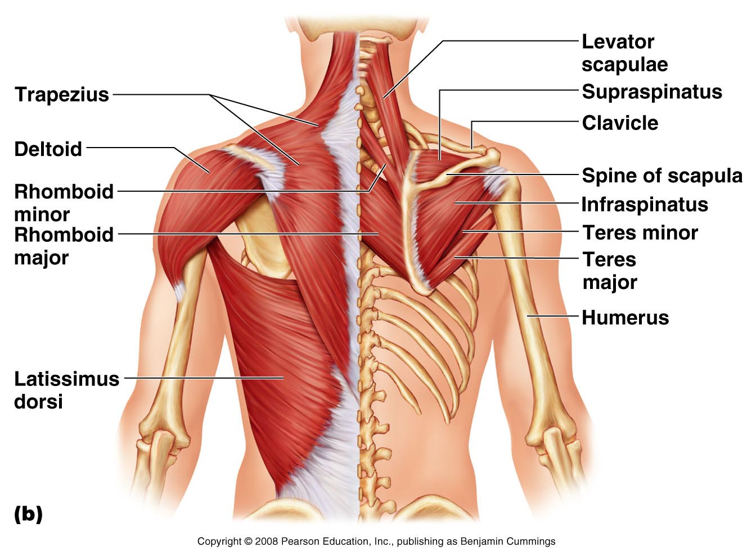
Superficial Muscles of the Posterior Thorax
PLAY
Rotator cuff muscles: an overview (a)
PLAY
Rotator cuff muscles: an overview (b)
Figure 11.15b

Slide 54
Superficial Muscles of the Posterior Thorax
Elevates scapula
Lifts shoulder
Pulls scapula towards vertebrae – RHOMBOID MUSCLES
PLAY
Rotator cuff muscles: an overview (a)
PLAY
Rotator cuff muscles: an overview (b)
Figure 11.15b

Slide 55
Superficial Muscles of the Anterior and Posterior Thorax: Movements of the Scapula
Posterior Thorax Muscles | ATTACHMENT | MUSCLE ACTION
Muscle | Origin | Insertion | Action | Nerve Supply
Trapezius | Occipital bone, ligamentum nuchae & spines of C7 – T12 | Acromion, scapular spine, lateral third of clavicle | Stabilizes, raises, retracts and rotates scapula | Accessory n.; C3 and C4
Levator scapulae | Transverse process of C1 – C4 | Medial border of scapulae | Elevates/adducts scapula | Cervical spinal nerves and dorsal scapular nerves (C3 – C5)
Rhomboid major | Spinous process of C7 and T1 | Medial border of scapulae | Stabilize scapula | Dorsal scapular nerve (C4 and C5)
Rhomboids minor | Spinous process of T2 – T5 | Medial border of scapulae | Stabilize scapula | Dorsal scapular nerve (C4 and C5)

Slide 59
END
AXIAL MUSCLES

