Slide 1
Arterial Vessel Tracing

Slide 2
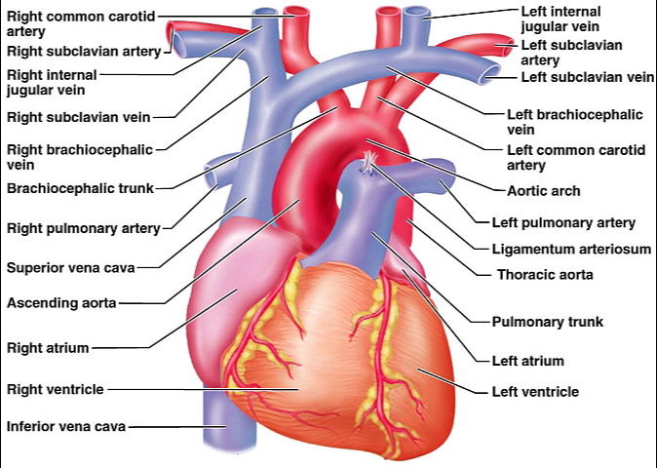

Slide 3


Slide 4


Slide 5


Slide 6
End

