Slide 1
Chapter 4: EPITHELIAL TISSUES Review
DR. PETER REONISTO

Slide 2
What is a group of cells of similar structure that perform a common function?
Molecules
Tissue
Organ
System
Copyright © 2008 Pearson Education, Inc., publishing as Benjamin Cummings
Notes:
Answer: B

Slide 3
The four basic tissues of the body include epithelium, connective tissue, and __________.
nervous tissue
muscle tissue
bone tissue
both a and b
Copyright © 2008 Pearson Education, Inc., publishing as Benjamin Cummings
Notes:
Answer: D

Slide 4
Four Main Tissues
Epithelium
Connective Tissue
Muscle
Nervous

Slide 5
Epithelium
A. Simple squamous
B. Simple cuboidal
C. Simple columnar
D. Pseudostratified Ciliated Columnar
E. Stratified squamous (Keratinized and Non-keratinized
F. Stratified cuboidal
G. Stratified columnar
H. Transitional

Slide 6
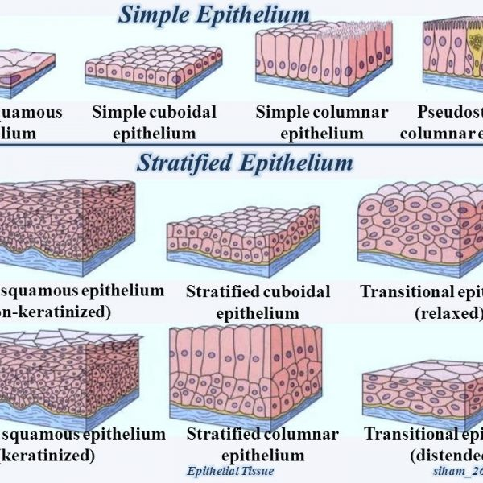

Slide 7
Simple Epithelium
A. Simple squamous
B. Simple cuboidal
C. Simple columnar
D. Pseudostratified Ciliated Columnar

Slide 8
Simple Epithelium
A. Simple squamous

Slide 9
A: SIMPLE SQUAMOUS (ENDOTHELIUM)

Slide 10
A: SIMPLE SQUAMOUS

Slide 11
A: SIMPLE SQUAMOUS

Slide 12
Simple Epithelium
A. Simple squamous
B. Simple cuboidal
C. Simple columnar
D. Pseudostratified Ciliated Columnar

Slide 13
B: SIMPLE CUBOIDAL

Slide 14
B: SIMPLE CUBOIDAL

Slide 15
B: SIMPLE CUBOIDAL

Slide 16
Simple Epithelium
A. Simple squamous
B. Simple cuboidal
C. Simple columnar
D. Pseudostratified Ciliated Columnar

Slide 17
C: SIMPLE COLUMNAR

Slide 18
C: SIMPLE COLUMNAR

Slide 19
C: SIMPLE COLUMNAR

Slide 20
C: SIMPLE COLUMNAR

Slide 21
Simple Epithelium
A. Simple squamous
B. Simple cuboidal
C. Simple columnar
D. Pseudostratified Ciliated Columnar

Slide 22
D: PSEUDOSTRATIFIED COLUMNAR (WITH CILIA)

Slide 23
D: PSEUDOSTRATIFIED COLUMNAR (WITH CILIA)

Slide 24
D: PSEUDOSTRATIFIED COLUMNAR (WITH CILIA)

Slide 25
D: PSEUDOSTRATIFIED COLUMNAR (WITH CILIA)

Slide 26
Stratified Epithelium
E. Stratified squamous (Keratinized and Non-keratinized
F. Stratified cuboidal
G. Stratified columnar
H. Transitional

Slide 27
Stratified Epithelium
E. Stratified squamous (Keratinized and Non-keratinized
F. Stratified cuboidal
G. Stratified columnar
H. Transitional

Slide 28
E: STRATIFIED SQUAMOUS KERATINIZED

Slide 29
E: STRATIFIED SQUAMOUS (NON-KERATINIZED)

Slide 30
E: STRATIFIED SQUAMOUS (NON-KERATINIZED)

Slide 31
E: STRATIFIED SQUAMOUS KERATINIZED

Slide 32
E: STRATIFIED SQUAMOUS NON-KERATINIZED

Slide 33
E: STRATIFIED SQUAMOUS NON-KERATINIZED

Slide 34
E: STRATIFIED SQUAMOUS KERATINIZED

Slide 35
E: STRATIFIED SQUAMOUS KERATINIZED

Slide 36
Stratified Epithelium
E. Stratified squamous (Keratinized and Non-keratinized
F. Stratified cuboidal
G. Stratified columnar
H. Transitional

Slide 37
F: STRATIFIED CUBOIDAL

Slide 38
Stratified Epithelium
E. Stratified squamous (Keratinized and Non-keratinized
F. Stratified cuboidal
G. Stratified columnar
H. Transitional

Slide 39
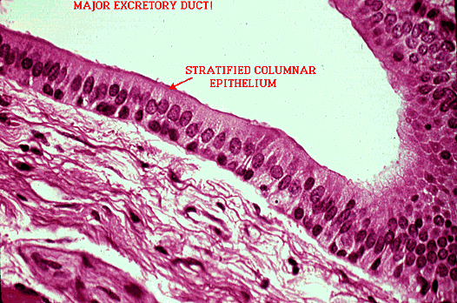
G: STRATIFIED COLUMNAR

Slide 40
Stratified Epithelium
E. Stratified squamous (Keratinized and Non-keratinized
F. Stratified cuboidal
G. Stratified columnar
H. Transitional

Slide 41
H: TRANSITIONAL

Slide 42
Histology Exercise

Slide 43
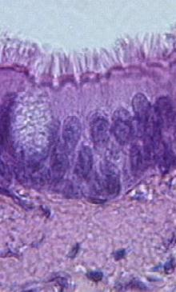
Identify this tissue:
Identify light grey region at the top of the image:
Identify the oval granular structure on the left side of the image:
Identify one major function of this specific type of tissue:

Slide 44
Identify this tissue: Ciliated pseudostratified
columnar epithelial tissue
Identify light grey region at
the top of the image: Lumen
Identify the oval granular
structure on the left side
of the image: Goblet cell
Identify one major function
of this specific type of tissue: Movement of mucus and
particles on
lining

Slide 45
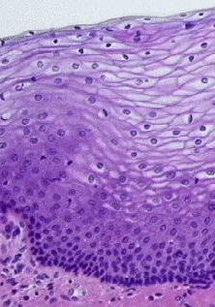
Identify this tissue (be specific):
Identify a location where this
tissue is found:
Identify the region of
closely-packed
cells near the bottom:

Slide 46
Identify this tissue (be specific): Nonkeratinized stratified
squamous epithelial tissue
Identify a location where this
tissue is found: Lining of mouth, esophagus,
vagina, part of epiglottis, tongue
Identify the region of
closely-packed cells near
the bottom: Basal layer (stratum germinativum)

Slide 47
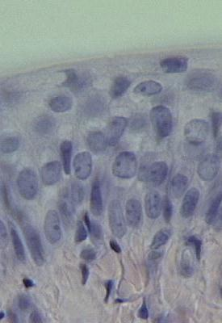
Identify the tissue shown here (mucosal lining of urinary bladder):
Identify the round purple structures
Identify a specific location where this tissue is found:

Slide 48
Identify the specific
tissue shown here: Transitional epithelial
tissue
Identify the round purple
structures Cell nuclei
Identify a specific location
where this tissue is found: Lines urinary bladder and
ureters

Slide 49
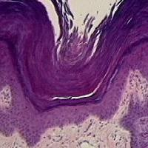
Identify the purple layer of tissue just above the pink region at the bottom of the image:
What is the thick purple debris above this tissue:
Identify a location where this tissue is found:

Slide 50
Identify the purple layer
of tissue just above the
pink region at the bottom of the image: Keratinized stratified
sqamous epithelial tissue
What is the thick purple
debris above this tissue: Keratin Identify a location where
this tissue is found: Outer layer of skin

Slide 51
Things to remember:
Keep in mind that all organs contain all 4 of the basic tissue types. You might have to scan the slide for the specific tissue.
As you scan the slide, look at the images in your lab manual or text or this tutorial and try to find the regions that are similar and exemplify the tissue being studied.
Sometimes different slides of the same tissue are dissimilar.
IF WHAT YOU ARE SEEING ON THE SLIDE IS NOT SIMILAR TO THE IMAGE, ASK YOUR INSTRUCTOR FOR HELP.
Sketch the tissues as you view them.
Remember the techniques you learned for focusing and storing your microscope. Keeping the microscopes clean and properly aligned and unscratched is essential for histology.

Slide 52
EPITHELIAL TISSUE
Think about what you expect to see for the various types of epithelial tissue:
Will the cells be one layer or multiple layers? (i.e. stratified or simple)
Will the cells be flat, cube-shaped, or tall? (squamous, cuboidal, or columnar)
Will the cells be scattered with large amounts of extracellular matrix or densely packed?

Slide 53
Histology Pictures

Slide 54
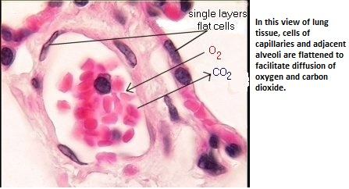

Slide 55
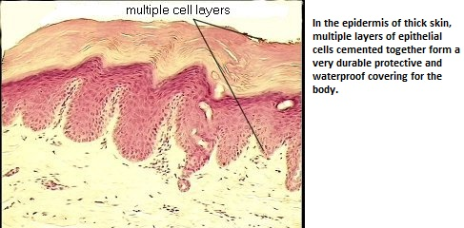

Slide 56
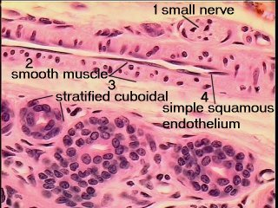

Slide 57
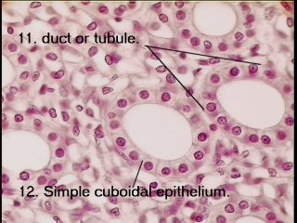

Slide 58
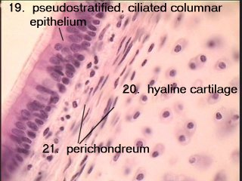

Slide 59
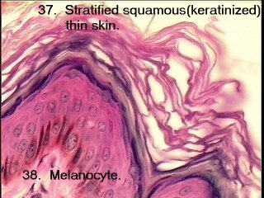

Slide 60
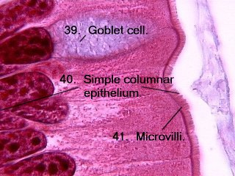

Slide 61
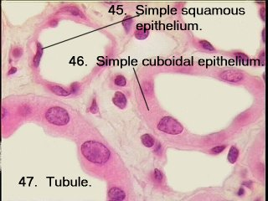

Slide 62
HISTOLOGY

Slide 72
END

