Slide 1
Histology Tutorial

Slide 2
Things to remember:
Keep in mind that all organs contain all 4 of the basic tissue types. You might have to scan the slide for the specific tissue.
As you scan the slide, look at the images in your lab manual or text or this tutorial and try to find the regions that are similar and exemplify the tissue being studied.
Sometimes different slides of the same tissue are dissimilar.
IF WHAT YOU ARE SEEING ON THE SLIDE IS NOT SIMILAR TO THE IMAGE, ASK YOUR INSTRUCTOR FOR HELP.
Sketch the tissues as you view them.
Remember the techniques you learned for focusing and storing your microscope. Keeping the microscopes clean and properly aligned and unscratched is essential for histology.

Slide 3
Connective Tissue
Connective tissue consists of sparse cells and large amounts of extracellular matrix.
Functions: cushions and wraps around tissues, connects tissues together
general types
Connective tissue proper: loose (areolar, reticular, adipose) and dense (dense regular connective, dense irregular, elastic)
Skeletal: osseous, hyaline cartilage, fibrocartilage, elastic cartilage
blood

Slide 4
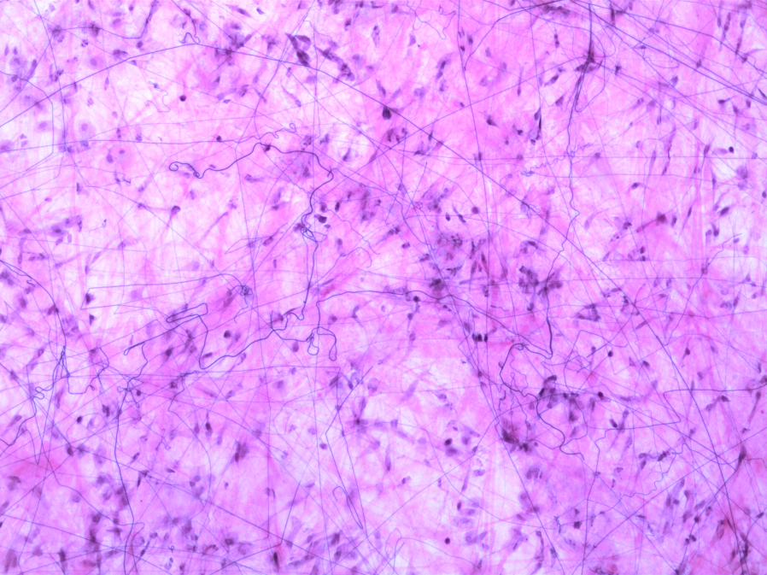
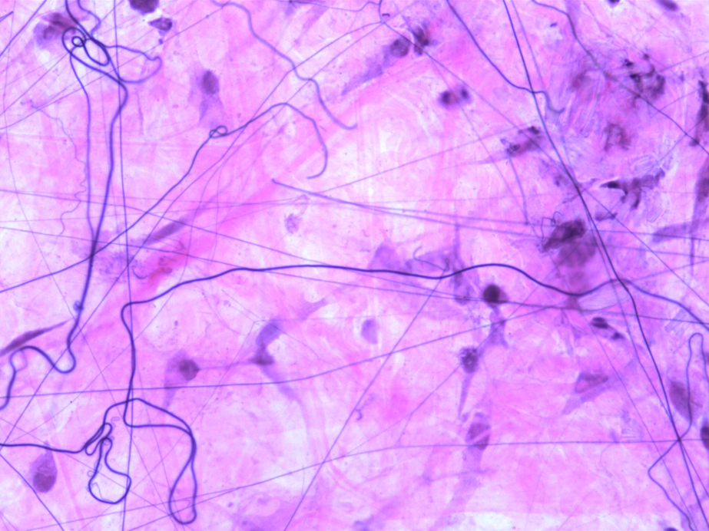
Fibroblast
Connective tissue proper:
Areolar (loose) connective tissue
Fibroblast nucleus
areolar tissue 93 W 3224 100 X
areolar tissue 93 W 3224 400 X
Elastic fiber
Collagen fiber
Reticular fiber
Where is areolar tissue found?

Slide 5
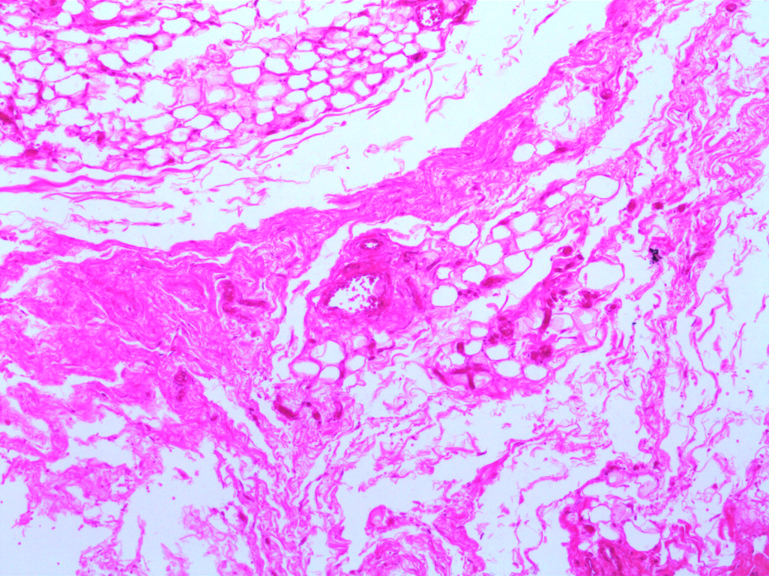
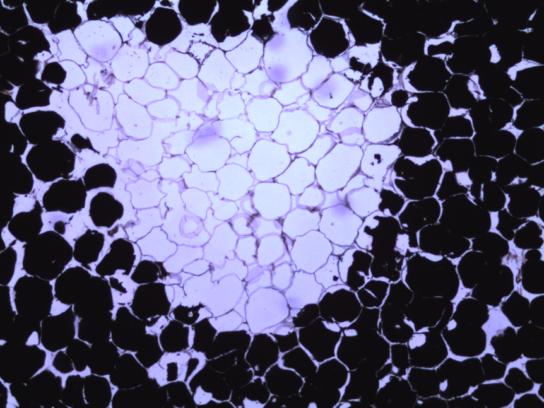
Adipose cells
Adipose tissue
adipose tissue OsO₄ 93 W 3232 100 X
Human adipose tissue sec. 31-2728 100 X
These cells have a small nucleus of to the side and enormous fat globule containing lipids

Slide 6
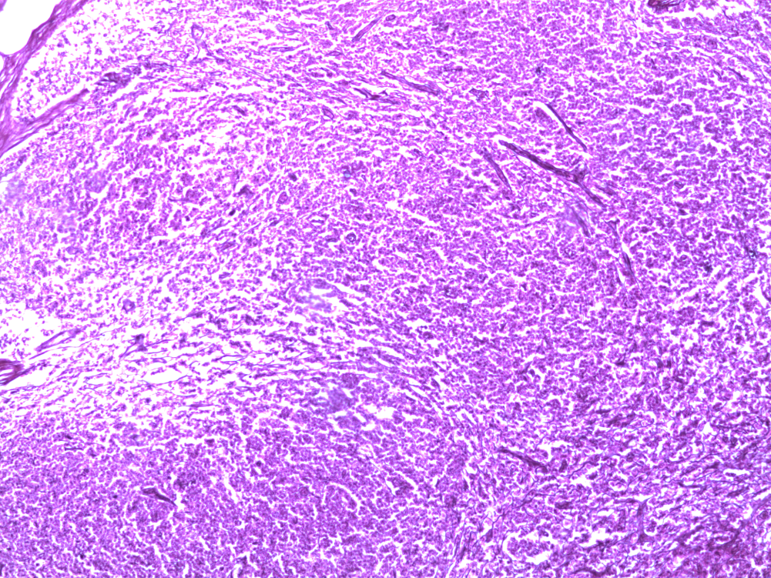
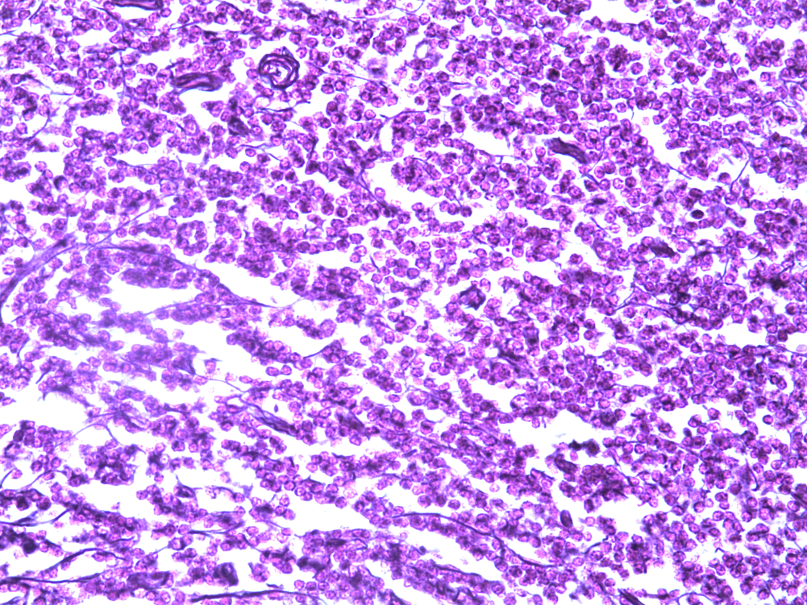
Reticular tissue sec. 31-2668 100X
Reticular tissue sec. 31-2668 400X
Reticular fibers
Location of reticular connective tissue: lymph nodes, bone, marrow, spleen
Function: Fibers provide support and framework other cell types like white blood cells

Slide 7
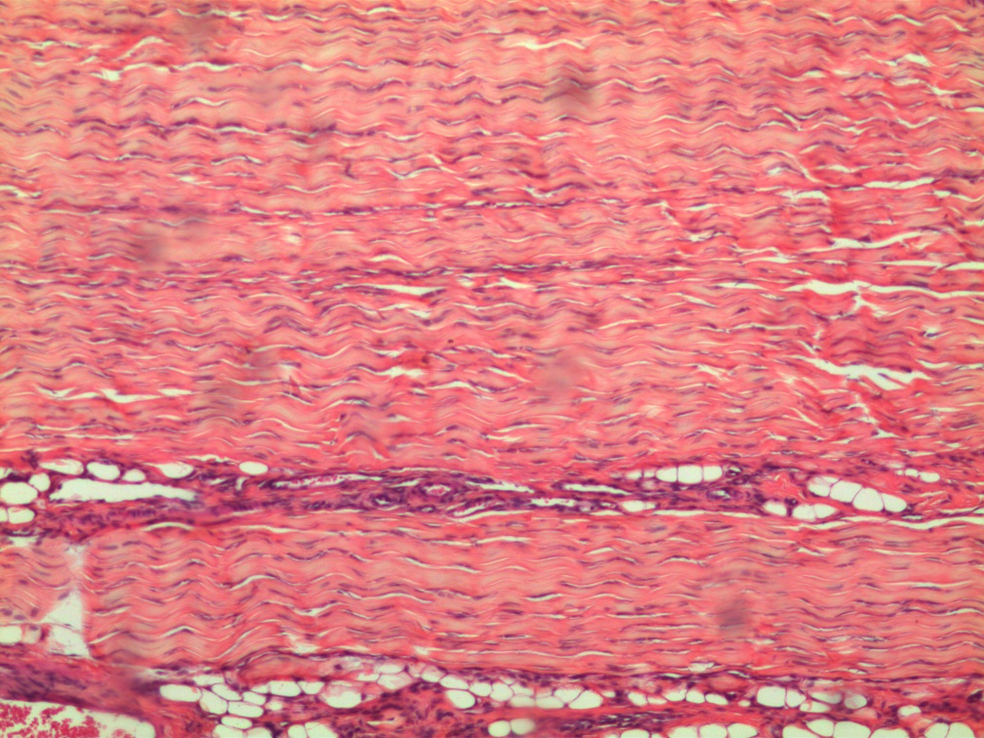
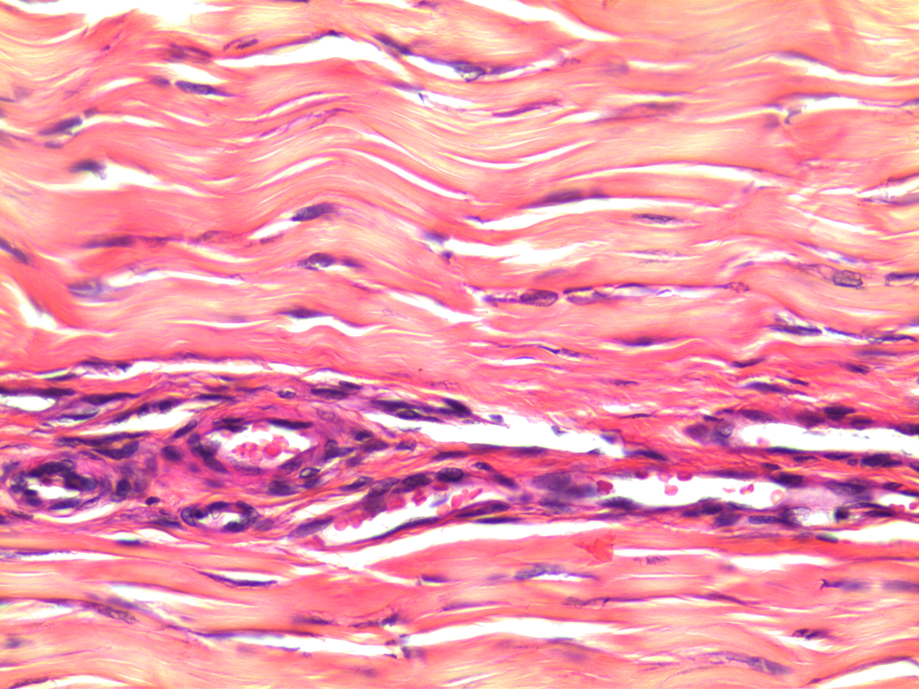
Dense regular fibrous connective tissue
Tendon white fibrous connective tissue l.s. 93 W 3248 100X
Tendon white fibrous connective tissue l.s. 93 W 3248 400X
Found in tendons
Why must all of the collagen
fibers align in parallel?
Think about the function of tendons.
Notice the density and the wavelike appearance of the
collagen fibers

Slide 8
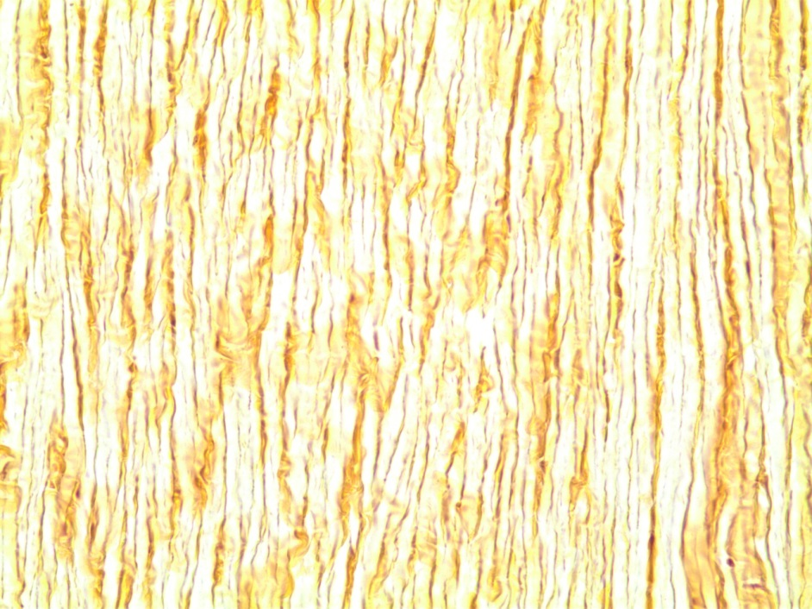
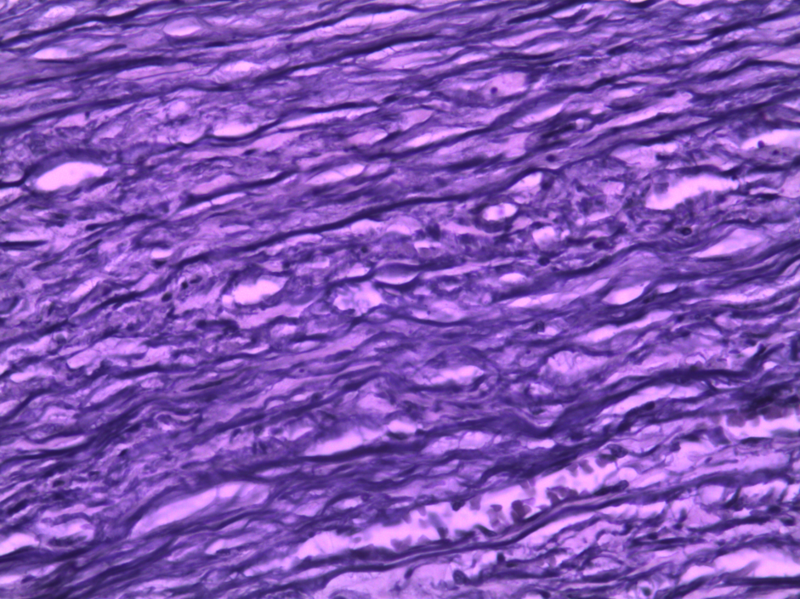
Elastic tissue
Notice the large numbers of elastic fibers
Found in aorta and large arteries. The elastic fibers have properties of stretch and recoil which drives blood flow through large arteries during diastole (when the heart relaxes and fills)
Found in ligmentum nuchae and ligamentum flavum: provides stretch in these ligaments
Found in lungs: provides recoil for expiration (exhalation)
Ligamentum nuchae l.s. 93 W 3260 400X
Human aorta c.s. 31-4010 40X

Slide 9
SKELETAL CONNECTIVE TISSUES
Cartilage– 3 types: hyaline cartilage, fibrocartilage, elastic cartilage
Consists of chondrocytes (cartilage cells) in lacuna (small caves) & large
amounts of extracellular matrix
Osseous (bone):
Consists of osteocytes (bone cells) in lacuna

Slide 10
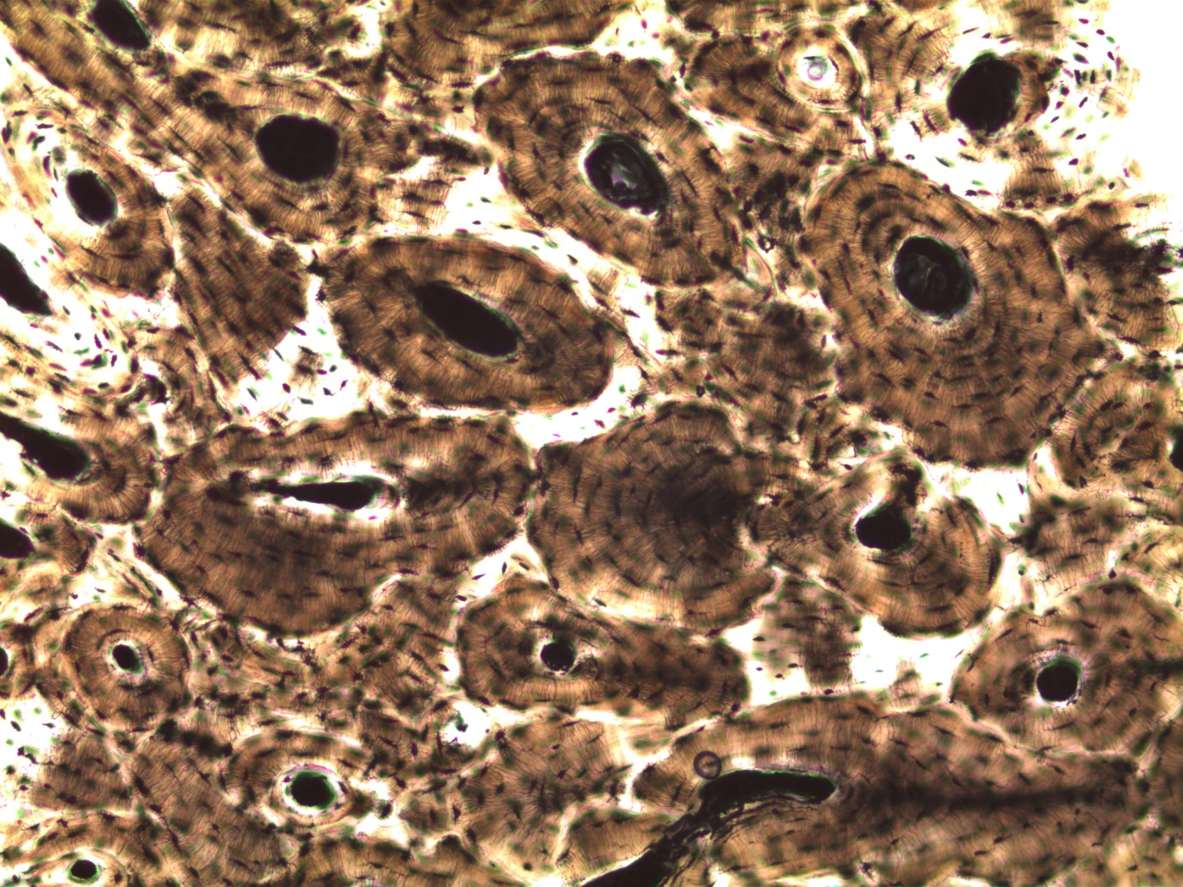
Osteocytes in lacuna
Compact bone
Central canal
Bone dry ground human c.s. 93 W 6140 10X

Slide 11
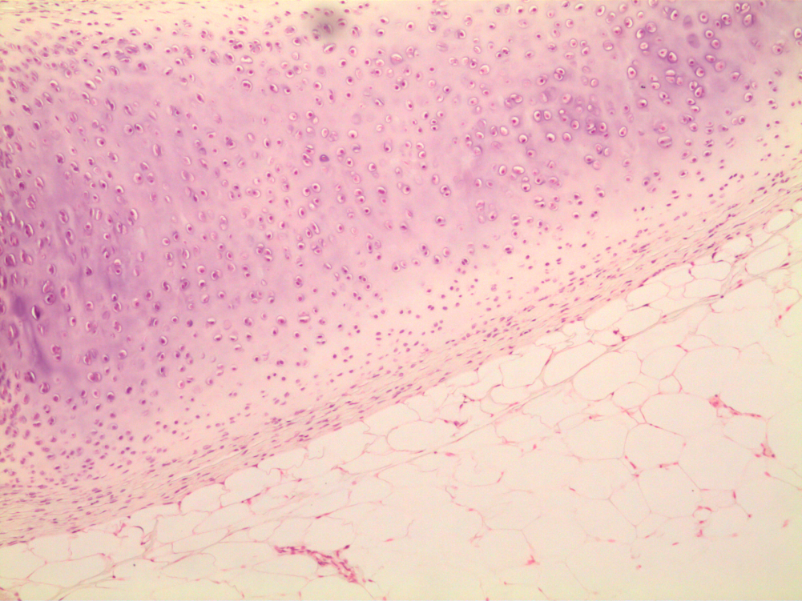
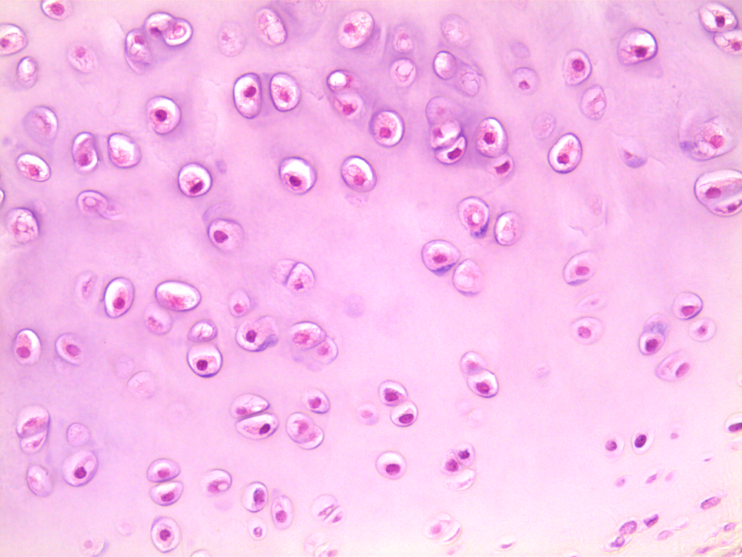
Hyaline cartilage
Locations: ends of long bones, growth plate of bones, ends of ribs, sternum
Function: supportive but flexible
Hyaline cartilage xiphisternum H&E sec. 93 W 3264 100X
Hyaline cartilage xiphisternum H&E sec. 93 W 3264 400X
Notice the chondrocyte in the lacuna
Notice the glassy
appearance of the matrix

Slide 12
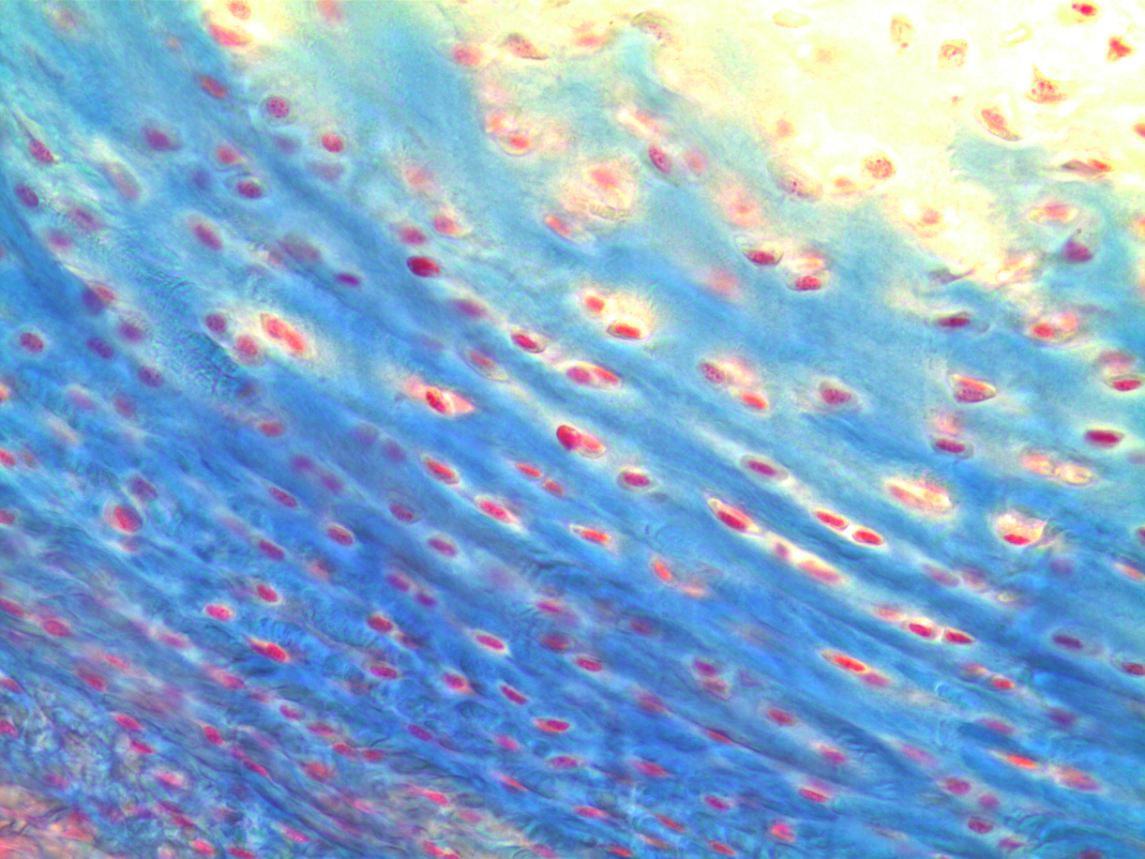
Fibrocartilage
Chondrocyte in lacuna
Collagen fiber
Mammal fibrocartilage sec 31-2922 400X
Where is fibrocartilage located and why?
Like hyaline cartilage, fibrocartilage contains chondrocytes in lacuna. The staining helps
reveal the fibers.

Slide 13
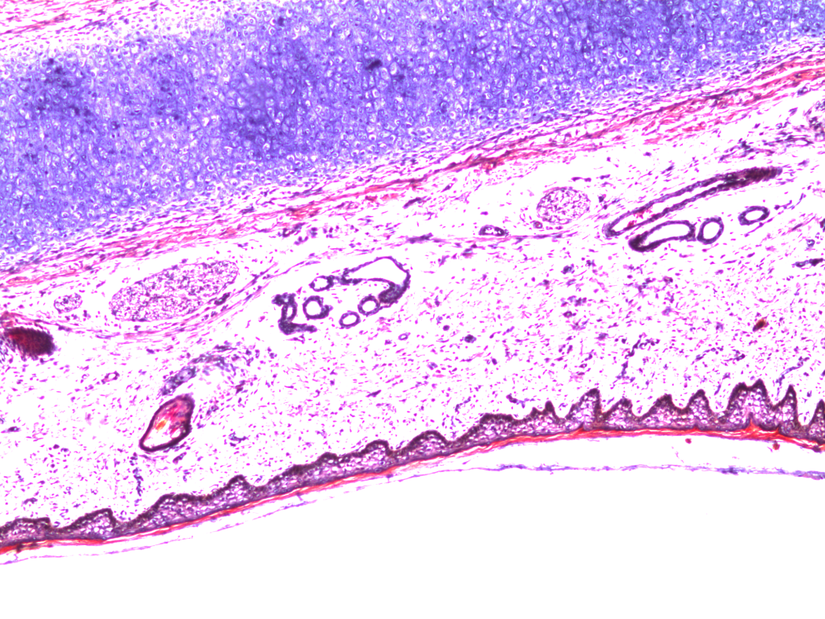
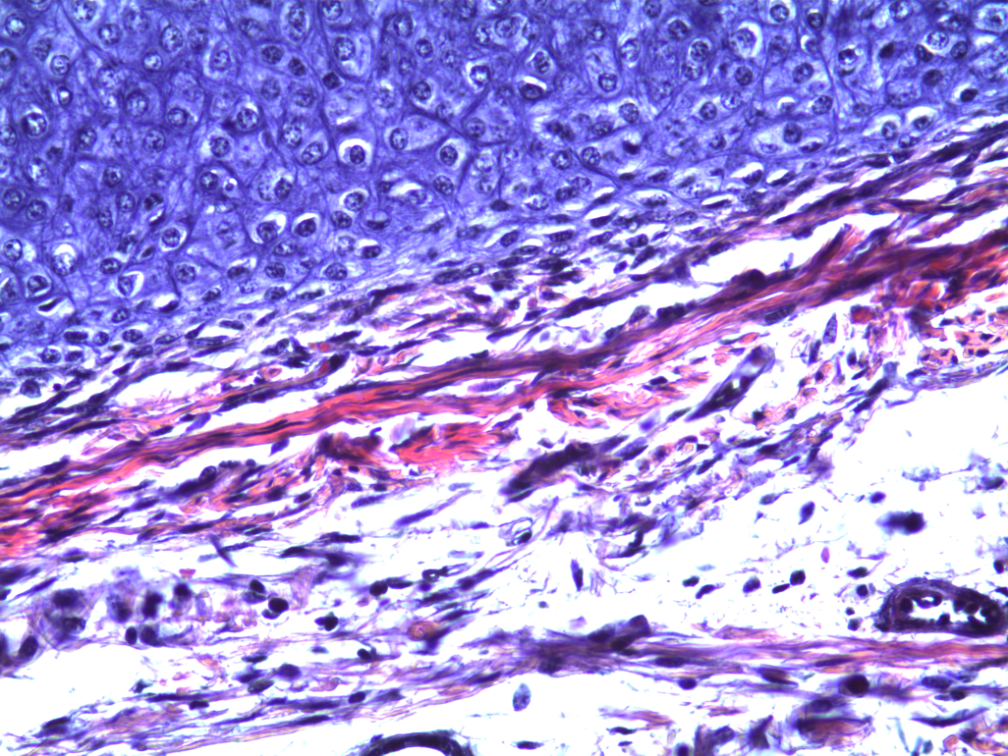
Elastic cartilage
Elastic fiber
Chondrocyte in lacuna
Elastic
cartilage
mammal elastic cartilage sec. 31-2910 100X
mammal elastic cartilage sec. 31-2910 400X
Notice how elastic cartilage is similar to hyaline cartilage but contains numerous elastic fibers

Slide 14
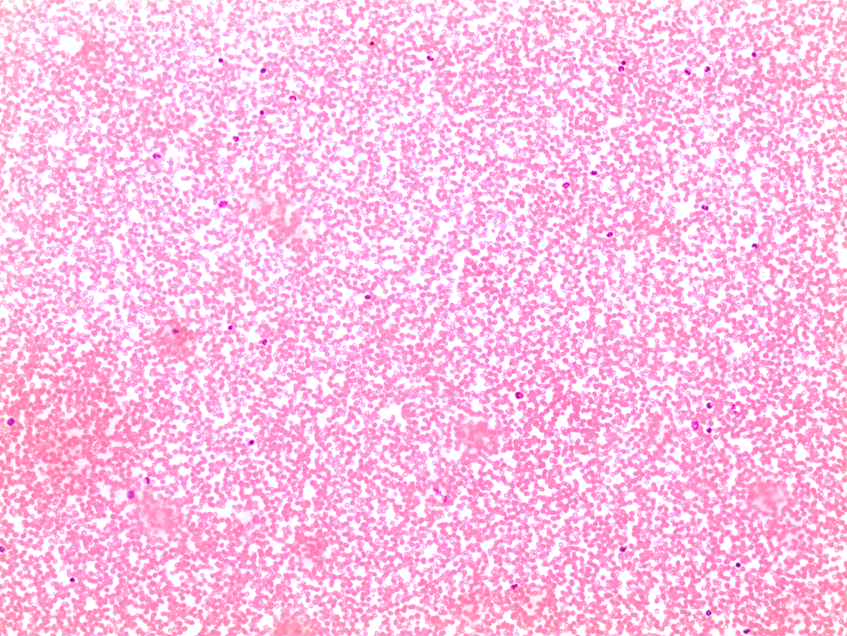
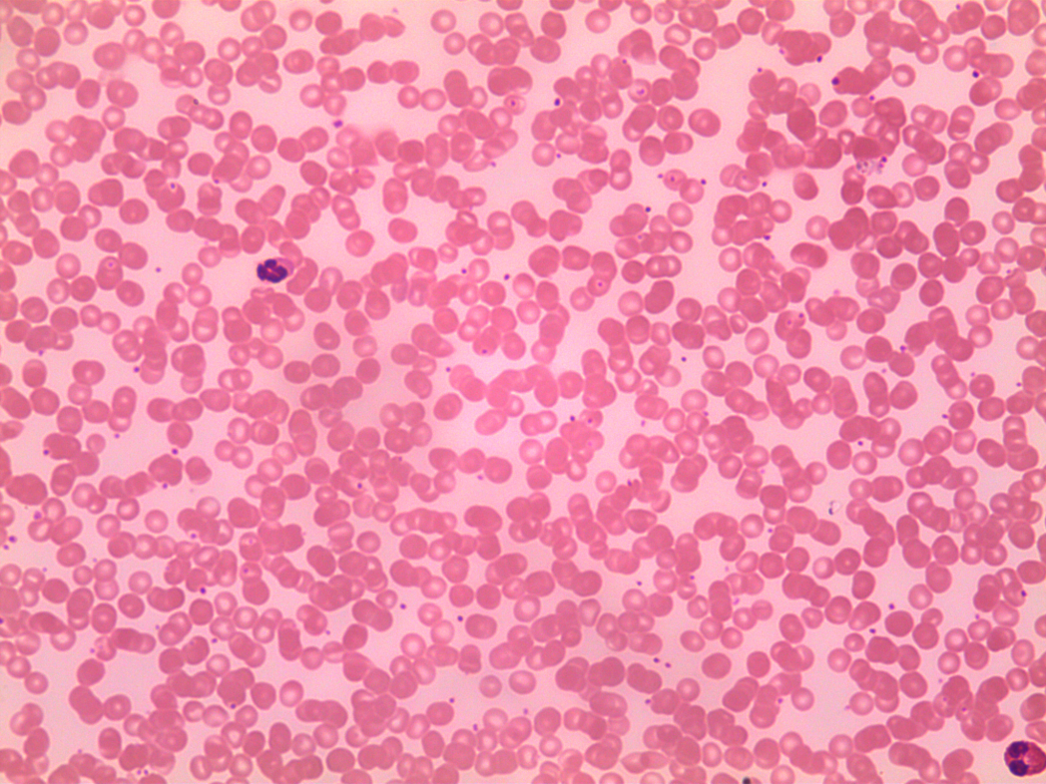
Blood
Human blood smear Wright 100X
Human blood smear Wright 400X

Slide 15
Muscle Tissue
3 types:
Skeletal
Smooth
Cardiac

Slide 16
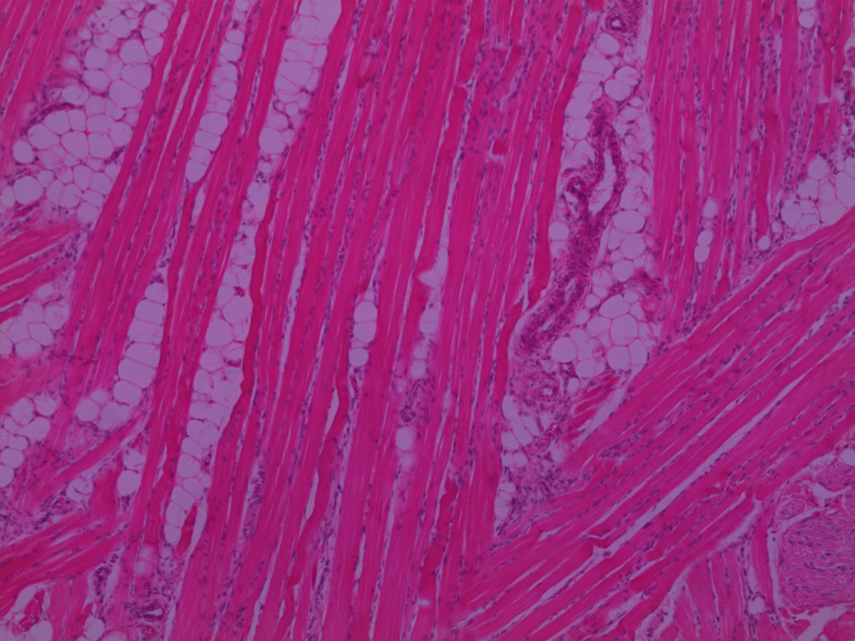
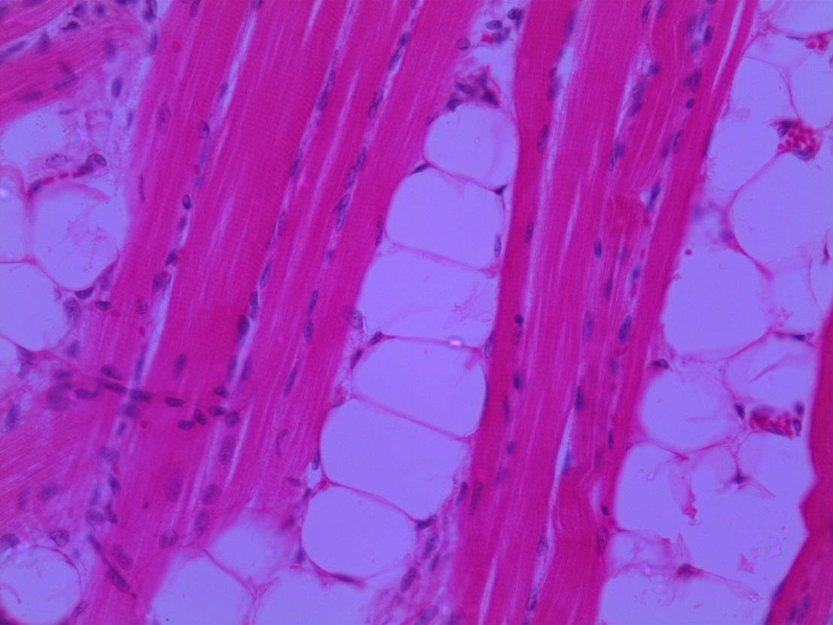
Skeletal Muscle
Mammal skeletal muscle sec. 31-3256 100X
Mammal skeletal muscle sec. 31-3256 400X
Notice how the muscle cells (fibers) are long, cylindrical, and parallel to each other. The striations are a little obscured in this image. Notice also how the multiple nuclei are at the edge of the cell.

Slide 17
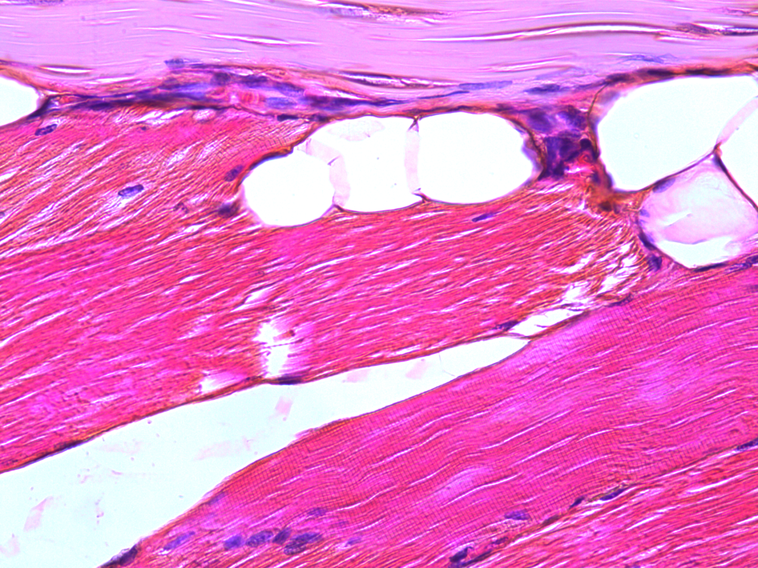
Muscle-tendon junction
In this image, the striations of the skeletal muscle tissue are more obvious.
tendon
muscle
striations
Muscle-tendon connection Sec. H&E 93 W 3539 400X

Slide 18
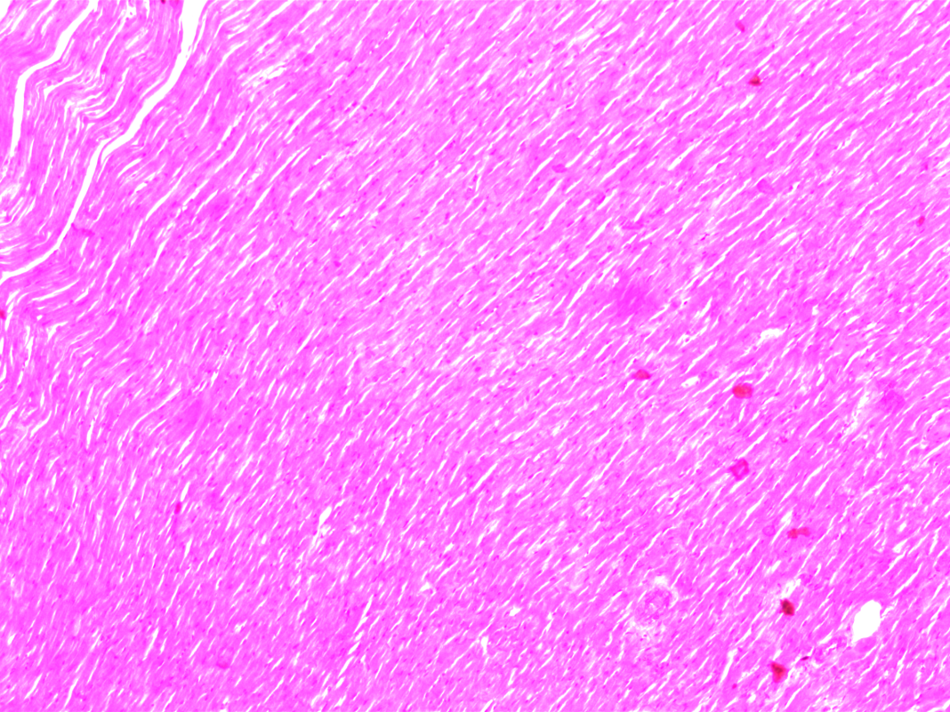
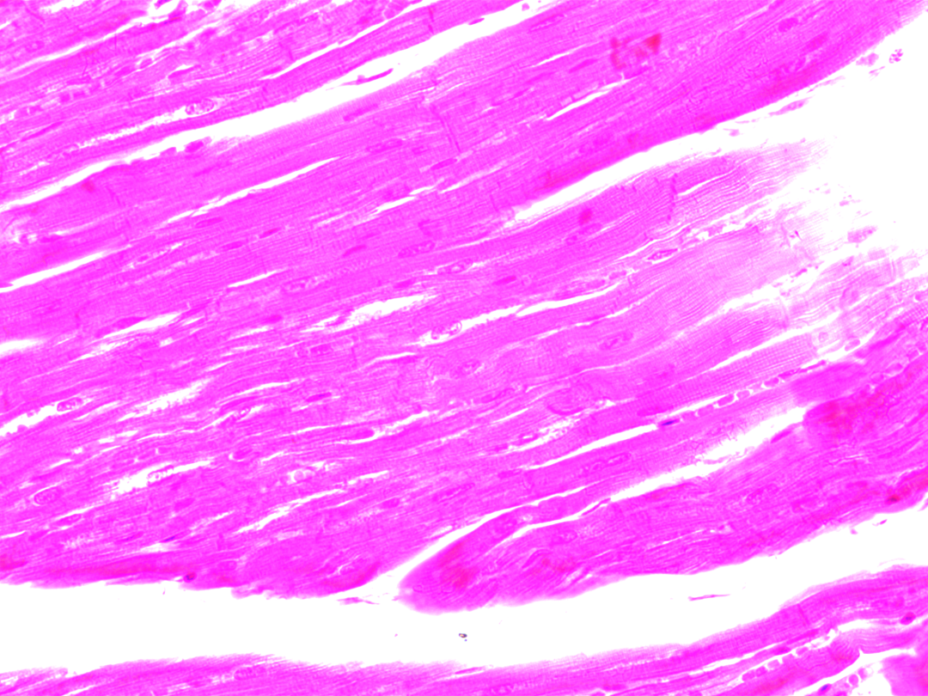
Cardiac muscle
Intercalated disk
Mammal cardiac muscle sec. 31-3388 100X
Mammal cardiac muscle sec. 31-3388 400X
Branched cells
striations
Cardiac muscle is similar to skeletal because it is striated. The unique
features are the branches and intercalated disks.
Location: heart muscle

Slide 19
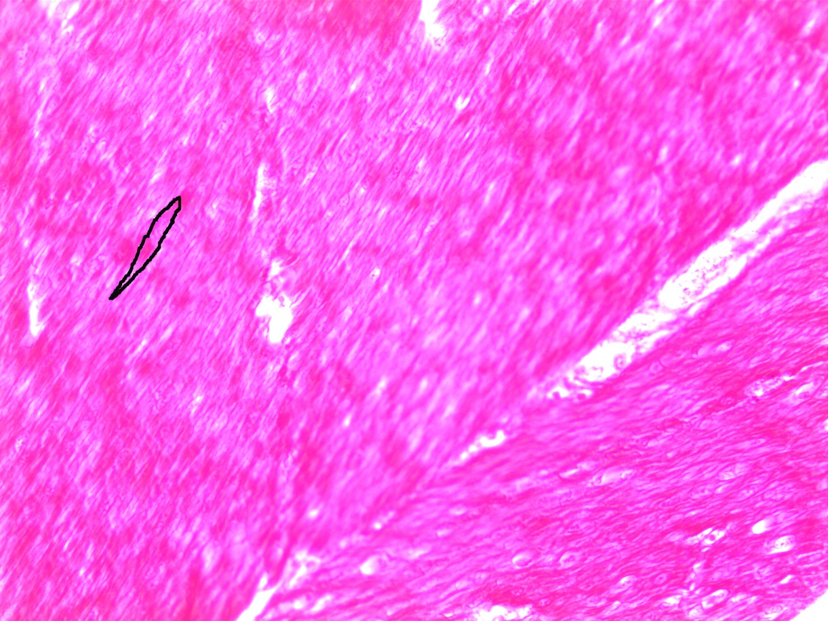
Smooth muscle
Border of spindle shaped cell
Nucleus
Mammal smooth muscle cs. 31-3340 40X
Where is smooth muscle found?
Notice the darkened circular nuclei in the center of these spindle shaped cells.

Slide 20
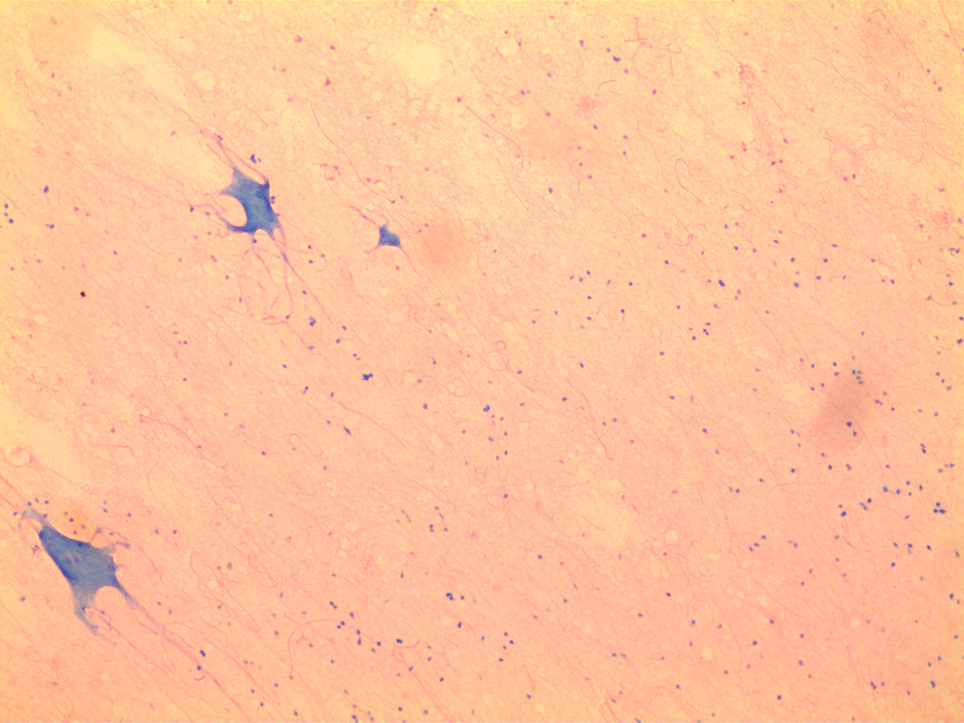
Nervous tissue
Spinal cord multipolar motor neuron nerve tissue smear 93 W 3616 100X

Slide 21
Histology Pictures

Slide 22
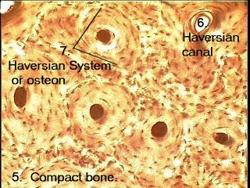

Slide 23
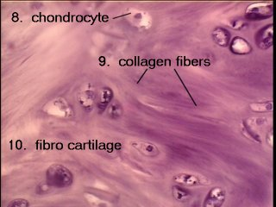

Slide 24
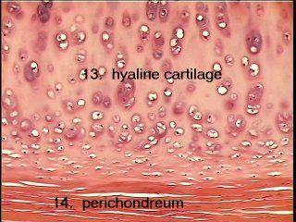

Slide 25
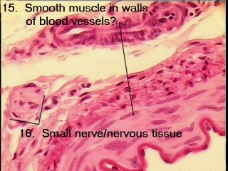

Slide 26
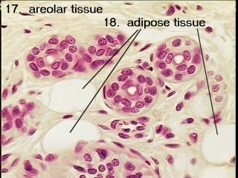

Slide 27
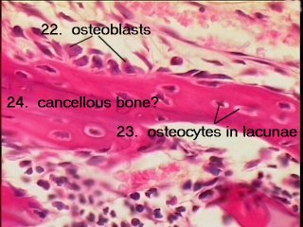

Slide 28
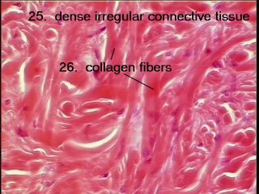

Slide 29
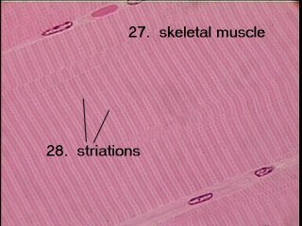

Slide 30
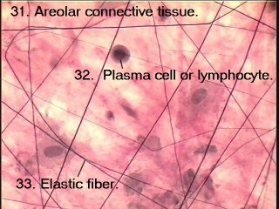

Slide 31
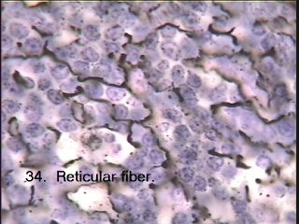

Slide 32
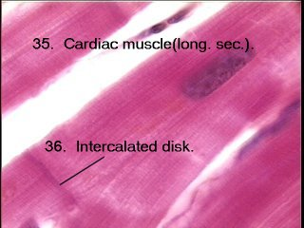

Slide 33
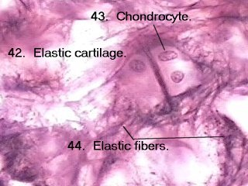

Slide 34
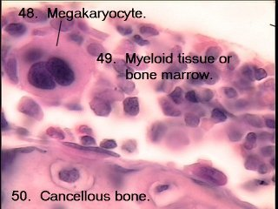

Slide 35
HISTOLOGY

Slide 52
END

