Slide 1
The Axial Skeleton, VERTEBRAL COLUMN AND THORACIC CAGE

Slide 2
The Vertebral Column
Formed from 26 bones in the adult
Transmits weight of trunk to the lower limbs
Surrounds and protects the spinal cord

Slide 3
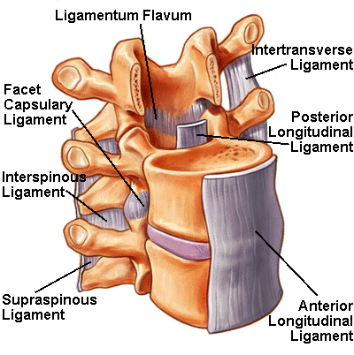
The Vertebral Column
Serves as attachment sites for muscles of the neck and back
Held in place by ligaments
Anterior and posterior longitudinal ligaments
Ligamentum flavum

Slide 4
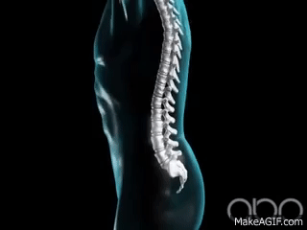
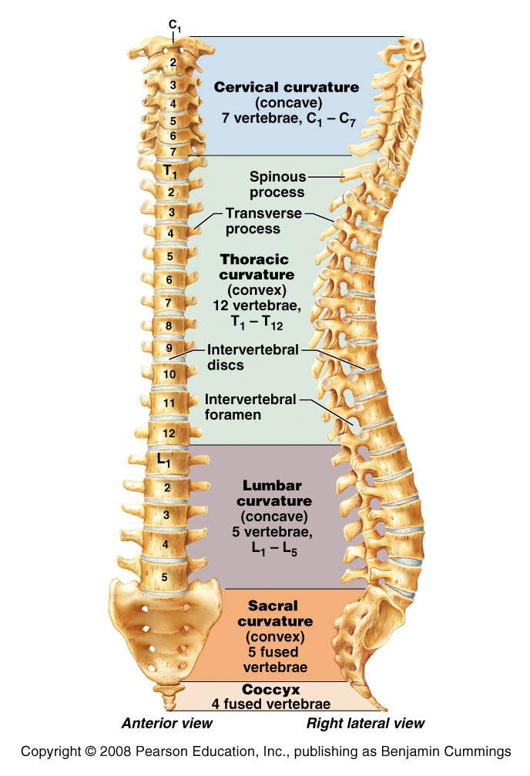
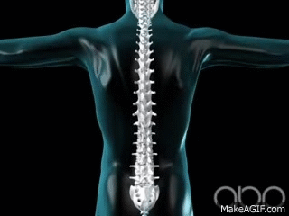
The Vertebral Column
Figure 7.13

Slide 5
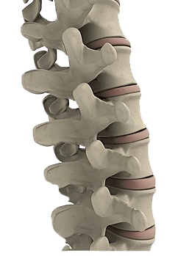
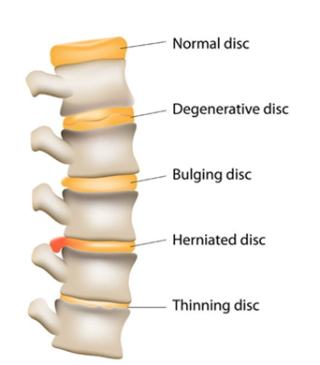
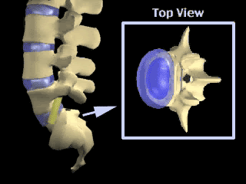
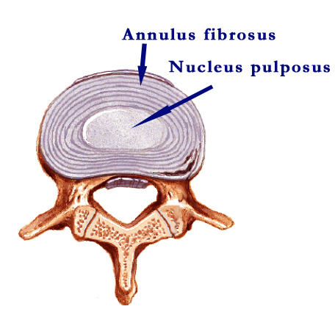
Intervertebral Discs
Cushion-like pads between vertebrae
Act as shock absorbers
Compose about 25% of height of vertebral column
Composed of
Nucleus pulposus and annulus fibrosis
Bulging of nucleus pulposus – HERNIATED DISC

Slide 6
Ligaments and Intervertebral Discs
Figure 7.14a

Slide 7
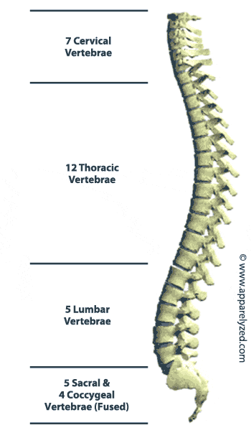
Regions and Normal Curvatures
Vertebral column is about 70 cm (28 inches)

Slide 8
Regions and Normal Curvatures
Cervical vertebrae
7 vertebrae of the neck region
Thoracic vertebrae
12 vertebrae of the thoracic region
Lumbar vertebrae
5 vertebrae of the lower back
Sacrum
Inferior to lumbar vertebrae
Articulates with coxal bones
Coccyx
Most inferior region of the vertebral column

Slide 9
Regions and Normal Curvatures
Four distinct curvatures give vertebral column an S-shape
Cervical and lumbar curvature
Are concave posteriorly
Thoracic and sacral curvatures
Are convex posteriorly
Curvatures increase the resilience of the spine

Slide 10
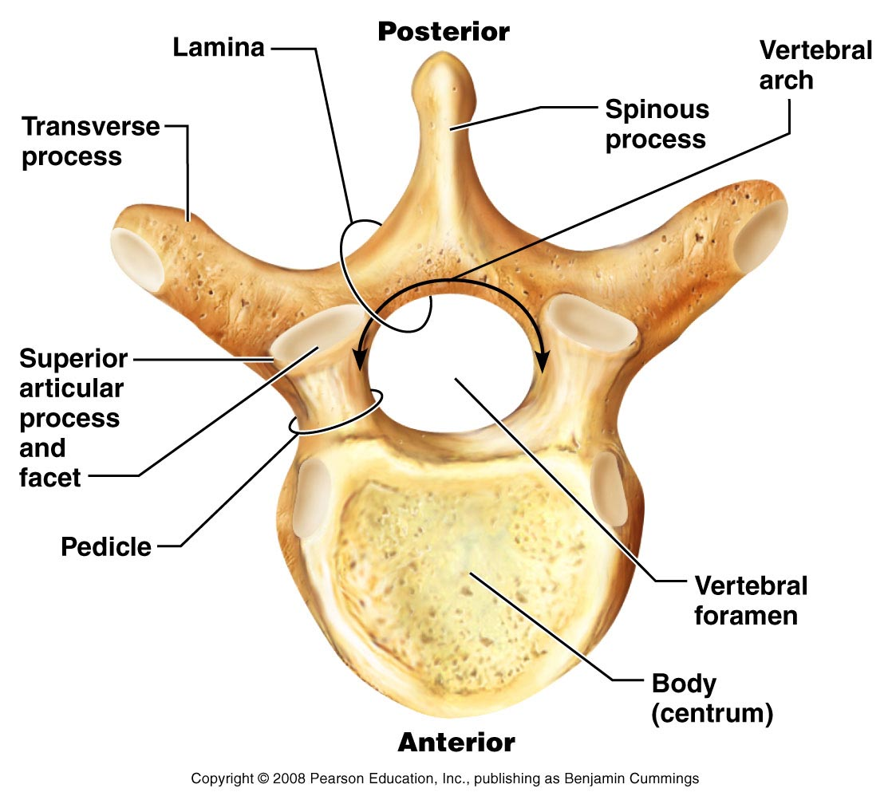
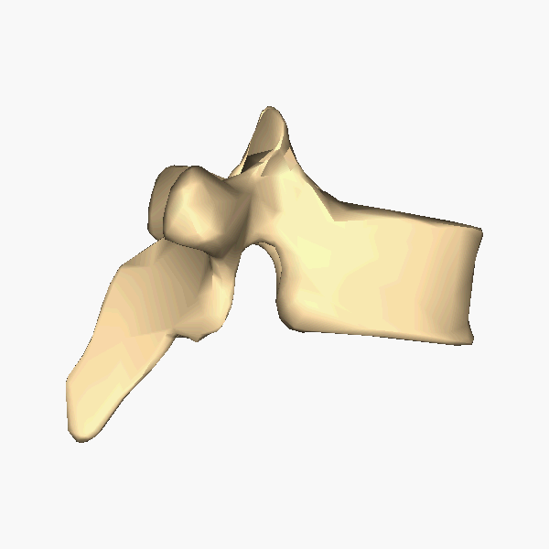
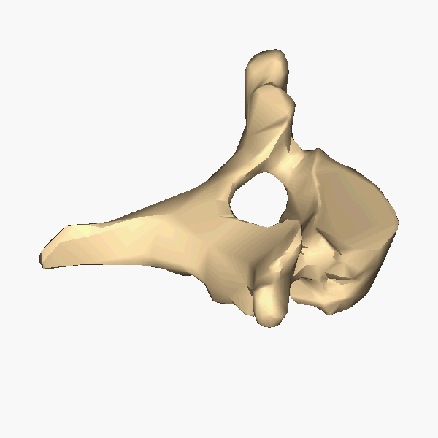
General Structure of Vertebrae (Typical – Thoracic vertebrae)
PLAY
Spine (horizontal)
Figure 7.15

Slide 11
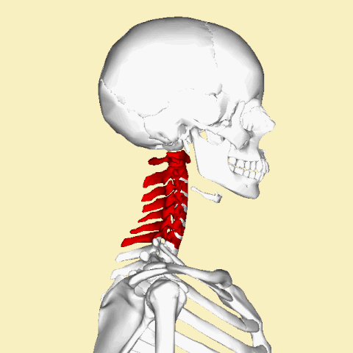
Cervical Vertebrae
Seven cervical vertebrae (C₁ – C₇) – smallest and lightest vertebrae
C₃ – C₇ are typical cervical vertebrae
Body is wider laterally
Spinous processes are short and bifid (except C₇)
Vertebral foramen are large and triangular
Transverse processes contain transverse foramina
Superior articular facets face superoposteriorly

Slide 12
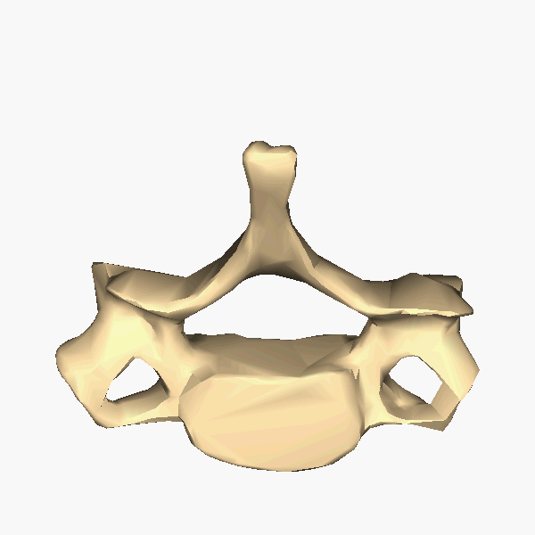
Cervical Vertebrae
Seven cervical vertebrae (C₁ – C₇) – smallest and lightest vertebrae
C₃ – C₇ are typical cervical vertebrae
Body is wider laterally
Spinous processes are short and bifid (except C₇)
Vertebral foramen are large and triangular
Transverse processes contain transverse foramina (passage of vertebral artery)
Superior articular facets face superoposteriorly

Slide 13
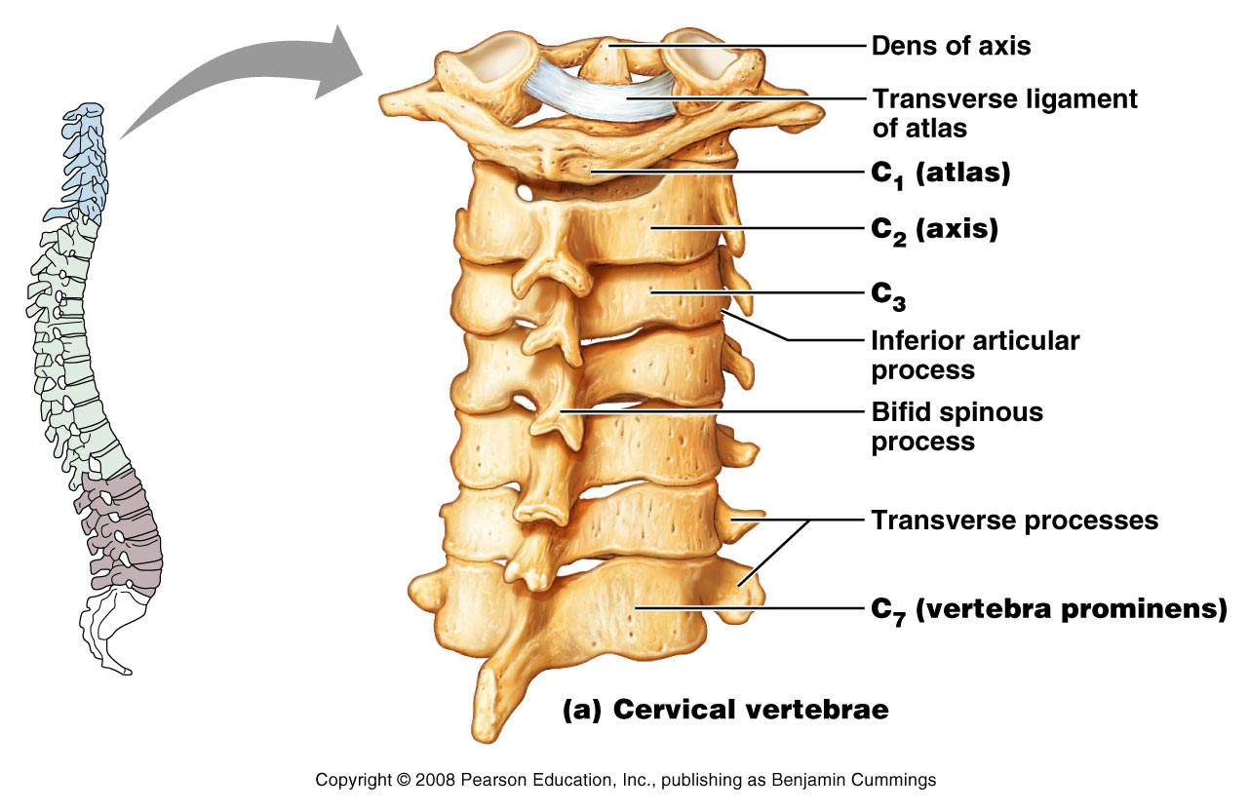
Cervical Vertebrae
Similar of snake tongue
Spinous process similar to Thoracic vertebrae
Flex your neck and you can feel the C7 – protrusion at neck
Figure 7.17a

Slide 14
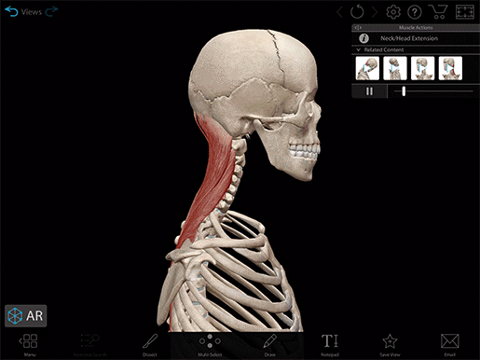
The Atlas
C₁ is termed the atlas
Lacks a body and spinous process
Supports the skull
Superior articular facets receive the occipital condyles
Allows flexion and extension of neck
Nodding the head “yes”
(atlanto-occipital joint)

Slide 15
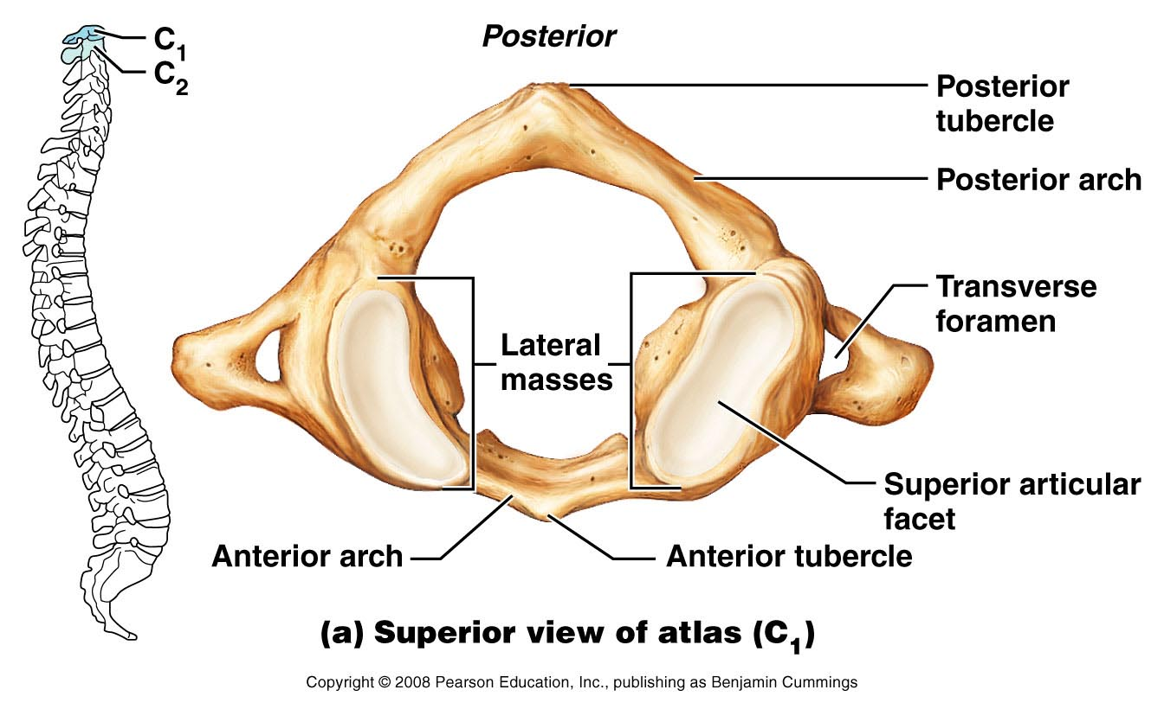
The Atlas
Lacks a body and spinous process (called posterior tubercle)
Transverse processes contain transverse foramina (passage of vertebral artery)
Figure 7.16a

Slide 16
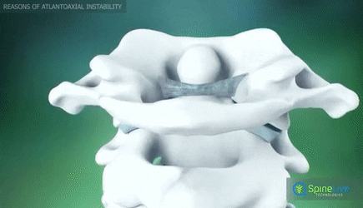
The Axis
Has a body and spinous process
Dens (odontoid process) projects superiorly
Formed from fusion of the body of the atlas with the axis
Acts as a pivot for rotation of the atlas and skull
Participates in rotating the head from side to side (“No”)
(atlanto-axial joint)

Slide 17
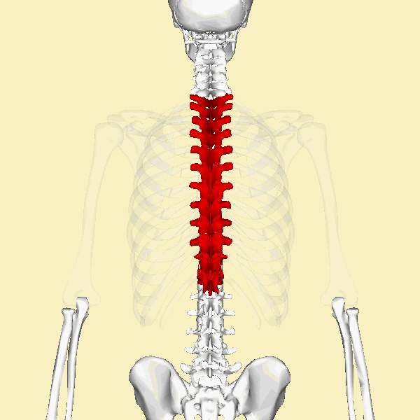
Thoracic Vertebrae
Table 7.2b

Slide 18
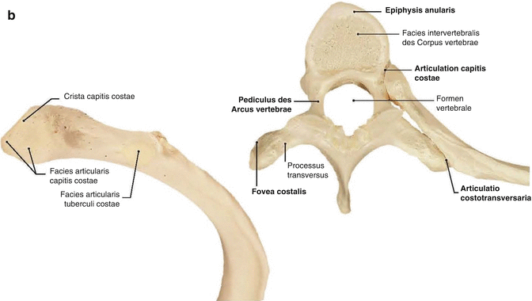
Thoracic Vertebrae (T₁ – T₁₂)
All articulate with ribs
Have heart-shaped bodies from the superior view

Slide 19
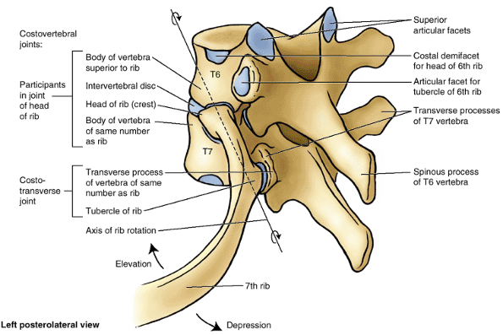
Thoracic Vertebrae (T₁ – T₁₂)
Each side of the body of T₁ – T₁₀ bears demifacts for articulation with ribs
T₁ has a full facet for the first rib
T₁₀ – T₁₂ only have a single facet

Slide 20
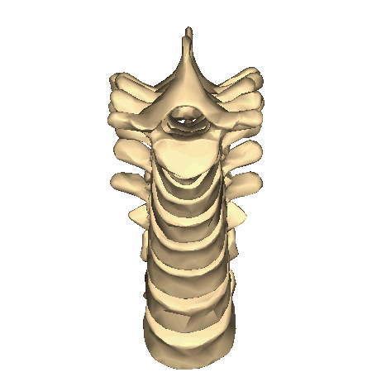
Thoracic Vertebrae
Spinous processes are long and point inferiorly
Vertebral foramen are circular
Transverse processes articulate with tubercles of ribs
Superior articular facets point posteriorly
Inferior articular processes point anteriorly
Allows rotation and prevents flexion and extension
Different from lumbar vertebrae

Slide 21
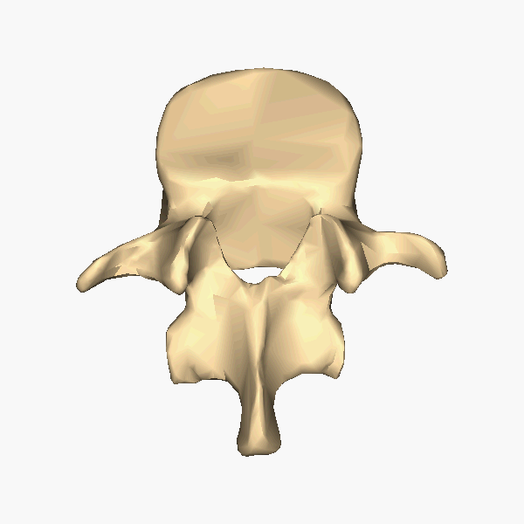
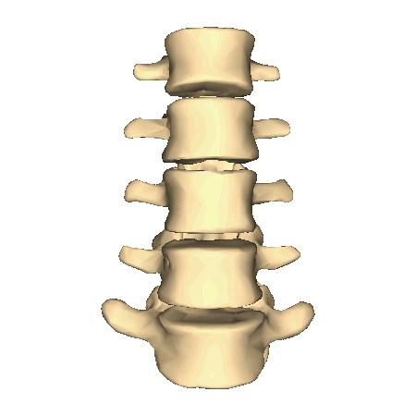
Lumbar Vertebrae
Table 7.2c

Slide 22
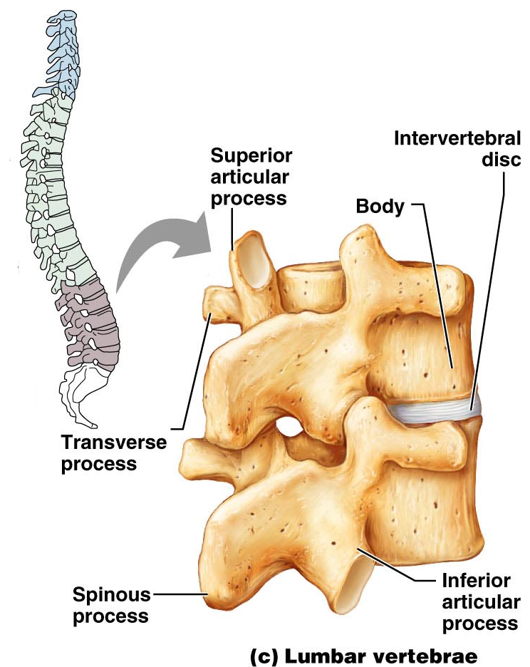
Lumbar Vertebrae (L₁ – L₅)
Bodies are thick and robust
Transverse processes are thin and tapered
Spinous processes are thick, blunt, and point posteriorly
Vertebral foramina are triangular
Superior and inferior articular facets directly medially
Allows flexion and extension – rotation prevented
Different from thoracic vertebrae

Slide 23
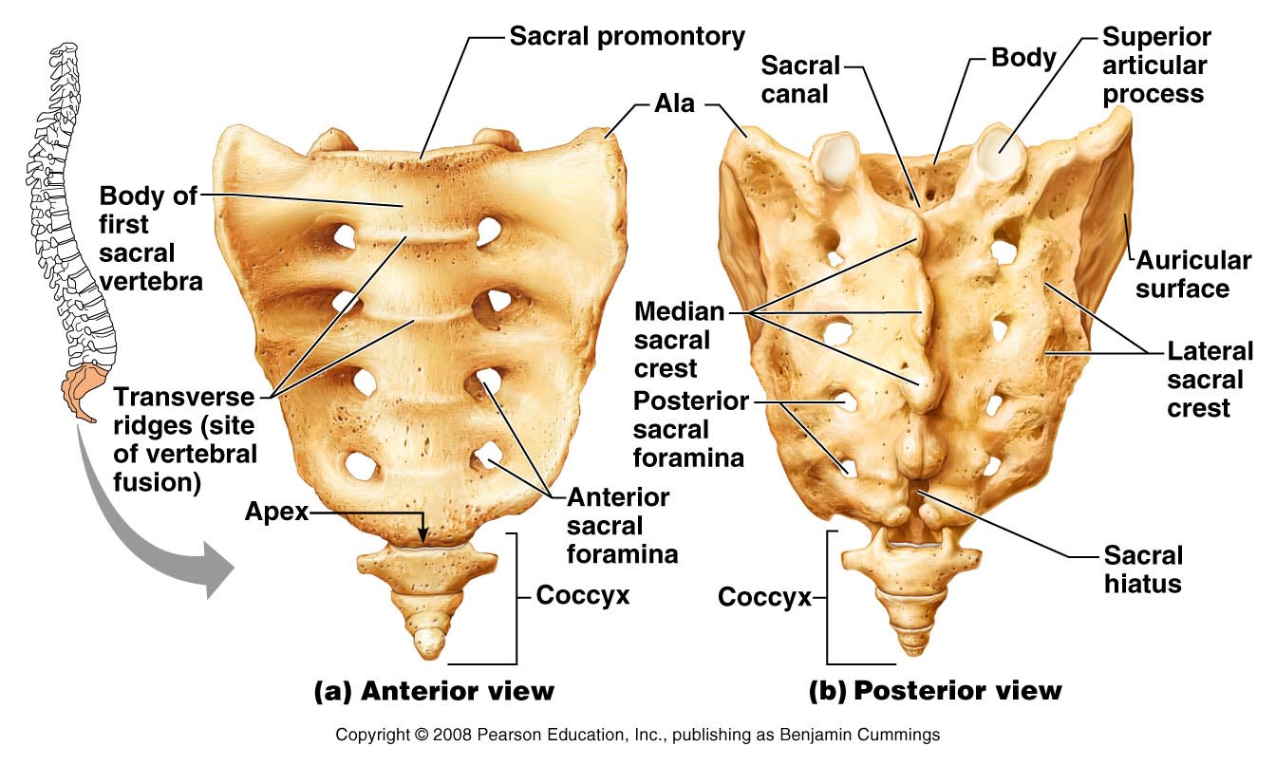
Sacrum
Figure 7.18a, b

Slide 24
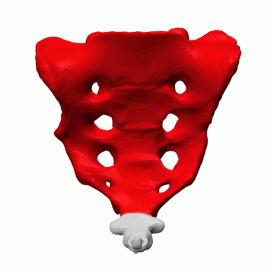
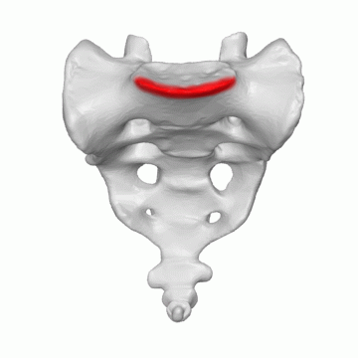
Sacrum (S₁ – S₅)
Shapes the posterior wall of pelvis
Formed from 5 fused vertebrae
Superior surface articulates with L₅
Inferiorly articulates with coccyx
Sacral promontory
Where the first sacral vertebrae bulges into pelvic cavity
Center of gravity is 1 cm posterior to sacral promontory
Sacral promontory

Slide 25
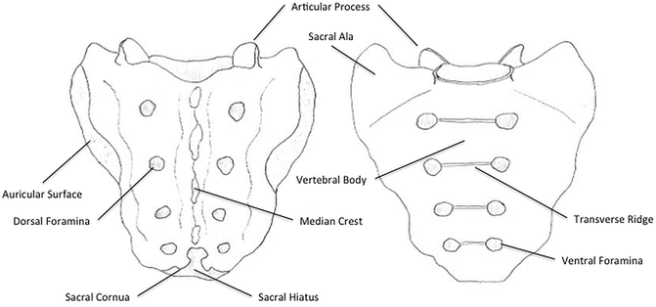
Sacrum
Sacral foramina
Ventral foramina
Passage for ventral rami of sacral spinal nerves
Dorsal foramina
Passage for dorsal rami of sacral spinal nerves

Slide 26
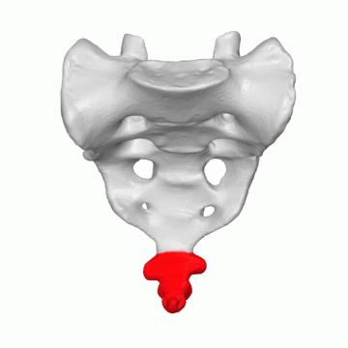
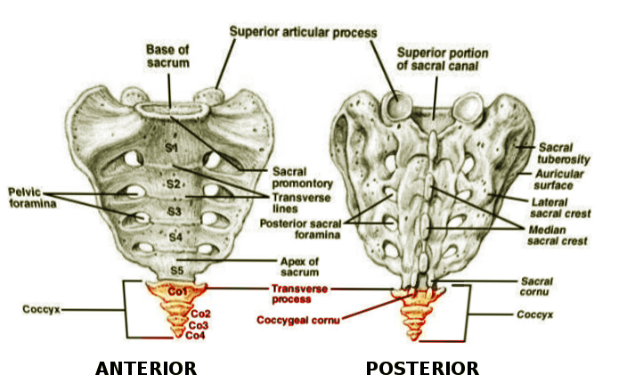
Coccyx
Is the “tailbone”
Formed from 3 – 5 fused vertebrae
Offers only slight support to pelvic organs

Slide 27
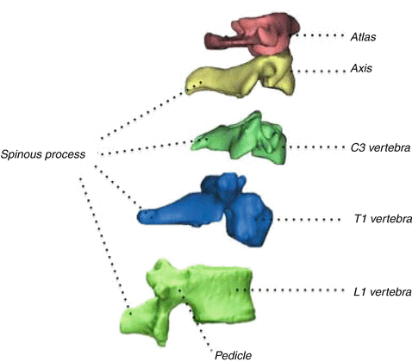
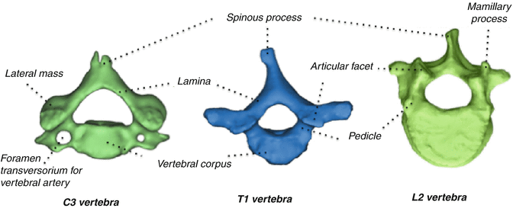
Differentiation of Vertebrae

Slide 28
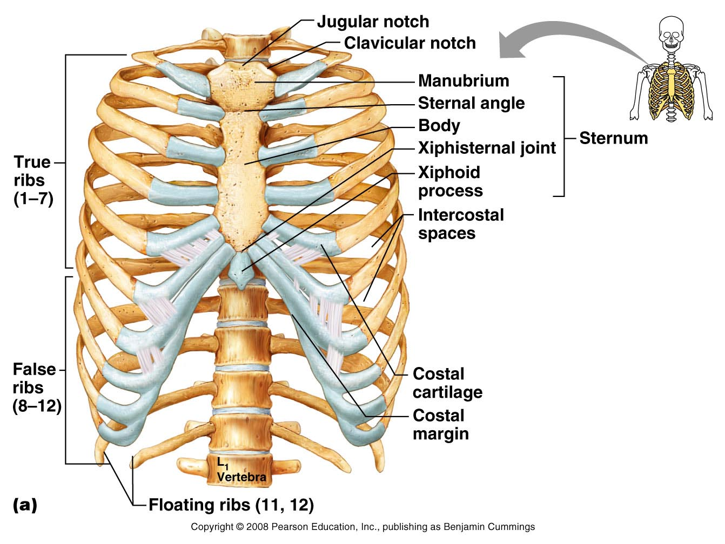
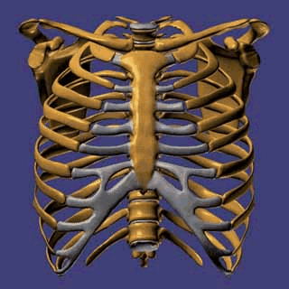
Bony Thorax
Forms the framework of the chest
Components of the bony thorax
Thoracic vertebrae – posteriorly
Ribs – laterally
Sternum and costal cartilage – anteriorly
Protects thoracic organs
Supports shoulder girdle and upper limbs
Provides attachment sites for muscles

Slide 29
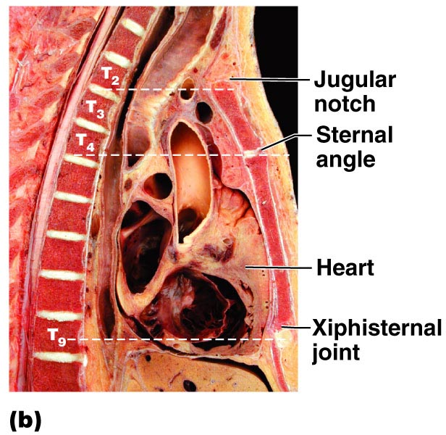
The Bony Thorax
Figure 7.19b

Slide 30
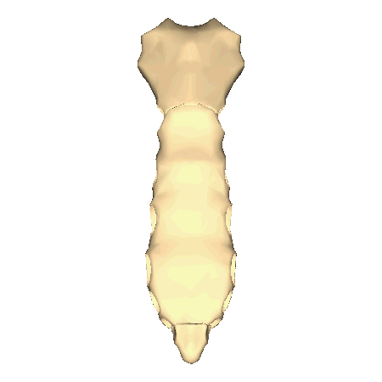
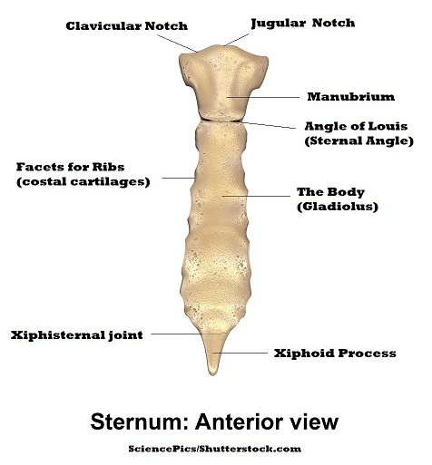
Sternum
Formed from three sections
Manubrium – superior section
Articulates with medial end of clavicles
Body – bulk of sternum
Sides are notched at articulations for costal cartilage of ribs 2–7
Xiphoid process – inferior end of sternum
Ossifies around age 40
Jugular notch
Central indentation at superior border of the manubrium
Sternal angle
A horizontal ridge where the manubrium joins the body

Slide 31
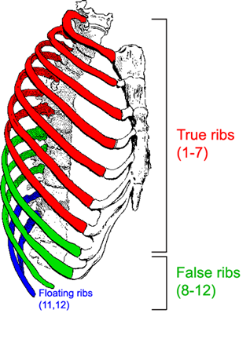
Ribs
All ribs attach to vertebral column posteriorly
True ribs - superior seven pairs of ribs
Attach to sternum by costal cartilage
False ribs – inferior five pairs of ribs
Ribs 11–12 are known as floating ribs

Slide 32
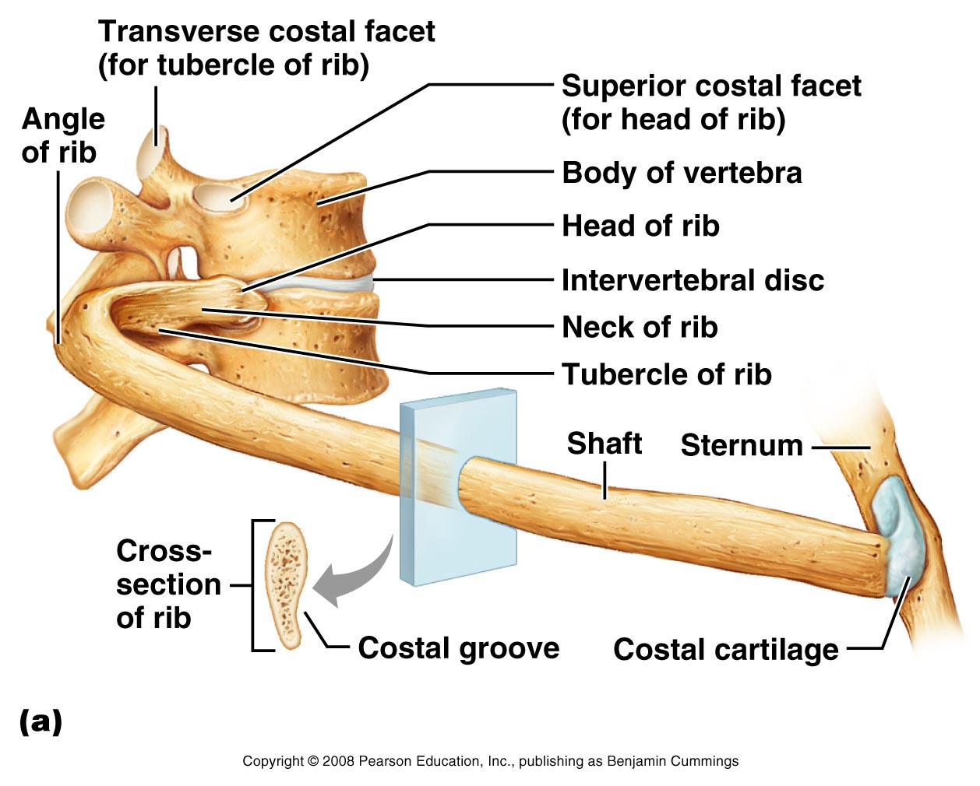
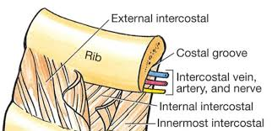
Ribs
Figure 7.20a

Slide 33
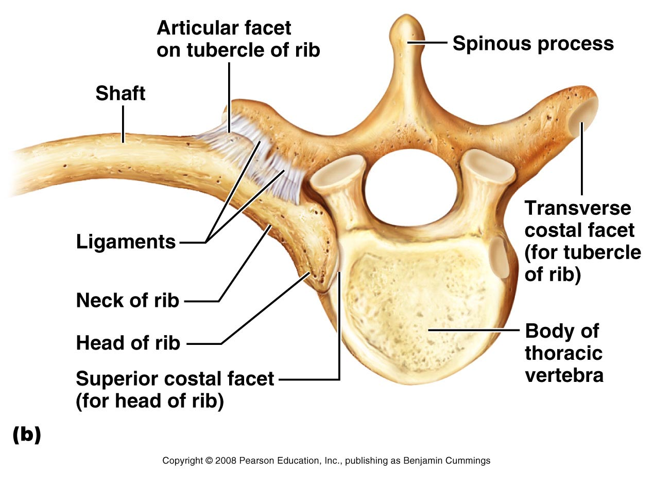
Ribs
Figure 7.20b

Slide 34
The Axial Skeleton Throughout Life
Curvatures of the vertebral column
Primary curvatures – thoracic and sacral curvatures
An infant's spine is C-shaped at birth
Secondary curvatures – cervical and lumbar curvatures
Develop when a baby begins to walk
Redistributes weight of the upper body over the lower limbs

Slide 35
The Axial Skeleton Throughout Life
Aging of the axial skeleton
Water content of the intervertebral discs decreases
By age 55, loss of a few centimeters in height is common
Thorax becomes more rigid
Bones lose mass with age

Slide 36
The Axial Skeleton
END

