Slide 1
Muscle Model Plasticus
Dr. Peter Reonisto

Slide 2
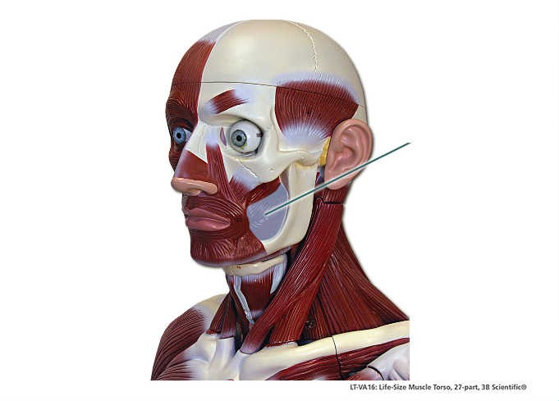
Buccinator – Risorius and Masseter was removed

Slide 3
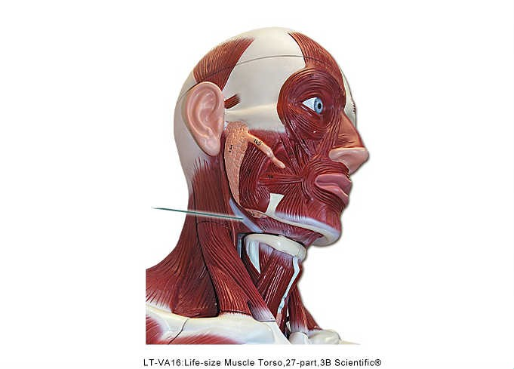
Stylohyoid

Slide 4
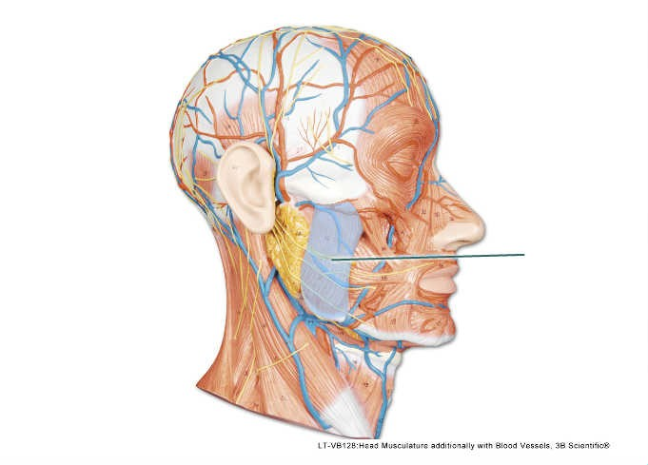
Masseter

Slide 5
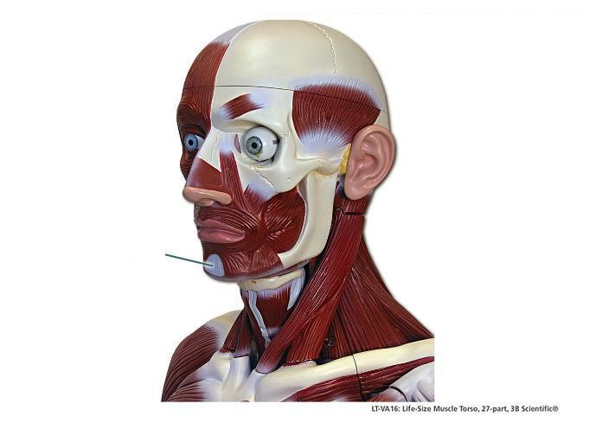
Mentalis

Slide 6
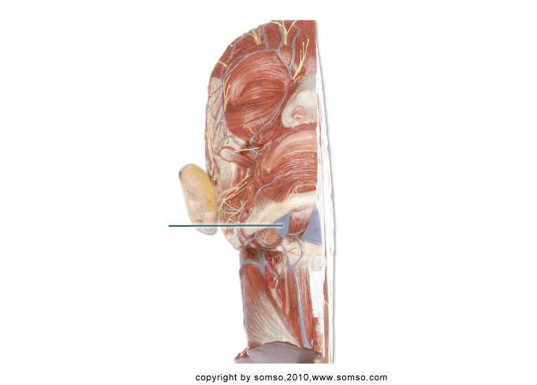
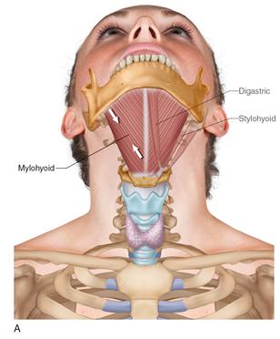
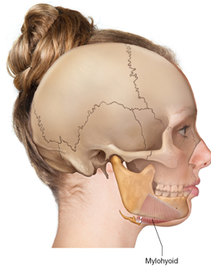
Mylohyoid

Slide 7
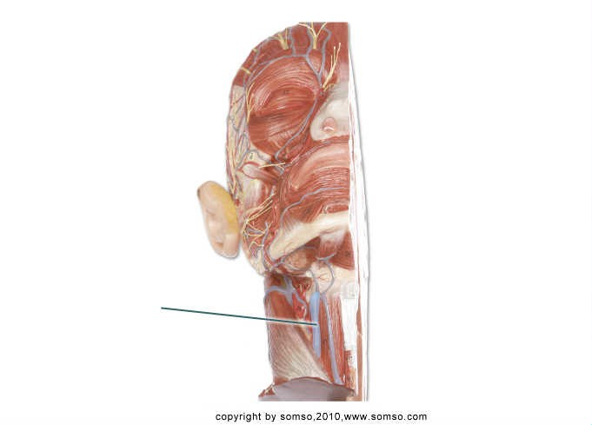
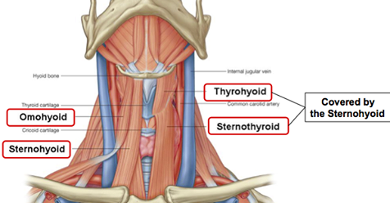
Omohyoid

Slide 8
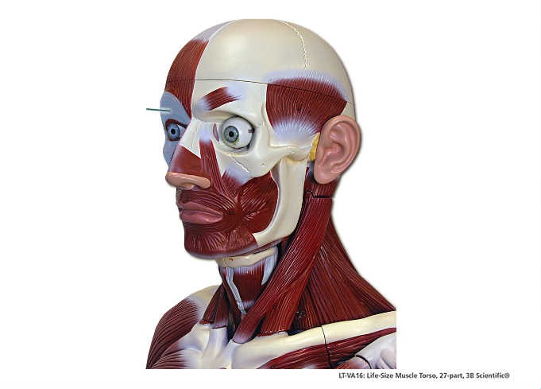
Orbicularis Oculi

Slide 9
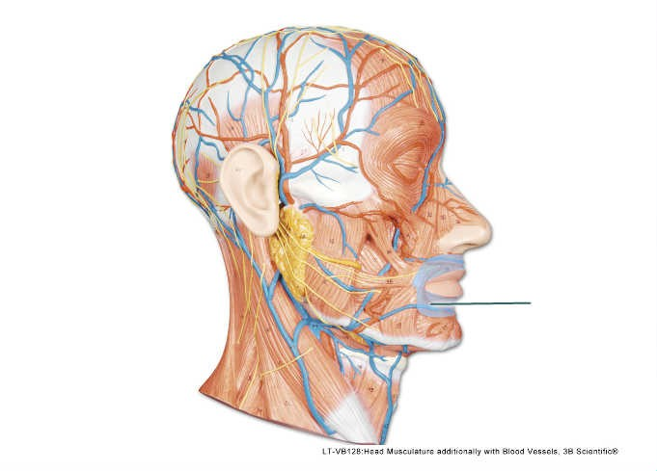
Orbicularis Oris

Slide 10
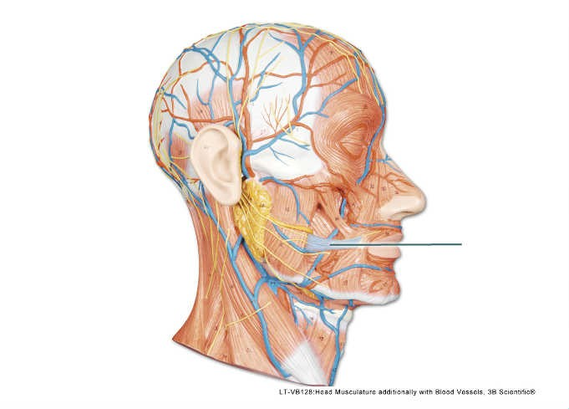
Risorius

Slide 11
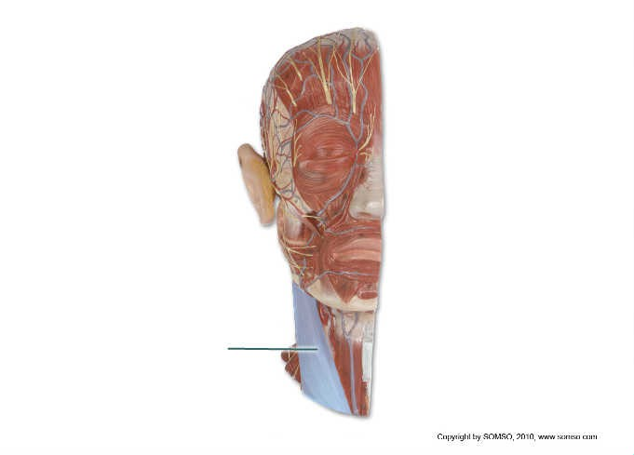
Sternocleidomastoid

Slide 12
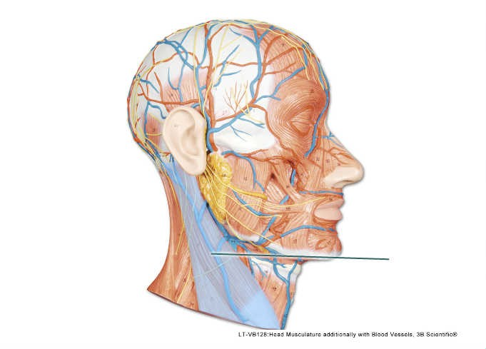
Sternocleidomastoid

Slide 13
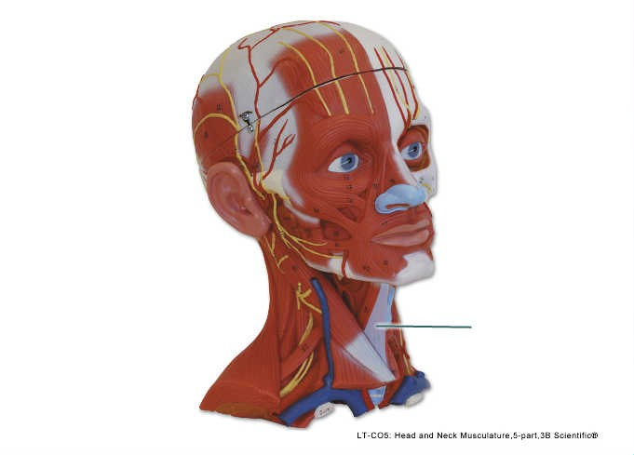
Sternohyoid

Slide 14
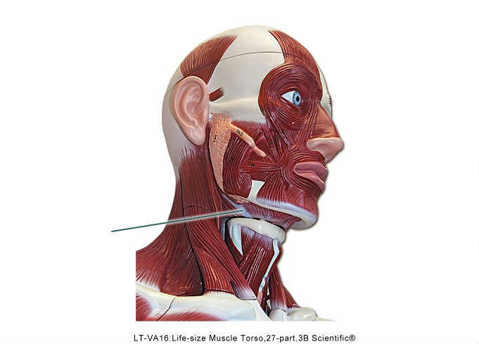
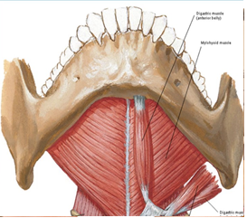
Digastric (posterior belly)

Slide 15
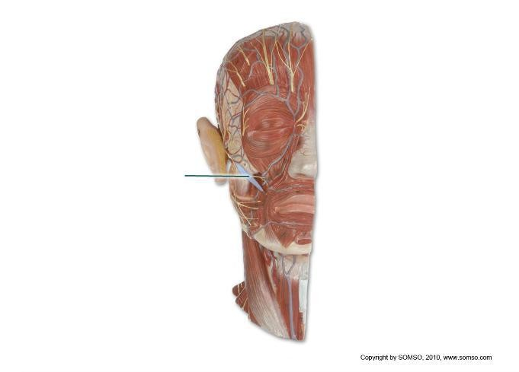
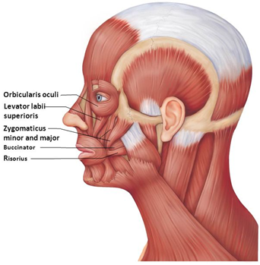
Zygomaticus

Slide 16
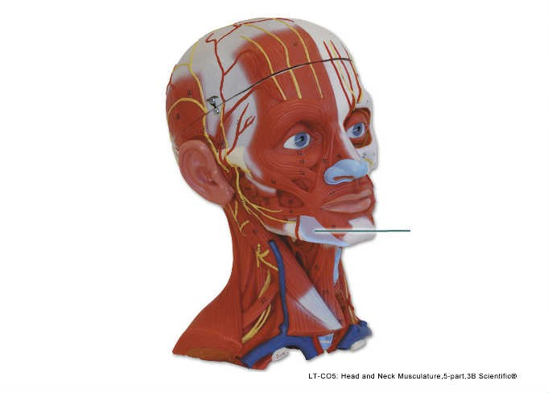
Depressor Anguli Oris

Slide 17
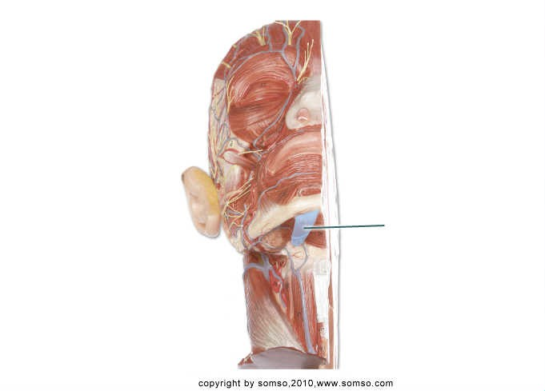
Digastric – (anterior belly)
What is a function of the highlighted muscle?
A) flexes neck B) elevates hyoid
C) depresses hyoid D) elevates mandible

Slide 18
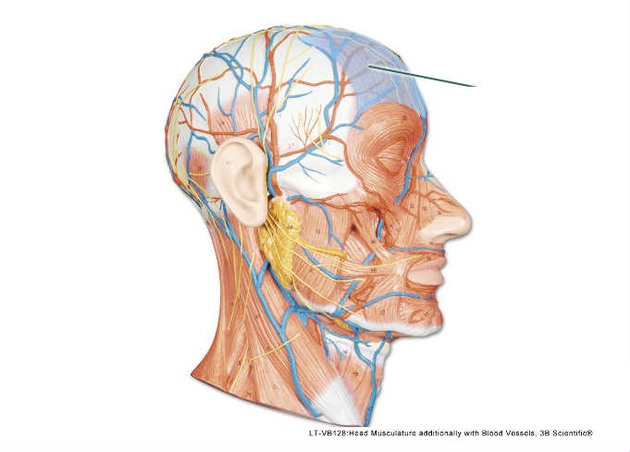
Frontalis

Slide 19
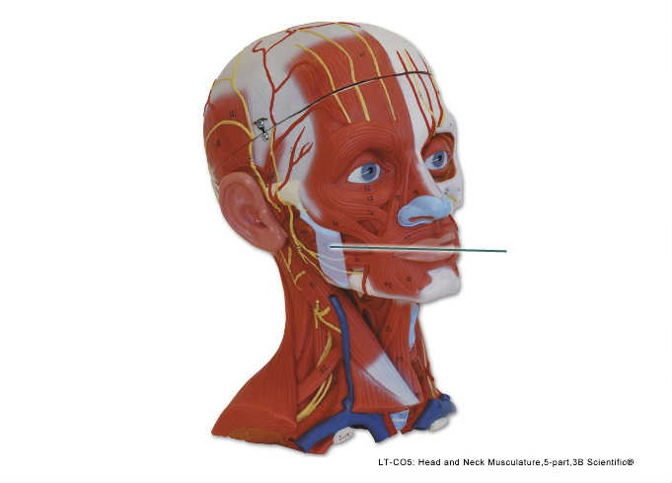
Masseter

Slide 20
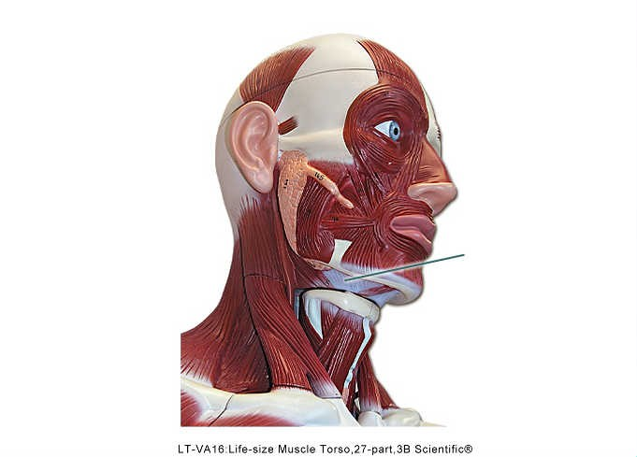
Mylohyoid
What is an action of the highlighted muscle?
A) rotates neck B) participates in swallowing
C) assists with speech D) elevates clavicle

Slide 21
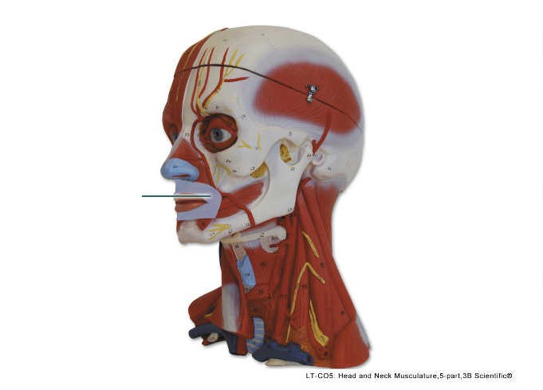
Orbicularis oris
From which two bones does the highlighted muscle indirectly originate?
A) zygomatic and mandible B) temporal and maxilla
C) mandible and maxilla D) frontal and nasal

Slide 22
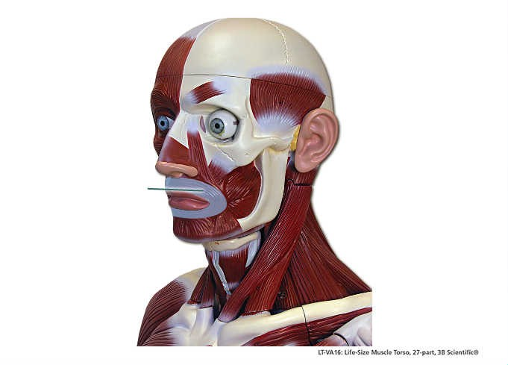
Orbicularis Oris

Slide 23
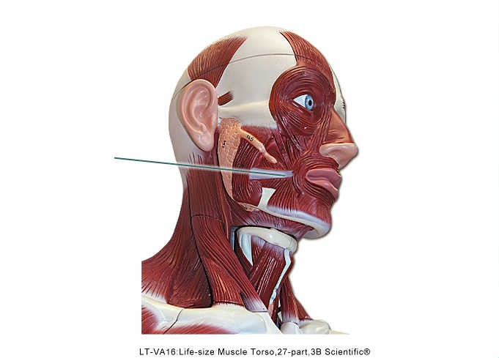
Risorius

Slide 24
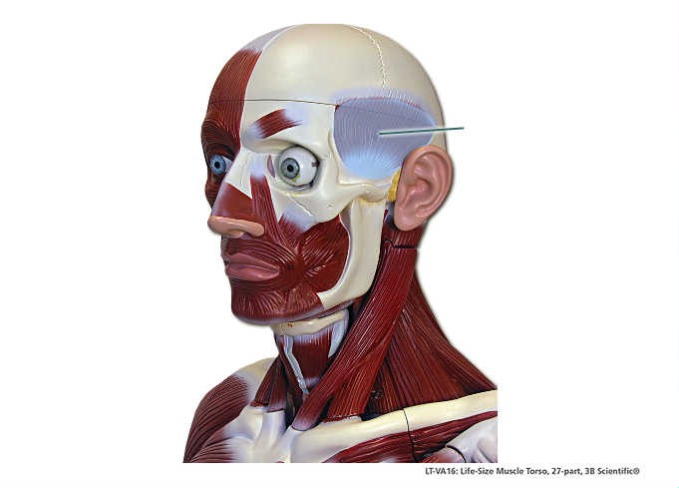
Temporalis

Slide 25
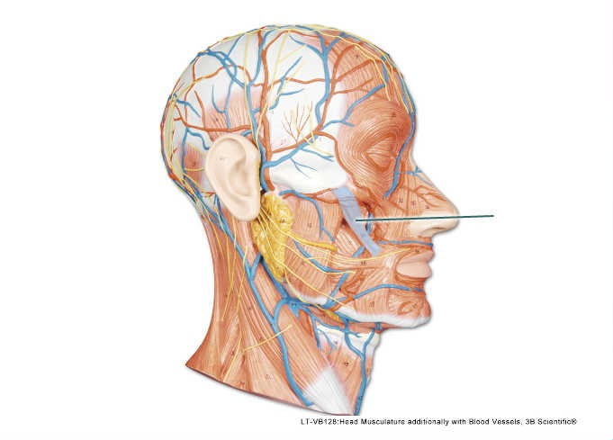
Zygomaticus

Slide 26
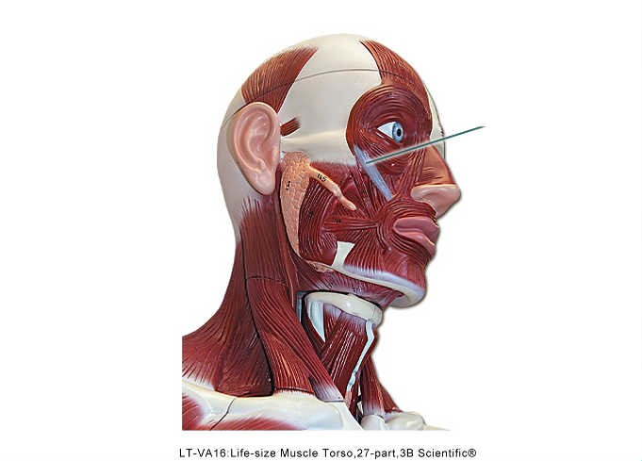
Levator labii superioris

Slide 27
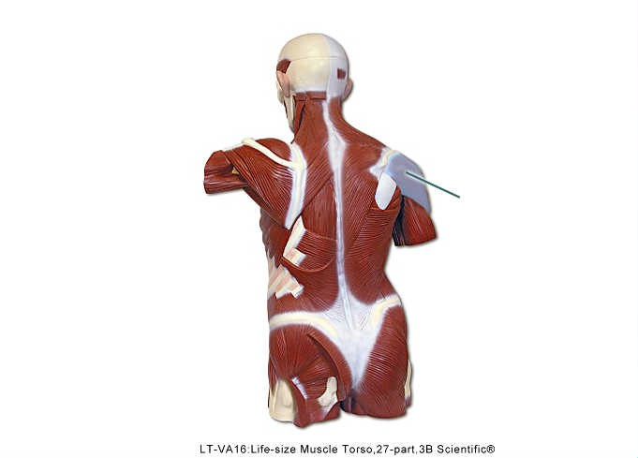
Deltoid

Slide 28
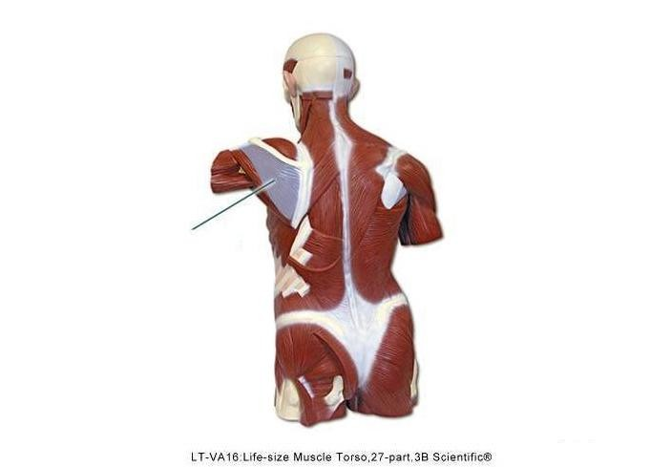
Infraspinatus

Slide 29
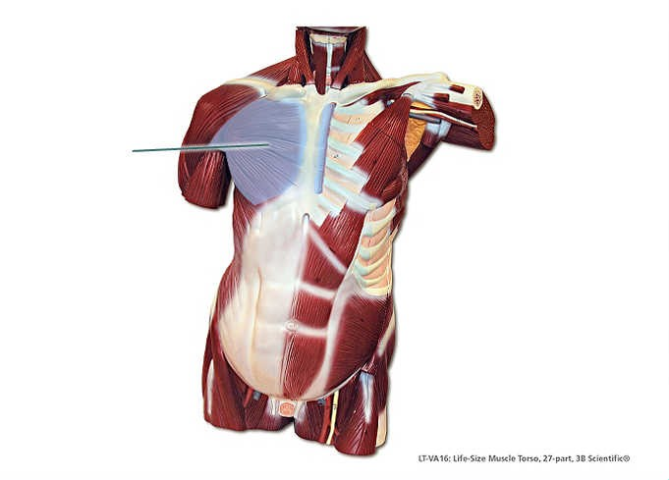
Pectoralis major

Slide 30
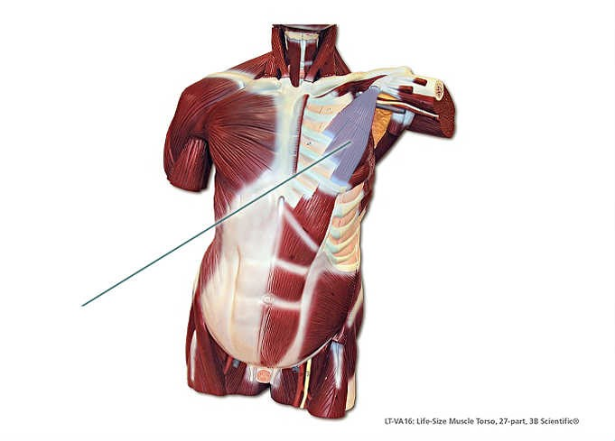
Pectoralis minor

Slide 31
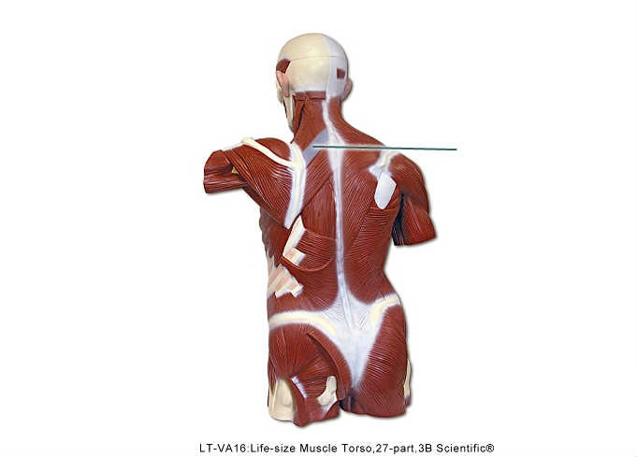
Rhomboid minor

Slide 32
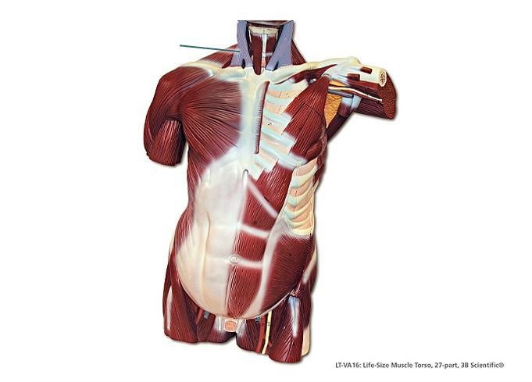
Sternocleidomastoid

Slide 33
Supraspinatus

Slide 34
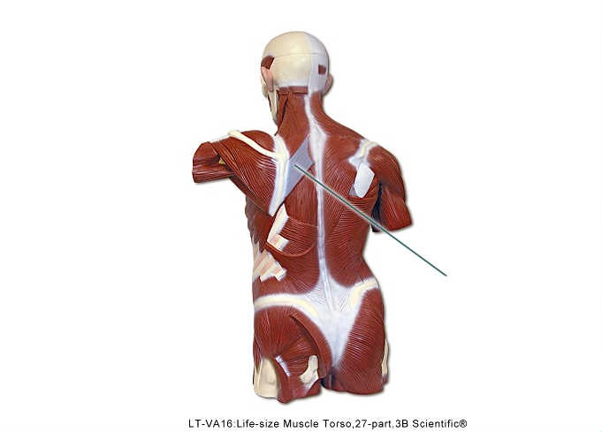
Rhomboid major

Slide 35
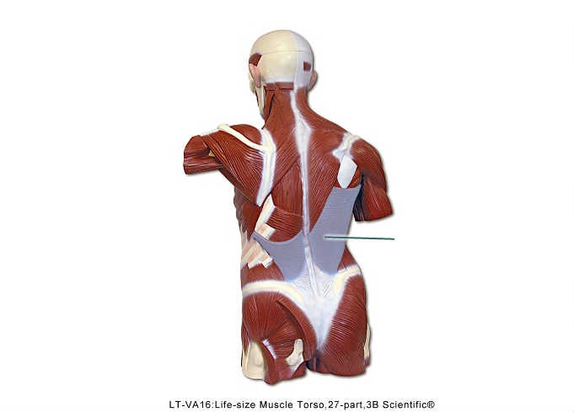
Latissimus dorsi

Slide 36
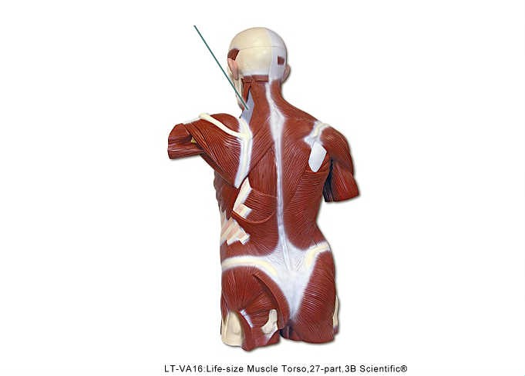
Levator scapulae

Slide 37
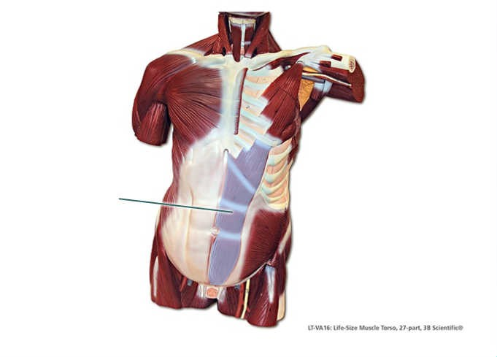
Rectus abdominis

Slide 38
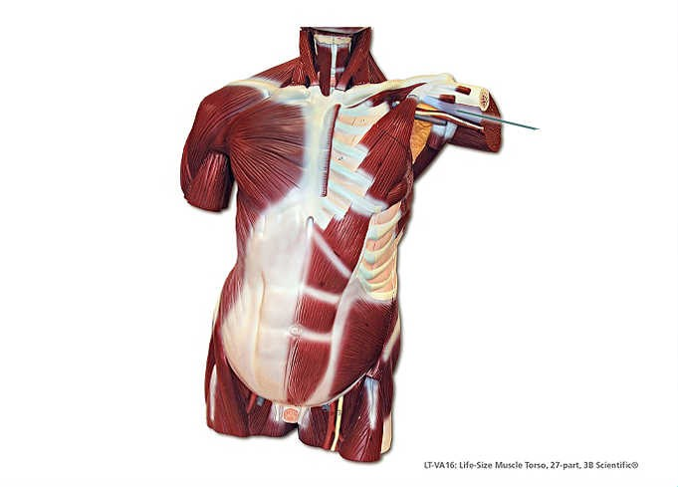
Coracobrachialis

Slide 39
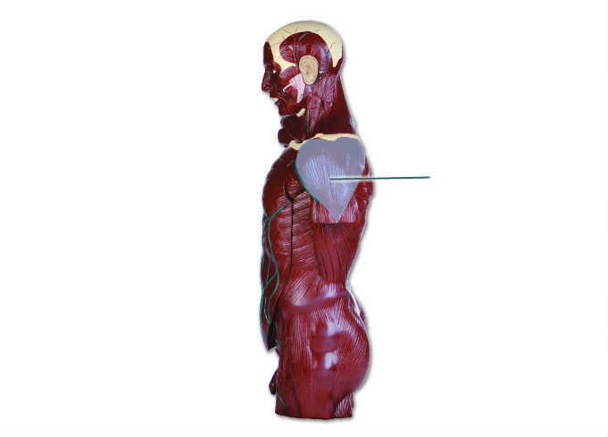
Deltoid

Slide 40
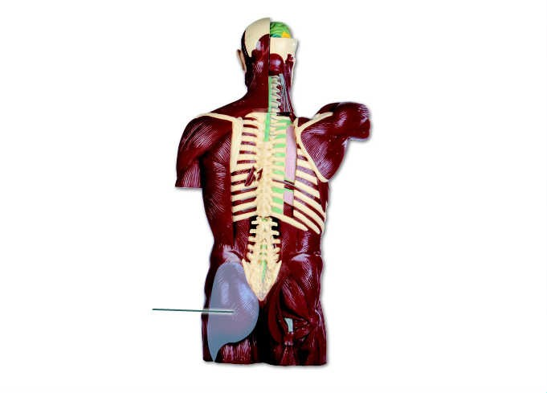
Gluteus maximus

Slide 41
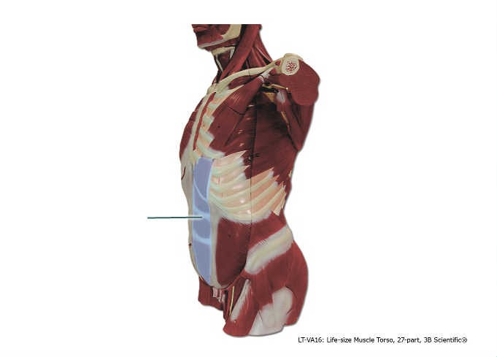
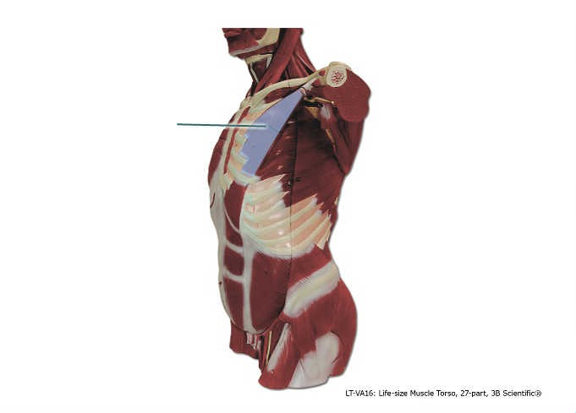
Rectus abdominis
What is an action of the highlighted muscle?
A) rotation of cervical vertebrae B) adduction of thigh at hip
C) flexion of vertebral column D) extension of vertebral column

Slide 42
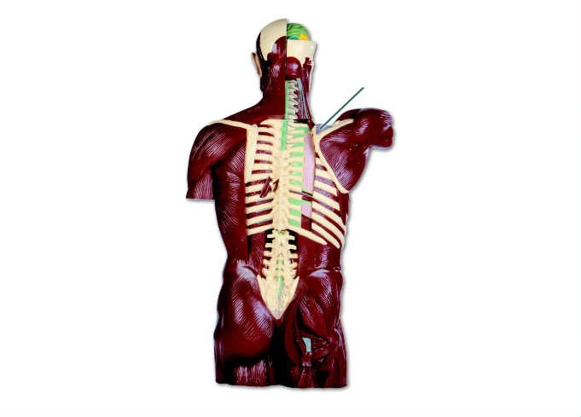
Supraspinatus

Slide 43
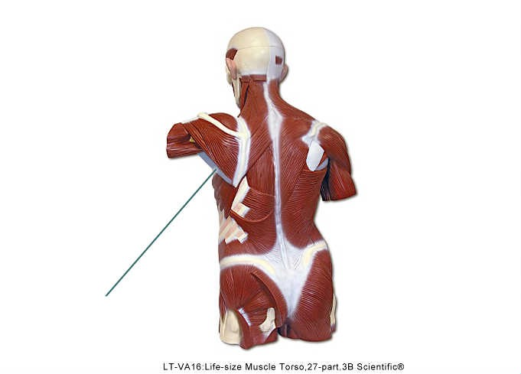

Slide 44
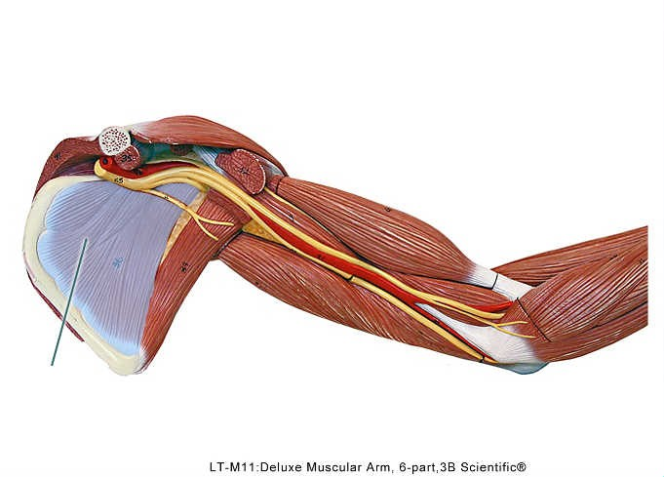

Slide 46
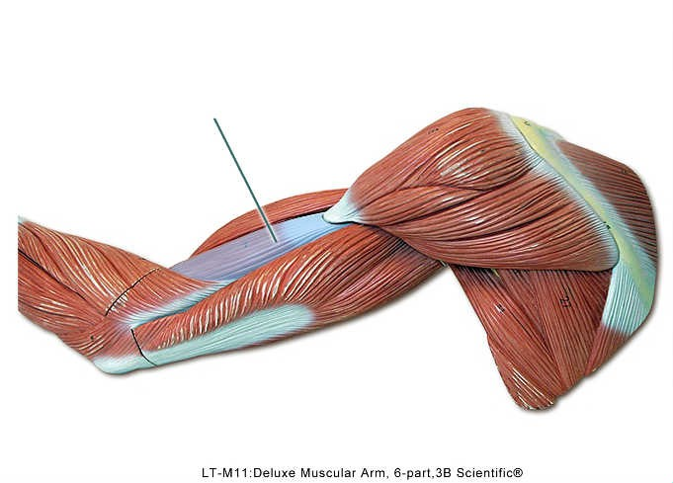

Slide 47
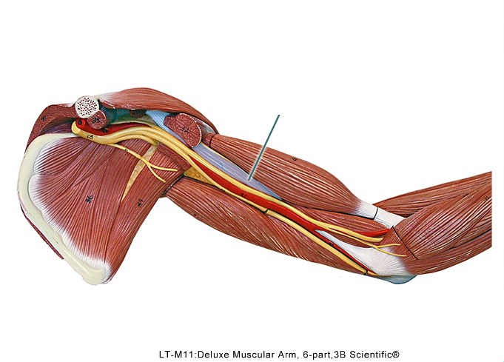

Slide 48
The highlighted muscle originates from which bone? ___Humerus__________

