Slide 1
QUICKBOOKS 2015: A COMPLETE COURSE
CHAPTER
1
LECTURE
INTRODUCTION TO
QUICKBOOKS 2015 AND COMPANY FILES
Notes:
QUICKBOOKS 2015: A COMPLETE COURSE.
CHAPTER 1—LECTURE: INTRODUCTION TO QUICKBOOKS 2015 AND COMPANY FILES.

Slide 2
Chapter Focus
Overview of QuickBooks Program Features
Begin using QuickBooks
Open, backup, and restore company files
Notes:
Chapter Focus: Chapter 1 provides an overview of the QuickBooks program features. In addition, students begin working with the tutorial company. In the student training, the company file is copied, opened, backed up, and restored. The students begin to become familiar with the QuickBooks Chart of Accounts and customizing accounts.

Slide 3
Lecture Note
Examples in lecture may or may not match textbook
Lectures illustrate key points within chapters
Lectures do not contain every transaction completed in text
Not everything presented in chapters will be shown in lecture
Notes:
Lecture Note: The examples in the lecture may or may not match the textbook. The lectures illustrate key points within the chapters but do not contain every transaction completed in the text. Not everything presented in the chapters will be shown in the lecture.

Slide 4
Manual Accounting vs. Computerized Accounting with QuickBooks
Manual Accounting
Analyze Transactions
Prepare business documents by hand—Invoice, Check, Sales Receipt
Record transactions in Debit/Credit format in General Journal
Post transactions to General Ledger and Subsidiary Ledgers
Prepare Reports by hand
Record Closing Entries manually
Calculate Net Income
Transfer Net Income to Owner’s Capital account or to Retained Earnings
Create Brought Forward Balances
Computerized Accounting with QuickBooks
Analyze Transactions
Prepare business documents using computer to record information directly on business form—Invoice, Check, Sales Receipt
QuickBooks enters transactions in Debit/Credit format automatically in Journal
QuickBooks automatically posts transactions to General and Subsidiary ledgers
Prepare reports by clicking a button
Close period by entering a closing date
QuickBooks automatically calculates Brought Forward Balances
QuickBooks calculates Net Income and transfers amount to Owner’s Equity or Retained Earnings
Notes:
Manual Accounting Vs. Computerized Accounting with QuickBooks: Show the comparison between the two
Manual Accounting:
Transactions are analyzed.
Based on the transaction analysis, business documents such as invoice, checks, and sales receipts are prepared by hand.
Transactions are recorded in debit/credit format in the General Journal.
The transactions are then posted to the General Ledger and various subsidiary ledgers.
Reports are prepared by hand.
When the books need to be closed, closing entries are recorded manually.
Brought forward balances need to be recorded manually.
Computerized accounting with QuickBooks:
Transactions are analyzed.
Based on the transaction analysis, transactions are recorded directly on business documents—invoices, checks, sales receipts, etc.—using the computer.
Based on the business form entry, QuickBooks automatically enters transactions in debit/credit format in the General Journal.
QuickBooks automatically posts transactions to the General Ledger and various subsidiary ledgers.
Reports are prepared by clicking a button.
A period is closed by entering a closing date.
QuickBooks automatically calculates Brought Forward Balances.
QuickBooks calculates Net Income and transfers the amount to Owner’s Equity or Retained Earnings.

Slide 5
Open QuickBooks
Double-click QuickBooks icon on desktop
Notes:
Open QuickBooks: Double-click the QuickBooks icon on the desktop

Slide 6
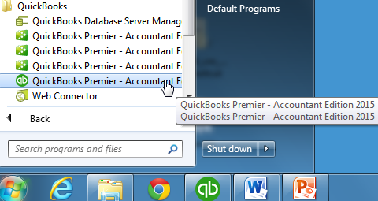
Open QuickBooks
OR
Click Windows Start button
On Start Menu, point to All Programs
Scroll until you see QuickBooks folder
Click QuickBooks folder, click QuickBooks 2015 (Your steps may differ from this)
Note: QuickBooks may show QuickBooks Premier 2015 or QuickBooks Premier-Accountant Edition 2015. All screens will refer to either name and QuickBooks 2015 will be used as program name.
Notes:
Open QuickBooks: OR
Click the Windows Start button. On the Start Menu, point to All Programs, scroll until you see QuickBooks, click the QuickBooks folder, click QuickBooks 2015. (Depending on your individual computer setup, your steps may differ from this.) Note: QuickBooks may show QuickBooks Premier 2015 or QuickBooks Premier-Accountant Edition 2015. All screens will refer to either name and QuickBooks 2015 will be used as the program name. (Your icons in the Task Bar at the bottom of your screen may not match the ones shown above.)

Slide 7
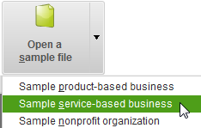
Open Sample File
On No Company Open screen:
Click Open a sample file button
Click Sample service-based business
Notes:
Open a Sample File: To open a sample file, click the Open a sample file button.
Click Sample Service Based Business.

Slide 8
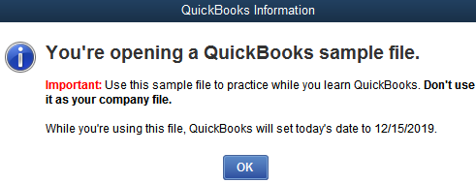
Open Sample File
Click OK on QuickBooks Information screen
Notes:
Open a Sample File: Click OK to accept the dates and open the company.

Slide 9
QuickBooks Desktop Features
Desktop Features include:
Title Bar
Menu Bar
Icon Bar
Notes:
QuickBooks Desktop Features: At the top of the QuickBooks screen are three desktop features. They are:
Title Bar
Menu Bar
Icon Bar

Slide 10
QuickBooks Desktop Features: Title Bar
Title Bar
Contains Company Name—Sample Larry’s Landscaping & Garden Supply
Program Name
Minimize, maximize, and close buttons
Notes:
QuickBooks Desktop Features: Title Bar—Once the company has been opened, verify the company name Sample Larry’s Landscaping & Garden Supply on the Title bar. The Title bar is located at the top of the QuickBooks screen and contains the company name; the program name—QuickBooks 2015; and the minimize, maximize, and close buttons.

Slide 11
QuickBooks Desktop Features: Menu Bar
Menu Bar
Has a list of menus available in QuickBooks
Important: Commands shown on various Menu Bars may differ depending on company used
Notes:
QuickBooks Desktop Features: Menu Bar—Contains a listing of the various menus available in QuickBooks. Menus are used to give commands to QuickBooks and to access various areas of the program. Important: Commands shown on the various Menu Bars may differ depending on the company used

Slide 12
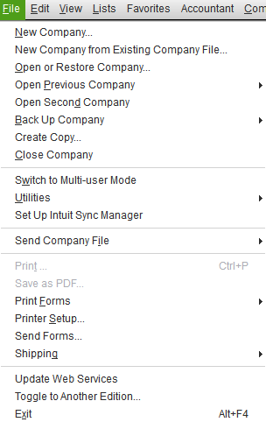
QuickBooks Menus
File Menu
Access company files
Notes:
QuickBooks Menus: File menu is used to access company files and perform several other functions—New Company, New Company from an Existing Company File, Open or Restore Company, Open Previous Company, Open Second Company, Back Up Company, Create Copy, Close Company, Switch to Multi-user Mode, Utilities, Set Up Intuit Sync Manager, Send Company File, Print, Save as PDF, Print Forms, Printer Setup, Send Forms, Shipping, Update Web Services, Toggle to Another Edition, and Exit.

Slide 13
QuickBooks Menus
Edit Menu
Make changes
Notes:
QuickBooks Menus: The Edit menu is used to make changes such as: Undo, Revert, Cut, Copy, Paste, Copy Line, Paste Line, Use Register, Use Calculator, Find, Search, and Preferences.

Slide 14
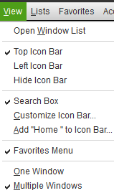
QuickBooks Menus
View Menu
Select
Icon Bars
Favorites Menu
QuickBooks Windows
Notes:
QuickBooks Menus: View menu is used to select the use of an Open Window List, Top Icon Bar (selected for the text), Left Icon Bar (QuickBooks default setting), Hide Icon Bar, Search Box, Customize Icon Bar, Add “Home” to Icon Bar, Favorites Menu, One Window, and Multiple Windows.

Slide 15
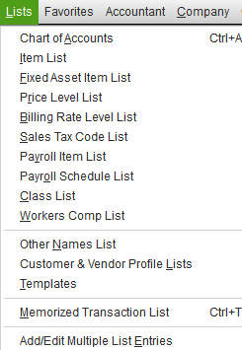
QuickBooks Menus
Lists Menu
Show lists used by QuickBooks
Notes:
QuickBooks Menus: Lists menu is used to show lists used by QuickBooks. These lists include: Chart of Accounts (the General Ledger), Item List, Fixed Asset Item List, Price Level List, Billing Rate Level List, Sales Tax Code List, Payroll Item List, Payroll Schedule List, Class List, Workers Comp List, Other Names List, Customer & Vendor Profile Lists, Templates, Memorized Transaction List, and Add/Edit Multiple List Entries.

Slide 16
QuickBooks Menus
Favorites Menu
Access your favorite or most frequently used commands
Notes:
QuickBooks Menus: Favorites Menu place and access your favorite or most frequently used commands.

Slide 17
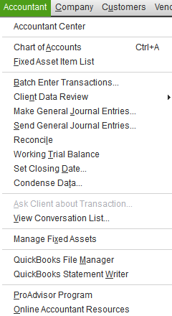
QuickBooks Menus
Accountant Menu
Access Accountant Center
Complete tasks performed by the accountant
Notes:
QuickBooks Menus: Accountant Menu access Accountant Center, the Chart of Accounts, and the Fixed Asset Item List. It is also used to Batch Enter Transactions, perform a Client Data Review, Make General Journal Entries, Send General Journal Entries, Reconcile (an account), prepare a Working Trial Balance, Set Closing Date, Condense Data, Ask Client about Transaction, View Conversation List, Manage Fixed Assets, QuickBooks File Manager, use the QuickBooks Statement Writer, participate in the ProAdvisor Program, and use the Online Accountant Resources.

Slide 18
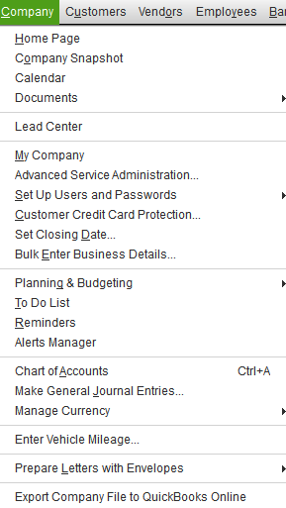
QuickBooks Menus
Company Menu
Access Home Page and Company Snapshot
Change company information
Perform other company related tasks
Notes:
QuickBooks Menus: Company menu is used to access the Home Page, , the Company Snapshot, the Calendar, Documents, and Lead Center. It is also used to access My Company (this contains information about the company), Advanced Service Administration, Set Up Users and Passwords, Customer Credit Card Protection, Set Closing Date, Bulk Enter Business Details, Planning & Budgeting, access the To Do List, access Reminders, use the Alerts Manager, display the Chart of Accounts, Make General Journal Entries, Manage Currency, Enter Vehicle Mileage, Prepare Letters with Envelopes, and Export Company File to QuickBooks Online.

Slide 19
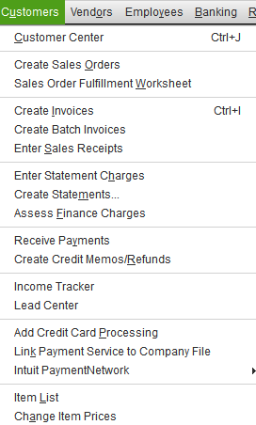
QuickBooks Menus
Customers Menu
Access Customer Center
Perform other tasks related to customers and sales
Notes:
QuickBooks Menus: Customers menu is used to access the Customer Center, Create Sales Orders, prepare Sales Order Fulfillment Worksheet, Create Invoices, Create Batch Invoices, Enter Sales Receipts, Enter Statement Charges, Create Statements, Assess Finance Charges, Receive Payments, Create Credit Memos/Refunds, use the Income Tracker, and access the Lead Center. In addition, you may Add Credit Card Processing, Link Payment Service to Company File, and use the Intuit Payment Network. It is also used to access the Item List and to Change Item Prices.

Slide 20
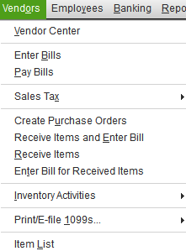
QuickBooks Menus
Vendors Menu
Access Vendor Center
Perform other tasks related to vendors and purchases
Notes:
QuickBooks Menus: Vendors menu is used to access the Vendor Center and the Item List. In addition, this menu is used to Enter Bills, Pay Bills, Sales Tax, Create Purchase Orders, Receive Items and Enter Bill, Receive Items, Enter Bill for Received Items, Inventory Activities, and Print/E‑file 1099s.

Slide 21
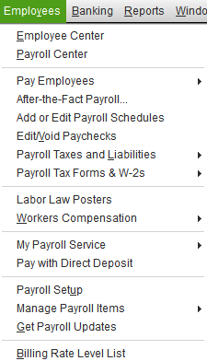
QuickBooks Menus
Employees Menu
Access Employee Center
Access Payroll Center
Perform other tasks related to employees and payroll
Notes:
QuickBooks Menus: Employees menu is used to access the Employee Center, the Payroll Center, Pay Employees, prepare After-the-Fact Payroll, Add or Edit Payroll Schedules, Edit/Void Paychecks, process Payroll Taxes and Liabilities, access Payroll Tax Forms & W-2s, offer Labor Law Posters, access Workers Compensation, perform My Payroll Service activities, Pay with Direct Deposit, Payroll Setup, Manage Payroll Items, Get Payroll Updates, and access the Billing Rate Level List.

Slide 22
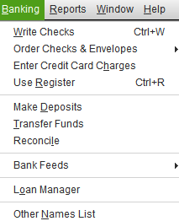
QuickBooks Menus
Banking Menu
Perform tasks related to
Banking
Checking
Loans
Notes:
QuickBooks Menus: The Banking menu is used to Write Checks, Order Checks & Envelopes, Enter Credit Card Charges, Use Register, Make Deposits, Transfer Funds, Reconcile accounts, access Bank Feeds, use the Loan Manager, and access the Other Names List.

Slide 23
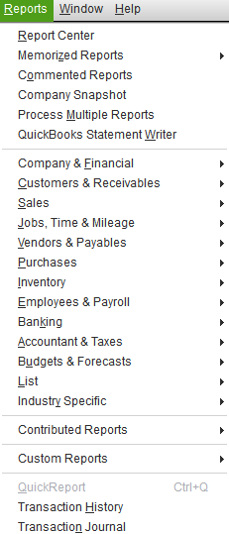
QuickBooks Menus
Reports Menu
Access Report Center
Prepare reports
View Company Snapshot
Notes:
QuickBooks Menus: Reports menu is used to access the Report Center, Memorized Reports, Commented Reports, Company Snapshot, Process Multiple Reports, and QuickBooks Statement Writer. In addition, it is used to prepare reports in the following categories: Company & Financial; Customers & Receivables; Sales; Jobs, Time & Mileage; Vendors & Payables; Purchases; Inventory; Employees & Payroll; Banking; Accountant & Taxes; Budgets & Forecasts; List; and Industry Specific. You may also create Contributed Reports, Custom Reports, QuickReport, Transaction History, and Transaction Journal.

Slide 24
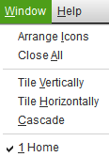
QuickBooks Menus
Window Menu
Switch between windows
Arrange icons
Notes:
QuickBooks Menus: Window menu is used to Arrange Icons, Close All, Tile Vertically, Tile Horizontally, or Cascade open windows.

Slide 25
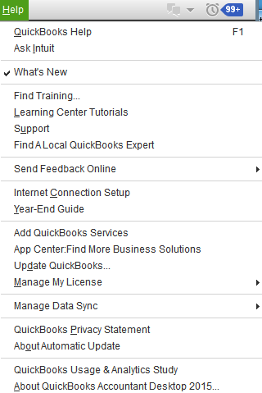
QuickBooks Menus
Help Menu
Access QuickBooks Help
Ask Intuit
Update QuickBooks
About QuickBooks Accountant 2015
And more
Notes:
QuickBooks Menus: Help menu is used to access QuickBooks Help, Ask Intuit, What’s New, Find Training, Learning Center Tutorials, Support, Find A Local QuickBooks Expert, and Send Feedback Online. The Help menu includes topics such as: Internet Connection Setup, Year-End Guide, Add QuickBooks Services, App Center: Find More Business Solutions, Update QuickBooks, Manage My License, Manage Data Sync, QuickBooks Privacy Statement, About Automatic Update, QuickBooks Usage & Analytics Study, and About QuickBooks Accountant Desktop 2015. If QuickBooks has not been registered, you will also see Register QuickBooks.

Slide 26
QuickBooks Desktop Features: Icon Bar
An icon bar contains small picture symbols called icons
Click icons to give commands to QuickBooks
Default is a Left Icon bar
Notes:
QuickBooks Desktop Features: Icon Bar—An icon bar contains small picture symbols called icons.
Click icons to give commands to QuickBooks. Default is a Left Icon bar.

Slide 27
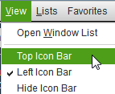
QuickBooks Desktop Features: Icon Bar
Change to a Top Icon bar
Click View Menu,
Click Top Icon Bar
Notes:
QuickBooks Desktop Features: Icon Bar—Change to a Top Icon bar, click the View Menu, and click Top Icon Bar.

Slide 28
QuickBooks Desktop Features: Icon Bar
Change to Colored Icon bar
Click Edit menu
Click Preferences
Click Desktop View
Click My Preferences tab
Click Switch to colored icons/light background on the Top Icon Bar
Click OK
Notes:
QuickBooks Desktop Features: Icon Bar—Change to colored Icon bar. Click the Edit menu, click Preferences, click Desktop View, click the My Preferences tab, click Switch to colored icons/light background on the Top Icon Bar, Click OK.

Slide 29
QuickBooks Desktop Features: Top Icon Bar
Top Icon Bar
Divided into four sections
QuickBooks Home and Calendar
Snapshots and Command Centers
Command Icons
QuickBooks Search and Additions
Notes:
QuickBooks Desktop Features: Top Icon Bar—Icons are pictures that may be clicked to give instructions or perform tasks.
The Top Icon bar is divided into four sections:
The first section contains: QuickBooks Home, My Company, Income Tracker, and Calendar.
The second section contains: Snapshots and Command Centers. The Centers contain information about customers, vendors, employees, bank feeds, docs, and reports. The Customer Center, for example, contains a listing of customers and their individual account details.
The third section contains: Commands that may be executed by QuickBooks. For example, clicking the Invoice icon will open an invoice.
The fourth section contains: QuickBooks Search, which may be used to search Help or through the company file.

Slide 30
QuickBooks Desktop Features: Top Icon Bar—Home AND My Company
QuickBooks Home
Used to go to Home screen (Home Page or Insights)
My Company
Displays
Company Information
Product Information
Recommend and Manage Apps, Services, and Subscriptions
Notes:
QuickBooks Desktop Features: Top Icon Bar—Home and My Company: QuickBooks Home is the first icon shown below the Menu bar and is used to go to the Home screen (Home Page or Insights).
My Company displays Company Information, which may be edited. It informs you of Product Information, allows you to manage apps, services, and subscriptions, and makes recommendations for you.

Slide 31
QuickBooks Desktop Features: Top-icon bar INCOME TRACKER AND Calendar
Income Tracker
View
Unbilled Sales Orders
Invoices for individual or all customers that are
Unpaid
Overdue
Paid
Calendar
Used to maintain a monthly calendar
Contains information for
To Do List
Upcoming: Next 7 days
Due: Past 60 days
Notes:
QuickBooks Desktop Features—Income Tracker And Calendar: Income Tracker allows you to view Unbilled Sales Orders, Unpaid, Overdue, and Paid Invoices. You may view individual customers or all customers. You may perform Batch Actions and Manage Transactions as well.
Calendar is used to maintain a monthly calendar and contains information for the To Do List, Upcoming: Next 7 days, and Due: Past 60 days

Slide 32
QuickBooks Desktop Features: Top Icon Bar—Snapshots
Snapshots
Snapshots has three tabs to display information
Company
Payments
Customers
Notes:
QuickBooks Desktop Features: Top Icon Bar—Snapshots: There are three tabs to display information with Snapshots: Company, Payments, Customers.

Slide 33
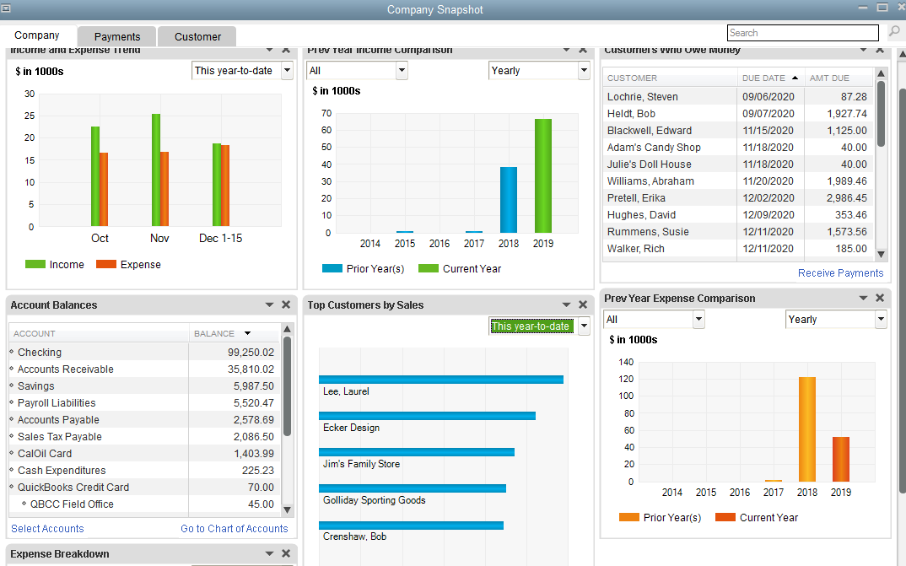
QuickBooks Desktop Features: Top Icon Bar—Snapshot
Company Snapshot
Shows information about company
May be customized
Notes:
QuickBooks Desktop Features: Top Icon Bar—Snapshot: The Company Snapshot shows information about how the business is doing. . When you click Add Content, there are 12 different items that may be displayed for the company. These options include listings or graphs for Account Balances, Previous Year Income Comparison, Income Breakdown, Previous Year Expense Comparison, Expense Breakdown, Income and Expense Trend, Top Customers by Sales, Best-Selling Items, Customers Who Owe Money, Top Vendors by Expense, Vendors to Pay, and Reminders.

Slide 34
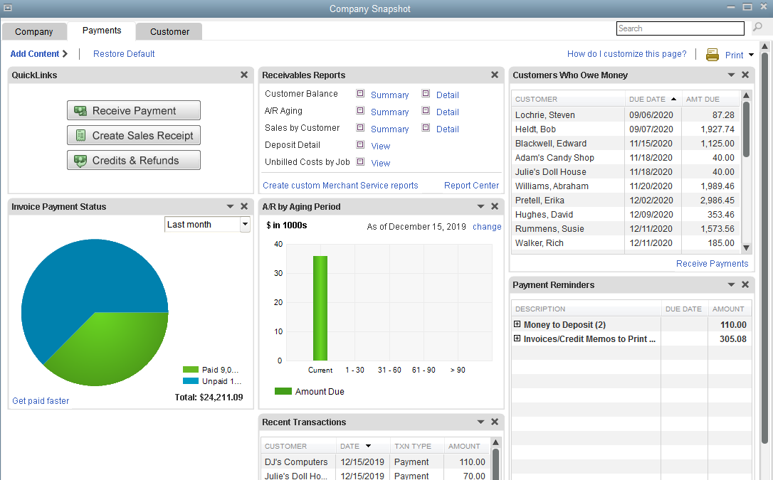
QuickBooks Desktop Features: Top Icon Bar—Snapshot
Payments Snapshot
Shows information about company revenues
It may be customized
Notes:
QuickBooks Desktop Features: Top Icon Bar—Snapshot: The Payment Snapshot shows information about the company revenues. When you click the Payments tab, you may select from among seven options on Add Content to display information about your company revenue. These include Recent Transactions, Receivables Reports, A/R by Aging Period, Invoice Payment Status, Customers Who Owe Money, QuickLinks, and Payment Reminders.

Slide 35
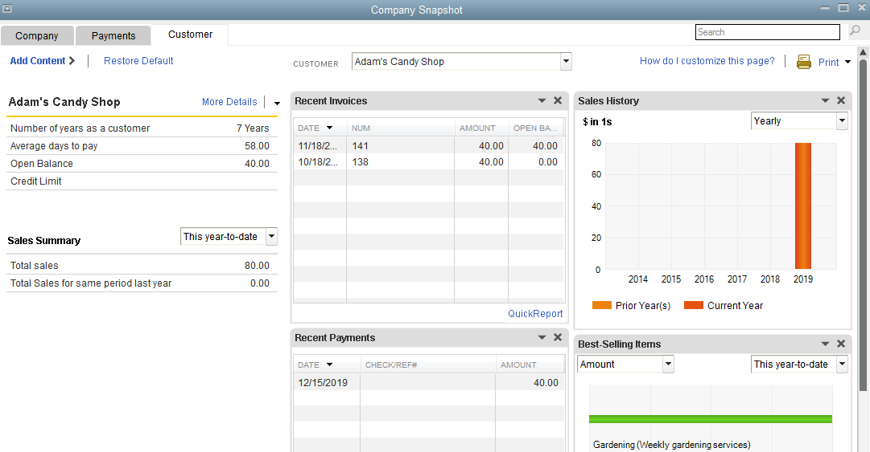
QuickBooks Desktop Features: Top Icon Bar—Snapshot
Customer Snapshot
Shows information about individual customers
It may be customized
Notes:
QuickBooks Desktop Features: Top Icon Bar—Snapshot: The Customer Snapshot shows information about individual customers. The screen may be customized by clicking on Add Content to select from Recent Invoices, Recent Payments, Sales History, and Best-Selling Items.

Slide 36
QuickBooks Desktop Features: Top Icon Bar—Command Centers
Command Centers
Provide access to specialized areas of information.
To access a center, click appropriate icon on icon bar.
Command Centers are:
Customers
Vendors
Employees
Bank Feeds
Docs
Reports
App Center
User Licenses
Notes:
QuickBooks Desktop Features: Top Icon Bar—Command Centers: Provide access to specialized areas of information.
To access a center, click the appropriate icon on the icon bar.
The Command Centers are:
Customer
Vendor
Employee
Bank Feeds
Doc
Report
App
User Licenses
There is no problem if the centers are in a different order on the icon bar.

Slide 37
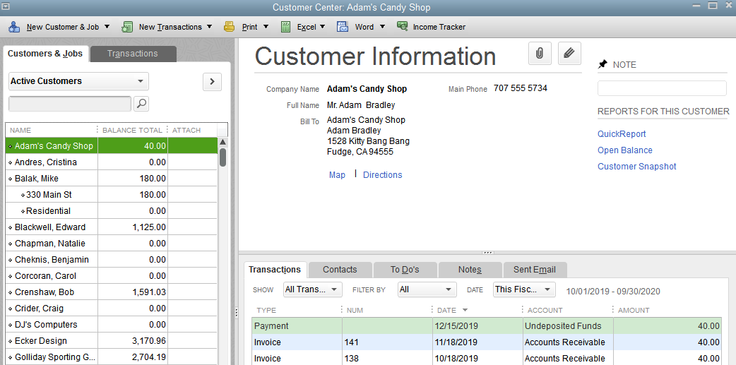
QuickBooks Desktop Features: Top Icon Bar—Customer Center
Customer Center
Customers & Jobs tab displays a list of customers and their balances, customer information and transactions for a selected customer (default tab shown)
Transactions tab displays transaction categories and allows you to get information about transaction groups
Notes:
QuickBooks Desktop Features: Top Icon Bar—Customer Center: Has a Customers & Jobs tab and a Transactions tab.
The Customers & Jobs Tab displays a list of customers and their balances, customer information and transactions for a selected customer. This is the default tab. The Transactions tab displays transaction categories and allows you to get information about transaction groups.
Using the Customer Center icon bar allows you to give commands to QuickBooks to add New customers, enter transactions, and print several lists. Customer lists and transactions may be exported and imported to Excel. A variety of letters applicable to customers may be prepared using Word.

Slide 38
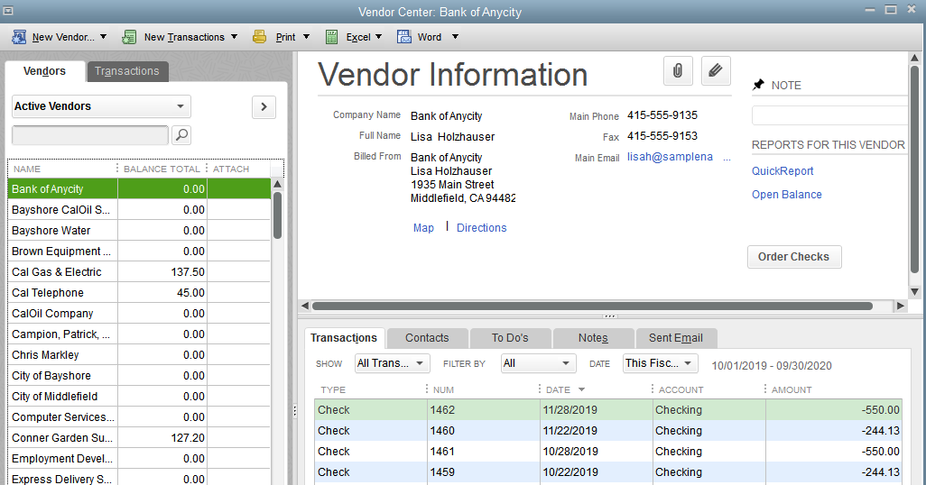
QuickBooks Desktop Features: Top Icon Bar—Vendor Center
Vendor Center
Vendors tab allows you to display information about vendors and is default tab (shown)
Transactions tab displays transaction categories and allows you to get information about transaction groups
Notes:
QuickBooks Desktop Features: Top Icon Bar—Vendor Center: Has a Vendors tab and a Transactions tab.
The Vendors tab allows you to display information about the vendors and is the default tab.
Clicking the Transactions tab displays transaction categories and allows you to get information about transaction groups.
Using the Vendor Center icon bar allows you to give commands to QuickBooks to add New customers, enter transactions, and print several lists. Vendor lists and transactions may be exported and imported to Excel. A variety of letters applicable to vendors may be prepared using Word.

Slide 39
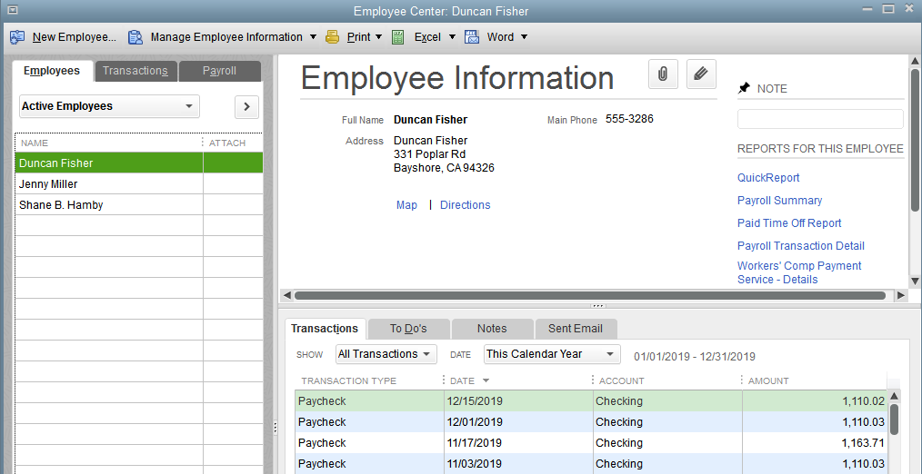
QuickBooks Desktop Features: Top Icon Bar—Employee Center
Employee Center
Employees tab allows you to display a list of employees, employee information and payroll transactions for a selected employee and is default tab (shown)
Transactions tab displays transaction categories and allows you to get information about transaction groups
Payroll tab provides information regarding payroll dates, payroll taxes, and payroll forms
Notes:
QuickBooks Desktop Features: Top Icon Bar—Employee Center has three tabs: Employees, Transactions, and Payroll.
The Employees tab allows you to display a list of employees, employee information and payroll transactions for a selected employee and is the default tab.
The Transactions tab displays transaction categories and allows you to get information about transaction groups.
The Payroll tab provides information regarding payroll dates, payroll taxes, and payroll forms.
Using the Employee Center icon bar allows you to give commands to QuickBooks to add New Employees, Manage Employee Information, and print several lists. Employee lists and transactions may be exported and imported to Excel. A variety of letters applicable to employees may be prepared using Word.

Slide 40
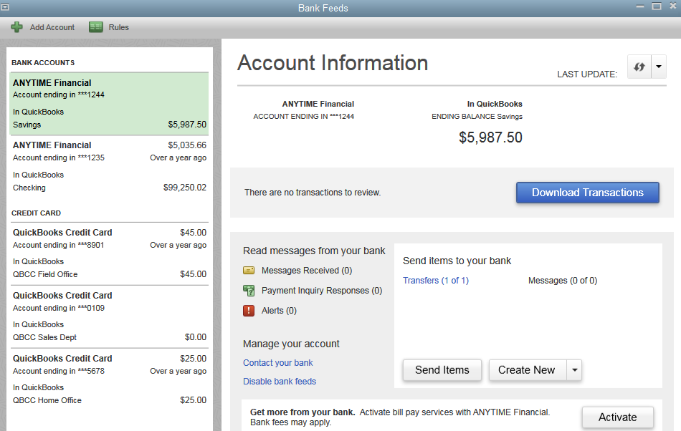
QuickBooks Desktop Features: Top Icon Bar—bank feeds
Bank Feeds
Shows information about bank accounts
Enables you to perform online banking transactions
Notes:
QuickBooks Desktop Features: Top Icon Bar—Bank Feeds: Shows information about your Bank Accounts, allows you to Download Transactions, and Send Items. When you click Create, you may prepare Online Checks, Pay Bills, Transfer Funds, Messages, Inquire About Payments, and Cancel Payments. In addition, you may click icons to Add Account and display Rules.

Slide 41
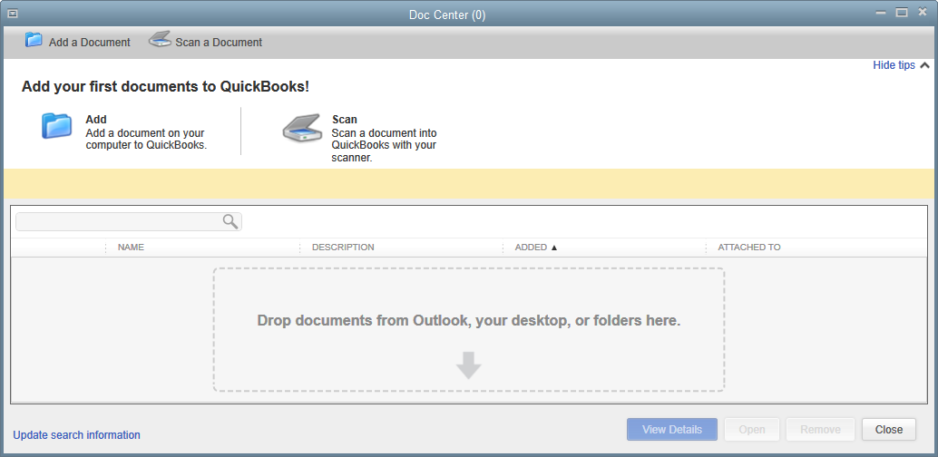
QuickBooks Desktop Features: Top Icon Bar—Doc Center
Doc Center
Allows you to add documents to QuickBooks
You may add documents stored on your computer or you may scan a document into QuickBooks
You may attach these documents to a transaction or item
Notes:
QuickBooks Desktop Features: Top Icon Bar—Doc Center: Is used to keep track of documents you use with QuickBooks. It allows you to Add a Document to the Doc Center from your computer or scanner. You may attach documents, view and add document details, search for documents, detach documents, and remove documents from the Doc Center. Documents may be items such as receipts, spreadsheets, bills, invoices, etc.

Slide 42
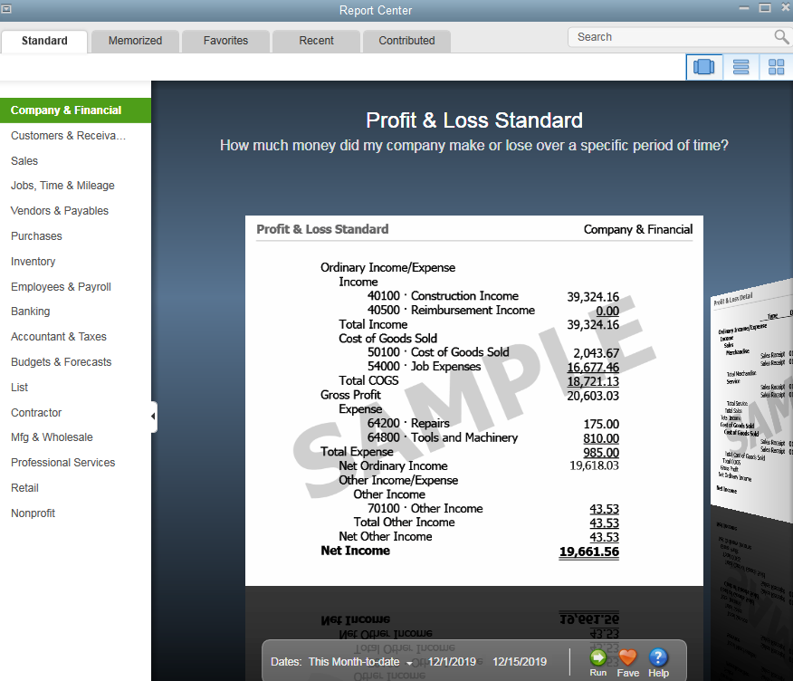
QuickBooks Desktop Features: Top Icon Bar—Report Center
Report Center
Used to prepare Reports in QuickBooks
Reports are arranged by category
Displays reports in three views:
Carousel (shown)
List
Grid
Notes:
QuickBooks Desktop Features: Top Icon Bar—Report Center: Prepares all of the available Reports in QuickBooks.
Reports are arranged by category. The categories are: Company & Financial; Customers & Receivables; Sales; Jobs, Time & Mileage; Vendors & Payables; Purchases; Inventory; Employees & Payroll; Banking; Accountant & Taxes; Budgets & Forecasts; List, Contractor, Mfg & Wholesale, Professional Services, Retail, and Nonprofit.
The available reports in each category may be displayed in a carousel view (shown), a list view, or a grid view.

Slide 43
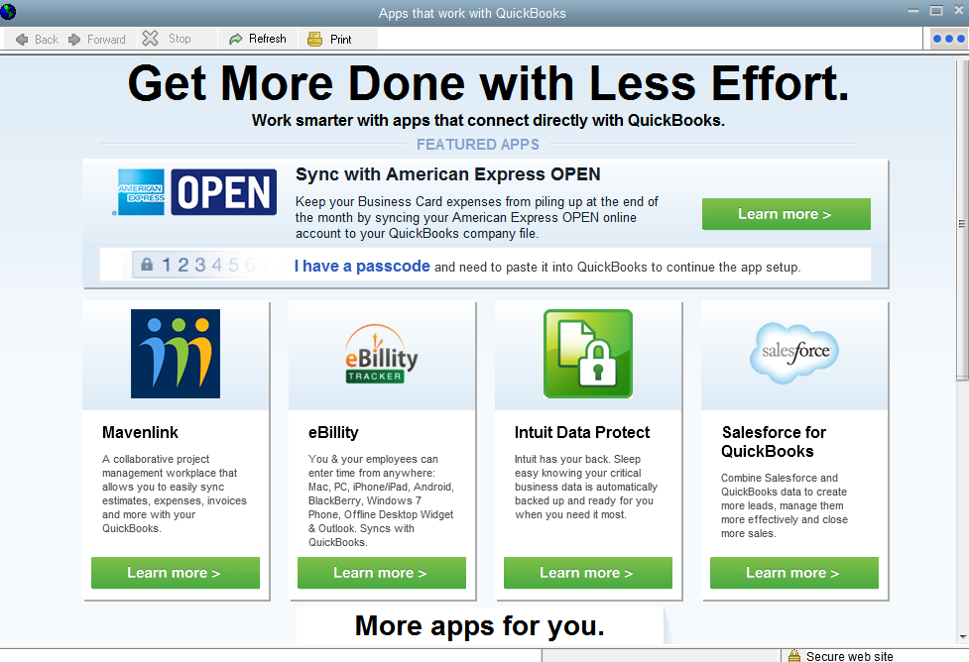
QuickBooks Desktop Features: Top Icon Bar—App Center
App Center
Link to Intuit subscription services with workplace applications
Some application categories are:
Mobile
Customer Management
Billing & Invoicing
Financial Management
Sales Management
And others
Notes:
QuickBooks Desktop Features: Top Icon Bar—App Center: Is a link to Intuit apps for Featured, Just Added, Mobile, Billing/Invoicing, Customer Management, Expense Management, eCommerce, and more. You may also access Intuit’s App Center to select other Apps. Some Apps are free and others require a subscription service.

Slide 44
QuickBooks Desktop Features: Top Icon Bar—USER LICENSES
User Licenses
Link to Intuit to add multiple users—up to five individuals may work in a QuickBooks Company File at same time
Notes:
QuickBooks Desktop Features: Top Icon Bar—User Licenses connects you to a link that will allow you to add multiple users to QuickBooks. You may purchase QuickBooks for a single user (1 individual) or multiple users (5 individuals). Multi-user access to QuickBooks allows up to five individuals to work in a QuickBooks company file at the same time.

Slide 45
QuickBooks Desktop Features: Top Icon Bar—Command Icon Bar
Command Icon Bar
Clicking an icon (picture) on icon bar is another way of giving commands
Icon bar may be customized
Notes:
QuickBooks Desktop Features: Top Icon Bar—Command Icon Bar: Clicking an icon on the icon bar is another way of giving commands. The command section of the icon bar has a list of buttons (icons) that may be clicked in order to enter transactions, use find, prepare a backup, get support, and give feedback. The icon bar may be turned on or off and it may be customized. If there is a double >> at the edge of the icon bar, that means that there are more icons available for use. The command icons will be discussed in more detail during training.

Slide 46
QuickBooks Desktop Features: Top Icon Bar—SEARCH AND ADDITIONS
Search and Additions
Services takes you to a QuickBooks Products and Services link. You will be able to add recommended services from this link.
Add Payroll takes you to an Intuit page for Accounting Software for Small Business – Intuit QuickBooks. Once you sign in, you may add services and apps.
Credit Cards allows you to sign up for plans so your company can accept credit card payments and bank transfers using QuickBooks.
QuickBooks Search used to search through
QuickBooks Help for information
Company file for various transactions, accounts, items, customers, vendors, employees, etc.
Notes:
QuickBooks Desktop Features: Top Icon Bar—Search And Additions has four items. Services takes you to a QuickBooks Products and Services link. You will be able to add recommended services from this link. Add Payroll takes you to an Intuit page for Accounting Software for Small Business – Intuit QuickBooks. Once you sign in, you may add services and apps. Credit Cards allows you to sign up for plans so your company can accept credit card payments and bank transfers using QuickBooks. QuickBooks Search is used to search through QuickBooks Help for information or through the Company file for various transactions, accounts, items, customers, vendors, employees, etc.

Slide 47
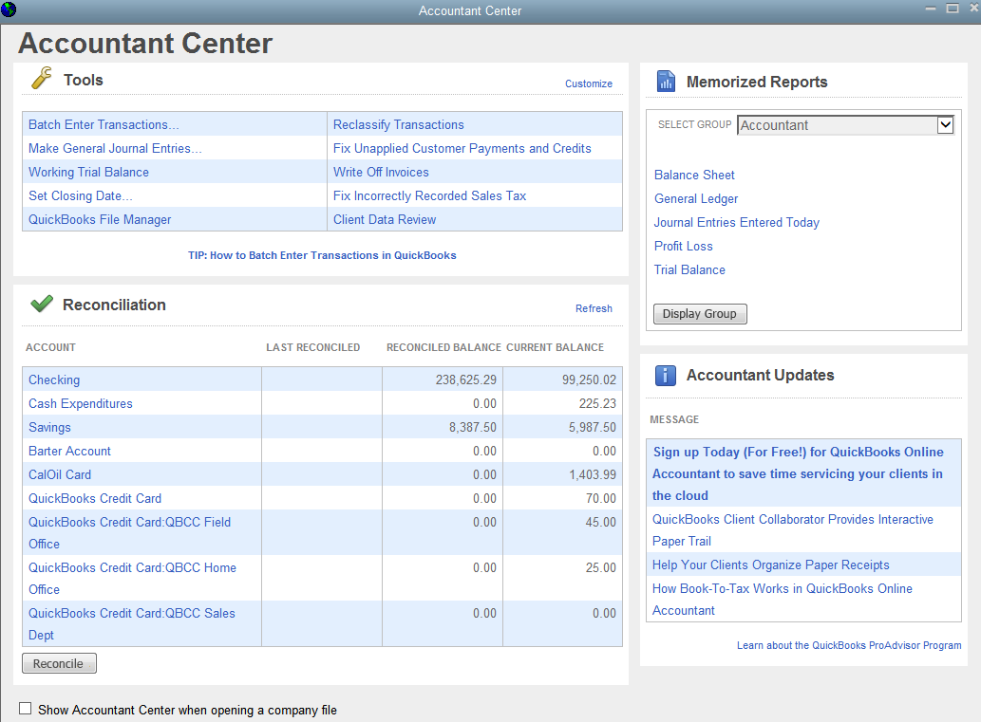
QuickBooks Accountant Center
Accountant Center
Accessed from Accountant Menu
Has Tools that may be customized
Shows Reconciliation information
Allows use of Memorized Reports
Shows Accountant Updates
Notes:
QuickBooks Accountant Center: Accessed from the Accountant Menu. The Center has Tools that may be customized and used for transactions, reports, and activities completed by accountants. In the Accountant Center you may select an account for reconciliation, select memorized reports, and get accountant updates. You may also select “Show Accountant Center when opening a company file” and the Center will be shown whenever you open QuickBooks.

Slide 48
Home Screen
QuickBooks Home screen has two tabs
Home Page
Insights
Notes:
Home Screen: QuickBooks Home screen has two tabs: Home Page and Insights

Slide 49
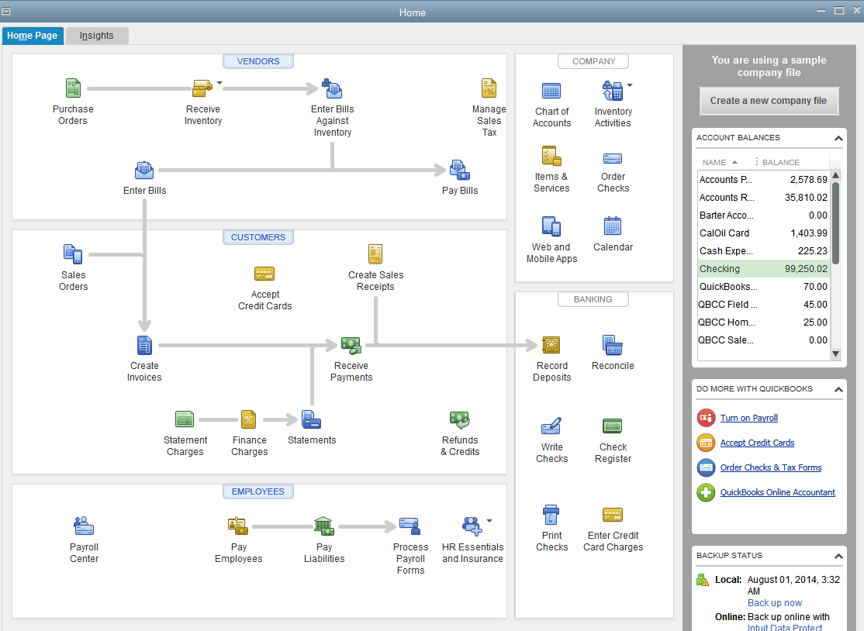
QuickBooks Home Page
Home Page
Give commands to QuickBooks
Get information from QuickBooks
Notes:
QuickBooks Home Page: Allows you to give commands to QuickBooks according to the type of transaction being entered.
Information regarding Getting Started, Account Balances, Do More with QuickBooks, Backup Status, and Reminders & Alerts is displayed on the right side of the Home Page and may be expanded or minimized.

Slide 50
QuickBooks Home Page
Home Page
Tasks to give commands organized into logical groups:
Vendors
Customers
Employees
Company
Banking
Notes:
QuickBooks Home Page: Tasks to give commands to QuickBooks are organized into logical groups (Vendors, Customers, Employees, Company, and Banking).

Slide 51
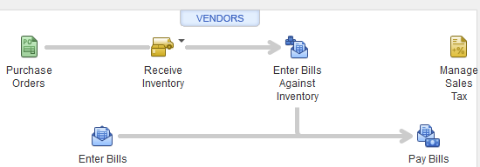
QuickBooks Home Page: Vendors Section
Vendors
Used to
Enter Bills
Pay Bills
Companies with inventory can select
Purchase Orders
Receive Items
Enter Bills Against Inventory
Manage Sales Tax
Click Vendors button on top of Vendor section to access Vendor Center
Notes:
QuickBooks Home Page: Vendors Section—Allows service and merchandising businesses to enter bills and to record the payment of bills. Companies with inventory can create purchase orders, receive inventory items, enter bills against inventory, and manage sales tax. The Vendor Center may be accessed by clicking the Vendors button at the top of the section.

Slide 52
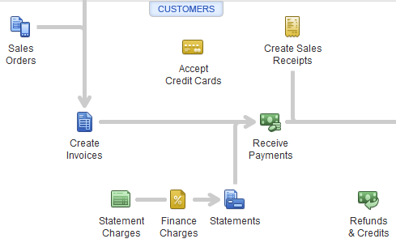
QuickBooks Home Page: Customers Section
Customers
Used for transactions associated with cash and credit sales:
Create Invoices
Create Sales Orders
Accept Credit Cards
Create Sales Receipts
Receive Payments
Statement Charges
Finance Charges
Statements
Refunds & Credits
Click Customers button on top of Customers section to access Customer Center
Notes:
QuickBooks Home Page: Customers Section—Allows transactions associated with cash sales, sales on account (credit sales), cash receipts, refunds and credits. Graphic icons used to prepare invoices, sales receipts, receive payments, statement charges, finance charges, statements, and refunds and credits are available. Clicking the Customers button on the top of the Customers section will access the Customer Center

Slide 53
QuickBooks Home Page: Employees Section
Employees
Used for payroll transactions
Pay Employees
Pay Liabilities (Payroll)
Process Payroll Forms
HR Essentials and Insurance
Access Payroll Center
Click Employees button on top of Employee section to access Employee Center
Notes:
QuickBooks Home Page: Employees Section—Used for payroll transactions, allows paychecks to be created, payroll tax liabilities to be paid, payroll forms to be processed, and access human resource essentials and insurance information that enables you to produce labor law posters, Workers’ Comp Payment Service, and View My Paycheck (Online Pay Stubs). If you subscribe to a paid payroll program, you may access the Payroll Center.
Clicking the Employees button on the top of the Employee section will access the Employee Center

Slide 54
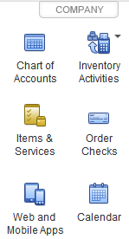
QuickBooks Home Page: Company Section
Company
Graphic icons can be clicked to show
Chart of Accounts
Items & Services
Web and Mobile Apps
Inventory Activities
Order Checks
Calendar
Notes:
QuickBooks Home Page: Company Section—Allows you to display information about your company. There are graphic icons used to display the Chart of Accounts, Items & Services, Web and Mobile Apps, Inventory Activities, Order Checks, and the Calendar.

Slide 55
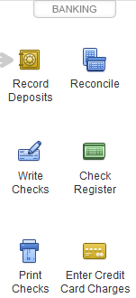
QuickBooks Home Page: Banking Section
Banking
Used for banking and checking
Icons allow you to
Record Deposits
Write Checks
Print Checks
Reconcile
All balance sheet accounts
Check Register
Enter Credit Card Charges
Notes:
QuickBooks Home Page: Banking Section—Allows you to write checks, print checks, make bank deposits, reconcile accounts, access the check register, and enter credit card charges.

Slide 56
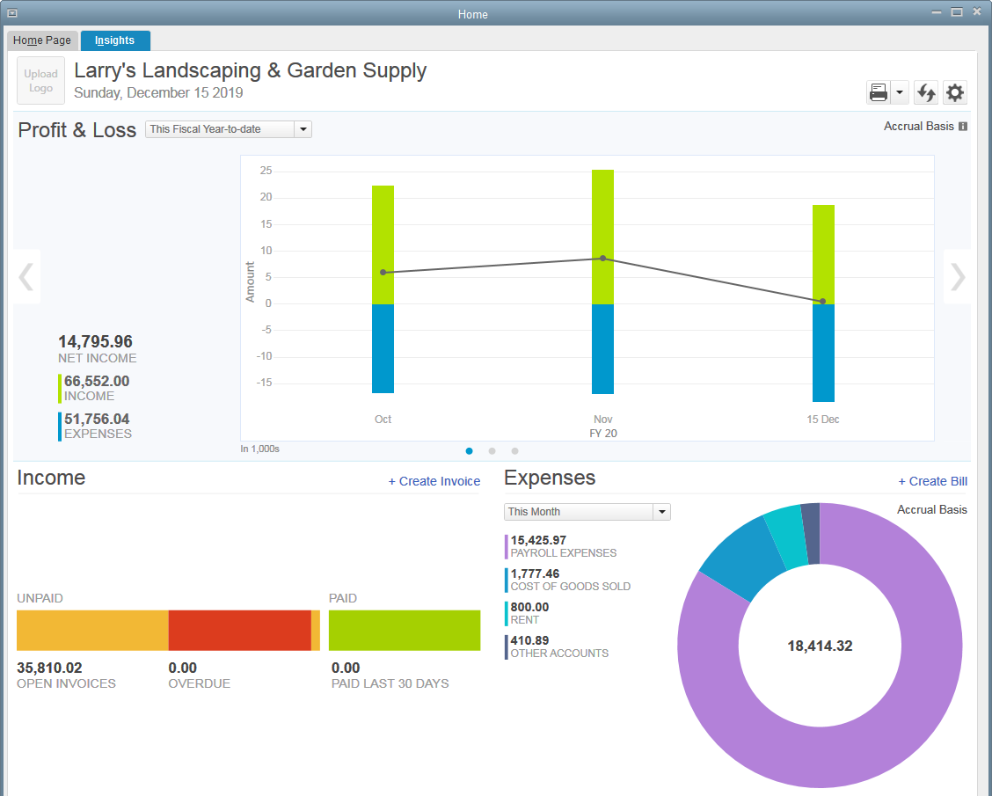
QUICKBOOKS INSIGHTS
Insights
Tab is on Home Screen
Displays information and data about company
Default shows information for
Profit & Loss
Income
Expenses
May customize to show other data
Notes:
QuickBooks Insights: When the Insights tab is selected on the Home Screen, information and data about the company is displayed. The company name, logo, and date and icons for Print, Refresh, and Customize are shown. The default is to display information about Profit & Loss, Income, and Expenses. There are gray arrows on the right and left sides of the Profit & Loss data that advance you to other selected information; such as, Prev Year Income Comparison and Top Customers by Sales. Clicking the Customize icon allows you to add Income and Expense Trend, Business Growth, Net Profit Margin, and Prev Year Expense Comparison to the information that may be displayed.

Slide 57
QuickBooks Forms
Used to record business transactions
Entries on a form are automatically recorded in Journal in Debit/Credit format
Notes:
QuickBooks Forms: Transactions are entered directly onto the business form that is prepared as a result of the transaction. Behind the scenes, QuickBooks enters the debit and credit to the Journal and posts to the individual accounts.
Two categories of forms:
Forms you want to send or give to people—invoices, sales receipts, credit memos, checks, deposit slips, and purchase orders.
Forms you have received—payments from customers, bills, credits for a bill, and credit card receipts.

Slide 58
QuickBooks Forms
Two categories of forms:
Forms to send or give to people
Invoices
Sales Receipts
Credit Memos
Checks
Deposit Slips
Purchase Orders
Forms you have received
Payments from customers
Bills
Credits for a Bill
Credit Card Receipts
Notes:
QuickBooks Forms: Two categories of forms:
Forms you want to send or give to people—invoices, sales receipts, credit memos, checks, deposit slips, and purchase orders.
Forms you have received—payments from customers, bills, credits for a bill, and credit card receipts.

Slide 59
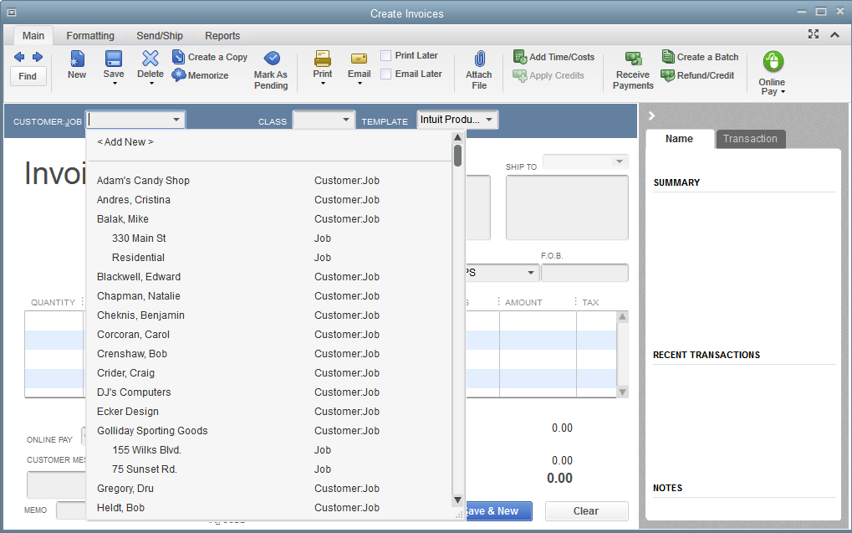
QuickBooks Forms: Invoice
Invoice
Prepared to record a sale on account to a customer
Click Create Invoices icon in Customer Section of Home Page
Title Bar
Tabs
Icon bar
Field
Text box
Drop-down list
Buttons
Notes:
QuickBooks Forms: Invoice—An invoice is prepared to record a sale on account (credit sale). An invoice is accessed by clicking the Invoices icon in the Customer Section of the Home Page. The invoice appears on the screen and is ready to be completed. The information to record an invoice is entered into various areas that are described on the following slides.

Slide 60
Invoice Title Bar
Title Bar
Indicates what task you are performing
(Create Invoices is shown below)
Has buttons to
Minimize
Maximize
Close an invoice
Minimize button: click to clear invoice from screen, yet keep it open for further use
Maximize or Restore button: click to make invoice full size of screen or to restore back to original size
Close button: click to close invoice
Notes:
Invoice Title Bar indicates what you are completing and has several buttons. The Title bar appears at the top of the Invoice and says “Create Invoices.”
The buttons are:
Minimize button: click to clear the invoice from the screen, yet keep it open for further use
Maximize button: click to make the invoice the full size of the screen
Restore button: click to restore the invoice back to the original size
Close button: click to close the invoice

Slide 61
Areas used in invoice
Field
Area on a form requiring information
Customer:Job is a field
Text box
Area within a field where information may be typed or inserted
Area to be filled in to identify Customer:Job is a text box
Notes:
Areas used in an invoice: The information to record an invoice is entered into various areas these are defined as: Field: an area on a form requiring information—Customer:Job is a field on an invoice.
Text box: an area within a field where information may be typed or inserted—area to be filled in to identify the Customer:Job is a text box.

Slide 62
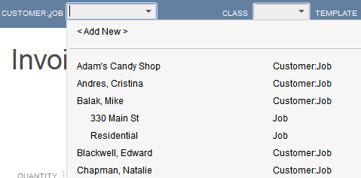
Areas used in invoice
Drop-down List arrow
Click to access a drop-down list
Drop-down list
Contains information that may be used to complete a field
Click a name to insert into field
Notes:
Areas used in an invoice: Drop-down List Arrow: Used to access a drop-down list. Drop-down List: contains information that may be used to complete a field. For example, a list of customers will be shown on the Customer:Job list. Click a name on the list to insert into the field.

Slide 63
Invoice Icon Bar Tabs
Click Invoice Icon Bar icons to
Give commands
Get information regarding linked or related transactions
Four Icon Bars Tabs available for Invoices:
Main
Formatting
Send/Ship
Reports
Notes:
The Invoice Icon Bar Tabs have icons that are clicked to give commands to QuickBooks or to get information regarding linked or related transactions. There are four Icon Bar Tabs available for Invoices: Main, Formatting, Send/Ship, and Reports.

Slide 64
Invoice Icon Bar Tabs
Main
Use to give basic commands
Find
Previous
Next
New
Save
Delete
Create a Copy
Memorize
Mark as Pending
Print
Email
Attach File
Add Time/Costs,
Apply Credits
Receive Payments
Create a Batch
Refund/Credit
Notes:
Invoice Icon Bar Tabs: Main—Give basic commands such as find, previous, next, new, save, delete, create a copy, memorize, mark as pending, print, email, attach file, add time/costs, apply credits, receive payments, create a batch, and refund/credit,.

Slide 65
Invoice Icon Bar Tabs
Formatting
Use to
Preview
Manage Templates
Download Templates
Customize Data Layout
Spelling
Insert Line
Delete Line
Copy Line
Paste Line
Customize Design
Notes:
Invoice Icon Bar Tabs: Formatting—Use to preview the invoice before printing; manage templates; download templates; customize data layout; check spelling; insert, delete, copy, and paste lines; and customize design

Slide 66
Invoice Icon Bar Tabs
Send/Ship
Use to
Send an invoice via
Email
Mail Invoice
Ship via
FedEx
UPS
USPS
Prepare Letter
Notes:
Invoice Icon Bar Tabs: Send/Ship—Use to send an invoice via email or mail; to prepare a letter; or ship via FedEx, UPS, or USPS.

Slide 67
Invoice Icon Bar Tabs
Reports
Use to prepare reports for
Quick Report
Transaction History
Transaction Journal
View Open Invoices
Sales By Customer Detail
Average Days to Pay Summary
Notes:
Invoice Icon Bar Tabs: Reports—Use to prepare reports: Quick Report, Transaction History, Transaction Journal, View Open Invoices, Sales By Customer Detail, Average Days to Pay Summary.

Slide 68
Invoice Buttons
Invoice Buttons
Save & Close
Click to save invoice and exit Create Invoices screen
Save & New
Click to save invoice and go to a new invoice for completion
Clear
Click to clear information entered on current invoice
Notes:
Invoice Buttons: When the Invoice is complete, click one of the buttons:
Save & Close: click to save the invoice and exit the Create Invoices screen.
Save & New: click to save the invoice and go to a new invoice for completion.
Clear: click to clear the information entered on the current invoice.

Slide 69
QuickBooks Lists
QuickBooks Lists are used to expedite entering transactions
Lists are an integral part of program
There are lists for:
Customers & Jobs
Vendors
Items & Services
Chart of Accounts
And Others
Notes:
QuickBooks Lists: In order to expedite entering transactions, QuickBooks uses lists as an integral part of the program. Customers & Jobs, Vendors, Items & Services, and Chart of Accounts are organized as lists.

Slide 70
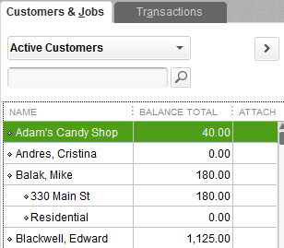
QuickBooks Lists: Customers & Jobs
Shown in Customer Center
To view Customers & Jobs List
Click Customers button on Home Page
Customers & Jobs List = Accounts Receivable Subsidiary Ledger
Notes:
QuickBooks Lists: Customers & Jobs—Click the Customers button to access the Customer Center and view the Customers & Jobs List. The Customers & Jobs list is also the Accounts Receivable Subsidiary Ledger.

Slide 71
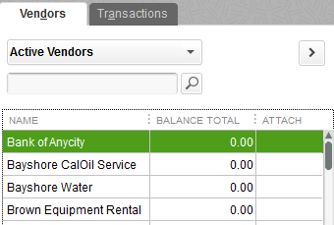
QuickBooks Lists: Vendors
Shown in Vendor Center
To view Vendors List
Click Vendors button on Home Page
Vendors List = Accounts Payable Subsidiary Ledger
Notes:
QuickBooks Lists: Vendors—Click the Vendors button to access the Vendor Center and view the list of vendors. The Vendors List is also the Accounts Payable Subsidiary Ledger.

Slide 72
QuickBooks Lists: Items
To view Item List
Click Items & Services icon in Company section of Home Page
Item List shows
Items available for sale
Services performed by company
Notes:
QuickBooks Lists: Items List—Click the Items & Services icon in the Company section of the Home Page to view the Item List. The Item List shows all of the items available for sale and services performed by the company.

Slide 73
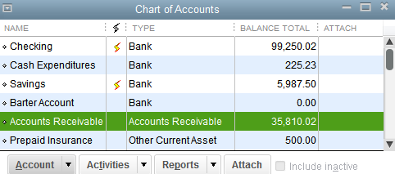
QuickBooks Lists: Chart of Accounts
To access Chart of Accounts
Click Chart of Accounts icon on Home Page
OR
Click Lists menu
Click Chart of Accounts
Chart of Accounts = General Ledger
Notes:
QuickBooks Lists: Chart of Accounts: To access the Chart of Accounts, click the Chart of Accounts icon on the Home Page OR click the Lists menu and Chart of Accounts. The Chart of Accounts is also the General Ledger.

Slide 74
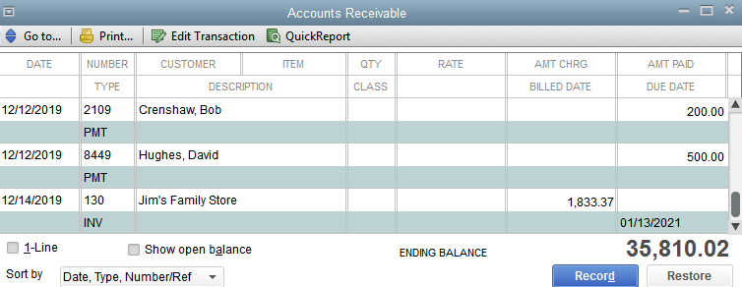
QuickBooks Lists: Chart of Accounts
Each individual account has a register that records all of account activity
Note that PMT and INV are shown as two transaction types
Notes:
QuickBooks Lists: Chart of Accounts—Each individual account has a register that records all of the account activity. Note that PMT and INV are shown as two transaction types.

Slide 75
QuickBooks Reports Center
QuickBooks Report Center allows preparation of all reports available in QuickBooks
Access Report Center
Click Reports icon on Icon Bar
OR
Click Reports on Menu bar
Click Report Center
Notes:
QuickBooks Reports Center: As previously discussed, QuickBooks Reports Center contains lists for all the reports available in QuickBooks. Access the Report Center by clicking the Reports menu and Report Center (OR click the Reports icon on the icon bar).

Slide 76
QuickBooks Reports Center
Reports are organized by category
Notes:
QuickBooks Reports Center: Reports are organized by category:
Company & Financial
Customers & Receivables
Sales
Jobs, Time & Mileage
Vendors & Payables
Purchases
Inventory
Employees & Payroll
Banking
Accountant & Taxes
Budgets & Forecasts
List
Contractor
Mfg & Wholesale
Professional Services
Retail
Nonprofit

Slide 77
QuickBooks Reports
To prepare Company and Financial Reports
Click Company & Financial in Category list
Company & Financial has several subcategories:
Profit & Loss (Income Statement)
Income & Expenses
Balance Sheet & Net Worth
Cash Flow
To display reports in Grid view, click Grid View button
Notes:
QuickBooks Reports: The report category for Company and Financial is divided into several subcategories: Profit & Loss (Income Statement), Income & Expenses, Balance Sheet & Net Worth, Cash Flow. To view Company and Financial Reports, click Company & Financial in the report list
To display the reports in Grid view, click the Grid View button.

Slide 78
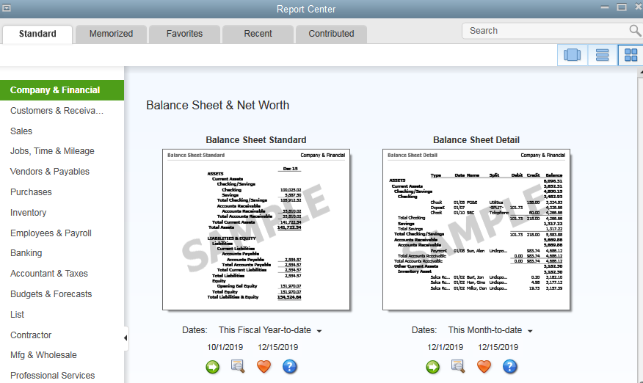
QuickBooks Reports: Balance Sheet
View a Standard Balance Sheet
Scroll down to Balance Sheet & Net Worth section
Click Run button for Balance Sheet Standard
Notes:
QuickBooks Reports: Balance Sheet—A standard balance sheet is located in the Balance Sheet & Net Worth subcategory. To view a standard balance sheet, scroll down until you see the sample Balance Sheet. Click the Run button for the Balance Sheet Standard in the Balance Sheet & Net Worth section.

Slide 79
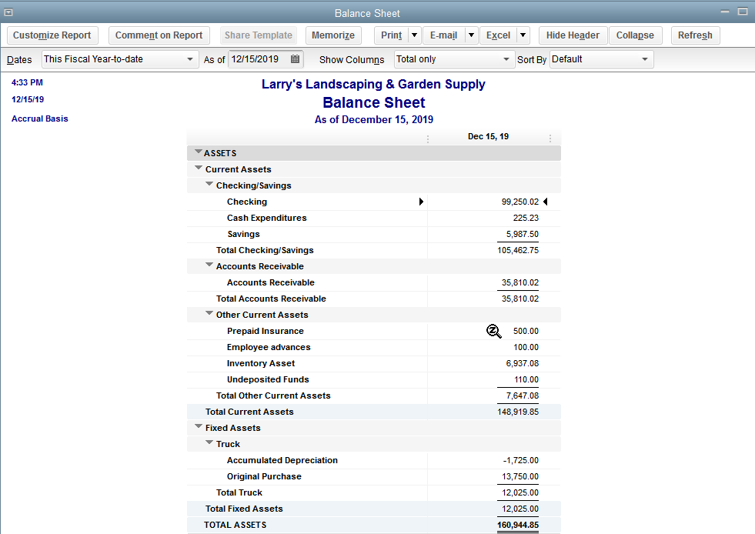
QuickBooks Reports: Balance Sheet
View report (Notice cursor)
Notes:
QuickBooks Reports: Balance Sheet—balance sheet will be displayed. When you point to Prepaid Insurance, your cursor will turn into a magnifying glass with a Z inside.

Slide 80
QuickZoom
To view transaction details for individual accounts from Balance Sheet
Position cursor over amount for Prepaid Insurance
When cursor turns into double-click amount
Transaction by Account report will be displayed
Notes:
QuickZoom: When looking at the Balance Sheet, you may view transaction details for individual accounts. To view transaction details for Prepaid Insurance, position the cursor over the amount for Prepaid Insurance. When the cursor turns into magnifying glass with a Z inside, double-click the amount. This will allow you to view the Transactions by Account report.

Slide 81
QuickBooks Reports
To see a listing of reports for Company & Financial in Report Center
Click List View button
Notes:
QuickBooks Reports: Click the List View button to see a listing of reports.

Slide 82
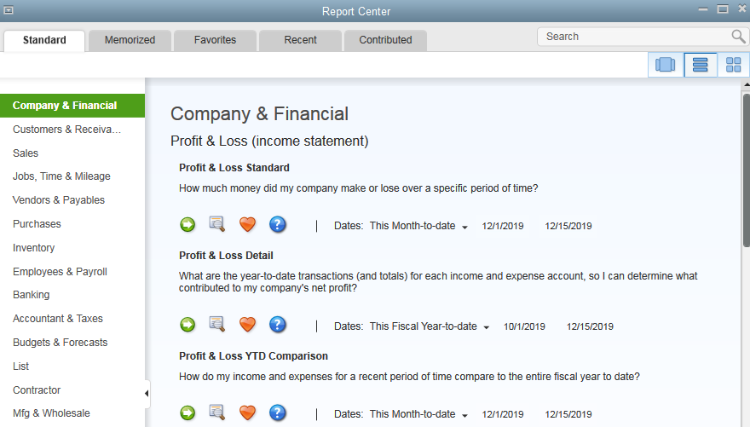
QuickBooks Reports
Report names and brief description of each report shown
Notes:
QuickBooks Reports: The report names and a brief description of each report is shown.

Slide 83
QuickBooks Graphs
QuickBooks has graphs to show
Net Worth
Income & Expense Accounts
Receivables
Sales
Graphs are both bar charts and pie charts
Click Carousel View button
Notes:
QuickBooks Graphs: QuickBooks has graphs to show Net Worth, Income & Expense, Accounts Receivables, and Sales. Graphs are both bar charts and pie charts. Click the list button to see a listing of reports. Click the Carousel View button.

Slide 84
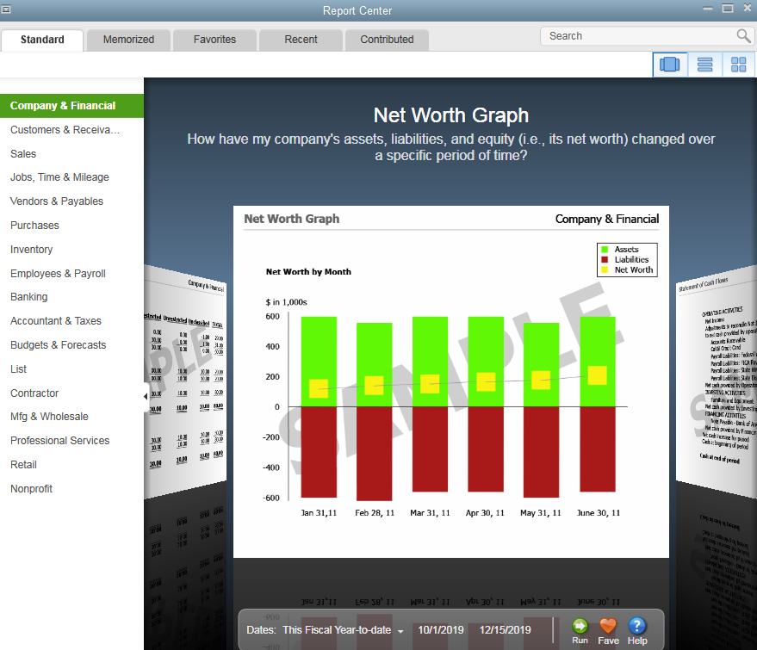
QuickBooks Graphs
Scroll through reports to see example of Net Worth Graph
Notes:
QuickBooks Graphs: Scroll through the reports to see an example of the Net Worth Graph.

Slide 85
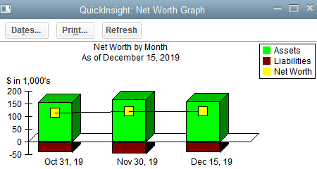
QuickBooks Graphs
View a Net Worth Graph
Click Run at bottom of Net Worth Graph shown in Carousel view
Report is displayed and shows a bar chart with information for
Assets
Liabilities
Net Worth
Notes:
QuickBooks Graphs: To view a Net Worth Graph, click Run at the bottom of the Net Worth Graph shown in the Carousel view. The report is displayed and shows a bar chart with information for: Assets, Liabilities, and Net Worth.

Slide 86
QuickMath
To use QuickMath to calculate amounts on a business form
For example, on an open Invoice:
Click in Amount column
Enter numbers 1 2 3
Press +
Enter next numbers
Press +, etc.
When finished press Enter to insert total
Notes:
QuickMath: QuickBooks can calculate amounts in business documents; such as, invoices, bills, etc. by using QuickMath. To use QuickMath on an open Invoice, click in an Amount column and enter the first row of numbers, press plus and enter the next row of numbers. As an example, you would enter the numbers 1 2 3. Press the plus + key. Enter the next numbers 4 5 6. Press the plus + key again. When finished entering the numbers for calculation, press the Enter key to insert the total into business document such as an invoice.

Slide 87
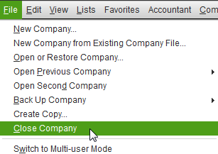
Close Sample Company
To close Larry’s Landscaping, click File menu, and Close Company
Notes:
To close sample company, Larry’s Landscaping, click the File menu, and click Close Company.

Slide 88
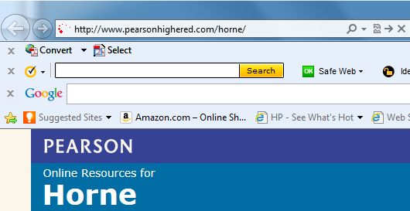
Download Company Files from Web Site Using Windows 7
Open Internet Explorer
Enter the address: http://www.pearsonhighered.com/horne/
Notes:
Download Company Files from Web Site Using Windows 7: Open Internet Explorer
Enter the address: http://www.pearsonhighered.com/horne/, press Enter.

Slide 89
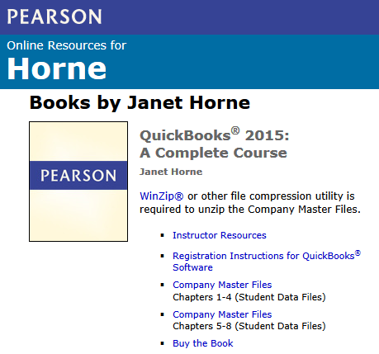
Download Company Files from Web Site Using Windows 7
Click Company Master Files Chapters 1-4 (Student Data Files)
Note: exact cover was not yet available when this was written. Look for cover for 2015 edition.
Notes:
Download Company Files from Web Site Using Windows 7: Click Company Master Files Download Chapters 1-4 (Student Data Files). Note: the exact title and cover was not yet available when this was written. Look for the cover for the 2015 edition.

Slide 90
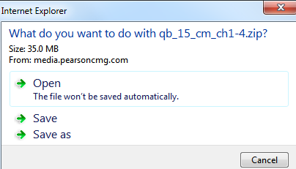
Download Company Files from Web Site Using Windows 7
Depending on your version of Windows and Internet Explorer, your screens may be different from examples shown
Click Save as on Windows Internet Explorer screen
Notes:
Download Company Files from Web Site Using Windows 7: Click Save as on the Windows Internet Explorer screen.

Slide 91
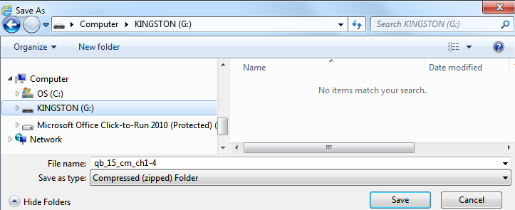
Download Company Files from Web Site Using Windows 7
When Save As screen appears, scroll down left side until you see your USB
Click location for your USB drive
Accept file name qb_15_cm_ch1-4
Save as type: Compressed (zipped) Folder
Click Save button
Notes:
Download Company Files from Web Site Using Windows 7: When the Save As screen appears, click the location for your USB drive (G: in this example). Accept the file name given qb_15_cm_ch1-4. Save as type: Compressed (zipped) Folder. Click the Save button.

Slide 92
Download Company Files from Web Site Using Windows 7
Internet Explorer will show you a message at bottom of screen while download is completed
Notes:
Download Company Files from Web Site Using Windows 7: Internet Explorer will show you a message at the bottom of the screen while the download is being completed.

Slide 93
Download Company Files from Web Site Using Windows 7
Folder should show on USB in Windows Explorer
Notice zipper on qb_15_cm_ch1-4 folder
This means compressed file needs to be unzipped
Notes:
Download Company Files from Web Site Using Windows 7: The folder should show on the USB in Windows Explorer. Notice the zipper on the qb_15_cm_ch1-4 folder. This means the compressed file needs to be unzipped.

Slide 94
Download Company Files from Web Site Using Windows 7
Screens when downloading may not necessarily match
You may not get any messages when download is complete
OR
You may get a message that Internet Explorer will show a message that download has completed
If so, click Open Folder on Internet Explorer Message
Notes:
Download Company Files from Web Site Using Windows 7: Internet Explorer will show a message that the download has completed. Click Open Folder on the Internet Explorer Message. Double-click the qb_15_cm_ch1-4 folder. Click Extract all files.

Slide 95
Download Company Files from Web Site Using Windows 7
Close Internet Explorer
Double-click qb_15_cm_ch1-4 folder
Click Extract all files
Notes:
Download Company Files from Web Site Using Windows 7: Close Internet Explorer. Double-click the qb_15_cm_ch1-4 folder. Click Extract all files.

Slide 96
Download Company Files from Web Site Using Windows 7
After clicking Extract all files, you will see
Notes:
Download Company Files from Web Site Using Windows 7: You will get the Extract Compressed (Zipped) Folders screen after clicking Extract all files.

Slide 97
Download Company Files from Web Site Using Windows 7
Backspace until you only see your USB drive letter (G:\ in example)
Make sure Show extracted files when complete has a check mark
Click it if it does not
Click Extract button
Notes:
Download Company Files from Web Site Using Windows 7: Backspace until you only see your USB drive letter (G:\ in this example). Make sure Show extracted files when complete has a check mark. Click it if it does not. Click the Extract button.

Slide 98
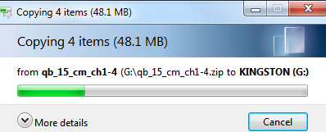
Download Company Files from Web Site Using Windows 7
While files are being extracted, you will see:
Notes:
Download Company Files from Web Site Using Windows 7: While the files are being extracted, you will see a screen telling you that the files are being copied.

Slide 99
Download Company Files from Web Site Using Windows 7
When files have been extracted, you will see:
Zipped folder qb_15_cm_ch1-4
Regular folder QB 2015 Ch 1-4 Master Company Files
Double-click folder QB 2015 Ch 1-4 Master Company Files
Notes:
Download Company Files from Web Site Using Windows 7: When the files have been extracted, you will see a zipped folder, qb_15_cm_ch1-4, and a regular folder, QB 2015 Ch 1-4 Master Company Files. Double-click the folder QB 2015 Ch 1-4 Master Company Files

Slide 100
Download Company Files from Web Site Using Windows 7
Company file names will be on right and listing for Removable Disk (your USB—G: in example) on left
Company files will be green in color
White colored files with extensions like .DSN, .ND, etc. are files QuickBooks includes whenever you access or use company files and cannot be used
Notes:
Download Company Files from Web Site Using Windows 7: You will see the company file names on the right and a listing for the Removable Disk (your USB, the example is G:) on the left.
The company files will be green in color. If you see folders and/or white colored files with extensions like .DSN, .ND, etc. these are files that QuickBooks includes whenever you access or use company files and are not files that may be used

Slide 101
Download Company Files from Web Site Using Windows 7
Possible that company file will be marked as “Read Only” and/or “Archive”
As you work, QuickBooks might remark your company file as read only.
If this happens, refer to following steps on how to change file Properties from Read Only.
Notes:
Download Company Files from Web Site Using Windows 7: It is possible that the company file will be marked as “Read Only” and/or “Archive.” In addition to removing the properties at this point, as you work through the chapters and switch from one company to the next; i.e., Computer to Landscape and then back to Computer, QuickBooks might mark your company file as read only. If this happens, refer to the following steps on how to change the file Properties from Read Only.

Slide 102
Changing Properties for Company File Using Windows 7
Right-click on Computer
Click Properties
Notes:
Changing Properties for a Company File Using Windows 7: Remove Read Only and Archive Properties from a Company File: It is possible that the company file will be marked as “Read Only” and/or “Archive.” Right-click on the file Computer. Click Properties.

Slide 103
Remove Read Only and Archive Properties from Company File
If there is a check mark next to Read Only and/or Archive:
Click check box to remove mark
Click Apply button
Click OK
File is now ready for use
Repeat for Landscape and Service
If open, close Internet Explorer
Notes:
Remove Read Only and Archive Properties from a Company File: If there is a check mark next to Read Only and/or Archive, click the check box to remove the mark, click the Apply button, and then click OK. The file is now ready for use. If open, close Internet Explorer.

Slide 104
Open QuickBooks and Company File
After company files are downloaded, open QuickBooks
On No Company Open screen, click button to Open or restore an existing company
Notes:
Open QuickBooks and a Company File: After the company files are downloaded, open QuickBooks. On the No Company Open screen, click the button to Open or restore an existing company.

Slide 105
Open and update Company File
Make sure “Open a company file” is selected, click Next button
Remember: A usable company file has an extension of .qbw
Notes:
Open and Update a Company File: Make sure “Open a company file” is selected (Remember: A usable company file has an extension of .qbw), click the Next button.

Slide 106
Open Company File
If need be, click location of your USB drive
Double-click QB 2015 Ch 1-4 Master Company Files
Click company file “Computer”
Do not be concerned with date shown in Date modified
Notes:
Open a Company File: If need be, click the location of your USB drive in the Look in section of the Open a Company screen. Double-click QuickBooks 2015 Ch 1-4 Master Company Files
Click the company file “Computer.” Do not be concerned with the date shown in Date modified.

Slide 107
Open Company File
Notice File type:
QuickBooks Files (*.QBW, *QBA)
.QBW
Means QuickBooks Working file
Is used to record all transactions for a company
.QBA
Is file used by company’s accountant
Click Open button
Notes:
Open a Company File: Notice the File type identified is QuickBooks Files (*.QBW, *QBA).
.QBW stands for QuickBooks Working file and is used to record all transactions for a company.
.QBA is the copy of the company file used by the company’s accountant.
Click the Open button to open the company Computer.

Slide 108
update Company File
You should get one of two possible update screens:
If you do not get one of the following screens, continue with next section: Begin Using QuickBooks
If you get an Update Company File for New Version, skip instructions below and go to next page
If you get Update Company screen, click Yes on Update Company screen
Notes:
Update a Company File: You should get one of two possible update screens: If you do not get one of the following screens, continue with the next section: Begin Using QuickBooks. If you get an Update Company File for New Version, skip the instructions below and go to the next page. If you get the Update Company screen, click Yes on the Update Company screen.

Slide 109
update Company File
If you get a screen “Update Company File for New Version
Click I understand that my company file will be updated to this new version of QuickBooks
Then, click Update Now button
Notes:
Update a Company File: If you get a screen “Update Company File for New Version, click I understand that my company file will be updated to this new version of QuickBooks. Then, click the Update Now button.

Slide 110
update Company File
Click OK on QuickBooks Information screen to back up your company data
Notes:
Update a Company File: Click OK on the QuickBooks Information screen to back up your company data.

Slide 111
update Company File
Make sure Local backup is selected
Click Next
Notes:
update a Company File: Make sure Local backup is selected. Click Next.

Slide 112
update Company File
First time you create a backup, you will get a screen listing Backup Options
Notes:
Update a Company File: The first time you create a backup (a duplicate copy) of the company file, you will get a screen listing Backup Options.

Slide 113
update Company File
Click Browse button
Next to “Tell us where to save your backup copies (required)”
Scroll through list of folders,
Click location of your USB drive
Text uses (G:\).
Click OK
To remove check marks, click checkboxes for:
Add date and time of backup to file name
Remind me to back up when I close my company file
Keep Complete verification
Notes:
Update a Company File: Click the Browse button next to “Tell us where to save your backup copies (required).” Scroll through the list of folders, click the location of your USB drive (or designated storage area). The text uses (G:\). Click OK. To remove check marks, click the checkboxes for Add the date and time of the backup to the file name , and Remind me to back up when I close my company file. Keep Complete verification.

Slide 114
update Company File
Click OK
Notes:
Update a Company File: Click OK.

Slide 115
Update Company File
If you are saving backup file to same USB drive that you are using to store company file, you will get following screen
Click Use this Location button
Notes:
Update a Company File: If you are saving the backup file to the same USB drive that you are using to store the company file, you will a QuickBooks message screen. Click the Use this Location button.

Slide 116
update Company File
On Save Backup Copy screen
Save in: should be USB Drive Location
If necessary, click drop-down list arrow next to Save in: and click USB Drive Location
File name: is Computer (Backup)
Save as type: is .QBW Backup (*.QBB)
Notes:
Update a Company File: On the Save Backup Copy screen: Save in: should be USB Drive Location (If necessary, click the drop-down list arrow next to Save in: and click the USB Drive Location), File name: is Computer (Backup), Save as type: is .QBW Backup (*.QBB).

Slide 117
Update Company File
On Save Backup Copy screen, click Save
When finished, click Yes on Update Company screen
If you get a Set Closing Date Password screen, click No
Notes:
Update a Company File: On the Save Backup Copy screen, Save in: should be USB Drive Location. (If necessary, click the drop-down list arrow next to Save in: and click the USB Drive Location.) When finished, click Yes on the Update Company screen. If you get a Set Closing Date Password screen, click No.

Slide 118
Begin Using QuickBooks
Close any other QuickBooks screens that appear
Some screens that may need to be closed include:
Set Closing Date Password?
Setup an External Accountant User
Alerts
What’s New
Close by clicking
May be accessed on Help Menu
Notes:
Begin Using QuickBooks: Close any QuickBooks screens that appear. Some of the screens that may need to be closed include: Set Closing Date Password? Setup an External Accountant User, Alerts, What’s New (Close by clicking the X. What’s New may be accessed on the Help Menu.)

Slide 119
Add Your Name to Company Name
Click Company on Menu bar
Click My Company
Click Edit button
In upper-right corner of My Company screen
Click to left of Student’s Name
Drag through words Student’s Name to highlight
Notes:
Add Your Name to a Company Name: Once the company Computer has been opened, add Your Name to the Company Name. To do this, click Company on the Menu bar. Click My Company. The Company Name will be “Computer Consulting by Student’s Name.” On the Company Information screen, click to the left of Student’s Name in the Company Name text box, drag through the words Student’s Name to highlight.

Slide 120
Add Your Name to Company Name
Type your actual name (author’s name is shown in this example
Click Legal Information
Change legal name to Computer Consulting by Your Name, click OK
Verify name change on title bar heading
Notes:
Add Your Name to a Company Name: Type your actual name. For example, the author’s company name would be Computer Consulting by Janet Horne. Repeat the steps to change the Legal Name to Computer Consulting by Your Name, then click OK. Verify the name change on the title bar. It should say: Computer Consulting by Janet Horne - QuickBooks Accountant Desktop 2015.

Slide 121
Back Up Company
A backup file
Is a condensed version of a QuickBooks Company file
Contains all entries made for a company up to the time it is created
Will not contain any New transactions that are entered
CANNOT be used to record transactions or perform any QuickBooks tasks
Notes:
Back Up a Company: A backup file is a condensed version of a QuickBooks Company file. A backup file contains all entries made for a company up to the time it is created. If any new transactions are made, they are not included until a new backup is made. A QuickBooks backup company file CANNOT be used to record transactions or perform any QuickBooks tasks.

Slide 122
Back Up Company
Click File on Menu bar
Click Back Up Company
Click Create Local Backup
Notes:
To back up a company, click File on the Menu bar, click Back Up Company, click Create Local Backup.

Slide 123
Back Up Company
Make sure Local Backup is backup method, click Next
Notes:
Back Up a Company: On the Save Backup: Method screen, select Local Backup as the backup method, click the Next button.

Slide 124
Back Up Company
First time you backup a company file
Must tell QuickBooks where to save backup copy
Not all students created a backup copy when updating a company file
This and the following slides repeat information on Slide 1-113
You may also select or remove different backup items:
Adding date and time of backup
Back up reminders
Verifying that company data is ok
Notes:
Back Up a Company: The first time you backup a company file, you must tell QuickBooks where to save the backup copy. (This and the following slides repeat the information on Slide 1-113. Not all students will create a backup copy when updating a company file.) You may also select or remove different backup items: Adding the date and time of backup, back up reminders, and verifying that company data is ok.

Slide 125
Back Up Company
On Backup Options screen, click Browse button
Enter location of your USB drive
(G:) in example
Click OK
Notes:
Back Up a Company: Click the Browse button on the Backup Options screen. Enter the location of your USB drive (G:) in the example. Click OK.

Slide 126
Back Up Company
To remove check marks, click:
Add the date and time of the backup to the file name
Remind me to back up when I close my company file every 4 times
Keep Complete verification
Click OK button
Notes:
Back Up a Company: Click “Add the date and time of the backup to the file name” to remove the check mark. Click “Remind me to back up when I close my company file every 4 times” to remove the check mark. Keep Complete verification. Click the OK button.

Slide 127
Back Up Company
If you get a notification about backup location, click Use this Location
Notes:
Back Up a Company: If you get a notification about the backup location, click Use this Location.

Slide 128
Back Up Company
Make sure Save it now is selected, click Next
Notes:
Back Up a Company: On the Save Backup: When screen, make sure Save it now is selected, click the Next button.

Slide 129
Back Up Company
File Name should be: Computer (Backup Ch. 1)
Add Ch. 1 after Computer (Backup)
Note file type is *.QBB
.QBB means QuickBooks Backup
Click Save button
Notes:
Back Up a Company: Add Ch. 1 at the end of Computer (Backup). The name of the file will be Computer (Backup Ch. 1). Note that the file type is QBW Backup (*.QBB).
Remember: .QBB is a file extension that means QuickBooks Backup.
Click the Save button to save Computer (Backup Ch. 1).QBB.

Slide 130
Back Up Company
QuickBooks Information screen appears
Click OK
Notes:
Back Up a Company: Click OK on the QuickBooks Information screen.

Slide 131
Change Account Names
Click Lists on menu bar
Click Chart of Accounts
Scroll through accounts until you see Company Cars
Click Company Cars
Notes:
Change Account Names: Change the account name of Company Cars to Automobiles. Click Lists on the menu bar, click Chart of Accounts. Scroll through accounts until you see Company Cars. Click Company Cars.

Slide 132
Change Account Names
Click Account button
Click Edit Account
Keyboard shortcut is Ctrl+E
Notes:
Change Account Names: After clicking the Account button, click Edit Account. (Notice the keyboard shortcut is Ctrl+E. This means you can access the Edit Account screen by using the keyboard.)

Slide 133
Change Account Names
Change Company Cars to Automobiles
Click Save & Close button
Notes:
Change Account Names: Change Company Cars to Automobiles. Click the Save & Close button.

Slide 134
Change Account Names
Verify name change in Chart of Accounts
Notes:
Change Account Names: After saving the account name change, verify the change by viewing the Chart of Accounts.

Slide 135
View Report
Click Reports on icon bar to open Report Center
Click the icon for List View
Notes:
View a Report: Click Reports on the icon bar to open the Report Center. Click the icon for List View.

Slide 136
View Report
In list of report categories, click Accountant & Taxes
Click Trial Balance
Click Run button
Your dates will not be 12/1/2014-12/31/2014
Notes:
VIEW A REPORT: In the list of report categories shown on the left side of the Report Center, click Accountant & Taxes . Click Trial Balance. Click the Run button. (Note that your dates will not be 12/1/2014-12/31/2014.)

Slide 137
View Report
Press Tab key to highlight From
Key in date 01/01/15
Press Tab and key in To date of 01/01/15
Press Tab key until report is displayed
View Trial Balance
Verify account name of Automobiles
Master or Controlling account Automobiles is shown with its subaccounts that have a balance
Account and its subaccount will be shown as Automobiles: Original Cost
Notes:
VIEW A REPORT: Press Tab key to highlight From. Key in the date 01/01/15. Press Tab and key in the To date of 01/01/15. Press the Tab until the report is displayed. View the Trial Balance. Verify the account name of Automobiles. (The account Automobiles will be followed by a colon and the subaccount Original Cost)

Slide 138
View Report
Verify account name Automobiles: Original Cost
Close report and Report Center
Notes:
View a Report: Verify the account name Automobiles: Original Cost. Then close the report and the Report Center.

Slide 139
Restore Backup File
Restoring file will erase any transactions entered and changes made since backup was created
Restore backup file if
Made errors that you cannot find
Want to start over on a chapter
Chapter 1 backup file for was made after you added your name to company name
But prior to changing Company Cars to Automobiles
Restoring file will show Company Cars
Notes:
Restore a Backup File: Restoring the file will erase any transactions entered or changes made since the backup was made. You would restore a backup file if you made errors that you cannot find or to start over on a chapter. The backup file for Chapter 1 was made after you added your name to the company name but prior to changing the Company Cars to Automobiles. Restoring the file will show Company Cars for the account name.

Slide 140
Restore Backup File
Click File menu, click Open or Restore Company…
Click Restore a backup copy
This has an extension of .QBB
Click Next
Notes:
Restore a Backup File: To begin the file restore, click the File menu, click Open or Restore Company. On the Open Company: Type screen, click Restore a backup copy (.QBB). Click the Next button.

Slide 141
Restore Backup File
Click Local backup, then click Next
Notes:
Restore a Backup File: On the Restore Backup: Method screen, click Local backup, then click the Next button.

Slide 142
Restore Backup File
On Open Backup Copy screen
Look in: USB drive location (G: in example)
Click Computer (Backup Ch. 1)
Click Open button
Notes:
Restore a Backup File: The next step is to tell QuickBooks where to Restore From. On the Open Backup Copy screen, make sure that the area for Look in: indicates the USB drive location (G: in this example). Computer (Backup Ch. 1) should show in the area beneath the Look in: textbox. Click the file “Computer (Backup Ch. 1).” Click the Open button.

Slide 143
Restore Backup File
Click Next on Open or Restore Company screen
Notes:
Restore a Backup File: Click Next on the Open or Restore Company screen.

Slide 144
Restore Backup File
On Save Company File as screen, Save in should be location of your USB drive (G:\)
File name should be Computer
Click Save button
Notes:
Restore a Backup File: On the Save Company File as screen, Save in should be the location of your USB drive (G:\). The file name should be Computer. Click the Save button.

Slide 145
Restore Backup File
Click Yes to erase original Computer.qbw file and replace it with Computer (Backup Ch. 1) file
To confirm deletion of original file, type Yes and click OK
Click OK when file restored
Notes:
Restore a Backup File: Since you already have a G:\Computer.qbw file, you will get a message that the file already exists. You will click the Yes button to tell QuickBooks to replace the information in the file with the information from the Computer (Backup Ch. 1).qbb file. To confirm the entire file deletion, you will type in the word Yes and click the OK button on the Delete Entire File message box. When the file has been restored, click OK.

Slide 146
View Company Name on Title Bar
Company name was changed before making Computer (Backup Ch. 1) backup file
Restoring backup file kept company name
Author’s name was used in example
Notes:
View Company Name on Title Bar: The company name was changed before making the Computer (Backup Ch. 1) backup file. Restoring the backup file kept the company name. The author’s name was used in the example.

Slide 147
View Chart of Accounts in Restored Company File
When company file has been restored, click Chart of Accounts icon on Home Page
Account name changed after backup file Computer (Backup Ch. 1) made
Chart of Accounts should show Company Cars
Change to account name erased and “restored” to original
Notes:
View Chart of Accounts in Restored Company File: Open the Chart of Accounts by clicking the Chart of Accounts icon on the Home Page. Scroll through the Chart of Accounts. The Chart of Accounts should show Company Cars. The change to the account name was erased and “restored” to the original.
The account name was changed after the Computer (Backup Ch. 1) backup file was made. This illustrates the fact that using a .qbb file or backup file will erase any new information entered into the company file.

Slide 148
Close Company and Exit QuickBooks
To close company
Click File on Menu bar
Click Close Company
Click Close button to Close QuickBooks
Notes:
Close the Company and Exit QuickBooks: Whenever you finish your work, close the company file. To do this, click the File menu and click Close Company. To close QuickBooks, click the Close button on the upper right side of the QuickBooks title bar.

Slide 149
Remove USB drive
Click icon for USB drive in lower right portion of Taskbar
Click USB drive location on Eject message
Remove your USB drive when you see
Notes:
Remove the USB drive: In order to remove the USB drive you must follow appropriate procedures. Failure to remove the drive properly, can result in damage to your USB or to your company file. This could cause your USB to become unusable. To remove the USB, click the icon for the USB drive in the lower right portion of the Taskbar. It looks like a green arrow over a small USB drive or a green circle with a check mark. Click the Eject message for your USB drive (K:) or click the message “Safely remove USB Mass Storage Device – Drive (K:).” When you see the Safe to Remove Hardware screen, remove your USB drive. Note that your letter designating your USB drive may not be K.

Slide 150
All rights reserved. No part of this publication may be reproduced, stored in a retrieval system, or transmitted, in any form or by any means, electronic, mechanical, photocopying, recording, or otherwise, without the prior written permission of the publisher. Printed in the United States of America.
Copyright © 2016 Pearson Education, Inc.
Notes:
This work is protected by United States copyright laws.
Copyright © 2016 Pearson Education, Inc.

