Slide 1
Shelly Cashman: Microsoft Excel 2016
Module 1: Creating a Worksheet and a Chart

Slide 2
Objectives (Slide 1 of 2)
Describe the Excel worksheet
Enter text and numbers
Use the Sum button to sum a range of cells
Enter a simple function
Copy the contents of a cell to a range of cells using the fill handle
Apply cell styles
Format cells in a worksheet

Slide 3
Objectives (Slide 2 of 2)
Create a 3-D pie chart
Change a worksheet name and sheet tab color
Change document properties
Preview and print a worksheet
Use the AutoCalculate area to display statistics
Correct errors on a worksheet

Slide 4
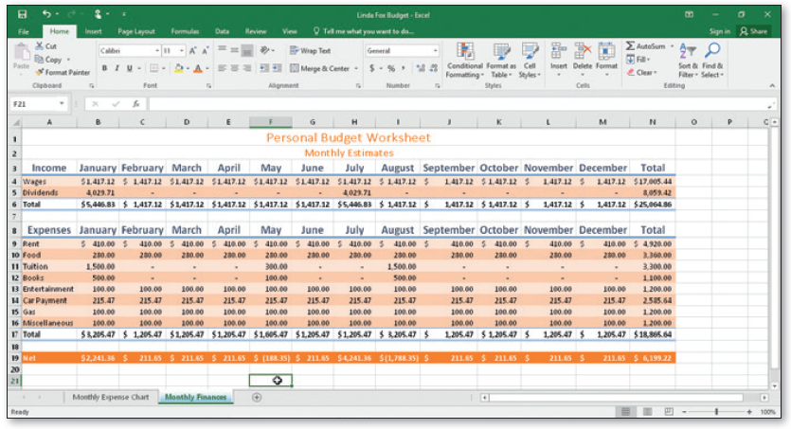
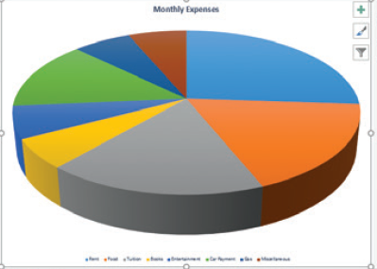
Project – Personal Budget Worksheet and Chart
Notes:
Figure 1-1a: depiction of a personal budget worksheet
Figure 1-1b: depiction of a pie chart of a monthly budget

Slide 5
Roadmap
Enter text in a blank worksheet
Calculate sums and use formulas in the worksheet
Format text in the worksheet
Insert a pie chart into the worksheet
Assign a name to the worksheet tab
Preview and print the worksheet

Slide 6
Selecting a Cell
Make the cell active
Use the mouse
Use the arrow keys
Cell is active when a heavy border surrounds the cell

Slide 7
Entering Text (Slide 1 of 4)
To Enter the Worksheet Titles
Run Excel and create a blank workbook in the Excel window
Click the A1 to make the cell A1 the active cell
Type desired text
Click the ENTER button to complete the entry and enter the worksheet title
Click cell A2 to select it
Click the ENTER button to complete the entry and enter the worksheet subtitle

Slide 8
Entering Text (Slide 2 of 4)
To Enter Column Titles
Click cell A3 and enter a column title
Press the RIGHT ARROW key to enter a column title and make the cell to the right the active cell
Repeat the previous steps until all column titles are entered. Click the Enter box after entering the last column title

Slide 9
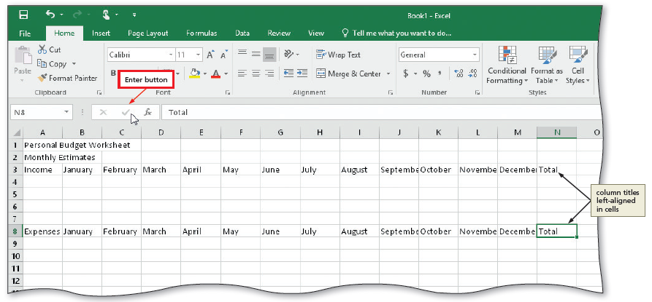
Entering Text (Slide 3 of 4)
Notes:
Figure 1-11; display of the enter button

Slide 10
Entering Text (Slide 4 of 4)
To Enter Row Titles
Click cell A4 and enter a row title
Press the DOWN ARROW key to enter a row title and make the cell below the current cell the active cell
Repeat the previous steps until all row titles are entered

Slide 11
Entering Numbers
In Excel, you can enter numbers in Excel to represent amounts
If a cell entry contains any other keyboard character, Excel interprets it as text and treats it accordingly
To Enter Numbers
Click cell B4 to select it
Type desired number and then press the RIGHT ARROW key to enter the data in the selected cell and make the cell to the right the active cell
Continue until all numbers are entered

Slide 12
Calculating a Sum (Slide 1 of 2)
To Sum a Column of Numbers
Click the first empty cell below the column of numbers to sum
Click the Sum button on the HOME tab to display a formula in the formula bar and in the active cell
Click the Enter box in the formula bar to enter a sum in the active cell
Repeat above steps to enter the SUM function in other locations

Slide 13
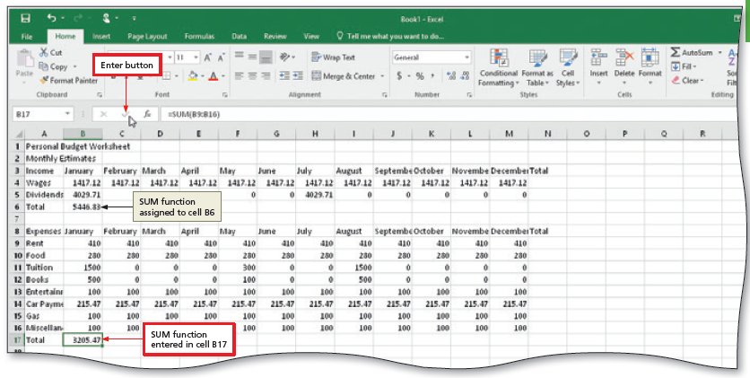
Calculating a Sum (Slide 2 of 2)
Notes:
Figure 1-18: display of a sum function

Slide 14
Using the Fill Handle to Copy a Cell to Adjacent Cells (Slide 1 of 4)
To Copy a Cell to Adjacent Cells in a Row
With the cell containing the contents to fill across the row active, point to the fill handle to activate it
Drag the fill handle to select the destination area to display a shaded border around the source area and the destination area
Release the mouse button to copy the SUM function from the active cell to the destination area and calculate the sums
Repeat the above steps to copy the SUM function to other ranges
Notes:
Figure 1-22: SUM function range displayed

Slide 15
Using the Fill Handle to Copy a Cell to Adjacent Cells (Slide 2 of 4)
To Calculate Multiple Totals at the Same Time
Highlight a range at the end of rows or columns of numbers to total
Click the Sum button on the HOME tab to calculate and display the sums of the corresponding rows
Repeat the above steps to calculate and display the sums of the corresponding rows

Slide 16
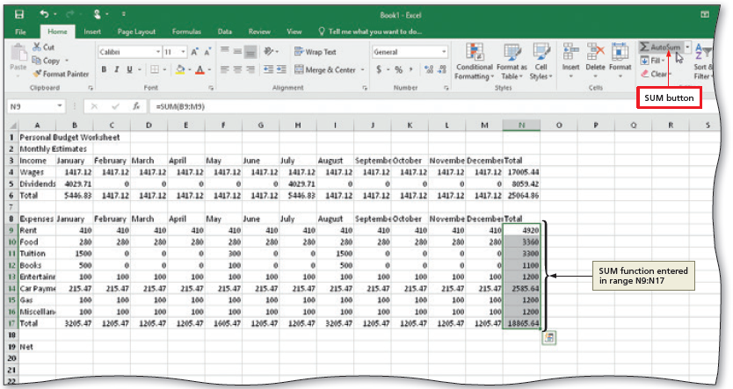
Using the Fill Handle to Copy a Cell to Adjacent Cells (Slide 3 of 4)
Notes:
Figure 1-26: multiple sums calculated displayed

Slide 17
Using the Fill Handle to Copy a Cell to Adjacent Cells (Slide 4 of 4)
To Enter a Formula Using the Keyboard
Select the cell that will contain the formula
Type the formula in the cell to display it in the formula bar and in the current cell and to display colored borders around the cells referenced in the formula
Click the cell to the right to complete the formula and to display the result in the worksheet.

Slide 18
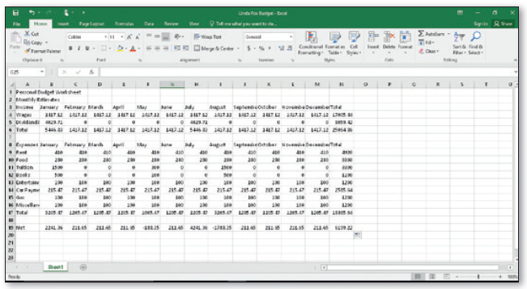
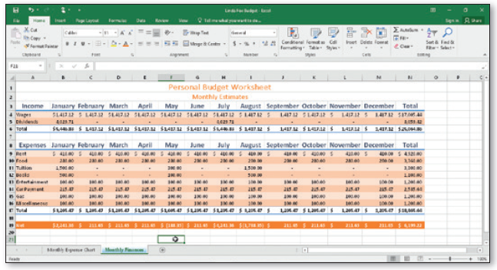
Formatting the Worksheet (Slide 1 of 10)
Unformatted Worksheet
Formatted Worksheet
Notes:
Figure 1-29: unformatted worksheet and formatted worksheet

Slide 19
Formatting the Worksheet (Slide 2 of 10)
To Change a Cell Style
Click the desired cell and then click the Cell Styles button on the HOME tab to display the Cell Styles gallery
Point to the Title cell style in the Titles and Headings area of the Cell Styles gallery to see a live preview of the cell style in the active cell
Click the Title cell style to apply the cell style to the active cell

Slide 20
Formatting the Worksheet (Slide 3 of 10)
To Change the Font
Click the desired cell for which you want to change the font
Click the Font arrow on the HOME tab to display the font gallery
Point to desired font in the Font gallery to see a live preview of the selected font in the active cell
Click the desired font to change the font of the selected cell

Slide 21
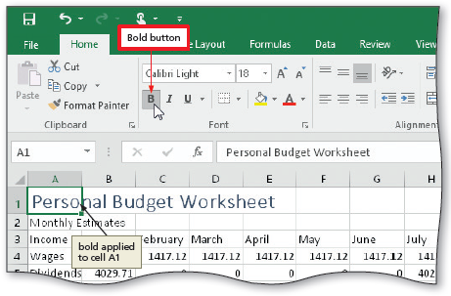
Formatting the Worksheet (Slide 4 of 10)
To Apply Bold Style to a Cell
Click a cell to bold and then click the Bold button on the HOME tab to change the font style of the active cell to bold
Notes:
Figure 1-35: display of bold button

Slide 22
Formatting the Worksheet (Slide 5 of 10)
To Increase the Font Size of a Cell Entry
With the desired cell selected, click the Font Size arrow on the HOME tab to display the Font Size gallery
Point to the desired font size in the Font Size gallery to see a live preview of the active cell with the selected font size
Click the desired font size in the Font Size gallery to change the font size in the active cell

Slide 23
Formatting the Worksheet (Slide 6 of 10)
To Change the Font Color of a Cell Entry
Select the cell for which you want to change the font color and then click the Font Color arrow on the HOME tab
Point to the desired color in the Theme Colors area of the Font Color gallery to see a live preview of the font color
Click the desired theme to change the font color of the in the active cell

Slide 24
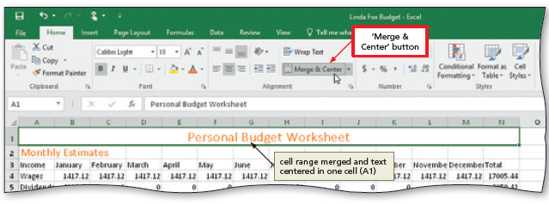
Formatting the Worksheet (Slide 7 of 10)
To Center Cell Entries across Columns by Merging Cells
Drag to select the range of cells you want to merge and center
Click the ‘Merge & Center’ button on the HOME tab to merge the selected range and center the contents of the leftmost cell across the selected columns
Repeat the above steps to merge and center other titles
Notes:
Figure 1-41: display of Merge and Center button

Slide 25
Formatting the Worksheet (Slide 8 of 10)
To Format Rows Using Cell Styles
Click a cell and drag to select the desired range
Click the Cell Styles button on the HOME tab to display the Cell Styles gallery
Click a Heading cell style to apply the cell style to the selected range and then click the Center button on the HOME tab to center the column headings in the selected range
Repeat the above steps to format other ranges

Slide 26
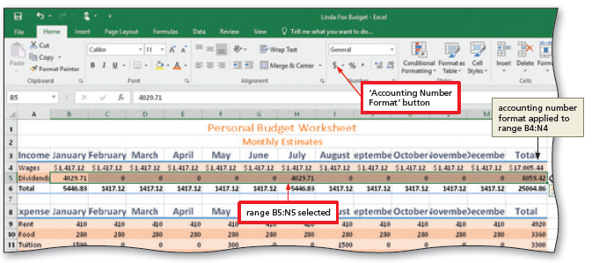
Formatting the Worksheet (Slide 9 of 10)
To Format Numbers in the Worksheet
Select the range of cells containing numbers to format
Click the desired format on the HOME tab to apply the format to the cells in the selected range
Notes:
Figure 1-47: how to format numbers displayed

Slide 27
Formatting the Worksheet (Slide 10 of 10)
To Adjust the Column Width
Point to the boundary on the right side of the column of which you want to change the size to change the mouse pointer to a split double arrow
Double-click on the boundary to adjust the width of the column to the width of the largest item in the column
To Use the Name box to Select a Cell
Click the Name box in the formula bar and then type the cell reference of the cell you wish to select
Press the ENTER key to change the active cell in the Name box

Slide 28
Adding a Pie Chart to the Worksheet (Slide 1 of 2)
To Add a 3-D Pie Chart
Select the range for the 3-D pie chart
Click the ‘Insert Pie or Doughnut Chart’ button on the INSERT tab to display the Insert Pie or Doughnut Chart gallery
Click the Insert Pie or Doughnut Chart gallery to insert the chart
Click the chart title to select it
Type a chart title and then press the ENTER key to change the title
Deselect the chart title

Slide 29
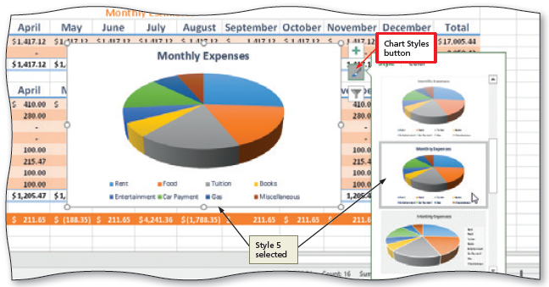
Adding a Pie Chart to the Worksheet (Slide 2 of 2)
To Apply a Style to a Chart
Click the Chart Styles button to display the Chart Styles gallery
Click a style in the Chart Styles gallery to change the chart style to the desired style
Notes:
Figure 1-60: a display of changing the styles

Slide 30
Changing the Sheet Tab Names (Slide 1 of 3)
To Move a Chart to a New Sheet
Click the Move Chart button on the CHART TOOLS DESIGN tab
Click New sheet to select it and then type a title for the worksheet that will contain the chart
Click the OK button to move the chart to a new chart sheet with a new sheet tab name

Slide 31
Changing the Sheet Tab Names (Slide 2 of 3)
To Change the Sheet Tab Name
Double-click the sheet tab you wish to change in the lower-left corner of the window
Type a new name as the worksheet tab name
Right-click the sheet tab in the lower-left corner of the window to display a shortcut menu
Point to Tab Color in the Tab Color gallery
Click the desired color in the Theme Colors area to change the color of the tab

Slide 32
Changing the Sheet Tab Names (Slide 3 of 3)
Document Properties
To Change Document Properties
Click File on the ribbon to open the Backstage view and then click the Info tab in the Backstage view to display the Info gallery
Click to the right of the property category to display a text box
If necessary, click the Properties button to display the Properties menu

Slide 33
Printing a Worksheet
To Preview and Print a Worksheet in Landscape Orientation
In Backstage view, click the Print tab to display the Print gallery
Verify that the printer listed on the Printer Status button will print a hard copy of the workbook. If necessary, click the Printer Status button to display a list of available printer options and then click the desired printer to change the currently selected printer
Click the Portrait Orientation button in the Settings area and then select Landscape Orientation to change the orientation of the page to landscape.
Click the No Scaling button and then select ‘Fit Sheet on One Page’ to print the entire worksheet on one page
Click the Print button in the Print gallery to print the worksheet in landscape orientation on the currently selected printer
When the printer stops, retrieve the hard copy

Slide 34
AutoCalculate
Using the AutoCalculate Area to Determine a Maximum
Select the range of which you wish to determine a maximum, and then right-click the status bar to display the Customize Status Bar shortcut menu
Click Maximum on the shortcut menu to display the Maximum value in the range in the AutoCalculate area of the status bar

Slide 35
Correcting Errors
Correcting Errors after Entering Data into a Cell
If the entry is short, select the cell, retype the entry correctly
If the entry is long, use the EDIT mode using in-cell editing
To Clear the Entire Worksheet
Click the Select All button on the worksheet
Click the Clear button and then click Clear All

