Slide 1
Shelly Cashman: Microsoft Word 2016
Module 2: Creating a Research Paper with References and Sources

Slide 2
Objectives (Slide 1 of 2)
Describe the MLA documentation style for research papers
Modify a style
Change line and paragraph spacing in a document
Use a header to number pages of a document
Apply formatting using keyboard shortcuts
Modify paragraph indentation
Insert and edit citations and their sources

Slide 3
Objectives (Slide 2 of 2)
Add a footnote to a document
Insert a manual page break
Create a bibliographical list of sources
Cut, copy, and paste text
Find text and replace text
Find a synonym
Check spelling and grammar at once
Look up information

Slide 4
Project-Research Paper
Roadmap
Change the document settings
Create the header for each page of the research paper
Type the research paper text with citations
Create an alphabetical works cited page
Proofread and revise the research paper.

Slide 5
Changing Document Settings (Slide 1 of 4)
To Modify a Style
Right-click the style to modify in the Styles gallery to display a shortcut menu related to styles
Click Modify on the shortcut menu to display the Modify Style dialog box
Make the desired changes to the style in the Modify Style dialog box, and then click the OK button to update the style

Slide 6
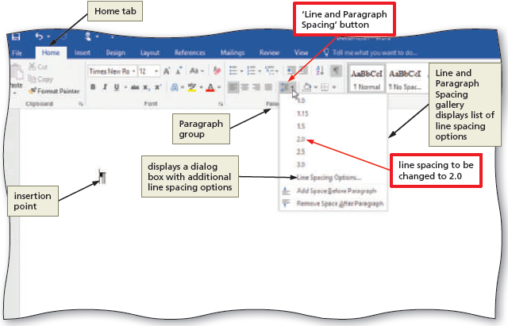
Changing Document Settings (Slide 2 of 4)
To Change Line Spacing
Click the ‘Line and Paragraph Spacing’ button to display the Line and Paragraph Spacing gallery
Click the desired setting in the Line and Paragraph Spacing gallery to change the line spacing at the location of the insertion point
Notes:
Figure 2-5: display of ‘Line and Paragraph Spacing’ button

Slide 7
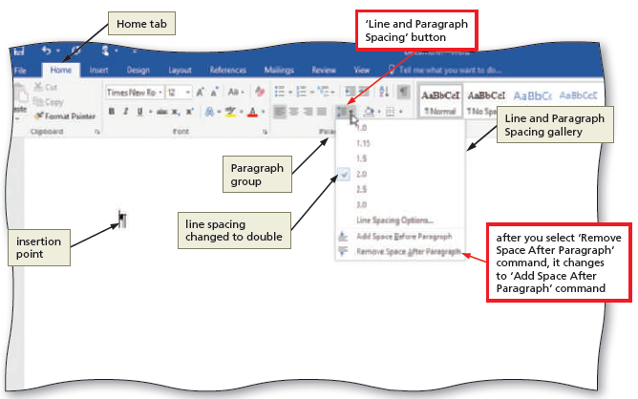
Changing Document Settings (Slide 3 of 4)
To Remove a Space after a Paragraph
Click the ‘Line and Paragraph Spacing’ button (HOME tab | Paragraph group) to display the Line and Paragraph Spacing gallery
Click ‘Remove Space After Paragraph’ in the Line and Paragraph Spacing gallery so that no blank space appears after paragraphs
Notes:
Figure 2-6: display of ‘Remove Space After Paragraph’ command

Slide 8
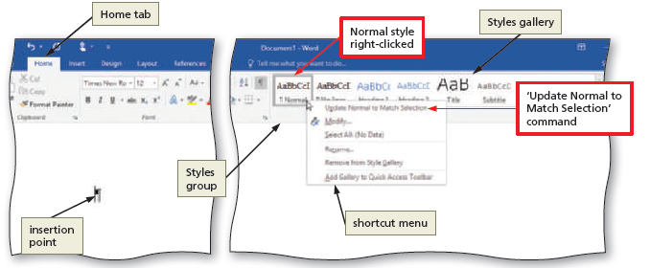
Changing Document Settings (Slide 4 of 4)
To Update a Style to Match a Selection
Right-click Normal in the Styles gallery to display a shortcut menu
Click ‘Update Normal to Match Selection’ on the shortcut menu to update the selected (or current) style to reflect the settings at the location of the insertion point
Notes:
Figure 2-7: display of ‘Update Normal to Match Selection’ command

Slide 9
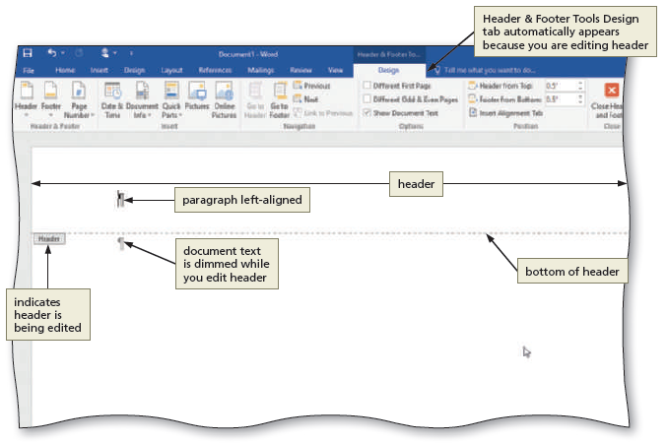
Creating a Header (Slide 1 of 2)
To Switch to the Header
Click INSERT in the ribbon to display the INSERT tab
Click the ‘Add a header’ button to display the Add a Header gallery
Click Edit Header in the Add a Header gallery to switch from the document text to the header, which allows you to edit the contents of the header
Notes:
Figure 2-9: display of Header & Footer Tools Design tab

Slide 10
Creating a Header (Slide 2 of 2)
To Right-Align a Paragraph
Click HOME on the ribbon to display the HOME tab
Click the Align Right button to right-align the current paragraph
To Insert a Page Number
Click HEADER & FOOTER TOOLS DESIGN on the ribbon to display the HEADER & FOOTER TOOLS DESIGN tab
Click the ‘Add Page Numbers’ button to display the Add Page Numbers menu
Point to the desired location on the Add Page Numbers menu to display the gallery
Click the desired style
To Close the Header
Click the ‘Close Header and Footer’ button to close the header and switch back to the document text

Slide 11
Typing the Research Paper Text (Slide 1 of 12)
To Click and Type
Position the mouse pointer in the location where you want to type, in the center of the document window until a center icon appears below the I-beam
Double-click to center the paragraph and mark the insertion point between the left and right margins
Type the desired text and then press the ENTER key to position the insertion point on the next line

Slide 12
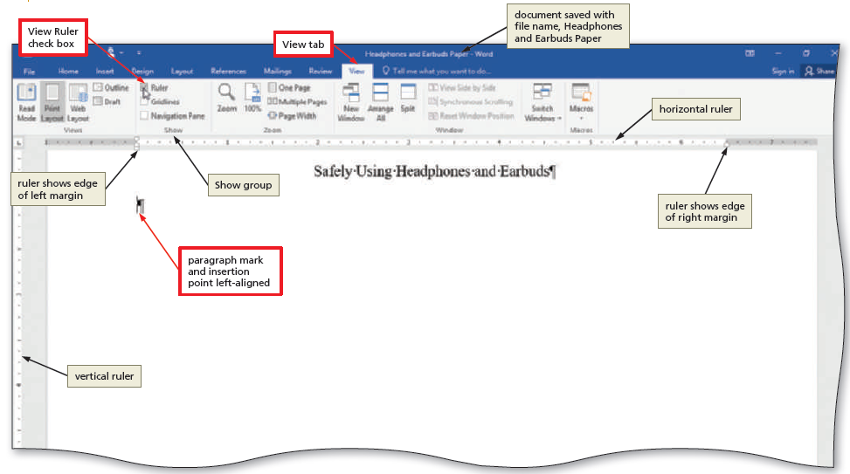
Typing the Research Paper Text (Slide 2 of 12)
To Display the Rulers
Click VIEW on the ribbon to display the VIEW tab
If the rulers are not displayed, click the View Ruler check box to place a check mark in the check box and display the horizontal and vertical rulers on the screen
Notes:
Figure 2-17: display of View Ruler check box

Slide 13
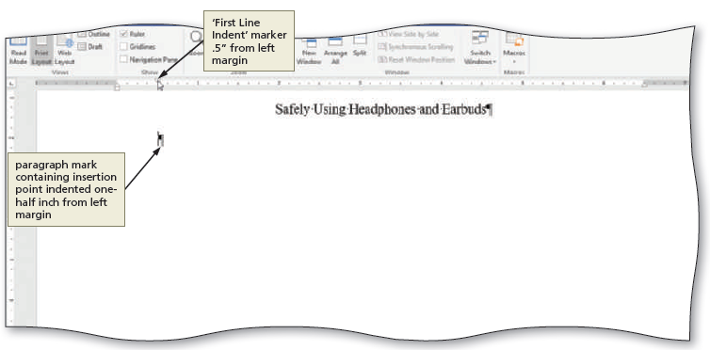
Typing the Research Paper Text (Slide 3 of 12)
To First-Line Indent Paragraphs
With the insertion point in the paragraph to be indented, drag the First Line Indent marker to the desired location on the ruler to set the location for the first-line indent
Notes:
Figure 2-20: display of ‘First Line Indent’ marker

Slide 14
Typing the Research Paper Text (Slide 4 of 12)
To AutoCorrect as You Type
Word provides an AutoCorrect feature that automatically corrects certain typing, spelling, capitalization, or grammar errors as you type a document
Notes:
Figure 2-23: display of AutoCorrect feature

Slide 15
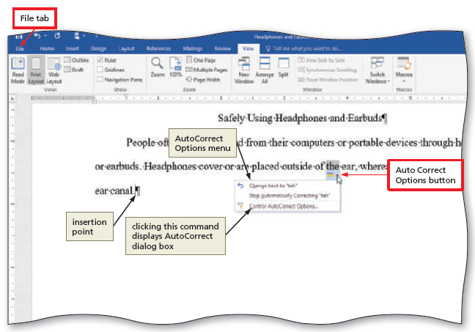
Typing the Research Paper Text (Slide 5 of 12)
To Use the AutoCorrect Options Button
Position the mouse pointer in the text automatically corrected by Word to display a small blue box below the automatically corrected word
Point to the small blue box to display the AutoCorrect Options button
Click the AutoCorrect Options button to display the AutoCorrect Options menu
Press the ESCAPE key to remove the AutoCorrect Options menu from the screen
Notes:
Figure 2-25: display of the Auto Correct Options button

Slide 16
Typing the Research Paper Text (Slide 6 of 12)
To Create an AutoCorrect Entry
Click FILE on the ribbon to open the Backstage view
Click Options in the Backstage view to display the Word Options dialog box
Click Proofing in the left pane to display proofing options in the right pane
Click the AutoCorrect Options button in the right pane to display the AutoCorrect dialog box
When Word displays the AutoCorrect dialog box, type the word you want to replace in the Replace text box, and the word to replace with in the With text box
Click the Add button
Click the OK button (AutoCorrect dialog box)
Click the OK button (Word Options dialog box)

Slide 17
Typing the Research Paper Text (Slide 7 of 12)
To Change the Bibliography Style
Click REFERENCES on the ribbon to display the REFERENCES tab
Click the Bibliography Style arrow to display a gallery of predefined documentation styles
Click the desired style in the Bibliography Style gallery to change the documentation style

Slide 18
Typing the Research Paper Text (Slide 8 of 12)
To Insert a Citation and Create Its Source
Click the Insert Citation button to display the Insert Citation menu
Click ‘Add New Source’ on the Insert Citation menu to display the Create Source dialog box
Click the ‘Type of Source’ arrow, and then tap or click the type of source you are adding
Type the source information in the appropriate text boxes, and then click the OK button to insert the citation in the document at the location of the insertion point

Slide 19
Typing the Research Paper Text (Slide 9 of 12)
To Insert a Footnote Reference Mark
Click the Insert Footnote button to display a note reference mark (a superscripted 1) in two places:
(1) in the document window at the location of the insertion point and
(2) at the bottom of the page where the footnote will be positioned, just below a separator line
To Insert a Citation Placeholder
Click the Insert Citation button to display the Insert Citation menu
Click ‘Add New Placeholder’ on the Insert Citation menu to display the Placeholder Name dialog box
Type the placeholder name, and then click the OK button

Slide 20
Typing the Research Paper Text (Slide 10 of 12)
To Modify a Style Using a Shortcut Menu
Right-click the text to display a shortcut menu
Click Style on the shortcut menu to display the Style dialog box
To Edit a Source
Click somewhere in the citation placeholder to be edited to select the citation placeholder
Click the Citation Options arrow to display the Citation Options menu
Click Edit Source on the Citation Options menu to display the Edit Source dialog box
If necessary, click the ‘Type of Source’ box arrow and then select the type of source
Enter the source information, and then click the OK button

Slide 21
Typing the Research Paper Text (Slide 11 of 12)
To Edit a Citation
Click somewhere in the citation to be edited, which selects the citation and displays the Citation Options arrow
Click the Citation Options arrow to display the Citation Options menu
Click Edit Citation on the Citation Options menu to display the Edit Citation dialog box
Change the information as necessary in the Edit Citation dialog box, and then click the OK button

Slide 22
Typing the Research Paper Text (Slide 12 of 12)
To Count Words
Click the Word Count indicator on the status bar to display the Word Count dialog box
If necessary, place a check mark in the ‘Include textboxes, footnotes and endnotes’ check box
Click the Close button to close the dialog box
To Hide and Show White Space
Position the pointer in the document window in the space between pages so that the pointer changes to a ‘Hide White Space’ button
Position the pointer in the document window on the page break between pages so that the pointer changes to a ‘Show White Space’ button

Slide 23
Creating an Alphabetical Works Cited Page (Slide 1 of 3)
To Page Break Manually
Position the insertion point where you wish to insert the page break
Click INSERT on the ribbon to display the INSERT tab
Click the ‘Insert a Page Break’ button to insert a manual page break immediately to the left of the insertion point and position the insertion point immediately below the manual page break

Slide 24
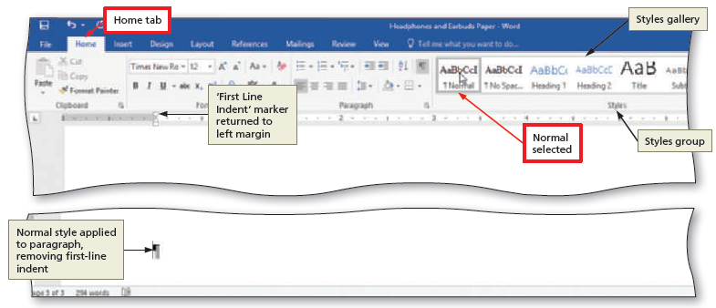
Creating an Alphabetical Works Cited Page (Slide 2 of 3)
To Apply a Style
Click HOME on the ribbon to display the HOME tab
With the insertion point in the paragraph to be modified, click the desired style in the Styles gallery
Notes:
Figure 2-56: display of styles gallery

Slide 25
Creating an Alphabetical Works Cited Page (Slide 3 of 3)
To Create a Bibliographical List
Click REFERENCES on the ribbon to display the REFERENCES tab
With the insertion point positioned where the bibliographical list is to be inserted, click the Bibliography button to display the Bibliography gallery
Click Insert Bibliography in the Bibliography gallery to insert a list of sources at the location of the insertion point

Slide 26
Proofreading and Revising the Research Paper (Slide 1 of 12)
To Modify the Source
Click the Manage Sources button to display the Source Manager dialog box
Click the source you wish to edit in the Current List
Click the Edit button to display the Edit Source dialog box
Make the desired changes to the source, and then click the OK button
If necessary, click Yes to update all occurrences of the source
Click the Close button to update the list of sources in the document and close the dialog box

Slide 27
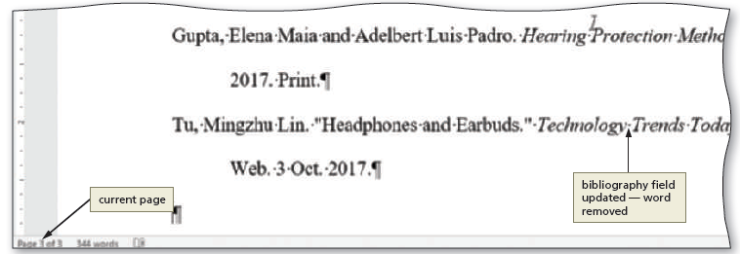
Proofreading and Revising the Research Paper (Slide 2 of 12)
To Update a Field
Right-click anywhere in the bibliography text to display a shortcut menu related to fields
Click Update Field on the shortcut menu to update the selected field
Notes:
Figure 2-61: display of the bibliography filed updated

Slide 28
Proofreading and Revising the Research Paper (Slide 3 of 12)
To Go to a Page
Click VIEW on the ribbon to display the VIEW tab
Place a check mark in the ‘Open the Navigation Pane’ check box to open the Navigation Pane on the left side of the Word window
If necessary, click the PAGES tab in the Navigation Pane to display thumbnails of the pages in the document
Scroll to and then click the thumbnail of the desired page

Slide 29
Proofreading and Revising the Research Paper (Slide 4 of 12)
To Copy and Paste
Select the item to be copied
Click the Copy button to copy the selected item in the document to the Office Clipboard
Position the insertion point at the location where the item should be pasted
Click the Paste button to paste the copied item in the document at the location of the insertion point

Slide 30
Proofreading and Revising the Research Paper (Slide 5 of 12)
To Display the Paste Options Menu
Immediately after pasting text, click the Paste Options button to display the Paste Options menu
Click anywhere to remove the Paste Options menu from the window
To Find Text
Click the Find button to display the Navigation Pane
Type the text to find in the Navigation Pane text box to display all occurrences of the typed text, called the search text, in the Navigation Pane and to highlight the occurrences of the search text in the document window

Slide 31
Proofreading and Revising the Research Paper (Slide 6 of 12)
To Replace Text
Click the Replace button to display the Replace sheet in the Find and Replace dialog box
Type the text to find in the Find what text box
Type the text to replace within the Replace with text box
Click the Replace All button to instruct Word to replace all occurrences of the Find what text with the Replace with text. If Word displays a dialog box asking if you want to continue searching from the beginning of the document, click the Yes button
Click the OK button
Click the Close button

Slide 32
Proofreading and Revising the Research Paper (Slide 7 of 12)
To Find and Insert a Synonym
Right-click the word for which you want to find a synonym to display a shortcut menu
Point to Synonyms on the shortcut menu to display a list of synonyms for the word you right-clicked
Click the synonym you want on the Synonyms submenu to replace the selected word in the document with the selected synonym

Slide 33
Proofreading and Revising the Research Paper (Slide 8 of 12)
To Check Spelling and Grammar at Once
Press CTRL+HOME because you want the spelling and grammar check to begin from the top of the document
Click REVIEW on the ribbon to display the REVIEW tab
Click the Spelling & Grammar button to begin the spelling and grammar check at the location of the insertion point, which in this case, is at the beginning of the document
Click the desired spelling in the list of suggestions
If items are found, click the desired selection

Slide 34
Proofreading and Revising the Research Paper (Slide 9 of 12)
To Look Up Information
Locate the word you want to look up
While holding down the ALT key, click the word you want to look up to open the Research task pane and display a dictionary entry for the ALT+clicked word. Release the ALT key
Click the Source arrow in the Research task pane to display a list of search locations and then click ‘All Research Sites’ in the list
Click the Close button in the Research task pane

Slide 35
Proofreading and Revising the Research Paper (Slide 10 of 12)
To Zoom Multiple Pages
Click HOME on the ribbon to display the HOME tab
If the ‘Show/Hide ¶’ button is selected, click it to hide formatting marks
Click VIEW on the ribbon to display the VIEW tab
If the rulers are displayed, click the View Ruler check box to remove the check mark from the check box and remove the horizontal and vertical rulers from the screen
Click the Multiple Pages button to display the all three pages at once in the document window
When finished, click the Page Width button to return to the page width zoom

Slide 36
Proofreading and Revising the Research Paper (Slide 11 of 12)
To Change Read Mode Color
Click the Read Mode button on the status bar to switch to Read mode
Click the VIEW tab to display the VIEW menu
Point to Page Color on the VIEW menu to display the Page Color menu
Click the desired color on the Page Color submenu to change the color of the Read mode screen

Slide 37
Proofreading and Revising the Research Paper (Slide 12 of 12)
Notes:
Figure 2-77: display of Page Color command

