Slide 1
Shelly Cashman: Microsoft Excel 2016
Module 2: Formulas, Functions, and Formatting

Slide 2
Objectives (Slide 1 of 2)
Use Flash Fill
Enter formulas using the keyboard
Enter formulas using Point mode
Apply the MAX, MIN, and AVERAGE functions
Verify a formula using Range Finder
Apply a theme to a workbook
Apply a date format to a cell or range

Slide 3
Objectives (Slide 2 of 2)
Add conditional formatting to cells
Change column width and row height
Check the spelling on a worksheet
Change margins and headers in Page Layout view
Preview and print versions and sections of a worksheet

Slide 4
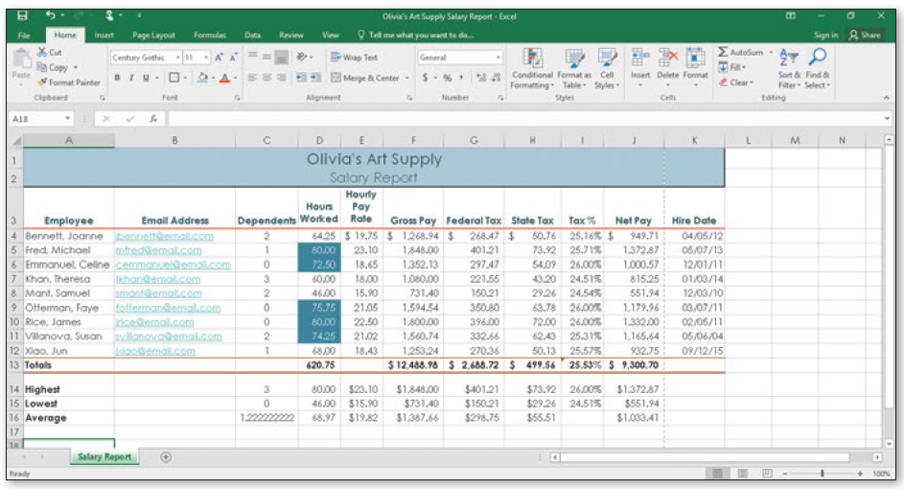
Project – Worksheet with Formulas and Functions (Slide 1 of 2)
Notes:
Figure 2-1: display of an Excel worksheet

Slide 5
Project – Worksheet with Formulas and Functions (Slide 2 of 2)
Roadmap
Enter formulas in the worksheet
Enter functions in the worksheet
Verify formulas in the worksheet
Format the worksheet
Check spelling
Print the worksheet

Slide 6
Entering the Titles and Numbers into the Worksheet
To Enter the Worksheet Title and Subtitle
Run Excel and create a blank workbook
Select cell A1 and type the desired text, then press the DOWN ARROW key to enter the worksheet title
Select cell A2 and type the desired then press the DOWN ARROW key to enter the worksheet subtitle
To Enter the Column Titles
Select cell A3 and type the desired text, then press the RIGHT ARROW key to enter the column heading
Continue until all the columns you desire have headings

Slide 7
Flash Fill (Slide 1 of 2)
To Use Flash Fill
Click a cell
Type desired text and then press the DOWN ARROW to select the next cell
Type desired text again following the same pattern (for example an email address)
Click Data on the ribbon to select the Data tab
Click Flash Fill to enter similarly formatted text

Slide 8
Flash Fill (Slide 2 of 2)
To Enter the Row Titles
Select a cell in the A column
Type desired text and then press the DOWN ARROW key to enter a row header.
Continue until all Rows have a header
To Change the Sheet Tab Name and Color
Double-click the Sheet1 tab and enter the desired text as the sheet tab name and then press the ENTER key
Right-click the sheet tab to display the shortcut menu
Point to Tab Color on the shortcut menu to display the Tab Color gallery. Click desired color
Save the workbook

Slide 9
Entering Formulas (Slide 1 of 3)
To Enter a Formula Using the Keyboard
With the cell to contain the formula selected, type the formula in the cell to display the formula in the formula bar and in the current cell and to display colored borders around the cells referenced in the formula
Press the right arrow key to complete the arithmetic operation indicated by the formula, to display the result in the worksheet, and to select the cell to the right

Slide 10
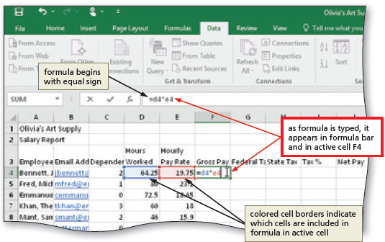
Entering Formulas (Slide 2 of 3)

Slide 11
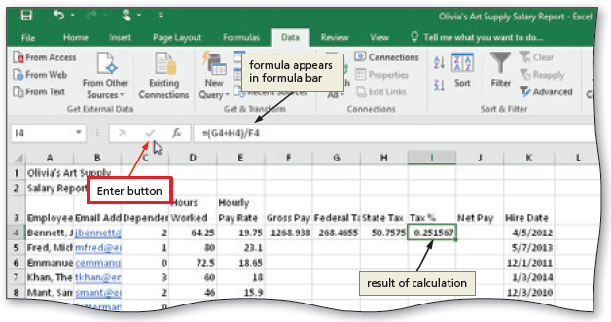
Entering Formulas (Slide 3 of 3)
To Enter Formulas Using Point Mode
With the cell that is to contain the formula selected, begin typing the formula and then click another cell to add a cell reference in the formula
Finish typing the rest of the formula
Click the Enter box in the formula bar when you have finished entering the formula
Notes:
Figure 2-12: display of the formula bar

Slide 12
Option Buttons
Table 2-4 Option Buttons in Excel
Name | Menu Function
Auto Fill Options | Provides options for how to fill cells following a fill operation, such as dragging the fill handle
AutoCorrect Options | Undoes an automatic correction, stops future automatic corrections of this type, or causes Excel to display the AutoCorrect Options dialog box
Insert Options | Lists formatting options following an insertion of cells, rows, or columns
Paste Options | Specifies how moved or pasted items should appear (for example, with original formatting, without formatting, or with different formatting)
Trace Error | Lists error-checking options following the assignment of an invalid formula to a cell
Notes:
Table 2-4: Option Buttons in Excel

Slide 13
Using the AVERAGE, MAX, and MIN Functions (Slide 1 of 6)
To Determine the Highest Number in a Range of Numbers Using the Insert Function Dialog box
Select the cell to contain the maximum number
Click the Insert Function box in the formula bar to display the Insert Function dialog box
If necessary, scroll to and then click MAX in the Select a function list
Click the OK button to display the Function Arguments dialog box and type the cell range in the Number1 box to enter the first argument of the function
Click the OK button to display the highest value in the chosen range in the selected cell

Slide 14
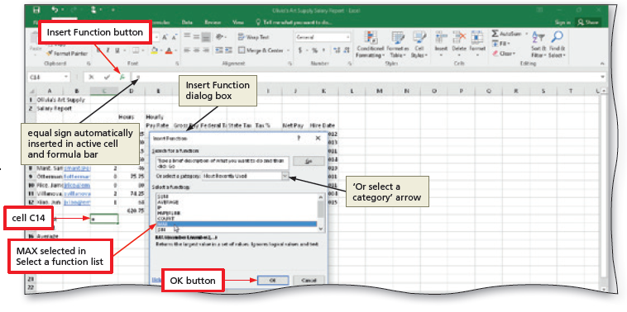
Using the AVERAGE, MAX, and MIN Functions (Slide 2 of 6)
Notes:
Figure 2-17: display of the MA selected in Select a function list

Slide 15
Using the AVERAGE, MAX, and MIN Functions (Slide 3 of 6)
To Determine the Lowest Number in a Range of Numbers Using the Sum Menu
Select cell that is to contain the minimum value and then click the Sum arrow in the HOME tab
Click Min to display the MIN function in the formula bar and in the active cell
Drag through the range of values of which you want to determine the lowest number
Click the Enter box to determine the lowest value in the range and display the result in the formula bar and in the selected cell

Slide 16
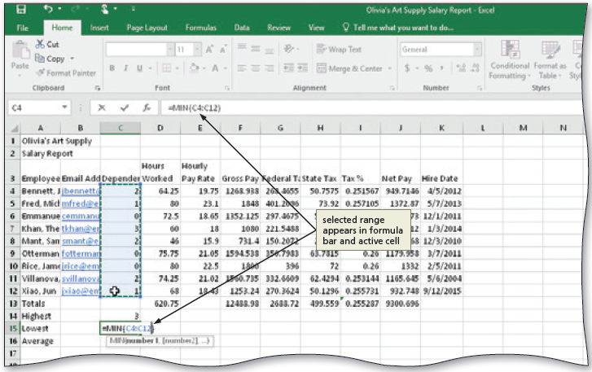
Using the AVERAGE, MAX, and MIN Functions (Slide 4 of 6)
Notes:
Figure 2-22: display of selected range appearing in the formula bar and active cell

Slide 17
Using the AVERAGE, MAX, and MIN Functions (Slide 5 of 6)
To Determine the Average of a Range of Numbers Using the Keyboard
Select the cell that will contain the average
Type =av in the cell to display the Formula AutoComplete list Press the DOWN ARROW key to highlight the required formula
Double-click AVERAGE in the Formula AutoComplete list to select the function
Select the range to be averaged to insert the range as the argument to the function
Click the Enter box to compute the average of the numbers in the selected range and display the result in the selected cell

Slide 18
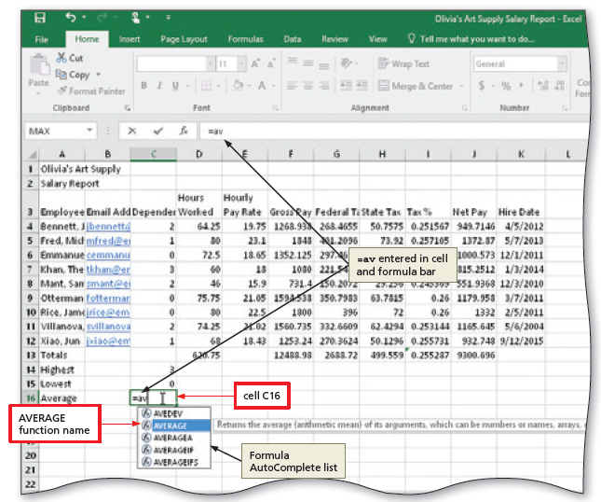
Using the AVERAGE, MAX, and MIN Functions (Slide 6 of 6)

Slide 19
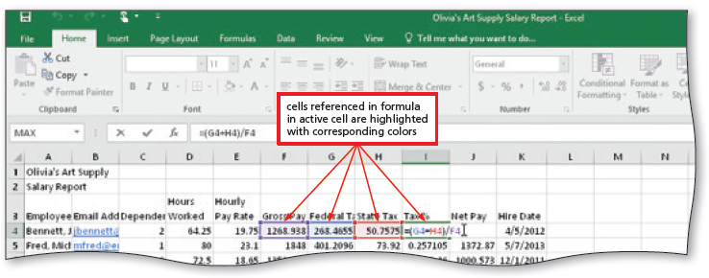
Verifying Formulas using Range Finder
To Verify a Formula Using Range Finder
Double-click a cell to activate Range Finder
Press the ESC key to quit Range Finder and then click anywhere in the worksheet to deselect the current cell
Notes:
Figure 2-28: display of using the Range Finder

Slide 20
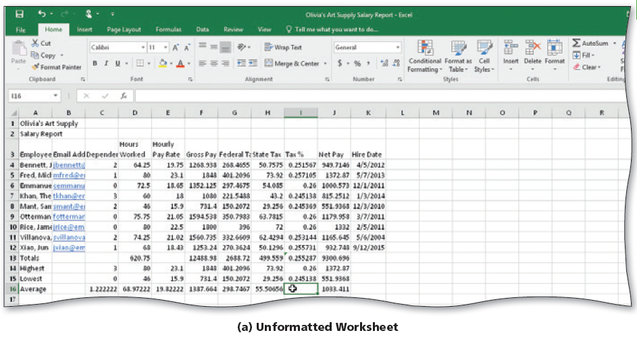
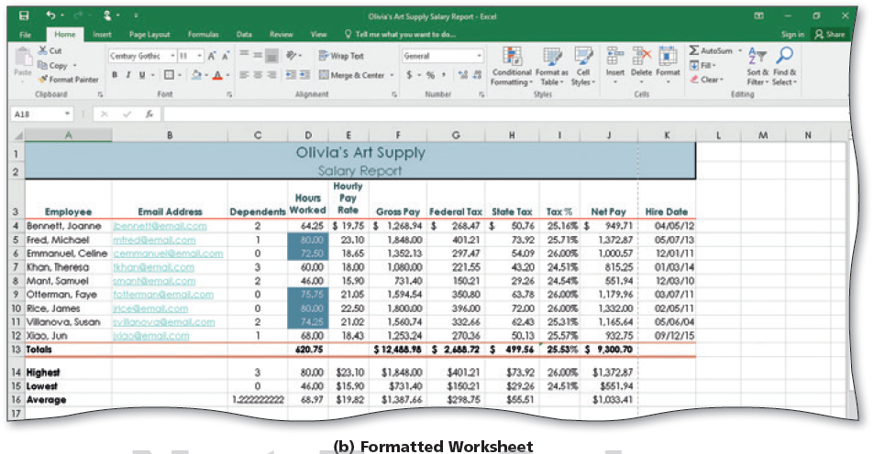
Formatting the Worksheet (Slide 1 of 11)
Notes:
Figure 2-29: formatted worksheet
Unformatted worksheet
Formatted worksheet

Slide 21
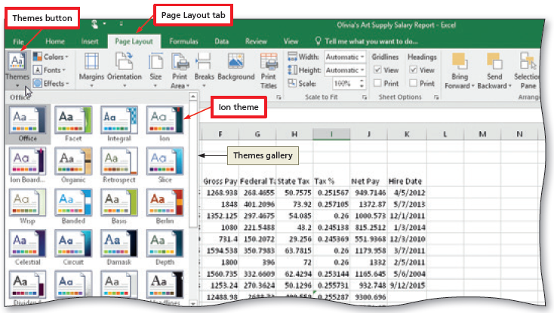
Formatting the Worksheet (Slide 2 of 11)
To Change the Workbook Theme
Click the Themes button on the PAGE LAYOUT tab to display the Themes gallery
Click the desired theme in the Themes gallery to change the workbook theme
Notes:
Figure 2-30: display of the Themes button

Slide 22
Formatting the Worksheet (Slide 3 of 11)
To Change the Background Color and Apply a Box Border to the Worksheet Title and Subtitle
Select the range to color and then click the Fill Color arrow on the HOME tab to display the Fill Color gallery
Click a color to select it and change the background color of the range of cells
Click the Borders arrow on the HOME tab to display the Borders gallery
Click a border in the Borders gallery to select it and display a border around the selected range

Slide 23
Formatting the Worksheet (Slide 4 of 11)
To Format Dates and Center Data in Cells
Select the range to contain the new date format
Click the Format Cells: Number Format Dialog Box Launcher in the HOME tab to display the dialog box
If necessary, click the NUMBER tab and click Date in the Category list, and then click a date type to choose the format for the selected range
Click the NUMBER tab and then click Date in the Category list to choose the format for the selected range
Click the OK button to format the dates in the current column using the selected date format style
Select the range to be centered and then click the Center button on the HOME tab to center the data in the selected range

Slide 24
Formatting the Worksheet (Slide 5 of 11)
To Apply an Accounting Number Format and Comma Style Format Using the Ribbon
Select the range to contain the accounting number format
While holding down the CTRL key, select the nonadjacent ranges and cells
Click the ‘Accounting Number Format’ button on the HOME tab to apply the accounting number format to the selected nonadjacent ranges
Click the Comma Style button on the HOME tab to assign the Comma style format to the selected range

Slide 25
Formatting the Worksheet (Slide 6 of 11)
To Apply a Currency Style Format with a Floating Dollar Sign Using the Format Cells Dialog Box
Select the range to format and then click the Number Format Dialog Box Launcher in the HOME tab to display the Format Cells dialog box
If necessary, click the NUMBER tab to display the Number sheet
Click Currency in the Category list to select the necessary number format category and then tap or click a style in the Negative numbers list to select the desired currency format
Click the OK button to assign the currency style format to the selected ranges

Slide 26
Formatting the Worksheet (Slide 7 of 11)
To Apply Percent Style Format and Using the Increase Decimal Button
Select the range to format
Click the Percent Style button in the HOME tab to display the numbers in the selected range as a rounded whole percent
Click the Increase Decimal button in the HOME tab two times to display the numbers in the selected range with two decimal places

Slide 27
Formatting the Worksheet (Slide 8 of 11)
To Apply Conditional Formatting
Select the range to which you wish to apply conditional formatting
Click the Conditional Formatting button on the HOME tab to display the Conditional Formatting list
Click New Rule in the Conditional Formatting list to display the New Formatting Rule dialog box
Click the desired rule type in the Select a Rule Type area
Select and type the desired values in the Edit the Rule Description area

Slide 28
Formatting the Worksheet (Slide 9 of 11)
Table 2-5 Summary of Conditional Formatting Relational Operators
Relational Operator | Formatting will be applied if…
between | cell value is between two numbers
not between | cell value is not between two numbers
equal to | cell value is equal to a number
not equal to | cell value is not equal to a number
greater than | cell value is greater than a number
less than | cell value is less than a number
greater than or equal to | cell value is greater than or equal to a number
less than or equal to | cell value is less than or equal to a number
Notes:
Table 2-5: Summary of Conditional Formatting Relational Operators

Slide 29
Formatting the Worksheet (Slide 10 of 11)
To Change Column Width
Drag through column headings to select the columns
Point to the boundary on the rightmost column heading to cause the pointer to become a split double arrow
Double-click the right boundary of the column to change the width of the selected columns to best fit
To resize a column by dragging, point to the boundary of the right side of the column heading. When the mouse pointer changes to a split double arrow, drag to the desired width, and then Lift your finger or release the mouse button to change the column widths

Slide 30
Formatting the Worksheet (Slide 11 of 11)
To Change the Row Height
Point to the boundary below the row heading to resize
Drag the boundary to the desired row height and then release the mouse button
Lift your finger or release the mouse button to change the row height

Slide 31
Checking Spelling
To Check Spelling on the Worksheet
Click cell A1 so that the spell checker begins at the beginning of the worksheet
Click the Spelling button on the REVIEW tab to run the spell checker and display the misspelled words in the Spelling dialog box
Apply the desired action to each misspelled word
When the spell checker is finished, click the Close button

Slide 32
Printing the Worksheet (Slide 1 of 2)
To Change the Worksheet’s Margins, Header, and Orientation in Page Layout View
Click the Page Layout button on the status bar to view the worksheet in Page Layout view
Click the Adjust Margins button on the PAGE LAYOUT tab to display the Margins gallery
Click the desired margin style to change the worksheet margins to the selected style
Click above cell A1 in the center area of the Header area
Type the desired worksheet header, and then press the ENTER key
Click the ‘Change Page Orientation’ button on the PAGE LAYOUT tab to display the Change Page Orientation gallery
Click the desired orientation in the Orientation gallery to change the worksheet’s orientation

Slide 33
Printing the Worksheet (Slide 2 of 2)
To Print a Section of the Worksheet
Select the range to print
Click FILE on the ribbon to open Backstage view
Click the Print tab to display the Print gallery
Click ‘Print Active Sheets’ in the Settings area on the PRINT tab to display a list of printing options
Click Print Selection to print the selected range
Click the Print button in the Print gallery to print the selected range of the worksheet
Click the Normal button on the status bar to return to Normal view

Slide 34
Displaying and Printing the Formulas Version of the Worksheet
To Display the Formulas in the Worksheet and Fit the Printout on One Page
Press CTRL+ACCENT MARK (`) to display the worksheet with formulas
Click the Page Setup Dialog Box Launcher on the PAGE LAYOUT tab to display the Page Setup dialog box
If necessary, click the desired Orientation in the Page sheet to select it
If necessary, click Fit to in the Scaling area to select it
Click the Print button to print the formulas in the worksheet on one page. If necessary, in the Backstage view, select the Print Active Sheets option in the Settings area of the Print gallery
When Excel displays the Backstage view, click the Print button to print the worksheet
After viewing and printing the formulas version, press CTRL+ACCENT MARK (`) to display the values version

