Slide 1
Shelly Cashman: Microsoft PowerPoint 2016
Module 2: Enhancing a Presentation with Pictures, Shapes, and WordArt

Slide 2
Objectives (Slide 1 of 2)
Search for and download an online theme
Insert and format pictures
Insert and size a shape
Apply effects to a shape
Add text to a shape
Change the text font

Slide 3
Objectives (Slide 2 of 2)
Insert a picture to create a background
Insert and format WordArt
Format slide backgrounds
Find and replace text and check spelling
Add and print speaker notes

Slide 4
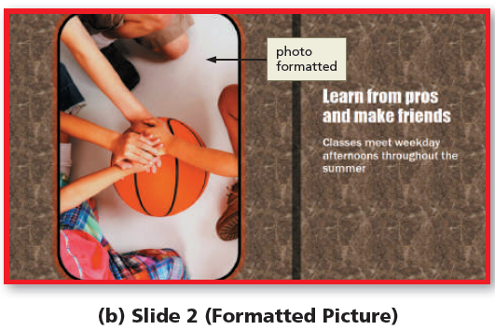
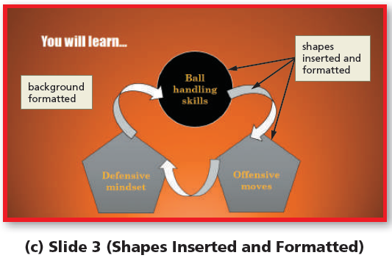
Project – Presentation with Pictures, Shapes, and WordArt (Slide 1 of 2)
Notes:
Figure 2-1: display of presentation slides
Slide 1 (Title Slide)
Slide 2 (Formatted Picture)
Slide 3 (Shapes Inserted and Formatted)
Slide 4 (Picture Background)

Slide 5
Project – Presentation with Pictures, Shapes, and WordArt (Slide 2 of 2)
Download a theme and select slides for the presentation
Insert and format pictures for the slides
Insert and format shapes on one slide
Format slide backgrounds with a gradient, texture, and picture fill
Insert and format WordArt by changing the shape, fill, and outline
Review, revise, and print slides by finding a synonym, checking spelling, and adding speaker notes

Slide 6
Downloading a Theme and Editing Slides (Slide 1 of 2)
To Search for and Download an Online Theme
Point to the desired category in the Suggested searches list
Click the desired category to search for themes
Scroll to and then click the desired theme to display a theme preview dialog box with a thumbnail view of the theme
Click the Create button to download the theme and open a presentation with the theme in PowerPoint

Slide 7
Downloading a Theme and Editing Slides (Slide 2 of 2)
To Delete a Slide
Click the slide thumbnail in the Thumbnail pane for the slide to delete
Press and hold the SHIFT key and then click the thumbnail for the last slide in the series to delete
Right-click any selected slide to display the shortcut menu
Click Delete Slide to delete the selected slides from the presentation

Slide 8
Inserting and Formatting Pictures in a Presentation (Slide 1 of 6)
Inserting a Picture into a Slide without a Content Placeholder
Click INSERT on the ribbon to display the INSERT tab
Click the Pictures button to display the Insert Picture dialog box
Navigate to the location containing the picture
Click the desired picture to select the file name
Click the Insert button to insert the illustration
If necessary, drag the picture to the desired location on the slide

Slide 9
Inserting and Formatting Pictures in a Presentation (Slide 2 of 6)
To Change a Picture
Right-click the picture to display the shortcut menu
Click Change Picture to display the Insert Picture dialog box
Click the Browse button in the From a file area to display the Insert Pictures dialog box
Navigate to the location containing the new picture, and then click the new picture to select the file name
Click the Insert button to insert the picture

Slide 10
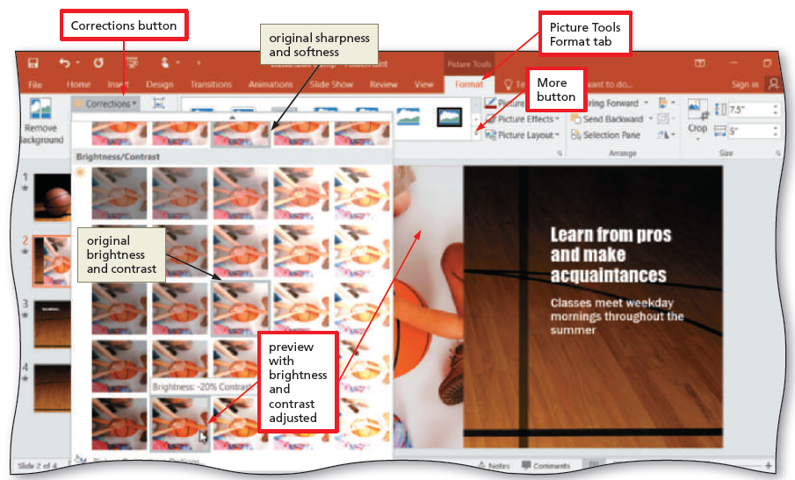
Inserting and Formatting Pictures in a Presentation (Slide 3 of 6)
To Correct a Picture
With the desired picture selected and the PICTURE TOOLS FORMAT tab active, click the Corrections button to display the Corrections gallery
Click the desired correction to apply the correction to the picture
Notes:
Figure 2-17: display of Picture Tools Format tab

Slide 11
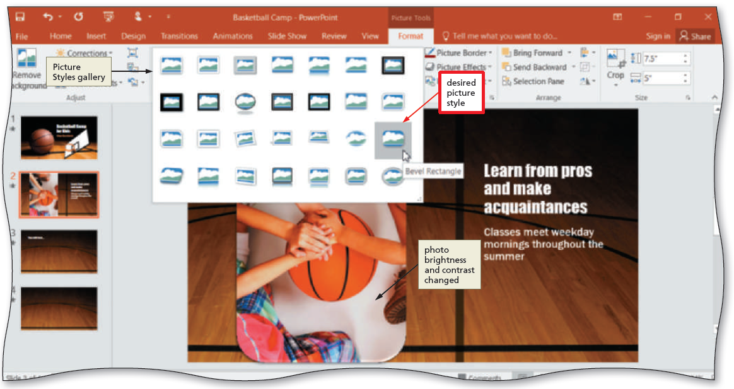
Inserting and Formatting Pictures in a Presentation (Slide 4 of 6)
To Apply a Picture Style
With the picture selected, click the PICTURE TOOLS FORMAT tab and then click the More button in the Picture Styles gallery to expand the gallery
Click the desired picture style to apply the style to the selected picture
Notes:
Figure 2-:18: display of desired picture styles

Slide 12
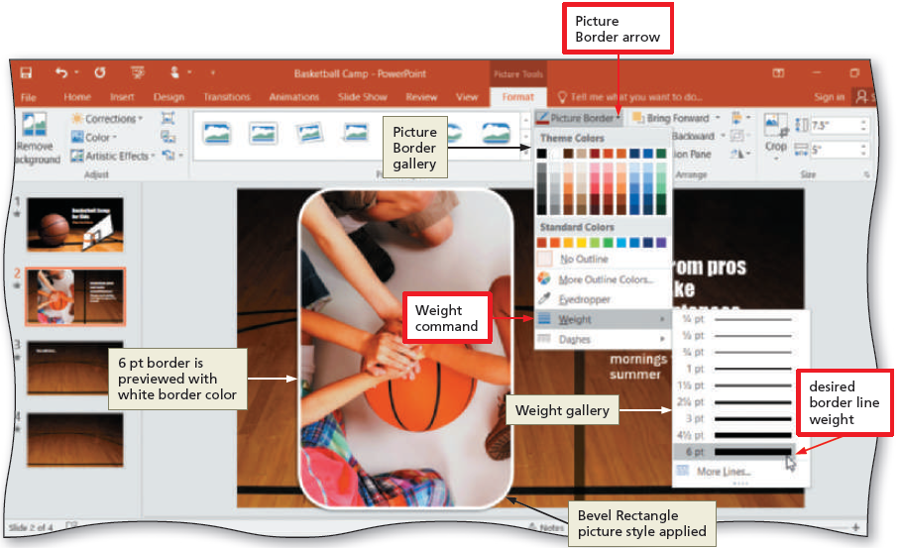
Inserting and Formatting Pictures in a Presentation (Slide 5 of 6)
To Add a Picture Border
With the picture selected, click the Picture Border arrow on the PICTURE TOOLS FORMAT tab to display the Picture Border gallery
Point to Weight on the Picture Border gallery to display the Weight list
Click the desired line weight to add the line weight to the picture
Notes:
Figure 2-19: display of picture border arrow

Slide 13
Inserting and Formatting Pictures in a Presentation (Slide 6 of 6)
To Change a Picture Border Color
With the photo selected, click the Picture Border button on the PICTURE TOOLS FORMAT tab to display the Picture Border gallery
Click the desired color to change the picture border color
To Apply Picture Effects
With the picture selected, click the Picture Effects button on the PICTURE TOOLS FORMAT tab to display the Picture Effects menu
Point to the desired command in the Picture Effects menu to display the associated gallery
Click the desired picture effect to apply it

Slide 14
Inserting and Formatting a Shape (Slide 1 of 5)
To Add a Shape
Click the Shapes More button on the HOME tab to display the Shapes gallery
Click the desired shape in the Shapes gallery
Position the mouse pointer where you wish to insert the shape, and then click the slide to insert the shape
To Resize a Shape
With the shape selected, drag a corner sizing handle on the picture diagonally to the desired size
Release the mouse button to resize the shape

Slide 15
Inserting and Formatting a Shape (Slide 2 of 5)
To Apply a Shape Style
Click the shape to select it, and then click the Quick Styles button on the HOME tab
Click the desired shape style to apply the selected style to the shape
To Add Text to a Shape
Click the shape to select it and then type the desired text

Slide 16
Inserting and Formatting a Shape (Slide 3 of 5)
To Change the Font
With the shape selected, position the insertion point in the text to select, and then drag the selection handles to select the text
Click the Font arrow on the mini toolbar to display the Font gallery
Scroll to the desired font in the Font gallery
Click the desired font

Slide 17
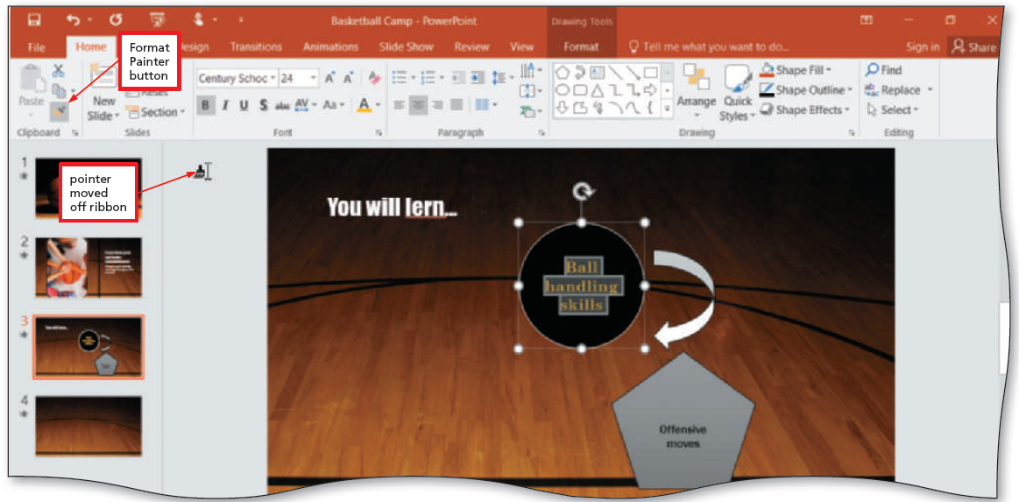
Inserting and Formatting a Shape (Slide 4 of 5)
To Format Text Using the Format Painter
With the text selected with the format you wish to copy, double-click the Format Painter button on the HOME tab
Move the mouse pointer off the ribbon
Select the text to which you wish to copy the formatting
Tap the Format Painter button or press the ESC key to turn off the Format Painter feature
Notes:
Figure 2-39: display of Format Painter button

Slide 18
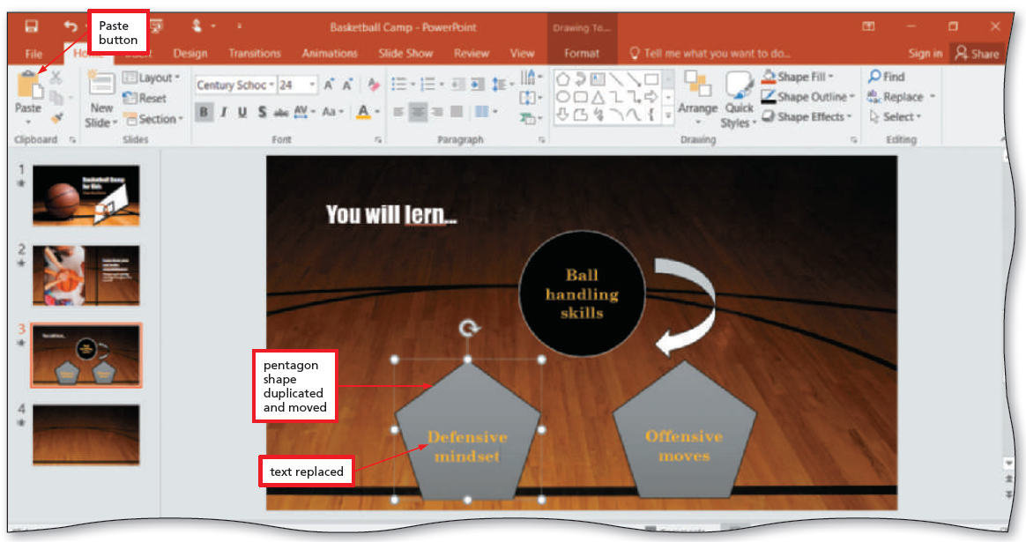
Inserting and Formatting a Shape (Slide 5 of 5)
To Copy and Paste a Shape
With the shape selected, click the Copy button on the HOME tab
Click the Paste button on the HOME tab to insert a duplicate shape
Notes:
Figure 2-42: display of the Paste button

Slide 19
Formatting Slide Background (Slide 1 of 5)
To Insert a Texture Fill
Display the DESIGN tab and then click the Format Background button
With the Fill pane displaying and ‘Picture or texture fill’ selected, click the File button to display the Insert Picture dialog box
Navigate to the location of the picture
Click the desired picture to select it, and then click the Insert button to insert the picture

Slide 20
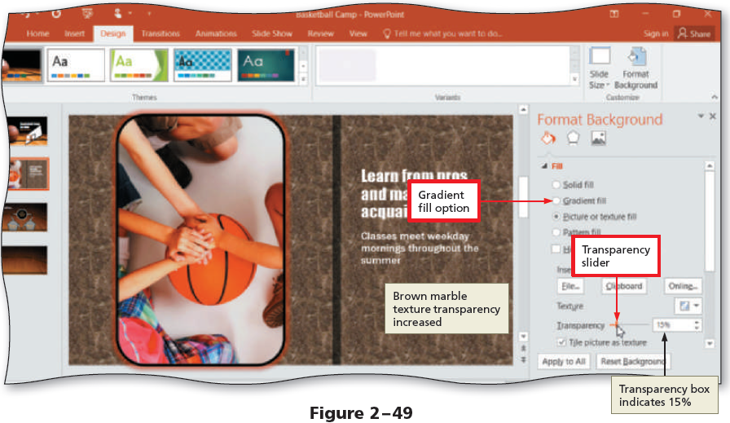
Formatting Slide Background (Slide 2 of 5)
To Format the Background Texture Fill Transparency
Click the Transparency slider in the Format Background dialog box and drag it to the desired transparency setting
Notes:
Figure 2-49: display of transparency slider

Slide 21
Formatting Slide Background (Slide 3 of 5)
To Insert a Gradient Fill
Click the Format Background button on the DESIGN tab to display the Format Background task pane
Click the Preset gradients button to display the Preset gradients gallery
Click the desired gradient

Slide 22
Formatting Slide Background (Slide 4 of 5)
To Insert a Picture to Create a Background
Display the DESIGN tab and then click the Format Background button
With the Fill pane displaying and ‘Picture or texture fill’ selected, click the File button to display the Insert Picture dialog box
Navigate to the location of the picture
Click the desired picture to select it, and then click the Insert button to insert the picture

Slide 23
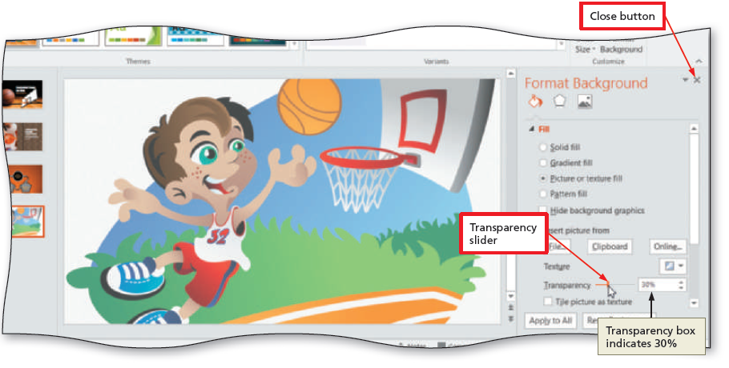
Formatting Slide Background (Slide 5 of 5)
To Format the Background Picture Fill Transparency
Click the Transparency slider in the Format Background dialog box and drag it to the desired transparency setting
Notes:
Figure 2-54: display of the transparency slider

Slide 24
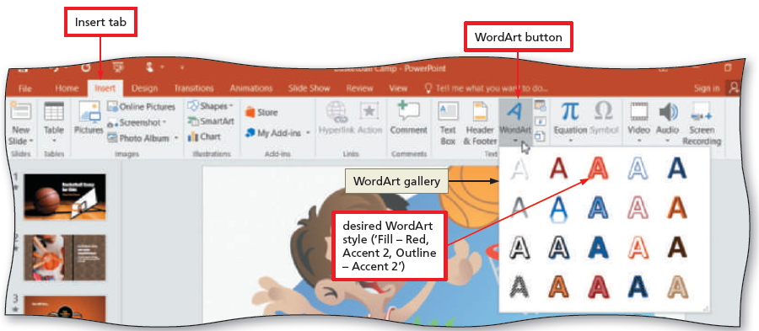
Inserting and Formatting WordArt (Slide 1 of 4)
To Insert WordArt
Display the INSERT tab
Click the WordArt button to display the WordArt gallery
Click the desired WordArt style to insert the WordArt object
Type the desired text in the WordArt text box
Notes:
Figure 2-55: display of the WordArt button

Slide 25
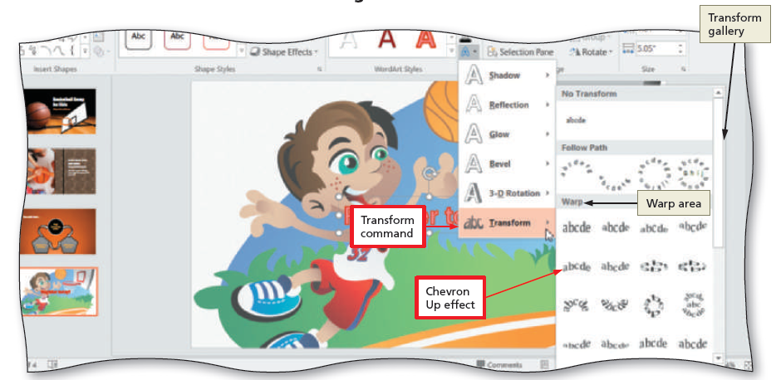
Inserting and Formatting WordArt (Slide 2 of 4)
To Change the WordArt Shape
With the WordArt selected, click the Text Effects button on the DRAWING TOOLS FORMAT tab to display the Text Effects menu
Point to the desired group in the Text Effects menu to display the associated gallery
Click the desired shape in the gallery to change the WordArt shape
Notes:
Figure 2-59: display of the Transform gallery

Slide 26
Inserting and Formatting WordArt (Slide 3 of 4)
To Apply a WordArt Text Fill
With the WordArt text selected, click the Text Fill button arrow on the DRAWING TOOLS FORMAT tab to display the Text Fill gallery
Point to Texture in the Text Fill gallery to display the Texture gallery
Click the desired texture to apply this texture as the fill for the WordArt object
To Change the Weight of the WordArt Outline
With the WordArt selected, click the Text Outline arrow on the DRAWING TOOLS FORMAT tab to display the Text Outline gallery
Point to Weight in the gallery to display the Weight list
Click the desired weight to apply this line weight to the WordArt text outline

Slide 27
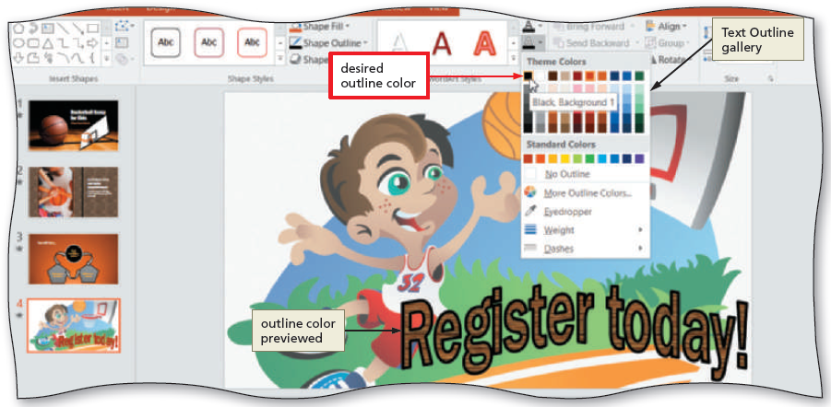
Inserting and Formatting WordArt (Slide 4 of 4)
To Change the Color of the WordArt Outline
With the WordArt selected, display the Text Outline gallery
Click the desired color to apply this color to the WordArt outline
Notes:
Figure 2-65: display of the Text Outline gallery

Slide 28
Reviewing and Revising Individual Slides (Slide 1 of 5)
To Find and Insert a Synonym
Select the word for which you want to find the synonym
Right-click to display a shortcut menu related to the words you right-clicked. Then, point to Synonyms on the shortcut menu to display a list of synonyms for these words
Click the synonym you want on the Synonyms submenu

Slide 29
Reviewing and Revising Individual Slides (Slide 2 of 5)
To Add Notes
Click the Notes button on the status bar to display the Notes pane
Click the Notes pane and then type the desired note
Notes:
Figure 2-69: display of Notes button

Slide 30
Reviewing and Revising Individual Slides (Slide 3 of 5)
To Find and Replace Text
Display the HOME tab and then click the Replace button to display the Replace dialog box
Type the text to find in the Find what box
Type the replacement text in the Replace with box
Click the Replace All button to instruct PowerPoint to replace all occurrences of the Find what words with the Replace with words
Click the OK button
Click the Close button

Slide 31
Reviewing and Revising Individual Slides (Slide 4 of 5)
To Check Spelling
Click REVIEW on the ribbon to display the REVIEW tab
Click the Spelling button to start the spelling checker and display the Spelling pane
Click the button corresponding to how you want to handle each word

Slide 32
Reviewing and Revising Individual Slides (Slide 5 of 5)
To Print Speaker Notes
Click FILE on the ribbon to open the Backstage view, and then click the Print tab in the Backstage view to display Slide 1 in the Print gallery
Click ‘Full Page Slides’ in the Settings area to display the Print gallery
Click Notes Pages in the Print Layout area to select this option
Click the print button in the Print gallery to print the notes pages on the currently selected printer

