Slide 1
Shelly Cashman: Microsoft Word 2016
Module 1: Creating, Formatting, and Editing a Word Document with a Picture

Slide 2
Objectives (Slide 1 of 2)
Enter text in a Word document
Check spelling as you type
Format paragraphs
Format text
Undo and redo commands or actions
Change theme colors

Slide 3
Objectives (Slide 2 of 2)
Insert digital pictures in a Word document
Format pictures
Format pictures
Add a page border
Adjust spacing
Correct errors and revise a document

Slide 4
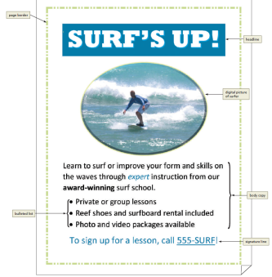
Project – Flyer with a Picture
Notes:
Figure 1-1: display of a flyer

Slide 5
Roadmap
Enter text in a new document
Format the text in the flyer
Insert a picture, called Surfer, in the flyer
Format the picture in the flyer
Enhance the page with a border and spacing
Correct errors and revise text in the flyer

Slide 6
Entering Text (Slide 1 of 3)
To Type Text
Type the text in the Word document
To move the insertion point to the beginning of the next line, press the ENTER key
To Display Formatting Marks
If the HOME tab is not the active tab, click HOME on the ribbon to display the HOME tab
If it is not selected already, click the Show/Hide ¶ button to display formatting marks on the screen

Slide 7
Entering Text (Slide 2 of 3)
To Insert a Blank Line
Press the ENTER key to insert a blank line in the document
To Zoom Page Width
Click VIEW on the ribbon to display the VIEW tab
Click the Page Width button to display the page the same width as the document window
To Wordwrap Text as You Type
Wordwrap allows you to type words in a paragraph continually without pressing the ENTER key at the end of each line

Slide 8
Entering Text (Slide 3 of 3)
To Check Spelling and Grammar as You Type
Type the misspelled text and then press the SPACEBAR so that a red wavy line appears below the misspelled word
Right-click the flagged word to display a shortcut menu that presents a list of suggested spelling corrections for the flagged word
Click the correct word on the shortcut menu

Slide 9
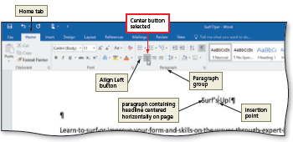
Formatting Paragraphs and Characters (Slide 1 of 10)
To Center a Paragraph
Click somewhere in the paragraph to be centered to position the insertion point in the paragraph to be formatted
Click the Center button to center the paragraph containing the insertion point
Notes:
Figure 1-15: display of the center button selected

Slide 10
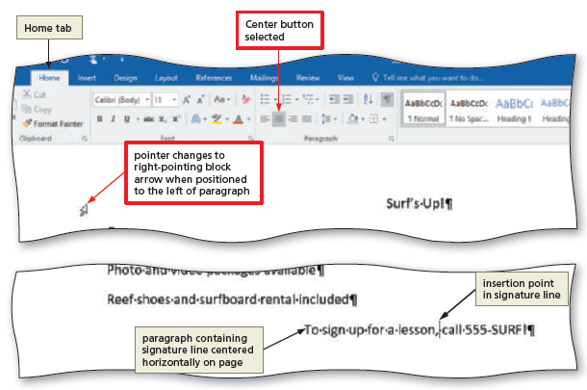
Formatting Paragraphs and Characters (Slide 2 of 10)
To Select a Line
While the pointer is a right-pointing block arrow, click the mouse to select the entire line to the right of the pointer
Notes:
Figure 1-16: display of right-pointing block arrow

Slide 11
Formatting Paragraphs and Characters (Slide 3 of 10)
To Change the Font Size of Selected Text
With the text selected, click the Font Size arrow to display the Font Size gallery
Point to the desired point size in the Font Size gallery to display a live preview of the selected text at the selected point size
Click the desired point size to change the font size of the selected text
To Change the Font of Selected Text
With the text selected, click the Font arrow to display the Font gallery
Scroll through the Font gallery, and then point to the desired font to display a live preview of the selected text in the selected font
Click the font to change the font of the selected text

Slide 12
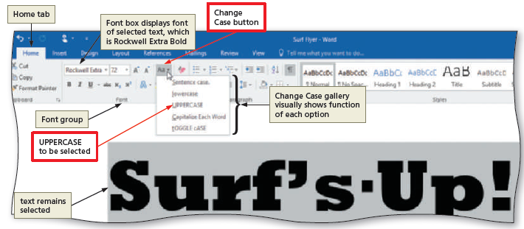
Formatting Paragraphs and Characters (Slide 4 of 10)
To Change the Case of Selected Text
With the text selected, click the Change Case button to display the Change Case gallery
Click the desired case in the Change Case gallery to change the case of the selected text
Notes:
Figure 1-22: display of the Change Case button

Slide 13
Formatting Paragraphs and Characters (Slide 5 of 10)
To Apply a Text Effect to Selected Text
With the text selected, click the Text Effects button to display the Text Effects and Typography gallery
Point to the desired text effect to display a live preview of the selected text in the selected text effect
Click the text effect to change the text effect of the selected text
To Shade a Paragraph
Click somewhere in the paragraph to be shaded
Click the Shading arrow to display the Shading gallery
Click the desired shading color

Slide 14
Formatting Paragraphs and Characters (Slide 6 of 10)
To Select Multiple Lines
Move the pointer to the left of the first paragraph to be selected until the pointer changes to a right-pointing block arrow
While the pointer is a right-pointing block arrow, drag downward to select all lines that will be formatted
To Change the Font Size of Selected Text
With the text selected, click the Font Size arrow to display the Font Size gallery
Click the desired font size
Click anywhere in the document window to remove the selection from the text

Slide 15
Formatting Paragraphs and Characters (Slide 7 of 10)
To Bullet a List of Paragraphs
Select the paragraphs to be formatted
Click the Bullets button to place a bullet character at the beginning of each selected paragraph
To Undo and Redo an Action
Click the Undo button on the Quick Access Toolbar to reverse your most recent action
Click the Redo button on the Quick Access Toolbar to reverse your most recent undo

Slide 16
Formatting Paragraphs and Characters (Slide 8 of 10)
To Italicize Text
Click somewhere in the word to be italicized to position the insertion point in the word to be formatted
Click the Italic button to italicize the word containing the insertion point
To Color Text
With the insertion point in the word to format, click the Font Color arrow to display the Font Color gallery
Click the font color to change the color of the text
To Use the Mini Toolbar to Format Text
Select the text to format to display the mini toolbar

Slide 17
Formatting Paragraphs and Characters (Slide 9 of 10)
To Underline Text
With the text selected, click the Underline button to underline the selected text
To Bold Text
With the text selected, click the Bold button to bold the selected text
To Zoom One Page
Click VIEW on the ribbon to display the VIEW tab
Click the One Page button to display the entire page in the document window as large as possible

Slide 18
Formatting Paragraphs and Characters (Slide 10 of 10)
To Change Theme Colors
Click DESIGN on the ribbon to display the DESIGN tab
Click the Theme Colors button to display the Theme Colors gallery
Click the desired theme color to change the document theme colors

Slide 19
Inserting and Formatting a Picture in a Word Document (Slide 1 of 3)
To Insert a Picture
Position the insertion point where you want to insert the picture
Click INSERT on the ribbon to display the INSERT tab
Click the From File button to display the Insert Picture dialog box
Navigate to the picture location
Select the picture you wish to insert
Click the Insert button to insert the picture at the location of the insertion point in the document

Slide 20
Inserting and Formatting a Picture in a Word Document (Slide 2 of 3)
To Zoom the Document
Click the Zoom Out or Zoom In button as many times as necessary until the Zoom button on the status bar displays the desired value
To Resize a Graphic
Drag one of the sizing handles to increase or decrease the size of the graphic
To Zoom 100%
Click VIEW on the ribbon to display the VIEW tab
Click the 100% button to display the page at 100% in the document window

Slide 21
Inserting and Formatting a Picture in a Word Document (Slide 3 of 3)
To Apply a Picture Style
Click PICTURE TOOLS FORMAT on the ribbon to display the PICTURE TOOLS FORMAT tab
Be sure the graphic still is selected
Click the More button in the Picture Styles gallery to expand the gallery
Click the desired style in the Picture Styles gallery to apply the style to the selected picture
To Apply Picture Effect
With the picture still selected, click the Picture Effects button to display the Picture Effects menu
Point to the desired effect category
Click the desired picture effect in the gallery to apply the selected picture effect

Slide 22
Enhancing the Page (Slide 1 of 3)
To Add a Page Border
Click DESIGN on the ribbon to display the DESIGN tab
Click the ‘Borders and Shading’ button to display the Borders and Shading dialog box
Click the desired border style
Click the Color arrow to display a Color palette
Click the desired color
Click the Width arrow to display the Width list
Click the desired width
Click the OK button to add the border to the page

Slide 23
Enhancing the Page (Slide 2 of 3)
To Change Spacing before and after Paragraphs
Position the insertion point in the paragraph to be adjusted
Click LAYOUT on the ribbon to display the LAYOUT tab
Change the values in the Spacing Before and Spacing After boxes

Slide 24
Enhancing the Page (Slide 3 of 3)
To Center Page Contents Vertically
If necessary, click LAYOUT on the ribbon to display the LAYOUT tab
Click the Page Setup Dialog Box Launcher to display the Page Setup dialog box
Click the Layout tab to display the Layout sheet
Click the Vertical alignment arrow to display the list of alignment options and then click Center in the list
Click the OK button to center the page contents vertically on the screen

Slide 25
Correcting Errors and Revising a Document (Slide 1 of 2)
To Delete Text
Select the text to be deleted
With the text selected, press the DELETE key to delete the selected text
To Move Text
Select the text to be moved
With the pointer in the selected text, press and hold down the mouse button, which displays a small dotted box with the pointer
Drag the insertion point to the location where the selected text is to be moved
Release the mouse button to move the selected text to the location of the dotted insertion point
Click anywhere in the document window to remove the selection

Slide 26
Correcting Errors and Revising a Document (Slide 2 of 2)
To Save and Print the Document
Save the document again on the same storage location with the same file name
Print the document
To Switch to Read Mode
Click the Read Mode button on the status bar to switch to Read mode
To Switch to Print Layout View
Click the Print Layout button on the status bar to switch to Print Layour

