Slide 1
PRINCIPLES OF MACROECONOMICS 2e
Chapter 07 Economic Growth
PowerPoint Image Slideshow

Slide 2
CH.7 OUTLINE
7.1: The Relatively Recent Arrival of Economic
Growth
7.2: Labor Productivity and Economic Growth
7.3: Components of Economic Growth
7.4: Economic Convergence

Slide 3
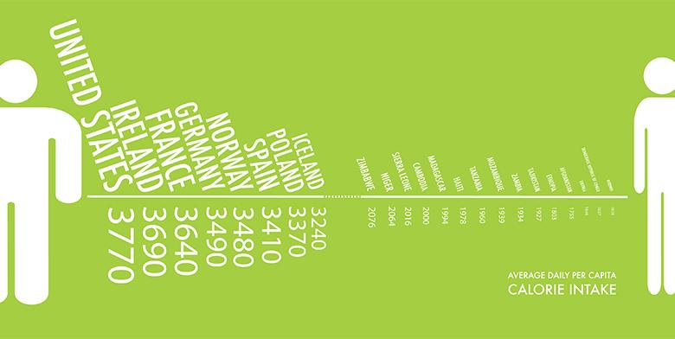
Average Daily Calorie Consumption
Not only has the number of calories that people consume per day increased, so has the amount of food calories that people are able to afford based on their working wages.
(Credit: modification of work by Lauren Manning/Flickr Creative Commons)

Slide 4
7.1 The Relatively Recent Arrival of
Economic Growth
Modern economic growth - the period of rapid economic growth from 1870 onward.
Rapid and sustained economic growth is a relatively recent experience for the human race.
Before the last two centuries, the average person’s standard of living had not changed much for centuries.

Slide 5
Industrial Revolution
Industrial Revolution - the widespread use of power-driven machinery and the economic and social changes that resulted in the first half of the 1800s.
The Industrial Revolution led to increasing inequality among nations.
1870: GDP of the top economies of the world was 2.4 times the GDP per capita of the world’s poorest economies.
1960: the top economies had 4.2 times the GDP per capita of the world’s poorest economies.

Slide 6
Rule of Law and Economic Growth
Influence of two key factors on an economy's long-run economic growth:
Adherence to rule of law -
The process of enacting laws that protect individual and entity rights to use their property as they see fit.
Laws must be clear, public, fair, and enforced, and applicable to all members of society.
Protection of contractual rights -
The rights of individuals to enter into agreements with others regarding the use of their property
Providing recourse through the legal system in the event of noncompliance.

Slide 7
7.2 Labor Productivity and
Economic Growth
Sustained long-term economic growth comes from increases in worker productivity.
Labor productivity - the value of what is produced per worker, or per hour worked (sometimes called worker productivity).
Determinants of worker productivity:
Human capital - the accumulated knowledge (from education and experience), skills, and expertise that the average worker in an economy possesses.
Technological change - a combination of invention and innovation.
Invention - advances in knowledge.
Innovation - putting advances in knowledge to use in a new product or service.
Economies of scale - the cost advantages that industries obtain due to size.

Slide 8
Sources of Economic Growth:
The Aggregate Production Function
Production function - the process whereby a firm turns economic inputs like labor, machinery, and raw materials into outputs like goods and services that consumers use.
A microeconomic production function describes a firm's or an industry's inputs and outputs.
In macroeconomics, we call the connection from inputs to outputs for the entire economy an aggregate production function.
Aggregate production function - the process whereby an economy as a whole turns economic inputs such as human capital, physical capital, and technology into output measured as GDP per capita.

Slide 9
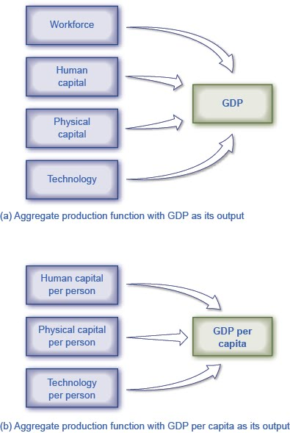
Components of the Aggregate Production Function
An aggregate production function shows what goes into producing the output for an overall economy.
This aggregate production function has GDP as its output.
This aggregate production function has GDP per capita as its output. Because we calculate it on a per-person basis, we already figure the labor input into the other factors and we do not need to list it separately.

Slide 10
Measuring Productivity
An economy’s rate of productivity growth is closely linked to the growth rate of its GDP per capita.
A common measure of U.S. productivity per worker is the dollar value (output) per hour that the worker contributes to the employer’s output.
This measure excludes government workers and farming.

Slide 11
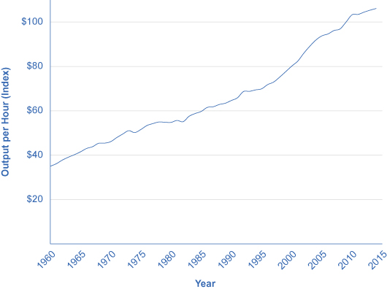
Output per Hour Worked in the
U.S. Economy, 1947–2011
Output per hour worked is a measure of worker productivity.
In the U.S. economy, worker productivity rose more quickly in the 1960s and the mid-1990s compared with the 1970s and 1980s.
However, these growth-rate differences are only a few percentage points per year.
The average U.S. worker produced over twice as much per hour in 2014 than he did in the early 1970s. (Source: U.S. Department of Labor, Bureau of Labor Statistics.)

Slide 12
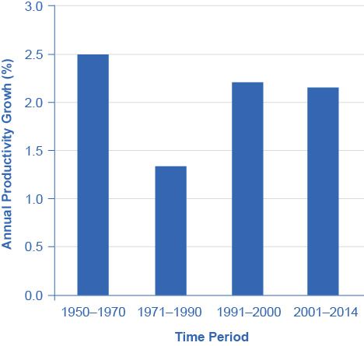
Productivity Growth Since 1950
U.S. growth in worker productivity was very high between 1950 and 1970.
It then declined to lower levels in the 1970s and the 1980s.
The late 1990s and early 2000s saw productivity rebound, but then productivity sagged a bit in the 2000s.
Some think the productivity rebound of the late 1990s and early 2000s marks the start of a “new economy” built on higher productivity growth, but we cannot determine this until more time has passed. (Source: U.S. Department of Labor, Bureau of Labor Statistics.)

Slide 13
The Power of Sustained Economic Growth
Nothing is more important for people’s standard of living than sustained economic growth.
Even small changes in the rate of growth, when sustained and compounded over long periods of time, make an enormous difference in the standard of living.
To calculate what GDP will be at the given growth rate in the future:
GDP at starting date × (1 + growth rate of GDP)^{years} = GDP at end date
Examples of growth of GDP over different time horizons:

Slide 14
GDP and Compound Growth Rates
Compound growth rate - the rate of growth when multiplied by a base that includes past GDP growth.
Example: If South Korea had a GDP of $1.67 trillion with a growth rate of 2.8%, we can estimate future GDP’s.

Slide 15
7.3 Components of Economic Growth
Physical capital - the plant and equipment that firms use in production; this includes infrastructure.
Infrastructure - a component of physical capital such as roads and rail systems.
increase in the quantity
increase in the quality
Human capital
Technology - all the ways in which existing inputs produce more or higher quality, as well as different and altogether new products.

Slide 16
Capital Deepening
Capital deepening - when society increases the level of capital per person.
The idea of capital deepening can apply both to additional human capital per worker and to additional physical capital per worker.

Slide 17
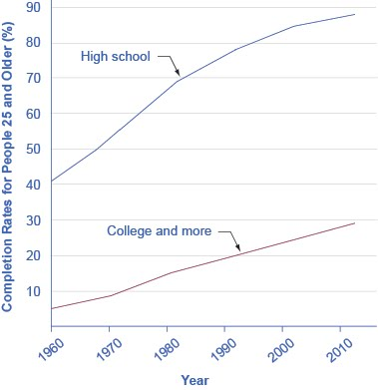
Human Capital Deepening in the U.S.
Rising levels of education for persons 25 and older show the deepening of human capital in the U.S. economy.
Today, under one-third of U.S. adults have completed a four-year college degree.
There is clearly room for additional deepening of human capital to occur. (Source: US Department of Education, National Center for Education Statistics)

Slide 18
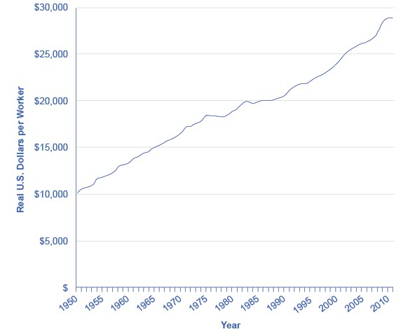
Physical Capital per Worker in the United States
The value of physical capital, measured by plant and equipment, used by the average worker in the U.S. economy has risen over the decades.
The increase leveled off in the 1970s and 1980s, which were also times of slower-than-usual growth in worker productivity.
We see a renewed increase in physical capital per worker in the late 1990s, followed by a flattening in the early 2000s. (Source: Center for International Comparisons of Production, Income and Prices, University of Pennsylvania)

Slide 19
Growth Accounting Studies
Economists can conduct growth accounting studies to determine the extent to which physical and human capital deepening and technology have contributed to growth.
Technology is typically the most important contributor to U.S. economic growth.
Growth in human capital and physical capital explains only half or less of economic growth.
The three factors of human capital, physical capital, and technology must all be present to succeed.

Slide 20
A Healthy Climate for Economic Growth
Markets that allow personal and business rewards and incentives for increasing human and physical capital encourage overall macroeconomic growth.
There are times when markets fail to allocate capital or technology in a manner that provides the greatest benefit for society as a whole.
Some areas in which governments around the world have chosen to invest in to facilitate capital deepening and technology:
Education
Savings and Investment
Infrastructure
Special Economic Zones - area of a country, usually with access to a port where, among other benefits, the government does not tax trade.
Scientific Research

Slide 21
7.4 Economic Convergence
Convergence - pattern in which economies with low per capita incomes grow faster than economies with high per capita incomes.
(Source: http://databank.worldbank.org/data/views/variableSelection/selectvariables.aspx?source=world-development-indicators#c_u)
Middle-income countries have GDP growth that is faster than that of the low-income countries.
Low-income countries have GDP growth that is faster than that of the high-income countries.

Slide 22
Arguments Favoring Convergence
Low-income countries might have an advantage in achieving greater worker productivity and economic growth in the future.
Diminishing marginal returns: low-income economies could converge to the levels that the high-income countries achieve.
Low-income countries may find it easier to improve their technologies than high-income countries, by applying technology that has already been invented.
Economist Alexander Gerschenkron names this “the advantages of backwardness”.
Low-income countries have observed the experience of those that have grown more quickly and have learned from it.

Slide 23
Arguments That Convergence Is Neither Inevitable nor Likely
Developing new technology can provide a way for an economy to sidestep the diminishing marginal returns of capital deepening.
Will technological improvements run into diminishing returns over time?
Does not seem so because we can apply widely the ideas of new technology at a marginal cost that is very low or even zero.
When it comes to adapting and using new technology, a society’s performance is not necessarily guaranteed.
Low-income countries may have opportunities to copy and adapt technology, but if they lack the appropriate supportive economic infrastructure and institutions, new technologies may not have relevance.

Slide 24
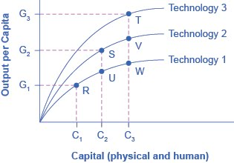
Capital Deepening and New Technology
If the economy relies only on capital deepening, while remaining at the technology level shown by the Technology 1 line, then it would face diminishing marginal returns as it moved from point R to point W.
Now imagine that capital deepening combines with improvements in technology.
As capital deepens, technology also improves from Technology 1 to Technology 2, and the economy moves from R to S.
Similarly, if capital deepens more and technology increases from Technology 2 to Technology 3, then the economy moves from S to T.
With improvements in technology, there is no longer any reason that economic growth must necessarily slow down.

Slide 25
The Slowness of Convergence
Economic convergence between high-income countries and the rest of the world seems possible, but it will proceed slowly.
High-income countries have been building up their advantage in standard of living over decades or even centuries.
Example:
A high-income country with a GDP per capita now of $40,000, with a 2% annual growth rate, after 30 years, will end up with a GDP of $72,450. (= $40,000(1 + 0.02)^30)
While in a poor country with a GDP per capita now of $4,000, with a 7% annual growth rate, after 30 years, will end up with a GDP of $30,450. (= $4,000(1 + 0.07)^30).
Convergence has occurred.
The rich country was 10 times as wealthy as the poor one, and now it is only about 2.4 times as wealthy.
Even after 30 consecutive years of very rapid growth, people in the low-income country are still likely to feel quite poor compared to people in the rich country.

Slide 26
Attribution
This OpenStax ancillary resource is © Rice University under a CC-BY 4.0 International license; it may be reproduced or modified but must be attributed to OpenStax, Rice University and any changes must be noted.

