Slide 1
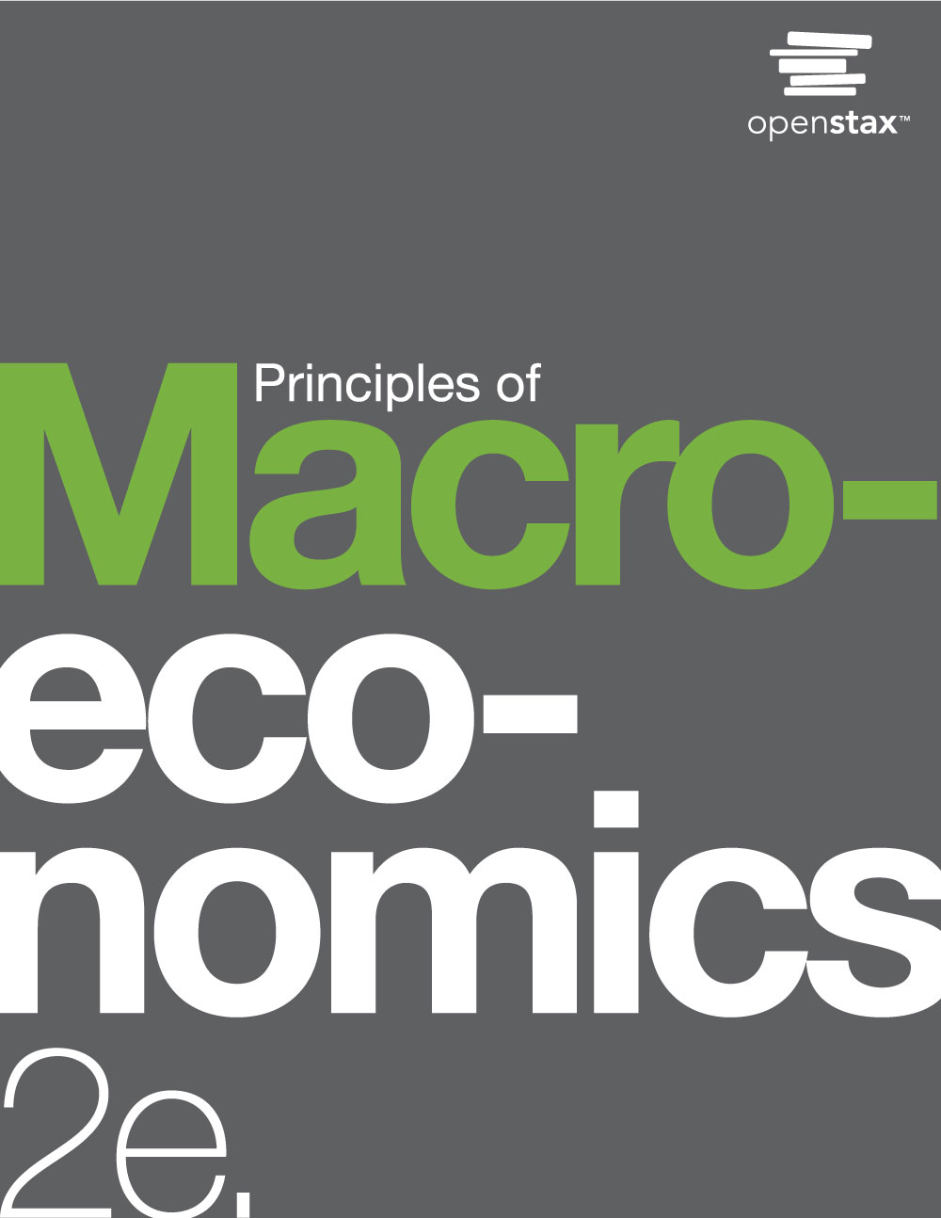
PRINCIPLES OF MACROECONOMICS 2e
Chapter 16 Exchange Rates and International Capital Flows
PowerPoint Image Slideshow
This OpenStax ancillary resource is © Rice University under a CC-BY 4.0 International license; it may be reproduced or modified but must be attributed to OpenStax, Rice University and any changes must be noted. Any images attributed to other sources are similarly available for reproduction, but must be attributed to their sources.

Slide 2
CH.16 OUTLINE
16.1: How the Foreign Exchange Market Works
16.2: Demand and Supply Shifts in Foreign
Exchange Markets
16.3: Macroeconomic Effects of Exchange Rates
16.4: Exchange Rate Policies
This OpenStax ancillary resource is © Rice University under a CC-BY 4.0 International license; it may be reproduced or modified but must be attributed to OpenStax, Rice University and any changes must be noted. Any images attributed to other sources are similarly available for reproduction, but must be attributed to their sources.

Slide 3
FIGURE 29.1
Is a trade deficit between the United States and the European Union good or bad for the U.S. economy?
(Credit: modification of work by Milad Mosapoor/Wikimedia Commons)
This OpenStax ancillary resource is © Rice University under a CC-BY 4.0 International license; it may be reproduced or modified but must be attributed to OpenStax, Rice University and any changes must be noted. Any images attributed to other sources are similarly available for reproduction, but must be attributed to their sources.

Slide 4
16.1 How the Foreign Exchange Market
Works
Dollarize - a country that is not the United States uses the U.S. dollar as its currency.
Foreign exchange market - the market in which people use one currency to buy another currency.
An exchange rate is the price of one currency expressed in terms of units of another currency.
The foreign exchange market is the largest market in the world economy.
In 2013, about $5.3 trillion per day was traded.
In 2013 U.S. real GDP was $15.8 trillion per year.
This OpenStax ancillary resource is © Rice University under a CC-BY 4.0 International license; it may be reproduced or modified but must be attributed to OpenStax, Rice University and any changes must be noted. Any images attributed to other sources are similarly available for reproduction, but must be attributed to their sources.

Slide 5
Demanders and Suppliers of Currency in Foreign Exchange Markets
4 groups of people or firms who participate in the foreign exchange markets:
firms that are involved in international trade of goods and services;
tourists visiting other countries;
international investors buying ownership (or part-ownership) of a foreign firm;
international investors making financial investments that do not involve ownership.
Firms that buy and sell on international markets:
Costs for workers, suppliers, and investors measured in the currency of the nation where production occurs
Revenues from sales are measured in the currency of the different nation where their sales happened.
This OpenStax ancillary resource is © Rice University under a CC-BY 4.0 International license; it may be reproduced or modified but must be attributed to OpenStax, Rice University and any changes must be noted. Any images attributed to other sources are similarly available for reproduction, but must be attributed to their sources.

Slide 6
International Financial Investment
Financial investments that cross international boundaries and require exchanging currency:
Foreign direct investment (FDI) - purchasing a firm (at least 10%) or starting up a new enterprise in another country.
Portfolio investment - an investment in another country that is purely financial and does not involve any management responsibility.
Hedge - using a financial transaction as protection against risk.
Example: guaranteeing a certain exchange rate in the future.
This OpenStax ancillary resource is © Rice University under a CC-BY 4.0 International license; it may be reproduced or modified but must be attributed to OpenStax, Rice University and any changes must be noted. Any images attributed to other sources are similarly available for reproduction, but must be attributed to their sources.

Slide 7
A Portfolio Investor Trying to Benefit from Exchange Rate Movements
Expectations of the future value of a currency can drive demand and supply of that currency in foreign exchange markets.
This OpenStax ancillary resource is © Rice University under a CC-BY 4.0 International license; it may be reproduced or modified but must be attributed to OpenStax, Rice University and any changes must be noted. Any images attributed to other sources are similarly available for reproduction, but must be attributed to their sources.

Slide 8
Participants in the Exchange Rate Market
Foreign exchange dealers - banks and other firms that trade foreign exchange in the interbank market.
Roughly 2,000 firms worldwide are foreign exchange dealers.
U.S. economy has less than 100 foreign exchange dealers.
Most transactions in the foreign exchange market are for portfolio investment.
The foreign exchange market involves firms, households, and investors who demand and supply currencies coming together through their banks and the key foreign exchange dealers.
This OpenStax ancillary resource is © Rice University under a CC-BY 4.0 International license; it may be reproduced or modified but must be attributed to OpenStax, Rice University and any changes must be noted. Any images attributed to other sources are similarly available for reproduction, but must be attributed to their sources.

Slide 9
Strengthening and Weakening Currency
Appreciating (or “strengthening”) - when the exchange rate for a currency rises, so that the currency is worth more in terms of other currencies.
Depreciating (or “weakening”) - when the exchange rate for a currency falls, so that a currency is worth less in terms of other currencies.
This OpenStax ancillary resource is © Rice University under a CC-BY 4.0 International license; it may be reproduced or modified but must be attributed to OpenStax, Rice University and any changes must be noted. Any images attributed to other sources are similarly available for reproduction, but must be attributed to their sources.

Slide 10
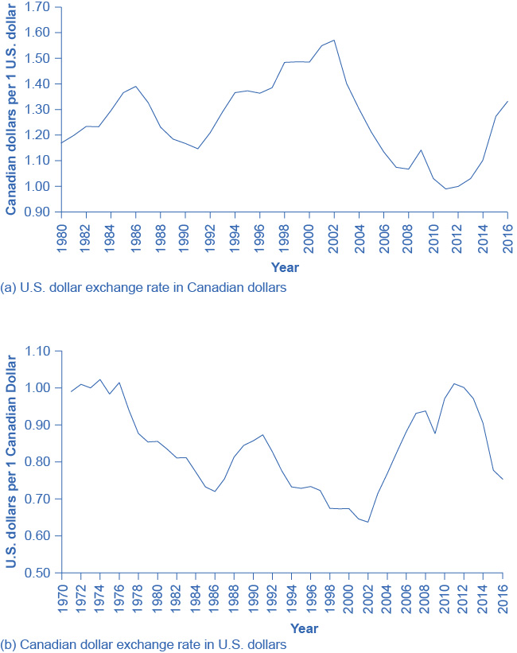
Illustrate: Strengthen or Appreciate vs. Weaken or Depreciate
Exchange rates can fluctuate substantially, even between bordering countries such as the U.S. and Canada.
By looking closely at the time values (the years vary slightly on these graphs), we see that the values in part (a) are a mirror image of part (b).
The depreciation of one currency correlates to the appreciation of the other and vice versa.
When comparing the exchange rates between two countries, the depreciation (or weakening) of one country (like the U.S. dollar here) indicates the appreciation (or strengthening) of the other currency (like the Canadian dollar).
(Source: Federal Reserve Economic Data (FRED) https://research.stlouisfed.org/fred2/series/EXCAUS)
This OpenStax ancillary resource is © Rice University under a CC-BY 4.0 International license; it may be reproduced or modified but must be attributed to OpenStax, Rice University and any changes must be noted. Any images attributed to other sources are similarly available for reproduction, but must be attributed to their sources.

Slide 11
How Do Exchange Rate Movements
Affect Each Group?
Exchange rate movements affect exporters, tourists, and international investors in different ways.
This OpenStax ancillary resource is © Rice University under a CC-BY 4.0 International license; it may be reproduced or modified but must be attributed to OpenStax, Rice University and any changes must be noted. Any images attributed to other sources are similarly available for reproduction, but must be attributed to their sources.

Slide 12
16.2 Demand and Supply Shifts in
Foreign Exchange Markets
One reason to demand a currency on the foreign exchange market is the belief that the currency's value is about to increase.
One reason to supply a currency on the foreign exchange market is the expectation that the currency's value is about to decline.
This OpenStax ancillary resource is © Rice University under a CC-BY 4.0 International license; it may be reproduced or modified but must be attributed to OpenStax, Rice University and any changes must be noted. Any images attributed to other sources are similarly available for reproduction, but must be attributed to their sources.

Slide 13
Example: Demand and Supply for the U.S. Dollar and Mexican Peso Exchange Rate
The quantity measured on the horizontal axis is in U.S. dollars, and the exchange rate on the vertical axis is the price of U.S. dollars measured in Mexican pesos.
This OpenStax ancillary resource is © Rice University under a CC-BY 4.0 International license; it may be reproduced or modified but must be attributed to OpenStax, Rice University and any changes must be noted. Any images attributed to other sources are similarly available for reproduction, but must be attributed to their sources.

Slide 14
Example: Demand and Supply for the U.S. Dollar and Mexican Peso Exchange Rate, Continued
The quantity measured on the horizontal axis is in Mexican pesos, while the price on the vertical axis is the price of pesos measured in U.S. dollars.
In both graphs, the equilibrium exchange rate occurs at point E, at the intersection of the demand curve (D) and the supply curve (S).
This OpenStax ancillary resource is © Rice University under a CC-BY 4.0 International license; it may be reproduced or modified but must be attributed to OpenStax, Rice University and any changes must be noted. Any images attributed to other sources are similarly available for reproduction, but must be attributed to their sources.

Slide 15
Exchange Rate Market for Mexican
Peso Reacts to Expectations about
Future Exchange Rates
An announcement that the peso exchange rate is likely to strengthen in the future will lead to greater demand for the peso from investors who wish to benefit from the appreciation (from D₀ to D₁).
Similarly, it will make investors less likely to supply pesos to the foreign exchange market (from S₀ to S₁).
Both the shift of demand to the right and the shift of supply to the left cause an immediate appreciation in the exchange rate.
This OpenStax ancillary resource is © Rice University under a CC-BY 4.0 International license; it may be reproduced or modified but must be attributed to OpenStax, Rice University and any changes must be noted. Any images attributed to other sources are similarly available for reproduction, but must be attributed to their sources.

Slide 16
Differences across Countries in
Rates of Return
The motivation for investment, whether domestic or foreign, is to earn a return.
If rates of return in a country look relatively high, then that country will tend to attract funds from abroad.
Conversely, if rates of return in a country look relatively low, then funds will tend to flee to other economies.
Changes in the expected rate of return will shift demand and supply for a currency.
This OpenStax ancillary resource is © Rice University under a CC-BY 4.0 International license; it may be reproduced or modified but must be attributed to OpenStax, Rice University and any changes must be noted. Any images attributed to other sources are similarly available for reproduction, but must be attributed to their sources.

Slide 17
Exchange Rate Market for U.S. Dollars
Reacts to Higher Interest Rates
A higher rate of return for U.S. dollars makes holding dollars more attractive.
Thus, the demand for dollars in the foreign exchange market shifts to the right, from D₀ to D₁, while the supply of dollars shifts to the left, from S₀ to S₁.
The new equilibrium (E₁) has a stronger exchange rate than the original equilibrium (E₀), but in this example, the equilibrium quantity traded does not change.
This OpenStax ancillary resource is © Rice University under a CC-BY 4.0 International license; it may be reproduced or modified but must be attributed to OpenStax, Rice University and any changes must be noted. Any images attributed to other sources are similarly available for reproduction, but must be attributed to their sources.

Slide 18
Relative Inflation
If a country experiences a relatively high inflation rate compared with other economies:
then the buying power of its currency is eroding, and
will tend to discourage anyone from wanting to acquire or to hold the currency.
This OpenStax ancillary resource is © Rice University under a CC-BY 4.0 International license; it may be reproduced or modified but must be attributed to OpenStax, Rice University and any changes must be noted. Any images attributed to other sources are similarly available for reproduction, but must be attributed to their sources.

Slide 19
Exchange Rate Markets React to Higher Inflation
If a currency is experiencing relatively high inflation, then its buying power is decreasing and international investors will be less eager to hold it.
Thus, a rise in inflation in the Mexican peso would lead demand to shift from D₀ to D₁, and supply to increase from S₀ to S₁.
Both movements in demand and supply would cause the currency to depreciate.
Here, we draw the effect on the quantity traded as a decrease, but in truth it could be an increase or no change, depending on the actual movements of demand and supply.
This OpenStax ancillary resource is © Rice University under a CC-BY 4.0 International license; it may be reproduced or modified but must be attributed to OpenStax, Rice University and any changes must be noted. Any images attributed to other sources are similarly available for reproduction, but must be attributed to their sources.

Slide 20
Purchasing Power Parity
Arbitrage - the process of buying a good and selling goods across borders to take advantage of international price differences.
Purchasing power parity (PPP) - the exchange rate that equalizes the prices of internationally traded goods across countries.
PPP exchange rate has two functions:
for international comparison of GDP and other economic statistics.
exchanges rates will often get closer to it as time passes.
This OpenStax ancillary resource is © Rice University under a CC-BY 4.0 International license; it may be reproduced or modified but must be attributed to OpenStax, Rice University and any changes must be noted. Any images attributed to other sources are similarly available for reproduction, but must be attributed to their sources.

Slide 21
16.3 Macroeconomic Effects of Exchange Rates
A central bank will be concerned about the exchange rate because:
movements in the exchange rate will affect the quantity of aggregate demand in an economy;
frequent substantial fluctuations in the exchange rate can disrupt international trade and cause problems in a nation’s banking system.
This OpenStax ancillary resource is © Rice University under a CC-BY 4.0 International license; it may be reproduced or modified but must be attributed to OpenStax, Rice University and any changes must be noted. Any images attributed to other sources are similarly available for reproduction, but must be attributed to their sources.

Slide 22
Fluctuations in Exchange Rates
Financial institutions measure most international loans in a few large currencies, like U.S. dollars, European euros, and Japanese yen.
This process of borrowing in a foreign currency and lending in a domestic currency can work just fine, as long as the exchange rate does not shift.
One of the most economically destructive effects of exchange rate fluctuations can happen through the banking system.
Banks would not be able to repay their loans.
This OpenStax ancillary resource is © Rice University under a CC-BY 4.0 International license; it may be reproduced or modified but must be attributed to OpenStax, Rice University and any changes must be noted. Any images attributed to other sources are similarly available for reproduction, but must be attributed to their sources.

Slide 23
Banking and International Borrowing
The scenario of international borrowing that ends on the left is a success story, but the scenario that ends on the right shows what happens when the exchange rate weakens.
This OpenStax ancillary resource is © Rice University under a CC-BY 4.0 International license; it may be reproduced or modified but must be attributed to OpenStax, Rice University and any changes must be noted. Any images attributed to other sources are similarly available for reproduction, but must be attributed to their sources.

Slide 24
16.4 Exchange Rate Policies
A nation may adopt one of a variety of exchange rate regimes:
floating rates in which the foreign exchange market determines the rates;
pegged rates where governments intervene to manage the exchange rate's value;
a common currency where the nation adopts another country or group of countries' currency.
This OpenStax ancillary resource is © Rice University under a CC-BY 4.0 International license; it may be reproduced or modified but must be attributed to OpenStax, Rice University and any changes must be noted. Any images attributed to other sources are similarly available for reproduction, but must be attributed to their sources.

Slide 25
Floating Exchange Rates
Floating exchange rate - a country lets the exchange rate market determine its currency's value.
The U.S. dollar is a floating exchange rate, as are the currencies of about 40% of the countries in the world economy.
The major concern with this policy is that exchange rates can move a great deal in a short time.
This OpenStax ancillary resource is © Rice University under a CC-BY 4.0 International license; it may be reproduced or modified but must be attributed to OpenStax, Rice University and any changes must be noted. Any images attributed to other sources are similarly available for reproduction, but must be attributed to their sources.

Slide 26
U.S. Dollar Exchange Rate in
Japanese Yen
Even seemingly stable exchange rates such as the Japanese Yen to the U.S. Dollar can vary when closely examined over time.
This figure shows a relatively stable rate between 2011 and 2013.
In 2013, there was a drastic depreciation of the Yen (relative to the U.S. Dollar) by about 14% and again at the end of the year in 2014 also by about 14%. (Source: Federal Reserve Economic Data (FRED) https://research.stlouisfed.org/fred2/series/DEXJPUS)
This OpenStax ancillary resource is © Rice University under a CC-BY 4.0 International license; it may be reproduced or modified but must be attributed to OpenStax, Rice University and any changes must be noted. Any images attributed to other sources are similarly available for reproduction, but must be attributed to their sources.

Slide 27
Using Soft Pegs and Hard Pegs
Soft peg - an exchange rate policy in which the government usually allows the market to set the exchange rate, but in some cases, especially if the exchange rate seems to be moving rapidly in one direction, the central bank will intervene.
Hard peg - an exchange rate policy in which the central bank sets a fixed and unchanging value for the exchange rate.
This OpenStax ancillary resource is © Rice University under a CC-BY 4.0 International license; it may be reproduced or modified but must be attributed to OpenStax, Rice University and any changes must be noted. Any images attributed to other sources are similarly available for reproduction, but must be attributed to their sources.

Slide 28
Pegging an Exchange Rate
If an exchange rate is pegged below (30 cents/real) what would otherwise be the equilibrium, then the quantity demanded of the currency will exceed the quantity supplied.
If an exchange rate is pegged above (40 cents/real) what would otherwise be the equilibrium, then the quantity supplied of the currency exceeds the quantity demanded.
This OpenStax ancillary resource is © Rice University under a CC-BY 4.0 International license; it may be reproduced or modified but must be attributed to OpenStax, Rice University and any changes must be noted. Any images attributed to other sources are similarly available for reproduction, but must be attributed to their sources.

Slide 29
A Merged Currency
Merged currency - when a nation chooses to use another nation's currency.
Eliminates foreign exchange risk.
A nation has given up on domestic monetary policy.
This OpenStax ancillary resource is © Rice University under a CC-BY 4.0 International license; it may be reproduced or modified but must be attributed to OpenStax, Rice University and any changes must be noted. Any images attributed to other sources are similarly available for reproduction, but must be attributed to their sources.

Slide 30
How do Tobin taxes control the flow of capital?
International capital flows - capital that flows across national boundaries as either portfolio investment or direct investment.
Tobin taxes - taxes on international capital flows.
The goal of such policies is to reduce international capital flows, in the hope that doing so will reduce the chance of large movements in exchange rates that can bring macroeconomic disaster.
Practical difficulty because national governments impose taxes, not international ones.
This OpenStax ancillary resource is © Rice University under a CC-BY 4.0 International license; it may be reproduced or modified but must be attributed to OpenStax, Rice University and any changes must be noted. Any images attributed to other sources are similarly available for reproduction, but must be attributed to their sources.

Slide 31
Attribution
This OpenStax ancillary resource is © Rice University under a CC-BY 4.0 International license; it may be reproduced or modified but must be attributed to OpenStax, Rice University and any changes must be noted.
This OpenStax ancillary resource is © Rice University under a CC-BY 4.0 International license; it may be reproduced or modified but must be attributed to OpenStax, Rice University and any changes must be noted. Any images attributed to other sources are similarly available for reproduction, but must be attributed to their sources.

