Slide 1
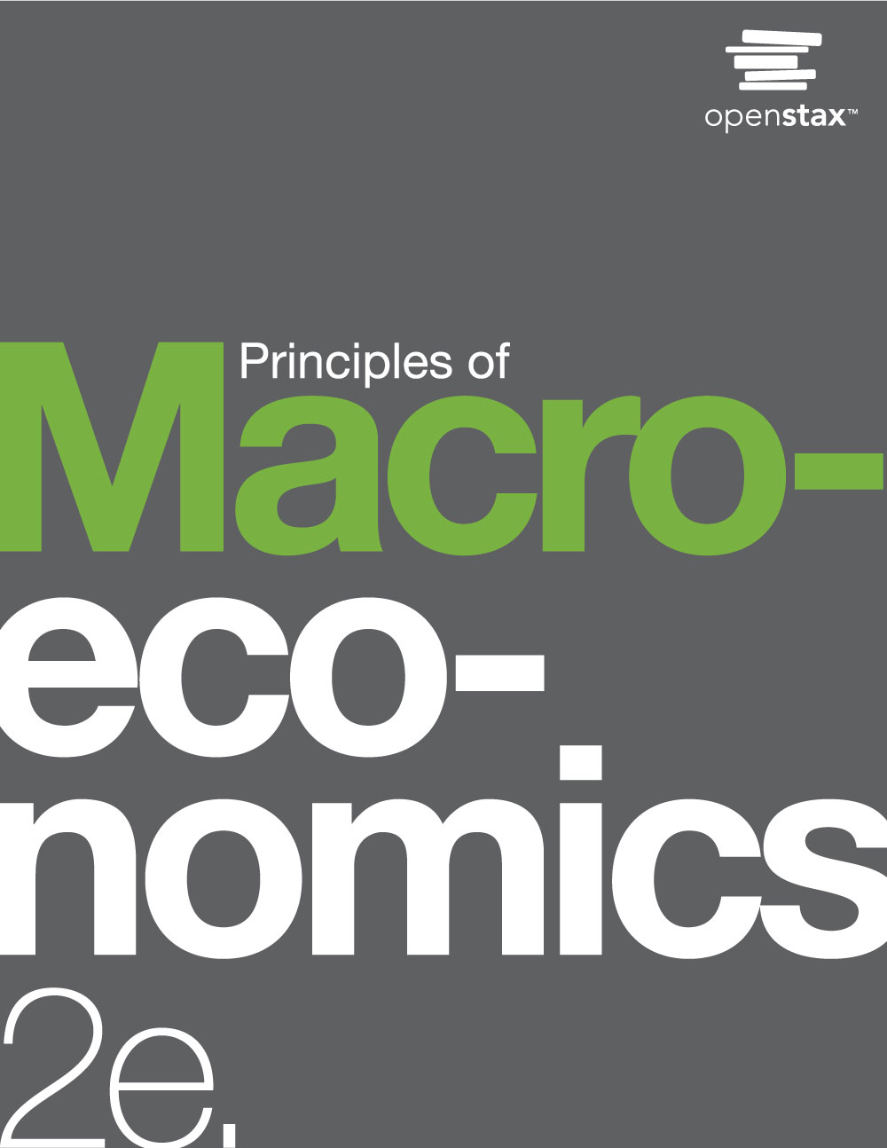
PRINCIPLES OF
MACROECONOMICS 2e
Chapter 21 Globalization and Protectionism
PowerPoint Image Slideshow

Slide 2
CH.21 OUTLINE
21.1: Protectionism: An Indirect Subsidy from
Consumers to Producers
21.2: International Trade and Its Effects on Jobs,
Wages, and Working Conditions
21.3: Arguments in Support of Restricting Imports
21.4: How Governments Enact Trade Policy:
Globally, Regionally, and Nationally
21.5: The Tradeoffs of Trade Policy

Slide 3
Flat Screen Competition
The market for flat-panel displays in the United States is huge.
The manufacturers of flat screens in the United States must compete against manufacturers from around the world.
(Credit: modification of work by “Jemimus”/Flickr Creative Commons)

Slide 4
21.1 Protectionism: An Indirect Subsidy
from Consumers to Producers
Protectionism - when a government legislates policies to reduce or block imports.
Protectionist policies often seek to shield domestic producers and domestic workers from foreign competition.
Protectionism takes three main forms:
Tariffs
Import quotas
Nontariff barriers

Slide 5
Import Quotas and Nontariff Barriers
Import quotas - numerical limitations on the quantity of products that a country can import.
Nontariff barriers - ways a nation can draw up rules, regulations, inspections, and paperwork to make it more costly or difficult to import products.
Examples: Rules requiring certain safety standards or origin regulations.
World Trade Organization (WTO) - organization that seeks to negotiate reductions in barriers to trade and to adjudicate complaints about violations of international trade policy.
successor to the General Agreement on Tariffs and Trade (GATT)

Slide 6
Demand and Supply Analysis of
Protectionism
To the non-economist, restricting imports may appear to be nothing more than taking sales from foreign producers and giving them to domestic producers.
A demand and supply analysis of protectionism shows that it is not just a matter of domestic gains and foreign losses, but a policy that imposes substantial domestic costs as well.

Slide 7
The Sugar Trade between Brazil and the United States
Before trade, the equilibrium price of sugar in Brazil is 12 cents a pound and 24 cents per pound in the United States (points E).
When trade is allowed, businesses will buy cheap sugar in Brazil and sell it in the United States.
This will result in higher prices in Brazil and lower prices in the United States.

Slide 8
The Sugar Trade between Brazil and the United States, Continued
Ignoring transaction costs, prices should converge to 16 cents per pound, with Brazil exporting 15 tons of sugar and the United States importing 15 tons of sugar.
If trade is only partly open between the countries, it will lead to an outcome between the free-trade and no-trade possibilities.

Slide 9
Free Trade of Sugar
Free trade results in gains from trade.
Total surplus increases in both countries, as the two blue-shaded areas show.
However, there are clear income distribution effects.
Producers gain in the exporting country, while consumers lose; and in the importing country, consumers gain and producers lose.

Slide 10
Effects of Trade Barriers: U.S. Sugar
Supply and Demand
When there is free trade, the equilibrium is at point A.
When there is no trade (due to barriers), the equilibrium is at point E.

Slide 11
21.2 International Trade and Its Effects
on Jobs, Wages, and Working Conditions
In theory, imports might injure workers in several different ways:
fewer jobs
lower wages
poor working conditions
Protectionism can save jobs in a specific industry being protected, but it costs jobs in other unprotected industries.
If consumers are paying higher prices to a protected industry, they have less money to spend on goods from other industries - so jobs are lost in those other industries.
If a firm sells a protected product to other firms, so that other firms must now pay a higher price for a key input, then those firms will lose sales to foreign producers. Lost sales = lost jobs.

Slide 12
21.2 International Trade and Its Effects
on Jobs, Wages, and Working Conditions
The U.S. International Trade Commission, in its study of barriers to trade, predicts that reducing trade barriers would not lead to an overall loss of jobs.

Slide 13
Trade and Wages
Because trade raises the amount that an economy can produce by letting firms and workers play to their comparative advantage, trade will cause the average level of wages in an economy to rise.
By contrast, barriers to trade will reduce the average level of wages in an economy.
Concern: While globalization may be benefiting high-skilled, high-wage workers, it may impose costs on low-skilled, low-wage U.S. workers.
But:
About half of U.S. trade is intra-industry trade.
Many low-skilled U.S. workers hold service jobs that imports from low-wage countries cannot replace.

Slide 14
Labor Standards and Working Conditions
Workers in many low-income countries around the world:
labor under conditions that would be illegal for workers in the U.S.
are often paid less than the U.S. minimum wage.
have working conditions that may be extremely unpleasant or unsafe.
What are acceptable and enforceable minimum labor standards and protections to have the world over?
In thinking about labor standards in other countries, it is important to draw some distinctions between what is truly unacceptable and what is painful to think about.
The United States is not a world leader in government laws to protect employees.
Only one of 41 countries that does not provide mandated paid leave for new parents.

Slide 15
21.3 Arguments in Support of Restricting Imports
Arguments that are in support of restricting imports:
Infant Industry Argument
Anti-dumping Argument
Environmental Protection Argument
Unsafe Consumer Products Argument
National Interest Argument
The Infant Industry Argument - block imports for a limited time, to give an infant industry time to mature, before it starts competing on equal terms in the global economy.

Slide 16
The Anti-Dumping Argument
Dumping - selling goods below their cost of production.
Anti-dumping laws - block imports that are sold below the cost of production by imposing tariffs that increase the price of these imports to reflect their cost of production.
Dumping is not allowed under WTO rules.
Why would foreign firms export a product at less than its cost of production - presumably taking a loss?
Innocent explanation: demand and supply set market prices, not the cost of production.
Sinister explanation: dumping is part of a long-term strategy to drive out the domestic competition, then raise prices.
This is called predatory pricing.

Slide 17
The Environmental Protection Argument
Race to the bottom - when production locates in countries with the lowest environmental (or other) standards, putting pressure on all countries to reduce their environmental standards.
Does not appear to describe reality: generally, other factors that determine location are much more important to companies than trying to skimp on environmental protection costs.
Alternatively, the threat of blocking international trade can pressure low-income countries for higher environmental standards.

Slide 18
The Unsafe Consumer Products Argument
Another argument for shutting out certain imported products is that they are unsafe for consumers.
For imported products, WTO says:
Countries can set their own safety standards.
Regulations must be based on science.
They should not arbitrarily or unjustifiably discriminate between countries where identical or similar conditions prevail.
Examples of recalls:
2007 - Mattel recalled nearly two million toys imported from China due to concerns about high levels of lead in the paint, as well as some loose parts.
2013 - Japan blocked imports of U.S. wheat because of concerns that genetically modified (GMO) wheat might be included in the shipments.

Slide 19
The National Interest Argument
National interest argument - the argument that there are compelling national interests against depending on key imports from other nations. Examples:
oil
special materials or technologies that might have national security applications
This argument for protectionism proves weak.
Examples of more reasonable strategies for the U.S. to protect from a cutoff of foreign oil:
Import 100% of petroleum supply now, and save domestic oil resources for when/if foreign supply cut off.
Discourage use through raising taxes on oil, and start a high-powered program to seek out alternatives to oil.
Economists often treat the national interest argument skeptically because lobbyists and politicians can tout almost any product as vital to national security.

Slide 20
21.4 How Governments Enact Trade
Policy: Globally, Regionally, and Nationally
General Agreement on Tariffs and Trade (GATT) - forum in which nations could come together to negotiate reductions in tariffs and other barriers to trade.
The precursor to the World Trade Organization
Free trade agreement - economic agreement between countries to allow free trade between members.
Without tariffs or quotas
Common market - economic agreement between countries to allow free trade in goods, services, labor, and financial capital between members while having a common external trade policy.
Economic union - economic agreement between countries to allow free trade between members, a common external trade policy, and coordinated monetary and fiscal policies

Slide 21
Regional Trade Agreements
Many nations belong both to the World Trade Organization and to regional trading agreements.
Examples:
European Union
North American Free Trade Agreement (NAFTA)
Asia Pacific Economic Cooperation (APEC)
General trend in the last 60 years is toward lower barriers to trade.
The average level of tariffs on imported products charged by industrialized countries:
40% in 1946
less than 5% by 1990

Slide 22
21.5 The Tradeoffs of Trade Policy
Over time the “average” person gains from international trade.
The “average” person is hypothetical - representing a mix of those who have done very well, those who have done all right, and those who have done poorly.
Common belief among economists - it is better to embrace the gains from trade, than it is to cut off trade.
Deal with the costs and tradeoffs with other policy tools.
Disruptive market change - innovative new product or production technology which disrupts the status quo in a market.
The innovators earn more income and profits.
The other firms lose income and profits, unless they can come up with their own innovations.

Slide 23
This OpenStax ancillary resource is © Rice University under a CC-BY 4.0 International license; it may be reproduced or modified but must be attributed to OpenStax, Rice University and any changes must be noted.

