Slide 1
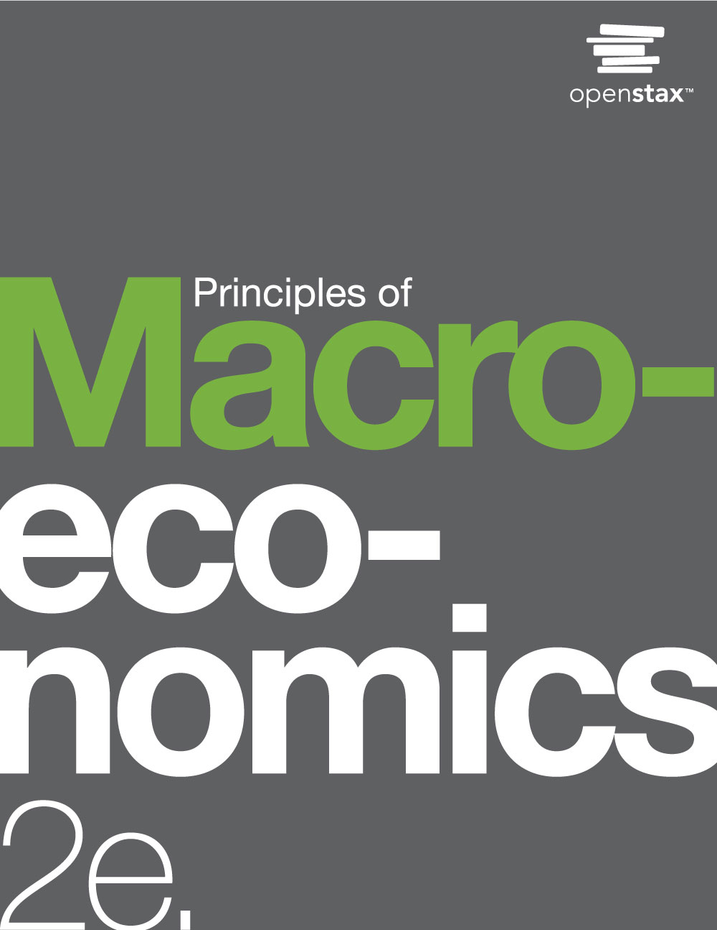
PRINCIPLES OF MACROECONOMICS 2e
Chapter 20 International Trade
PowerPoint Image Slideshow

Slide 2
CH.20 OUTLINE
20.1: Absolute and Comparative Advantage
20.2: What Happens When a Country Has an
Absolute Advantage in All Goods
20.3: Intra-Industry Trade between Similar
Economies
20.4: The Benefits of Reducing Barriers to
International Trade

Slide 3
Apple or Samsung iPhone?
While the iPhone is readily recognized as an Apple product, 26% of the component costs in it come from components made by rival phone-maker, Samsung.
In international trade, there are often “conflicts” like this as each country or company focuses on what it does best.
(Credit: modification of work by Yutaka Tsutano Creative Commons)

Slide 4
20.1 Absolute and Comparative
Advantage
The evidence that international trade confers overall benefits on economies is pretty strong.
Absolute advantage -
When one country can use fewer resources to produce a good compared to another country;
When a country is more productive compared to another country.
Comparative advantage - when a country can produce a good at a lower cost in terms of other goods.

Slide 5
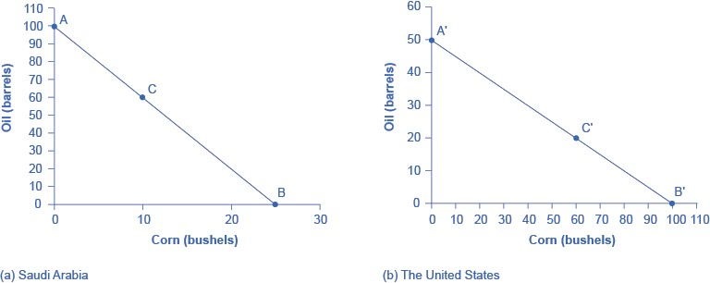
Production Possibilities Frontiers Before Trade
(a) Saudi Arabia can produce 100 barrels of oil at maximum and zero corn (point A).
Or 25 bushels of corn and zero oil (point B).
It can also produce other combinations of oil and corn if it wants to consume both goods, such as at point C.
All points above the frontiers are impossible to produce given the current level of resources and technology.

Slide 6
Production Possibilities Frontiers Before Trade, Continued
(b) If the United States produces only oil, it can produce at maximum, 50 barrels and zero corn (point A').
Or at the other extreme, it can produce a maximum of 100 bushels of corn and no oil (point B').
Other combinations of both oil and corn are possible, such as point C'.

Slide 7
Opportunity Cost and
Comparative Advantage
The slope of the production possibility frontier illustrates the opportunity cost of producing oil in terms of corn.

Slide 8
Opportunity Cost and
Comparative Advantage, Continued
Recall that we defined comparative advantage as the opportunity cost of producing goods.
Since Saudi Arabia gives up the least (in terms of corn) to produce a barrel of oil, it has a comparative advantage in oil production.
The United States gives up the least (in terms of oil) to produce a bushel of corn, so it has a comparative advantage in corn production.

Slide 9
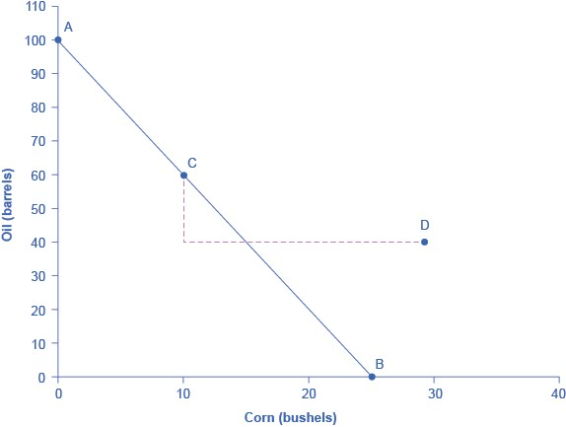
Gains from Trade
The graph shows the Production Possibilities Frontier in Saudi Arabia after trade.
If 20 units of oil is exported to the United States and exchanged for 20 units of corn, the Saudi domestic oil consumption is reduced by 20.
This enables Saudi to reach point D, where oil consumption is now 40 barrels and corn consumption has increased to 30.
Since the post-trade consumption point D is beyond its production possibility frontier, Saudi Arabia has gained from trade.
Gain from trade - a country that can consume more than it can produce as a result of specialization and trade.

Slide 10
20.2 What Happens When a Country
Has an Absolute Advantage in All Goods
Can one country have an absolute advantage in everything?
This is typical for high-income countries that often have well-educated workers, technologically advanced equipment, and the most up-to-date production processes.
These high-income countries can produce all products with fewer resources than a low-income country.
Even when one country has an absolute advantage in all products, trade can still benefit both sides.
This is because gains from trade come from specializing in one’s comparative advantage.

Slide 11
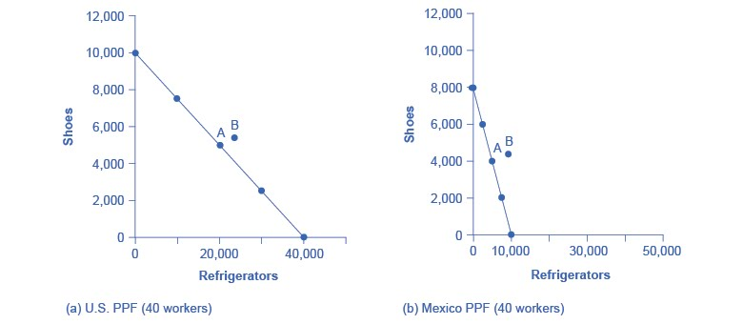
Mutually Beneficial Trade with Comparative Advantage
(a) With 40 workers, the United States can produce either 10,000 shoes and zero refrigerators or 40,000 refrigerators and zero shoes.
(b) With 40 workers, Mexico can produce a maximum of 8,000 shoes and zero refrigerators, or 10,000 refrigerators and zero shoes.
Point A on both graphs is where the countries start producing and consuming before trade.
Point B is where they end up after trade.

Slide 12
Mutually Beneficial Trade
Even when one country has an absolute advantage in all goods and another country has an absolute disadvantage in all goods, both countries can still benefit from trade.
Trade allows each country to take advantage of lower opportunity costs in the other country.
Gains from international trade, on both sides, result from pursuing comparative advantage and producing at a lower opportunity cost.

Slide 13
Comparative Advantage Goes Camping
A simple example to better understand comparative advantage: a group of friends who decide to go camping together.
The six friends have a wide range of skills and experiences,
But one person in particular has done lots of camping before and is also a great athlete.
She has an absolute advantage in all aspects of camping: but should she do all the work?
No! If everyone sits around and waits for her to do everything, not only will she be an unhappy camper, but there will not be much output for her group of friends to consume.
Everyone will benefit if they figure out their areas of comparative advantage - the area of camping where their productivity disadvantage is least.
If the campers coordinate their efforts according to comparative advantage, they can all gain.

Slide 14
20.3 Intra-Industry Trade between
Similar Economies
The theory of comparative advantage suggests that trade should happen between economies with large differences in opportunity costs of production.
But roughly half of all world trade involves shipping goods between the fairly similar high-income economies of the United States, Canada, the European Union, Japan, Mexico, and China.

Slide 15
Intra-Industry Trade between
Similar Economies
A high proportion of trade is intra-industry trade - international trade of goods within the same industry.
There are two reasons:
(1) the division of labor leads to learning, innovation, and unique skills;
(2) economies of scale.

Slide 16
Gains from Specialization and Learning
In working on very specific and particular products, firms in certain countries develop unique and different skills.
Specialization in the world economy can be very finely split.
Splitting up the value chain - many of the different stages of producing a good happen in different geographic locations.
Value chain - how a good is produced in stages.

Slide 17
Economies of Scale, Competition, Variety
The concept of economies of scale becomes especially relevant to international trade when it enables one or two large producers to supply the entire country.
International trade provides a way to combine the lower average production costs that come from economies of scale and still have competition and variety for consumers.
Discussion question: What are industry examples in international trade where economies of scale are relevant?

Slide 18
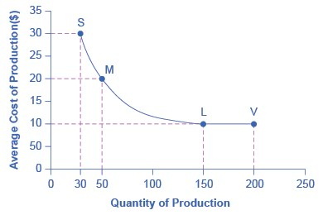
Economies of Scale Example
Average cost of production per toaster oven:
Production plant S = $30
Production plant M = $20
Production plant L = $10
Production plant V = $10
Production plant M can produce toaster ovens more cheaply than plant S because of economies of scale,
Plants L or V can produce more cheaply than S or M because of economies of scale.
However, the economies of scale end at an output level of 150.
Plant V, despite being larger, cannot produce more cheaply on average than plant L.

Slide 19
20.4 The Benefits of Reducing Barriers to International Trade
Tariffs - taxes that governments place on imported goods.
Traditionally, tariffs were used simply as a political tool to protect certain vested economic, social, and cultural interests.
The World Trade Organization (WTO) is committed to lowering barriers to trade.
The world’s nations meet through the WTO to negotiate how they can reduce barriers to trade, such as tariffs.

Slide 20
Benefits of Reducing Barriers to
International Trade
Low-income countries benefit more from trade than high-income countries do.
But before dismissing the gains from trade, it is worth remembering two points:
Even a small gain is enough money to deserve attention, since this increase is not a one-time event; it would persist each year into the future.
Estimates of gains may be on the low side because some of the gains from trade are not measured well in economic statistics.
It is difficult to measure the advantages to consumers of having a variety of products available and a greater degree of competition among producers.
Trade between countries often involves a transfer of knowledge that can involve skills in production, technology, management, finance, and law.

Slide 21
This OpenStax ancillary resource is © Rice University under a CC-BY 4.0 International license; it may be reproduced or modified but must be attributed to OpenStax, Rice University and any changes must be noted.

