Slide 1
Jamestown Settlement
Jamestown was the first permanent English settlement in what became the United States.
Roanoke Colony, recently a subject of “American Horror Story,” preceded Jamestown and was established in 1585, abandoned in 1586, reestablished in 1587, and abandoned again in 1590 without any survivors.
Jamestown was established in 1607 and survived as a settlement until 1699 when a fire devasted the town and people moved away to neighboring towns.
The site of Jamestown fort was lost in the 18th century.

Slide 2
Jamestown Considered Lost
After 1699, Jamestown’s residents drifted away, its streets grew silent, its buildings decayed, and even its lots and former public places became cultivated fields.
The original site of the fort was lost, and the prevailing view was that the James River washed it away.
From 1934 to 1956 archeologists searched for the original fort.

Slide 3
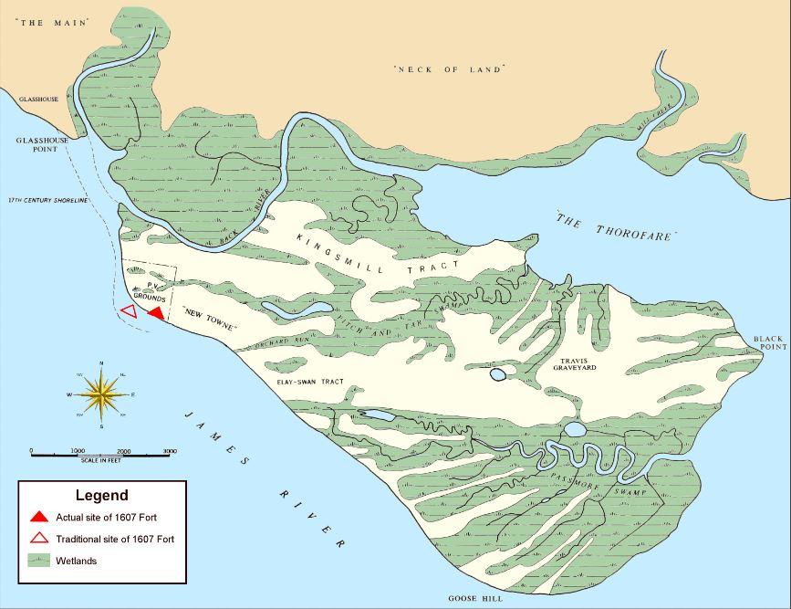
Jamestown Island

Slide 4
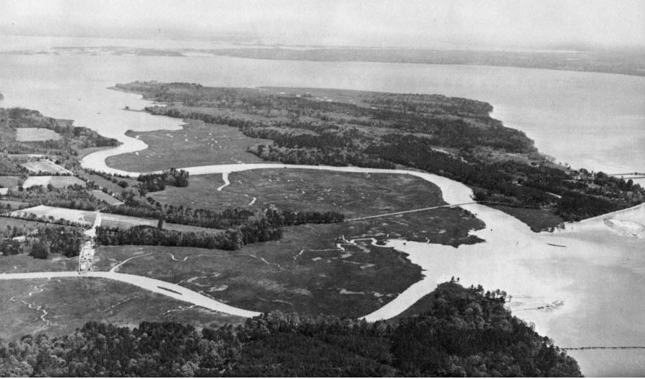
Jamestown from the Air

Slide 5
Jamestown Rediscovered
In 1994, William Kelso led an archeological team searching for the original Jamestown fort.
They dug near Pinky Harrington’s 1939 excavations and found the fort almost immediately.
Most of Jamestown’s fortified compound had escaped the James River’s erosion.

Slide 6
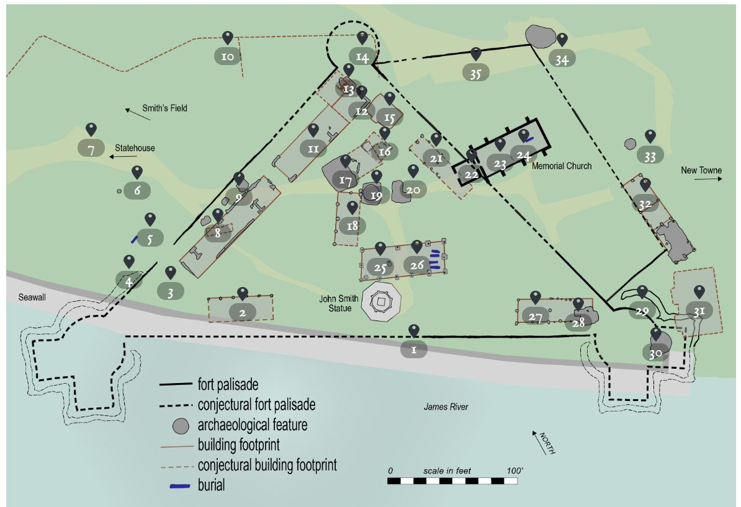
Jamestown Today

Slide 7
The Issue of Cannibalism
John Smith wrote that cannibalism occurred at Jamestown. “And one amongst the rest did kill his wife, powdered her, and had eaten part of her before it was knowne, for which hee was executed, as hee well deserved”
Historians generally took the case of cannibalism in Jamestown for granted.
The traditional view was that cannibalism may or may not have taken place during 1609–10; some evidence exists to suggest that it did, whereas other accounts might be cited to argue that it did not. Ultimately, there was no way to answer this particular question deﬁnitively.

Slide 8
Proof of Cannibalism
William Kelso and his team captured international attention when they found the butchered remains of a teenage girl.
This was clear evidence that the Jamestown settlers cannibalized their dead to survive during the famine.
The team named the girl “Jane” and, along with Doug Owsley and the forensic anthropology lab at Smithsonian’s National Museum of Natural History, reconstructed her skull and digitally recreated her face.

Slide 9
Archeology Confirms Primary Sources
Jane’s remains, confirm several colonists' written accounts of last-ditch cannibalism at Jamestown’s walled fort during the winter of 1609 to 1610.
Historians refer to those months as Jamestown's "starving time," when sickness, starvation and a siege by neighboring Powhatan Indians nearly wiped out the settlement.
Jane represents the only skeletal evidence of cannibalism in what would become the United States during colonial times.
Oxygen in Jane's teeth indicates that she probably spent her childhood in coastal southern England.

Slide 10
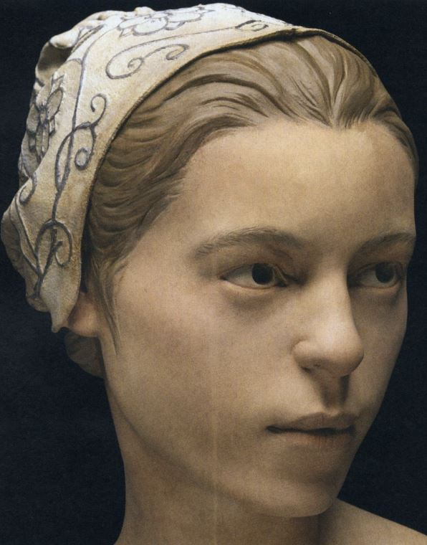
Jane

