Slide 1
Limitations of Statistics
Statistics do not interpret themselves.
There are often multiple, competing explanations for the same result.
Sometimes the same data can support opposing positions.

Slide 2
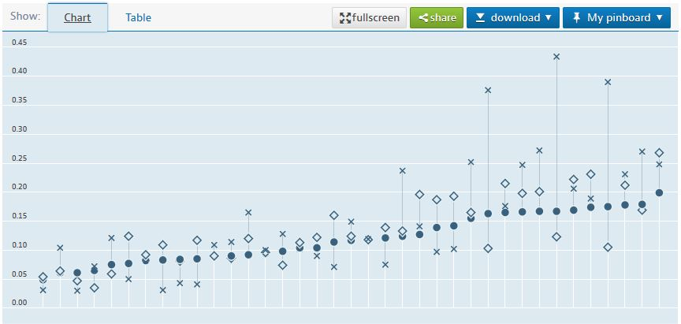
OECD Poverty Rate Statistics
A study the Organization for Economic Co-operation and Development found that the United States had a higher rate of poverty than Mexico, 17.8% to 16.6%. This study defined poverty by using wage income only.

Slide 3
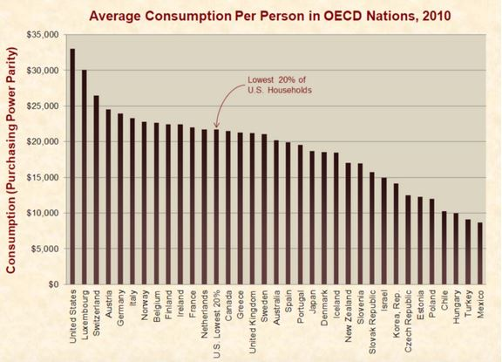
“Just the Facts” Consumption Comparison
An organization called “Just the Facts” produced a different study based on average consumption per person indicating that if the poorest 20% of America’s population made up their own nation it would be one of the richest in the world

Slide 4
Competing Statistical Interpretations
These two studies demonstrate competing statistical interpretations of the economic life in the United States of America.
The first study creates the image of the United States with large populations of poor enduring a cruel existence.
The second study paints America as a prosperous nation where even the poor live comfortable lives.

