Slide 1
What is a Primary Source
A primary source is first-hand information of an event.
A primary source was created at the time the event occurred or soon after based on the personal experience of someone who participated in the event.

Slide 2
What is a Secondary Source
A secondary source interprets or analyzes primary sources.
Someone who did not witness the original event creates a secondary source.
Secondary sources get written after the original event occurred.

Slide 3
No Tertiary Category for this Discussion
For the purposes of this introductory PowerPoint we will treat all tertiary sources as secondary sources.

Slide 4
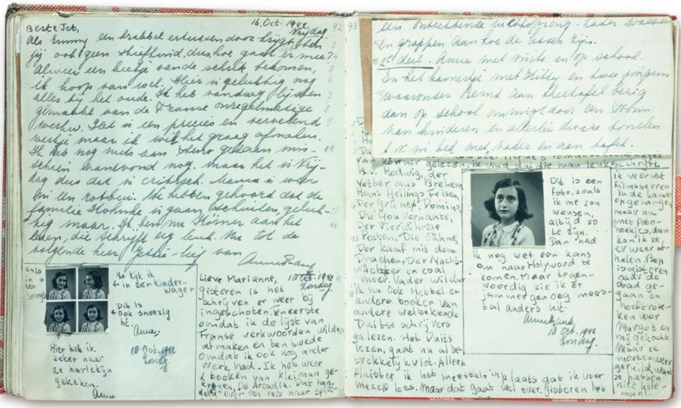
Primary Sources-Diaries
Diaries represent first-hand accounts of events.
They contain the personal perspectives of the author of events they experienced.
They can contain second-hand knowledge.
The Diary of a Young Girl by Anne Frank is probably the most important diary of the twentieth century.

Slide 5
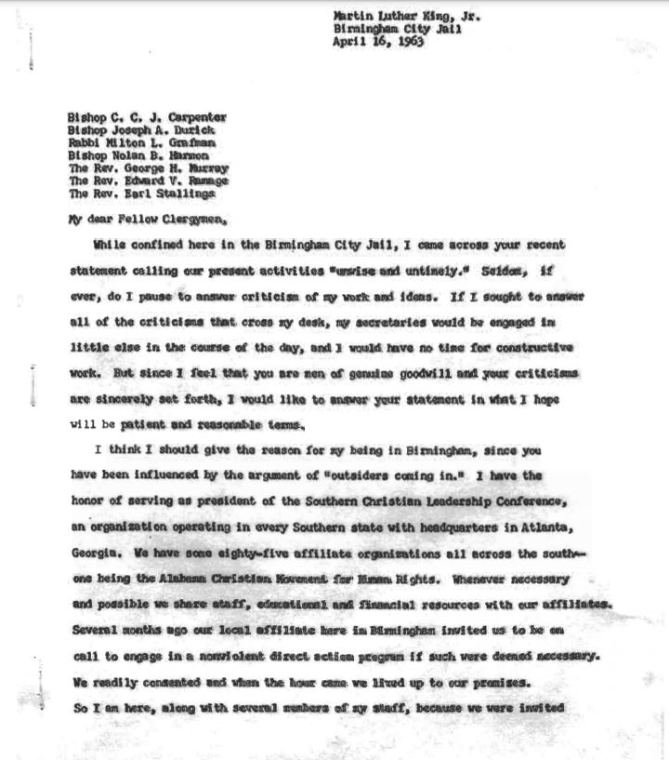
Primary Sources-Letters
Collections of letters and individual letters represent a primary source because they contain first-hand evidence.
Some letters represent private correspondence and other authors pen letters meant for society-wide publication.
The correspondence of Abigail and John Adams represent a valuable collection of letters.
Martin Luther King’s Letter from a Birmingham Jail is one of America’s most important public letters.

Slide 6
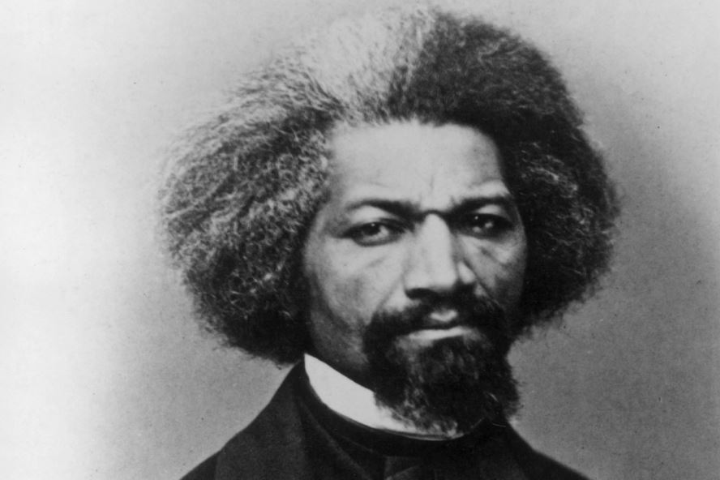
Primary Sources-Autobiographies
An individual writes an autobiography based on the first-hand knowledge of events experienced during their lifetime.
In the narrative of his life Frederick Douglass shares his experiences as a slave in the antebellum South.
The Narrative of the Life of Frederick Douglass is one of the most important primary sources of American slavery.

Slide 7
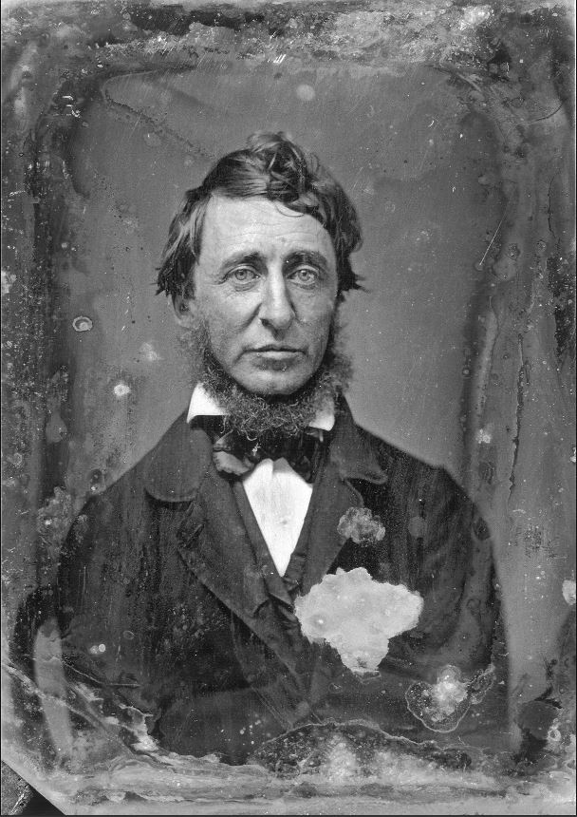
Primary Sources-Memoirs
An individual writing a memoir of a particular period or experience in their lives provides first-hand evidence.
With the Old Breed by Eugene Sledge is a famous memoir of fighting in the Pacific Theater during World War II.
On Walden Pond by Henry David Thoreau is a famous memoir of civil disobedience.

Slide 8
Primary Sources-Journals
Journals recording specific events provide first-hand evidence.
The journals that Lewis and Clark kept of the Corps of Discovery’s exploration of the Louisiana Purchase is probably the most famous American Journal.
The research journals of Madame Curie contain first-hand evidence of her discovery of radium and palladium.

Slide 9
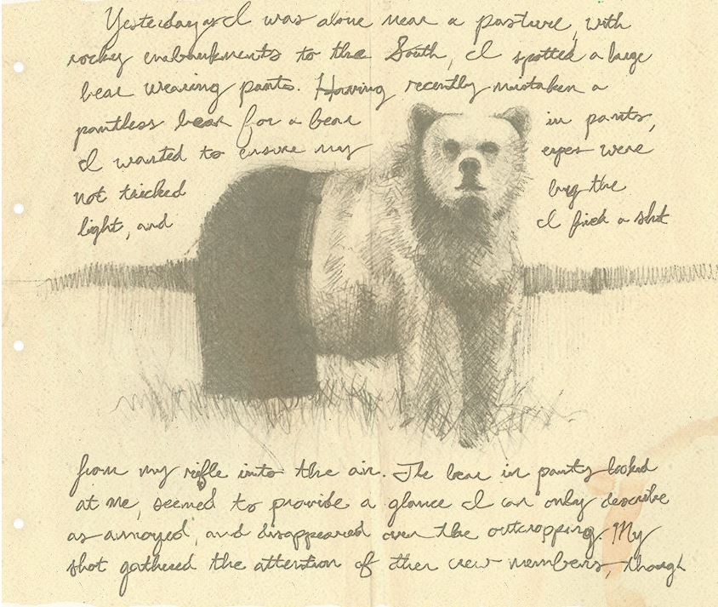
Primary Sources-Journals
Journals recording specific events provide first-hand evidence.
The journals that Lewis and Clark kept of the Corps of Discovery’s exploration of the Louisiana Purchase is probably the most famous American Journal.

Slide 10
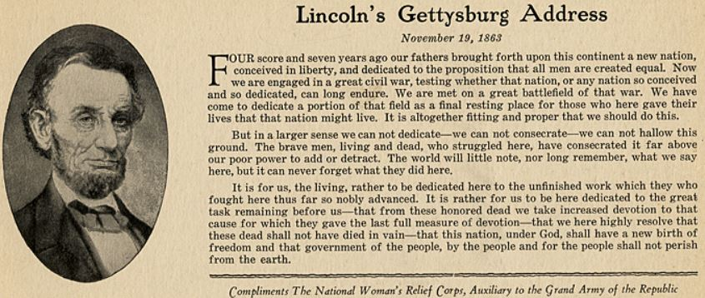
Primary Sources-Speeches
The transcript, recording, or video of a public speech is the first-hand record of the event.
The transcript of Lincoln’s Gettysburg address is an example.
The video of Martin Luther King’s “I Have a Dream” speech is another example.
The recording of William Jennings Bryan’s “Cross of Gold” speech is yet another example.

Slide 11
Primary Sources-Original Documents
Original documents constitute one of the most important types of first-hand account.
Original documents include marriage licenses, diplomas, death certificates, birth certificates, driver’s license, social security cards, tax returns, census records, real estate deeds, titles to property, court documents, military records, financial records, employment records, and receipts.

Slide 12
Primary Sources-Physical Objects
Photographs
Sculptures
Paintings
Novels
Films
Recordings
All of these provide first-hand evidence.

Slide 13
Secondary Sources-Textbooks
A group of individuals wrote a textbook long after the events analyzed in that book took place.
The textbook may and should contain primary source material in them, but analysis of primary documents constitutes the majority of the material in textbooks.

Slide 14
Secondary Sources-Documentary Films
Documentary films made after the event it examines is a secondary source.
The documentary film series “Eyes on the Prize” examining the American civil rights movement is a secondary source.
Documentary films contain and examine primary sources such as original film footage of actual events but represent a secondary source.

Slide 15
Secondary Sources-Magazine and Journal Articles
Magazine articles examining events in the past represent a secondary source.
Scholarly articles in peer reviewed publications examining events in the past represent a secondary source.

Slide 16
Secondary Sources-Wikipedia
A Wikipedia article is a secondary source.
Wikipedia crowdsources information created after the subject of its articles took place.

Slide 17
Secondary Sources-History Books
A history book is written after the fact and analyzes a collection of primary sources relevant to the subject of the book.

Slide 18
Secondary Sources-Biographies
A biography is an account of someone's life written by someone else and represents an analysis of an individual’s life usually written after the death of the subject and is not a first-hand account like an autobiography.

