Slide 1
Motivations for Exploration
The Portuguese hoped to find a sea route to the spice-producing lands of South and Southeast Asia in order to bypass the Ottoman Turks, who controlled the old land routes between Europe and Asia.
Prince Henry the Navigator financed and directed Portugal’s exploration and development of the caravel, a 65-foot, easily maneuvered three-masted ship that made exploration possible.
Searching for gold and then slaves, the Portuguese gradually established forts down the West African coast and rounded the Cape of Good Hope in 1487, with Vasco da Gama reaching India in 1598.

Slide 2
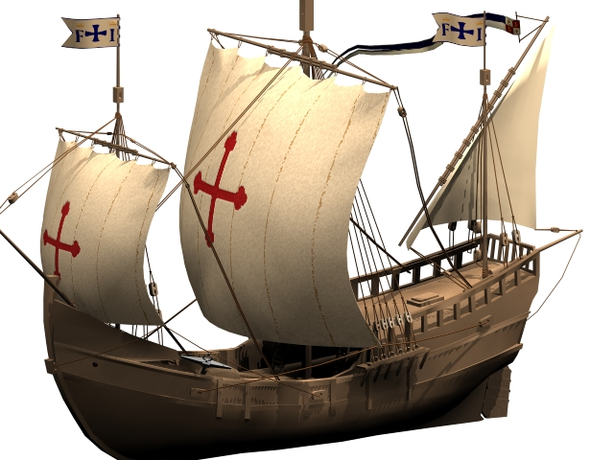
The Pinta-A Caravel

Slide 3
Christopher Columbus
While the Portuguese went south down the coast of Africa and east to the Spice Islands, an Italian sailor, Christopher Columbus (Cristoforo Colombo in Italian) persuaded the Spanish monarchs, Ferdinand and Isabella, to fund his voyage west to China and Japan in the Nina, Pinta, and Santa Maria.
After leaving Spain in August 1492 the fleet landed the Bahamas encountering the Arawak Indians.
Word of the discovery spread rapidly across Europe. Columbus made four voyages total to the New World, and died believing he was in the islands off the coast of Japan.

Slide 4
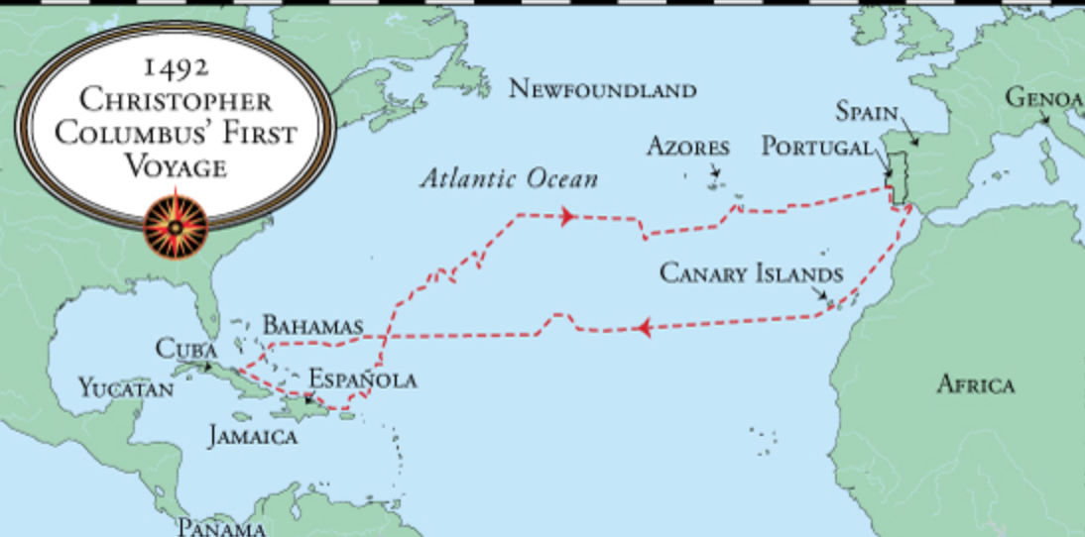
The First Voyage of Columbus

Slide 5
Spanish and Portuguese Competition
The success of Columbus put Spain into competition with Portugal.
To prevent conflict between the two most important Catholic Kingdoms in Europe the Pope, Alexander VI, negotiated the Treaty of Tordesillas in 1494 that divided the Atlantic world.
Portugal ended up with the West Coast of Africa and Brazil with Spain claiming the rest of the New World.

Slide 6
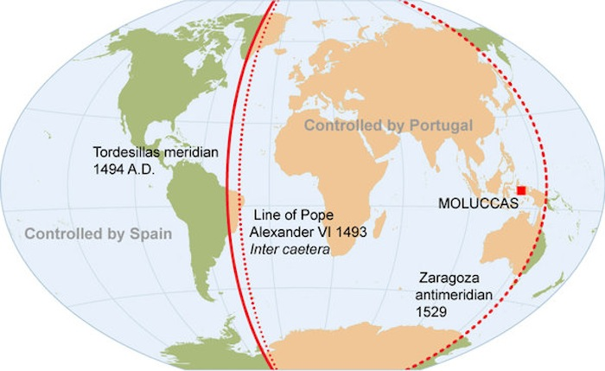
Treaty of Tordesillas

Slide 7
Old World Slavery
Slavery existed in the Old World for thousands of years.
Old world slavery was a class-based institution that exploited the labor of slaves in an era without machines.
Africans, Arabs, and Christians in the Mediterranean Basin traded slaves of all races throughout the region.
Slaves came from all ethnicities and could be Greek, Slav, European, African, or Turkish.

Slide 8
New World Slavery
The discovery of America and its favorable climate for sugar and tobacco created an insatiable appetite for African slaves who could survive the tropical climate that killed European indentured servants.
The Portuguese exploited their control of the West African coast to make huge profits in a slave trade that brought Africans to Brazil.

Slide 9
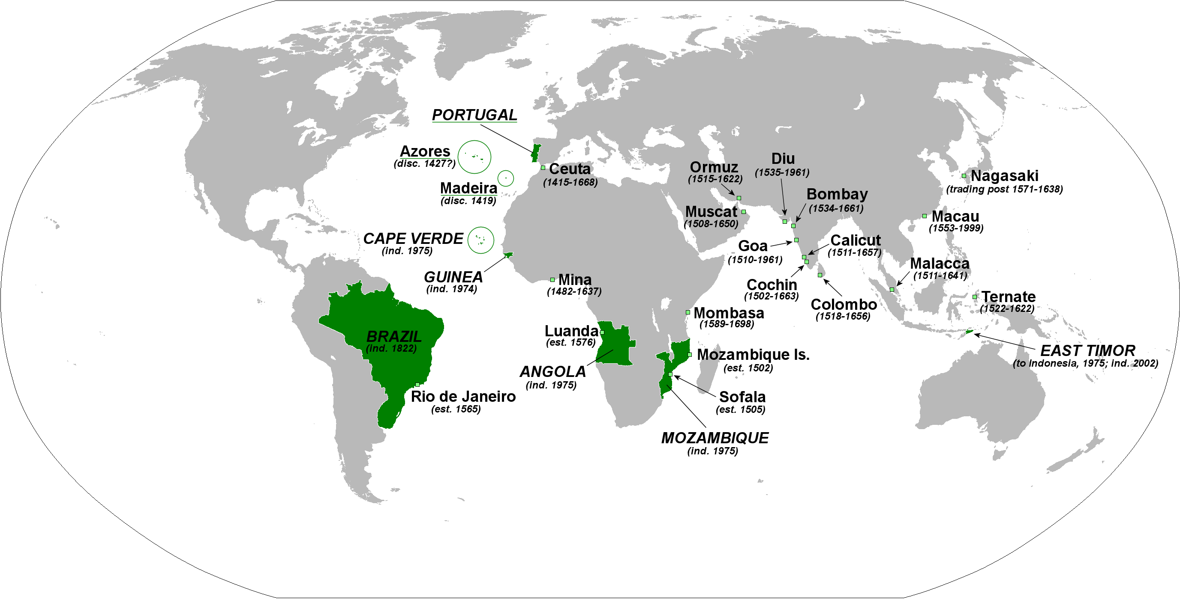
Portuguese Empire

Slide 10
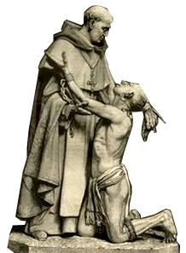
Bartolomé de Las Casas
The Spanish Dominican Bartolomé de Las Casas (1474–1566), for example, argued that Africans were constitutionally more suitable for labor than native Americans and should therefore be imported to the plantations in the Americas to relieve the indigenous peoples, who were being worked to death.

Slide 11
Hernán Cortés
With a band of fewer than three hundred
Spanish soldiers and a few thousand native allies, Cortés captured the Aztec capital,
Tenochtitlán (present-day Mexico City),

Slide 12
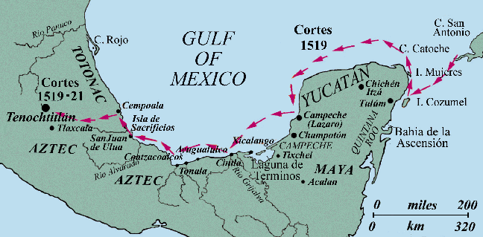
The Aztecs
With a band of fewer than three hundred Spanish soldiers and a few thousand native allies, Cortés captured the Aztec capital, Tenochtitlán (present-day Mexico City).

Slide 13
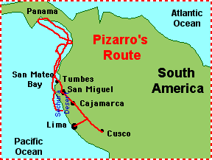
Conquest of the Incas
Francisco Pizarro conquered the Inca Empire in Peruvian highlands in 1532 to 1533.

Slide 14
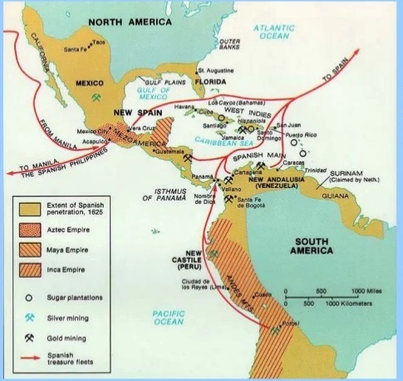
Potosi
The real prize of the Spanish New World was the discovery of vast silver deposits in Potosí, Bolivia.

Slide 15
Collision of Flora and Fauna
The movement of peoples, animals, plants, manufactured goods, precious metals, and diseases between Europe, the New World, and Africa — the Columbian exchange — was one of the most dramatic transformations of ecology, agriculture, and ways of life in all of human history.
Old World- pigs, chickens, goats, sheep, cattle, wheat, melons, yams, sorghum, millet, rice and sugarcane.
New World-tobacco, cacao, sweet potatoes, maize, tomatoes, manioc, peppers, pineapples, cashew nuts, potatoes, and peanuts.

Slide 16
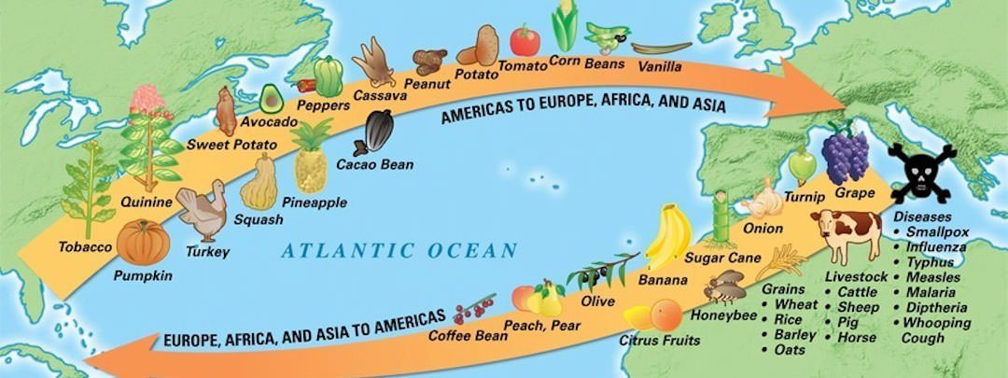
The Columbian Exchange

Slide 17
Johannes Gutenberg and the Printing Press
In the 1440s by Johannes Gutenberg, a German goldsmith, marked a revolutionary departure from the old practice of copying works by hand or stamping pages with individually carved wood blocks.
In 1467, two German printers established the first press in Rome; within five years, they had produced twelve thousand volumes, a feat that in the past would have required a thousand full-time scribes.
The invention of mechanical printing dramatically increased the speed at which people could transmit knowledge, and it freed individuals from having to memorize everything they learned. Printed books and pamphlets, even one-page flyers, would create a wide community of scholars no longer dependent on personal patronage or church sponsorship for texts. Printing thus encouraged the free expression and exchange of ideas

Slide 18
Causes of the Reformation
Pious Christians yearned for a faith more meaningful to their daily lives and for a clergy more responsive to their needs.
The sale of indulgences unless a torrent of resentment and frustration among laypeople.
Evangelicals believed they were living in the last days of the world and supported reform as a cause of the Last Judgment.
Luther’s ideas fused social, nationalist, and religious protests with lower-class resentments.

Slide 19
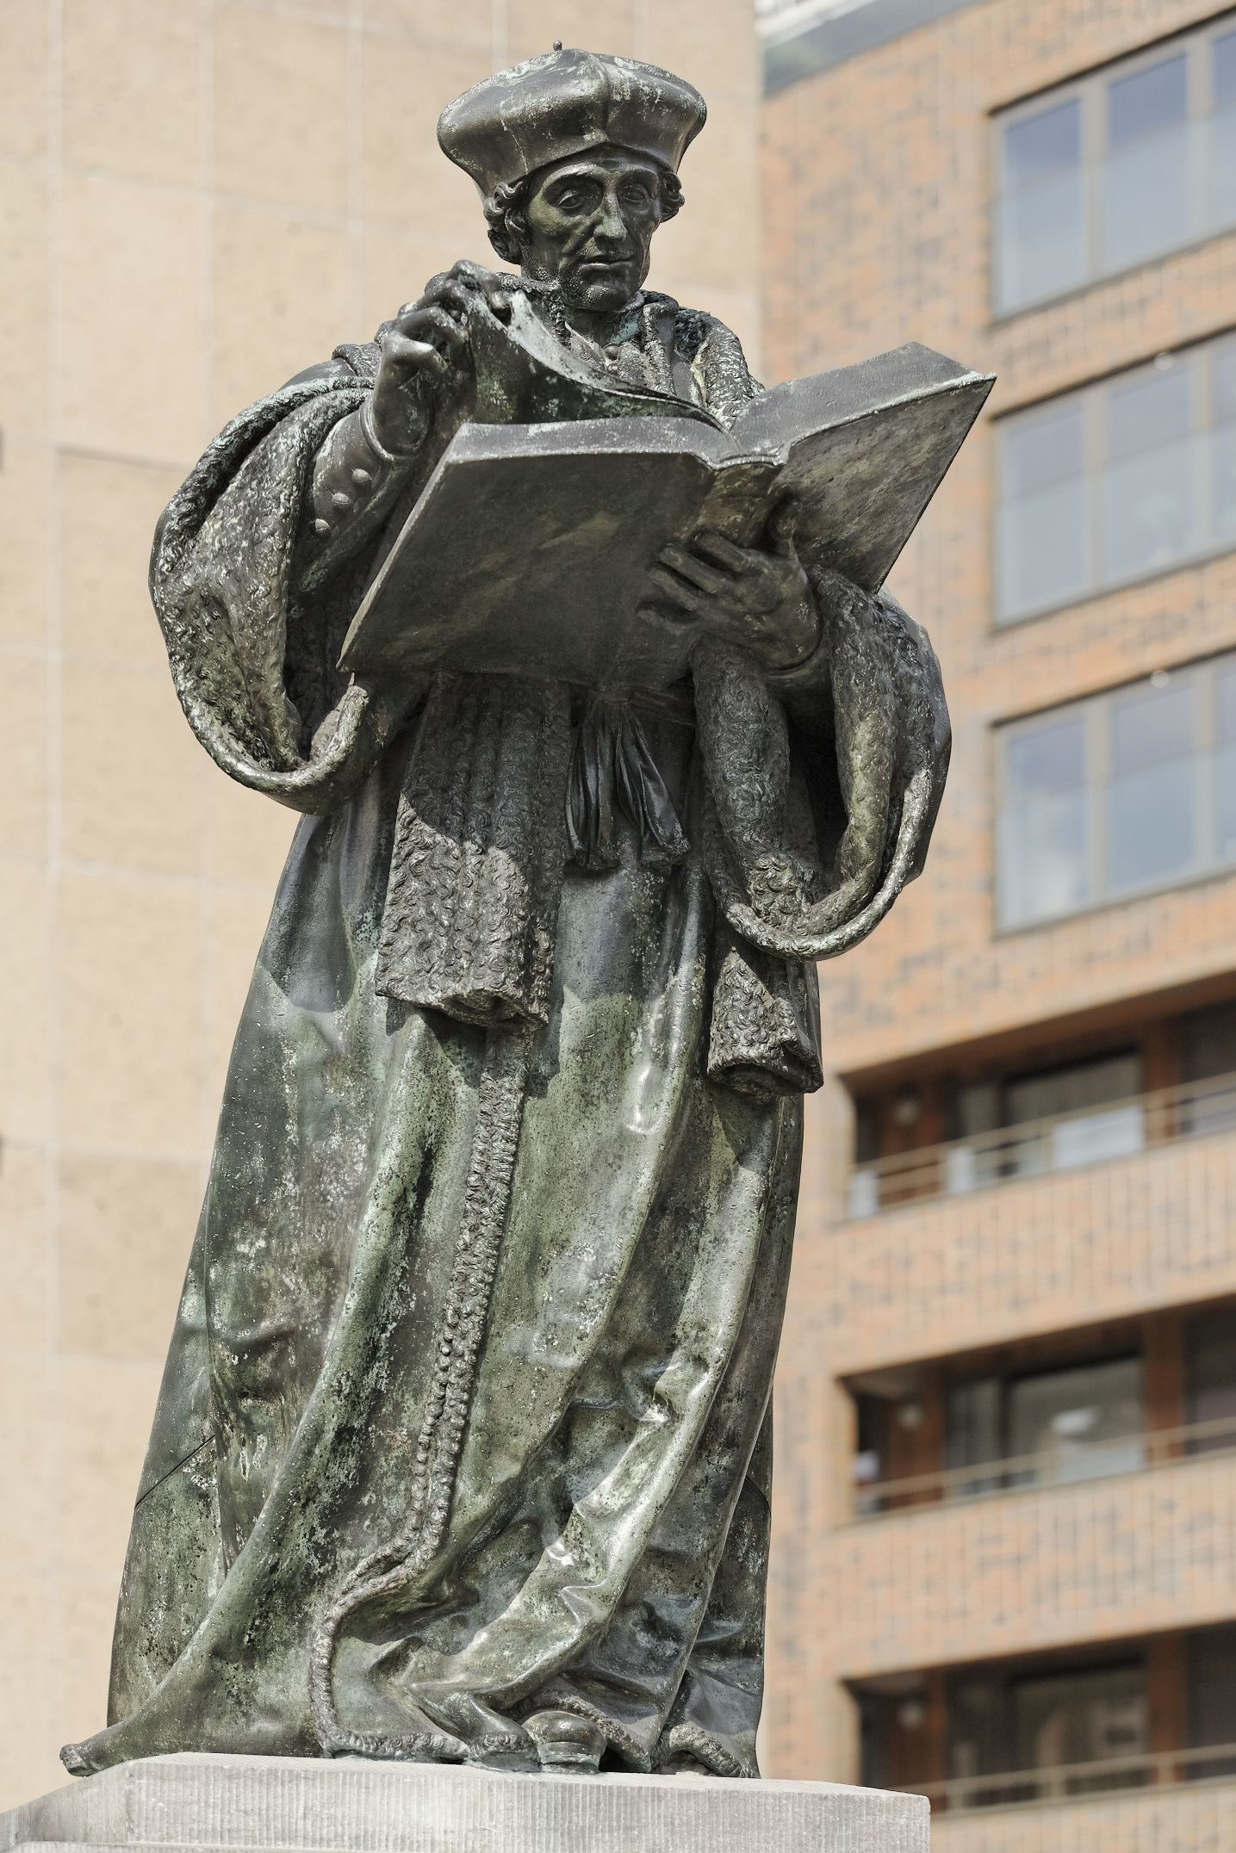
Erasmus-Christian Humanist
An intellectual trend in the sixteenth century that coupled love of classical learning with an emphasis on religious devotion.
The most influential was Christian humanist Desiderius Erasmus who strove for a unified, peaceful Christendom in which charity and good works, not empty ceremonies, would mark true religion.

Slide 20
Indulgences
Just as Luther was working out his own personal search for salvation, a priest
Johann Tetzel arrived in Wittenberg to sell indulgences.
The church also sold monetary substitutions for the sacrament of penance known as indulgences.
A person could even buy indulgences for a deceased relative to reduce that person’s time in purgatory and release his or her soul for heaven.

Slide 21
Martin Luther
Martin Luther abandoned his studies in the law to enter the Augustinian Order.
Luther became convinced that sinners were saved only through faith and that faith was a gift freely given by God. No amount of good works could produce the faith on which salvation depended.
Luther condemned challenged the basis of Catholic doctrine in his Ninety-Five Theses and burned his bridges by advocating “the priesthood of all believers,” insisting that the Bible provided all the teachings necessary for Christian living and that a professional caste of clerics should not hold sway over laypeople. These principles — “by faith alone,” “by Scripture alone,” and “the priesthood of all believers” — became central features of the reform movement.

Slide 22
Swiss Reform
Huldrych Zwingli disagreed with many of Luther’s idea, especially the meaning of the Eucharist, and began his own faction of reforms in Switzerland.
John Calvin gained religious and politically control of Geneva as a Christian republic, and developed the doctrine of predestination that
God had ordained every man, woman, and child to salvation or damnation — even before the creation of the world and God saved only the “elect.”
For Calvinists, a righteous life might be a sign that a person had been chosen for salvation.

Slide 23
The Reformation in England
Henry VIII sought a divorce from his wife, Catherine of Aragon, because they only had a daughter, Mary, and not a male heir.
The Pope, Clement VII, failed to approve a divorce.
The English Parliament passed the Act of Supremacy in 1534 that established the Church of England under Henry’s leadership.
Henry then divorced Catherine, married Anne Boleyn, and the marriage produced a child, Elizabeth.
Henry had four other wives after Anne, and Jane Seymour finally produced a son, the future Edward VI, of Prince and the Pauper fame.

Slide 24
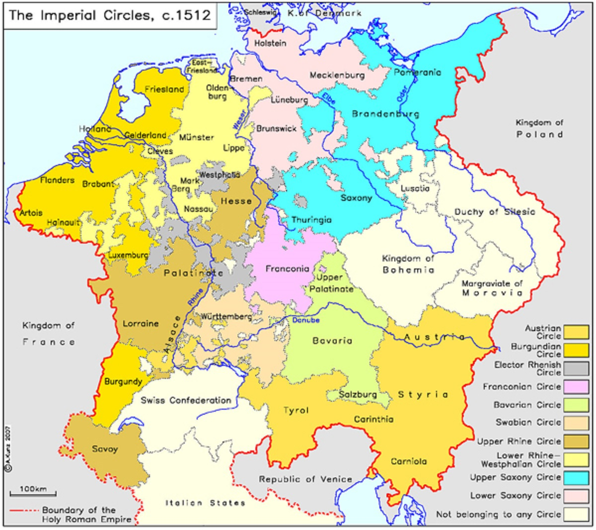
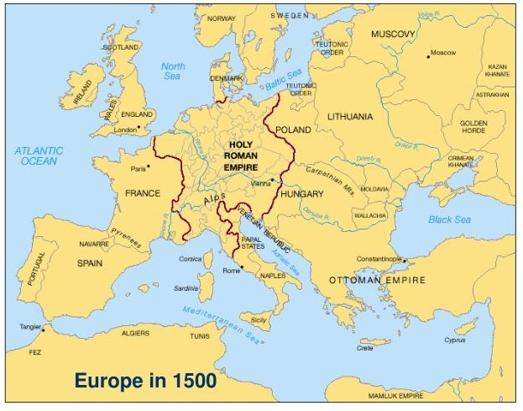
Reformation Germany

Slide 25
The Peasant War
Luther’s rebellion against religious authority inspired the peasants of southern and central Germany to rebel against secular authority.
In 1525, peasants attacked nobles’ castles, convents, and monasteries and Thomas Müntzer rose as a leader.
Catholic and Protestant princes joined forces to crush Müntzer and his supporters. All over the empire, princes trounced peasant armies and hunted down their leaders. By the end of the year, more than 100,000 rebels had been killed.
The religious revolt was not allowed to become a social revolt.

Slide 26
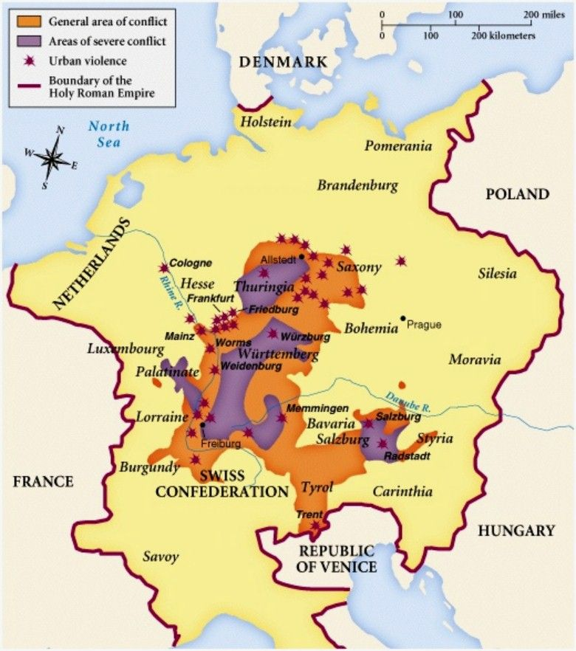
The Peasants’ War 1525 C.E.

Slide 27
Anabaptists
Anabaptists believed that true faith came only to those with reason and free will.
How could a baby knowingly choose Christ?
Only adults could believe and accept baptism; hence, the Anabaptists (“rebaptizers”) rejected the validity of infant baptism and called for adult rebaptism.
The Anabaptist movement drew its leadership primarily from the artisan class and its members from the middle and lower classes.

Slide 28
Luther’s German Bible
Luther translated the New Testament in 1522 and the Old Testament in 1534.
Peppered with witty phrases and colloquial expressions, Luther’s Bible not only made the sacred writings more accessible to ordinary people but also helped standardize the German language.
It initiated a new Bible-centered culture with Bible reading becoming a common pastime undertaken in solitude or at family and church gatherings.
To counter Protestant success, Catholic German Bibles soon appeared, thus sanctioning Bible reading by the Catholic laity, a sharp departure from medieval church practice.

Slide 29
New Protestant Attitudes
Protestants appointed officials to head urban agencies that would certify the genuine poor and distribute them welfare funds.
Protestant reformers denounced sexual immorality, glorified the family, and championed the end of clerical celibacy.
Protestants asserted government control over marriage.
Protestant magistrates closed brothels and established marriage courts to handle disputes over marriage promises, child support, and allowed divorce in rare situations.

Slide 30
The Counter Reformation
Pope Paul III convened the Council of Trent effectively set the course of Catholicism until the 1960s.
Catholic leaders sought renewal of religious devotion and reform of clerical morality as well as clarification of church doctrine.
New religious orders set out to win converts overseas or to reconvert Catholics who had turned to Protestantism.
The church did not hesitate to root out dissent by giving greater powers to the Inquisition, including the power to censor books.
The papal Index, or list of prohibited books, was established in 1557 and not abolished until 1966.

Slide 31
The Jesuits
The Counter Reformation saw founding of new religious orders such as the Society of Jesus, or Jesuits, founded by Ignatius of Loyola.
The Jesuits became the most vigorous defenders of papal authority.
They established hundreds of colleges throughout the Catholic world, educating future generations of Catholic leaders.
Jesuit missionaries played a key role in the Spanish and Portuguese empires and brought Roman Catholicism to Africans, Asians, and native Americans.
Francis Xavier preached in India and Japan, his work greatly assisted by a network of Portuguese trading stations.

Slide 32
The Hapsburgs vs the Valois
The Hapsburgs controlled Spain and the Holy Roman Empire and fought dynastic wars with the Valois rulers of France.
In 1494, they fought the Italian War for control Italy that ended with French defeat in the Treaty of Cateau Cambrésis.
The Papacy supported the French which led to Catholic Hapsburg attacks on Rome that employed German Protestant mercenaries.
The Hapsburgs and Valois made religion only one factor among many in power politics between the two dynasties

Slide 33
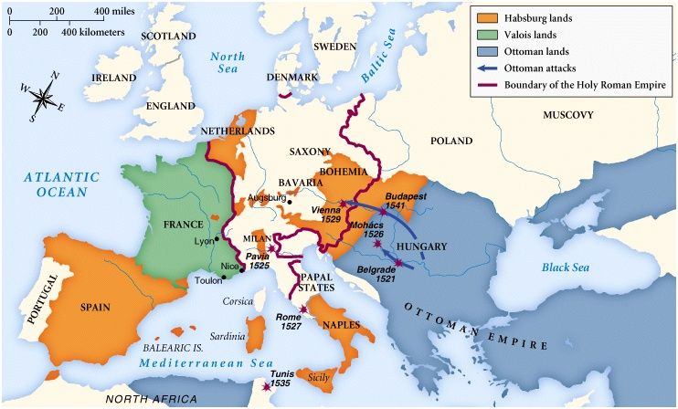
European Dynastic Wars

Slide 34
Suleiman and the Ottomans
The Ottoman Empire reached its height of power under Suleiman the Magnificent.
In 1526, a Turkish expedition destroyed the Hungarian army at Mohács and gained control of Hungary.
In 1529, the Ottomans unsuccessfully besieged Vienna; an attack that shocked Christian Europe.
In 1535, Charles V attacked Tunis, home of North African pirates loyal to the Ottomans.
This led the Valois French king Francis I to forge an alliance with the Turkish sultan.

Slide 35
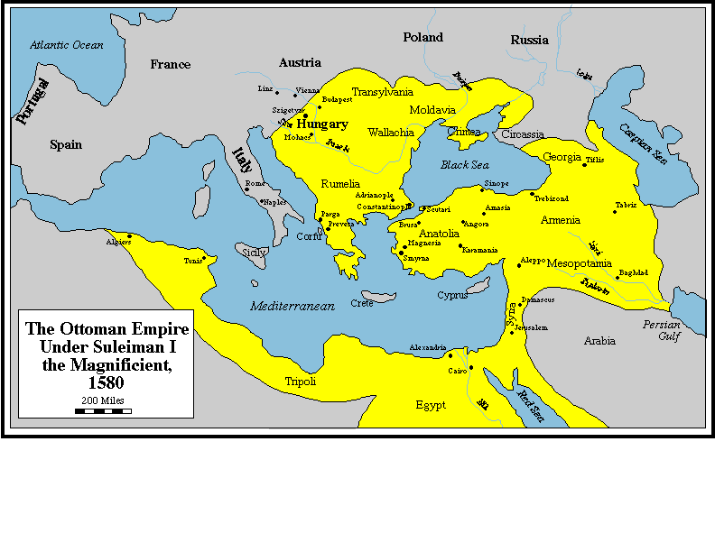
The Ottoman Empire of Suleiman I

Slide 36
Financing War
Sixteenth century armies grew in size and firepower and more costly.
Royal Mohacs revenues could not keep up with war expenditures.
To pay their bills, governments routinely devalued their coinage causing rapid inflation that devasted peasants.
Gold and silver coming in from Hapsburg New World colonies financed the armies of Charles V early on in the conflict.
The Valois in France became massively indebted to bankers in Lyon.
Despite New World metals the Hapsburgs became indebted to Jakob Fugger’s German bank.

Slide 37
Religion divides society
French attempts to tolerate Protestantism failed and led to civil war between French Catholics and Protestants that lasted decades.
In England, the Tudor dynasty produced Protestant monarchs, Henry VIII and Edward VI, followed by a devout Catholic queen, Mary II, that stoked religious turmoil for decades that did not calm until the ascension of Elizabeth I firmly established Protestantism.
In Scotland, James Stuart, James V, married a French Catholic bride and had a daughter, Mary Stuart. After the king’s death the mother and child fell under French influence that caused deep resentment among Scots and led to an embrace of Presbyterian Protestantism and the overthrow of Catholic Mary Stuart in favor of her son, James VI.

Slide 38
Religious War in the Holy Roman Empire
Charles Hapsburg, Charles I- King of Spain and Charles V-Holy Roman Emperor, went to war with the Protestant princes of the Schmalkaldic League in 1547.
After five years of fighting, Charles V signed the Peace of Augsburg in 1555 that established the principle that all princes, whether Catholic or Lutheran, enjoyed the sole right to determine the religion of their lands and subjects.
The Peace of Augsburg did not recognize Calvinists or Anabaptists.
Charles abdicated after the conflict and divided Hapsburg lands between his sons. Phillip II received Netherlandish-Burgundian and Spanish dominions and his brother, Ferdinand, received Austria.

Slide 39
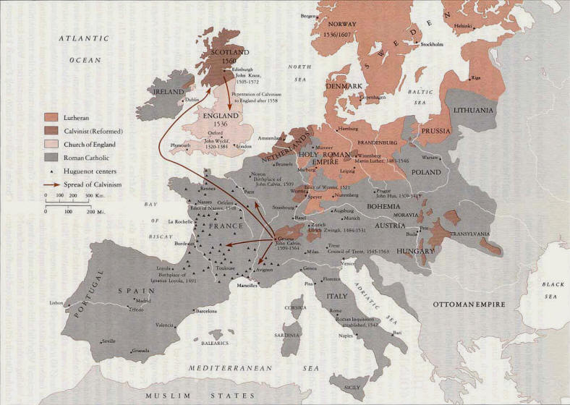
European Religious Division 1555 C.E.

Slide 40
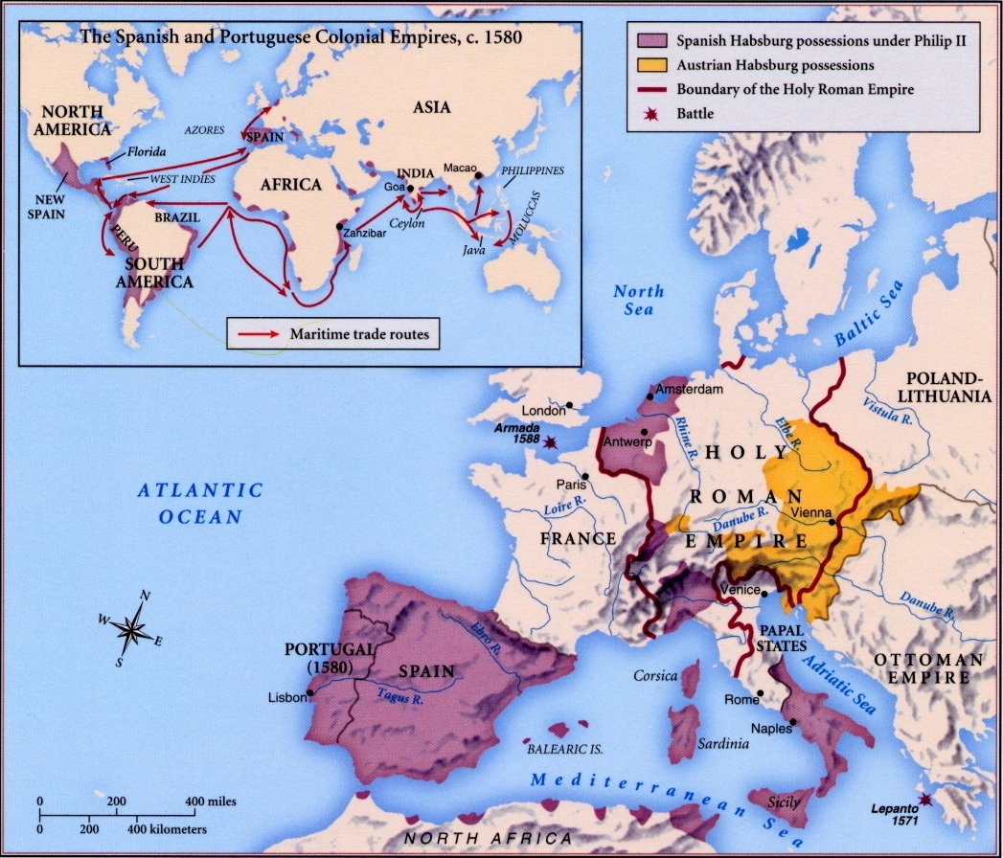
The Division of Charles V’s Empire

