Slide 1
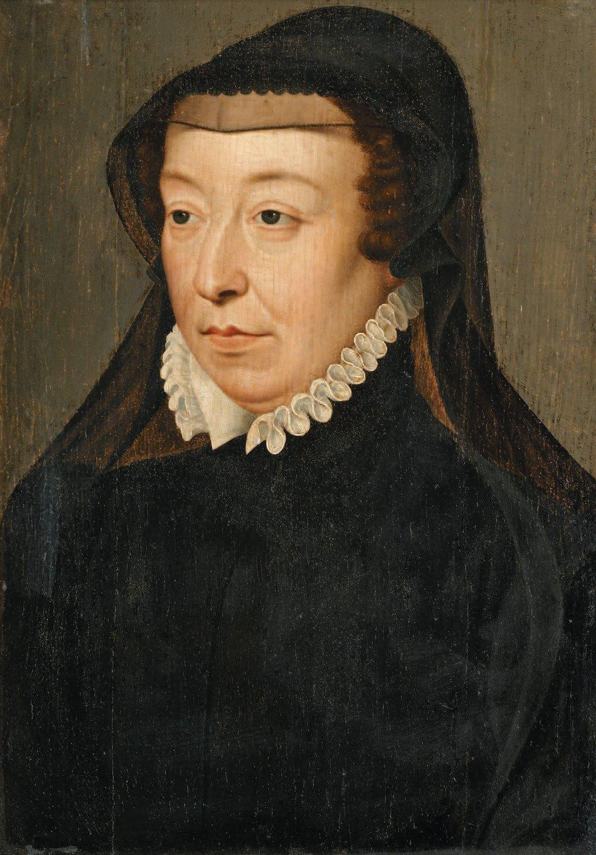
Catherine de Médicis
Italian-born mother of French king Charles IX, she served as regent and tried to prevent civil war by playing the Bourbon and Guise factions against each other but failed.
Catherine feared the rise of Guise influence, so she arranged the marriage of the king’s Catholic sister, Marguerite de Valois, to Henry of Navarre, a Huguenot and Bourbon.

Slide 2
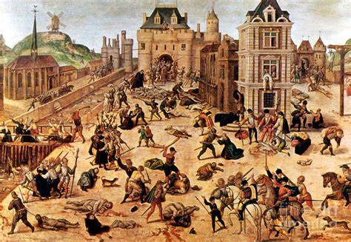
St. Bartholomew’s Day Massacre
On August 24, 1572, French Catholic mobs attacked Huguenots.
In three days, Catholics murdered some two thousand Huguenots in Paris. Three thousand Huguenots died in the provinces over the next six weeks.

Slide 3
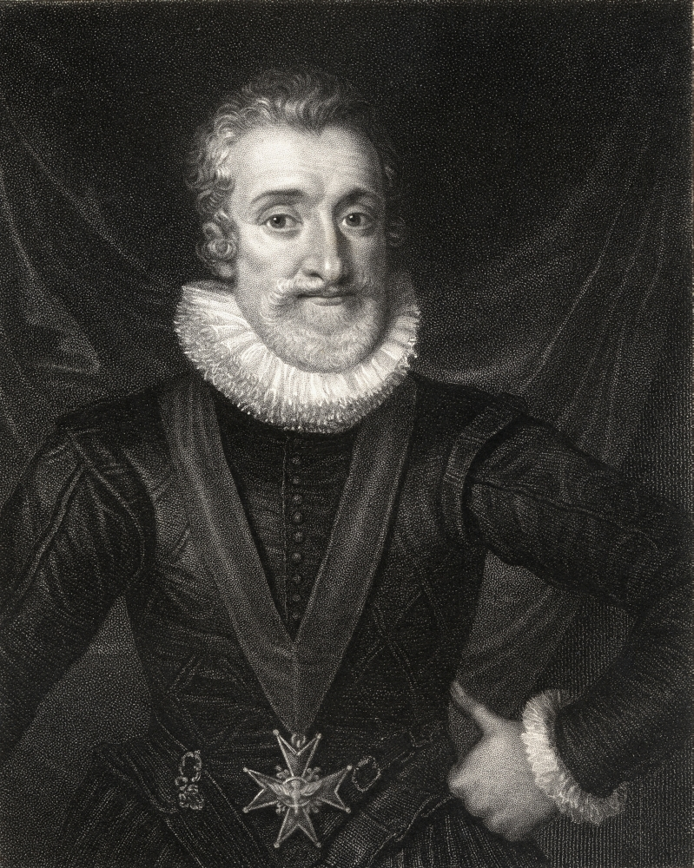
Henry Navarre
A Huguenot and a Bourbon, Henry Navarre married Charles IX’s Catholic sister, Marguerite de Valois.
After the deaths of Charles IX and Henry III he became King Henry IV and brought about peace by converting to Catholicism after stating “Paris is worth a Mass.”

Slide 4
The Edict of Nantes
After driving King Phillip II’s Spanish forces in 1598, Henry IV issued the Edict of Nantes, in which he granted the Huguenots a large measure of religious toleration.
The approximately 1.25 million Huguenots became a legally protected minority within an officially Catholic kingdom of some 20 million people.
Protestants were free to worship in specified towns and were allowed their own troops, fortresses, and even courts.

Slide 5
politiques
A group of moderate Catholics and Calvinists — together called politiques — urged
Henry IV to give priority to the development of a durable state following the devastation caused by the French Wars of Religion.
The politiques believed that religious disputes could be resolved only in the peace provided by strong government.
The French Catholic writer Michel de Montaigne (1533–1592) questioned the certainty of religious beliefs that fueled conflict by reviving the ancient doctrine of skepticism that denied any religion the right to claim certainty that their belief was the correct one.

Slide 6
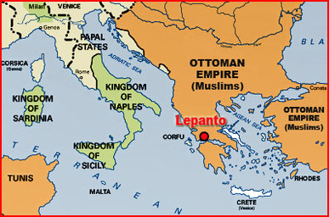
Lepanto
In 1571, Phillip II and the Republic of Venice achieved a decisive military victory when they joined with Venice to defeat the Turks in a great sea battle off the Greek coast at Lepanto.
The Turks never threatened the western Mediterranean again.

Slide 7
The Morisco Rebellion
Moriscos were Spanish Muslims forced to convert to Christianity who remained secretly faithful to Islam.
Between 1568 and 1570, the Moriscos revolted in the south of Spain.
Philip retaliated by forcing fifty thousand Moriscos to leave their villages and resettle in other regions.
In 1609, his successor, Philip III, ordered their expulsion from Spanish territory, and by 1614 some 300,000 Moriscos had been forced to relocate to North Africa.

Slide 8
The Dutch Revolt Against Spain
Phillip II inherited his Dutch lands from his father Charles V.
During the Reformation, the Dutch embraced Protestant Calvinism, and this caused conflict with staunchly Catholic Phillip II.
After the Spanish Fury devastated Antwerp, Prince William of Orange led the Netherlands’ seven predominantly Protestant northern provinces into an alliance with the ten mostly Catholic southern provinces and drove out the Spaniards.
Spain regained the southern provinces in 1579, but the northern Protestants established the Dutch Republic.

Slide 9
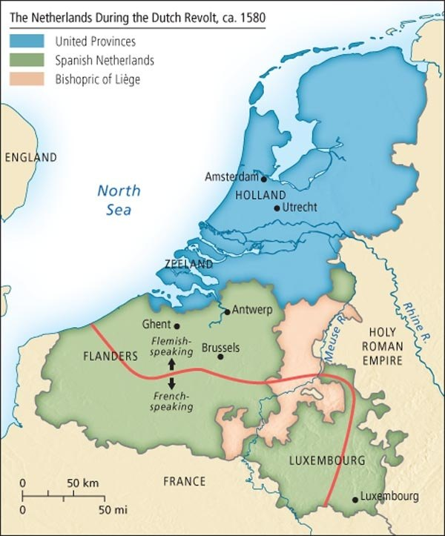
The Low Countries Revolt

Slide 10
Religious Toleration in the Dutch Republic
In addition to its majority Calvinist Protestant population One-third of the Dutch population remained Catholic, and the Dutch Republic also had a large Jewish population because
Toleration allowed Jews to worship openly in their synagogues, and local authorities allowed Catholics to worship as they chose in private.
Religious toleration helped make the Dutch Republic one of Europe’s chief intellectual and scientific centers in the seventeenth and eighteenth centuries.

Slide 11
Calvinism in England
Calvinists in England became known as Puritans because they opposed all vestiges of Catholic ritual in the Church of England.
The Thirty-Nine Articles of Religion, issued by Elizabeth I in 1563, incorporated elements of Catholic ritual along with Calvinist doctrines in the Church of England.
Puritans tried to undercut the authority of the Church of England by placing control of church administration in the hands of a minister and the elders of the congregation.
Elizabeth rejected these Calvinist actions.

Slide 12
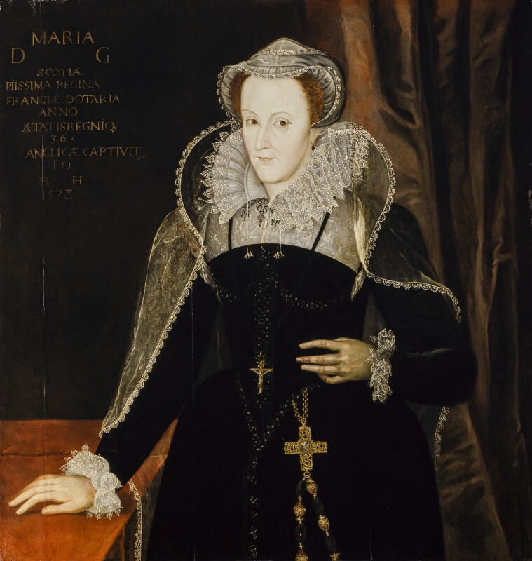
Mary Queen of Scots
Mary, queen of Scots, stood next in line after Elizabeth I to inherit the English throne.
Mary was a Catholic, and after she married the man who assassinated her first husband, Scottish Calvinists forced Mary to abdicate the throne of Scotland in favor of her one-year-old son James who was then raised as a Protestant.
After her abdication, Mary spent nearly twenty years under house arrest in England, but after she plotted against England with Phillip II, Elizabeth ordered Mary’s beheading.

Slide 13
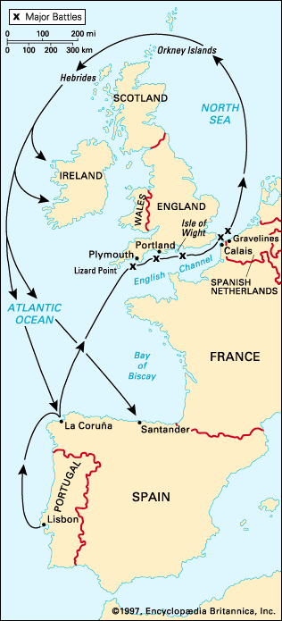
The Spanish Armada
The execution of Mary Queen of Scots, the refusal of Elizabeth I to marry him, England’s support of the Dutch Revolt, and English attacks on Spanish gold fleets prompted Phillip II to send the Spanish Armada to attack England in 1588.
The English Navy prevented it from landing a Spanish army and storms sank much of the Armada ensuring its defeat.

Slide 14
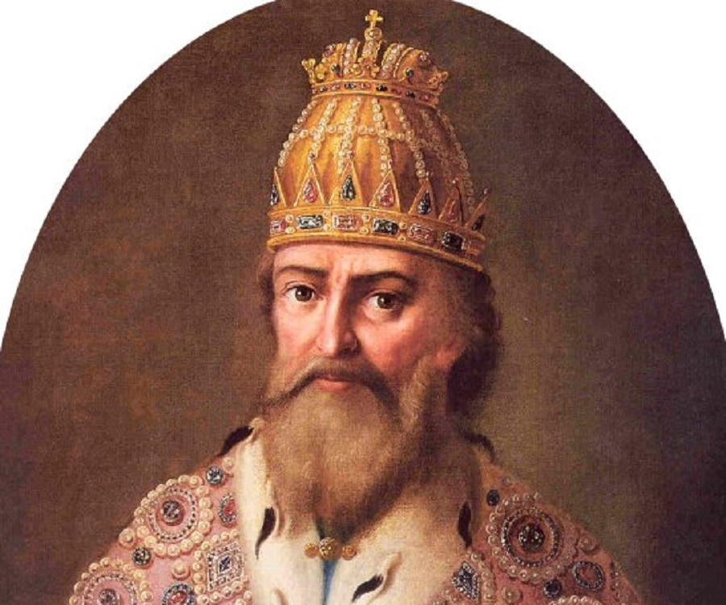
Ivan the Terrible
Tsar Ivan IV, the Terrible, stopped at nothing to make Muscovy the leader of a Russian empire.
Ivan initiated Russian expansion eastward into Siberia, but two formidable foes blocked his plans for expansion westward: Sweden and Poland-Lithuania.

Slide 15
The Origins of the Thirty Years’ War
Religious disputes, ethnic competition, and political weakness helped start the Thirty Years’ War.
The Austrian Habsburgs ruled the Holy Roman Empire, which had eight major ethnic groups.
The emperor and four of the seven electors who chose him were Catholic; the other three electors were Protestants.
Tensions rose as Calvinism, unrecognized by the Peace of Augsburg, made inroads into Lutheran areas.
By 1613, two of the three Protestant electors had become Calvinists.
When the Catholic Habsburg Archduke Ferdinand was crowned king of Bohemia, he began to curtail the religious freedom of Czech Protestants.
When Ferdinand was elected emperor, the Czechs deposed him as king and chose in his place the young Calvinist Frederick V of the Palatine, and war broke out.

Slide 16
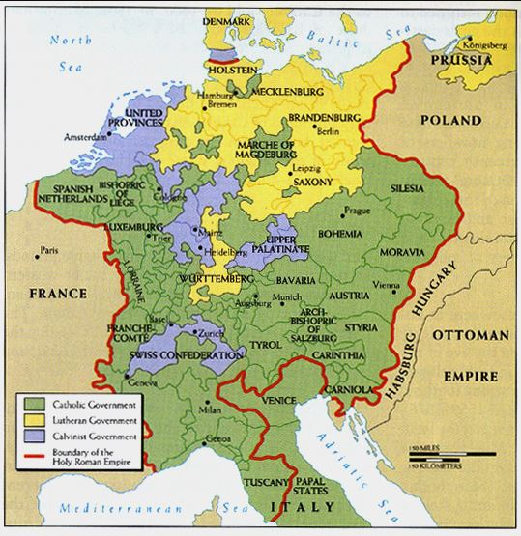
The Holy Roman Empire 1618

Slide 17
The Course of the Thirty Years’ War
Ferdinand crushed the Czech rebellion at White Mountain, and Austria would control Bohemia for the next three hundred years.
The war became a German struggle of Catholics against Protestants.
Denmark, under Christian IV, and Sweden, under Gustavus Adolphus invaded the Holy Roman Empire to assist Protestant Germans.
The Spanish Hapsburgs joined the war to assist the Austrian Hapsburgs against the Danes and Swedes.
Catholic France did want Catholic Spain to gain power in Germany and surround her so Cardinal Richelieu joined the war on the Protestant side and changed the war from one of religion to one of dynastic interest.

Slide 18
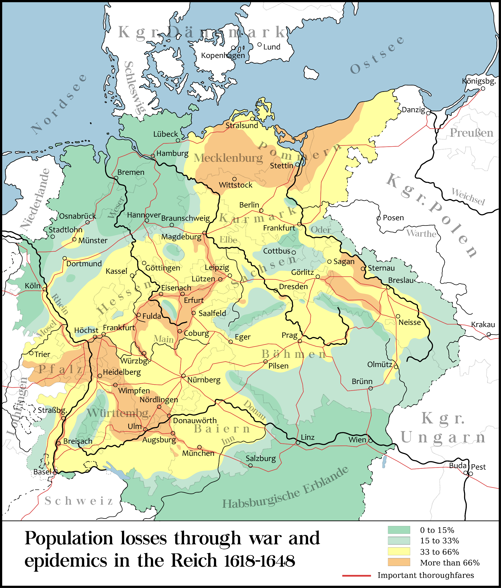
The Devastation of the Thirty Years’ War

Slide 19
The Peace of Westphalia
The Peace of Westphalia became a model for resolving future conflicts among warring European states by bringing all parties together at one time to sign a comprehensive peace.
France acquired parts of Alsace and replaced Spain as the prevailing power on the continent.
The Spanish Habsburgs recognized Dutch independence.
Each German prince in the Holy Roman Empire gained the right to establish Lutheranism, Catholicism, or Calvinism in his realm.
The Hohenzollern Elector of Brandenburg, who increased his territories and developed a small but effective standing army.
In the future, national security, commercial ambition, or dynastic pride would cause wars instead of the need for religious uniformity.

Slide 20
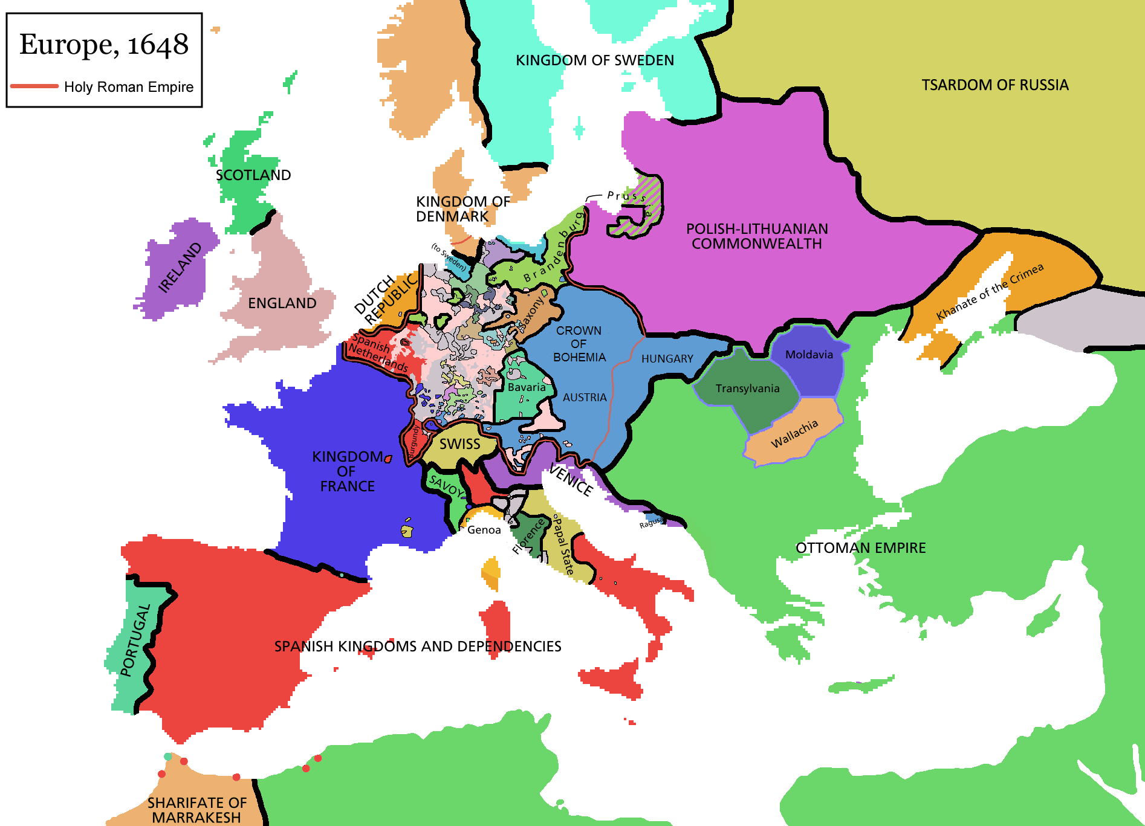
The Holy Roman Empire After 1648

Slide 21
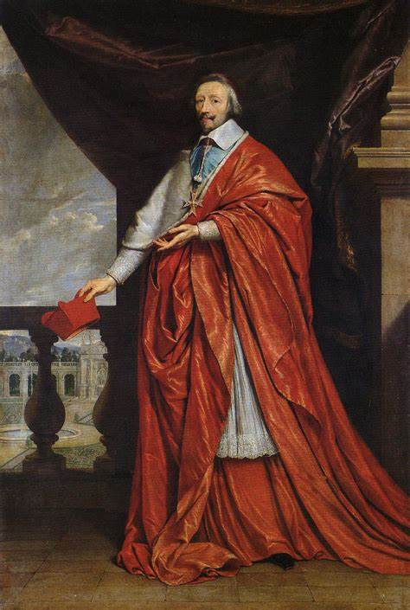
Cardinal Richelieu
The costs of the Thirty Years’ War caused drastic changes in France as Louis XIII turned over control of the government to his chief adviser, Cardinal Richelieu.
The Cardinal claimed that raison d’état allowed the government to raise taxes, restrict religious freedom, and subdue the objections of the nobility.

Slide 22
Causes of the Economic Crisis
The Thirty Years’ War deepened the existing economic crisis.
Population growth slowed causing stagnation, agricultural yields also declined, and peasants were less able to pay the escalating taxes needed to finance the wars.
A post-war famine caused large-scale uprisings and revolts.
The economic balance of power gradually shifted as northwestern Europe began to dominate international trade and broke the stranglehold of Spain and Portugal in the New World.

Slide 23
Consequences of the Economic Crisis
The economic crisis deepened the division between prosperous and poor peasants and fostered the development of a new pattern of late marriages and smaller families.
Grain replaced more expensive meat as the essential staple of most Europeans’ diets.
Successive bad harvests led to malnutrition and weakened the people making them more susceptible to epidemic diseases.
As the recession deepened, women lost some of their economic opportunities as men claimed sparse jobs and prohibited females.

Slide 24
The Economic Rise of Northern Europe
The economies of southern Europe declined during the crisis, whereas those of the northwest emerged stronger.
The English, Dutch, and French established New World colonies to compete with the Spanish and Portuguese.
Southern and Central Europe took generations to recover the Thirty Years’ War, but northwestern Europe quickly replaced its lost population, no doubt because this area’s people had suffered less.
Northern Europe pioneered a new business model, the joint-stock company that developed markets and commerce much better than the economies controlled by the monarchs of southern Europe.

Slide 25
The Scientific Revolution
Secularization made religion a matter of private practice instead of public policy, and this allowed more freedom of thought.
Scientists and scholars sought laws to explain the world around them.
The scientific method which combined experimental observation and mathematical deduction culminated in the astounding breakthroughs explaining the motion of the planets, as well as everyday objects on earth, and gave science enormous new prestige.

Slide 26
Astronomical and Anatomical Revolutions
Nicolaus Copernicus argued that the earth and other planets revolved around the sun, a view known as heliocentrism.
Tycho Brahe challenged the view that the universe was unchanging.
Johannes Kepler developed three laws of planetary motion.
Galileo Galilei built a sophisticated telescope and published his observations of Venus, Jupiter, and our Moon that challenged church teaching and supported heliocentrism, but the Papacy silenced him.
William Harvey examined the circulation of blood.
Andreas Vesalius examined the anatomy of the human body.

Slide 27
Advances in Rational Thought
Sir Francis Bacon attacked reliance on ancient writers and predicted that the scientific method would lead to social progress.
René Descartes argued that mathematical and mechanical principles provided the key to understanding all of nature.
Isaac Newton the Principia Mathematica which contained the calculus and his law of universal gravitation.
Newtonian physics combined mass, inertia, force, velocity, and acceleration and made them quantifiable.

Slide 28
Absolute Monarchy Defended
Jean Bodin (1530–1596) sought systematic secular answers to political problems and concluded that there were three basic types of sovereignty: monarchy, aristocracy, and democracy.
Only strong monarchical power offered hope for maintaining order, he insisted.
He rejected any doctrine of the right to resist tyrannical authority.

Slide 29
Natural Rights
Hugo Grotius systematized the notion of “natural law” — laws of nature that give legitimacy to government and stand above the actions of any particular ruler or religious group.
Grotius argued that natural law stood beyond the reach of either secular or divine authority; natural law would be valid even if God did not exist.
Grotius argued, governments had to defend natural rights, which he defined as life, body, freedom, and honor.

Slide 30
The Arts in the Age of Crisis
William Shakespeare wrote plays that reflected the concerns of his age: the nature of power and the crisis of authority.
The new artistic style of Baroque featured curves, exaggerated lighting, intense emotions, release from restraint, and even a kind of artistic sensationalism.
A new secular musical form, the opera, grew up parallel to the baroque style in the visual arts.
Opera combined music, drama, dance, and scenery in a grand sensual display, often with themes chosen to please the ruler and the aristocracy.

Slide 31
Witchcraft
Educated and ordinary people alike also firmly believed in witchcraft, that is, the exercise of magical powers gained by a pact with the devil.
Witches had long been blamed for destroying crops and causing personal catastrophes ranging from miscarriage to madness.
Witch trials concentrated especially in the German lands of the Holy Roman Empire, the boiling cauldron of the Thirty Years’ War.
The victims of the persecution were overwhelmingly female: women accounted for 80 percent of the accused witches in about 100,000 trials in Europe and North America during the sixteenth and seventeenth centuries.
The tide turned against witchcraft trials when physicians, lawyers, judges, and even clergy came to suspect that accusations were based on superstition and fear.

