Slide 1
Absolutism vs Constitutionalism
Absolutism was a system of government in which the ruler claims sole and uncontestable power.
Constitutionalism was a system in which the ruler shares power with an assembly of elected representatives.
Constitutionalism provided a strong foundation for state power in En gland, the Dutch Republic, and the British North American colonies, while absolutism dominated in France, central ,and eastern Europe.

Slide 2
Absolutism under Louis XIV
French king Louis XIV personified the absolutist ruler, who in theory shared his power with no one.
He reputedly stated “L’état, c’est moi” (“I am the state”), emphasizing that state authority rested in him personally.
Louis cleverly manipulated the affections and ambitions of his courtiers, chose as his ministers middle-class men who owed everything to him, built up Europe’s largest army, and snuffed out every hint of religious or political opposition.
His power should not be exaggerated, Louis depended on the cooperation of many people: local officials who enforced his decrees, peasants and artisans who joined his armies and paid his taxes, clergy who preached his notion of Catholicism, and nobles who joined court festivities rather than causing trouble.

Slide 3
The Fronde
Louis was only five when he came to the throne in 1643.
Louis XIV’s mother, Anne of Austria, and her Italian-born adviser and rumored lover, Cardinal Mazarin ruled as regents.
Mazarin’s financing of the Thirty Years’ War and refusal to accept reform led to the Fronde, revolts by the nobility and the peasants.
Fearing for the young king’s safety, Anne took Louis and fled Paris.
The Fronde was suppressed but Louis XIV never forgot the humiliation and uncertainty that marred his childhood. His own policies as ruler would be designed to prevent the recurrence of any such revolts.

Slide 4
Court Culture
Louis controlled the nobility by replacing violence with court ritual.
Using a systematic policy of bestowing rewards while threatening disfavor or punishment, Louis induced the nobles to cooperate.
The aristocracy increasingly vied for his favor and in the process became his clients, dependent on him for advancement.
Court culture changed without notice, and the tiniest lapse in attention to etiquette could lead to ruin for a noble’s family.

Slide 5
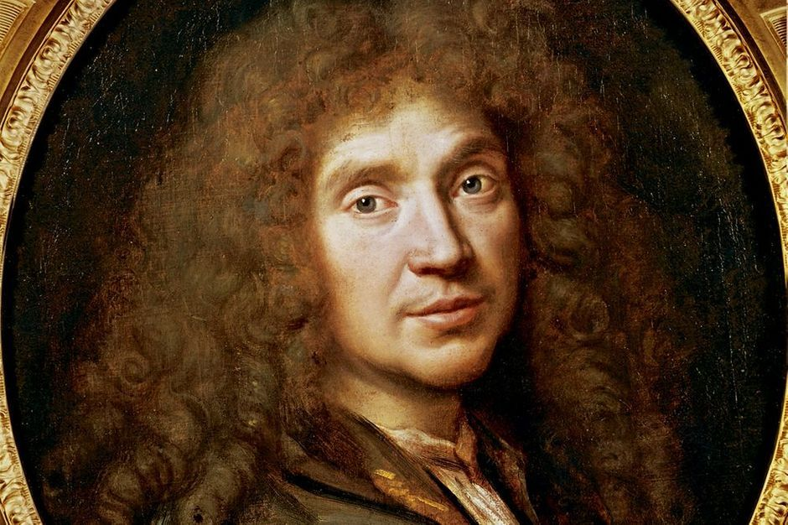
Molière
The king gave pensions to artists and the most famous of these writers was the playwright Molière (the pen name of Jean-Baptiste Poquel), whose comedy Tartuffe made fun of religious hypocrites and was condemned by church leaders.
Louis forced Molière to delay public performances of the play but resisted calls for his dismissal.

Slide 6
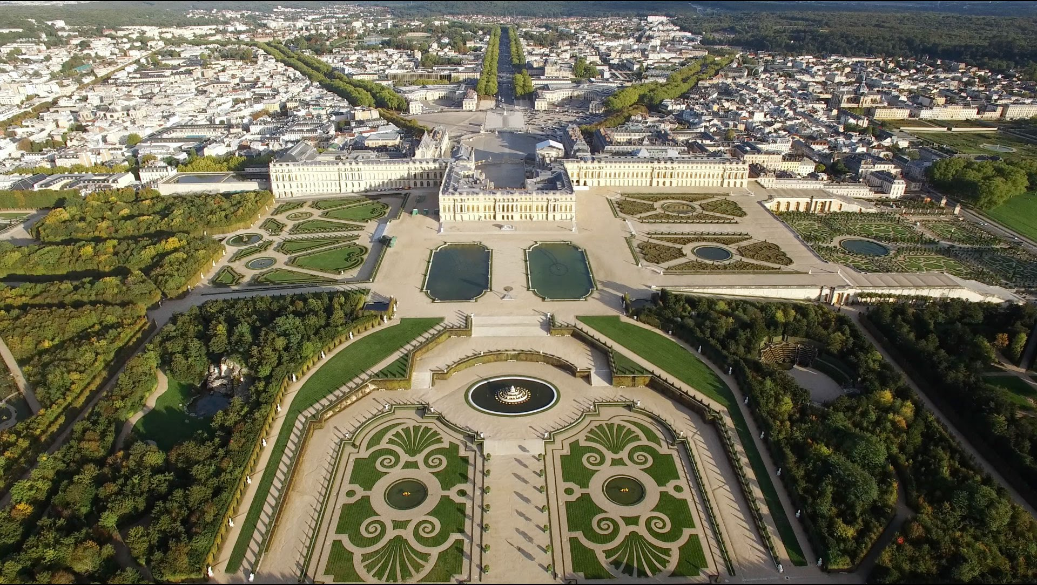
Versailles
Building Versailles engaged thirty-six thousand workers.
Versailles symbolized Louis’s success at reining in the nobility and dominating Europe, and other monarchs eagerly mimicked French fashion and often conducted their business in French.

Slide 7
Jansenists
The Jansenists wer Catholics whose doctrines and practices resembled some aspects of Protestantism. Follow-
Jansenists stressed the need for God’s grace in achieving salvation.
Louis rejected the Jansenists doctrine because it gave priority to considerations of individual conscience over the demands of the official church hierarchy.
In 1660, he began enforcing various papal bulls (decrees) against Jansenism and closed down Jansenist theological centers.

Slide 8
Revocation of the Edict of Nantes
Louis considered the Edict of Nantes (1598), by his grandfather Henry IV granted a temporary measure, and he hoped to reconvert the Huguenots to Catholicism.
In 1685, his revocation of the Edict of Nantes closed Calvinist churches and schools, forced all pastors to leave the country, and ordered the conversion of all Calvinists.
Children of Calvinists could be taken away from their parents and raised Catholic.
Tens of thousands of Huguenots responded by illegally fleeing to England, Brandenburg-Prussia, the Dutch Republic, or North America.
Protestant European countries were shocked by this crackdown on religious dissent and would cite it in justification of their wars against Louis.

Slide 9
Crucial Role of Government Bureaucracy
Louis XIV could not have enforced his policies without the services of a nationwide bureaucracy of a network of state officials carrying out orders.
Louis personally supervised the activities of his bureaucrats and handpicked an intendant for each region to represent his rule against entrenched local interests.
The intendants supervised the collection of taxes, the financing of public works, and the provisioning of the army.
In 1673, Louis decreed that local officials could no longer vote against his proposed laws or even speak against them.

Slide 10
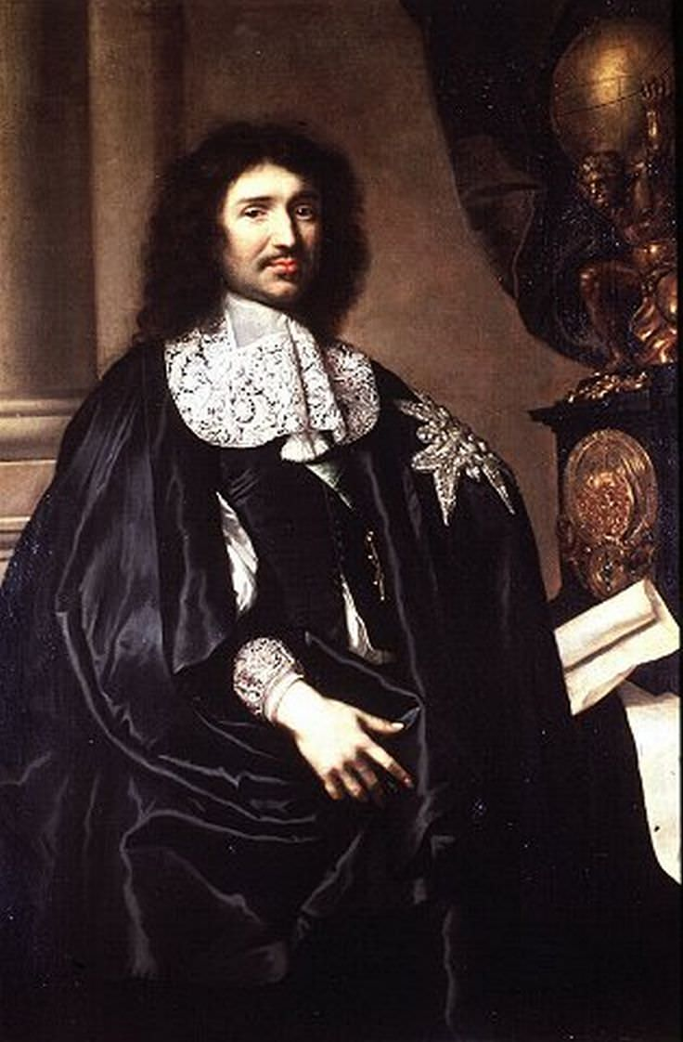
Jean-Baptiste Colbert
Jean-Baptiste Colbert was Louis XIV’s most important minister.
Colbert used the bureaucracy to establish a new economic doctrine, mercantilism, to compete more effectively with England and the Dutch Republic.
Colbert expanded the French Navy and army.

Slide 11
Mercantilism
Two parts-the mother country and the colonies.
Closed system-the colonies could only trade enumerated goods with the mother country.
The goal of the system was to make the mother country self-sufficient economically.
Bullionism-economic strength was judged by bullion reserves.
The object of trade was to export more goods than one imported to increase a kingdom’s bullion reserves, “a favorable balance of trade.”

Slide 12
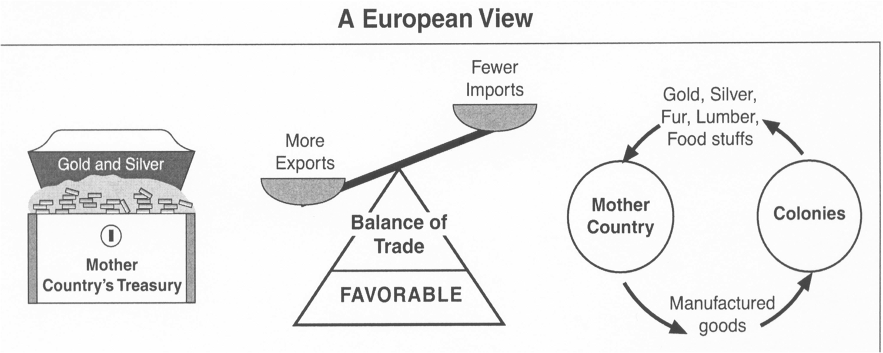
Mercantilism Visual

Slide 13
French Foreign Policy
Colonial settlement occupied only a portion of Louis XIV’s attention.
His main foreign policy goal was to extend French power in Europe.
Louis’s wartime army could field a force as large as that of all his enemies combined.

Slide 14
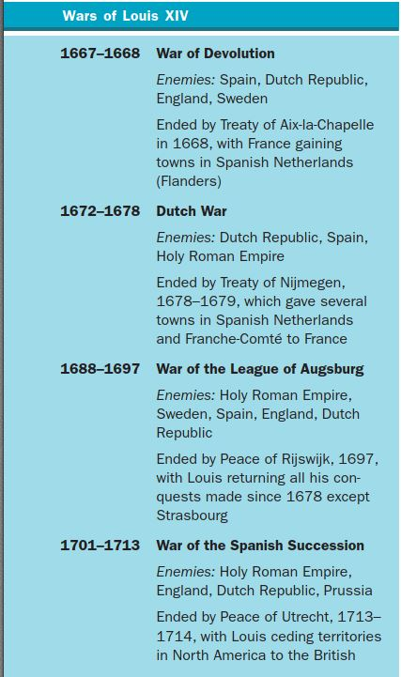
Wars of Louis XIV

Slide 15
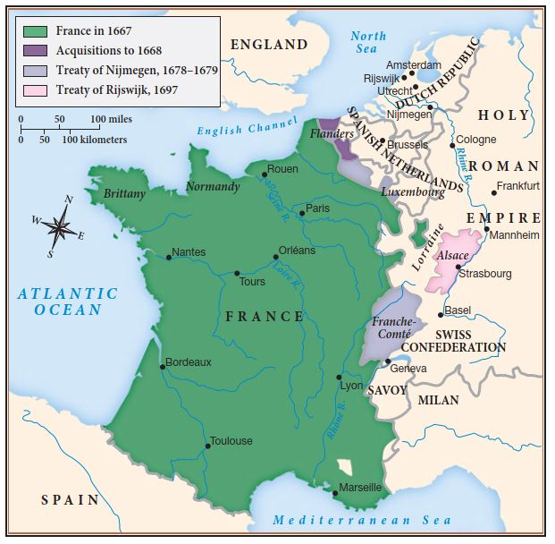
Louis XIV Expands French Territory

Slide 16
Consequences of Absolutism
Louis XIV’s policy of absolutism fomented bitter hostility among his own subjects.
Critics complained about the secrecy of Louis’s government, and nobles resented his promotions of commoners to high office.
Ordinary people suffered from Louis’s ambitions as one in six Frenchmen had served in the military.
Everyone paid higher taxes to support his lavish court and constant wars.
The law required common people to house and feed soldiers; only nobles were exempt from this requirement.

Slide 17
Constitutionalism in England
Constitutionalism had its own distinctive strengths, which came from the ruler sharing power
through a representative assembly such as the English houses of Parliament.
Some English rulers hoped to establish their own absolutist policies.
Two revolutions, in 1642–1660 and 1688–1689, confirmed the constitutional powers of an elected parliament.
These laid the foundation for the idea that government must guarantee certain rights to the people under the law.

Slide 18
Puritan Revolution
The Puritan Revolution, also called the English Civil War, began because of conflict between Anglicans allied with the King & Puritans in the English Parliament.
Charles I led the Cavalier faction and Oliver Cromwell led the Roundheads, the Puritan and Parliamentary faction.
The war raged from 1642 until the Cromwell triumphed in 1645 at the battle of Naseby and captured King Charles.
When Charles I refused to negotiate in any way with Parliament and the Puritans Cromwell had him beheaded for treason. The English monarch was dead, and Cromwell ruled England as “Lord Protector”

Slide 19
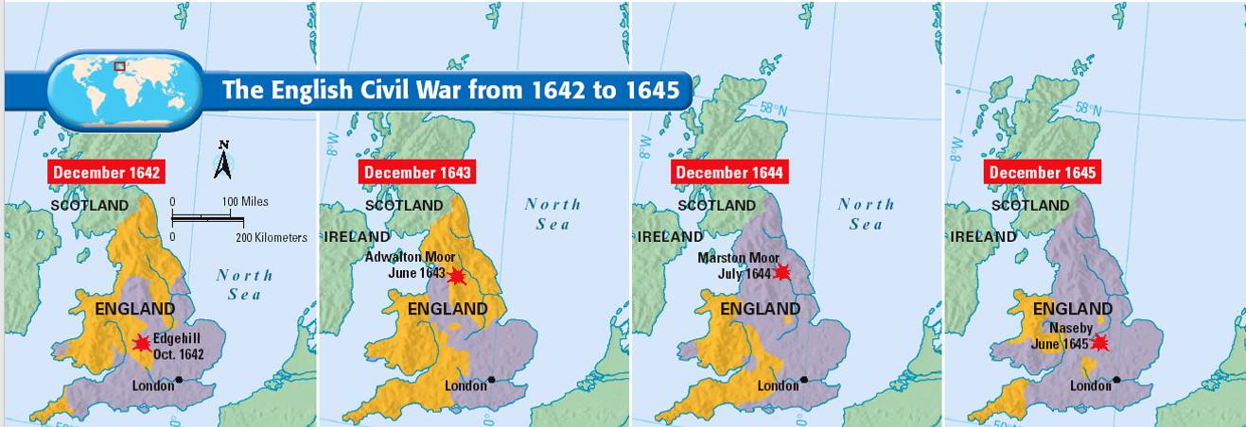
Phases of the Puritan Revolution

Slide 20
Levellers
When Parliament tried to disband the New Model Army in 1647, disgruntled soldiers called Levellers protested because of their insistence on leveling social differences.
The soldiers took on their officers in a series of debates about the nature of political authority.
The Levellers demanded that Parliament meet annually, that members be paid so as to
allow common people to participate, and that all male heads of households be
allowed to vote.
Their ideal of political participation excluded servants, the propertyless, and women but offered access to artisans, shopkeepers, and modest farmers.
Cromwell and other army leaders rejected the Levellers’ demands as threatening to property owners.

Slide 21
The Quakers
The Religious Society of Friends, who came to be called Quakers, demonstrated their beliefs in equality and the inner light by refusing to doff their hats to men in authority.
Manifesting their religious experience by trembling, or “quaking,” the Quakers believed that anyone — man or woman — inspired by a direct experience of God could preach.
In keeping with their notions of equality and individual inspiration, many of the new sects provided opportunities for women to become preachers and prophets.

Slide 22
The Rump Parliament
The army purged the Presbyterians from Parliament in late 1648, leaving a “rump” of about seventy members.
This Rump Parliament created a high court to try Charles I.
The court found him guilty of attempting to establish “an unlimited and tyrannical power” and pronounced a death sentence.
On January 30, 1649, Charles was beheaded before an enormous crowd.
The Rump Parliament abolished the monarchy and the House of Lords and set up a Puritan republic with Oliver Cromwell as Lord Protector.

Slide 23
Cromwell’s Expansion
Cromwell laid the foundation for a Great Britain by reconquering Scotland and brutally subduing Ireland.
In 1649, Cromwell went to Ireland with a large force and easily defeated the Irish, and massacring whole garrisons and their priests.
He encouraged expropriating land from the Irish, and Scottish immigrants resettled the northern county of Ulster.
This seventeenth-century English conquest left a legacy of bitterness that the Irish even today call “the curse of Cromwell.”

Slide 24
British Mercantilism
The English controlled where her New World colonies could export and import goods with legislation called Navigation Acts.
The Navigation Acts designated valuable commodities as enumerated goods that colonies could only export to England.
Tobacco, Rice, Sugar, Indigo, Beaver pelts, and pig iron were all enumerated goods.
Only English ships could visit her New World colonies, and this targeted the commercial power of the Dutch Republic.
Fish, flour, jerked meat, and other agricultural products were not enumerated & colonies exported these to Europe and other colonies

Slide 25
Restoration of the English Monarchy
After the beheading of Charles I in 1649, the monarch ended, and Oliver Cromwell ruled England as Lord Protector.
The English did not enjoy the harsh Puritans social standards.
When Cromwell died in 1659, the English Parliament asked the dead King’s son, Charles, to restore the monarchy and rule England.
Charles II accepted and the monarchy was restored in 1660.
As part of the arrangement Parliament received assurances of its authority.
Charles II was given nearly complete control of the colonies.

Slide 26
Political Factions Emerge
The death of Charles II and the possible ascension of Catholic James II created two distinct factions in Parliament.
The Tories, who supported a strong, hereditary monarchy and the restored ceremony of the Church of England.
The Whigs advocated parliamentary supremacy and toleration of Protestant dissenters such as Presbyterians.
Both labels were originally derogatory: Tory meant an Irish Catholic bandit and Whig was the Irish Catholic designation for a Presbyterian Scot.
The Tories favored James’s succession despite his Catholicism, whereas the Whigs opposed a Catholic monarch.

Slide 27
The Glorious Revolution
After creating the Dominion of New England, James II attempted to diminish the power of Parliament back home in England.
James’ second wife was a Catholic princess who had a son and heir.
The prospect of Catholic monarch enraged Protestants in Parliament.
James’ first wife was Protestant and had two daughters, Mary & Anne
Parliament invited Mary’s husband, the Dutch William of Orange to invade England with Parliament’s blessing and overthrow James II.
William invaded England in what became known as the Glorious Revolution and overthrew James II who fled to France.

Slide 28
William & Mary
In the Bill of Rights (1689), William and Mary agreed not to raise a standing army or to levy taxes without Parliament’s consent.
They also agreed to call meetings of Parliament at least every three years, to guarantee free elections to parliamentary seats, and to abide by Parliament’s decisions.
The agreement gave England’s constitutional government a written, legal basis by formally recognizing Parliament as a self-contained, independent body that shared power with the rulers.

Slide 29
Religious Tolerance
The Toleration Act of 1689 granted all Protestants freedom of worship, though non-Anglicans (those not in the Church of England)
were still excluded from the universities; Catholics got no rights but were more often left alone to worship privately.
When the Catholics in Ireland rose to defend James II, William and Mary’s troops savagely suppressed them.

Slide 30
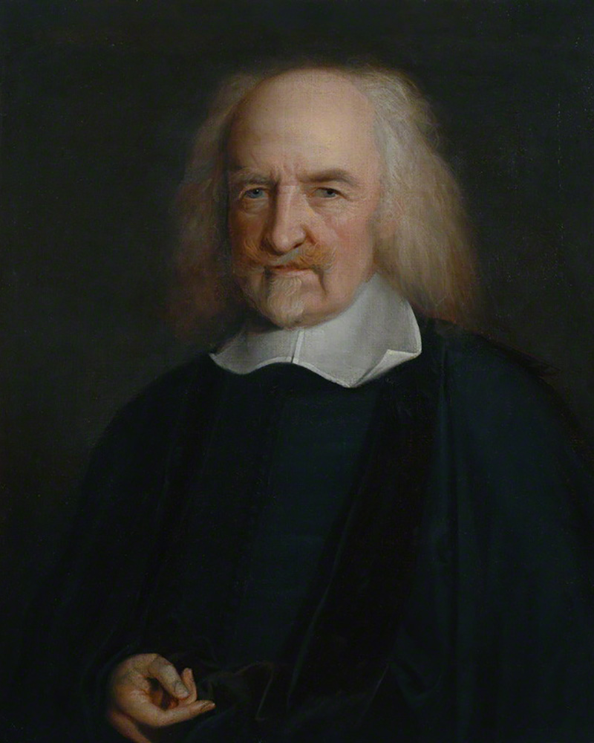
Thomas Hobbes-Leviathan
In 1651, Hobbes published his masterpiece, Leviathan, in which he argued for unlimited authority in a ruler in order to overcome the defects of human nature.
Giving up personal liberty, he maintained, was the price of collective security.
He enraged royalists by arguing that authority came not from divine right but from the social contract.

Slide 31
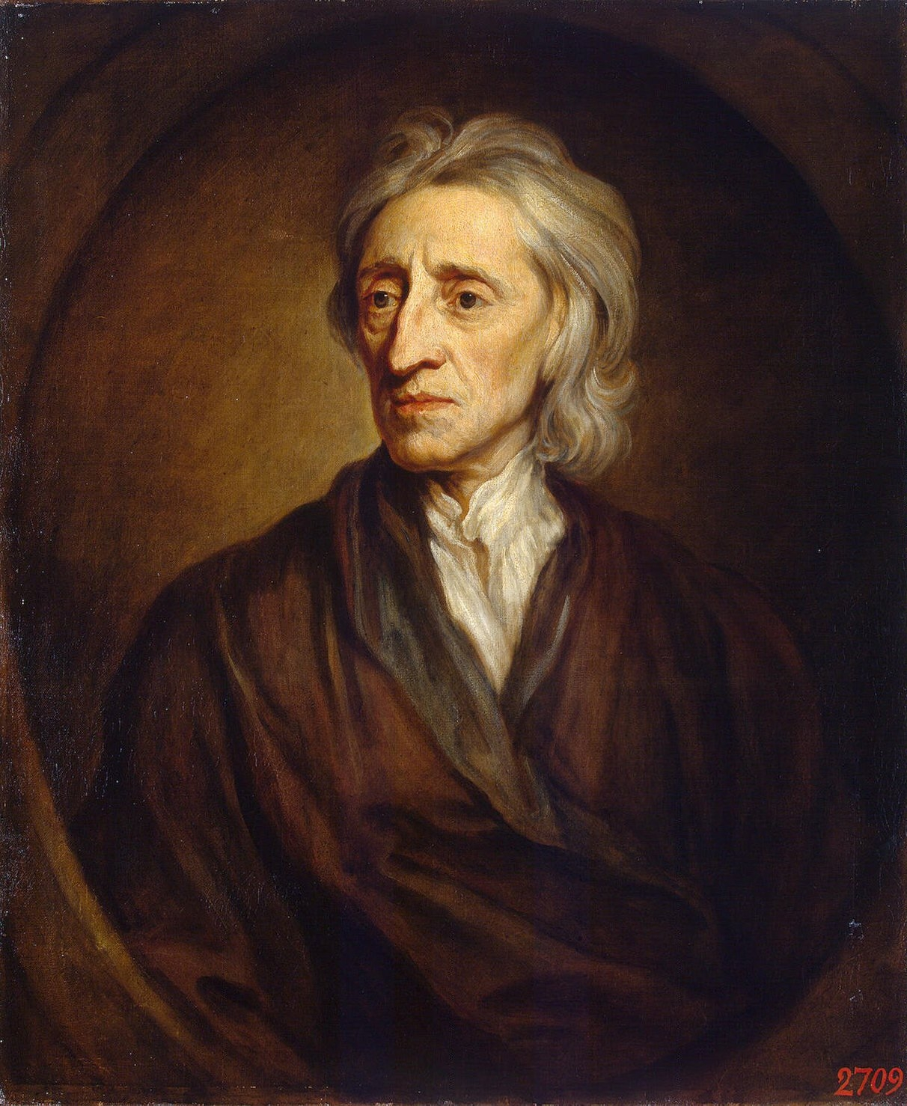
John Locke-Two Treatises of Government
Rejecting Hobbes, John Locke used the notion of a social contract to provide a foundation for constitutionalism.
His Two Treatises of Government denied the divine right of kings.
Unlike Hobbes, he thought people were reasonable and the state of nature peaceful instead of brutish and violent.
Locke insisted that government’s only purpose was to protect life, liberty, and property.
Ultimate authority rested in the will of a majority of men who owned property, and government should be limited to its basic purpose of protection.

Slide 32
Constitutionalism in the Dutch Republic
The Dutch established a decentralized, constitutional state.
Rich merchants called regents effectively controlled the internal affairs of each province and chose the stadholder, the executive officer responsible for defense and for representing the state at all ceremonial occasions.
They almost always picked one of the princes of the house of Orange, but the stadholder resembled a president more than a king.

Slide 33
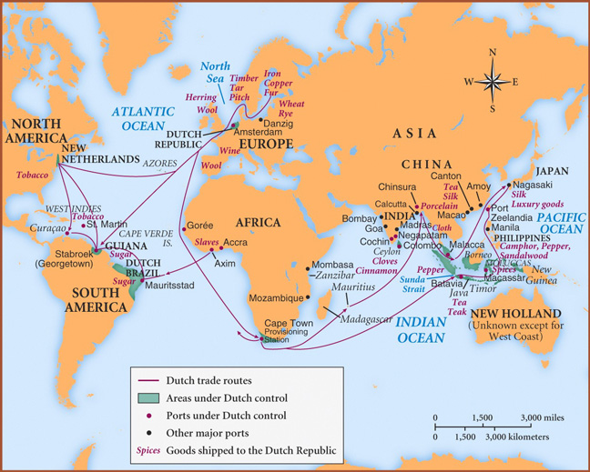
Dutch Commercial Dominance
The Dutch Republic became Europe’s financial capital because they dominated overseas commerce with their shipping.
They imported products from all over the world: spices, tea, and silk from Asia; sugar and tobacco from the Americas; wool from England and Spain; timber and furs from Scandinavia and grain from eastern Europe.
The Dutch rapidly became the most prosperous and best-educated people in Europe

Slide 34
Decline of the Dutch
The Dutch lived in a world of international rivalries.
Naval wars with England between 1652 and 1674 and the land wars with France, which lasted until 1713, drained the state’s revenues.
The Dutch survived but began to lose their position in international trade as both the British and French used mercantilism to limit commerce with their own colonies to merchants from their own nations.
At the end of the seventeenth century the Dutch “golden age” came to an end.

Slide 35
Origins of the Slave Trade
The Spanish and Portuguese had shown that African slaves could be transported and forced to labor in South and Central America.
The English and French endeavored to set up similar labor systems in their new Caribbean island colonies.
European planters with large tracts of land bought African slaves to work fields of sugarcane.

Slide 36
The Establishment of Law Governing Slavery
By the end of the seventeenth century, slav ery had become codified as an inherited status that applied only to blacks.
In 1661, Barbados instituted a slave code that stripped all Africans of rights under En glish law.
Louis XIV promulgated a “black code” in 1685 to regulate the legal status of slaves in the French colonies and to prevent non-Catholics from owning slaves.
Laws defined slaves as property, slaves could not themselves bring suit in court to demand better treatment.
The highest church and government authorities in Catholic and Protestant countries alike condoned the gradually expanding slave trade.

Slide 37
The Growth of Slave Trade
In 1600, 7600 Africans were exported annually from Africa to the New World.
By 1700, this number had increased to 33,000.
Several factors increased the slave trade-
First - improvements in muskets made European slavers more effective.
Second- the rising price for slaves made their sale more attractive for the Africans
who sold them.
Third- The increasing size of African armies and their use of muskets in fighting and capturing other Africans increased the number of slaves for sale.

Slide 38
Self-Government of New World Colonies
New World English colonies enjoyed more freedom than ever before.
Virtually left to themselves during the upheavals in England, the fledgling English colonies in North America developed representative government on their own.
Almost every colony had a two-house legislature.
William and Mary reluctantly allowed emerging colonial elites even more control over local affairs.
Plentiful land prevented the transplantation of English social hierarchy dominated by rich landowners and allowed ordinary to carve out their own farms.

Slide 39
Native American Catastrophe
Native Americans faced death through disease, warfare, and the accelerating loss of their homelands.
Most Native Americans believed that land was for collective use and not subject to individual ownership while Europeans claimed that they owned exclusive land rights.
These differing views led to violence and war.
In 1675–1676, three tribes allied under Metacomet (called King
Philip by the English) attacked New England.
The colonists savagely repulsed the attacks and sold their captives as slaves.

Slide 40
Poland Lithuania Overwhelmed
In the version of constitutionalism adopted in Poland-Lithuania, the great nobles dominated the Sejm (parliament) and each noble each wielded an absolute veto power.
This “free veto” constitutional system deadlocked parliamentary government.
Ukrainian Cossack warriors revolted against the king of Poland-Lithuania in 1648, inaugurating two decades of tumult known as the Deluge.
In 1654, the Cossacks offered Ukraine to Russian rule, provoking a Russo-Polish war that ended with the tsar annexing eastern Ukraine and Kiev.
As much as a third of the Polish population perished.
The once prosperous Jewish and Protestant minorities suffered greatly: 56,000 Jews were killed by the Cossacks, the Polish peasants, or the Russian troops.

Slide 41
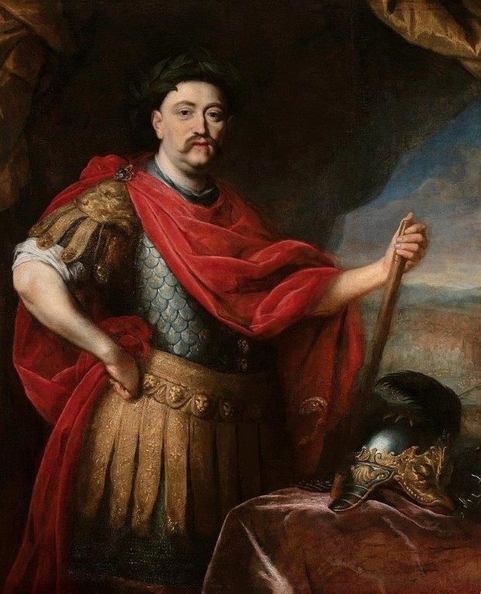
Jan Sobieski Revives Poland-Lithuania
The commonwealth revived briefly when a man of ability and ambition, Jan Sobieski was elected king.
Sobieski gained a reputation throughout Europe when he led 25,000 Polish cavalrymen into battle in the siege of Vienna and helped rout the Ottomans.
Despite his efforts to rebuild the monarchy, Sobieski could not halt Poland-Lithuania’s decline.
The Polish version of constitutionalism fatally weakened the state and made it prey to neighboring powers.

Slide 42
Absolutism in Brandenburg-Prussia
Frederick William of Hohenzollern turned Brandenburg-Prussia into an absolutist state.
Frederick William struck a deal with the Junkers (nobles) of each province: in exchange for allowing him to collect taxes, he gave them complete control over their enserfed peasants and exempted them from taxation. By the end of his reign, the estates met only on ceremonial occasions.
Frederick William was able to expand his army from 8,000 to 30,000 with peasants filling the ranks, and Junkers becoming officers.

Slide 43
Habsburgs vs Ottomans
Austria fought the Turks for control of Hungary for more than 150 years. ‘
In 1682, war broke out again. The Turks in 1683, laid siege to Vienna.
With the help of Polish cavalry, the Austrians finally broke the siege and turned the tide in a
major counteroffensive.
By the Treaty of Karlowitz of 1699, the Ottoman Turks surrendered almost all of Hungary to the Austrians, marking the beginning of the decline
of Ottoman power.
Austrian rule over Hungary tightened as they systematically destroyed Turkish buildings and rebuilt Catholic churches, monasteries, road-
side shrines, and monuments in the baroque style.
The Ottoman Turks pushed hundreds of thousands of Turkish families into the Balkan peninsula in the 1400s and 1500s.
As locals converted to Islam, administration passed gradually into Ottoman hands.

Slide 44
Absolutism in Russia
Russia was evolving as an absolutist state and the tsars wanted to claim unlimited autocratic power.
The code of 1649 assigned all subjects to a hereditary class with slaves and peasants merged into a serf class.
Serfs were tightly tied to the soil and to their noble masters.
The code also forbade towns people to move from the community where they resided.
Nobles owed absolute obedience to the tsar and were required to serve in the army, but in return no other group could own estates worked by serfs.
Serfs became the chattel of their lord, who could sell them like horses or land.
Their lives differed little from those of the slaves on the plantations in the Americas.

Slide 45
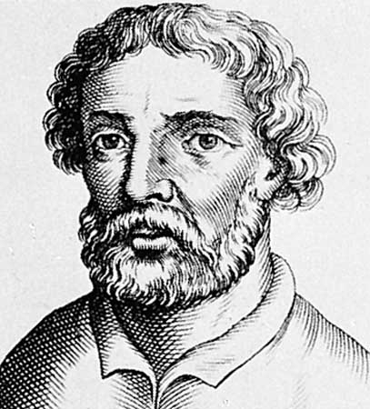
Stenka Razin and Rebellion in Russia
In 1667, Stenka Razin, the head of a powerful band of pirates and outlaws in southern Russia, led a rebellion that promised liberation from the great noble landowners.
Captured four years later by the tsar’s army, Razin was taken to Moscow, where he was dismembered in front of the public and his body thrown to the dogs.
Thousands of his followers also suf-fered grisly deaths, but Razin’s memory lived on in folk songs and legends.

Slide 46
Significant Artists
The English Puritan poet John Milton wrote about limitations on individual liberty, and in his epic poem Paradise Lost he used the biblical Adam and Eve’s fall from grace to demonstrate the limits to freedom while recognizing personal liberty remains essential to their humanity.

Slide 47
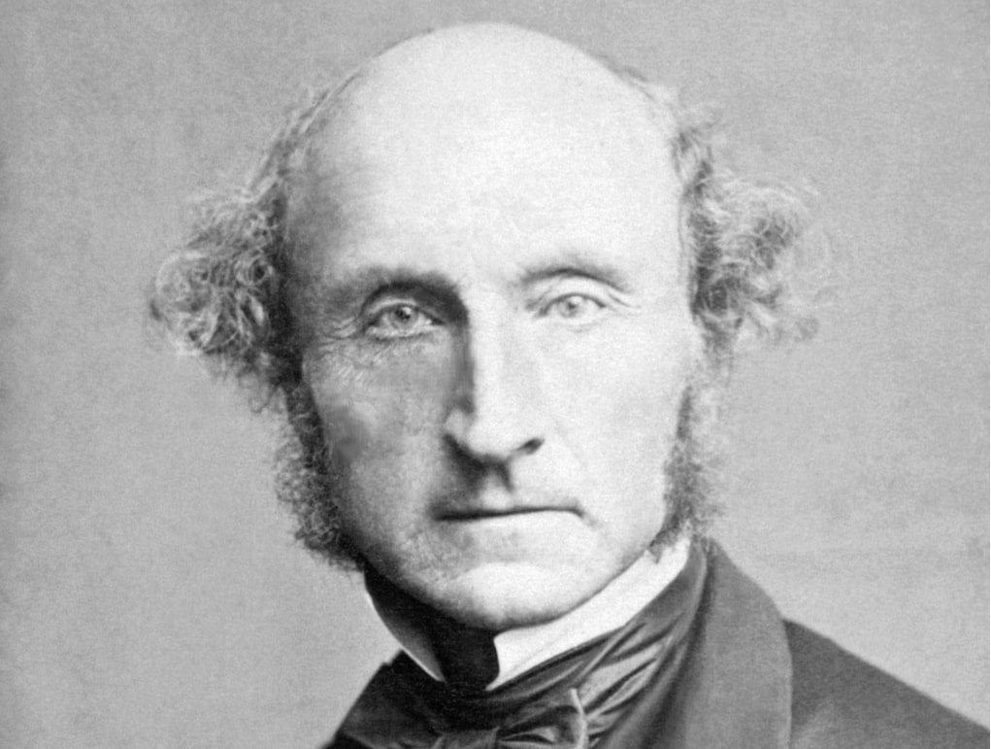
John Stuart Mill-Paradise Lost
The English Puritan poet John Milton wrote about limitations on individual liberty, and in his epic poem Paradise Lost he used the biblical Adam and Eve’s fall from grace to demonstrate the limits to freedom while recognizing personal liberty remains essential to their humanity.

Slide 48
Classicism
Classicism reflected the ideals of the art of antiquity: geometric shapes, order, and harmony of lines took precedence over the sensuous, exuberant, and emotional forms of the baroque.
Iclassicism the individual could be found at the intersection of con-
verging, symmetrical, straight lines.
These influences were apparent in the work of Nicolas Poussin and Claude Lorrain.

Slide 49
The Salon and Courtly Manner
Courtly manners often permeated the upper reaches of society by means of the salon, an informal gathering held regularly in a private home and presided over by a socially eminent woman.
The French government occasionally worried that these gatherings might challenge its authority, but the three main topics of salon conversa-tion were love, literature, and philosophy.
Before publishing a manuscript, many authors would read their compositions to a salon gathering.

Slide 50
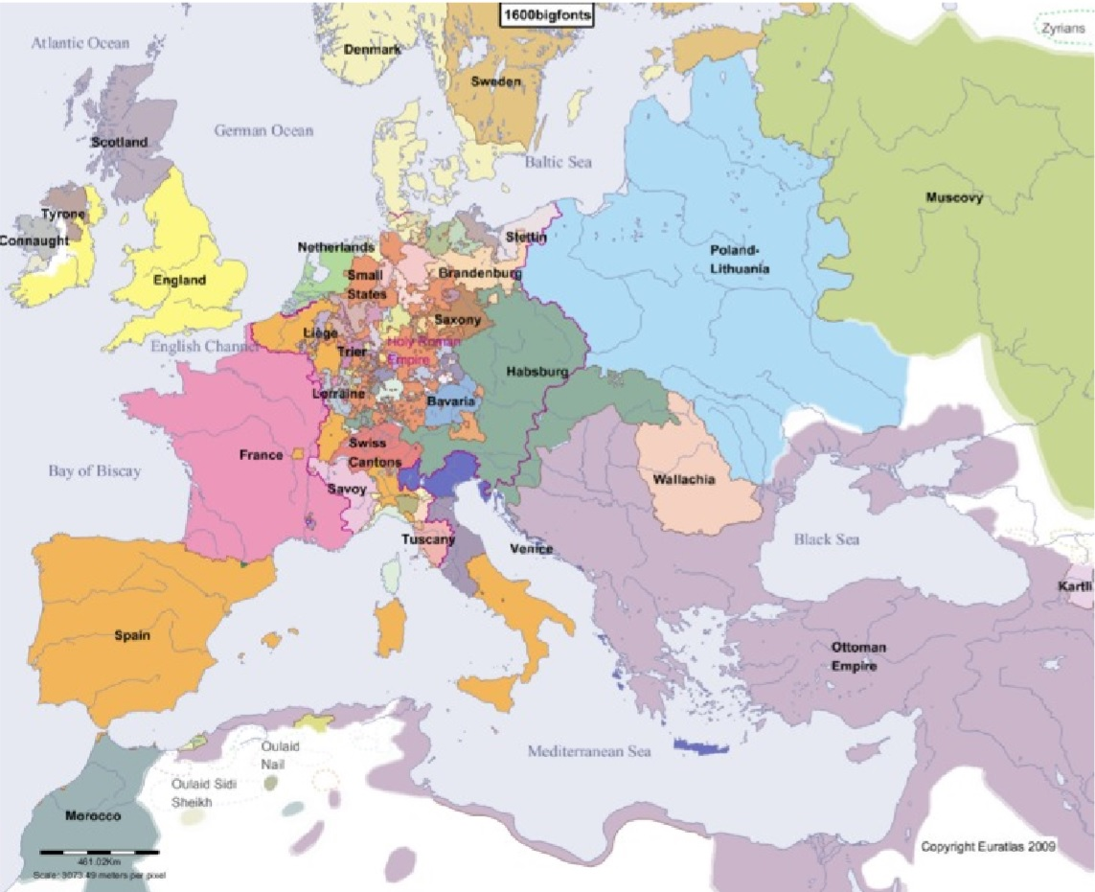
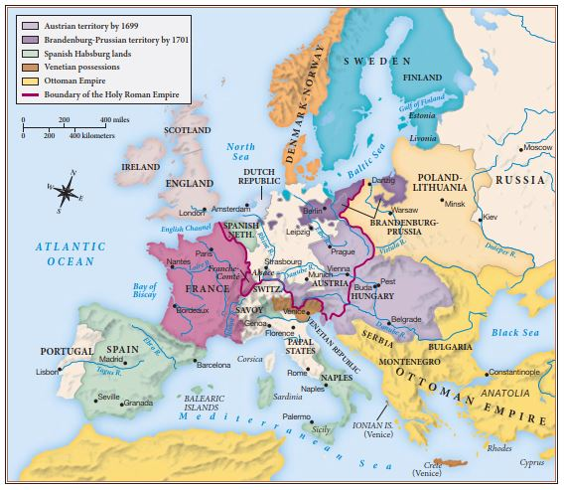
Europe changes in the 17th Century

