Slide 1
Coffee
Europeans in the sixteenth century learned of a Middle Eastern drink called kavah.
An Arab monopoly on its production kept prices too high for widespread consumption.
In 1699, Dutch traders brought coffee plants from India to Java, which proved ideal
for growing the beans.
Within two decades, Europe was flooded with 200,000 pounds of coffee a year.
Coffee went to the Caribbean island of Martinique in 1721, and quickly spread throughout the Caribbean.

Slide 2

World Coffee Growing Regions

Slide 3
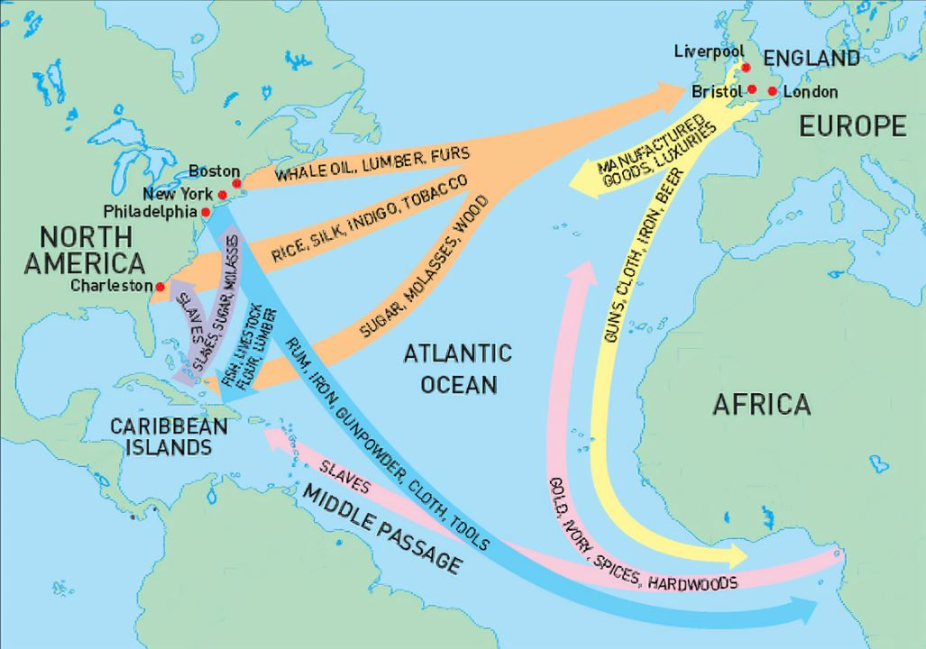
The Atlantic System
The web of trade routes that bound together western Europe, Africa, and the Americas.
It first took clear shape in the early eighteenth century.

Slide 4
The African Slave Trade
In the eighteenth century, European Atlantic trade rapidly expanded.
By 1650, Portugal had already sent 40,000 African slaves to Brazil.
Before 1675, most Africans went to Brazil or Spanish America on Portuguese or Dutch ships, but by 1725 more than 60 percent landed in the Caribbean and more and more on British or French ships.
Ten million Africans, not counting those who were captured but died before or during the sea voyage, were transported to the Americas before 1850.

Slide 5
Plantations
A plantation was a large tract of land that produced a staple crop such as sugar, coffee, or tobacco; was farmed by slave labor; and was owned by a European.
As trade in precious metals dwindled Europeans saw that plantations producing staples with slave labor could produce fabulous wealth.
Brazil, the Caribbean, and Spanish America imported most of the Africans before 1700, but then the plantation economy began to expand on the North American mainland.

Slide 6
The Inhumanity of the Slave Trade
The enslaved women and men suffered terribly.
West Coast Africans attacked interior tribes, marched the captives to the coast, and sold the victims to Europeans.
The vast majority were between fourteen and thirty-five years old.
Before cramming them onto the ships for the three-month Middle Passage to the New World, slavers shaved their heads and stripped them naked, and branded some with red-hot irons.
They separated men and women, and shackled men with leg irons.
Sailors and officers raped the women at will.
In the cramped and appalling conditions of the Middle Passage across the Atlantic as many as one-fourth of the slaves died.

Slide 7
Slave Life on a Plantation
Those who survived the transit were sold and given new names, often only first names.
Slaves had no social identities of their own; they were expected to learn their master’s language and to do any job assigned.
Slaves worked fifteen- to seventeen-hour days and were fed only enough to keep them on their feet.

Slide 8
Worked to Death on Sugar Plantations
The death rate among slaves was high on the sugar plantations.
Slaves had to cut and haul sugarcane to the grinders and boilers before it spoiled. During the harvest, grinding and boiling went on around the clock.
Women could not do the work so only strong males were imported.
Because so many slaves died in the sugar growing regions, new slaves had to be constantly imported.
In North America, in contrast, where sugar was a minor crop, women were imported, and the slave population increased tenfold by 1863 through natural growth.

Slide 9
European and African Population Ratios
Blacks made up only 3 percent of the population in eighteenth-century New England, compared with 60 percent in South Carolina.
By 1713, the French Caribbean colony of St. Domingue had four times as many black slaves as whites; by 1754, slaves there, outnumbered whites more than ten to one.

Slide 10
Sugar and Tobacco inundate Europe
Sugar had been prescribed as a medicine before the end of the sixteenth century
The development of plantations in Brazil and the Caribbean made it a standard food item.
By 1700, the British were sending home fifty million pounds of sugar a year, a figure that doubled by 1730.
Equally pervasive was the spread of tobacco; by the 1720s, men of every country and class smoked pipes or took snuff.

Slide 11
The Growth of European Colonization
To expand their trade in the rest of the world, Europeans seized territories and tried to establish permanent settlements.
In contrast to the sparsely inhabited European trading outposts in Asia and Africa, the colonies in the Americas bulged with settlers.
The British North American colonies contained about 1.5 million Europeans and Africans by 1750.

Slide 12
Differing Colonial Societies
Unlike the French and English, the Spanish and Portuguese tolerated intermarriage with the native populations in both America and Asia.
By 1800, mestizos, people born to a Spanish father and an Indian mother, accounted for more than a quarter of the population in the Spanish colonies.
Where intermarriage between colonizers and natives was common, conversion to Christianity proved most successful.
In the early years of American colonization, many more men than women emigrated from Europe.
Two and a half times more men than women immigrated from Liverpool, England, between 1697 and 1707.

Slide 13
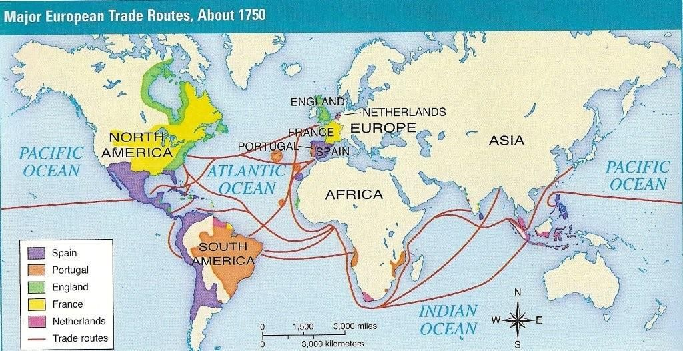
Eighteenth Century European Colonization

Slide 14
Buccaneers
In the 1500s and 1600s, the English and Dutch governments had routinely authorized pirates to prey on the ships of their rivals, the Spanish and Portuguese.
Then, in the late 1600s, English, French, and Dutch bands made up of deserters and crews from wrecked vessels began to form their own associations of pirates, especially in the Caribbean.
Called buccaneers, the pirates governed themselves and preyed on everyone’s shipments without regard to national origin.
After 1700, the colonial governments tried to stamp out piracy.

Slide 15
Increased Longevity
A decline in death rate in the eighteenth century began the modern population explosion.
Three main factors contributed to increased longevity.
1-Better weather and hence more bountiful harvests.
2-Improved agricultural techniques.
The plague’s disappearance after 1720.

Slide 16
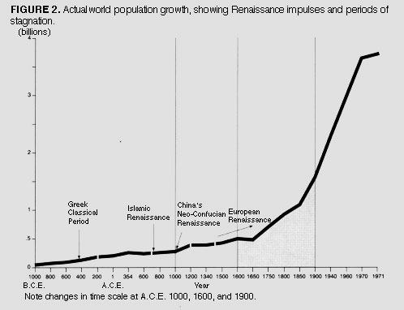
Population Growth

Slide 17
The Consumer Revolution
The eighteenth century saw a rapid increase in consumption of new staples produced in the Atlantic system as well as of other items of daily life that were previously unavailable or beyond the reach of ordinary people.
Rising population increased demand that created more jobs and income that allowed more people to escape the subsistence economy
Tea, chocolate, and coffee became virtual necessities, but also tables, chairs, sheets, chamber pots, lamps, mirrors, china, cutlery, chests of drawers, desks, clocks, and pictures for the walls.

Slide 18
The Agricultural Revolution
Four major changes caused the agricultural revolution.
First, farmers increased the amount of land under cultivation by draining wetlands and by growing crops on previously uncultivated common lands.
Second, those farmers who could afford it consolidated small, scattered plots into larger, more efficient units.
Third, livestock raising became more closely linked to crop growing, and the yields of each increased as farmers planted carefully chosen fodder crops such as clover and turnips that added nutrients to the soil and with more fodder available, farmers could raise more livestock, which in turn produced more manure to fertilize grain fields
Fourth, selective breeding of animals combined with the increase in fodder to improve the quality and size of herds.

Slide 19
Enclosure
The “enclosure movement followed an act of parliament allowed British landowners to fence off (enclose) property previously used by the community for common grazing
Such acts became increasingly common in the second half of the eighteenth century, and by the century’s end six million acres of common lands had been enclosed and developed.
In this way the English peasantry largely disappeared, replaced by a more hierarchical society of landlords, tenant farmers, poor agricultural laborers.

Slide 20
Urbanization
Enclosure forced many peasant to emigrate to cities.
Between 1650 and 1750, cities with at least ten thousand inhabitants increased in population by 44 percent.
From the eighteenth century onward, urban growth has been continuous.
Southern Europe was more urban before 1500, but by 1750 northern Europe caught up while Eastern Europe remained less urban.

Slide 21
Urban Classes
At the top of the ladder in the big cities were the landed nobles who might employ thirty to forty servants in their homes.
The middle classes of officials, merchants, professionals, and landowners occupied the next rung down on the social ladder.
Below the middle classes came the artisans and shopkeepers, then the journeymen, apprentices, servants, and laborers.
At the bottom of the social scale were the unemployed poor.

Slide 22
Symbols of Class Status
The size of houses was the first and most important symbol of status.
Clothing was a reliable social indicator.
The ability to read and write also reflected social differences and the literate purchased newspapers, books, and magazines.
The arts marked social status with the purchase of paintings.
Attending concerts also marked social status.

Slide 23
New Art Forms
The new rococo style of painting challenged the hold of the baroque and classical schools, especially in France.
Rococo paintings depicted scenes of intimate sensuality rather than the monumental, emotional grandeur favored by classical and baroque painters.
The growth of public appreciation for music allowed artists like Frideric Handel to liberate themselves from court patronage.
Nothing captured the imagination of the new public more than the novel, and such masters as Eliza Haywood, Daniel Defoe, and Miguel de Cervantes captivated the public.

Slide 24
Religious Revival
A Protestant revivalist movement known as Pietism promised a a deeply emotional religious experience driving by intense Bible study.
It emphasized the virtues of hard work, obedience, and devotion to duty.
Jansenists enjoyed a revival in France.
Jeanne Marie Guyon established her own Catholic brand of Pietism, known as Quietism.

Slide 25
The Decline of Spain
Spain began a long decline after the War of the Spanish Succession.
Catholic censorship hurt Spain’s social development.
Church laws prohibited people from smoking, reading newspapers, or talking politics in cafés and inns — precisely the activities flourishing in England, France, and the Dutch Republic.
The Spain consistently imported more from Britain and France than it exported to them.

Slide 26
Dutch Decline and England’s Rise
After the death of King William III, Dutch and English ties dissolved.
Constant warfare and a small population coupled with stout commercial competition from England forced the Dutch to become dependent on alliances with larger countries to ensure its survival.
The English ended religious and political strife by joining with Scotland and Wales in the Act of Union 1707, and outlawing a Catholica on the throne.

Slide 27
The House of Hanover
To ensure a Protestant succession, Parliament ruled that Mary’s sister, Anne, would succeed William and Mary and that the Protestant house of Hanover in Germany would succeed Anne.
The house of Hanover — renamed the house of Windsor during World War I because of Hanover’s German heritage— still occupies the British throne today.
George of Hanover became King George I of England in 1727.

Slide 28
The First Minister-Robert Walpole
George I and George II relied on one man, Sir Robert Walpole to help them manage their relations with Parliament.
From his position as First Lord of the Treasury, Walpole made himself into the first, or “prime,” minister.
Although appointed initially by the king, Walpole established an enduring pattern of parliamentary government in which a prime minister from the leading party guided legislation through the House of Commons.
Walpole also built a vast patronage machine that dispensed government jobs to win support for the crown’s policies.

Slide 29
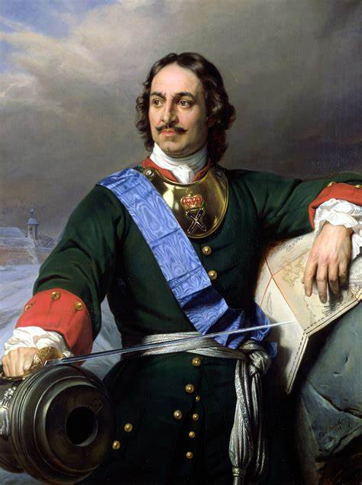
Peter the Great
Peter the Great dragged Russia kicking and screaming to great-power status.
Peter transformed public life in Russia and established an absolutist state based on the Western model.
He built a new capital city to replace Moscow, St. Petersburg.

Slide 30
Westernization
To Westernize Russia Peter set up the first laboratories and technical schools and founded the Russian Academy of Sciences.
He ordered translations of Western classics, hired a German theater company to perform the French plays of Molière, and replaced the traditional Russian calendar with the Western one.
He ordered his officials and the nobles to shave their beards and dress in Western fashion.
Peter encouraged foreigners to move to Russia to offer their advice and skills, especially for building the capital city, St. Petersburg
The tsar allowed nothing to stand in his way and ordered the torture and execution of thousands who opposed him.

Slide 31
Establishing Russian Absolutism
To control the nobility, Peter insisted that all noblemen engage in state service.
The Table of Ranks (1722) classified them into military, administrative, and court categories, a codification of social and legal relationships in Russia that would last for nearly two centuries.
Peter replaced the patriarch of the Russian Orthodox church with the Holy Synod, a bureaucracy of laymen under the Tsar’s supervision.

Slide 32
The Great Northern War
To make Russia a great European power he took on Sweden, which had dominated the Baltic region since the Thirty Years’ War.
The resulting Great Northern War saw Sweden defeating Peter’s allies and finally invading Russia.
Peter defeated the Swedes at the battle of Poltava.
The peace treaty gave Russia control of Estonia, Lithuania, and Latvia on the coast of the Baltic Sea.

Slide 33
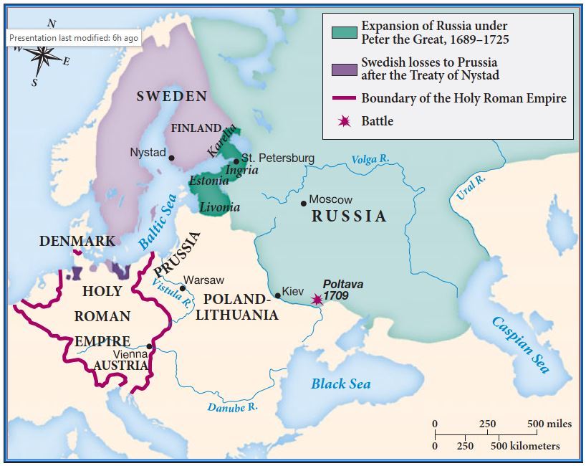
Russia Expands in Europe

Slide 34
War of Polish Succession
France, Spain, and Sardinia joined in the War of the Polish Succession (1733–1735) against Austria and Russia, each side supporting rival claimants to the Polish throne.
Russian forces were still strong enough to drive the French candidate out of Poland-Lithuania, prompting France to accept the Austrian candidate.
Austria gave the province of Lorraine to the French.

Slide 35
Hungary
Austrians had forced the Turks to recognize their rule over all of Hungary and Transylvania in 1699.
In 1703, a Hungarian noble, Ferenc Rákóczi, raised an army of 70,000 men who fought for independence until 1711.
The revolt forced the Austrians to recognize local Hungarian institutions, grant amnesty, and restore confiscated estates in exchange for confirming hereditary Austrian rule.

Slide 36
The Ascension of Maria Theresa
Holy Roman Emperor Charles VI died without a male heir in 1740, and this led to the War of Austrian Succession when his daughter Maria Theresa ascended to the throne.
The new king of Prussia, Frederick the Great saw his chance to grab territory and immediately invaded the rich Austrian province of Silesia.
France joined Prussia in an attempt to further humiliate its traditional enemy Austria, and Great Britain allied with Austria to prevent the French from taking the Austrian Netherlands.
The war soon expanded to the overseas colonies of Great Britain and France.
The Peace of Aix-la-Chapelle (1748) recognized Maria Theresa as the heiress to the Austrian lands; her husband, Francis I, became Holy Roman Emperor, thus reasserting the integrity of the Austrian Empire.

Slide 37
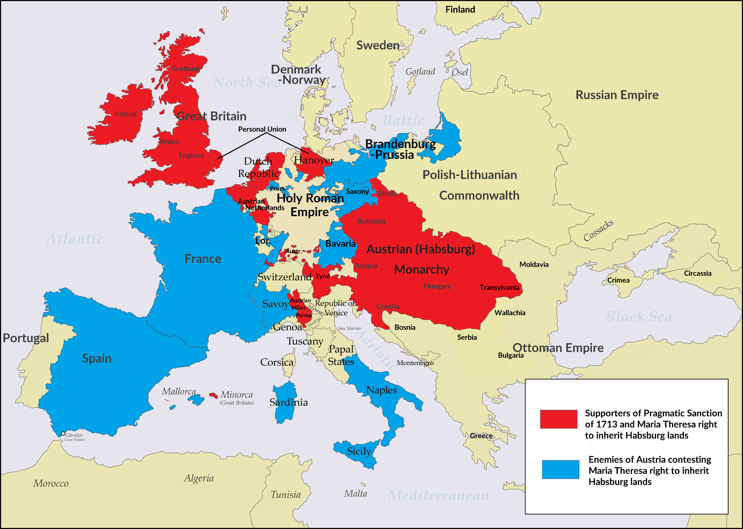
War of Austrian Succession

Slide 38
Population Statistics
Europe began to scientifically study population with the publication of William Petty’s Political Arithmetick in 1690.
It offered statistical estimates of human capital — population and
wages — to determine Britain’s national wealth.
Government officials devoted increased effort to the statistical estimation of total population and rates of births, deaths, and marriages.

Slide 39
The State of Medicine
Hardly any infectious diseases could be cured, though inoculation against smallpox spread from the Middle East to Europe.
Inoculation against smallpox spread more widely only after 1796, when the English physician Edward Jenner developed a serum based on cowpox, a milder disease.
A medical profession with nationwide organizations and licensing had not yet emerged.
Patients in a hospital were as likely to catch a deadly disease as to be cured there.
Antiseptics were virtually unknown

Slide 40
The Enlightenment
A movement begun by a loosely knit group of writers and scholars who believed that human beings could apply a critical, reasoning spirit to every problem they encountered in this world.
The new secular, scientific attitude scrutinized everything from the absolutism of Louis XIV to the traditional role of women in society.
Writers provided new theories for the organization of society and politics;
Even while slavery expanded in the Atlantic system, Enlightenment writers began to insist on the need for new freedoms in Europe.

Slide 41
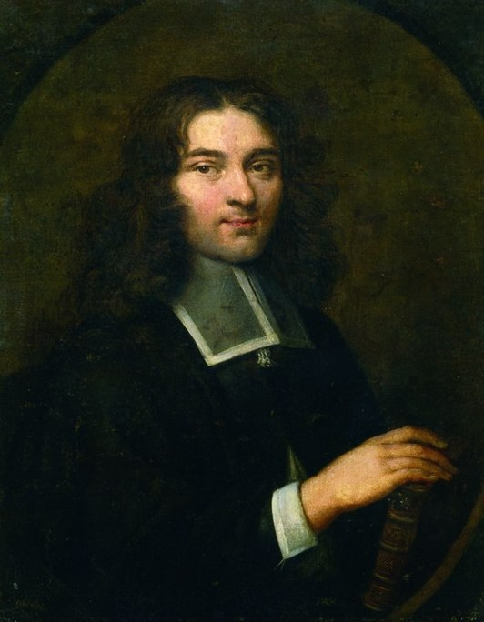
Pierre Bayle
Pierre Bayle, a French Huguenot refugee from Louis XIV’s persecutions, launched an internationally influential campaign against religious intolerance.
Bayle published his Historical and Critical Dictionary, which cited all the errors and delusions that he could find in past and present writers of all religions.

Slide 42
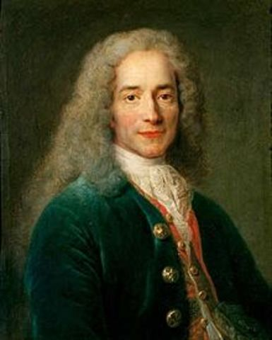
Voltaire
The most influential writer of the early Enlightenment was a Frenchman, Voltaire.
Voltaire popularized Newton’s scientific discoveries.
Voltaire published Letters Concerning the British Nation to promote the virtues of the British and attack Catholic bigotry and absolutist government rigidity in France.

Slide 43
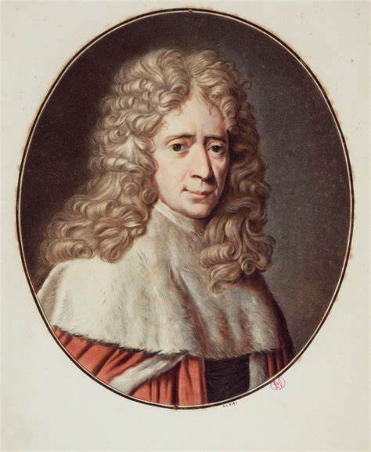
Montesquieu
Montesquieu satirized French customs and politics and suggested the French monarchy might verge on despotism.
Montesquieu examined the various types of government and favored constitutional forms.

Slide 44
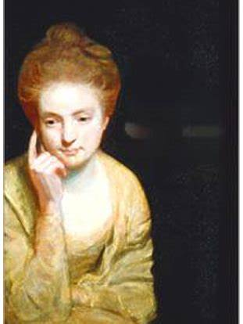
Mary Astell
She advocated founding a private women’s college to remedy women’s lack of education.
Astell criticized the relationship between the sexes within marriage: If all men are born free, how is it that all women are born slaves?

