Slide 1
Enlightenment Rationalism
In a word, the Enlightenment depended on “reason.”
Enlightenment thinkers, inspired by the tremendous advances of the scientific revolution, believed that the power of human reason could solve the problems plaguing society the same way that reason had revealed the mechanics of the universe.
Enlightenment thinkers exalted the power of reason, and they were skeptical about traditional beliefs and practices.

Slide 2
Philosophes
The philosophes were public intellectuals dedicated to solving the real problems of the world.
They wrote on subjects ranging from current affairs to art criticism, and they wrote in every conceivable format.
Philosophes could be found from Philadelphia to St. Petersburg.
The philosophes considered themselves part of a grand “republic of letters” that transcended national political boundaries.

Slide 3
The Encyclopedia
The Encyclopedia attempted to capture the state of human knowledge in the mid-eighteenth century.
Many Enlightenment writers collaborated on the multivolume Encyclopedia.
The chief editor of the Encyclopedia, Denis Diderot explained the goal: “All things must be examined, debated, investigated without exception and without regard for anyone’s feelings.”

Slide 4
Madame Geoffrin’s Salon
Madame Marie-Thérèse Geoffrin (1699–1777), a wealthy middle-class widow. She corresponded extensively with influential people across Europe, including Catherine the Great.
Women’s salons like hers helped galvanize intellectual life and reform movements all over Europe.
Madame Geoffrin did not approve of discussions that attacked the Catholic church.

Slide 5
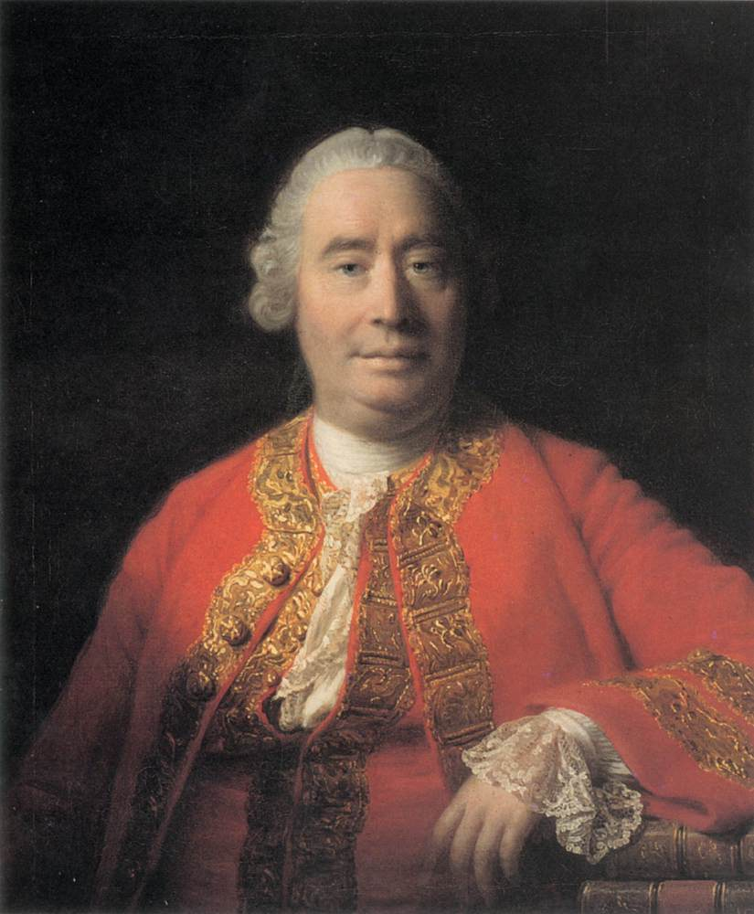
David Hume
Scottish philosopher David Hume argued in The Natural History of Religion that belief in God rested on superstition and fear rather than on reason at a time that most Europeans believed in God.

Slide 6
Deism
Deism was a belief in God as creator of the wonderous natural world that awed mankind but gave him no role in earthly affairs.
Deists conceived of the universe as an eternally existing, self-perpetuating machine, in which God’s intervention was unnecessary.
Deists continued to believe in a benevolent, all-knowing God who had designed the universe and set it in motion. But they usually rejected the idea that God directly intercedes in the functioning of the universe.

Slide 7
Philosophical Dictionary
Voltaire was a deist, and his influential Philosophical Dictionary (1764) attacked most of the claims of organized Christianity, both Catholic and Protestant.
Christianity, he argued, had been the prime source of fanaticism and brutality among humans.
Throughout his life, Voltaire’s motto was Écrasez l’infâme — “Crush the infamous thing” (the “thing” being bigotry and intolerance).
French authorities publicly burned his Philosophical Dictionary.

Slide 8
Jean Calas
Jean Calas was a Calvinist accused of hanging his son to prevent him from converting to Catholicism.
The all-Catholic parlement of Toulouse tried to extract the names of accomplices through torture but Calas refused to confess.
The torturers then executed him by breaking every bone in his body with an iron rod.
Voltaire launched a successful crusade to rehabilitate Calas’s good name and to restore the family’s properties, which had been confiscated after his death.
Voltaire’s efforts eventually helped bring about the extension of civil rights to French Protestants and encouraged campaigns to abolish the judicial use of torture.

Slide 9
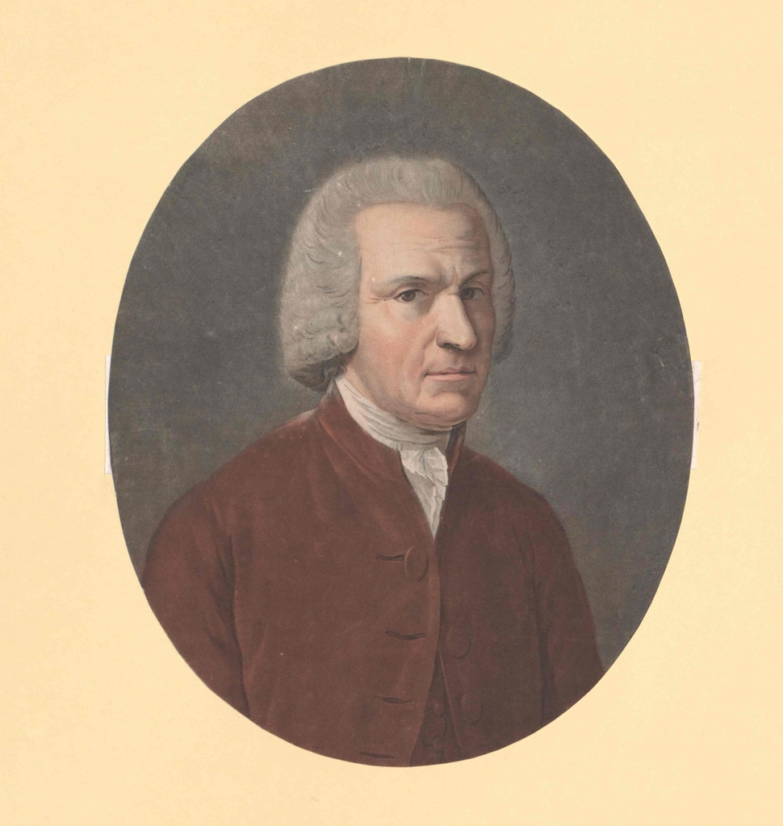
Guillaume Raynal
Guillaume Raynal, a French Catholic clergyman, wrote one of the most popular books of the time was the Philosophical and Political History of European Colonies and Commerce in the Two Indies, published in 1770 by
Raynal and his collaborators described in excruciating detail the destruction of native populations by Europeans and denounced the slave trade. Despite the criticism, the slave trade continued.

Slide 10
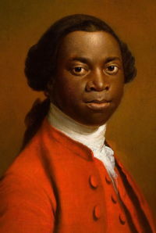
Olaudah Equiano
A freed slave from the American colonies, Olaudah Equiano, wrote of his kidnapping and enslavement in Africa and his long effort to free himself.
The Interesting Narrative of the Life of Olaudah Equiano, published in 1788, became an international best seller.
Armed with such firsthand accounts of slavery, abolitionists began to petition their governments for the abolition of the slave trade and then of slavery itself.

Slide 11
The Enlightenment’s Effect on Society
The Enlightenment interest in secular society produced two major results.
First, it advanced the secularization of European political life that had begun after the French Wars of Religion of the sixteenth and seventeenth centuries.
Second, it laid the foundations for the social sciences of the modern era.
Historians and philosophers consider the Enlightenment to be the origin of modernity, which they define as the belief that human reason, rather than theological doctrine, should set the patterns of social and political life.

Slide 12
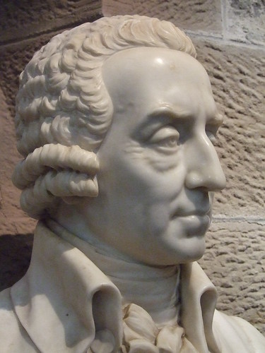
Adam Smith
Adam Smith provided a theory of modern capitalist society and devoted much of his energy to defending free markets as the best way to make the most of individual efforts.
The modern discipline of economics took shape around the questions raised by Smith

Slide 13
Laissez-Faire
Adam Smith published An Inquiry into the Nature and Causes of the Wealth of Nations in 1776.
Smith insisted that individual self-interest, even greed, was quite compatible with society’s best interest: the laws of supply and demand served as an “invisible hand” ensuring that individual interests would be synchronized with those of the whole society.
Smith rejected the prevailing mercantilist views and argued that the division of labor in manufacturing increased productivity and generated more wealth for society and well-being for the individual.
Using the example of the ordinary pin, Smith showed that when the manufacturing process was broken down into separate operations — one man to draw out the wire, another to straighten it, a third to cut it, a fourth to point it, and so on — workers who could make only one pin a day on their own could make thousands by pooling their labor.
To maximize the effects of market forces and the division of labor, Smith endorsed a concept called laissez-faire (“to leave alone”), in which the government neither controls nor intervenes in the economy.

Slide 14
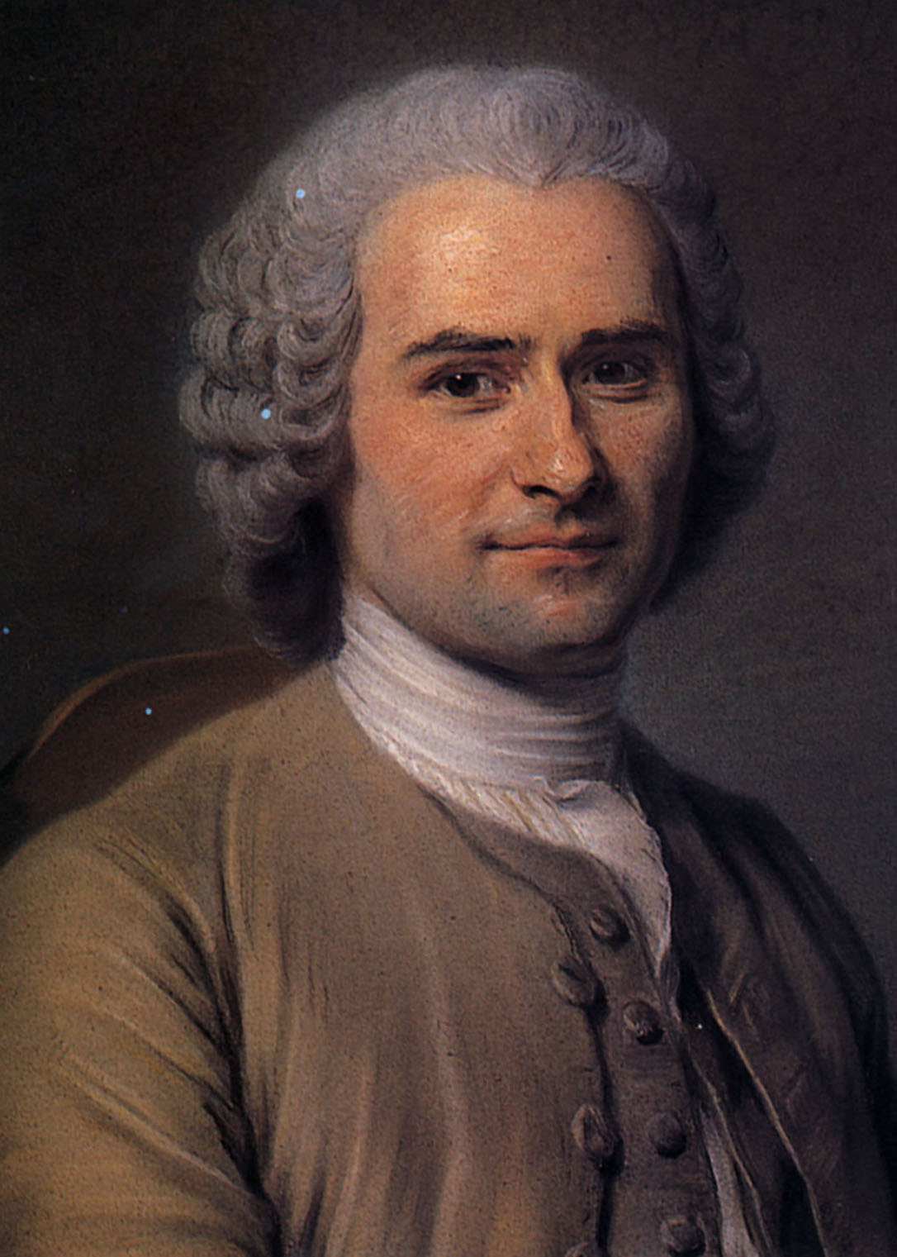
Jean-Jacques Rousseau
In Rousseau’s view, society itself threatened natural rights or freedoms: “Man is born free, and every-
He argued that the revival of science and the arts had corrupted social morals, not improved them.
Rather than improving society, he claimed, science and art raised artificial barriers between people and their natural state.
Rousseau’s works extolled the simplicity of rural life over urban society.

Slide 15
The Social Contract
In The Social Contract (1762) Rousseau argued that the right kind of political order could make people truly moral and free.
Individual moral freedom could be achieved only by learning to subject one’s individual interests to “the general will,” that is, the good of the community.
Individuals did this by entering into a social contract not with their rulers, but with one another.
If everyone followed the general will, then all would be equally free and equally moral because they lived under a law to which they had all consented.

Slide 16
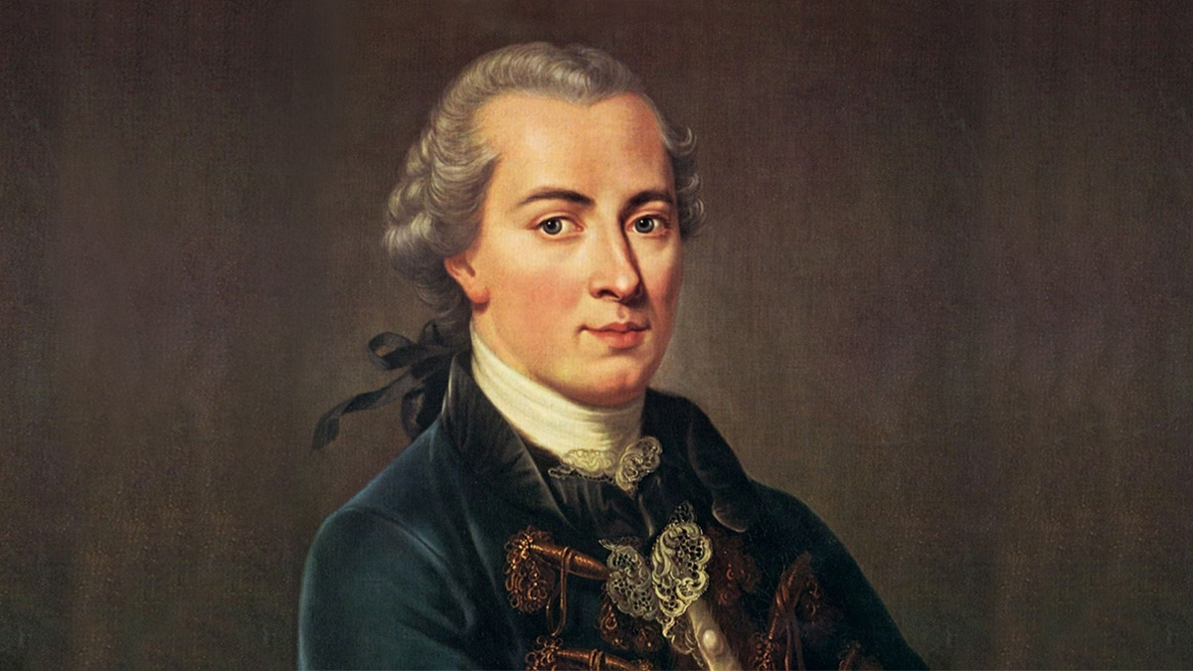
Immanuel Kant
The most influential German thinker of the Enlightenment was Immanuel Kant.
Kant established the doctrine of idealism, the belief that true understanding can come only from examining the ways in which ideas are formed in the mind.

Slide 17
Romanticism
In reaction to what some saw as the Enlightenment’s excessive reliance on the authority of human reason, a new artistic movement called romanticism took root.
Although it would not fully flower until the early nineteenth century, romanticism traced its emphasis on individual genius, deep emotion, and the joys of nature to thinkers like Rousseau who had scolded the philosophes for ignoring those aspects of life that escaped and even conflicted with the power of reason.

Slide 18
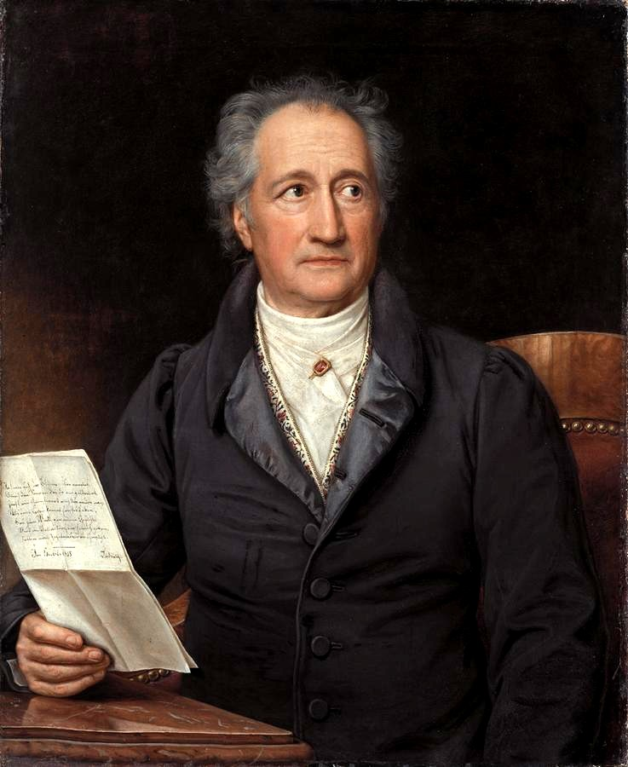
Johann Wolfgang von Goethe
German writer Johann Wolfgang von Goethe captured the early romantic spirit with its glorification of emotion in The Sorrows of Young Werther (1774).
It told of a young man who loves nature and rural life and is unhappy in love.
When the woman he loves marries someone else, he falls into deep melancholy and eventually kills himself.
Reason cannot save him

Slide 19
Revivalism
Revivalism sought to underline the limits of reason by emphasizing a direct emotional connection with God.
Revivalist Protestant preachers drew thousands of fervent believers in a movement called the Great Awakening.
Revivalism prompted supporters and opponents to establish new colleges to support their beliefs and these included Princeton, Columbia, Brown, and Dartmouth, all founded between 1746 and 1769 by either revivalists or antirevivalists.

Slide 20
Hasidism
Israel ben Eliezer laid the foundation for Hasidism in the 1740s and 1750s.
He traveled the Polish countryside offering miraculous cures and became known as the Ba’al Shem Tov (“Master of the Good Name”) because he used divine names to effect healing and bring believers into closer personal contact with God.
He emphasized mystical contemplation of the divine, rather than study of Jewish law, and his followers, the Hasidim (Hebrew for “most pious” Jews), often expressed their devotion through music, dance, and fervent prayer.

Slide 21
Methodism
John Wesley founded Methodism, a term evoked by Wesley’s insistence on strict self-discipline and a methodical approach to religious study and observance.
In 1738, Wesley began preaching his new brand of Protestantism, which emphasized an intense personal experience of salvation and a life of thrift, abstinence, and hard work.
Traveling all over the British Isles, Wesley preached forty thousand sermons in fifty years, an average of fifteen a week.
Considered radical in religious views, the Methodist leadership remained politically conservative during Wesley’s lifetime.
Wesley himself wrote many pamphlets urging order, loyalty, and submission to higher authorities.

Slide 22
Nobles and Peasants
Nobles made up about 3 percent of the European population.
Nobles had legal rights, called seigneurial dues.
Peasants had to pay fees to grind grain at the lord’s mill, bake bread in his oven, press grapes at his winepress, or even pass on their own land as inheritance.
In addition, peasants had to work without compensation for a specified number of days every year on the public roads.
They also paid taxes to the government on salt, an essential preservative, and on the value of their land; customs duties if they sold produce or wine in town; and the tithe on their grain (one-tenth of the crop) to the church.

Slide 23
The Middle Class
The term middle class referred to the middle position on the social ladder; middle-class families did not have legal titles like the nobility above them, but neither did they work with their hands like the peasants, artisans, or laborers below them.
Most middle-class people lived in towns or cities and earned their living in the professions — as doctors, lawyers, or lower-level officials — or through investment in land, trade, or manufacturing.
In the eighteenth century, the ranks of the middle class grew steadily in western Europe as a result of economic expansion.

Slide 24
Freemasons
The Masonic lodges began as social clubs organized around elaborate secret rituals of stonemasons’ guilds.
They called their members Freemasons because that was the term given to apprentice masons when they were deemed “free” to practice as masters of their guild.
Freemasons were not explicitly political in aim, their members wrote constitutions for their lodges and elected their own officers, thus promoting a direct experience of constitutional government.
Freemasonry arose in Great Britain and spread throughout Europe and to the American colonies. In
In the 1700s many high-ranking nobles became active members and saw no conflict with their privileged status.

Slide 25
Poverty
Those at the bottom of the social ladder — day laborers in the cities and peasants with small holdings — lived on the edge of dire poverty
At least 10 percent of Europe’s urban population depended on some form of charity, and poor people overwhelmed local governments.
German towns created workhouses that were part workshop, part hospital, and part prison.
The French government created dépôts de mendicité (“beggar houses”) and the government sent people to these new workhouses to labor in manufacturing, but most were too weak or sick to work, and 20 percent of them died within a few months of incarceration.

Slide 26
Decay of the Family
Rates of births out of wedlock soared, from less than 5 percent of all births in the seventeenth century to nearly 20 percent at the end of the eighteenth.
Family and community pressure had once forced a man to marry a woman pregnant with his child, but now a man could abandon a pregnant lover by simply moving away.
Women who came to the city as domestic servants had little recourse against masters or fellow servants who seduced or raped them.
The result was a startling rise in abandoned babies.

Slide 27
Enlightened Despots
Enlightened despots were rulers — such as Catherine the Great of Russia, Frederick the Great of Prussia, and Joseph II of Austria — who tried to promote Enlightenment reforms without giving up their own supreme political power.
Monarchs dedicated to reform insisted on greater attention to merit, hard work, and professionalism.
The enlightened despot should be a benevolent administrator who worked for the general well-being of his or her people.

Slide 28
Prussian Militarism
The Prussian army nearly tripled in size between 1740 and 1789.
The army helped vault Prussia to the rank of leading powers.
Prussia had the third or fourth largest army in Europe even though Prussia was tenth in population and thirteenth in land area.
Under Frederick the Great, Prussia’s military expenditures rose to two-thirds of the state’s revenue.
Virtually every nobleman served in the army, paying for his own support as officer and buying a position

Slide 29
The Seven Years’ War
This world war for colonial dominance between Great Britain and France began when the expansion of America and Canada collided.
The French and British fought each other in Europe, the West Indies, North America, and India.
British naval superiority, fully achieved only in the 1750s, enabled Great Britain to rout the French in North America, India, and the West Indies.
Underlying Britain’s success was its rapidly modernizing financial system led by the Bank of England.

Slide 30
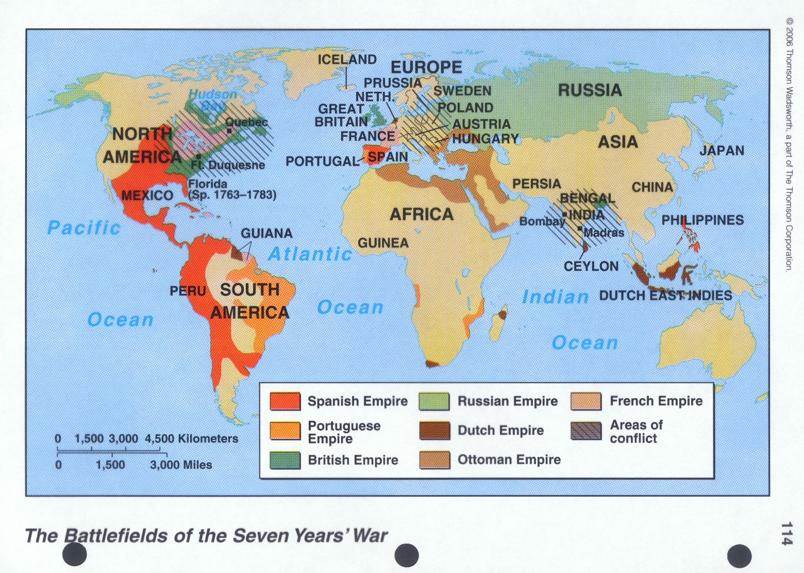
France and Britain Fight a Worldwide War

Slide 31
Treaty of Paris 1763
In the Treaty of Paris 1763, Britain gained control over Canada and India but gave back to France the West Indian islands of Guadeloupe and Martinique.
Britain was now the dominant colonial power in the world.
Eagerness to avenge this defeat would motivate France to support the British North American colonists in their War of Independence just fifteen years later.

Slide 32
Partition of Poland
Prussia’s power grew so dramatically that in 1772 Frederick the Great proposed that large chunks of Poland-Lithuania be divided among Austria, Prussia, and Russia.
Although the Austrian empress Maria Theresa protested that the partition would spread “a stain over my whole reign,” she agreed to the first partition of Poland, splitting one-third of Poland-Lithuania’s territory and half of its people among the three powers.
Russia took over most of Lithuania, effectively ending the large but weak Polish-Lithuanian commonwealth.

Slide 33
Joseph II
Joseph II of Austria was the most reformed minded Enlightenment ruler.
He ordered the compilation of a unified law code.
Joseph II of Austria suppressed the Jesuits and required Austrian bishops to swear fidelity and submission to him.
Joseph had the Austrian state supervise Catholic seminaries, abolish monastic orders, and confiscated monastic property to pay for education and poor relief.
Joseph II ordered state subsidies for local schools, which the state would regulate.
By 1789, one-quarter of the school-age children attended school.
in 1781 granted freedom of religious worship to Protestants, Orthodox Christians, and Jews.
When Joseph died his brother Leopold II had to revoke most reforms to appease the nobles.

Slide 34
The Physiocrats
In France, a group of economists called the physiocrats urged the government to deregulate the grain trade and make the tax system more equitable to encourage agricultural productivity.
In the interest of establishing a free market, they also insisted that urban guilds be abolished because the guilds prevented free entry into the trades.
The French government heeded some of this advice and gave up its sys-tem of price controls on grain in 1763, but it had to reverse the decision in 1770 when grain shortages caused a famine.

Slide 35
Jacques Turgot
Louis XVI chose the physiocrat Jacques Turgot as his chief minister.
Turgot pushed through several edicts that again freed the grain trade, suppressed guilds, converted the peasants’ forced labor on roads into a money tax payable by all landowners, and reduced court expenses.
He also began making plans to introduce a system of elected local assemblies, which would have increased representation in the government. Faced with broad-based resistance led by the parlements and his own courtiers as well as with riots against rising grain prices.
Louis XVI dismissed Turgot, and one of the last possibilities to overhaul France’s government collapsed.

Slide 36
The Pugachev Rebellion
Frustrations with serfdom and hopes for a miraculous transformation provoked the Pugachev rebellion in Russia beginning in 1773.
Nearly three million people eventually participated, making this the largest single rebellion in the history of tsarist Russia.
When Pugachev urged the peasants to attack the nobility and seize their estates, hundreds of noble families perished.
Finally, the army captured the rebel leader and brought him in an iron cage to Moscow, where he was tortured and executed.
In the aftermath, Catherine tightened the nobles’ control over their serfs with the Charter of the Nobility and harshly punished those who dared to criticize serfdom.

Slide 37
The Wilkes Affair
John Wilkes, a member of Parliament, attacked the government in his newspaper, North Briton, and sued the crown when he was arrested.
He won his release as well as damages. When he was reelected, Parliament denied him his seat, not once but three times.
The Wilkes episode soon escalated into a major campaign against the corruption and social exclusiveness of Parliament.
Wilkesites proposed sweeping reforms of Parliament, including more frequent elections, more representation for the counties, elimination of “rotten boroughs” (election districts so small that they could be controlled by one big patron), and restrictions of pensions used by the crown to gain support.
These demands would be at the heart of agitation for parliamentary reform in Britain for decades to come.

Slide 38
The Gordon Riots
In 1780, the Gordon riots devastated London.
They were named after the fanatical anti-Catholic crusader Lord George Gordon, who helped organize huge marches and petition campaigns against a bill the House of Commons passed to grant limited toleration to Catholics.
The demonstrations culminated in a seven-day riot that left fifty buildings destroyed and three hundred people dead.
Despite the continuing limitation on voting rights in Great Britain, British politicians were learning that they could ignore public opinion only at their peril.

Slide 39
Taxation after the Seven Years’ War
Britain ended the Seven Years’ War with a colossal debt.
The British public wanted the high wartime taxes reduced.
Parliament decided to institute taxes on the American colonies at a fraction of the rate paid by Englishmen on the island of Britain.
Parliament imposed the Stamp Act on the American colonies in 1765, but this led to violent rioting.
The late Tea Act led to the infamous Boston Tea Party that deepened the divide between the American colonies and Parliament.

Slide 40
The American Revolution Begins
Political opposition in the American colonies turned belligerent when Britain threatened to use force to maintain control.
After actual fighting had begun, in 1776, the Second Continental Congress issued the Declaration of Independence.
An eloquent statement of the American cause drafted by the Virginia planter and lawyer Thomas Jefferson, the Declaration of Independence was couched in the language of universal human rights, which enlightened Europeans could be expected to understand.

Slide 41
The Articles of Confederation
The newly independent states still faced the challenge of republican self-government.
The Articles of Confederation, drawn up in 1777 as a provisional constitution, proved weak because they gave the central government few powers.
The Articles of Confederation government proved unworkable and the delicate union threatened to fall apart.

Slide 42
The United States Constitution
In 1787, a constitutional convention met in Philadelphia to draft a new constitution, which was ratified the following year.
It established a two-house legislature, an indirectly elected president, and an independent judiciary.
The U.S. Constitution’s preamble insisted explicitly, for the first time in history, that government derived its power solely from the people and did not depend on divine right or on the tradition of royalty or aristocracy.

Slide 43
The Bill of Rights
Appended to the Constitution in 1791, the Bill of Rights outlined the essential rights (such as freedom of speech) that the government could never overturn.
Although slavery continued in the American republic, the new emphasis on rights helped fuel the movement for its abolition in both Britain and the United States.

