Slide 1
Dutch Patriot Revolt
The Dutch Patriots wanted to reduce the powers of the prince of Orange, the stadholder, because of his close ties to Great Britain.
Dutch relations with Britain deteriorated during the American Revolution, and those favoring the Americans attacked the stadholder
Dutch Patriots gained popular support by demanding political reforms and organizing armed citizen militias called Free Corps that took on the troops of the prince of Orange and got the upper hand.
In 1787, thousands of Prussian troops intervened for the stadholder.
The House of Orange then crushed the rebellion.

Slide 2
The Belgian Independence Movement
The reforms of Joseph II led to revolt in the Austrian Netherlands.
The upper classes resisted these reforms, and this galvanized democrats, who to organized clubs to give voice to their demands.
A secret society formed armed companies to prepare an uprising, and by late 1789, declared the United States of Belgium.
When the democrats began to challenge noble authority, aristocratic leaders allied with the Catholic Church to oppose the democrats
Faced with the choice between the Austrian emperor and the rule of nobles and the church the democrats chose a return of the Austrians.

Slide 3
Polish Patriots
A reform party called the Patriots emerged in Poland, which was shocked by the loss of a third of its territory in the first partition of 1772.
The Patriots sought to overhaul the weak commonwealth along modern western European lines and looked to King Stanislaw August Poniatowski to lead them.
In 1788, the Patriots summoned a reform minded parliament, which eventually enacted the constitution of May 3, 1791, that ended the veto power that each aristocrat had over legislation, granted towns people limited political rights, and vaguely promised future Jewish emancipation.
Within a year, however, Catherine the Great turned her attention to Poland, engineered the downfall of the Patriots and ended reform.

Slide 4
Origins of the French Revolution
By the late 1780s, the French monarchy faced a serious fiscal crisis.
In response, the King tried to reform the tax system that exempted nobles and the clergy and put the full burden on peasants.
With the growing support of public opinion, the middle and upper classes now demanded a clearer system of fiscal accountability.
The ineffectiveness of Louis XVI and the Marie Antoinette’s growing unpopularity helped undermine the monarchy as an institution.
Faced with a mounting deficit, in 1787 Louis submitted a package of reforms first to the Assembly of Notables and then to his old rival the parlement of Paris.
After both refused to consider the reforms, Louis called a meeting of the Estates General, which had last met 175 years before.

Slide 5
The Estates General
The Estates General was a legislature made up of the three estates, or orders, of France.
The First Estate represented the Catholic church, which owned about 10 percent of the land in France and collected a 10 percent tax (the tithe) on peasants.
The Second Estate represented the nobility who owned about one-third of the land, enjoyed many tax exemptions, and collected seigneurial dues and rents from their peasant tenants.
The Third Estate represented everyone else, at least 95 percent of the nation.
Included in the Third Estate were the vast mass of peasants, some 75 percent of the population, and the sans-culottes who worked with their hands and middle classes of the cities.

Slide 6
Voting by Order
Voting by order gave each estate one vote for a total of three votes.
This allowed the clergy and nobility of the first two estates (representing 5% of the population) to dominate the third estate.
The Third Estate wanted to vote by head instead of order because this would allow them to dominated the first two estates.
The King refused to approve the reform to allow voting by head instead of order.

Slide 7
Non-Political Factors
The calling of the Estates General meant that villagers and towns people alike held elections and wrote down their grievances.
The humblest peasants burst forth with complaints, especially about taxes, and the process raised expectations for real reform.
One village meeting summed up the frustration: “misery is so great in the country that we cannot make enough complaints.”
Just at that moment France experienced a food shortage, bread prices rose dramatically, and a slump in textile production caused massive unemployment. Starvation faced a growing number of the poor.

Slide 8
The “tennis court oath”
The Estates General opened in May 1789.
When the nobles insisted on voting by order, the deputies of the Third Estate refused to proceed on that basis.
After six weeks of stalemate, the deputies of the Third Estate took unilateral action on June 17 and declared themselves and whoever would join them the National Assembly.
Two days later, the clergy voted by a narrow margin to join them.
When authorities denied the members of the National Assembly .
Suddenly access to their meeting hall on June 20, the deputies met on a nearby tennis court and swore an oath not to disband until they had given France a constitution that reflected their newly declared authority.
This “tennis court oath” expressed the determination of the Third Estate to carry through a constitutional revolution.

Slide 9
The sans-culottes
At first, Louis XVI appeared to agree to the new National Assembly, but he also ordered thousands of soldiers to march to Paris.
The Assembly feared a plot to disperse them, and their fears were confirmed when, on July 11, the king fired Jacques Necker, the finance minister sympathetic to the cause.
The popular reaction in Paris changed the course of the French Revolution.
When the news spread, the sans-culottes in Paris began to arm themselves and attack places where either grain or arms were thought to be stored.

Slide 10
The Bastille
On July 14, after the sans-culotte rose up an armed crowd marched on the Bastille, a huge fortified prison that symbolized royal authority
After a chaotic battle in which a hundred-armed citizens died, the prison officials surrendered.
The fall of the Bastille showed the common people willing to intervene violently for the cause.
Local governments were forced out of power and replaced by committees of “patriots.”

Slide 11
The National Guard
To restore order and protect property of the urban middle class, the patriots relied on newly formed National Guard units composed of civilians.
In Paris, the Marquis de Lafayette, a hero of the American War of Independence and a noble deputy in the National Assembly, became commander of the new National Guard.
One of Louis XVI’s brothers and many other leading aristocrats fled into exile.
The Revolution thus had its first heroes, its first victims, and its first enemies.

Slide 12
The Great Fear
The threat of starvation led to growing violence in the countryside.
As food shortages spread, peasants feared that the beggars and vagrants crowding the roads might be part of an aristocratic plot to starve the French people by burning crops or barns.
In many places, this Great Fear turned into peasant attacks on aristocrats or on the records of peasants’ seigneurial dues kept in lords’ castles.

Slide 13
August 4, 1789
Alarmed by peasant unrest, the National Assembly decided to make changes.
On the night of August 4, 1789, noble deputies renounced their traditional privileges and gave up their tax exemptions and seigneurial dues.
The National Assembly decreed the abolition of what it called the feudal regime.
This freed the few remaining serfs and eliminated all special privileges in matters of taxation, including all seigneurial dues on land.
The Assembly also mandated equality of opportunity in access to government positions. Talent, rather than birth, was to be the key to success. Enlightenment principles were beginning to become law.

Slide 14
The Rights of Man
Three weeks later, the deputies drew up the Declaration of the Rights of Man and Citizen as the preamble to a new constitution.
It proclaimed, “Men are born and remain free and equal in rights.”
The Declaration granted freedom of religion, freedom of the press, equality of taxation, and equality before the law.
It established the principle of national sovereignty: the king derived his authority henceforth from the nation rather than from tradition or divine right.
Women never received the right to vote during the French Revolution, though Protestant and Jewish men did.

Slide 15
Declaration of the Rights of Women
Some women did not accept their exclusion.
Women wrote petitions, published tracts, and organized political clubs to demand more participation.
In her Declaration of the Rights of Woman of 1791, Olympe de Gouges played on the language of the official Declaration to make the point that women should also be included: “Woman is born free and lives equal to man in her rights.”
De Gouges linked her complaints to a program of social reform in which women would have equal rights to property and public office and equal responsibilities in taxes and criminal punishment.

Slide 16
Writing the Constitution
The National Assembly established the first government of the revolution, the National Convention
It gave voting rights only to white men who passed a test of wealth.
Despite these limitations, France became a constitutional monarchy in which the king served as the leading state functionary.
A one-house legislature was responsible for making laws.
The king could postpone enactment of laws but not veto them.
The deputies abolished all the old administrative divisions of the provinces and replaced them with a national system of eighty-three departments with identical administrative and legal structures.
All officials were elected; no offices could be bought or sold.
The deputies also abolished the old taxes and replaced them with new ones that were supposed to be uniformly levied.
The new administrative system survived and the departments are still the basic units of the French state today.

Slide 17
Reform of the Catholic Church
Reforming the Catholic church created enduring conflicts.
The deputies outlawed monastic vows and encouraged monks and nuns to return to private life by offering state pensions.
The National Assembly confiscated all the church’s property and promised to pay clerical salaries in return.
The Civil Constitution of the Clergy provided that the voters elect their own parish priests and bishops just as they elected other officials.
Faced with resistance the National Assembly required all clergy to swear an oath of loyalty to the Civil Constitution of the Clergy.
Pope Pius VI in Rome condemned the constitution, and half of the French clergy refused to take the oath.
The oath of allegiance permanently divided the Catholic population.

Slide 18
The “flight to Varennes”
On June 20, 1791, the royal family escaped in disguise from Paris and fled toward the eastern border of France, where they hoped to gather support from Austrian emperor Leopold II, the brother of Marie-Antoinette.
The plans went awry when a postmaster recognized the king from his portrait on the new French money, and the royal family was arrested at Varennes, forty miles from the Austrian Netherlands border.
The “flight to Varennes” touched off demonstrations in Paris against the royal family.
Cartoons circulated depicting the royal family as animals being returned “to the stable.”

Slide 19
War with Austria
By early 1792 everyone seemed intent on war with Austria.
Louis and Marie-Antoinette hoped that such a war would lead to the defeat of the Revolution.
Deputies who favored a republic believed that war would lead to the king’s downfall.
On April 21, 1792, Louis declared war on Austria.
Prussia immediately entered on the Austrian side.
Thousands of French aristocrats, including both of the king’s brothers and two-thirds of the army officer corps, had already emigrated and were gathering along France’s eastern border in expectation of joining a counterrevolutionary army.

Slide 20
The Jacobin Club
Many of the deputies in the Convention belonged to the Jacobin Club
The Jacobin Club in Paris headed a national political network of clubs that linked all the major towns and cities.
The Jacobin Club represented the radical, urban elements of the revolution as opposed to the more conservative rural factions.

Slide 21
The Girondins and the Mountain
The more conservative, rural based elements of the Jacobin Club became known as the Girondins.
They resented the growing power of Parisian militants and tried to appeal to the departments outside of Paris.
The Mountain in contrast to the Girondins, was closely allied with the Paris militants and rejected the conservatism of the rural factions.

Slide 22
The End of the Monarchy
The National Convention abolished the monarchy and on September 22 established the first republic in French history.
The first showdown between the Girondins and the Mountain was the trial of
the king in December 1792.
Although the Girondins agreed that the king was guilty of treason, many of them argued for clemency, exile, or a popular referendum on his fate.
After a long and difficult debate, the National Convention supported the Mountain and voted by a very narrow majority to execute the king.
Louis XVI went to the guillotine on January 21, 1793.

Slide 23
The Committee of Public Safety
The continuing war with Austria and Prussia require more men and money.
The introduction of a national draft provoked massive resistance.
In response to growing pressures, the National Convention named a Committee of Public Safety to supervise food distribution, direct the war effort, and root out counterrevolutionaries.

Slide 24
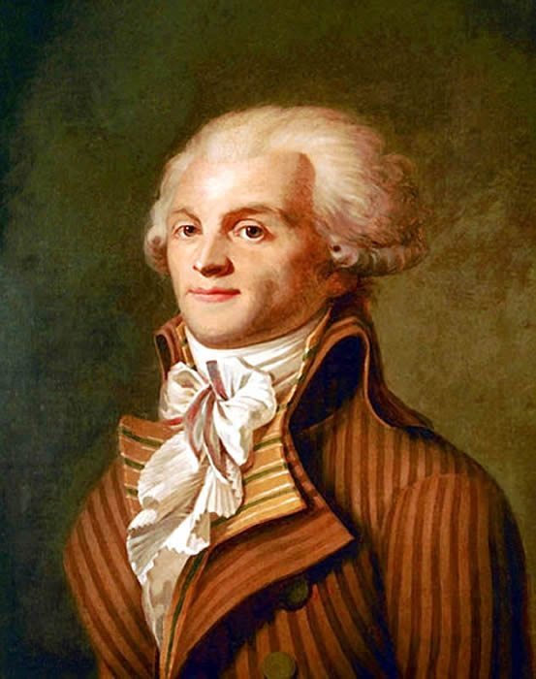
Maximilien Robespierre
The leader of the Committee of Public Safety, Maximilien Robespierre, wanted to create a “republic of virtue,” in which the government would teach, or force, citizens to become virtuous republicans through a massive program of political reeducation.
This led to the Terror, in which the guillotine became the most terrifying instrument of a government that suppressed almost every form of dissent.

Slide 25
Origins of the Terror
The conflict between the more moderate Girondins and the more radical Mountain came to a head in spring 1793.
The Girondins arrested Jean-Paul Marat, and Parisian militants marched into the National Convention on June 2, forcing the deputies to decree the arrest of their twenty-nine Girondin colleagues.
The Convention established paramilitary bands called revolutionary armies to hunt down political suspects and hoarders of grain.
Robespierre enacted price controls and requisitioning.
The National Convention established the General Maximum on September 29, 1793, which set limits on the prices of thirty-nine essential commodities and on wages.

Slide 26
The Terror
The Committee of Public Safety sent deputies out to purge unreliable officials and organize the war effort.
Revolutionary tribunals tried political suspects and convicted Marie-Antoinette of treason and sent her to the guillotine.
The program of the Terror sought to “republicanize everything” and it organized revolutionary festivals modeled to establish a civic religion.

Slide 27
de-Christinization
Extremists initiated a campaign of de-Christianization that included closing
churches (Protestant as well as Catholic), selling many church buildings to the high-
est bidder, and trying to force even those clergy who had taken the oath of loyalty
to abandon their clerical vocations and marry.
Great churches became storehouses for arms or grain, or their stones were sold off to contractors.
The medieval statues of kings on the facade of Notre Dame cathedral were beheaded.
Church bells were dismantled and church treasures melted down for government use.

Slide 28
Competing Cults
Extremists tried to establish what they called the Cult of Reason to supplant Christianity. In Paris in the fall of 1793,
The Committee of Public Safety halted the de-Christianization campaign, and tried to institute an alternative, the Cult of the Supreme Being, in June 1794.
Neither the Cult of Reason nor the Cult of the Supreme Being attracted many followers, but both show the depth of the commitment to overturning the old order and all its traditional institutions.

Slide 29
Revolutionary Indoctrination
Georges-Jacques Danton thought the people needed revolutionary education and the National Convention took control of public education away from the Catholic church, but a shortage of non-Catholic teachers made this reform ineffective.
The National Convention applied the revolution to all aspects of life.
The revolution’s tricolor became the new flag of France, a new calendar replaced the Christian one, the metric system replaced the traditional system of measure, state courts took jurisdiction over family law, and primogeniture was outlawed in favor of partible inheritance.

Slide 30
The Vendée
The arrest of the Girondin deputies in June 1793 set off resistance against the republic in many parts of France.
In the Vendée region of western France, resistance turned into a bloody and prolonged civil war.
Both sides committed horrible atrocities.
Many thousands lost their lives in fighting that continued on and off for years.

Slide 31
The Peak of the Terror
The Vendée intensified the Terror with ordinary people risking the guillotine if they expressed any discontent.
The rate of executions in Paris rose from five a day in the spring of 1794 to twenty-six a day in the summer.
Robespierre and his inner circle had made so many enemies that they could not afford to loosen the grip of the Terror.
As many as 300,000 French people — 1 out of every 50 — went to prison as suspects between March 1793 and August 1794

Slide 32
The Thermidorian Reaction
On July 27, 1794, Robespierre appeared before the Convention with yet another list of deputies to be arrested.
Many feared they would be named, and they shouted him down and ordered him arrested.
The next day he and scores of followers went to the guillotine.
The new government released hundreds of suspects and arranged a temporary truce in the Vendée.
It purged Jacobins from local bodies and it arrested some of the most notorious “terrorists” in the National Convention, and put them to death.

Slide 33
The Directory
The National Convention prepared yet another constitution in 1795, setting up a two-house legislature and an executive body — the Directory, headed by five directors.
The Directory regime tenuously held on to power for four years.
The puritanical atmosphere of the Terror gave way to the pursuit of pleasure.
Between 1795 and 1799, the republic endured in France, but it directed a war effort abroad that would ultimately bring to power the man who would dismantle the republic itself.

Slide 34
The Republican Army at War
By the end of 1793, the French had a huge and powerful fighting force of 700,000 men.
Although France had a relatively large navy, the dominance of Great Britain on the seas meant that France had to seek victory on the land.
The Republic proclaimed a war of liberation and began conquering territory outside of France, but as the French annexed more and more territory, however, “liberated” people in many places began to view them as an army of occupation.

Slide 35
Napoleon Bonaparte Emerges
The brilliant young general Napoleon Bonaparte gained a reputation by defeating the Austrian armies in northern Italy in 1797.
Next he overwhelmed Venice, attacked the Swiss cantons in 1798, and conquered the Papal States in 1798, forcing the pope to flee to Siena.
France set up a series of sister republics in the former Dutch Republic and in various Italian states.

Slide 36
Poland Disappears
In 1793, Prussia took over territory that included 1.1 million Poles while Russia gained 3 million new inhabitants.
Austria gave up any claims to Poland in exchange for help from Russia and Prussia in acquiring Bavaria.
In the final division of 1795, Prussia absorbed an additional 900,000 Polish subjects, including those in Warsaw; Austria incorporated 1 million Poles and the city of Cracow; Russia gained another 2 million Poles.
The three powers determined never to use the term Kingdom of Poland again.

Slide 37
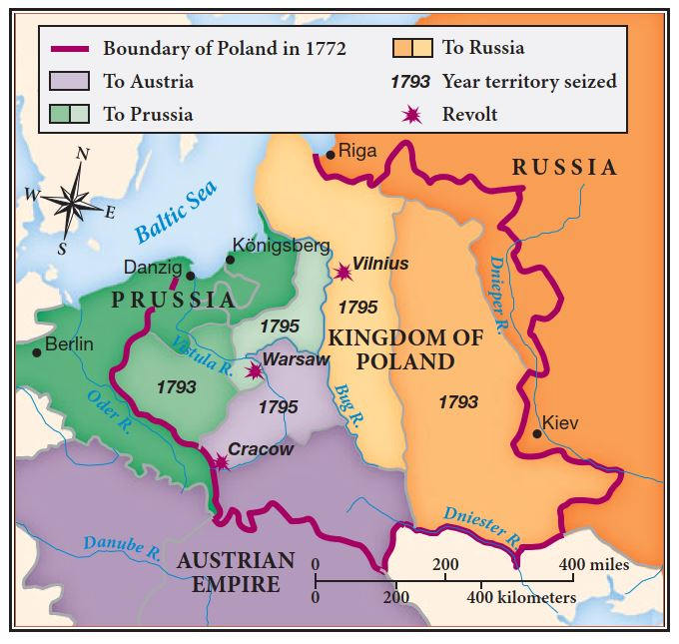
Final Partitions of Poland

Slide 38
The Haitian Revolt
Haiti was known as St. Domingue in 1789.
It was inhabited by 465,000 slaves, 30,000 whites, and 28,000 free people of color, whose primary job was to apprehend runaway slaves and ensure plantation security.
In August 1791, the slaves in northern Haiti revolted.
The few thousand French republican troops on St. Domingue were outnumbered and the governor freed all the slaves in his jurisdiction in August 1793 without permission from the government in Paris to avert catastrophe.
In February 1794, the National Convention formally abolished slavery and granted full rights to all black men in the colonies

Slide 39
Toussaint L’Ouverture
The French actions freeing slaves convinced the the ablest black generals from the Spanish half of the island, the ex-slave François Dominique Toussaint L’Ouverture, to take control of Haiti.
In 1802, Napoleon sent French troops to regain control of the island.
They arrested Toussaint and transported him to France, where he died in prison.
Toussaint became a hero to abolitionists everywhere, a potent symbol of black struggles to win freedom.
Napoleon attempted to restore slavery, but the remaining black generals defeated his armies and in 1804 proclaimed the Republic of Haiti.

