Slide 1
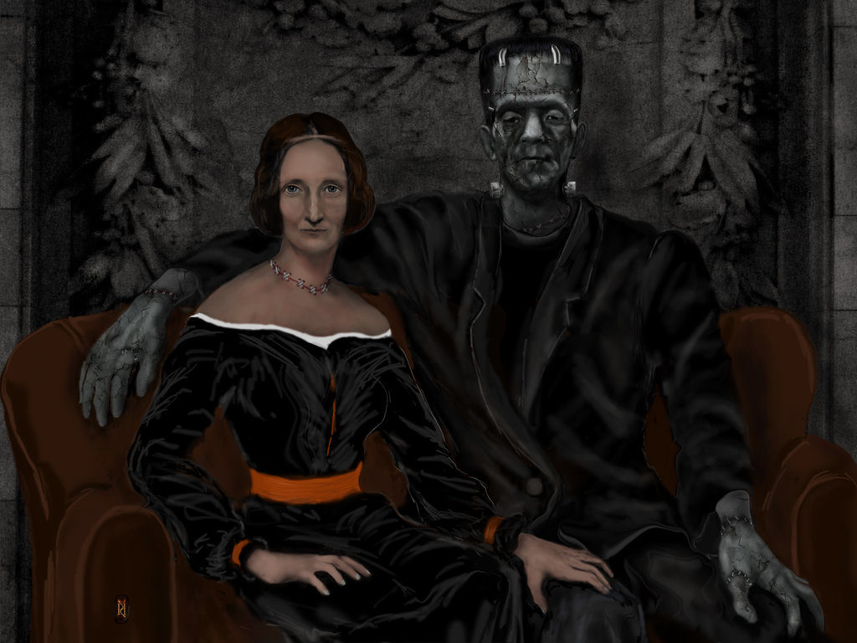
Mary Shelley
Mary Shelley wrote her great gothic horror novel Frankenstein in 1818.
It became the prototype for modern thrillers.
In the 1930s, Hollywood made the novel into a classic movie that kept the story alive into the 21st century.

Slide 2
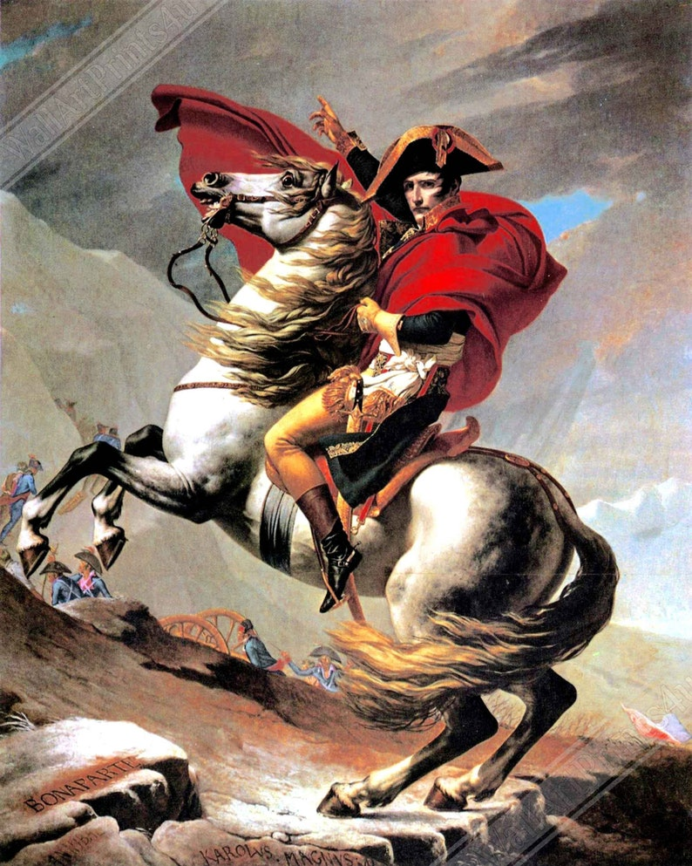
Napoleon Bonaparte Emerges
Napoleon Bonaparte, a twenty-six-year-old son of a noble Corsican family came on the scene in 1796 in the Italian campaign and in four years was the supreme ruler of France and one of the greatest military leaders in world history.
Napoleon won the loyalty of his men by paying them in cash from tribute taken from conquered land as Gaius Marius had with Roman client armies.

Slide 3
The Egyptian Campaign
In 1798, the Directory sent Napoleon to invade Egypt hoping that French occupation would strike a blow at British trade by cutting the route to India.
British admiral Lord Horatio Nelson destroyed the French fleet that carried the army to Egypt and left it isolated and cut off from home.
Bonaparte tried to gain Egyptian support by liberating them from the Ottoman Empire and instituted Enlightenment legal reforms such as equality before the law and religious toleration.
French scientists that accompanied the expedition discovered the Rosetta Stone.

Slide 4
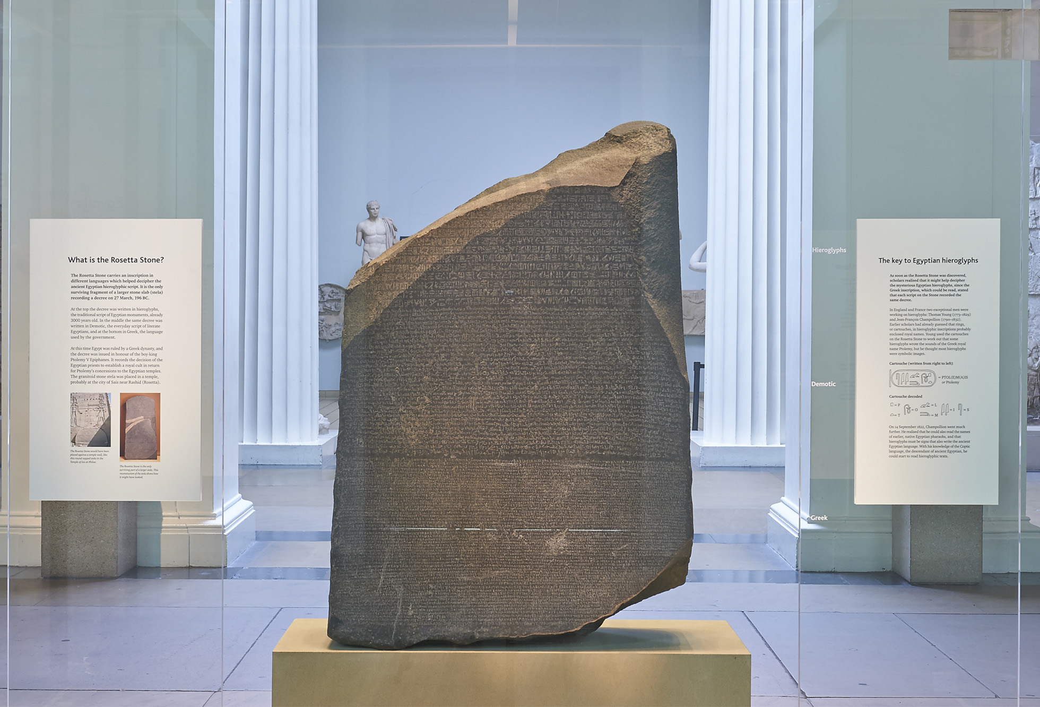
The Rosetta Stone
French scientists in Egypt discovered the Rosetta Stone that had identical inscriptions of a royal decree in hieroglyphics, Demotic script (common Egyptian) and Ancient Greek.
It allowed Jean-Francois Champollion to translate ancient hieroglyphics for the first time in 1822.

Slide 5
The Fall of the Directory
After abandoning his isolated army in Egypt, Napoleon reached France in 1799 as the Directory was widely unpopular.
Disillusioned members of the government saw in Bonaparte’s return an occasion to overturn the constitution of 1795.
They got their wish on November 9, 1799, when troops guarding the legislature ejected those who opposed Bonaparte and left the remaining ones to vote to abolish the Directory and establish a new three-man executive called the consulate.
This effectively ended the Republic because the new French government was no longer representative, and the legislature had no independent power.

Slide 6
Napoleon as First Consul
Napoleon became First Consul (a title from the Roman Republic) of the three-member consulate.
This office gave him the right to pick the Council of State, which drew up all laws.
The new constitution drawn of by the Council of State let Napoleon and his advisers chose the legislature’s members out of a small pool of “notables.”
Elections no longer controlled the legislature’s membership.

Slide 7
The 1801 Concordant
Napoleon’s most urgent task was to reconcile to his regime Catholics who had been alienated by revolutionary policies.
In 1801, a concordat with Pope Pius VII ended a decade of church-state conflict in France.
The pope validated all sales of church lands, and the government agreed to pay the salaries of bishops and priests who would swear loyalty to the state.
Catholicism was officially recognized as the religion of “the great majority of French citizens.”
The state also paid Protestant pastors’ salaries.

Slide 8
Napoleon Suppresses Dissent
Napoleon never relied on mass executions to maintain control, but he refused
to allow those who opposed him to meet in clubs, influence elections, or publish
newspapers.
A decree reduced the number of newspapers in Paris from seventy-three
to thirteen, and later to just four.
Government censors had to approve all operas and plays, and they banned “offensive” artistic works even more frequently than their royal predecessors had.
The minister of police, Joseph Fouché, imposed house arrest, arbitrary imprisonment, and surveillance of political dissidents.
Political contest and debate shriveled to almost nothing.

Slide 9
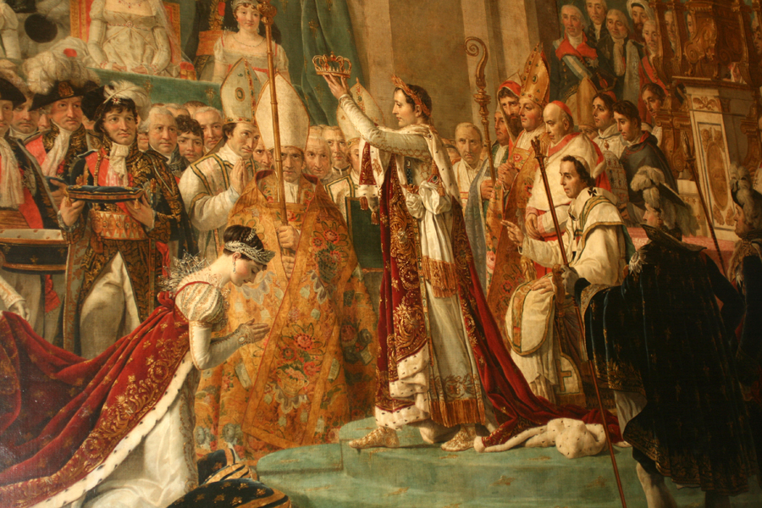
Napoleon Becomes Emperor
Napoleon named himself First Consul for life in 1802.
In 1804, with the pope’s blessing, he crowned himself emperor.
Napoleon’s face and name soon adorned coins, engravings, histories, paintings, and public monuments in a cult of personality.
He embarked on ostentatious building projects, including the Arc de Triomphe and the Stock Exchange.

Slide 10
The Legion of Honor
in 1802, Napoleon took the first step toward creating a new nobility by founding the Legion of Honor.
Members of the legion received lifetime pensions along with their titles.
In 1808, Napoleon introduced a complete hierarchy of noble titles, ranging from princes down to barons and chevaliers.
To go along with their new titles, Napoleon gave his favorite generals huge fortunes, often in the form of estates in the conquered territories.

Slide 11
The Bonaparte Family Rules Europe
Napoleon made his older brother, Joseph, ruler of the newly established kingdom of Naples in 1806.
In the same year he installed his younger brother Louis as king of Holland.
He proclaimed his twenty-three-year-old stepson, Eugène de Beauharnais, viceroy of Italy in 1805.
He established his sister Caroline and brother-in-law General Joachim Murat as king and queen of Naples in 1808 when he moved Joseph to the throne of Spain.

Slide 12
The Napoleonic Code
The Civil Code it reasserted male domination over women in the legal institution of feme covert that gave husbands control of family property and denied wives legal independent standing.
Divorce was severely restricted.
French women would not regain legal equality until 1965.
The Civil Code protected guaranteed religious liberty, established a uniform system of law that provided equal treatment for all adult males, and affirmed the right of men to choose their professions.
The code maintained the equal division of family property between all children, both male and female, but public education applied only to boys.
The code outlawed unions and favored businesses over workers.

Slide 13
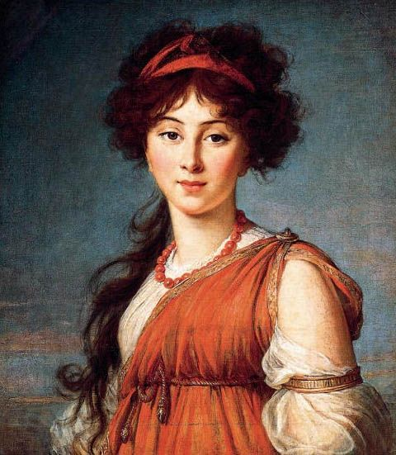
Anne-Louise-Germaine de Staël
Napoleon forced Anne-Louise-Germaine de Staël into exile because she criticized the Civil Code’s patriarchy.
While exiled in the German states, de Staël wrote Corinne, a novel whose heroine is a brilliant woman thwarted by a patriarchal system.
Her books were banned in France.

Slide 14
The Grande Armée
Napoleon united all the French armies into one — Grande Armée — under his personal command.
The levée en masse provided 1.3 million between 1800 and 1812 and another 1 million in 1813–1814.
Military service was a means of social mobility.
The men who rose through the ranks to become officers were young, ambitious, and accustomed to the new ways of war.
Consequently, the French army had higher morale than the armies of other powers, most of which rejected conscription as too democratic and continued to restrict their officer corps to the nobility.

Slide 15
Napoleon’s Military Mastery
Napoleon inspired almost fanatical loyalty.
Napoleon outmaneuvered virtually all his opponents.
He went directly for the main body of the opposing army and tried to crush it in a lightning campaign.
He gathered the largest possible army for one great and decisive battle and then followed with a relentless pursuit to break enemy morale altogether.

Slide 16
St. Domingue & Louisiana
Napoleon sent an expeditionary force to the Caribbean colony of St. Domingue to regain control of the island.
Continuing resistance among the black population and an epidemic of yellow fever forced Napoleon to withdraw his troops from St. Domingue and abandon his plans to extend his empire to the Western Hemisphere.
As part of his retreat, he sold the Louisiana Territory to the United States in 1803.

Slide 17
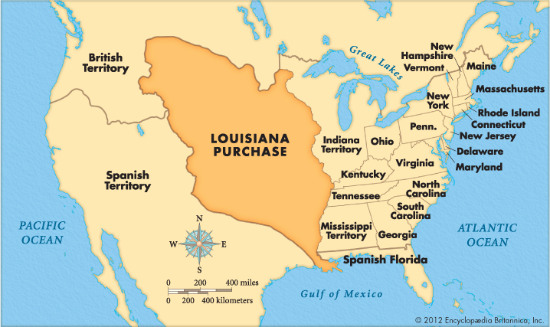
The Louisiana Purchase

Slide 18
British by Sea and France by Land
The British navy proved its superiority by blocking an attempted French invasion of England and by defeating the French and their Spanish allies in a huge naval battle at Trafalgar in 1805 under Horatio Nelson.
On land, Napoleon remained invincible.
In 1805, at the battle of Austerlitz, considered Napoleon’s greatest victory, he forced Austrian capitulation.
In 1806, at Jena and Auerstädt he conquered Prussia.
In 1807, Napoleon defeated the Russians at Friedland and had no more effective opposition.

Slide 19
The Map of Europe Changes
Napoleon’s victories allowed him to change the map of Europe.
He created the Kingdom of Westphalia, the Duchy of Warsaw, and the Confederation of the Rhine.
The French abolished serfdom, eliminated seigneurial dues, introducing the Napoleonic Code, suppressed monasteries, and subordinated church to state, as well as extending civil rights to Jews and other religious minorities.
They also imposed high taxes and forced conscription.

Slide 20
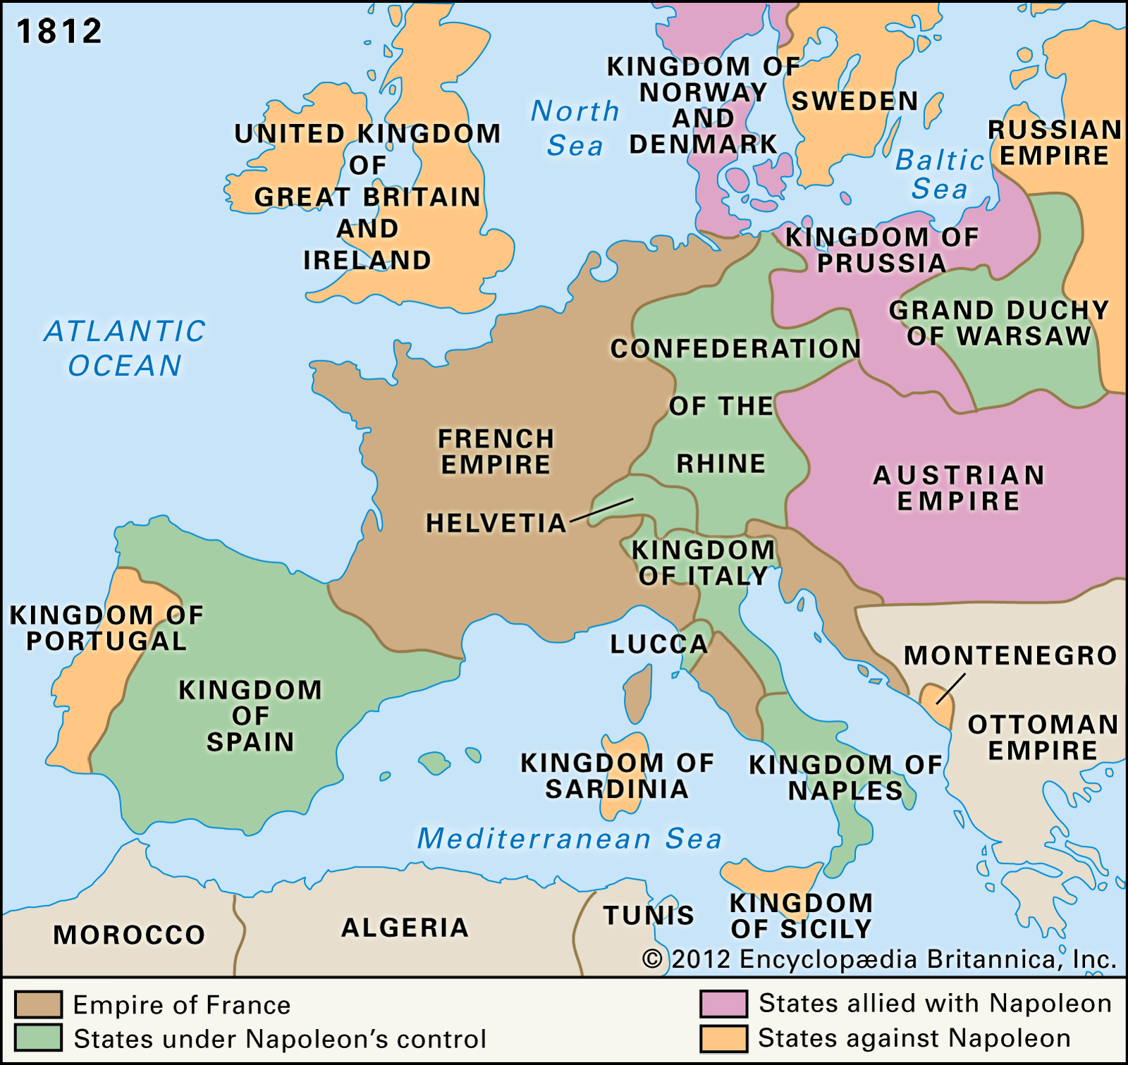
Europe under Napoleon

Slide 21
The Continental System
Unable to conquer England because the Royal Navy controlled the seas Napoleon inaugurated the Continental System in 1806.
It prohibited all commerce between Great Britain and France or France’s dependent states and allies.
At first, the system worked: in 1807–1808, British exports dropped by 20 percent and manufacturing by 10 percent.
Ultimately the Continental System proved impossible to enforce, and widespread smuggling brought British goods into the European market.

Slide 22
The Spanish Ulcer
In 1807, Napoleon sent 100,000 troops through Spain to invade Portugal, Great Britain’s ally.
When Napoleon named his brother Joseph king of Spain the Spanish clergy and nobles raised bands of peasants to fight the French.
The Spanish fought for six years and pinned down thousands of French soldiers.
The British sent troops to Spain and the fighting degenerated into massacres, reprisals, and atrocities by both sides that left and enduring hatred between the French and Spanish.

Slide 23
Disaster in Russia
In1812, Napoleon invaded Russia with 680,000 men.
The Russians avoided battle and destroyed anything that might be useful to the invaders.
In September, Napoleon fought the Russians at Borodino.
The French lost 30,000 men and the Russians 45,000.
The Russians set fire to Moscow and three-fourths of it had burned to the ground leaving Napoleon little shelter for the winter.
In October, Napoleon began his retreat; in November came the cold.
Russian forces harassed the retreating army, and by December only 100,000 troops made it to Poland.

Slide 24
Defeat and Exile
Russian, Austrian, Prussian, and Swedish armies met the French outside Leipzig in October 1813 and defeated Napoleon.
A combined Spanish-Portuguese army under British command invaded France.
The allied powers crossed the Rhine and marched toward Paris.
In March 1814, the French Senate deposed Napoleon, who abdicated when his remaining generals refused to fight.
Napoleon went into exile on the island of Elba off the Italian coast.
The allies restored to the throne Louis XVIII, the brother of Louis XVI.

Slide 25
Waterloo
Napoleon escaped from Elba in early 1815 and the period known as the Hundred Days began.
Napoleon moved his army into Belgium hoping to defeat a Prussian army before it could join a Belgian, Dutch, German, and British army led by British general Sir Arthur Wellesley, duke of Wellington.
The decisive battle of Waterloo took place on June 18, 1815.
Napoleon’s forces failed to break the British thin red line and the arrival of the Prussians led to a rout.
Napoleon had no choice but to abdicate again.
This time the victorious allies banished him permanently to the remote island of St. Helena, far off the coast of West Africa, where he died in 1821 at the age of fifty-two.

Slide 26
Congress of Vienna
The Congress of Vienna settled the boundaries of European states, determined who would rule each nation, and established a new framework for international relations based on periodic meetings, or congresses, between the major powers.
Austria’s Prince Klemens von Metternich, British prime minister Robert Castlereagh and France’s Prince Charles Maurice de Talleyrand negotiated the restoration.
Principally a new German Confederation replaced the defunct Holy Roman Empire.

Slide 27
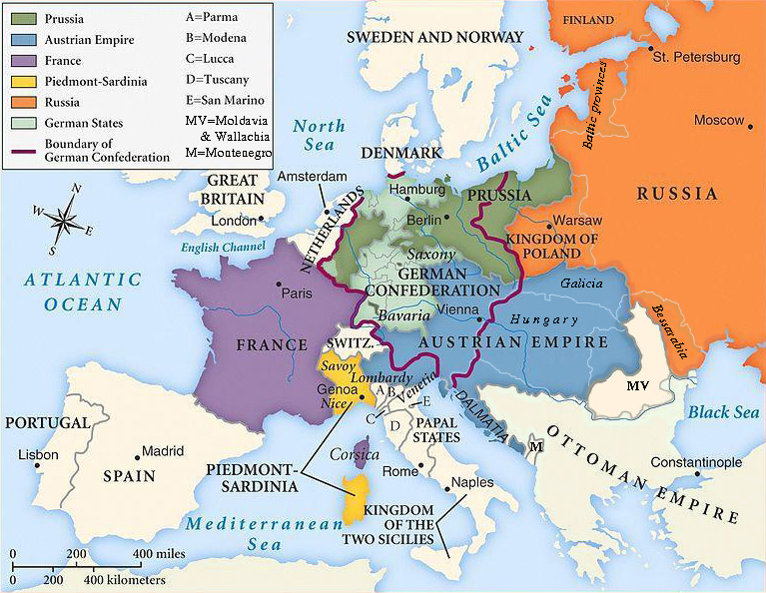
Europe after the Congress of Vienna

Slide 28
Attacks on the Slave Trade
Great Britain, which had abolished its slave trade in 1807.
The Congress of Vienna agreed in principle to condemn the slave trade but it continued in many places until 1850.
Nearly three million Africans were sold into slavery between 1800 and 1850, and most were transported on either Portuguese or Brazilian slave ships.

Slide 29
Rise of Conservatism
The political doctrine that justified the restoration was conservatism.
Conservatives saw a logical progression in recent history: the Enlightenment, based on reason, led to the French Revolution, with its bloody horrors, which spawned ogre Napoleon.
Conservatism rejected both the Enlightenment and the French Revolution and favored monarchies over republics, tradition over revolution, and established religion over Enlightenment skepticism.

Slide 30
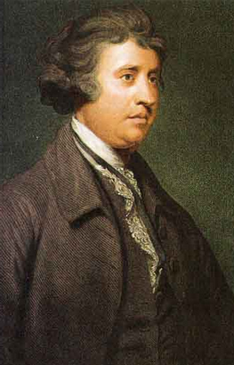
Sir Edmund Burke
The original British critic of the French Revolution, Edmund Burke, inspired many of the conservatives who followed.
He had argued that the revolutionaries erred in thinking they could construct an entirely new government based on reason.
Government, Burke said, had to be rooted in long experience, which evolved over generations.
All change must be gradual and must respect national and historical traditions.

Slide 31
Romantic Artists
Romanticism glorified nature, emotion, genius, and imagination.
Romantic poetry celebrated overwhelming emotion and creative imagination signified by Lord Byron and William Wordsworth.
The more nightmarish side of romanticism was captured by Mary Shelley in Frankenstein.
The towering presence of the German composer Ludwig van Beethoven established the direction for musical romanticism by transforming the symphony into a connected work with recurring and evolving musical themes.
The genre of historical novelists matured with the works of Sir Walter Scott in Rob Roy, The Lady of the Lake, and Ivanhoe.

Slide 32
Revolts in the 1820s
The restoration of regimes after Napoleon’s fall disappointed those who dreamed of constitutional freedoms and national independence.
Revolts broke out in the 1820s in Spain, Italy, Russia, and Greece.
The death of Czar Alexander I led to the Decembrist Revolt in Russia.
A Greek revolt in 1822, gained the support of a combined force of British, French, and Russian ships destroyed the Turkish fleet at Navarino Bay.
In 1830, Greece was declared an independent kingdom for the first time since 338 B.C.E.

Slide 33
South America Independence
Across the Atlantic, national revolts also succeeded after a series of bloody wars of independence.
Taking advantage of the upheavals in Spain and Portugal that began under Napoleon, restive colonists from Mexico to Argentina rebelled.
Simón Bolívar fought for the formation of a series of independent republics in South America between 1821 and 1823.
By 1825, Portugal had lost all its American colonies, including Brazil, and Spain was left with only Cuba and Puerto Rico

Slide 34
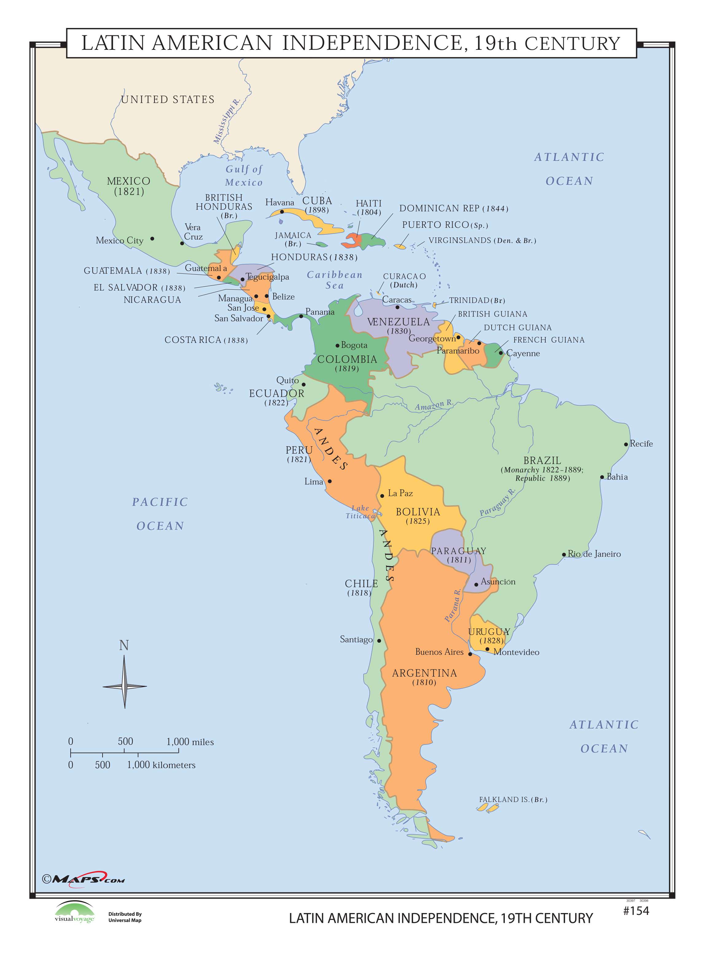
South American Independence

Slide 35
The Revolutions of 1830
In 1830, a new wave of liberal and nationalist revolts broke out.
French king Charles X brought about his own downfall.
On July 26, 1830, spontaneous demonstrations in Paris turned into street battles and agroup of moderate liberal leaders offered the crown Louis-Philippe and sent Charles into exile in England.
News of the July revolution in Paris ignited the Belgians to revolt against their Dutch rulers and a conference of leading nations guaranteed Belgium independence in exchange for its neutrality in international affairs.

Slide 36
British Political Reforms in 1832
Reform of Parliament rather than revolution preoccupied the British.
In August 1819, the suppression an illegal political meeting held in Manchester led to the deaths of eleven people and hundreds injured in the Peterloo massacre.
This led to a series of reforms, a new criminal code, repeal of laws prohibiting unions, toleration of Catholic MP’s, expansion of suffrage, and the Reform Bill of 1832 that nearly doubled the number of male voters, though only 8 percent of the population qualified to vote.
Nevertheless, the bill set a precedent for widening suffrage further.

