Slide 1
Ideology
A word coined during the French Revolution, ideology refers to a coherent set of beliefs about the way the social and political order should be organized.
The dual impact of the French Revolution and the Industrial Revolution prompted the development of a whole spectrum of ideologies to explain the meaning of the changes taking place. Nationalists, liberals, socialists, and communists offered competing visions of the social order they desired.

Slide 2
Great Britain’s Industrial Revolution
An abundant supply of coal
A well-developed banking and financial system
Limited liability legal system for corporations
Intellectual culture emphasized the public sharing of knowledge.
A colonial empire that produced ample natural resources and a market for manufactured goods
Agricultural productivity fed a growing population that supplied large numbers of workers for factories.

Slide 3
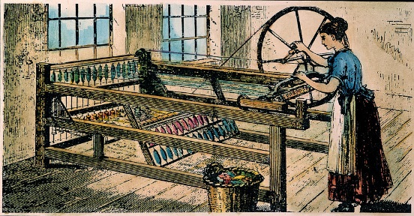
The Spinning Jenny
James Hargreaves, invented his cotton-spinning jenny about 1765.
Hargreaves’s spinning jenny was simple, inexpensive, and powered by hand. In early models from six to twenty-four spindles could mass produce a fine, slender thread.

Slide 4
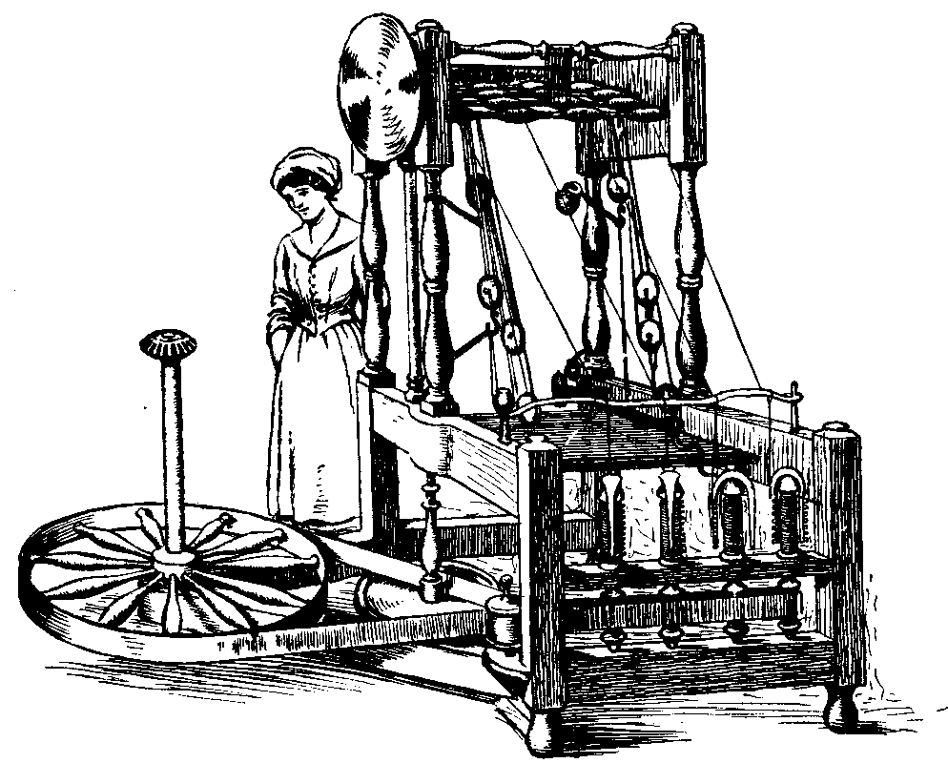
The Water Frame
Arkwright’s water frame had a capacity of several hundred spindles driven by waterpower. The water frame required large specialized mills located beside rivers and factories that employed as many as one thousand workers from the very beginning.
By 1790 the new machines were producing ten times as much cotton yarn as had been made in 1770.

Slide 5
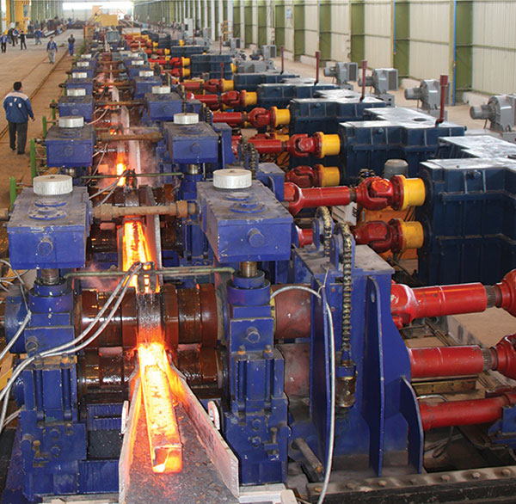
Steam-Powered Rolling Mill
The steam-powered rolling mills, which were capable of spewing out finished iron in every shape and form. The economic consequence of these technical innovations was a great boom in the British iron industry. Once scarce and expensive, iron became the cheap, basic, indispensable building block of the British economy.

Slide 6
The Steam Engine
A gifted young Scot named James Watt patented an efficient steam engine in 1769.
Watt needed skilled workers, precision parts, and capital, and the relatively advanced nature of the British economy proved essential.
A partnership in 1775 with Matthew Boulton, a wealthy English industrialist, provided Watt with adequate capital and exceptional skills in salesmanship
By the late 1780s the firm of Boulton and Watt had made the steam engine a practical and commercial success in Britain.

Slide 7
The Transportation Revolution
Railroads, Canals, and steamships drastically reduced shipping costs by allowing larger loaders to travel farther, faster, and cheaper.
Railroads connected previously isolated areas creating a large national market to buy supplies and sell manufactured goods in.
The growth of the railroad industry creating massive numbers of jobs in coal and iron mines, the timber industry, foundries, mills, and score of other enterprises.
The steamship made it possible to go upstream against the current and turned every river into a two-way highway for commerce.

Slide 8
The Causes of Continental Industrialization
British technicians and skilled workers immigration to the continent in search of better pay and opportunities and brought their knowledge.
Talent continental entrepreneurs duplicated the accomplishments and followed the models of their British counterparts.
Government policies like protective tariffs protected young continental firms from competition and fostered growth.
State established government monopolies that funneled massive investments into the transportation network that was critical to economic growth and industrialization.

Slide 9
Urbanization
Factories drew workers from the urban population surge, which had begun in the eighteenth century and now accelerated.
The number of agricultural laborers also increased during industrialization in Britain, suggesting that a growing birthrate created a larger population and fed workers into the new factory system.
Massive emigration from rural areas, rather than births to women already living in cities, accounted for most urban increase.
The rapid influx of people caused serious overcrowding in the cities because the housing stock expanded much more slowly than the population did.

Slide 10
The Working Class
As urban factories grew, their workers gradually came to constitute a new socioeconomic class with a distinctive culture and traditions.
The term working class, like middle class, came into use for the first time in the early nineteenth century.
It referred to the laborers in the new factories.
In the past, urban workers had labored in isolated trades: water and wood carrying, gardening, laundry, and building.
In contrast, factories brought working people together with machines, under close
supervision by their employers.
Soon developing a sense of common interests, they organized societies for mutual help and political reform. From these would come the first labor unions.

Slide 11
The Factory Act of 1833
The apprenticeship system that made virtual slaves out of children and the power that factory owners held over all workers led to numerous legal reforms that culminated in the Factory Act of 1833.
The Factory Act of 1833 installed a system of full-time professional inspectors to enforce the provisions of previous acts.
The Factory Acts constituted significant progress in preventing the exploitation of children.
After 1833 the number of children employed in industry declined rapidly.

Slide 12
Separate Spheres
With the restriction of child labor came a new sexual division of labor.
By 1850 the man was emerging as the family’s primary wage earner, while the married woman found only limited job opportunities.
Generally denied good jobs at high wages in the growing urban economy, wives were expected to concentrate on their duties at home.
Evolving gradually, but largely in place by 1850, this new pattern of separate spheres in Britain constituted a major development in the history of women and of the family.

Slide 13
Luddites
From the beginning, the British Industrial Revolution had its critics.
Skilled tradesmen and handicraft workers realized they could not compete with the cheaper pouring out of British factories.
Known as the Luddites, they attacked factories in northern England in 1811 and smashed the new machines, which they believed were putting them out of work.
The Luddites abhorred the prospect of losing their independent livelihoods, and having to work in factories as common laborers for a fraction of their previous living in horrible conditions.

Slide 14
Liberalism
Liberalism emerged as an intellectual response to Conservatism
Liberalism “was” demanded representative government and equality before the law as well as such individual freedoms as freedom of the press, freedom of speech, freedom of assembly, and freedom from arbitrary arrest.
Liberalism’s economic principles called for unrestricted private enterprise and no government interference in the economy. This philosophy was popularly known as the doctrine of laissez faire.

Slide 15
Nationalism
Nationalism was a second radical ideology that emerged in the years after 1815.
Early advocates of the “national idea” argued that the members of what we would call today an ethnic group had its own genius and its own cultural unity, which were manifested especially in a common language, history, and territory of the nation.
Nationalists sought to make the territory of each people coincide with well-defined boundaries in an independent nation-state. It was this political goal that made nationalism so explosive in central and eastern Europe after 1815.

Slide 16
Socialism
Socialism argued that the government should plan the economy to control prices and prevent unemployment.
Socialists also believed that government should regulate private property or that private property should be abolished and replaced by state or community ownership.
Karl Marx and Friedrich Engels published The Communist Manifesto, which became the guiding text of socialism.

Slide 17
The Great Famine
Ireland’s population doubled from 4 million to 8 million between 1780 and 1840, fueled in large part by the calories and nutritive qualities of the potato.
However, the potato crop failed in 1845, 1846, 1848, and 1851 in Ireland and throughout much of Europe. Many suffered in Europe, but in Ireland, where dependency on the potato was much more widespread, the result was starvation and death.
The Great Famine, as this tragedy came to be known, intensified anti-British feeling and promoted Irish nationalism.

Slide 18
The Revolutions of 1848
Ideological conflicts between liberalism, nationalism, and socialism and re-invigorated conservatism that stood against them helped turn economic and social conflicts into the revolutions of 1848.
France, Hungary, Bohemia, and Prussia all saw revolutionary uprisings in 1848.
Across Europe, the uprisings of 1848 were unsuccessful.
Reform movements splintered into competing factions, while the forces of order proved better organized and more united, on both a domestic and international level.

Slide 19
