Slide 1
The History of Psychoactive Drugs
Maria Buffo, M.A, LMFT
Pierce College 2022
Addiction Studies 2

Slide 2
5 Historical Themes:
Coping
Susceptibility
Business and Government
Refining, Synthesizing, Manufacturing
Delivery Efficiency
Notes:
1. There are five Historical themes:

Slide 3
1. Coping
Ease fear/anxiety
Reduce pain
Treat illnesses
Pleasure
Connection to God
Notes:
1. There are five Historical themes: Survival

Slide 4
2. Susceptibility
Desirable affect
Mimic brain chemistry
Affect the primitive brain
Affect the new brain(reasoning, decision)
Notes:
2. If not a desirable affect NO need for use​

Slide 5
3. Business and Government
Growth, distribution, sales
Taxed
Controlled (prohibited, accepted)
Power
Taxes fund:
American Revolution
Support colonization
Government budget
Notes:
3. Supply and demand: what cures and makes us feel good​
Taxes on whiskey, hemp Tobacco

Slide 6
Refining, Synthesizing, Manufacturing
Distilled alcohol beverages
Refine morphine from opium
Refine cocaine from coca leaves
Manufacturing: mass productions
Synthesizing amphetamine, LSD
Sinsemilla growing techniques
Notes:
Cocaine from coca leaves about .5-2% compared to street drug 60-70%
1970 to 2017 Marijuana THC is 14X more potent
Neurotransmitters are mimicked by medication
Serotionin- antidepressants
Dopamine- antipsychotics
GABA - Antianxiety

Slide 7
5. Delivery Efficiency
Then
Now
Drinking
Eating
Smoking
Mucus membrane absorption
Mixing drugs
Inhalation/ snort
Injection
Distilled liquor
Notes:
5. The development of Intensify the effects​

Slide 8
Prehistory/Neolithic Period
8500 - 4000BC

Slide 9
Plants
Opium poppies
Marijuana
Coca leaves
Tea leaves
Betel Nuts
Khat leaves
Coffee beans
Tobacco leaves
Fruit/plant ferment into alcohol
Notes:
4,000 plants known to produce psychoactive effects ONLY 60 are commonly used​
A shaman (priest-medicine man) would conduct religious ceremonies or act as the middle man for super-natural or natural

Slide 10
Ancient Civilization
4000 B.C - A.D 400
Notes:
BC- before Christ/ before Common Era​
AD- Anno Domini (latin= the year of the lord)

Slide 11
“Give strong drink to him who is perishing, and wine to those in bitter distress; let them drink and forget their poverty, and remember their misery not more.”
–Proverbs, 31: 6-7

Slide 12
Creations
Alcohol
Opium
Cannabis
Mescal Bean, Peyote Cacti
Mushrooms
Tobacco/Coca Leafs

Slide 14
Middle Ages
400-1400
Notes:
The age of psychedelics!!! The discovery of poisonous nature of plants and mold​
ERGOT-

Slide 15
“Double, double, toil and trouble; fire burn and cauldron bubble.
Fillet of fenny snake, in the cauldron boil and bake; Eye of newt and toe of frog, Wool of bat and tongue of dog, Adder’s fork and blind-worm’s sting.
Lizard’s leg and owelet’s wing, For a charm of powerful trouble, Like a hell-broth boil and bubble. ”
–William Shakespeare
Macbeth, Act 1
1606

Slide 16
Psychedelics
Plants
Hallucinations
Delirium
“Witchcraft”
Mold
Ergot-Lysergic Acid Diethylamide
Notes:
Plants such as Solanacea contained atropine and scopolamine = hallucination and delirium ( accused of being used for witch craft. ​
ERGOT- brown/purple fungus, grow on infected rye and wheat plants. Active ingredient Lysergic Acid Diethylamide --can be overdosed with poison.

Slide 17
Medicine to Psychoactive Drug
Example: Opium
Low Dosage: suppresses pain
Higher Dosage: euphoria
High Dosage: depresses breathing to dangerous levels
Notes:
Theophrastus (Greek philosopher and naturalist) dosage observation​
Healer and Shamans were well aware of the dose-dependent dangers​

Slide 18
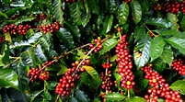
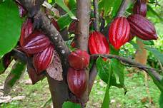
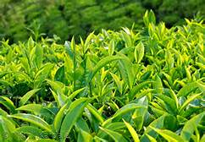
Coffee, Tea and Chocolate
Notes:
AKA : Caffeine
Chewed coffee bean or drank bean-infused water. Not until 1819 German doctor identified caffeine in tea and coffee.
Mayans were one of the first to have drank cocoa/chocolate

Slide 19
The Renaissance
The Age of Discovery
1400-1700
Notes:
​

Slide 20
Laws and Limits
The use of alcohol, cocoa, tobacco, coffee, tea and opium were traded
Laws were covered by the ruling class, government and merchants
Tobacco crosses the ocean
Notes:
-spread of trade routes​
-the ruling class, government and merchants controlled the trade​
​

Slide 21
The Return of Opium
Medicinal purposes were studied
Opium mixed with alcohol: Laudanum - Cure all medicine, inexpensive
Soothe a crying child
Inflammation
Diarrhea
Melancholy
Headaches
Pain Killers

Slide 22
Early Industrial Revolution
1700-1900

Slide 23
New Refinement Techniques
Refined
Distill Liquor (alcohol)
Morphine (opium)
Cocaine (coca leaf)
Techniques
Hypodermic Needle
Cigarette rolling machine
Notes:
Morphine is 10X more potent than opium USED in Civil War​
Higher potency the more rapid develop of tolerance and tissue dependence​
Until 1859 coca leaf was chewed. Albert Niemann isolated the ALKALOID COCAINE;;; became the refine powder​
Dr. Karl Koller found cocaine was a strong topical anesthetic (eye surgery possible)​

Slide 24
Other discoveries
Ether “Sweet Vapor”- Anesthetic
Nitrous Oxide “Laughing Gas”-Anesthetic
Opiates and Cocaine in Patent Medicines and Prescriptive drugs
Over the counter medication
Notes:
Over-the-counter Medicines sold around the turn of the twentieth century
Temperance and Prohibition Movement began as early as 1785
The American Temperance Society created in 1826

Slide 25
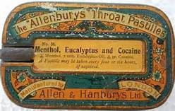
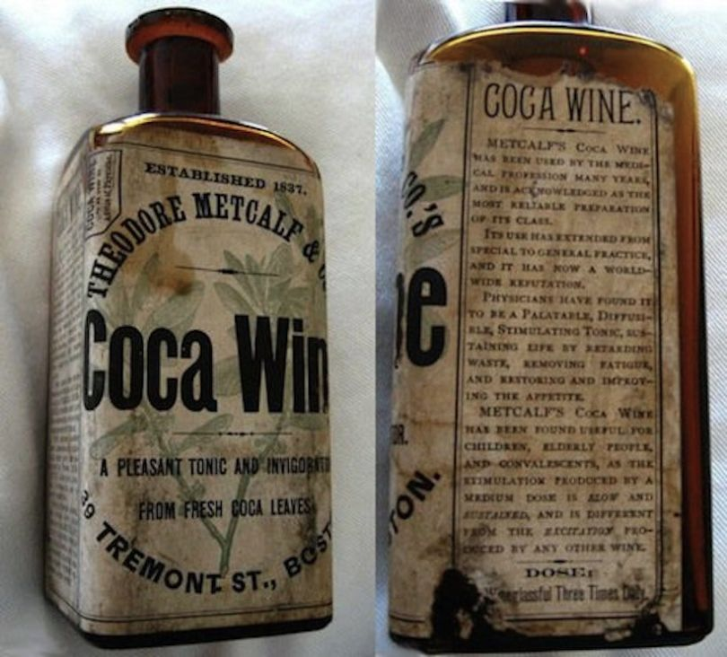
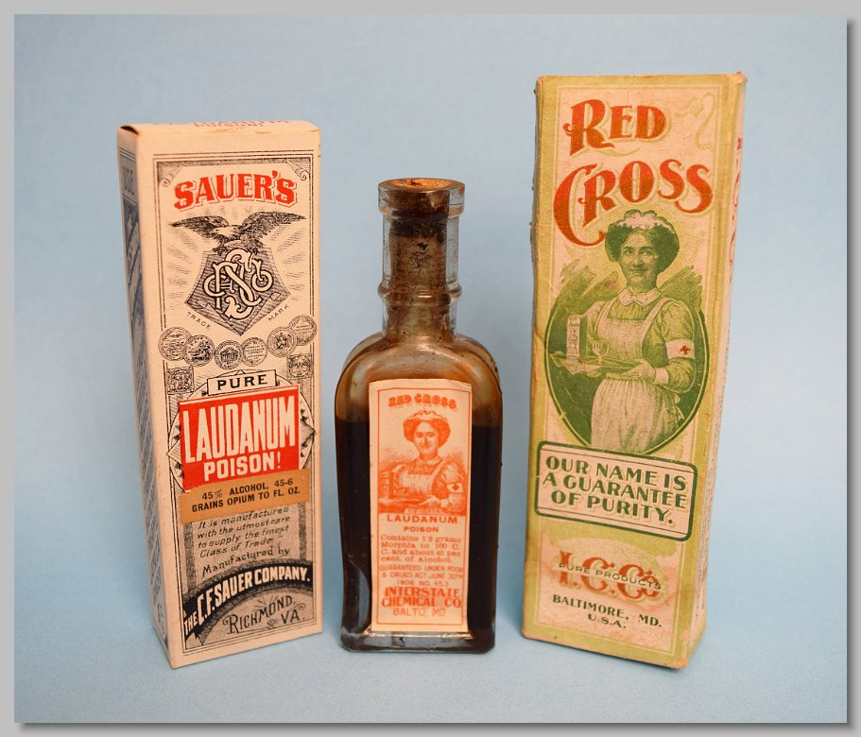

Slide 26
The Twentieth Century
Notes:
Marketing tobacco was a booming success

Slide 27
Drug Regulations
Late 1800’s physicians- understood addictive/health liabilities of opiates and cocaine
1906- Pure Food and Drug Act prohibited misbranded and adulterated food, drink and drugs (accurate labeling)
1909-Opium exclusion Act: gradual reduction and eventually banned smoking opium
1914- Harrison Narcotic Tax Act

Slide 28
Prohibition
1920- The Volstead Act implemented the 18th amendment prohibiting the manufacture and the sale of any alcoholic beverage
Notes:
President Woodrow Wilson vetoed the bill however was overridden by Congress.
During prohibition cirrhosis of the liver and other alcohol-related diseases declined dramatically, domestic violence fell and violent crime dropped by 2/3 and public drunkenness disappeared.
14 years later Prohibition was repealed.

Slide 29
Alcohol and Prohibition and Treatment
Alcoholic Anonymous founders Bill Wilson and Dr. Bob
Notes:
Probation helped decrease health and social issues however it was responsible for equally serious problems : new coalition of smugglers, strong armed thieves, corrupt politicians, crooked police and Italian, Irish and Jewish mobsters.
After prohibition alcoholism did increase although it took 20+ years before it got to the level prior to prohibition. Higher levels of alcoholism led to AA a spiritual program that teaches 12 recovery steps
Founded in 1934.

Slide 30
U.S. Laws

Slide 31
Timeline
1920: The Volstead Act 18th Amendment
1933: Prohibition and the Volstead Act repealed
1937: Marihuana Tax Act banned cultivate and use
1963: Community Mental Health centers Construction Act, first federal assistance for treatment
1965: Prohibited the illicit manufacture of stimulants and depressant
1970: The Comprehensive Drug Abuse Prevention and Control Act aka “Controlled Substances Act”

Slide 32
Timeline
1973: Drug Enforcement Administration (DEA)- classify and control all psychoactive drugs, limit imports and exports, define criminal penalties
1984: Drinking age was raised to 21 y/o
1986: Anti-Drug Act encourage foreign cooperation in eradicating drug crops
1990: Crime Control Act regulated precursor chemicals
2000: Prop 36 (California)
1996-PRESENT As of April 2017- 29 states legalized the medical use of marijuana, CA prop. 215
2000: Prop 36 (California)- drug treatment instead of jail
Notes:
Before 1984 various age between 18-21 in states
1990: allowed the seizure of drug traffickers assets, and controlled drug paraphernalia and money laundering
PROP 36– required treatment option for first time nonviolent offenders (drug court)
Guam. Puerto Rico, Wash,DC– medical marijuana

Slide 33
Timeline
2008: The Mental Health Parity and addiction equity Act classified addiction as a medical disorder
2010: Senate Bill 1449 – less than 1ounce of marijuana from criminal misdemeanor into a civil infraction
2013: Colorado and Washington State for recreational purposes is legalized
2016: November 8th Prop 64 in California - 21 yo. Possess and grow specified amounts of marijuana
2019: Marijuana recreation use in California
Notes:
2008---For insurance purposes to bill treatment
Prop 64: California passed recreational use of marijuana Jan 2018 need to come up with regulating law

Slide 34
A New Era
Amphetamine/weight loss
Sports and Drugs
Sedative-Hypnotic and Psychiatric Medications
LSD and New Psychedelics for treatment?
Methadone- Medication Assisted Treatment (MAT)
Smokable meth, cocaine
Club drugs - Ecstasy, MDMA

Slide 36
Next Week: February 21 HOLIDAY-NO CLASS

Slide 37
Week 3:
February 28
Neurochemistry and the Physiology of Addiction Part I
Notes:
Read Chapter 2

