Slide 1
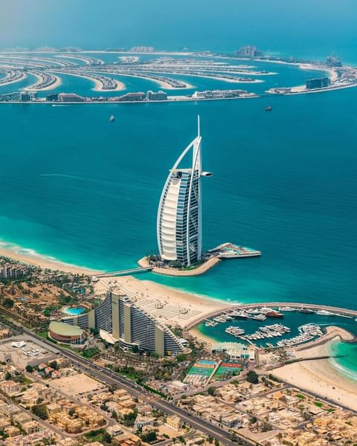
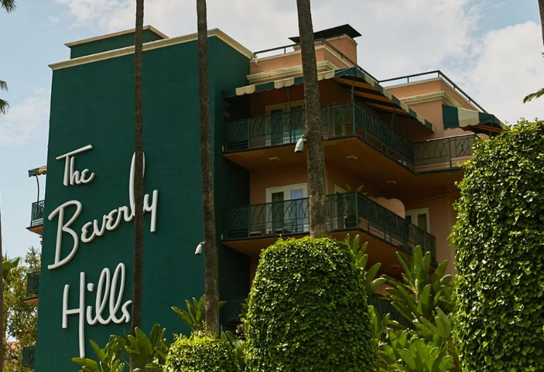
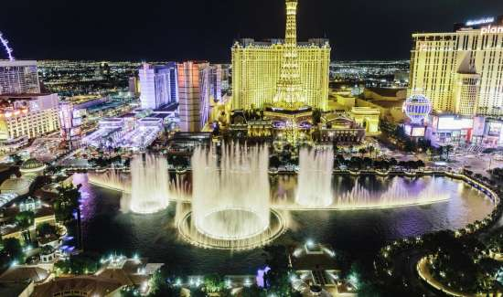
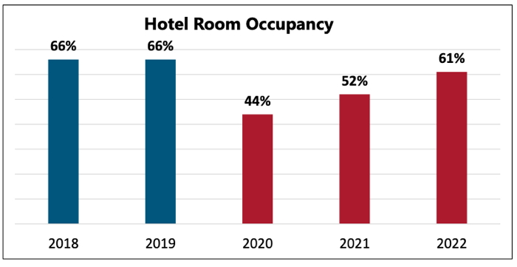
Be Hospitable to Hospitality!
Create memories with loved ones at historic hotels!
The Burj Khalifa
The Beverly Hills Hotel
The Bellagio
Sources
The Burj Khalifa holds the world record for being the tallest building in the world, and holds six additional world records. This is the tallest freestanding structure in the world, has the highest occupied floor in the world, has the highest number of stories, has the highest observation deck, the longest travel distance for an elevator, and has the tallest service elevator. (Source #1 and #2)
This historic hotel opened on May 12, 1912 before the city of Beverly Hills even existed! The founder was Margaret Anderson who had the motto, “Guests are entitled to the best of everything regardless of cost!”
In 2012, the hotel had its 100th anniversary and officially named the first historic landmark in the city of Beverly Hills. (Source #4)
The Bellagio is in Las Vegas and boasts more than 3,000 rooms, including its famous water fountain. It cost $1.6 billion to build, which was the most expensive at the time under the guidance of Steve Wynn. Its wedding chapel holds more than 600 weddings per year. (Source #3, #5 and #6)
1. https://www.jumeirah.com/en/stay/dubai/burj-al-arab-jumeirah
2. https://luxeadventuretraveler.com/fun-facts-about-the-burj-khalifa/
3. https://bellagio.mgmresorts.com/en.html
4. https://www.dorchestercollection.com/en/los-angeles/the-beverly-hills-hotel/
5. https://www.viator.com/Las-Vegas-attractions/Bellagio-Hotel-and-Casino/overview/d684-a15186
6. https://www.thetravel.com/surprising-facts-bellagio-hotel-las-vegas/
7. https://www.htrends.com/trends-detail-sid-114174.html
Let’s help reverse the losses to the hospitality industry from COVID 19 and bring the hospitality industry back in business!
Hospitality Trends
The American Hotel & Lodging Association (AHLA) today released “AHLA’s State of the Hotel Industry 2021” examines the hotel industry’s recovery from COVID 19. The pandemic dampened the hospitality workforce, which is down 4 million jobs compared to 2019. This sector faces an 18.9% unemployment rate according to the Bureau of Labor Statistics. Half of U.S. hotel rooms are projected to remain empty in 2021. (Source #7)

