Slide 1
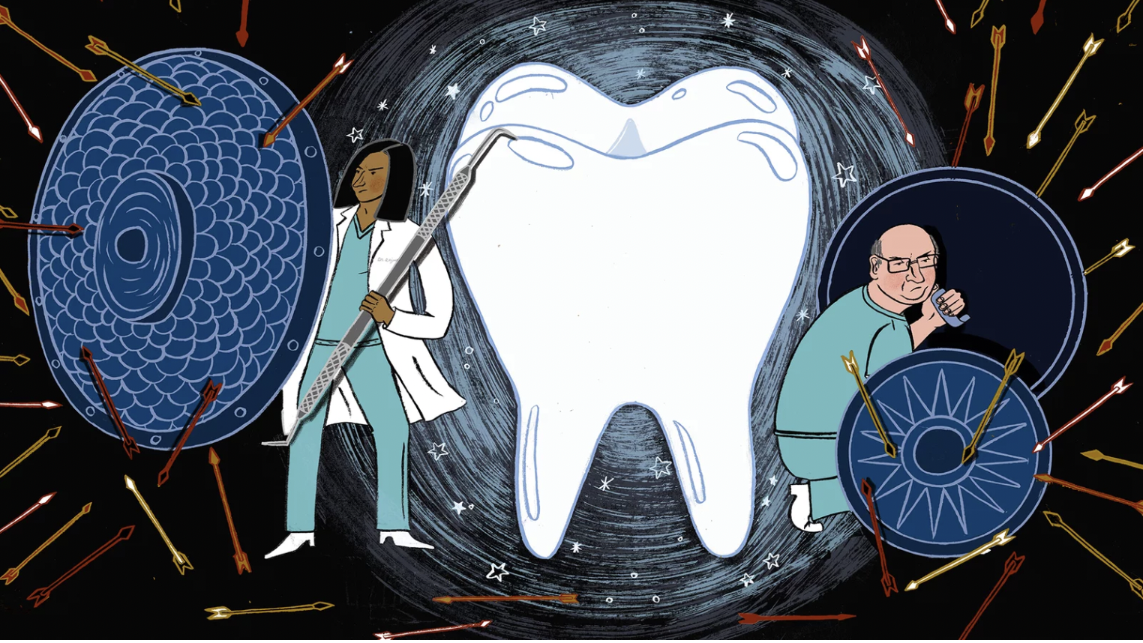
Why do we need Fluoride?

Slide 2
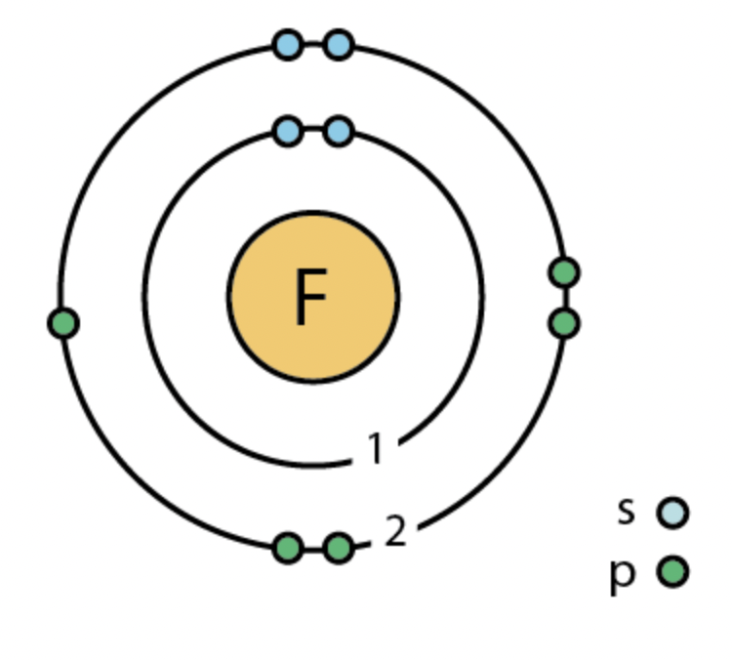
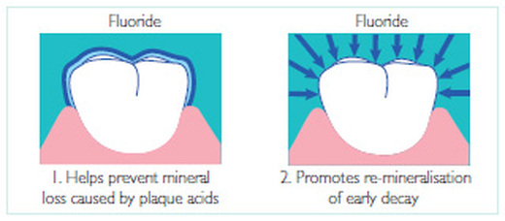
What is Fluoride?
There are two types of fluoride topical (fluoridated products) and systemic (water supply).
Fluoride is a mineral that occurs naturally and is released from rocks into the soil, water, and air. It is an element than can be found in many minerals and foods.
In dentistry fluoride is a natural mineral that strengthens the enamel and prevents caries.

Slide 3
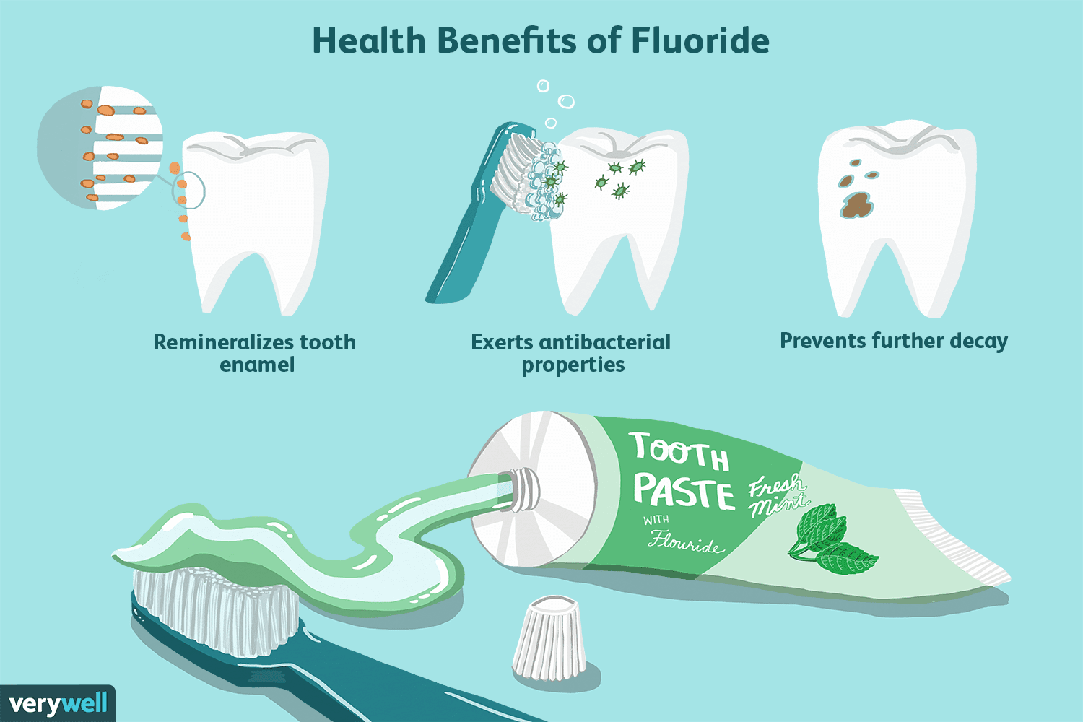
Benefits of Fluoride
Prevent tooth decay by making the tooth more resistant to acid attacks from oral bacterial and sugars
Speeds the remineralization process which helps rebuild worn-down or weakened enamel
Strengthens the enamel, and disrupts acid production in erupted teeth
Strengthens the enamel of permanent teeth in children under 6 years age making it difficult for acids to demineralize the tooth

Slide 4
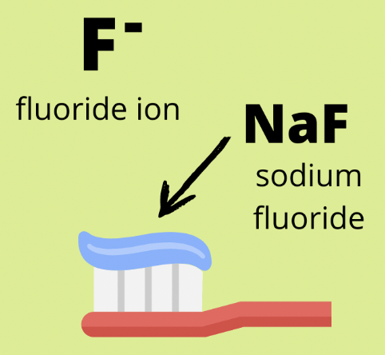
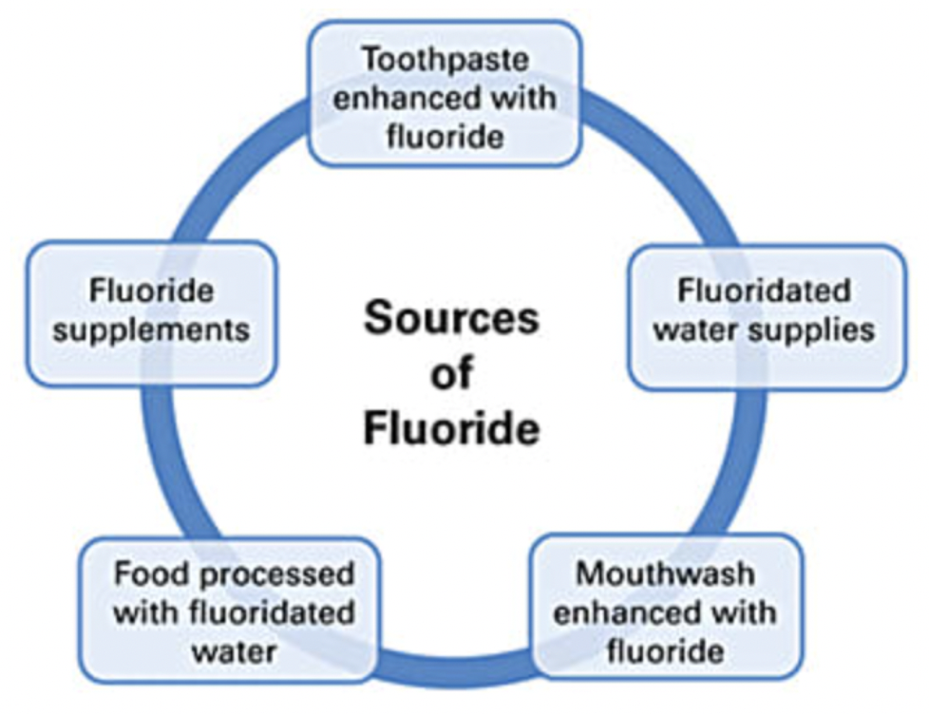
Common sources of Fluoride
The primary sources for fluoride intake include drinking water in fluoridated communities, toothpaste, beverages (e.g raw tea leaves, tea tree oils), food, dietary prescription supplements (e.g., tablets, drops, syrups, lozenges, tablets), and other professional dental products (e.g., mouth rinses, gels, varnishes, and foams).

Slide 7
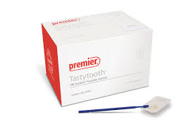
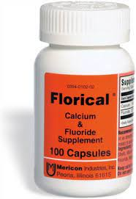
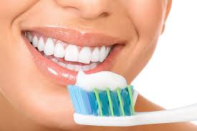
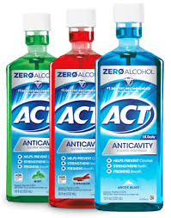
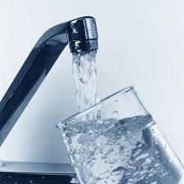
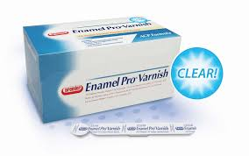
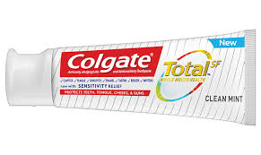
Type of Fluoride
Toothpaste Mouth Rinse Gel Water Varnish Supplement
1100 ppm 900 ppm 12,300 ppm 0.5 -1 ppm 22,600 ppm 44,800 ppm

Slide 8
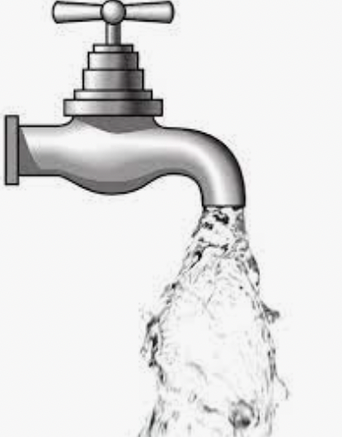
What is the COMMUNITY WATER FLUORIDATION?
Fluoride can also be added to drinking water supplies as a public health measure for reducing cavities.
Decisions about adding fluoride to drinking water are made at the state or local level.
In the United States, water and processed beverages (e.g., soft drinks and fruit juices) provide approximately 75% of a person’s fluoride intake.
Notes:
Fluoride can also be added to drinking water supplies as a public health measure for reducing cavities. Decisions about adding fluoride to drinking water are made at the state or local level.
Community water fluoridation is one of the 10 greatest public health achievements of the 20th century. National efforts of community water fluoridation prevent oral diseases, deliver health care savings and reduce oral health disparities. ADEA strongly supports optimal fluoridation of community water.

Slide 9
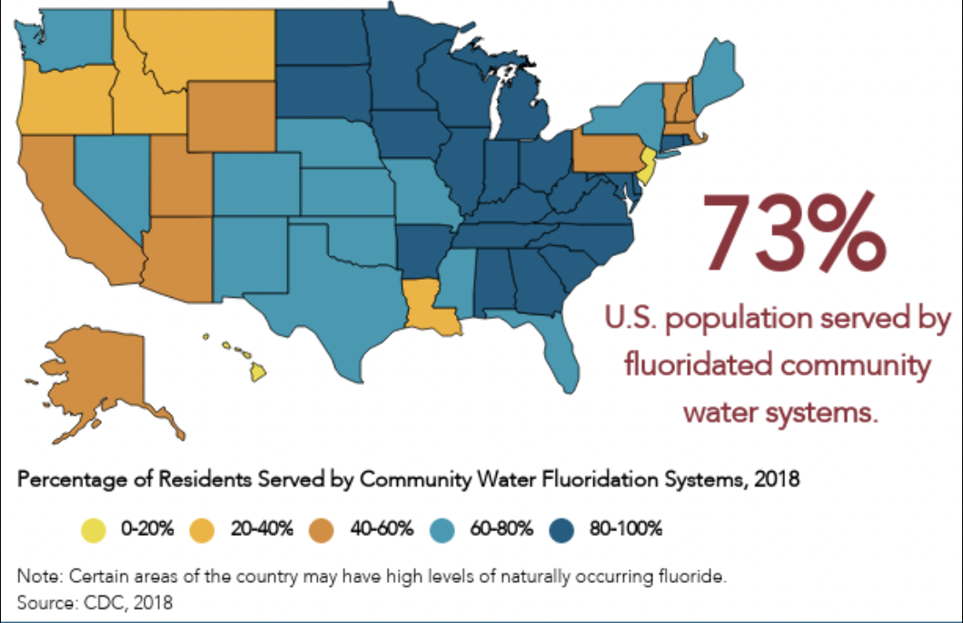
Copy from this —->
Notes:
Community water fluoridation is one of the 10 greatest public health achievements of the 20th century. National efforts of community water fluoridation prevent oral diseases, deliver health care savings and reduce oral health disparities. ADEA strongly supports optimal fluoridation of community water.

Slide 10
FLUORIDATED WATER PREVENTS ORAL DISEASES
Fluoride benefits children and adults throughout their lives.
Fluoride reduces tooth decay in children and adults about 25%.

Slide 11
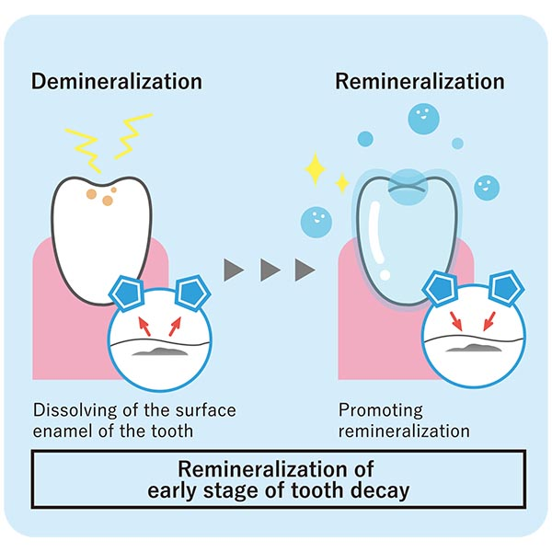
How Fluoride works?
Food we eat combines with mouth bacteria
Mouth bacteria creates acid, drawing minerals out of tooth enamel, and making your teeth weak
Demineralization - Plaque acid enters poles in the teeth and breaks down enamel
Remineralization- Fluoride enters poles in the tooth to treat enamel lesions. Fluoride replaces the lost minerals and repairs the tooth enamel
Fluoride harder than original tooth surface
More resistant to decay
Reduces acid production by bacteria
Notes:
Fluoride improves the quality of the tooth surface, making it harder to be dissolved in acid

Slide 12
How does Fluoride work to prevent tooth decay?

Slide 13
Fluoride is important for ALL AGES.
Many dentists and hygienists recommended fluoride treatments for their patients.
Patients can benefit from fluoride because as we age, our teeth weaken as well making them more susceptible to decay.
Patients who are prone to tooth decay, have dry mouth or reduced salivary flow, have gum disease, have had head or neck radiation treatments, and patients who have chronic tooth sensitivity should also consider having topical fluoride applied at their dental appointments.
Notes:
What is fluoride treatment for adults?
Fluoride treatments remineralize tooth enamel and reduce that sensitivity. Patients who undergo radiation treatment for cancer also benefit from topical fluoride applications. Radiation damages saliva glands, thus greatly reducing the flow of saliva.

Slide 14
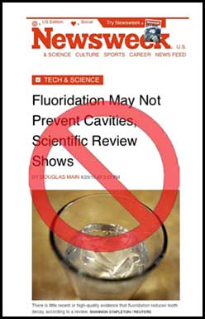
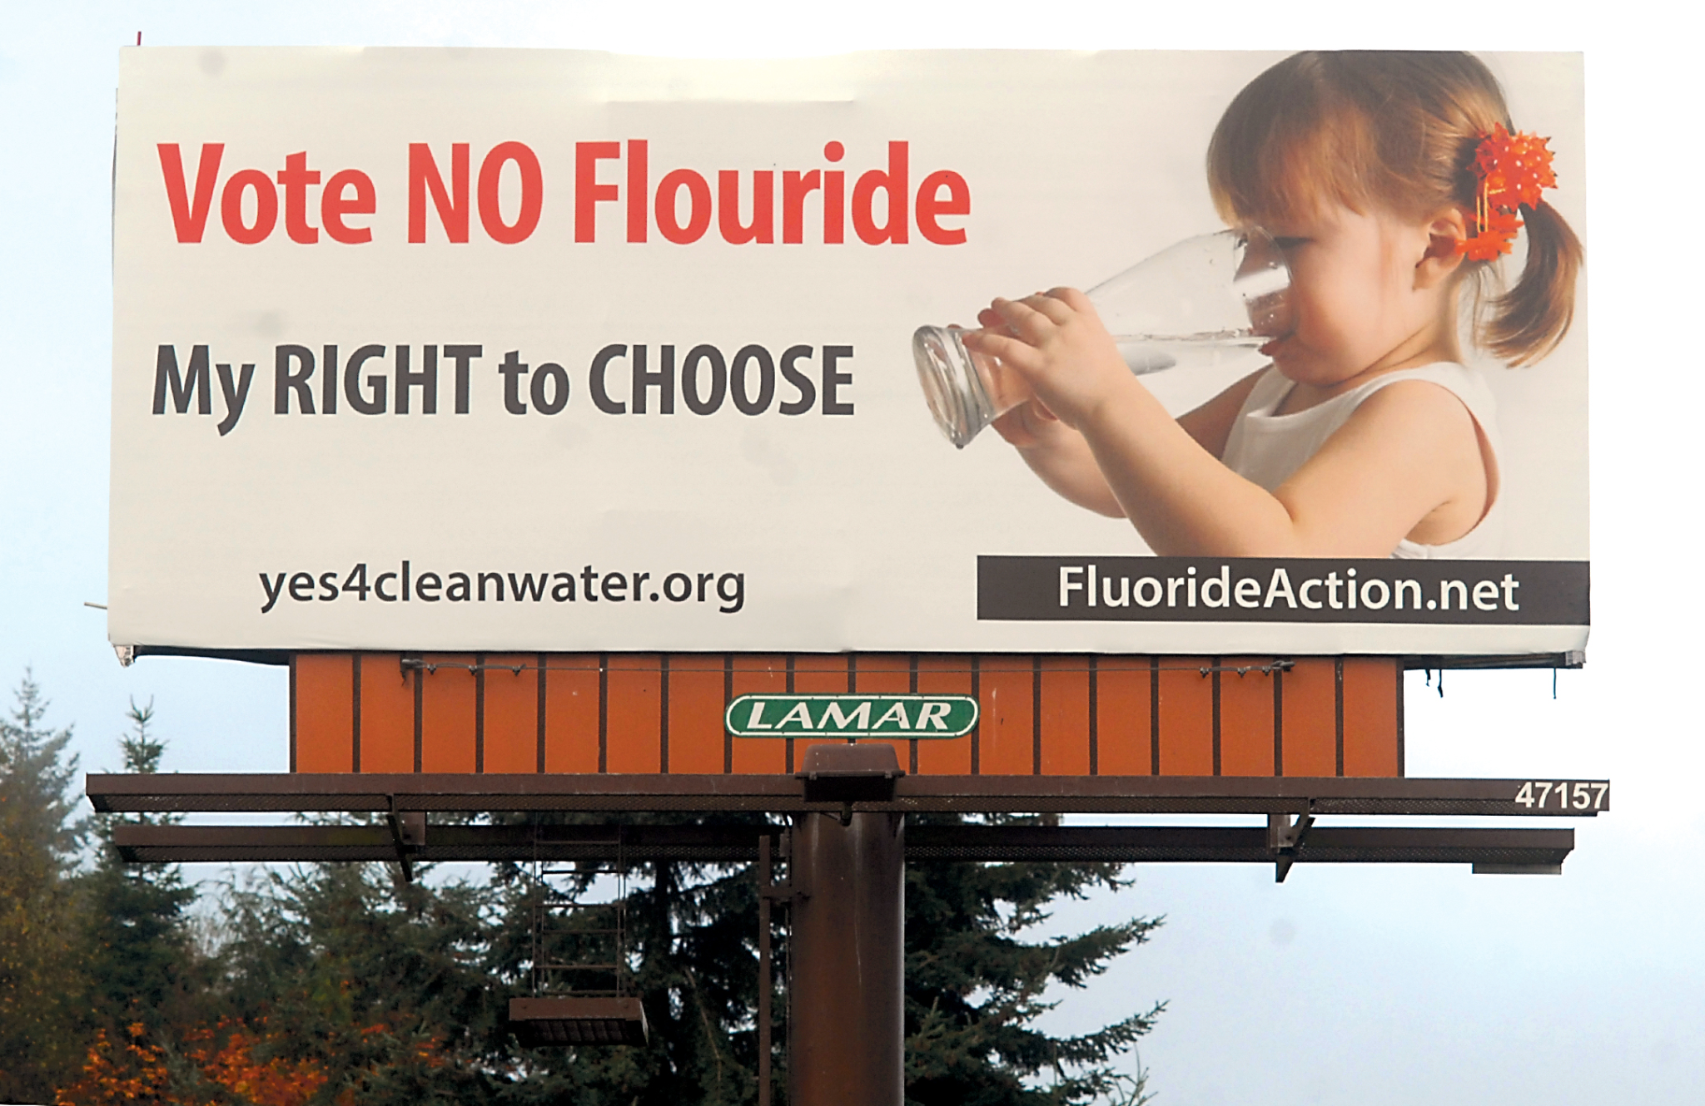
Misunderstanding of Fluoride
Why people hesitate to use Fluoride?
Myth 1: Fluoride is harmful to the body
Myth 2: Fluoride is only for children
Myth 3: Fluoride doesn’t stop tooth decay
Myth 4: Fluoride isn’t necessary to your health
Notes:
Ask (T/F) to audiences

Slide 15
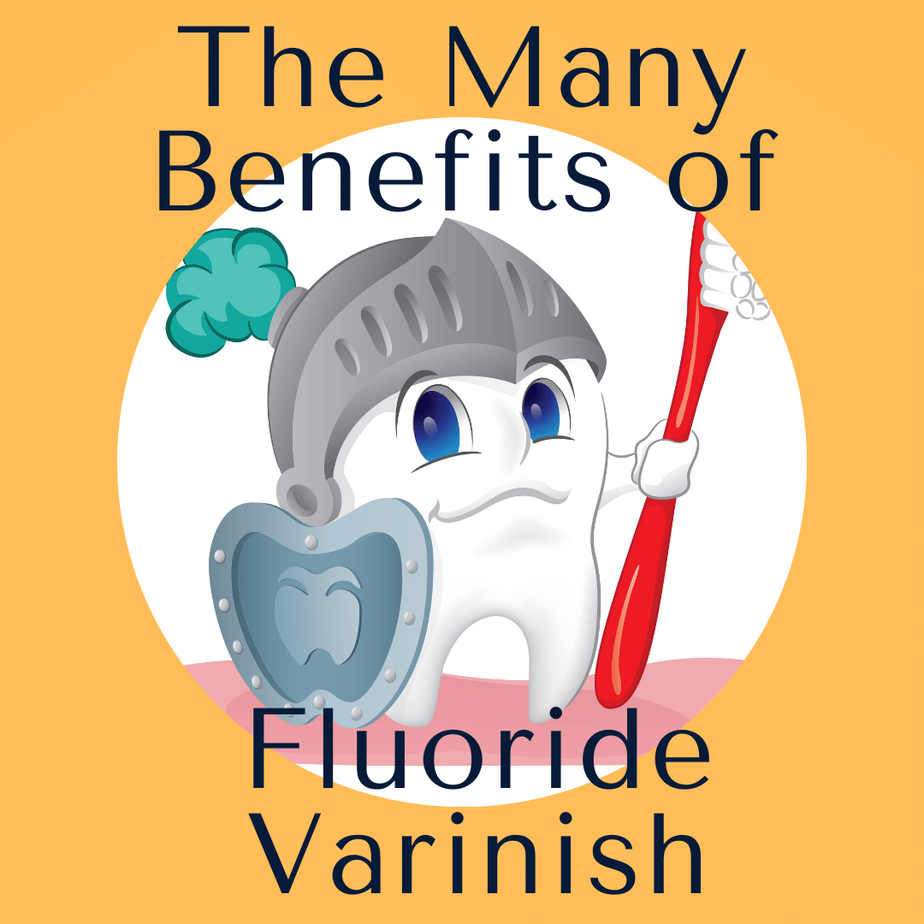
Conclusion
In proper concentrations fluoride can positively affect a person's oral health.
Fluoride:
Prevents plaque accumulation
Inhibits caries formation
Impedes tooth decay
Reduces acid-related enamel wear
Hinders demineralization
Reinforces remineralization
Fluoride is delivered from water, foods, beverage, and
Fluoride products: toothpaste, mouth rinse, gel, or
5% Sodium Varnish.

Slide 16
References
Hu, D., Li, X., Liu, H., et al. (2019)Evaluation of a stabilized stannous fluoride dentifrice on dental plaque and gingivitis in a randomized control trial with 6-month follow-up. J Am Dent Assoc, 150(4): 245. PMID: 30797257. https://pubmed.ncbi.nlm.nih.gov/30797257/
Fiorillo, L., Cervino, G., Herford, A.S., et al. (2020). Stannous fluoride effects on enamel: A systematic review. Biomimetics (Basel, Switzerland), 5(3), 41. https://doi.org/10.3390/biomimetics5030041
Myers, C.P., Pappas, I., Makwana, E., Begum-Gafur, R., Utgikar, N., Alsina, M.A., Fitzgerald, M., Trivedi, H.M., Gaillard, J.F., Masters, J.G., & Sullivan, R.J. (2019) Solving the problem with stannous fluoride: formulation, stabilization, and antimicrobial action. J Am Dent Assoc, 150(4S):S5-S13. doi:10.1016/j.adaj.2019.01.004. PMID: 30797260. https://pubmed.ncbi.nlm.nih.gov/30797260/
Benson, P. E., Parkin, N., Dyer, F., Millett, D. T., & Germain, P. (2019). Fluorides for preventing early tooth decay (demineralised lesions) during fixed brace treatment. The Cochrane database of systematic reviews, 2019(11), CD003809. https://doi.org/10.1002/14651858.CD003809.pub4
Kirsch, J., Hannig, M., Winkel, P., Basche, S., Leis, B., Pütz, N., Kensche, A., & Hannig, C. (2019). Influence of pure fluorides and stannous ions on the initial bacterial colonization in situ. Scientific reports, 9(1), 18499. https://doi.org/10.1038/s41598-019-55083-0
Marinho, V. C., Chong, L. Y., Worthington, H. V., & Walsh, T. (2016). Fluoride mouthrinses for preventing dental caries in children and adolescents. The Cochrane database of systematic reviews, 7(7), CD002284. https://doi.org/10.1002/14651858.CD002284.pub2
Notes:
Cafasso, J. (2019, July 3). What is fluoride? uses, benefits, side effects, and safety. Healthline. Retrieved May 7, 2022, from https://www.healthline.com/health/what-is-fluoride
Centers for Disease Control and Prevention. (2019, March 8). About fluoride. Centers for Disease Control and Prevention. Retrieved May 7, 2022, from https://www.cdc.gov/fluoridation/faqs/about-fluoride.html
Fluoride and biochemistry. Fluoride Action Network. (2012, August 5). Retrieved May 7, 2022, from https://fluoridealert.org/articles/fluoride-biochemistry/
The superhero that lives inside your mouth. Mouth Healthy TM. (n.d.). Retrieved May 7, 2022, from https://www.mouthhealthy.org/en/fluoride-superhero
What is fluoride & what does it do to your teeth? Dental Choice. (2021, August 16). Retrieved May 7, 2022, from https://www.dentalchoice.ca/what-is-fluoride-and-do-you-need-it/
What is fluoride toothpaste?｜Lion Corporation. (n.d.). Retrieved May 7, 2022, from https://www.lion.co.jp/en/oral/point/03.htm

