Slide 1
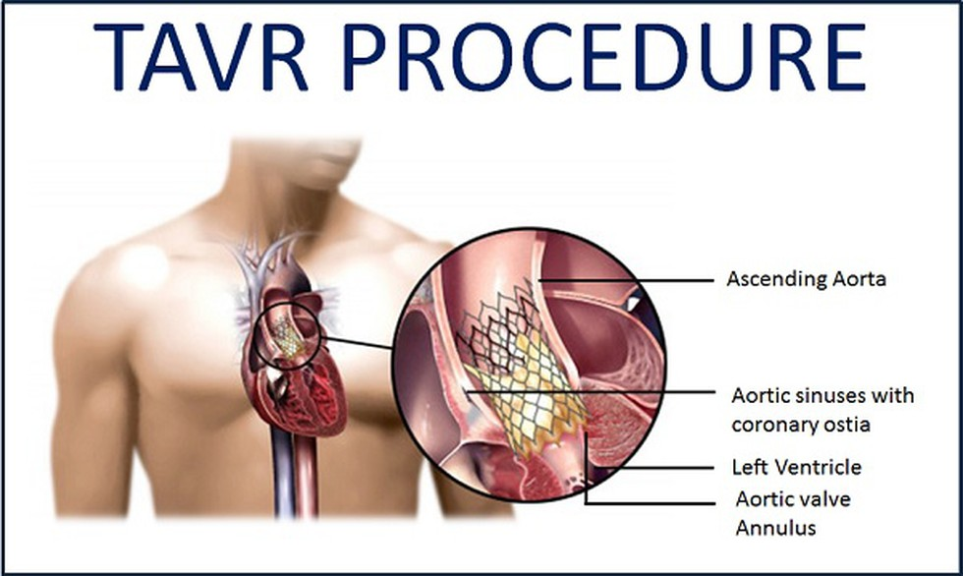
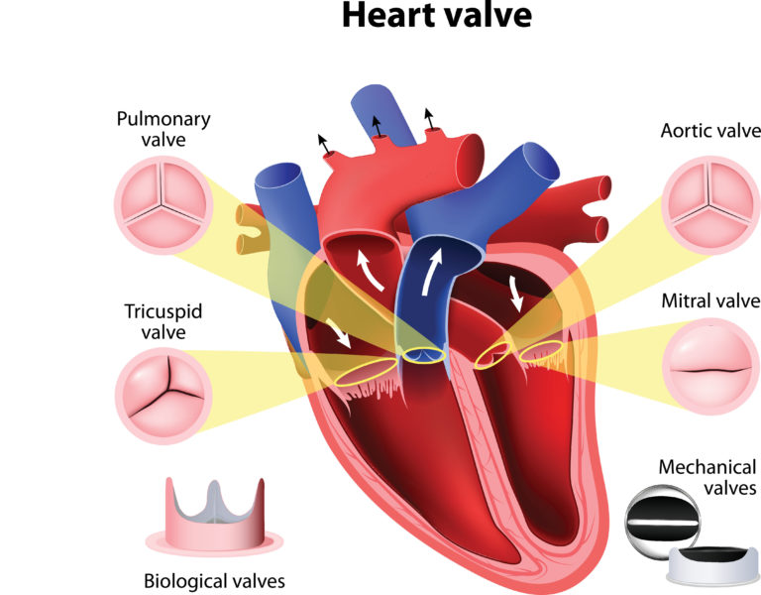
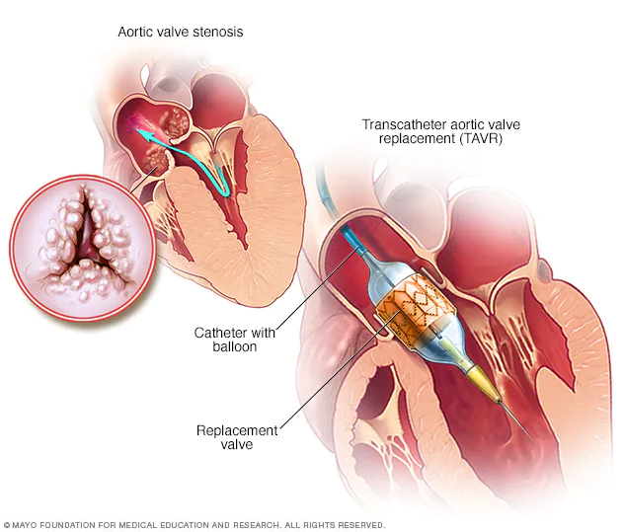
What is Transcatheter Aortic Valve Replacement?
Heart anatomy What are aortic valves?
What are aortic valves?
The valve between the left lower heart chamber and the main artery of the body is called the aorta.
What is its role?
Flow of blood from the heart to the rest of the bodyis controled by the aortic valve.
What happens when they do not work properly? Health experts can determine the reduced blood flow from the heart of the body if the valve fails to open correctly
What happens when they are too narrow?
When a valve becomes narrow, or stenotic, it can negatively impact the flow of blood from the heart into the rest of the body. Blood may be pumped too hard through the small opening of the valve to the rest of the body if the heart has to work hard to pump it. As a result, heart failure may increase.
What are some signs and symptoms of aortic valve stenosis?
Signs and symptoms of aortic valve stenosis, such as chest pain, fainting, fatigue, and shortness of breath.
What is TAVR?
Procedure
The TAVR procedure is carried out in one of two ways:
The transfemoral technique avoids a surgical incision in the chest by entering through the femoral artery (large artery in the leg).
The transapical technique involves making a small incision in the chest and entering through a major artery or the tip of the left ventricle.
Remember the procedure
Transcatheter aortic valve implantation lodges a catheter into a blood container in the upper leg or chest. This catheter helps pass the replacements towards the aortic valves, and this process guides and fixes the replacement valves.
Using the TAVR, heart experts can insert the catheter and reach the diseased valve. Next, the balloon is now useful to inflate with fluid (Popma, Deeb, Yakubov, Mumtaz, Gada, O’Hair, & Reardon, 2019). Then, this process causes the new valve to develop and magnify into place. Aside from that, TAVR can push the leaflets of the diseased valve and utilize them to secure themselves into place.
The high success rate of the TAVR procedure despite the risks of TAVR for patients to face bleeding, kidney injury, heart attack, and stroke.
Conclusions
Transcatheter aortic valve replacement (TAVR)
or transcatheter aortic valve implantation (TAVI)
is an important medical procedure that replaces a thickened aortic valve that can not fully open.
With this minimally invasive procedure, an entirely new valve is inserted without removing the old, damaged valve. The new man-made valve is placed inside the ill aortic valve (Webb & Wood, 2022).
How is it introduced?
In this medical practice, health experts can introduce TAVR with the catheter into the leg or chest to guide it to the heart.
How the TAVR Restrece Blood Flow
Benefits of TAVR
Using the TAVR helps refurbish blood flow. With TAVR, it helps diminish the number of people who are at risk of medical complications from open surgery who can use TAVR (Webb & Wood, 2022). In other words, TAVR is an option to choose when people are at risk of medical problems from surgical aortic valve replacement.
In conclusion, Transcatheter aortic valve replacement (TAVR) is a minimally invasive procedure that helps replace a narrowed aortic valve that has shown to be successful in treating diseases caused by narrow valves.
In this procedure, doctors insert a catheter into the chest or leg and guide it to the heart.
With TAVR the symptoms of aortic stenosis can be reduced, and patients can avoid open-heart surgery and get back to doing what they love as quickly as easily as possible.
The procedure is accessible to patients of all risks. Patients with limited options for aortic valve repair may find TAVR to be a useful way to improve their quality of life.
Bibliography
CHART or PICTURE
Webb, J. G., & Wood, D. A. (2012). Current status of transcatheter aortic valve replacement. Journal of the American College of Cardiology, 60(6), 483-492.
2. Popma, J. J., Deeb, G. M., Yakubov, S. J., Mumtaz, M., Gada, H., O’Hair, D., ... & Reardon, M. J. (2019). Transcatheter aortic-valve replacement with a self-expanding valve in low-risk patients. New England Journal of Medicine, 380(18), 1706-1715.
3. What is TAVR? (TAVI). www.heart.org. (2022). Retrieved 7 May 2022, from https://www.heart.org/en/health-topics/heart-valve-problems-and-disease/understanding-your-heart-valve-treatment-options/what-is-tavr.

