Slide 1
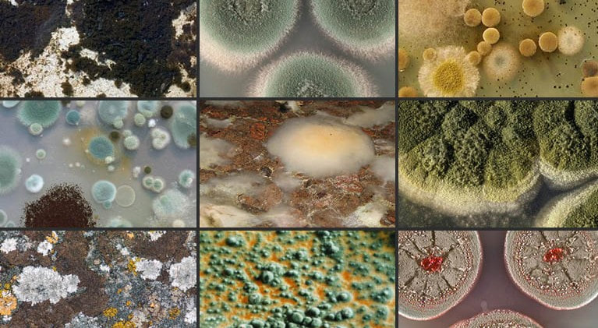
How Mold In Our Environment Affects Our Health

Slide 2
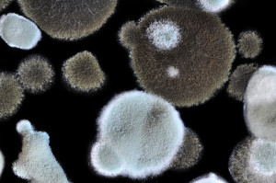
What Is Mold?
Mold is a
Type of fungus
It grows in a variety of habitats such as substrates that require organic matter to grow
Show decolorization and fuzzy appearance

Slide 3
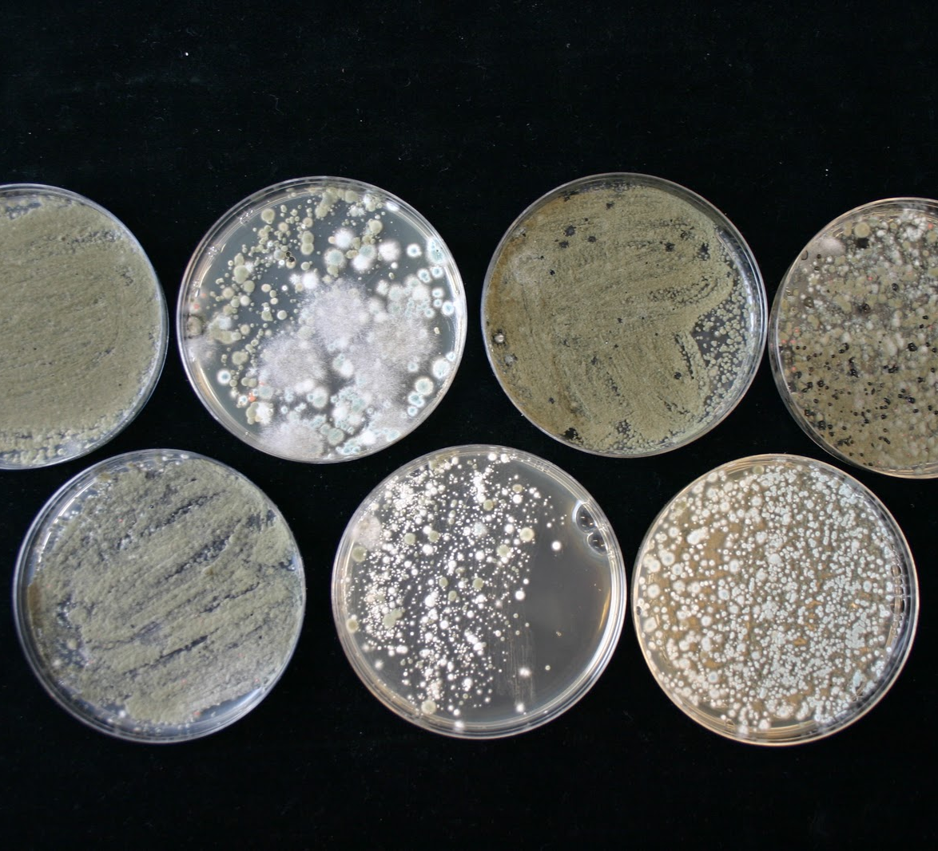
How Is Mold Reproduced?
Asexual –genetically identical to itself
Sexual – genetically distinct

Slide 4
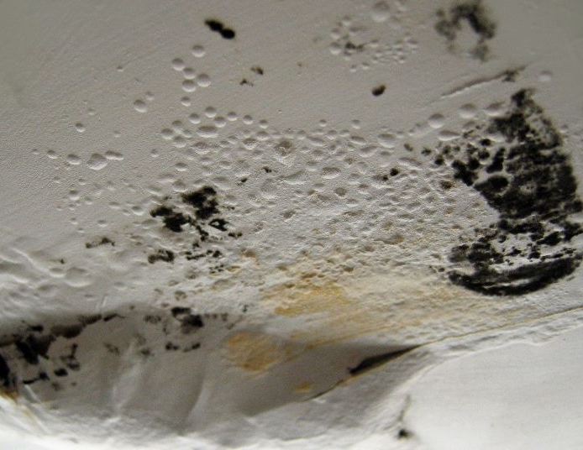
How Long Does It Take For Mold To Reproduce?
Depending on the type of mold and environment it varies on the number of days or hours it can take to grow.

Slide 5
Examples Where Mold Can Grow
Warm And Wet Conditions | Cold And Moist Conditions
Bathrooms | Refrigerators
Windows | Dish rack

Slide 6
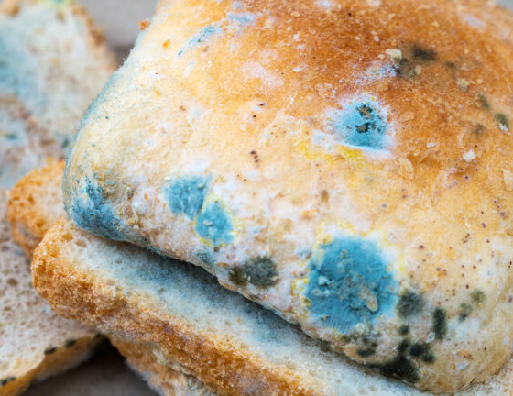
Symptoms That Develop When Consuming Mold
Nausea
Vomiting
Diarrhea

Slide 7
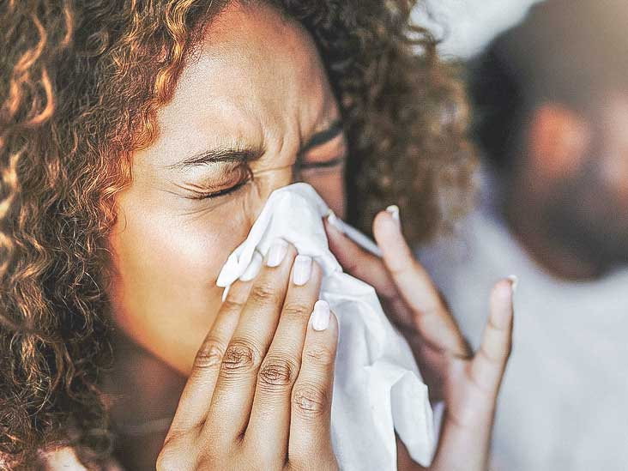
Symptoms That Develop When Inhaling Mold
Asthma Attacks
Running Nose
Sneezing

Slide 8
A Severe Health Problem Caused By Mold
Chronic Fatigue Syndrome (CFS) Is a condition with extreme fatigue that may last up to six months.
Symptoms:
Sore throat
Forgetfulness
Extremely dry eyes
Unable to concentrate
Headaches
Chills

Slide 9
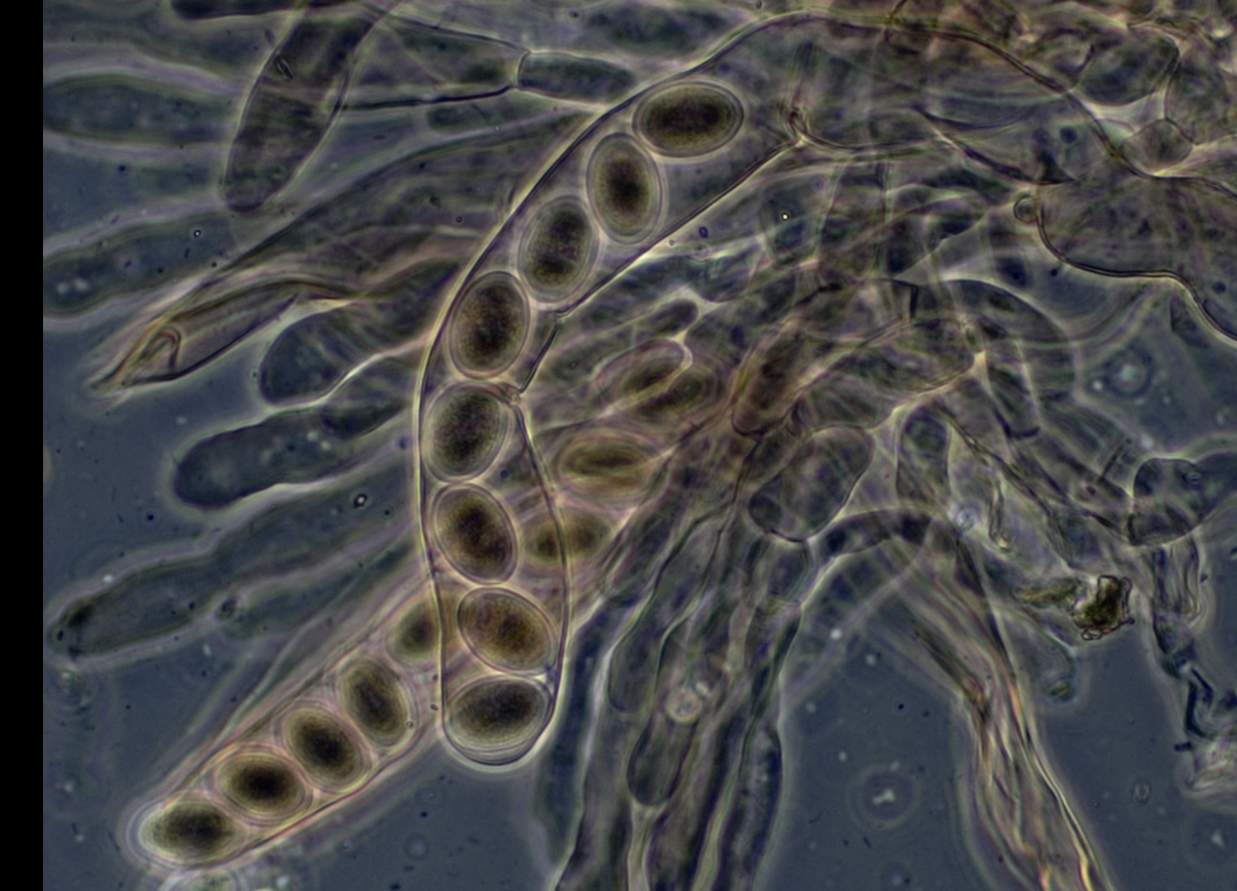
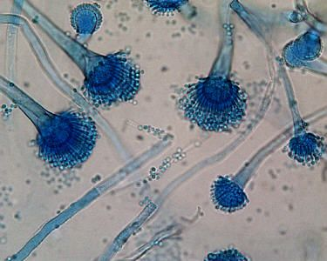
Examples Of Different Types Of Mold
Types of Fungi (Mold) | Where The Mold Grows On | Symptoms Developed By These Molds
 | Decaying plants Bathroom tiles Floors Walls Doors | Headaches Ringworm Nausea Asthma Fatigue and dizziness
 | Dark areas Bathrooms Kitchen Basement | Sneezing Coughing Tight chest Itchy/ watery eyes Difficult breathing
Ascospore
Aspergillus/Penicillium

Slide 10
How To Prevent Mold?
Keep the environment as dry as possible
Open windows occasionally in the bathrooms/kitchens/laundries
Repair leak damages or damp walls
Add mold inhibitors in your paint

Slide 11
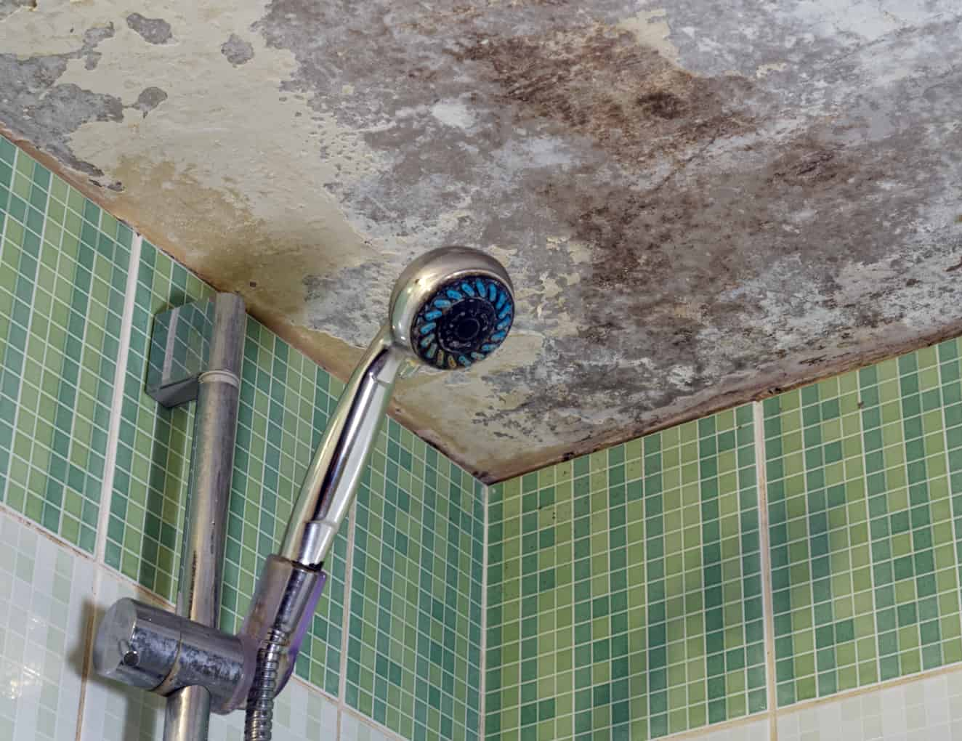
Reasons Why Mold Is Common In Low-Income Housing
Lack of care from landlords
Bad construction (small windows)
The use of cheap material that is nonresistance for mold
Unable to afford mold remediation and inspection

Slide 12
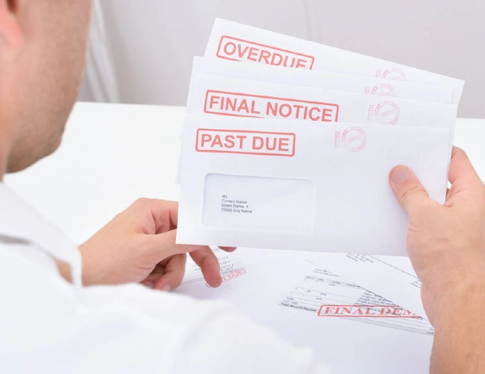
How Can Mold Impact Our Social Status?
Families may be embarrassed that the house is full of mold and wouldn’t want to have visitors over
Lost of income due to illness of inhaling or consuming mold

Slide 13
References
Camel, C., 2022. Mold Growth and Low Income Families. [online] Advanced Mold Diagnostics. Available at: <https://advancedmolddiagnostics.com/mold-growth-and-low-income-families-why-your-children-are-at-risk/> [Accessed 3 May 2022].
Cuisine Treat. 2022. What happens if you eat moldy bread - Will you get sick or die?. [online] Available at: <https://cuisinetreat.com/what-happens-if-you-eat-moldy-bread/> [Accessed 4 May 2022].
ECOFMR.Com Blog - Information and Articles. 2022. How to prevent mold growth in your home or office?. [online] Available at: <https://www.ecofmr.com/articles/prevent-mold-growth-home-or-office/> [Accessed 5 May 2022].
FindABusinessThat.com. 2022. Dangers of Black Mold Every Homeowner Should Know. [online] Available at: <https://www.findabusinessthat.com/blog/2500/dangers-of-black-mold-every-homeowner-should-know/> [Accessed 4 May 2022].
Kramer, Axel, et al. “Building-Related Illness (BRI) in All Family Members Caused by Mold Infestation after Dampness Damage of the Building.” GMS Hygiene and Infection Control, vol. 16, German Medical Science GMS Publishing House, 2021, p. Doc32–, https://doi.org/10.3205/dgkh000403.
Theoharides, Theoharis C. "Mold and Immunity." Clinical Therapeutics, vol. 40, no. 6, 2018, pp. 882-884. ProQuest, http://library.wlac.edu/login?url=https://www.proquest.com/scholarly-journals/mold-immunity/docview/2055562198/se-2, doi:https://doi.org/10.1016/j.clinthera.2018.05.005.
US EPA. 2022. What Are Molds? | US EPA. [online] Available at: <https://www.epa.gov/mold/what-are-molds> [Accessed 10 May 2022].
Ward, J. and Golubev, M., 2022. Ascospores - Health Effects, Allergy Symptoms & Treatment | Mold Busters. [online] Mold Busters. Available at: <https://www.bustmold.com/resources/mold-library/ascospores/> [Accessed 9 May 2022].

Slide 14
Image References
Behind, H. and Lookabaugh, E., 2022. Household Molds: What Hurricane Irene Left Behind. [online] Ncsupdicblog.blogspot.com. Available at: <http://ncsupdicblog.blogspot.com/2011/10/household-molds-what-hurricane-irene.html> [Accessed 10 May 2022].
Cuisine Treat. 2022. What happens if you eat moldy bread - Will you get sick or die?. [online] Available at: <https://cuisinetreat.com/what-happens-if-you-eat-moldy-bread/> [Accessed 4 May 2022].
Dfwinspector.com. 2022. [online] Available at: <https://www.dfwinspector.com/mold-inspection-frisco-tx/> [Accessed 10 May 2022].
FREE Stock Photos from Pik Wizard. 2022. 50+ World Day of the Sick images. [online] Available at: <https://pikwizard.com/most-popular/world-day-of-the-sick/?page=82> [Accessed 10 May 2022].
Fulgham Law Firm. 2022. Texas Rent-to-Own Service Threatening to File Charges? What to Know - Fulgham Law Firm. [online] Available at: <https://www.criminalattorneyfortworth.com/texas-rent-to-own-service-threatening-to-file-charges-what-to-know/> [Accessed 10 May 2022].
Innovaallergy.com. 2022. About – Innova Allergy. [online] Available at: <http://innovaallergy.com/about/> [Accessed 10 May 2022].
Microveggy.com. 2022. Mold on microgreens? Here's the Easy Solution. [online] Available at: <https://microveggy.com/mold/> [Accessed 10 May 2022].
Pinterest. 2022. Pin on Microbiology. [online] Available at: <https://id.pinterest.com/pin/199565827229249368/> [Accessed 10 May 2022].
The Mold Lawyer. 2022. Toxic Mold Claims - The Mold Lawyer. [online] Available at: <https://themold.lawyer/what-we-do/> [Accessed 2 May 2022].
Ward, J. and Golubev, M., 2022. Ascospores - Health Effects, Allergy Symptoms & Treatment | Mold Busters. [online] Mold Busters. Available at: <https://www.bustmold.com/resources/mold-library/ascospores/> [Accessed 7 May 2022].
2022. [online] Available at: <https://housely.com/black-mold-get-rid/> [Accessed 5 May 2022].
2022. [online] Available at: <https://tospitakimou.gr/simboules-gia-to-spiti/symvoyles-kathariotitas/10-symvoyles-katharismoy-mpanioy-me-ksydi-mageirikh-soda/> [Accessed 6 May 2022].

