Slide 1
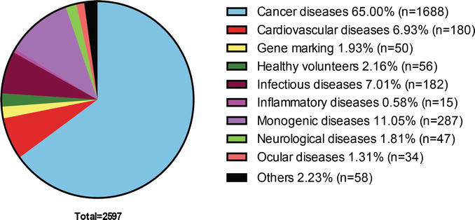
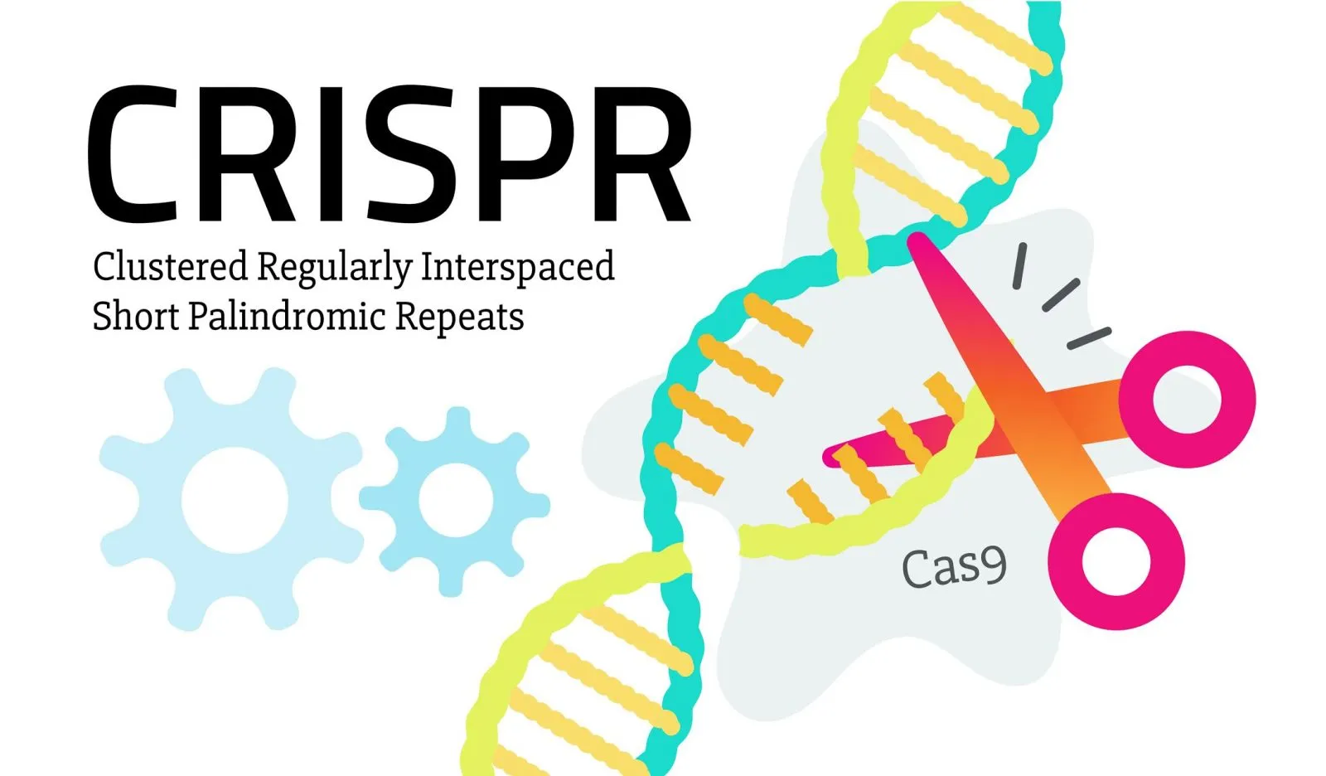
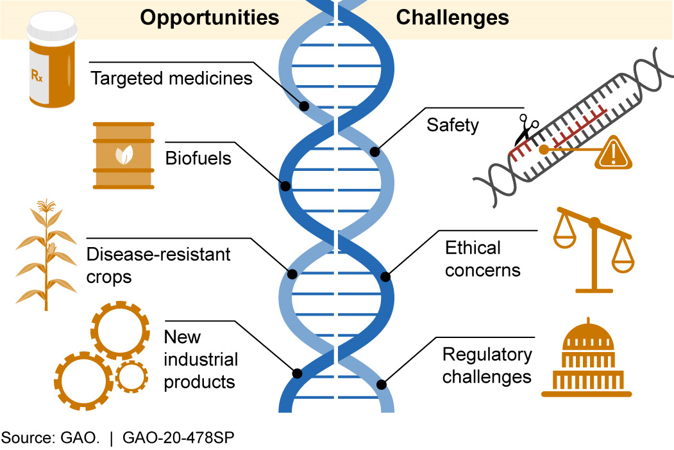
CRISPR/ CAS9 GENE EDITING
CRISPR/Cas9 gene editing has developed so much during recent years and has expanded its application in different fields including medicine, industry, agriculture and biofuels and environment field. Although this tool can have various benefits and efficiencies in the world, it can have its own challenges such as safety issues, ethical concerns and regulatory importance. The authorities should formulate and confirm laws and regulations and allow safe and ethical use of this precious tool.
INTRODUCTION
OPPORTUNITIES AND CHALLENGES
FIELDS OF STUDY IN GENE THERAPY
CONCLUSION
This year is the 10th anniversary of CRISPR development. CRISPR stands for “Clustered Regularly Interspaced Short Palindromic Repeats” and it is a genome editing technique that has founded by Jennifer Dounda and Emmanuel Charpentier. During these 10 years, CRISPR research has been improved to a great extent. During the first 5 years it was just the trial and error but in the recent 5 years, the CRISPR engineering has launched its new clinical trial and has resulted in wonderful outcomes. Cas9 is a CRISPR associated endonuclease or enzyme that acts as a molecular scissor and cuts DNA at a specified location by a guide RNA. The research on this technology has done remarkable and high efficiency work and it has been the most simple and efficient gene editing tool. This tool has shown a profound perspective in treating disease like HIV, cancer, lymphocytic leukemia, some hereditary disease, immune deficiency syndrome and much more by cutting the diseased part of the DNA with the help of Cas9 enzyme and inserting a replacing DNA in that place.
Opportunities: These days CRISPR/Cas9 is facing some opportunities and challenges. As mentioned earlier, using CRISPR/ Cas9 technology can cure many diseases including different kinds of cancer, sickle cell anemia, hereditary genetic diseases and Covid-19 that was a new and rapidly spreading disease. CRISPR technology can also be used in agriculture to produce stronger and healthier crops and protect crops from some special pests and dangerous insects. It can help diminish poverty in the world in future. Another benefit of CRISPR can be in industry and biofuels. Many industrial companies are using CRISPR potentials to develop new biofuels and bacteria to clean up the environment and produce new materials.
Gene therapy had been developed primarily for genetic disorders but nowadays has been expanded to other fields and different human diseases, in this diagram we will look at gene therapy basic field of research as well as the clinical activities. As we see, cancer has become the most prominent field of research in gene therapy.
Figure 3. Fields of Study in Gene Therapy. Ignacio García-Tuñon, Elena Vuelta, Sandra Pérez-Ramos, Jesús M Hernández-Rivas, Lucía Méndez, María Herrero and Manuel Sanchez-Martin. (March 14, 2018) “CRISPR-ERA for Switching Off (Onco) Genes” https://www.intechopen.com/chapters/62990
Figure 4. CRISPR/Cas9 Gene Editing. BY BISHAL KHATIWADA (FEB 8, 2019). “Things You Should Know About CRISPR Gene-Editing Tool” https://explorebiotech.com/crispr-gene-editing-tool/
Indications | Gene therapy clinical trials
 | Number | %
Cancer diseases | 1688 | 65.0
Cardiovascular diseases | 180 | 6.9
Gene marking | 50 | 1.9
Healthy volunteers | 56 | 2.2
Infectious diseases | 182 | 7.0
Inflammatory diseases | 15 | 0.6
Monogenic diseases | 287 | 11.1
Neurological diseases | 47 | 1.8
Ocular diseases | 34 | 1.3
DELETE
A larger fragment of DNA can be deleted by using two guide RNAs that target separate sites. After cleavage at each site, non-homologous end joining unites the separate ends, deleting the intervening sequence
CORRECT OR INSERT
Adding a DNA template alongside the CRISPR/Cas9 machinery allows the cell to correct a gene, or even insert a new gene, using a process called homology directed repair
DISRUPT
If a single cut is made, a process called non-homologous end joining can result in the addition or deletion of base pairs, disrupting the original DNA sequence and causing gene inactivation
REFERENCE
Figure 2. Opportunities and Challenges of CRISPR. GAO (Apr 4, 2020) “Science & Tech Spotlight: CRISPR Gene Editing” https://www.gao.gov/products/gao-20-478sp
. Adopted from “CRISPR/Cas9”. http://www.crisprtx.com/gene-editing/crispr-cas9
BISHAL KHATIWADA (FEB 8, 2019). “Things You Should Know About CRISPR Gene-Editing Tool” https://explorebiotech.com/crispr-gene-editing-tool/
Ignacio García-Tuñon, Elena Vuelta, Sandra Pérez-Ramos, Jesús M Hernández-Rivas, Lucía Méndez, María Herrero and Manuel Sanchez-Martin. (March 14, 2018) “CRISPR-ERA for Switching Off (Onco) Genes” https://www.intechopen.com/chapters/62990
GAO (Apr 4, 2020) “Science & Tech Spotlight: CRISPR Gene Editing” https://www.gao.gov/products/gao-20-478sp
Challenges: Beside the opportunities CRISPR has, there are some challenges that should be considered. Safety issue is one of them. For example, one of the concerns is if the CRISPR targets an unintended part of DNA, it may cause other disease or harm. In terms of ethical concerns, it may cause some extraordinary human characteristics that is not ethical, and no one is prepared for it. There are also some regulatory concerns regarding CRISPR technology and many countries are still struggling with this issue. For example, in US there are still hesitations on whether the same regulations should be observed for gene edited crops as conventional genetically modified (GM) organisms or not
Figure 1. CRISPR/Cas9 Gene Editing. Adopted from “CRISPR/Cas9”. Retrieved by http://www.crisprtx.com/gene-editing/crispr-cas9

